Slide 1

Patient Engagement in AUD Treatment
Dr. Carolyn Rekerdres MD

Slide 2

Learning Objectives
Explain why patient engagement is a cornerstone of modern medicine as regards quality and safety
Review the difference between Autonomy vs Paternalism and how these issues can affect patient engagement and decision making
Discuss strategies to build rapport which can translate to increased engagement in care
Describe how provider attitudes and behaviors can influence treatment outcomes
weitzmaninstitute.org | April 24, 2026
2

Slide 3
Patient Engagement
Over 20 years of evidence suggests that engagement of patients in their care with patient-centered decision making, respect for needs and preferences in care can lead to better outcomes.

Slide 4
Motivational Interviewing
ENGAGING
FOCUSING
EVOKING
PLANNING

Slide 5

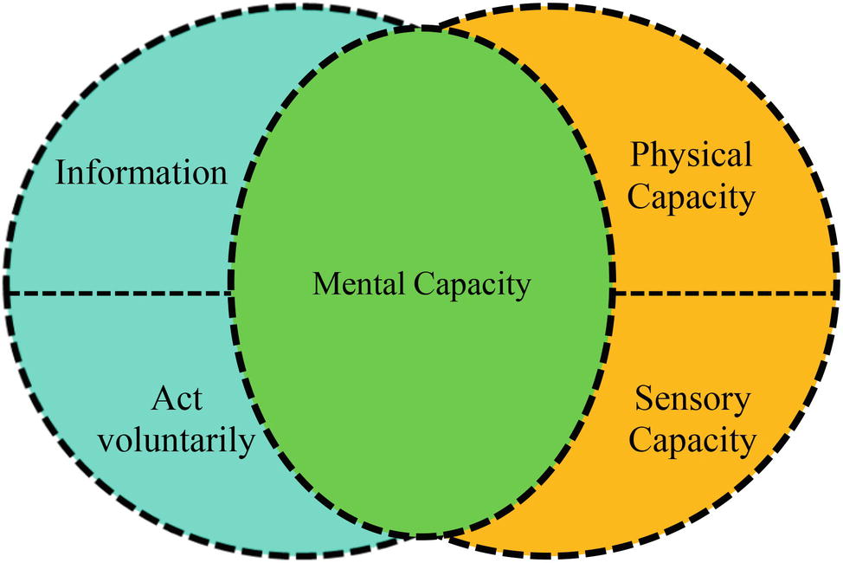
Capacity Considerations
Front. Psychol., 13 August 2019
Sec. Theoretical and Philosophical Psychology
Volume 10 - 2019 | https://doi.org/10.3389/fpsyg.2019.01857
weitzmaninstitute.org | April 24, 2026
5

Slide 6
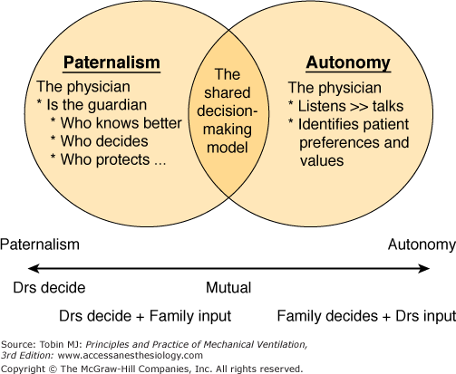

Slide 7
Patient Factors that Predict Engagement
Heavier drinking with more severe medical outcomes
Higher baseline self efficacy
Patients who have a clear goal for treatment

Slide 8
Provider Characteristics that predict engagement
Patients who perceived their treatment team as supportive while in inpatient care were more likely to still be in treatment 12 months later
Confidence and Competence (this is the basis of all influence)
Rapport built through genuine curiosity about the patient’s condition
Non-Judgment

Slide 9
Charisma
The strength of influence is defined psychologically as a combination of competence and confidence
Affability is the strength of likeability
Influence and affability together produce charisma which is advantageous in engagement

Slide 10
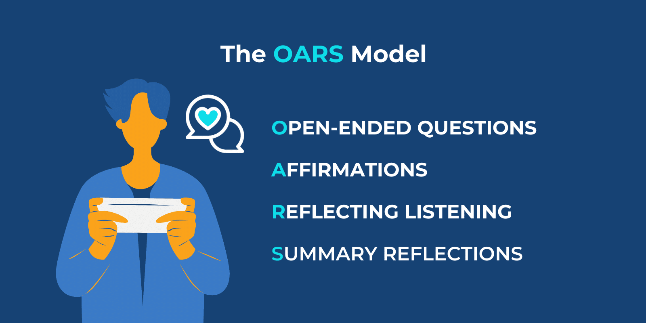
Sandstone Care. (2023). What is motivational interviewing? 11 things you need to know. https://www.sandstonecare.com/blog/what-is-motivational-interviewing-11-things-you-need-to-know-about-motivational-interviewing/

Slide 11
Open Ended Questions
"What are some of the reasons you've thought about changing your drinking?“
“What would be different in your life if you reduced or stopped your drinking?”
"What do you think you could do differently if you wanted to change?“
"What are the good things about your current drinking pattern?" Followed by, "What are the less good things?”
"What would be the consequences of not changing?"
"What have you tried in the past to change your drinking?"

Slide 12
Affirmations
"It took a lot of courage to come in today."
“It’s so good to see you here today.”
"I can see you're really trying to make this change."
“You’re so resilient. I see how hard this is for you.”

Slide 13
Reflective Listening
Patients feel heard when you let them know that you are listening. This can be done even when you are concurrently documenting.
“So what I’m hearing you say is,….”
Pay attention to affect- circle back on those statements

Slide 14
Summary Reflections
“What we discussed today was_______”
“You have a goal of _____ but you are worried about ______. We are going to work together by________ and then meet again in ____ time.”
SUMMARIZE what the patient says- focusing on change statements

Slide 15
Language Matters
Reflect abnormal urine drug screen or lab results in clinical language without judgment
Avoid using stigmatizing language like “clean” or “dirty”
Remember that the patient’s goals may be different from your idea of what success looks like
Choose terminology like describing the harm of “drinking behaviors” vs telling someone that they are “an alcoholic”

Slide 16
Final Thoughts
Making time for open ended questions, summary and reflection can sometimes require scheduling additional visits
Stages of change fluctuate- that’s ok!
If a patient comes back, then you are both doing something right

Slide 17

Questions?
Feel free to unmute or put your questions in the chat!

