Slide 1

From Lived Experience to Professional Practice:
Understanding Peer Support
Hannah Schilling (she, hers)
PRS, CDCA II, OCPSA, CHW
Carolyn Rekerdres, MD
May 11, 2026

Slide 2
Learning Objectives
By the end of this presentation, participants will be able to:
Explain the evolution of peer support within recovery-oriented systems
Define the role of a Peer Support Worker and the value of lived experience
Identify core competencies and how peer support is structured today

Slide 3
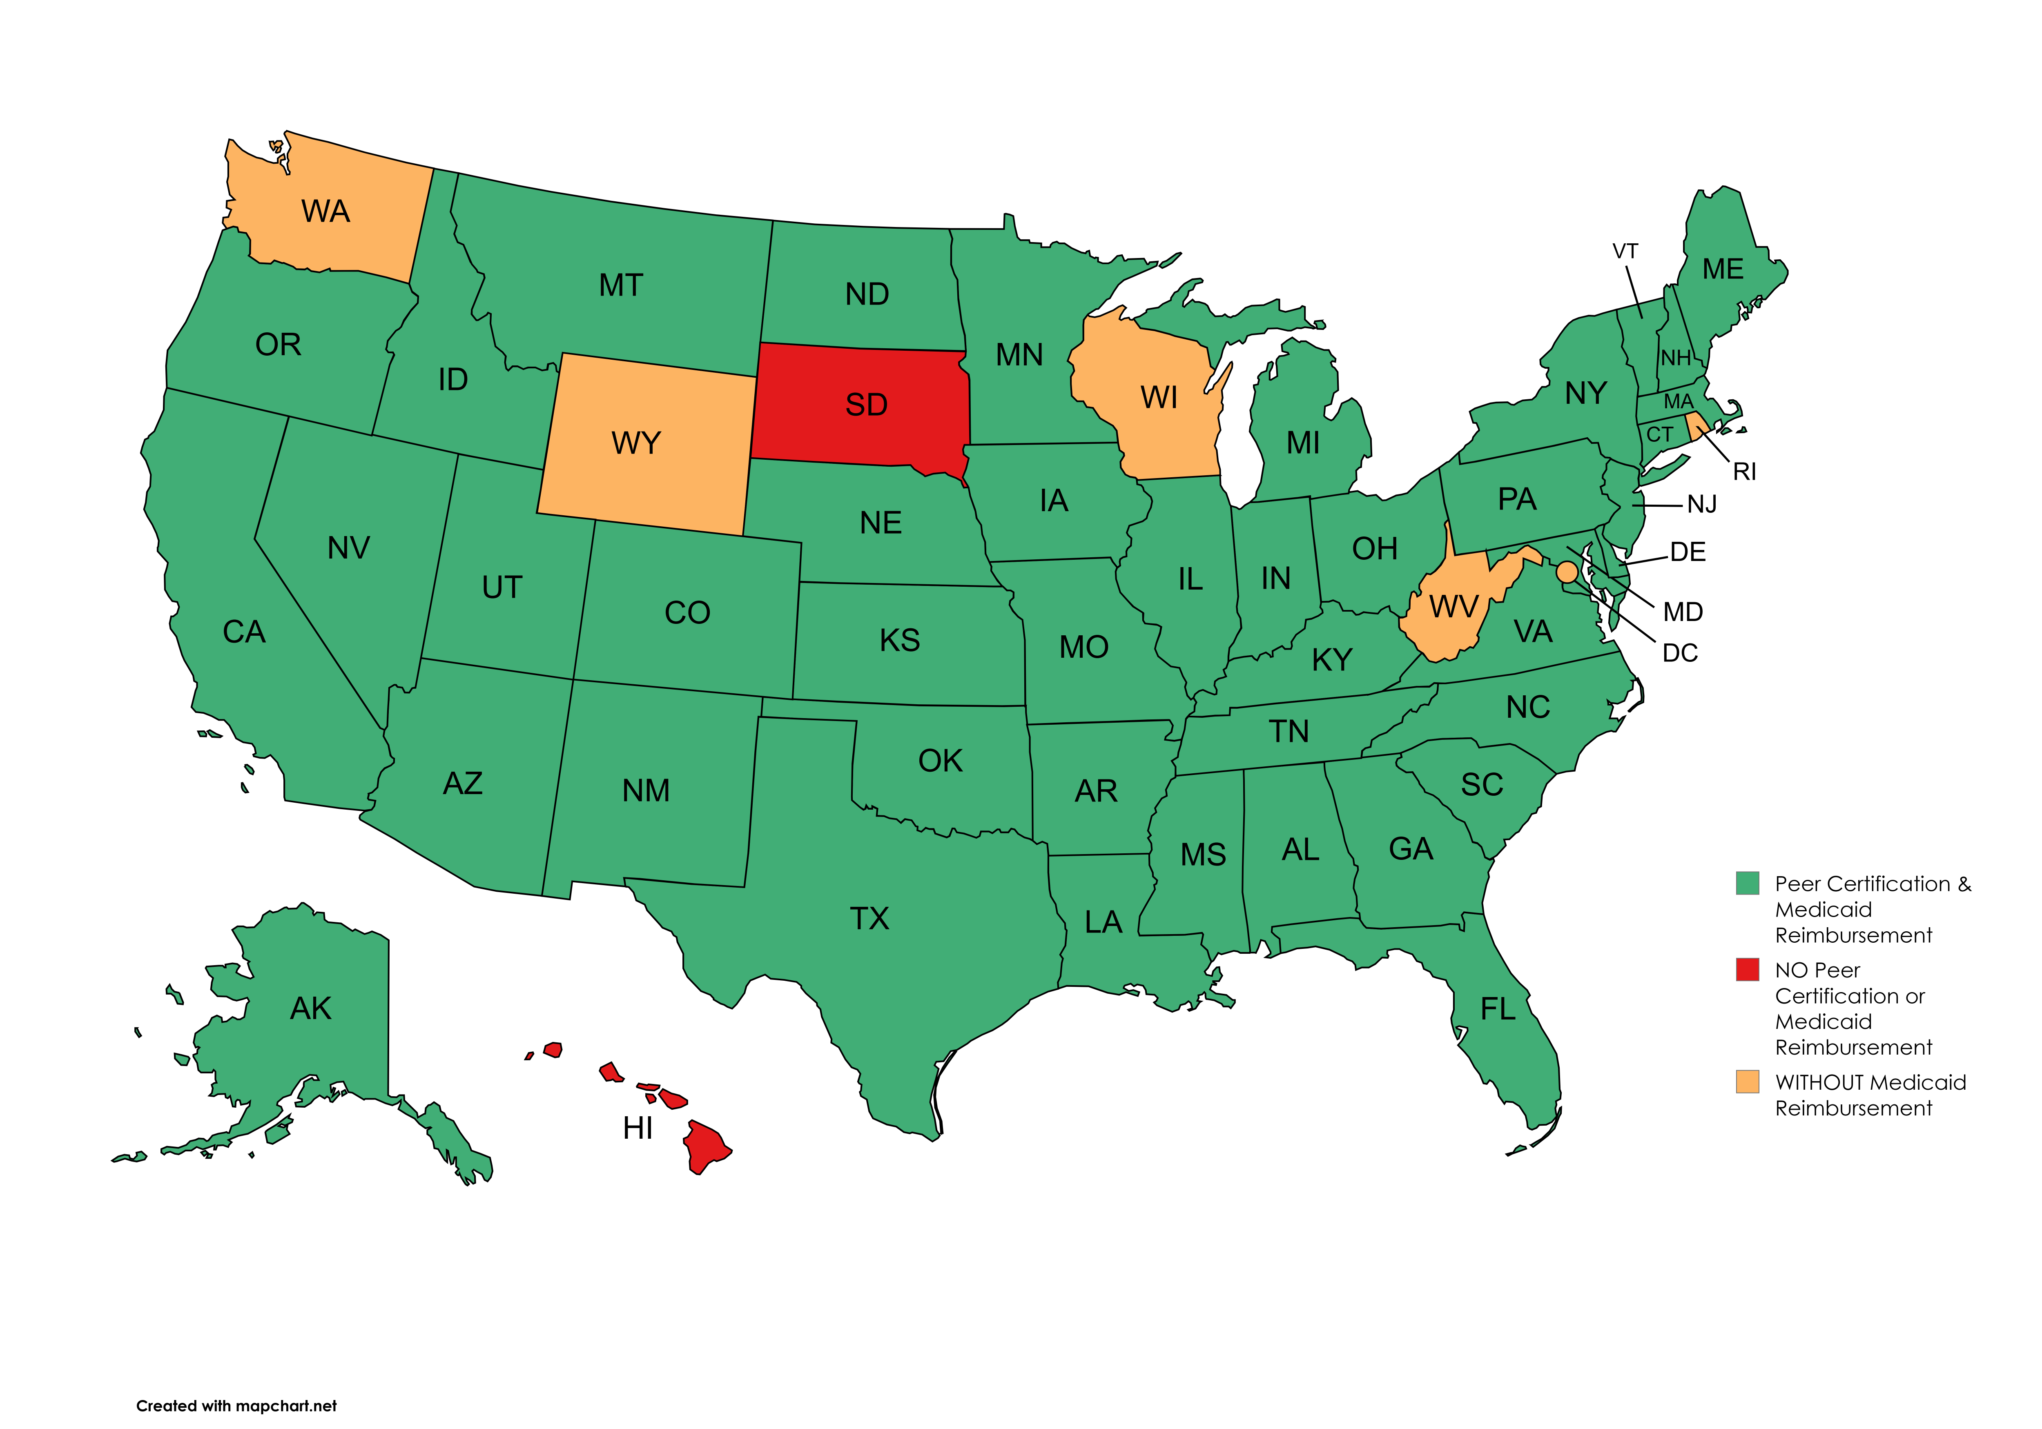
History of the Peer Movement
2007
Today
SAMHSA officially recognizes peer support as a key component of recovery services.
Peer support is now a nationally recognized, non-clinical workforce.
1700s–1900s
1935
1999
Peer support rooted in mutual aid, community care, and informal help among those with shared struggles.
Alcoholics Anonymous introduces the sponsor model and 12-step peer recovery framework.
Certification for peer support workers becomes formalized, beginning in Georgia.
Notes:
Peer support didn’t start in systems. Systems are just now catching up to what communities have always done.
Peer support became a profession not because lived experience needed to be controlled, but because it needed to be protected—protected from being misunderstood, misused, or co-opted. Certification brought role clarity, quality standards, and respect within systems that once excluded people in recovery.

Slide 4
Why Peer Support Became a Profession
Demand from Real-World Impact
Early studies (1990s–2000s) found that peer models led to:
Reduced hospitalizations and emergency visits
Improved self-efficacy, housing stability, and retention in care
Decreased system costs in behavioral health and Medicaid
Peers fill gaps traditional systems can’t
PSW rebuild trust and promote engagement through shared experience
Professionalization Became Essential
Needed clear boundaries, confidentiality, and integrity
Defined roles that distinguish peers from clinicians, case managers, and sponsors
Training and supervision ensure service quality and safety
Standardized credentials allow for funding and sustainability
Notes:
Peer support became a profession not because lived experience needed to be controlled, but because it needed to be protected—protected from being misunderstood, misused, or co-opted. Certification brought role clarity, quality standards, and respect within systems that once excluded people in recovery.

Slide 5
What Do We Mean By “Peer”?
Peer Support Worker (PSW)
Peer-Based Recovery Support
Structured, non-clinical assistance from someone with lived experience, designed to help others start and sustain recovery across settings like communities, housing, and harm reduction programs.
A professional with lived experience of substance use who is trained to support others in recovery, wellness, and harm reduction through non-judgmental, person-centered care that respects all recovery pathways.
This general role definition expands and becomes more complex when focused on specific contexts and settings:
Same core body of knowledge and general role
Job descriptions and position-specific training look very different
Notes:
“A peer is defined by lived experience, not by training. Training supports the role, it does not create it.”

Slide 6
Peer Recovery Supporters provide 4 core types aligned with national recovery frameworks:
Emotional
Builds trust through shared experience
Practical
Reduces barriers like transportation
Informational
Helps navigate systems and resources
Affiliational
Connects people to community and purpose
Notes:
Peer Recovery Supporters provide 4 core types of support, all of which are grounded in the principles of recovery-oriented systems of care and align with national recovery frameworks (e.g., SAMHSA):

Slide 7
Certification ensures quality.
It does not replace lived experience as the foundation.
Ensures ethical, safe, and effective peer support
Clarifies the peer role vs. sponsor or clinician
Protects the integrity of lived experience
Opens funding mechanisms including reimbursement.
Training
30–80 hours
Supervised Practice
250–1,000+ hours
Written Exam
on ethics and core competencies
Ongoing Education
20–40 CEUs every two years
Notes:
Peer support became a profession not because lived experience needed to be controlled, but because it needed to be protected—protected from being misunderstood, misused, or co-opted. Certification brought role clarity, quality standards, and respect within systems that once excluded people in recovery.

Slide 8
Relational Skills
Active listening & effective communication
Relationship building through trust
Strategic sharing of lived experience
Recovery-Oriented Practice
Understanding multiple pathways to recovery
Recovery planning & goal setting
Connecting to natural supports and communities
Professional Responsibilities
Ethics, confidentiality, and boundaries
Advocacy and systems navigation
Role clarity within interdisciplinary teams
Personal Wellness & Cultural Responsiveness
Self-care and maintaining personal recovery
Working with diverse populations and cultures
Trauma-informed and person-centered approaches
Core Knowledge
Notes:
Peer roles vary widely but always center on building trust through shared experience

Slide 9
Common Titles for Peer Recovery Supporters
Peer Support Worker (PSW) is an all-inclusive term
To have a formal certification, individuals delivering peer services needed to have one title for consistency
Peer Recovery Specialist
Peer Recovery Support Specialist
Peer Mentor
Peer Recovery Coach
Peer Support Worker
Peer Advocate
Peer Supporter
Peer Navigator
The core body of knowledge is the same across the roles
Th focus of the core competencies varies according to role and in different contexts
Regardless of the setting, function or role of peer specialists, it is critical to maintain the inherent “peerness” of the support they provide.

Slide 10
Peer Settings
Healthcare Settings
Community Settings
Justice System
Primary Care
Hospitals
Stabilization
RCC’s
Harm Reduction
Courts
Jails
Reentry
Social & Specialty Settings
Housing
Faith
Colleges
Outreach

Slide 11
Effectiveness of Peer Support
Proven to Improve Engagement
Recovery housing
Evidence shows reductions in substance use among those with PSWs.
While outcomes vary by setting, PSWs have been shown to:
The Human Factor:
Trust, Connection, Hope
The true power of peer support lies in connection.
Emergency departments
Community programs
People with lived experience bring unmatched authenticity that:
Peer Support Workers consistently improved treatment initiation and engagement.
Promising Outcomes in Reducing Use
In settings such as:
Reduce overdose recurrence
Support sustained recovery
Increase treatment retention in MAT programs
Breaks down stigma
Builds trust in marginalized communities
Promotes long-term recovery through mutual understanding

Slide 12
Peer Support Strategies for Alcohol Use Disorder
Peer support meets people wherever they are in their relationship with alcohol
Support Harm Reduction Strategies
Offer education on safer drinking practices and abstinence days
Help monitor drinking patterns using apps, journals, or check-ins
Educate on medication-assisted treatment options
Normalize Multiple Recovery Paths
Introduce diverse approaches: 12-Step, SMART Recovery, Recovery Dharma, etc.
Emphasize that recovery is personal and flexible
Provide Non-Judgmental Support
Use lived experience to build trust and reduce stigma
Walk alongside individuals through ambivalence, relapse, and re-engagement
Help Navigate Barriers to Care
Assist with transportation, scheduling appointments, and navigating systems
Provide reminders and motivational support to stay connected

Slide 13
Peer Support Strategies for Alcohol Use Disorder
Address Social Determinants of Health
Support in finding stable housing, employment, insurance, or basic needs
Help build routines that foster recovery-ready environments
Foster Connection to Community
Link to recovery groups, events, sober activities, and spiritual or cultural supports
Create safe spaces where individuals feel seen and included
Reinforce Life Skills & Resilience
Help individuals rebuild confidence, structure, and coping strategies
Model healthy boundaries, decision-making, and self-advocacy
Promote Holistic Wellness
Encourage emotional regulation, self-compassion, and whole-person healing
Support re-engagement with family, culture, and identity in recovery

Slide 14
National Peer Support Resources & Agencies
National Peer Recovery Alliance (NPRA)
Faces & Voices of Recovery
Center for Addiction Recovery Support
Peer Integration and the Stages of Change ToolKit
Boulder Care
Sober Grid
Peer-led national coalition supporting professional development and mentorship
Extensive toolkits and data platforms to support recovery organizations and peer integration
Offers technical assistance, a full resource library, and evidence-based guidance
Comprehensive toolkit that establishes the currency of peers in the workforce
National telehealth addiction clinic integrating peer support
24/7 mobile-based peer support and recovery social network

Slide 15
Peer Support Outcomes
Clinical Outcomes
Systems Benefits
Better Engagement
Better Retention in Services
Decreased Relapse
Cost Reduction
Better morale on team
Low barrier to train and add to the team
Eddie, D., O’Connor, J.B., George, S.S. et al. Peer Recovery Support Services and Recovery Coaching for Substance Use Disorder: A Systematic Review. Curr Addict Rep 12, 40 (2025). https://doi.org/10.1007/s40429-025-00645-8
Tracy K, Wallace S. Benefits of peer support groups in the treatment of addiction. Subst Abuse Rehabil. 2016;7:143-154
https://doi.org/10.2147/SAR.S81535

Slide 16
Collaboration Basics
  Peers are not AA “sponsors”
  Peers are part of the healthcare team and should be involved in case staffing
  Referring to a peer is NOT the same as referring to a SUD counselor
  INVITE THE PEER IN THE ROOM!

Slide 17
Examples of Peer Support in Action
  A patient is hesitant to consider medication assisted treatment with a long-acting medication and would like to hear about a peer’s experience
  A patient asks a peer to join them in the visit to discuss a medication change that they feel intimidated to ask the Provider about
  A patient is feeling discouraged about a continued drinking behavior and does not want to talk to a therapist or physician about it but is willing to discuss it with someone who has “been there before”

Slide 18
References
Bell, J. S., Hagaman, A., Beattey, J., Fears, G., White, W. L., & Watson, D. P. (2025). Advancing peer support workforce research: Insights and recommendations through the lens of professionalization. Journal of Substance Use and Addiction Treatment, 170, 209612. https://doi.org/10.1016/j.josat.2024.209612
Davidson, L., Bellamy, C., Guy, K., & Miller, R. (2006). Peer support among persons with severe mental illnesses: A review of evidence and experience. World Psychiatry, 5(1), 32–39.
Eddie, D., O’Connor, J. B., George, S. S., Klein, M. R., Lam, T. C. S., Abry, A., Hoffman, L. A., Hennessy, E. A., Vilsaint, C. L., & Kelly, J. F. (2025). Peer Recovery Support Services and Recovery Coaching for Substance Use Disorder: A Systematic Review. Current Addiction Reports, 12(1), 40. https://doi.org/10.1007/s40429-025-00645-8
Fortuna, K. L., Solomon, P., & Rivera, J. (2022). An Update of Peer Support/Peer Provided Services Underlying Processes, Benefits, and Critical Ingredients. The Psychiatric Quarterly, 93(2), 571–586. https://doi.org/10.1007/s11126-022-09971-w
Horn, K., Flinn, R. E., Hagaman, A. M., Zajac, K., Hoffman, L. A., Poulsen, M. N., et al. (2025). Systematizing peer recovery support services for substance use disorder: A taxonomy for measuring recovery milestones. Frontiers in Public Health, 13. https://doi.org/10.3389/fpubh.2025.1529078
Mette, E., Townley, C., & Purington, K. (2019). 50-State Scan: How Medicaid agencies leverage their non-licensed substance use disorder workforce. National Academy for State Health Policy.
National Association of Peer Supporters (NAPS). (2019). National Practice Guidelines for Peer Specialists and Supervisors. https://www.peersupportworks.org/national-practice-guidelines/
Peer Recovery Center of Excellence (PRCoE). (2022, November 21). State Certification Database. https://peerrecoverynow.org/resource-library/state-certification-database/
Peer Recovery Center of Excellence (PRCoE). (2023). Comparative Analysis of State Requirements for Peer Support Specialist Training and Certification in the United States. https://peerrecoverynow.org/wp-content/uploads/2023-FEB-07-prcoe-comp-analysis.pdf
Scannell, C. (2021). Voices of Hope: Substance Use Peer Support in a System of Care. Substance Abuse: Research and Treatment, 15, 11782218211050360. https://doi.org/10.1177/11782218211050360
Solomon, P. (2004). Peer support/peer provided services underlying processes, benefits, and critical ingredients. Psychiatric Rehabilitation Journal, 27(4), 392–401.
Substance Abuse and Mental Health Services Administration (SAMHSA). (2017). Peer Support Roles in Criminal Justice Settings. GAINS Center for Behavioral Health and Justice Transformation.
Substance Abuse and Mental Health Services Administration (SAMHSA). (2024). Peer Support Workers for those in Recovery. Bringing Recovery Supports to Scale Technical Assistance Center Strategy (BRSS TACS). https://www.samhsa.gov/peer-support-mental-health-substance-use
Notes:
3:51

Slide 19
References Cont
Eddie, D., O’Connor, J.B., George, S.S. et al. Peer Recovery Support Services and Recovery Coaching for Substance Use Disorder: A Systematic Review. Curr Addict Rep 12, 40 (2025). https://doi.org/10.1007/s40429-025-00645-8
White, W. L. (2005). Sponsor, Recovery Coach, Addiction Counselor: The Importance of Role Clarity and Role Integrity. Pennsylvania Department of Behavioral Health and Mental Retardation Services.
Tracy K, Wallace S. Benefits of peer support groups in the treatment of addiction. Subst Abuse Rehabil. 2016;7:143-154
https://doi.org/10.2147/SAR.S81535

Slide 20

Questions?
Feel free to unmute or put your questions in the chat!

