Slide 1
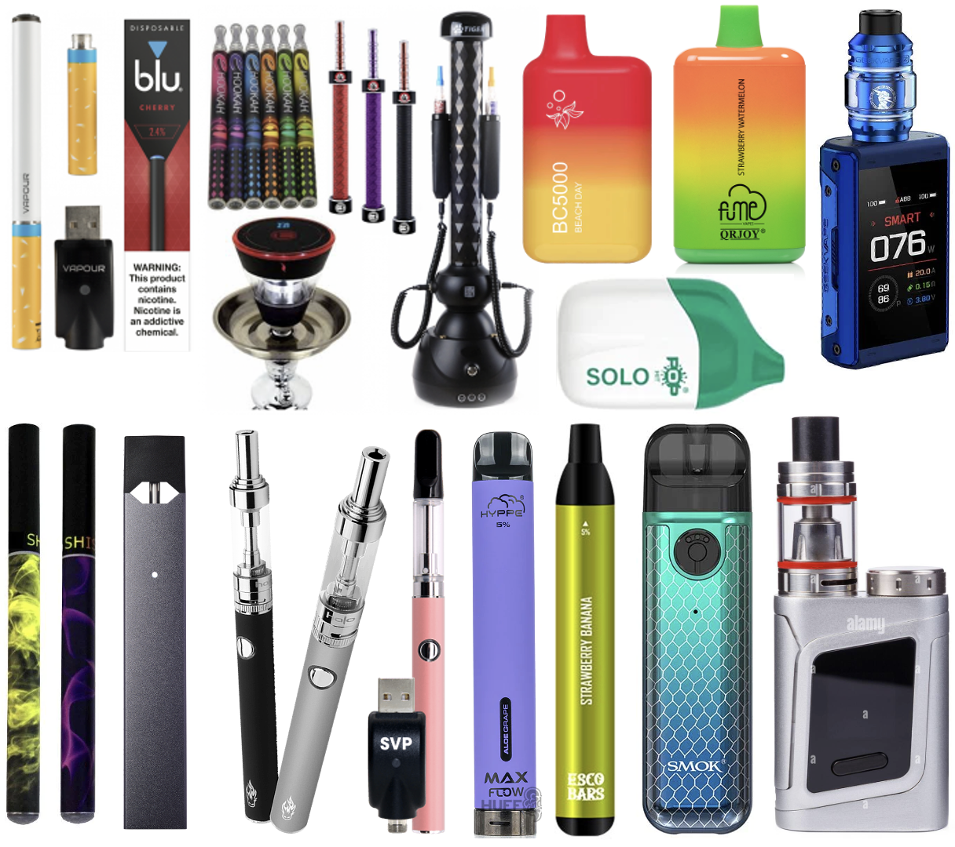
Vaping 101:
A Guide to
E-cigarettes and Youth
Yale University School of Medicine
Department of Psychiatry
Tobacco Research in Youth
May 2026

Slide 2


















Dana Cavallo, PhD
Associate Professor
of Psychiatry
Grace Kong, PhD
Associate Professor
of Psychiatry
Krysten Bold, PhD
Associate Professor
of Psychiatry
Danielle Davis, PhD
Assistant Professor
of Psychiatry
Suchitra Krishnan-Sarin, PhD
Albert E. Kent Professor
of Psychiatry
Meghan Morean, PhD
Research Scientist
in Psychiatry
Patricia Simon, PhD
Assistant Professor
Adjunct of Psychiatry
Deepa Camenga, MD, MHS, FAAP
Associate Professor of
Emergency Medicine
Heather LaVallee, LMFT
Research Assistant 2
Wei Li, MD, MPH, PhD
Postdoctoral Associate
Akshika Sharma, PhD
Postdoctoral Associate
Melissa Gordon, MFA
Research Associate 3
Tami Frankforter
Systems Programmer
Sakinah Carter Suttiratana, PhD, MPH, MBA
Associate Research Scientist
Rachel Ouellette, PhD
Associate Research Scientist
Tricia Dahl, BS
Research Assistant 3
Thomas Liss
Research Associate

Slide 3
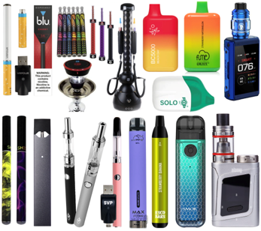
Understanding e-cigarette use in youth
Use rates
Definition of e-cigarettes
Available e-cigarette product
Concerns of e-cigarette use
Social media influence
Industry Influence
Strategies for parents and administrators
Resources

Slide 4
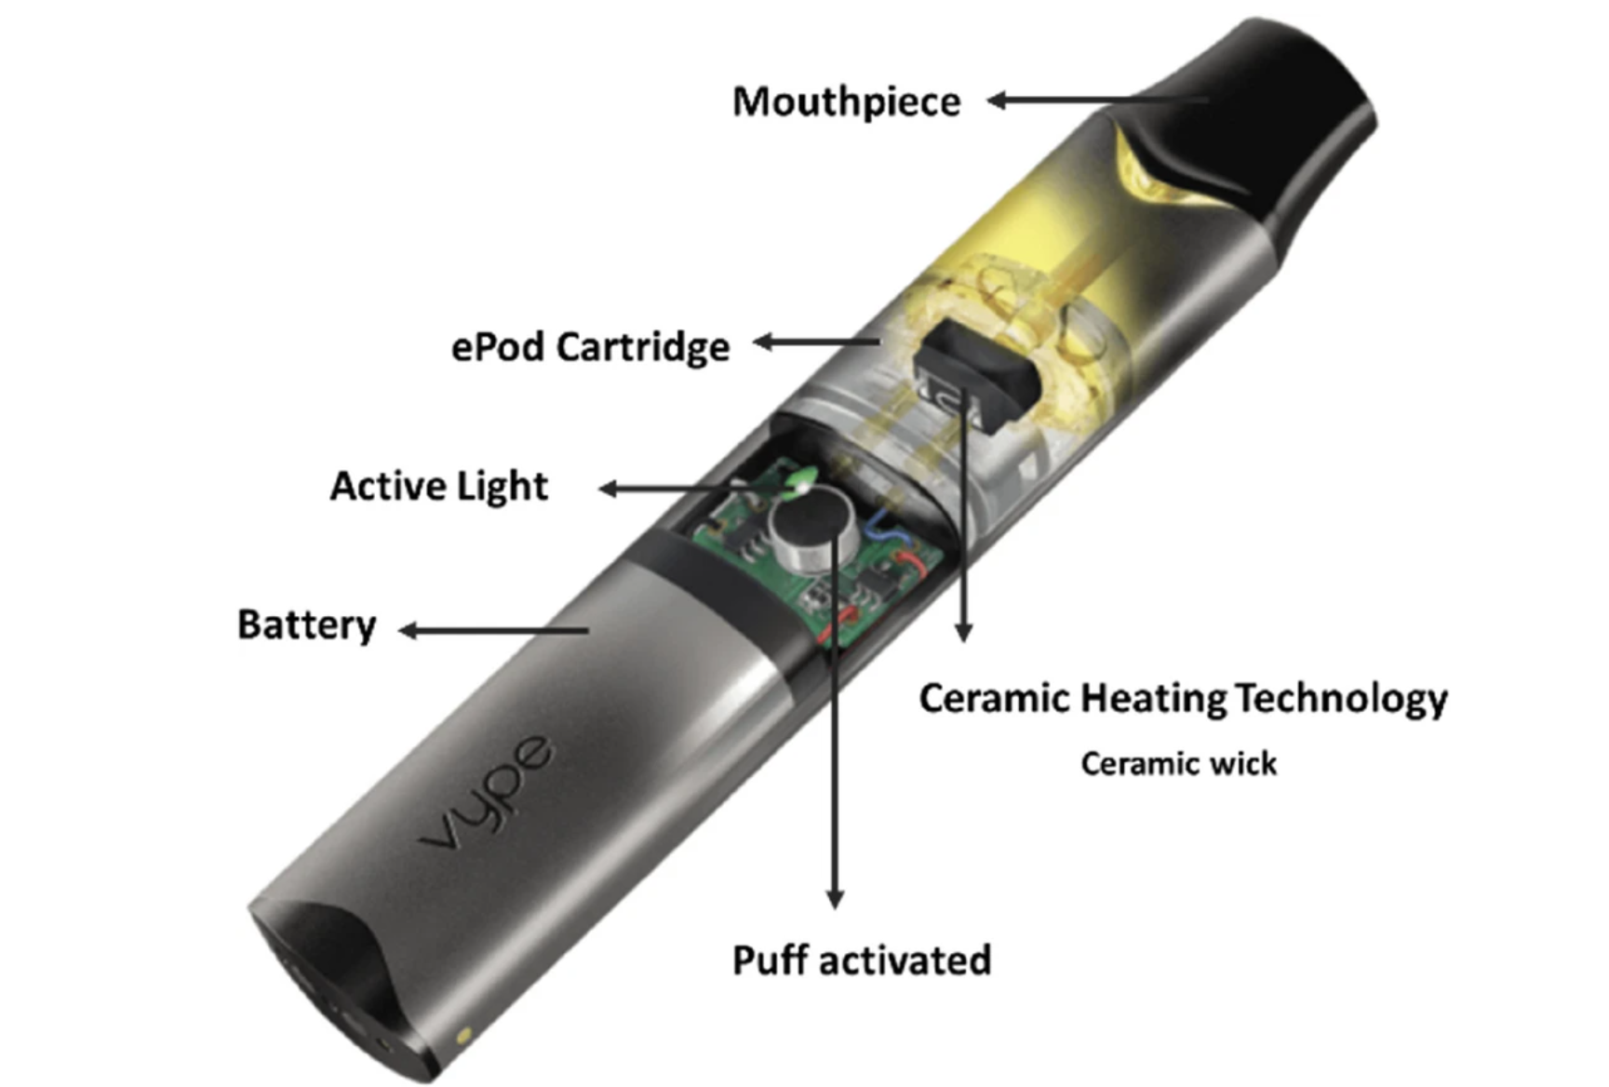
What are e-cigarettes?
Battery-operated devices used to inhale “vapor” that contains nicotine, flavorings, and other chemicals
1. The user breathes in or pushes a button
2. The heater turns on and boils the e-liquid
3. The “vapor” forms inside the device
4. The user breathes in the nicotine “vapor” and exhales (like smoking)

Slide 5
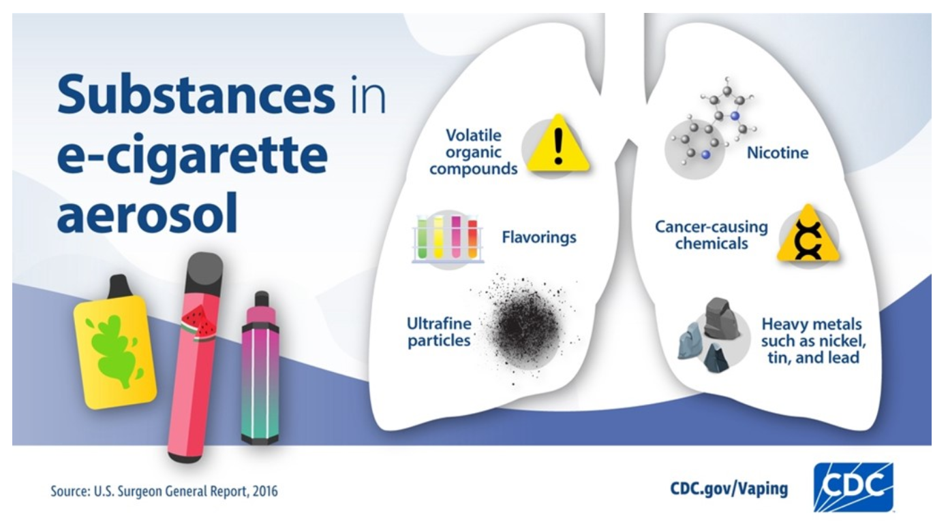
Contents in e-liquid and pods
Flavors
Propylene glycol
(throat hit)
Vegetable glycerin
(clouds)
Formaldehyde
Alcohol

Slide 6
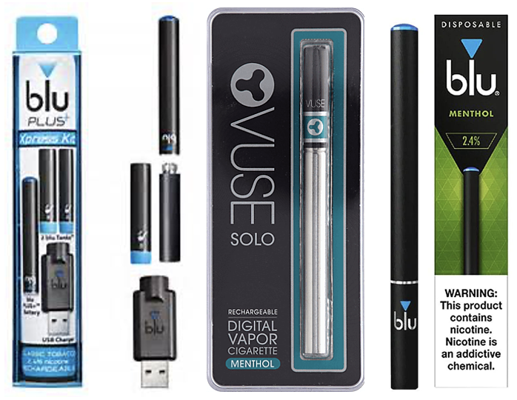
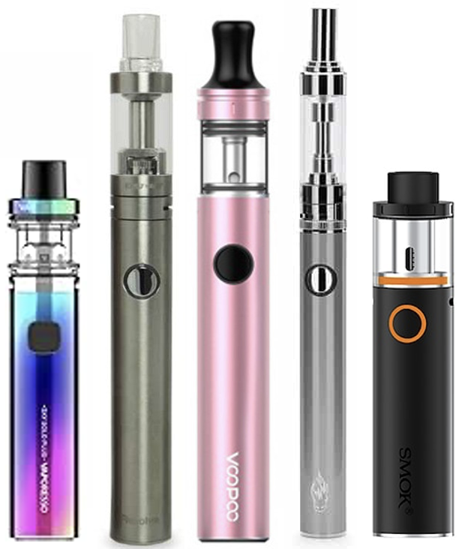
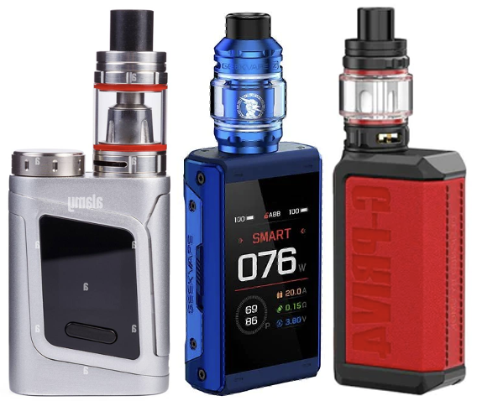
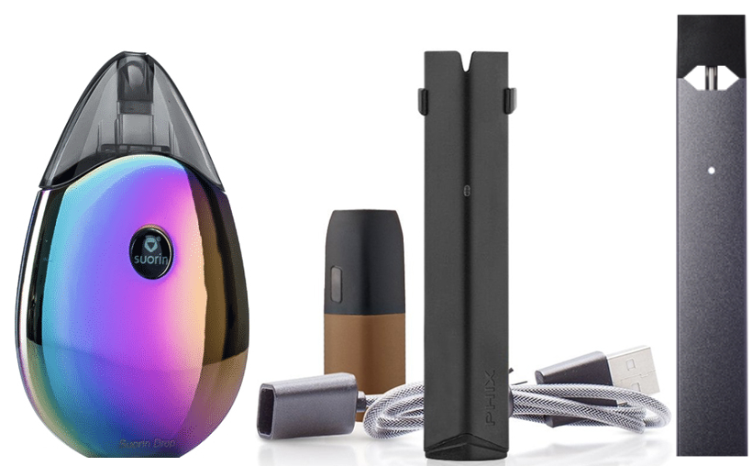
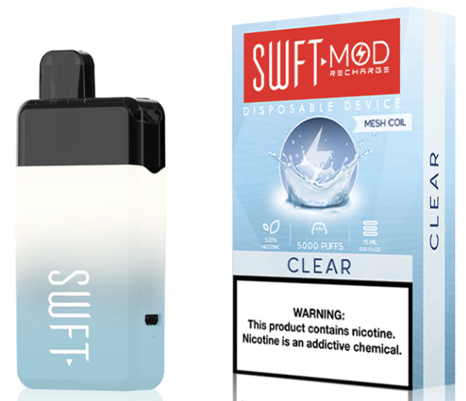
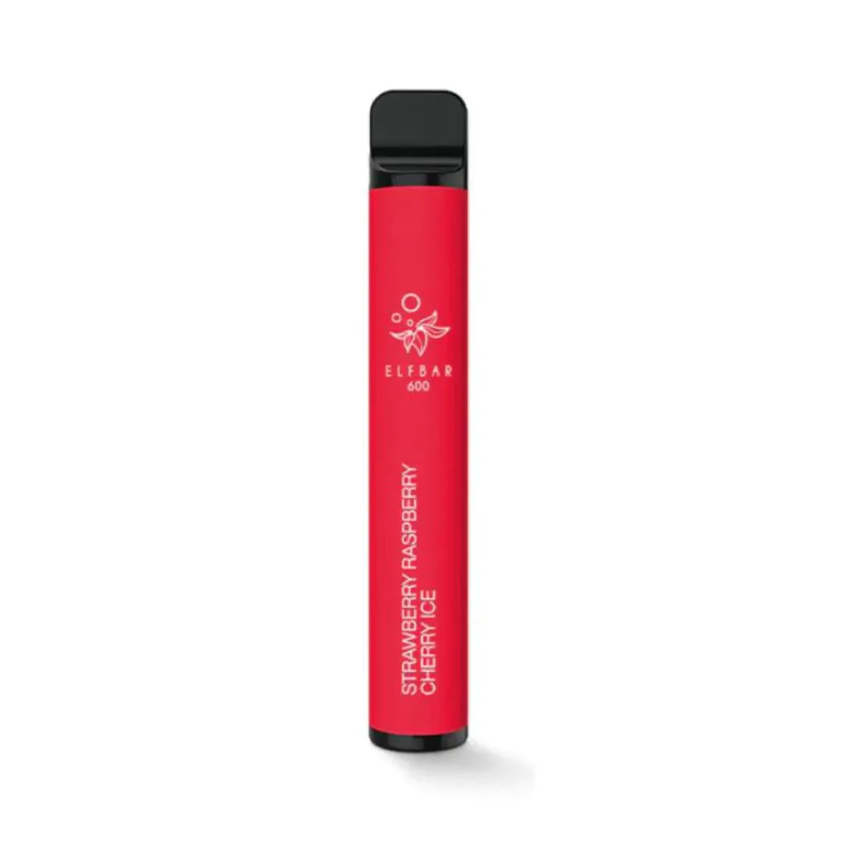
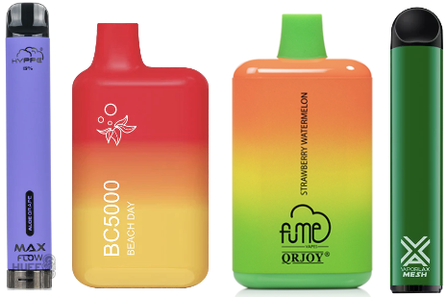
Evolution of e-cigarette device types
1
2
3
came onto market 2007, disposable, 1-2 strengths of nicotine, tobacco flavored
vape pens/tank style, bigger battery, rechargeable, customized, flavors
different power and heat settings, more aerosol and nicotine breathed into lungs at a faster rate
4
newest form, pod style, rechargeable and disposable, higher amount of nicotine

Slide 7
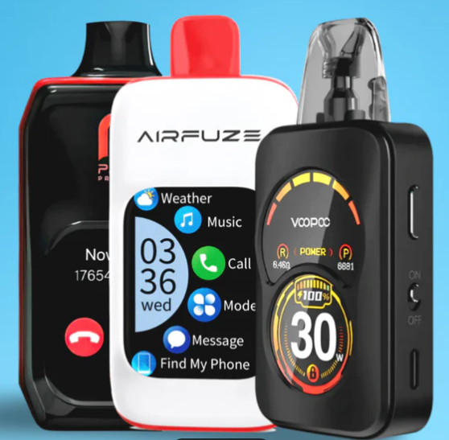

Reasons for Concern: Nicotine
What we see on the market
salt-based nicotine
freebase nicotine
smart vapes
5% (59 mg/mL) and higher
3% (36 mg/mL)
tobaccopreventiontoolkit.stanford.edu

Slide 8

Reasons for Concern: Nicotine
What we see on the market
25 packs of cigarettes
nicotine content
5,000 puffs

Slide 9
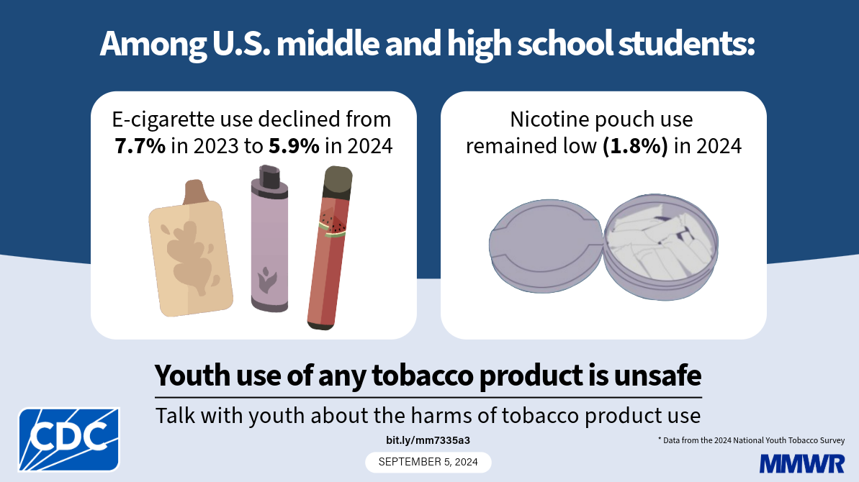
Nicotine vaping 2024
of the 1.63 million
More than 1 in 4 (26.3%) use an e-cigarette product daily
Current Use = 1.63 million
Numbers based on current use in the past 30 days

Slide 10
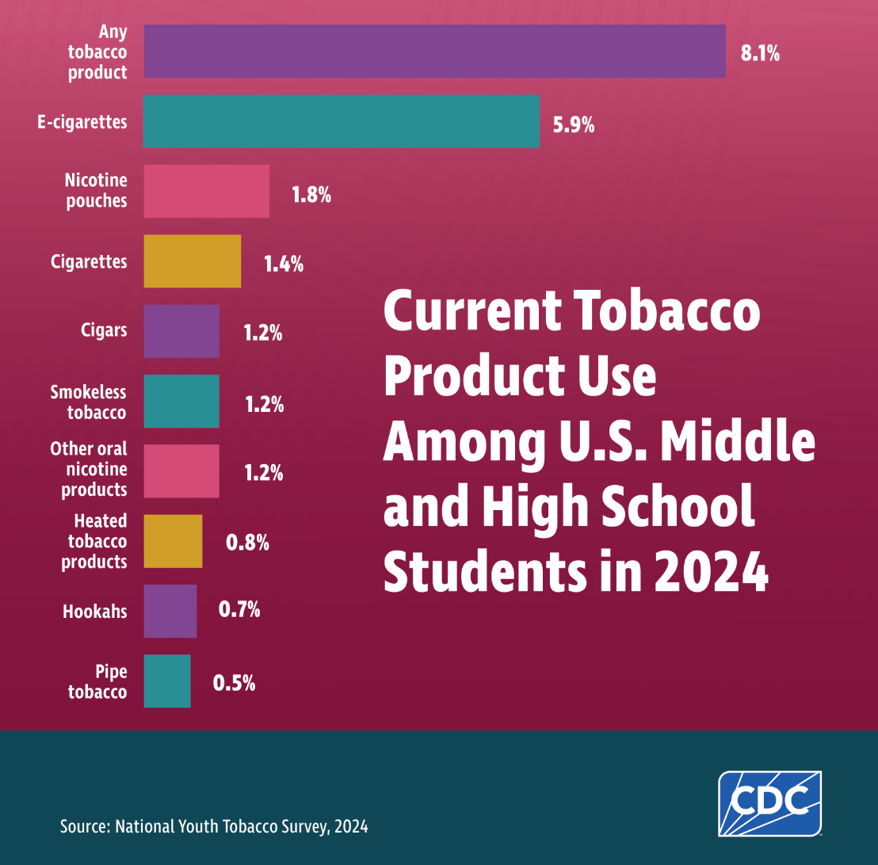
Nicotine products
2024
Down from 10.0% in 2023
Past 30 days

Slide 11
2025 Connecticut Survey
Tobacco Research in Youth (TRY)
CT School Survey
8 high schools participated
85% of students completed the survey
use in the past month
11.5%
10.3%
percentage %
Current Use = Past Month
2024
2025

Slide 12
2025 Connecticut Survey Tobacco
Research in Youth (TRY)
77%
percentage %
35.4%
24%

Slide 13






Why the decrease?
Raising Awareness & Prevention Campaigns

Slide 14


Education is vital to prevention
  nicotine can cause harms in the body
  the teen brain is sensitive to nicotine
  many teens vape nicotine to reduce stress but vaping can make mental health symptoms worse
  exposure to ads and marketing in social media makes it seem like everyone vapes
  genetic factors make quitting tobacco and nicotine harder for some
  both youth and adults have limited knowledge of what is in an e-cigarette

Slide 15
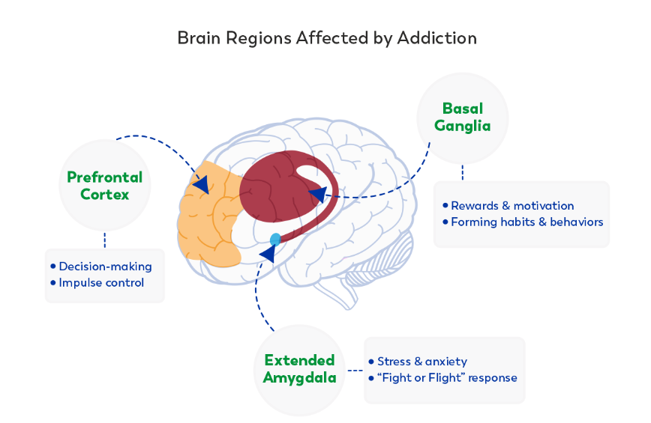

Reasons for concern: addiction and the brain
Nicotine cause dopamine release
pleasure center
adaptation of natural pathways
anticipation of reward
Wants more!

Slide 16

Reasons for Concern: Nicotine
Reason for concern: brain functioning
anxiety
depression
attention
learning
memory
impulsivity
brain circuitry

Slide 17
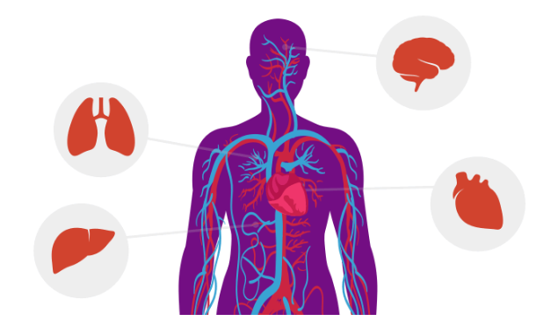
The Body on Nicotine
Reason for concern: nicotine & tobacco effect the body
Brain
-effects cognitive functioning
-impact on mental health
-decreases impulse control
-can cause dementia and strokes
Lungs
-breathing issues
-restricted air flow
Heart
-increases heart rate
-heart disease
Liver
-scarring
Blood vessels
-increased blood pressure
-blood clots

Slide 18
Reason for concern: gateway effect
using e-cigarettes can lead to use of other tobacco products

Slide 19
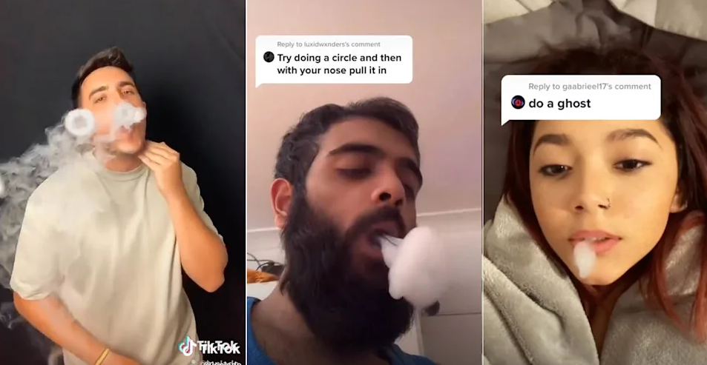
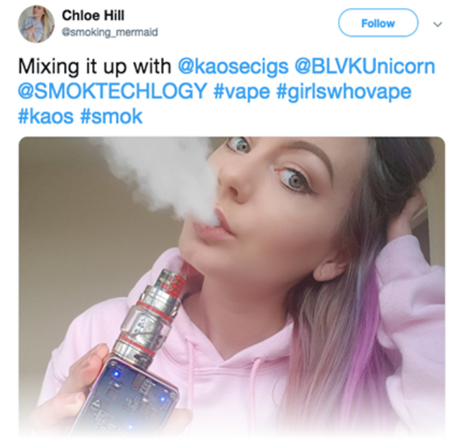
Reason for concern: social media
vape tricks
influencers
Notes:
.

Slide 20



Reason for concern: tobacco industry
industry marketing attractive to teens

Slide 21

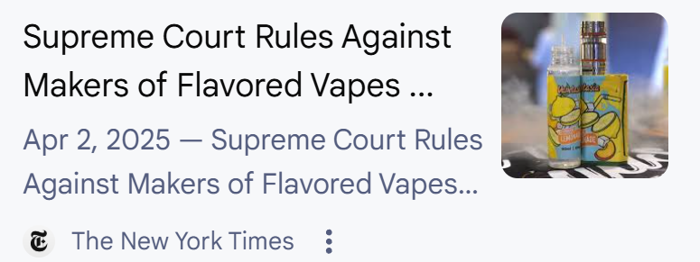
Reason for concern: tobacco industry
2020 U.S. Food and Drug Administration (FDA) banned flavored vapes (not inclusive of all types of vapes)
2025 Supreme Court upholds FDA ban
Connecticut does not have a law banning the sale of flavored vapes
Why are flavored vapes still being sold illegally?
lack of enforcement resources (federal, state, local)
  unless state and local levels have bans, difficult to enforce federal laws, retailers may choose to pay fines if caught selling unauthorized products
loopholes due to laws around types of vapes
legal challenges – unsettled

Slide 22
How to have a voice in CT
Contact the Public Health Committee
Advocacy
participate in decisions around town-level ordinances
Parents Against Vaping E-cigs (PAVe)
Contact the State Senator and State Representative
CT General Assembly "Find Your Legislators"
Reach out to Yale’s TRY Team for community and school system outreach

Slide 23

What can educators do?
Learn about different types of e-cigarettes and the risks
Develop, implement, and enforce tobacco and nicotine-free school policies
Reject tobacco industry sponsored youth prevention programs. These do not work!
Provide resources for students to quit vaping

Slide 24

What can parents do?
Keep lines of communication open with your child
Encourage them to say “no” to tobacco and nicotine
Ask your child what they are learning about vaping in school
Set a positive example by being tobacco and nicotine-free
Talk to them about the real risks of e-cigarette use
Ask them if they experience other people vaping nicotine around them
Be curious, understand what they are exposed to & pressures they face

Slide 25
What can parents do? If you learn your child vapes
practice self care | refrain from blaming or shaming yourself
stop and think about your thoughts and feelings | consider your options before making decisions
Use a collaborative approach in communicating with your child

Slide 26
What can parents do? If your child wants to quit vaping
Collaborative conversation starters
…I want to support you in quitting
…I want to understand what vaping does for you
…I am concerned about your health
…do you have way to distract yourself from urges
…what will motivate you in tough moments
…what are some things you’d rather I not do
…would it help if we check in regularly
Know the withdrawal symptoms your child may experience when they quit vaping
irritability
anxious / restless
can’t concentrate
can’t sleep
headaches
coughing
hungry
craving to vape

Slide 27
Teen and young adult cessation programs
“Vaping: know the truth” from the Truth Initiative
  Digitally delivered vaping prevention tool
  Curriculum developed for youth
  Provides education and facts about nicotine use
  Available to schools
“This Is Quitting” from the Truth Initiative
  Texting/Quitline support; phone, text, online chat sessions
  Text DITCHVAPE to 88709
  All tobacco including e-cigarettes

Slide 28
Teen and young adult cessation programs
My Life, My Quit (National Jewish Health)
  Texting/Quitline support; phone, text, online chat sessions
  Covers all tobacco including e-cigarettes
  Develop a quit plan, identify triggers, practice refusal skills and receive ongoing support for changing behaviors + Self-help and educational materials
CT Quitline
  1-800-QUIT-NOW or www.CommitToQuitCT.com or text VapeFreeCT to 88709
  1-on-1 assistance from quit coach when needed
  Online community with others trying to quit
  NRT like nicotine patches or gum is FREE
  Incorporates e-cigarette cessation along with other tobacco cessation

Slide 29
Teen and young adult quit lines
SAMHSA National Helpline
  1-800-662-4357
  Confidential free help, to find substance use treatment and information.
Smoke-free Text for Teens (National Cancer Institute)
  Information sheets, texts, app with quit tips, counselors
  Largely focused on smoking but some resources for e-cigarettes
INDEPTH (ALA)
  Alternative to suspension program
  Educational covers nicotine dependence and healthy alternatives
Not on Tobacco (N-O-T)
  Voluntary quit smoking program for 14–19-year-olds
  10-week program, participants learn to identify their reasons for smoking, healthy alternatives to tobacco use and people who will support them in their efforts to quit
Vape Free CT
  Quit tips, resources, support for teens and parents

Slide 30
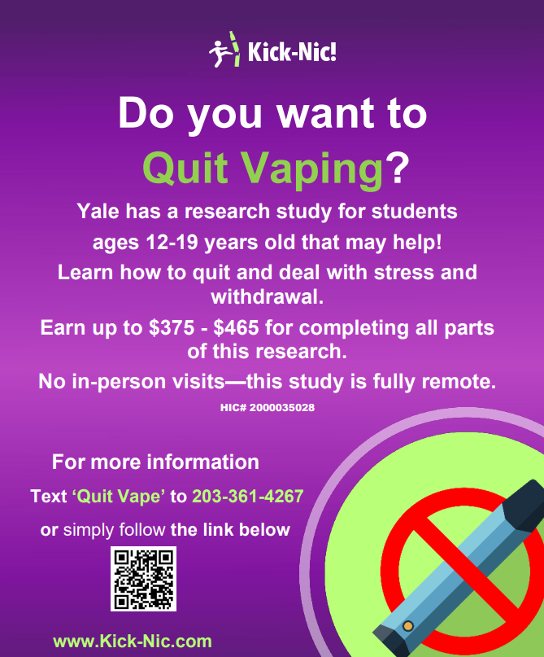

Now enrolling participants in a clinical research study
Use the QR code to see if you eligible

Slide 31

Questions

