Slide 1

Rehabilitation: A Patient’s Journey
Carlos Tirado, MPH, MD
June 8, 2026

Slide 2

Learning objectives
By the end of this session, participants will be able to…
Assess risk for alcohol withdrawal based on
individual and environmental risk factors
Incorporate American Society of Addiction Medicine (ASAM) Level of Care Criteria in treatment planning
Identify common misperceptions about treatment
Outline steps to develop and maintain a referral network

Slide 3

Heavy drinking in primary care
Population estimates range from 5-10% report episode of heavy drinking
About 10-20% of those reporting heavy drinking days (HDD) are likely to have moderate to severe AUD
Number of HDDs (5+ in a 3-month period) correlates with severe AUD
Lifetime heavy drinking years can predict AUD severity (and can supplement standard screening for current and past year use)
Those with chronic obstructive pulmonary disease (COPD), hypertension (HTN), and chronic liver disease had higher odds of being heavy drinkers

Slide 4
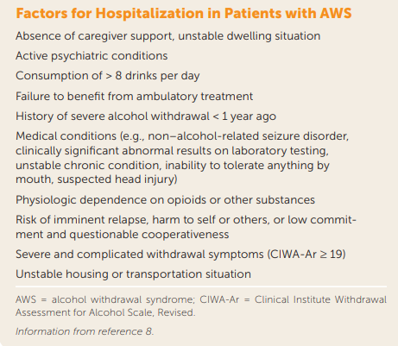
Ambulatory vs. Inpatient Withdrawal Management
Patient factors
Preference
Readiness
Medical/psych comorbidities
Prior withdrawal history
Use history
Environmental factors
Caregiver support
Housing
Access to clinic/clinic staff
(Tiglao et al., 2021)

Slide 5
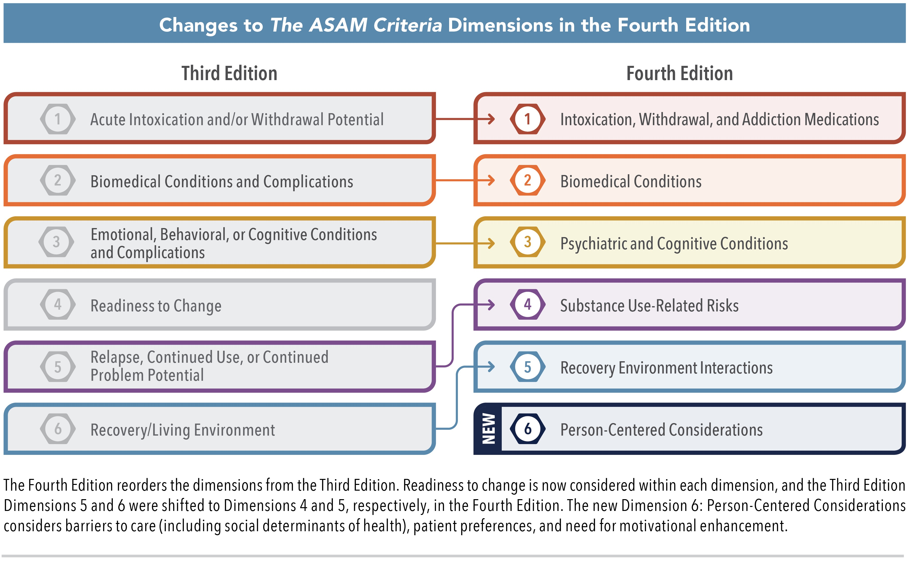
ASAM Criteria Dimensions
(American Society of Addiction Medicine, 2025)

Slide 6
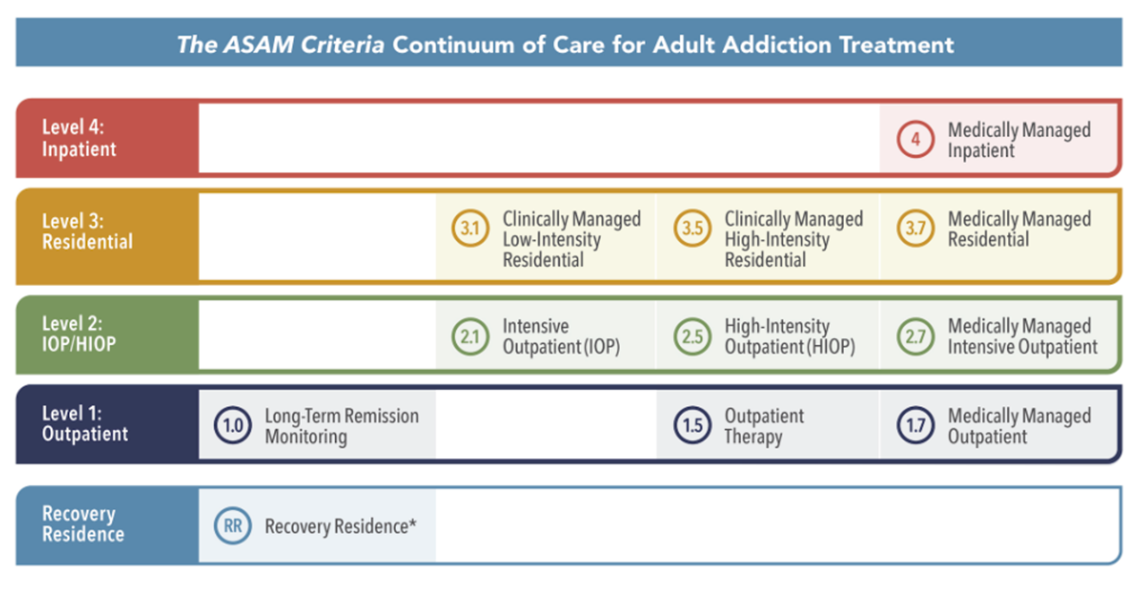
ASAM Continuum of Care Criteria
(American Society of Addiction Medicine, 2025)

Slide 7
Patient journey across levels of care: Zoom poll
Which level of care are you least familiar with in terms of what typically happens for the patient?
HOSPITAL
“DETOX”
RESIDENTIAL
PARTIAL HOSPITAL
INTENSIVE OUTPATIENT
OUTPATIENT

Slide 8
Patient journey across levels of care
HOSPITAL
“DETOX”
RESIDENTIAL
PARTIAL HOSPITAL
INTENSIVE OUTPATIENT
OUTPATIENT
Psychiatric
Med/Surg
High Acuity Conditions
  Pancreatitis
  Delirium
  Seizure
  Hallucinations
  Suicidality
  Psychosis
3-10 days
Protocol driven
Medically monitored
Inpatient setting
14-45 days
“Rehab”
Curriculum Driven
Lengths of stay vary by program and payer
Address comorbidities
Address familial and environmental factors
Typically 4-8 weeks
Attendance for 6-8 hours/day 4-5 days per week
Patient is in community often in recovery housing
Medication management
Typically 4-12 weeks
3-4 hrs/day 3-4 days/week
Patient in community
Patient expected to transition to outpatient provider
Patient in community
Indefinite duration of engagement
Psych med management, primary care, chronic disease management, MAUD

Slide 9
Misperceptions and barriers
Low motivation and unwillingness to change
  There is a difference between perceived need, ambivalence, and unwillingness to change
Affordability and access to providers/programs are common reasons cited for not pursuing treatment
A treatment episode cannot guarantee complete sustained remission
Moderation, “sobriety sampling”, and non-abstinence approaches must be offered/considered
MAUD should be thought of as a condition modifier, not an abstinence cure
A 25% reduction in alcohol use over 10 years matters the same way a 20mmHg reduction in systolic blood pressure (SBP) or a 2-point reduction in HA1C matters

Slide 10

How to spot a “good” program/provider
Mainstream, evidence-based behavioral treatment and MAT
Stable leadership, preferably by career health care professionals
Clinical staff are career professionals in SUD and co-occurring disorders
Accreditation by Commission on Accreditation of Rehabilitation Facilities (CARF) or Joint Commission
Medical staff capable of addressing medical and psychiatric co-morbidity
Not leading with amenities and location over their practitioners and program
Transparent and simple billing policies

Slide 11

How to develop a referral network
Think about your payer mix and match treatment and referral expectations to funding
Think about the entire continuum of care and where you fit
Primary care is a natural hub and spoke model
Set a goal to identify and contact one program at each level of care that
matches your payer mix and what you can’t offer in house
Agree to a referral workflow between entities
Make friends!
Collaborate on grants and RFPs if possible
Set a goal to attend at least one recovery event in your community
Don’t alienate either side in the SUD culture war (i.e. 12-Step Abstinence vs Safe Injection); maintain a pragmatic focus on helping your patients above all
Authentically connected referral networks take time to develop and are based on human connection
Unmute or share in the chat: What challenges do you face in developing a referral network?

Slide 12

Questions?
Feel free to unmute or put your questions in the chat!

Slide 13
References
American Society of Addiction Medicine. (2025). About the ASAM Criteria. https://www.asam.org/asam-criteria/about-the-asam-criteria
Tiglao, S. M., Meisenheimer, ES., & Oh, R. C. (2021). Alcohol Withdrawal Syndrome: Outpatient Management. American Family Physician, 104(3), 253-262.

