Slide 1

Ambulatory Withdrawal Management
Carlos Tirado, MPH, MD
June 22, 2026

Slide 2

Learning objectives
By the end of this session, participants will be able to…
Understand the time course and complications associated with the alcohol withdrawal syndrome
Evaluate selection criteria and decision making for outpatient management of alcohol withdrawal
Review sample protocols for outpatient withdrawal management

Slide 3
Ambulatory withdrawal management in AUD
Important service for patients with limited resources and/or inability/unwillingness to go to inpatient facility
Can be conducted in context of primary care
Requires adequate staff support
Can be done by telehealth
Applicable H Codes

Slide 4
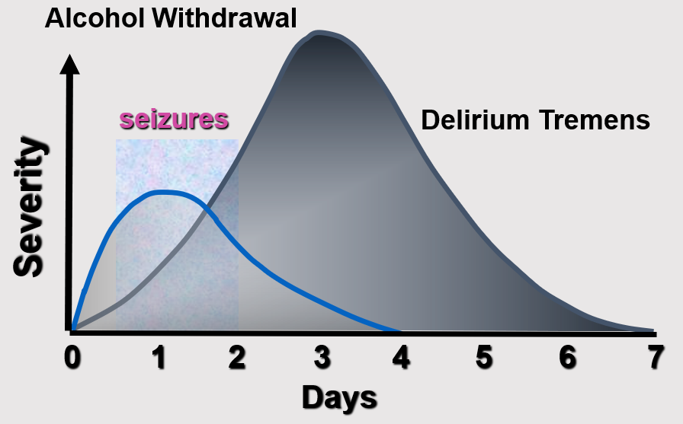
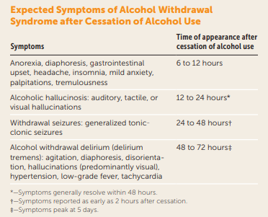
Alcohol Withdrawal: Complications Timeline

Slide 5
Ambulatory Withdrawal Management - Alcohol
General Selection Criteria
  Mild to moderate withdrawal symptoms (CIWA-Ar score < 15)
  No history of severe withdrawal complications (e.g., seizures, delirium tremens)
  Stable medical and psychiatric status
  Supportive home environment with reliable supervision
  No concurrent substance use requiring inpatient care
  Ability to adhere to frequent follow-up and medication regimen

Slide 6
Level 1 vs Level 2 Management
Level 1 (Supportive care)
  Low level withdrawal (CIWA < 10)
  Normal labs, generally benign physical exam
    Gabapentin or carbamazepine
Level 2 (Pharmacologic Management)
  Low-moderate to moderate (CIWA 10-18)
  Combined opioid induction/maintenance
  Severe withdrawal within past year
  Mild/stable psych comorbidoty

Slide 7
Sample Medication Protocols
Benzodiazepines (first-line)
  Chlordiazepoxide: 25–100 mg every 6–8 hours, taper over 3–5 days
  Diazepam: 10–20 mg every 6–8 hours, taper as tolerated
  Lorazepam: Preferred in liver disease; 1–2 mg every 6–8 hours
  Phenobarbital: 60-120mg q6-8hrs, taper as tolerated
Gabapentin (off-label)
  Loading dose 1200mg
  300–600 mg TID; useful for mild withdrawal and craving reduction
Carbamazepine (off-label)
  200 mg TID–QID for first 3d and taper to 200-400mg/day days 4-10; alternative to benzodiazepines in some cases
Adjuncts:
  Thiamine (200-300 mg daily) neuroprotective, can prevent encephalopathy
  Folic acid, multivitamins, and hydration support

Slide 8
Ambulatory Withdrawal Management - Alcohol
Monitoring and Follow-Up
Daily or twice-daily in-person or telehealth check-ins
Use of CIWA-Ar or Short Alcohol Withdrawal Scale to monitor symptom progression
Clear emergency plan if symptoms worsen
Transition to long-term AUD treatment (e.g., naltrexone, acamprosate) after stabilization

Slide 9
High Risk Factors
Med/Psych Condition requiring inpatient
Unstable chronic condition(s)
  Severe COPD, CHF, Decompensated Cirrhosis
Inability to tolerate oral meds
Persistently severely elevated CIWA (>19)
Known history of alcohol withdrawal delirium, repeat seizures
Onset of withdrawal with high BAC (>0.16,mmol)
Chaotic use of other substances

Slide 10
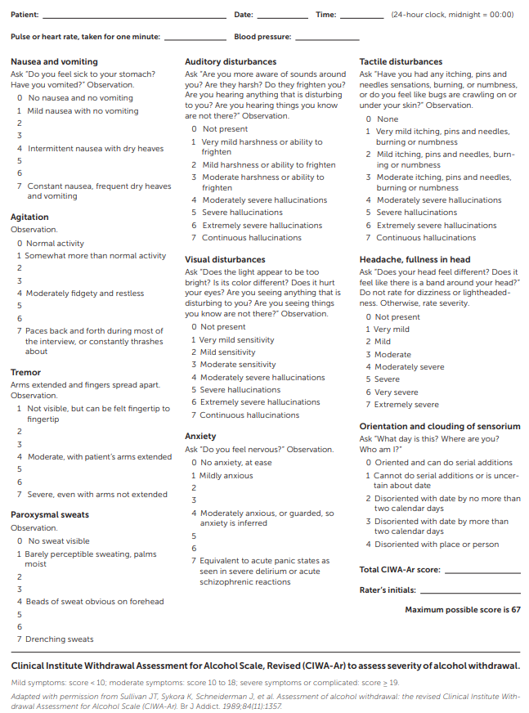
CIWA-Ar
Mild (<10)
Mod (10-18)
Severe (>19)

Slide 11
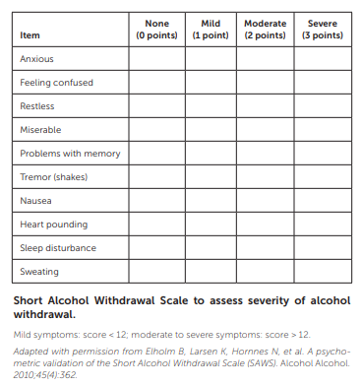
Short Alcohol Withdrawal Scale
Mild (<12)
Mod-Sev (>12)

Slide 12

Questions?
Feel free to unmute or put your questions in the chat!

Slide 13
References
The ASAM Clinical Practice Guideline on Alcohol Withdrawal Management – PubMed
Alcohol Withdrawal Syndrome: Outpatient Management – PubMed
PAYMENT FOR AMBULATORY ALCOHOL WITHDRAWAM MANAGEMENT:
Billing & Payment | CMS
ASAM Billing & Coding
Papers that changed the way I think about SUD:
Actual causes of death in the United States, 2000 – PubMed
Drug dependence, a chronic medical illness: implications for treatment, insurance, and outcomes evaluation – PubMed

