Slide 1


Headache in Primary Care: Fundamentals and Pearls
Jenna Kanter, MD
June 17, 2026
www.ConferMED.com

Slide 2
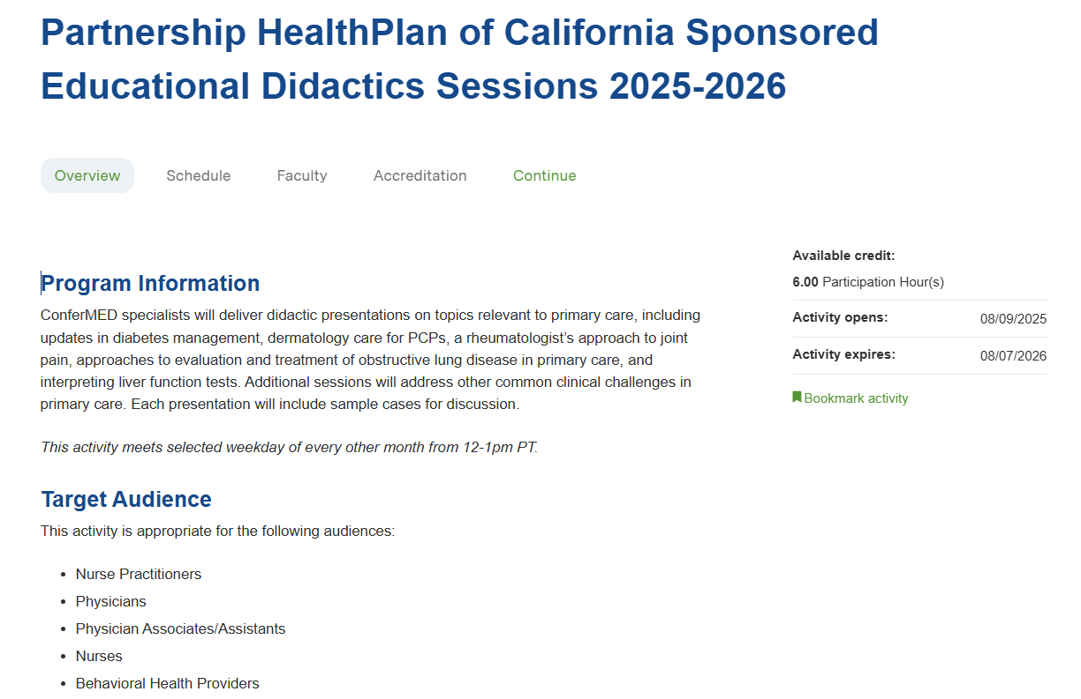
Claiming CME
Create an account on Weitzman Education Platform if you do not have one already.
Navigate to activity: Partnership HealthPlan of California Sponsored Educational Didactics Sessions 2025-2026
Under Register, select session you attended. Within that session, select Continue to navigate to activity instructions.
Select the Start Activity or Session Evaluation in the left-hand navigation bar.
Complete the session evaluation and select the Submit at the bottom of the evaluation.
You will be able to view your credits awarded and download your certificate.

Slide 3
I have no relevant financial relationships to disclose.
I will be discussing some off-label uses of medications in this presentation.
Thank you to Drs Dan Wilensky and Seth Kareus for their contributions to this slide deck.

Slide 4
Learning objectives
1. Differentiate primary and secondary headache disorders based on clinical presentation and history.
2. Identify red flag symptoms and risk factors that warrant urgent evaluation or referral.
3. Implement evidence-based acute and preventive migraine treatments.
4. Diagnose and manage medication-overuse headache.
5. Recognize less common primary headache syndromes.

Slide 5
General approach to headache diagnosis
Know migraine well – it’s the likely diagnosis for more than 90%* of patients who present to your clinic for headache.
Know the uncommon and rare primary headaches enough to know to look them up when a zebra walks in.
Pay extra attention to new headaches.
Take a detailed history (chronicity, location, frequency, duration, triggers, etc) and if the patient can only give vague answers at the first visit, tell them to keep a headache diary for a few weeks and then come back.
Keep in mind that headaches are often part of a bigger picture of complex chronic pain, pain related to psychosocial factors, multiple somatic complaints, etc.
*Tepper SJ, et al. Prevalence and diagnosis of migraine in patients consulting their physician with a complaint of headache: data from the Landmark Study. Headache. 2004 Oct;44(9):856-64.

Slide 6
Red flags for secondary headache: History
HPI: Recent onset or major change in previous pattern, focal neurologic features, positional, exertional (cough/exercise/intercourse), thunderclap onset → Many patients with any of these features will still turn out to have migraine, but investigation is needed.
Medical history: Cancer, recent trauma, >50 yrs old, pregnant/postpartum, immunosuppressed, anticoagulant or bleeding diathesis, hypercoagulable state, recent fevers/rigors or unintended weight loss.

Slide 7
Red flags for secondary headache: Exam
Highest-yield neurological exam:
  Mental status and speech
  Gait
  Cranial nerves – look for pupillary asymmetry (up to 1mm difference is normal), impairment of eye movements, ptosis or facial droop, unilateral sensory loss
If concern for temporal arteritis, check for tenderness directly over the temporal artery (general scalp/forehead tenderness is highly nonspecific)
Vital signs

Slide 8
A brief discussion of brain imaging
We should image everybody with a headache that is not clearly a primary headache disorder
  Be liberal …. Once
MRI with and without contrast for most headaches
  Choosing Wisely: Clinicians should not order CT imaging for headache when MRI is available, except in emergency settings
        Loder et. Al, “Choosing wisely in headache medicine:the American Headache Society’s list of five things [clnicians] and patients should question”, Headache. 2013 Nov;53(10)1651-9 https://www.uptodate.com/contents/evaluation-of-headache-in-adults/abstract/36
When might I add an MRA to initial imaging?
  Thunderclap onset
  Exertional or sex-related (Pearl: Most migraines are worsened by physical exertion. When I call a headache “exertional” I mean headaches that are triggered specifically by exertion.)

Slide 9
Evaluation in two specific common scenarios
Concern about GCA/Temporal Arteritis?
  Recent onset temporal HA in >50 y/o; jaw claudication, PMR symptoms, tender temporal artery
    To ER if TIA/CVA symptoms or vision loss
    ESR/CRP
  If patient meets any of these criteria and ESR/CRP elevated, start pred 60 mg daily and send for temporal artery biopsy and refer to rheumatology/neurology
    Risk of irreversible vision loss if treatment is delayed
Concern about IIH (Idiopathic Intracranial Hypertension)/Pseudotumor Cerebri?
  Obese woman of childbearing age
  Headaches often worse with Valsalva or laying flat, associated with visual obscurations
  Sometimes cranial nerve deficits (abducens palsy most common)
  First step is referral for dilated eye exam → If no papilledema, you have ruled out IIH
  If papilledema is present:
    Send for LP with opening pressure and basic CSF studies (cell count, protein, glucose)
    Brain MRI w/ and w/o contrast to rule out mass and venous sinus thrombosis

Slide 10
A healthy suspicion about “Sinus Headache”
In a study of 2991 patients with diagnosis of “sinus headache,” 80% met criteria for migraine*
A patient presenting with recurrent headaches being attributed to “sinuses” should be carefully evaluated for migraine
  A new onset headache presenting with signs and symptoms of acute infective sinusitis is the only time the diagnosis of “Acute sinus headache” should be made in the primary care clinic without further investigation
CT scan and MRI are frequently overinterpreted as demonstrating sinus disease – disregard mucosal thickening and polyps, pay attention to air-fluid levels or opacification
*Schreiber CP, et al. Prevalence of migraine in patients with a history of self-reported or physician-diagnosed "sinus" headache. Arch Intern Med. 2004 Sep 13;164(16):1769-72

Slide 11
Migraine overview
ICHD3 Criteria: “Recurrent headache disorder manifesting in attacks lasting 4-72 hours. Typical characteristics of the headache are unilateral location, pulsating quality, moderate or severe intensity, aggravation by routine physical activity and association with nausea and/or photophobia and phonophobia.”
By far the most common headache type you will see in clinic
Often mistaken for tension or sinus headaches
Two arms of treatment:
  acute
  preventive – as a guideline, consider if >4 migraine days per month or fewer but refractory to acute treatment

Slide 12
A brief word about tension-type headaches
Most patients don’t come to clinic for tension-type headaches alone; they usually have at least some overlap with migraine
Key questions:
  How would you describe your most severe headaches?
  What do you prefer to do when you have your most severe headache?

Slide 13
The tension-migraine spectrum
Tension-type
Bilateral
Dull/achy
Mild pain
No associated symptoms
Low interference with activities
Migraine-type
Unilateral
Throbbing
Severe pain
Photophobia/phonophobia/nausea
High interference with activities

Slide 14
Acute migraine treatment
Advise patient to treat early
Use combination therapy – NSAID, triptan, +/- antiemetic
Triptans are underprescribed (more on next slide)
Avoid opioids and butalbital products (Fioricet etc)
Watch for medication overuse – risk with acute treatment >2-3 days per week

Slide 15
Triptans
Several on the market, all now available as generics, eletriptan (Relpax) works best but insurances often have step therapy requirements. If one does not work, try another.
Warn patient about common but benign side effects: flushing, tightness in head/neck area, palpitations → “This just tells you it’s kicking in”
Use highest dose available unless patient very sensitive to SEs generally
Consider nasal spray or injectable (best) if severe N/V or slow response to oral triptan
Can be used in pregnancy! Can be used with SSRIs!
Contraindications: CAD or cerebrovascular disease (or reason to suspect it), uncontrolled HTN, Prinzmetal’s angina

Slide 16
CGRP antagonists for acute treatment
Three currently on the market: Ubrogepant (Ubrelvy) oral tablet, rimegepant (Nurtec) ODT, zavegepant (Zavzpret) nasal spray
Indicated when triptans are not effective or are contraindicated
Studies indicate lower efficacy on average compared to triptans
Likely minimal risk of medication overuse
Contraindications: uncontrolled HTN, pregnancy, ESRD/ESLD; check for drug interactions
Cost and insurance barriers

Slide 17
Nausea treatment in migraine
Ondansetron commonly used due to safety and minimal SEs
Dopamine blockers often work better since they also have antimigraine properties – metoclopramide, prochlorperazine, promethazine – however more sedating and carry risk of tardive dyskinesia with frequent use
Suppository available for prochlorperazine and promethazine

Slide 18
Migraine prevention pearls
Always focus on lifestyle modification concurrent with meds
Start low and titrate slowly to minimize SEs, target a therapeutic goal dose, continue for at least 2-3 months at goal dose if tolerated
My old-school favorites:
  Propranolol (especially if hypertensive or anxious)
  Nortriptyline (especially if insomnia or other chronic pain)
  Topiramate (overall higher level of evidence, good for overweight patients, remember it is teratogenic)
Second-line: CGRP inhibitors, Botox (if >14 headache days per month)

Slide 19
Menstrual migraine
Many women experience more or worse migraines just before or during menses, however menstrual migraine refers to those with migraines almost exclusively linked to menses
Continuous-cycle OCPs if not contraindicated
“Miniprophylaxis” with long-acting triptans: Frovatriptan (best) or naratriptan (cheaper)

Slide 20
Medication-overuse headache
ICHD3 criteria: “Headache occurring on 15 or more days/month in a patient with a pre-existing primary headache and developing as a consequence of regular overuse of acute or symptomatic headache medication (on 10 or more or 15 or more days/month, depending on the medication) for more than 3 months. It usually, but not invariably, resolves after the overuse is stopped.”
Patients often do not respond to preventive treatment until the overused medication is withdrawn
Can occur with any abortive med including OTCs (but maybe not CGRP inhibitors), worst offenders are butalbital and opioids

Slide 21
Don’t use butalbital
Off the market in Germany and other European countries
Extremely high risk of physical and psychological dependency as well as MOH
Can be life-threatening in overdose, also particularly dangerous in the elderly and when used in combination with opioids
If using daily, will need to be tapered to avoid seizures and other withdrawal effects

Slide 22
How to talk about medication overuse
We both want your migraines to get better. You wouldn’t be here talking to me about this if your current medications were working. I have many options available to help, but they will not work unless we also reduce the acute medications.
You didn’t do anything wrong, you are doing what any reasonable person would do to function under these circumstances.
Highlight safety issues with overuse of the acute meds → preventive options much safer

Slide 23
Medication overuse treatment
Introduce a preventive med concurrent with tapering the acute med
Topiramate, Botox, and CGRP inhibitors have highest level of evidence but any preventive can work
Warn that the migraines may get worse before they get better
Prednisone taper can be helpful if not contraindicated; I typically start at 40-60 mg and taper over 10 days up to a month

Slide 24
Migraine in pregnancy
Best acute meds: Triptans, antiemetics, Tylenol
Best preventive meds: Propranolol, nortriptyline
Unplanned pregnancy is common, think about it in advance when you are prescribing to a women of childbearing age
Avoid topiramate and Depakote in women of childbearing age unless you had an explicit discussion about risks and they are on reliable contraception (or don’t need it)
Be cautious with CGRP inhibitors because of limited data and theoretical concerns about effect on placenta; hopefully we will get better data in the coming years

Slide 25
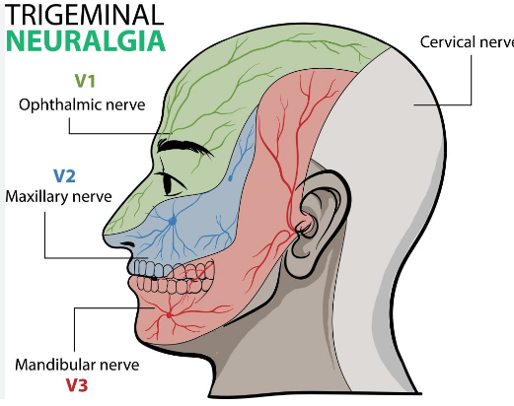
Trigeminal Neuralgia
Paroxysms of sudden, severe, unilateral pain in trigeminal pattern, V3>V2>>V1
Often triggered by light touch, chewing, talking, brushing teeth, cold air/liquids
May have milder lingering pain between attacks, but must have acute attacks in order to qualify as TGN; other types of facial pain have different diagnosis and treatment
Brain MRI w/ and w/o contrast with thin cuts through TGN to exclude structural cause
Oxcarbazepine and carbamazepine are most effective treatment by far in most cases

Slide 26
TACs (trigeminal autonomic cephalalgias)
  Consider when a patient describes focal (usually periorbital or temporal), side-locked pain, with multiple episodes per day (except hemicrania continua).
  Cluster headache is by far the most common TAC, good to have basic familiarity with treatment, the others you may never see but good to be able to recognize them.
  Refer to neurology if you suspect a TAC. Econsult can help with initial evaluation and treatment.

Slide 27
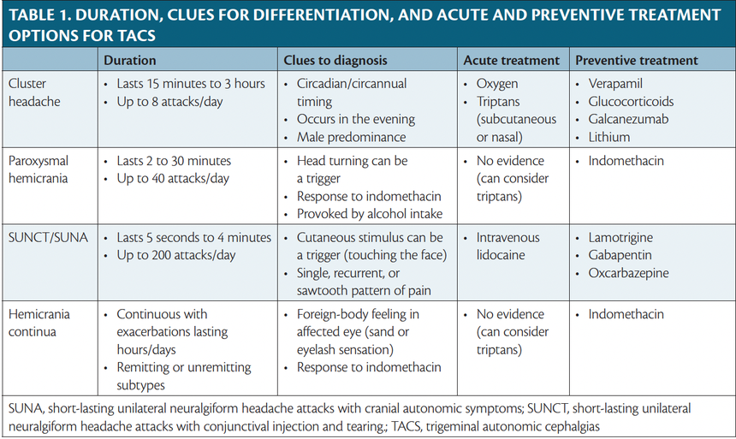
  Practical Neurology 2023

Slide 28
Cluster headache pearls
Imaging: MRI with and without contrast (for new onset cluster)
Many case reports of structural etiologies such as pituitary tumors
How to prescribe oxygen to abort cluster attacks:
“10-15 liters per minute via non-rebreather mask for 10-15 minutes at onset of attack”
Quick ways to help the patient while referring to neurology and getting an eConsult:
Prednisone taper: 60 mg daily with slow taper over 2-4 weeks
Triptan mini-prophylaxis: naratriptan or frovatriptan 2.5 mg BID. There does not appear to be any risk of medication overuse in cluster headache. Insurance coverage of necessary quantity can be a limitation.
Occipital nerve block if available

Slide 29

Questions?

