Slide 1



Screening and Management of Obesity and Cardiometabolic Comorbidities in HIV
John Koethe, MD, MSCI, FIDSA Associate Professor of Medicine Division of Infectious Diseases Vanderbilt University Medical Center

Slide 2

Disclosures
2
Dr. Koethe has received grant funding from Merck & Co. and Gilead Sciences, and served as a consultant to Merck & Co., Theratechnologies, and Gilead Sciences.
  The Health Resources and Services Administration (HRSA), Department of Health and Human Services (HHS) provided financial support for this project. The award provided 100% of total costs. The contents are those of the author. They may not reflect the policies of HRSA, HHS, or the U.S. Government.
  This content is owned by the AETC and is protected by copyright laws. Reproduction or distribution of the content without written permission of the sponsor is prohibited and may result in legal action.
March 2, 2026

Slide 3

AETC Program National Centers and HIV Curriculum
3
National AETC Support Center (NASC) – serves as the central web –based repository for AETC Program training and capacity building resources; its website includes a free virtual library with training and technical assistance materials, a program directory, and a calendar of trainings and other events. Learn more: https://aidsetc.org/
National Clinical Consultation Center (NCCC) – provides free, peer-to-peer, expert advice for health professionals on HIV prevention, care, and treatment and related topics. Learn more: https://nccc/ucsf.edu or 844-ASK-NCCC
National HIV Curriculum (NHC) – provides ongoing, up –to-date HIV training and information for health professionals through a free, web –based curriculum; also provides free CME credits, CNE contact hours, CE contact hours, and maintenance of certification credits. Learn more: www.hiv.uw.edu

Slide 4
Learning Objectives
4
By the end of this session, each participant will be able to:
Describe trends in obesity prevalence among PWH and how fat distribution in treated HIV differs from generalized obesity and contributes to cardiometabolic comorbidities.
Describe the challenges of diabetes diagnosis in PWH, and the most accurate approaches.
Identify the stages of metabolic-associated steatotic liver disease (MASLD), the groups at highest risk, and the options for disease screening.
Describe the essentials of cardiovascular disease screening in the clinic setting, the groups most prone to ASCVD risk underestimation, and the 2025 NIH/DHHS recommendations on statin use.

Slide 5

Case Presentation
5
Mr. Green is a 64 y/o Caucasian man diagnosed with HIV in 1998, who has maintained consistent viral suppression.
BMI 29.8 kg/m²
Current ART regimen: BIC/TAF/FTC
32 years total ART
Past thymidine analogue (AZT) exposure
Other medications: HCTZ, lisinopril, rosuvastatin
Never smoker, rare alcohol
Walks regularly for exercise
Current CD4 count: 1044 cells/ul
CD4 at ART start: 123 cells/ul
Fasting blood glucose: 119 mg/dL
Fasting total cholesterol: 222
Fasting triglycerides: 243
C-reactive protein: 2.9
Waist circumference: 108cm (42.5 inches)

Slide 6
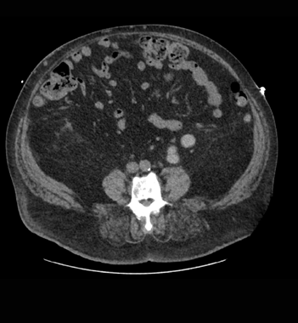
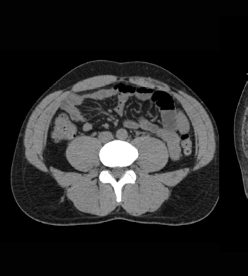



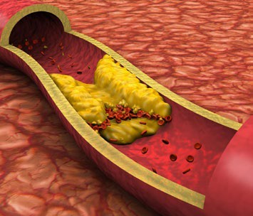
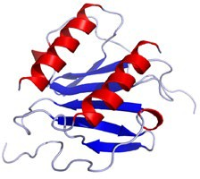
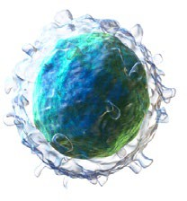
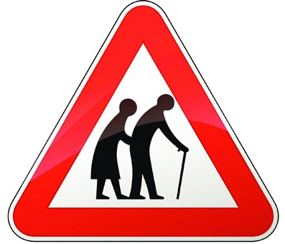
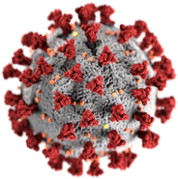
Why are We Still Talking about HIV and Comorbidities in 2025?
6
Modern ART regimens are more effective, durable, and non-toxic than ever
Residual virus and immune activity
HIV+
HIV-
Fat Redistribution
Inflammation
Viral Reservoir
Accelerated Atherosclerosis
Viral Proteins
Cellular Immune Activation
Frailty and
Functional Decline
Other Viral Infections (CMV)
…and many more

Slide 7

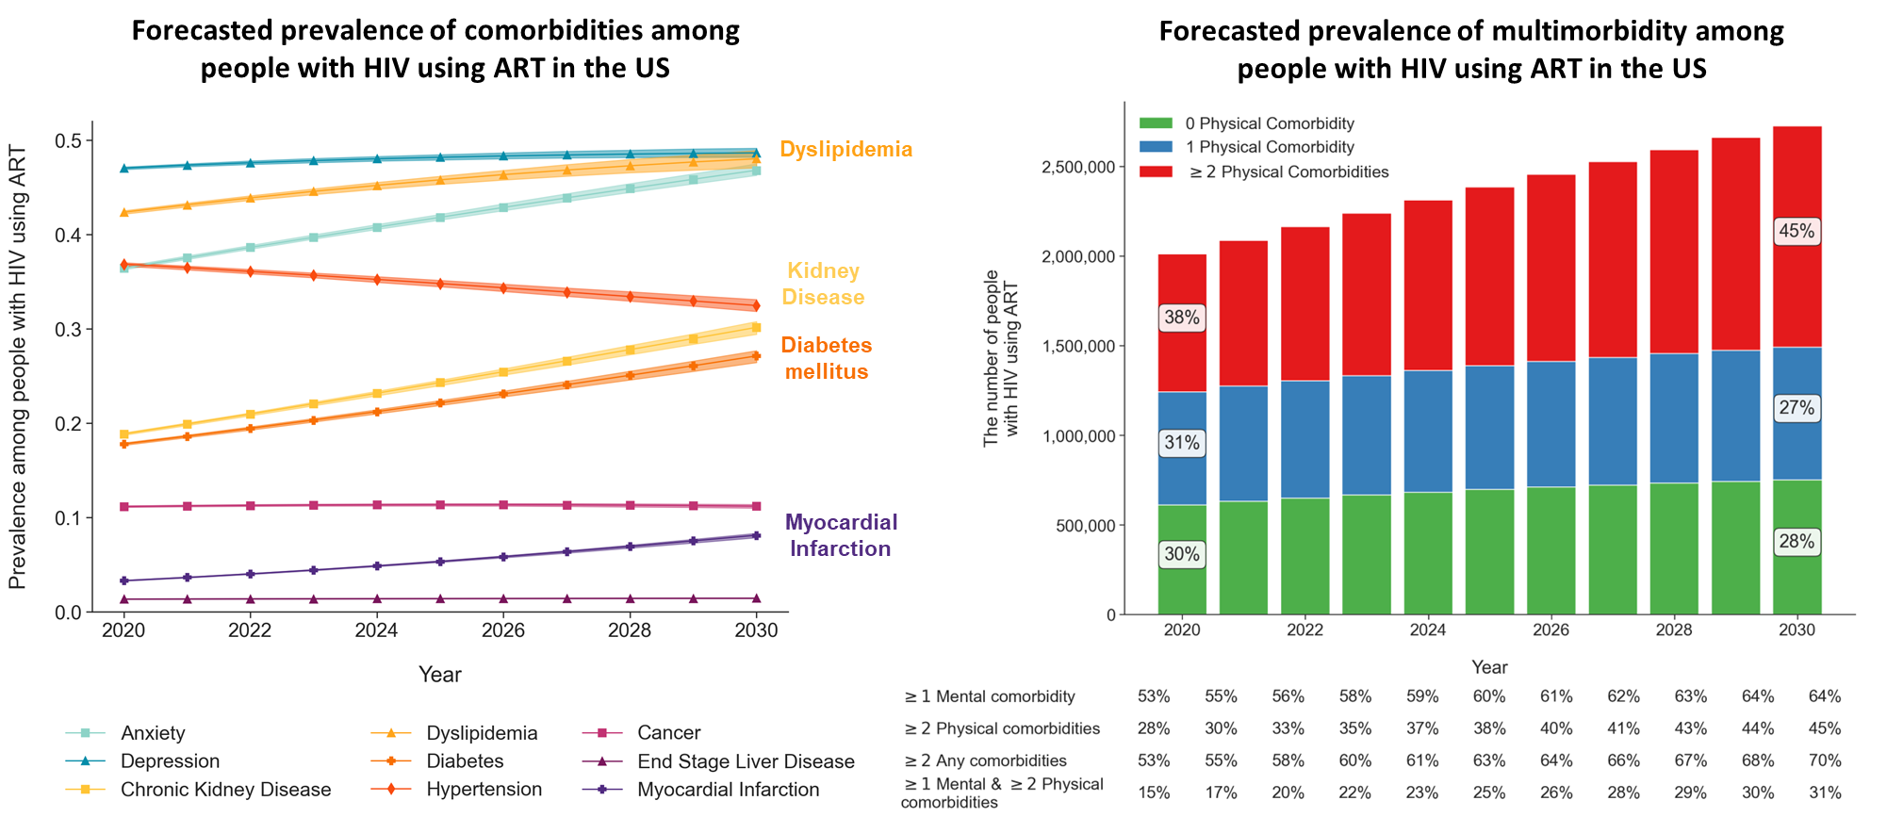
ProjEcting Age, multimoRbidity & poLypharmacy (PEARL) Simulation Model
7
Althoff K, et al. PLoS Med. 2024

Slide 8
Obesity and Body Composition in Treated HIV
8

Slide 9
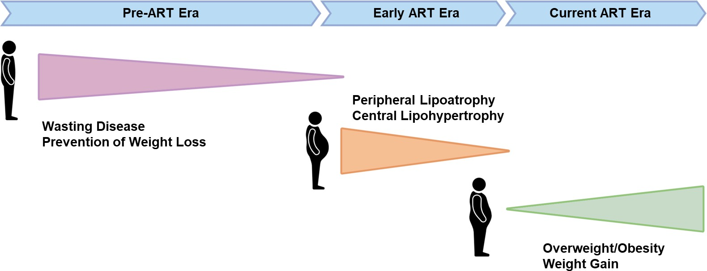
Nutrition and Weight Concerns in People With HIV Over Time
9
1981 to Today

Slide 10
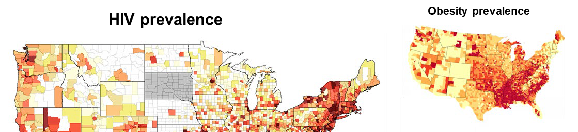
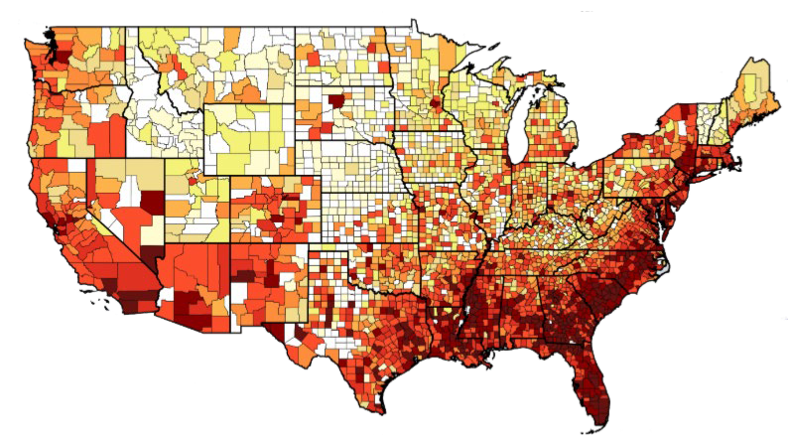
Overlapping Epidemics
County-level HIV and Comorbidities Prevalence in the United States
10
>40% of adults are obese (BMI >30) and >70% are overweight/obese (BMI >25) in the United States
After three years of ART, overweight and obesity rates are similar among U.S. People With HIV
1) AIDSVu County HIV Prevalence Map, AIDSvu.org. 2) Centers for Disease Control and Prevention, www.cdc.gov/dhdsp/maps/

Slide 11
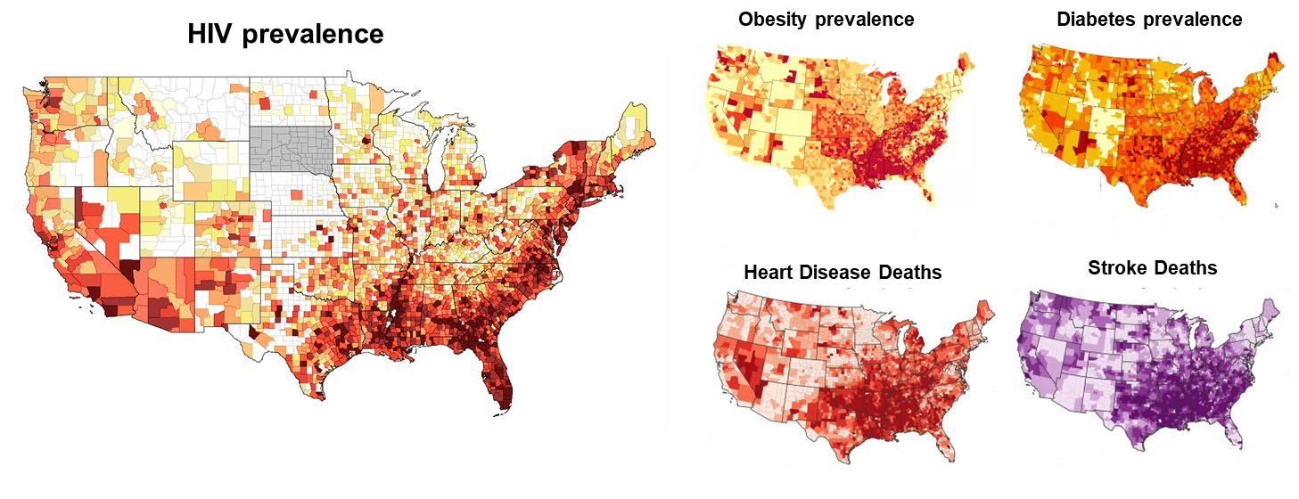
Overlapping Epidemics
County-level HIV and Comorbidities Prevalence in the United States
11
1) AIDSVu County HIV Prevalence Map, AIDSvu.org. 2) Centers for Disease Control and Prevention, www.cdc.gov/dhdsp/maps/

Slide 12
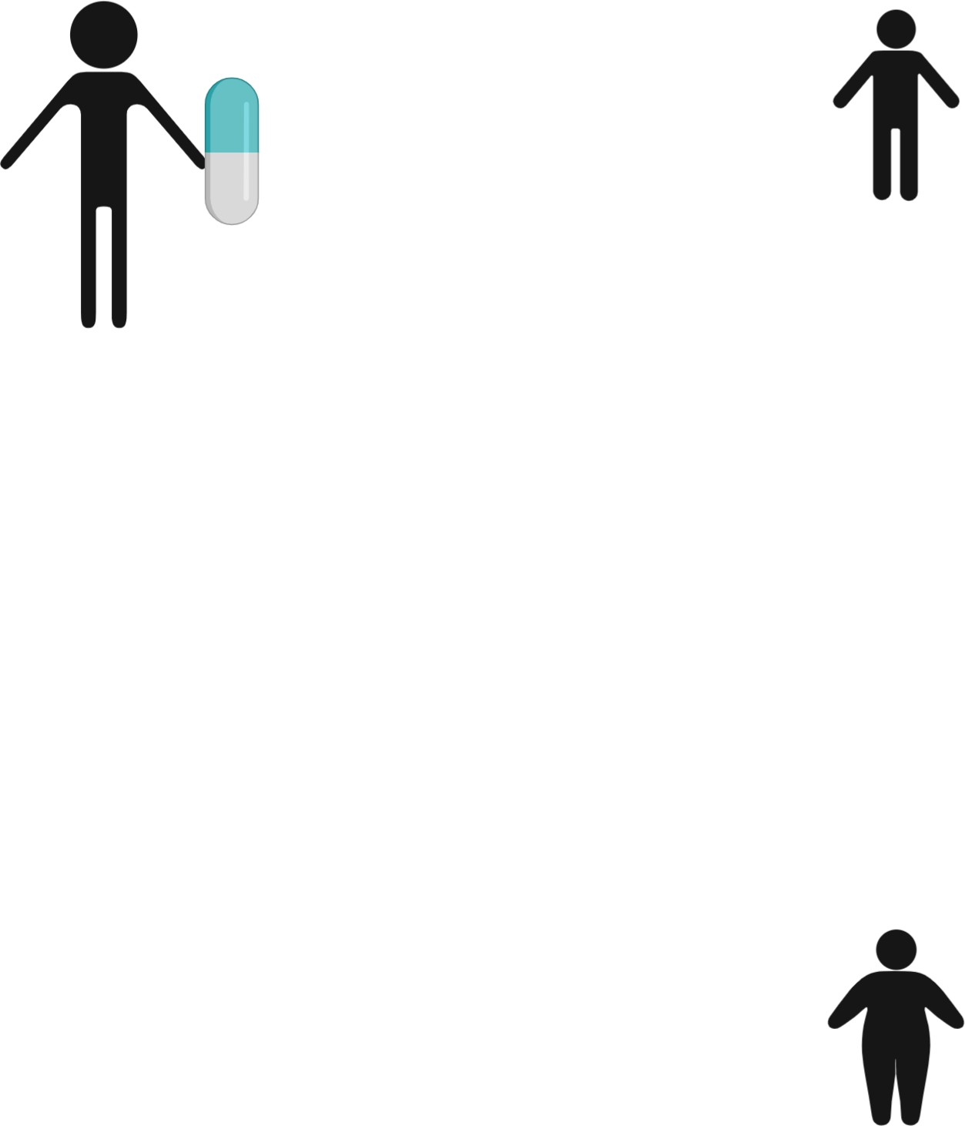
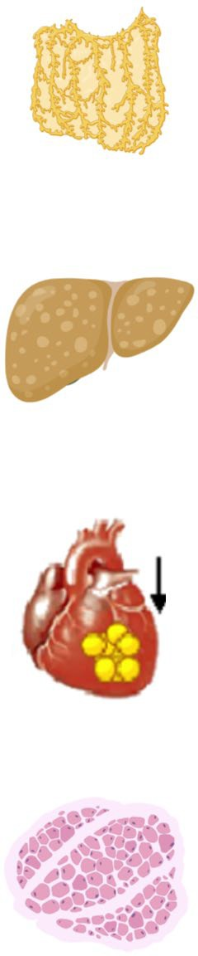

For Metabolic Health, Where Weight Is Gained on ART May Be More Important Than How Much
12
Weight Gain
Visceral fat
Subcutaneous Fat Depots
Ectopic Fat Depots (Visceral. Hepatic, etc.)
Preferential SAT expansion
(implies ectopic depots are regulated and limited)
?
“Lipid Overflow”
HIV-induced weight loss:
Increased resting energy expenditure
Response spectrum
Hepatic steatosis
Reduced appetite
Peri/epicardial fat
Accelerated skeletal muscle catabolism & reduced protein deposition
Ectopic Fat Depots (Visceral. Hepatic, etc.)
Reduced nutrient
Subcutaneous Fat
Muscle fat / sarcopenia
Depots
Impaired SAT expansion shunts lipids to ectopic depots
(implies an intrinsic defect in SAT lipid uptake or expansion rate exceeded)

Slide 13
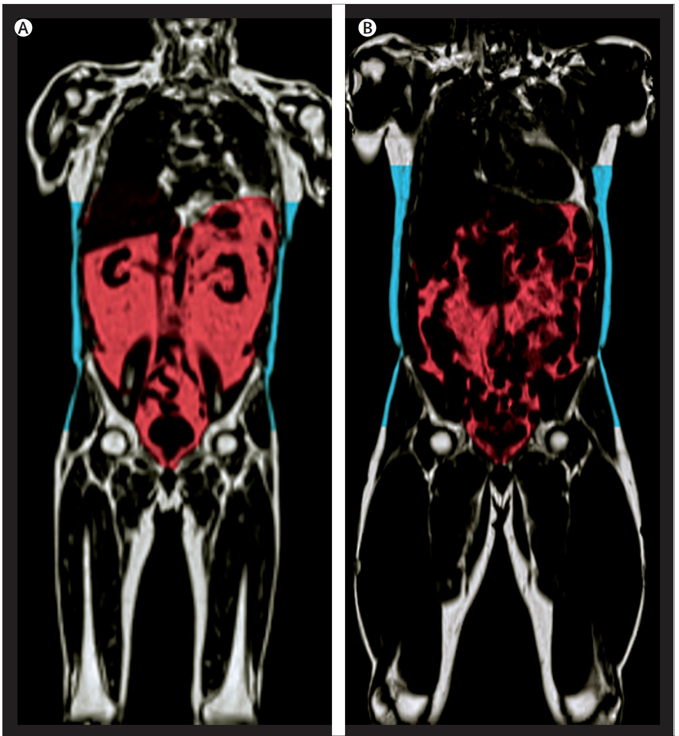


Visceral Adipose Tissue (VAT) Expansion is a Hallmark of Fat Redistribution in Treated HIV
13
HIV+
Health outcomes in persons with
obesity as defined by BMI >30 kg/m² are highly heterogeneous
Concept of Metabolically Healthy vs. Unhealthy Obesity largely defined by extent of visceral adipose tissue (VAT)
30 years of MRI and CT imaging studies demonstrate VAT is a marker of mortality and cardiometabolic disease risk, independent of body weight
HIV-
67 y/o male 53 y/o male
BMI 25 kg/m² and VAT 2.6 L/m² BMI 30 kg/m² and VAT 0.9 L/m²

Slide 14
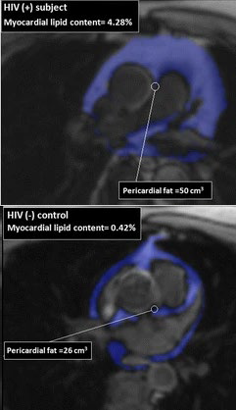
How Excess VAT Contributes to Cardiovascular Disease
14
The delivery of high free fatty acid levels to the liver raises triglyceride levels and leads to smaller, denser HDL and LDL particles
Smaller LDL bind to endothelial cells and are more atherogenic
Extension of VAT into peri-renal areas alters the renin-angiotensin system and promotes hypertension and increased blood volume
Ectopic cardiac fat accompanying VAT promotes coronary atherosclerosis, myocardial fibrosis, hypertrophy and remodeling
Neeland IJ, et al. Circulation, 2018; Diaz-Zamudio M, et al. J of Cardio Mag Resonance, 2015

Slide 15
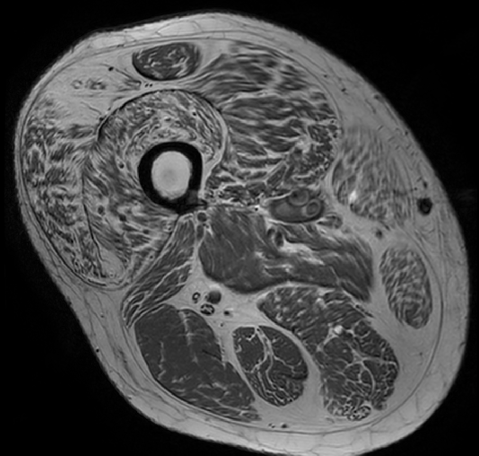
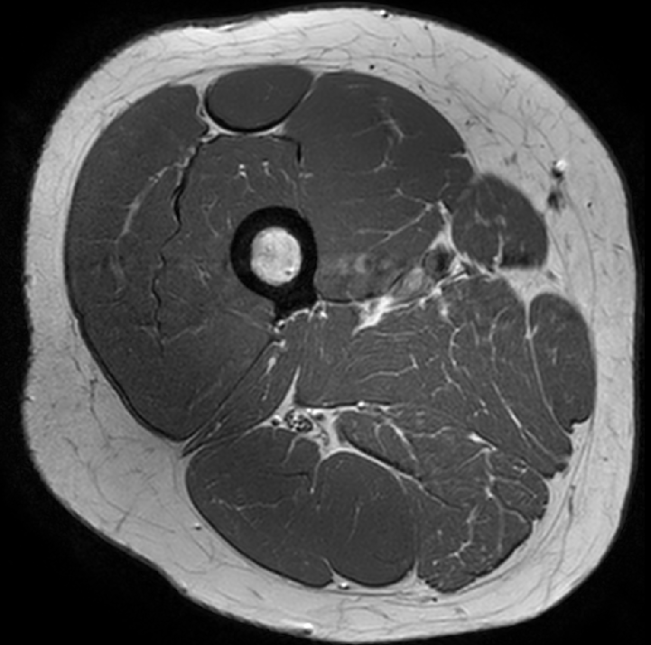
Myosteatosis: An Under Appreciated Contributor to Insulin Resistance and Frailty
15
Myosteatosis is a clinical entity distinct from VAT and hepatic steatosis, and contributes to insulin resistance, loss of lean muscle mass, and frailty
Skeletal muscle is responsible for ~70% of insulin-stimulated glucose uptake; excess free fatty acids (FFA) and incompletely oxidized FFA products reduce insulin signaling, glucose uptake, and ATP synthesis.
In MACS, men with HIV had greater thigh lipid content and lower lean mass, which increased at a greater rate with age
In the general population, myosteatosis confers a >2-fold risk of death compared to hepatic steatosis.
59 y/o Male Veteran On ART 14 yrs BMI 39.6 kg/m²
Thigh fat 52%
62 y/o Male Veteran On ART 11 yrs BMI 37.3 kg/m²
Thigh fat 5%
Nachit M, et al. Radiology 2023; Tibuakuu M, et al. Journal of Cardiovascular Computed Tomography 2018

Slide 16
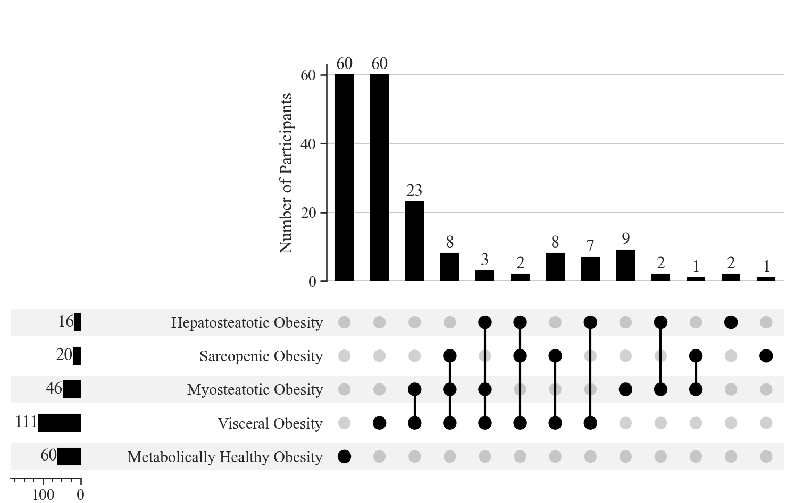
A Hidden Epidemic of Fat Redistribution?
16
Ectopic lipid deposition is widespread in the modern ART era
Fat distribution phenotypes determined by standard CT imaging thresholds in 187 overweight/obese People With HIV on contemporary ART
Overall:
59% excess visceral fat
25% myosteatosis
9% hepatic steatosis
11% sarcopenia
Only 32% without substantial ectopic fat accumulation or loss of lean muscle
Williams A, et al. OFID, 2024.

Slide 17
Key Points on Obesity and Ectopic Fat in Treated HIV
17
Individuals with HIV do not have to be obese by BMI to have obesity-related cardiometabolic diseases.
Even patients on ‘modern’ ART are at risk due to viral and immune-related factors.
Adverse accumulations of fat in the early ART period often persist for years and affect disease risk.
Increased visceral fat (indicated by a waist >40 inches in men and >35 inches in women) often means increased liver and heart fat are also present.

Slide 18
Weight Loss Interventions in Treated HIV
18

Slide 19
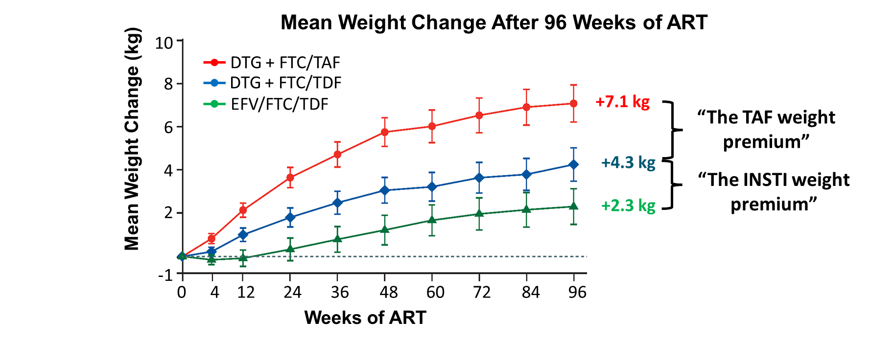
Our Understanding of Weight Gain and ART has Changed over Time
19
ADVANCE South Africa: ART- naïve Starting DTG + FTC/TAF, DTG + FTC/TDF, or EFV/FTC/TDF
Venter W, et al. N Engl J Med. 2019, Venter W, et al. Lancet HIV. 2020.

Slide 20

Our Understanding of Weight Gain and ART has Changed over Time
20
Early model: Some ART agents promote to ‘excessive’ weight gain
ART-related Weight Gain
Return to Health
Pre-ART Body Weight
Pre-ART Body Weight
Reversibility!
HIV
Treatment

Slide 21
ACTG A5391: Doravirine for Obese Persons on Integrase Inhibitors and Tenofovir Alafenamide
21
A 48-week, 3 parallel group, open-label, multicenter, superiority, randomized, controlled trial in adult People With HIV with obesity on an INSTI (bictegravir, dolutegravir, or raltegravir) and TAF/FTC for at least 48 weeks with sustained viral suppression.
To ensure representation of groups at high risk of weight gain and metabolic disease on INSTIs, enrollment targets prespecified >50% female sex at birth and >50% Black participants.
Week 0 Week 48
Obese (BMI >30 kg/m²) persons on RAL, DTG, or BIC + TAF/FTC
Arm 1: Switch to DOR+TAF/FTC
Arm 2: Switch to DOR+TDF/FTC
Arm 3: Continuation of INSTI+TAF/FTC
Koethe JR, IAS 2025 abstract OAB0206LB and EACS 2025 abstract PS15.4

Slide 22
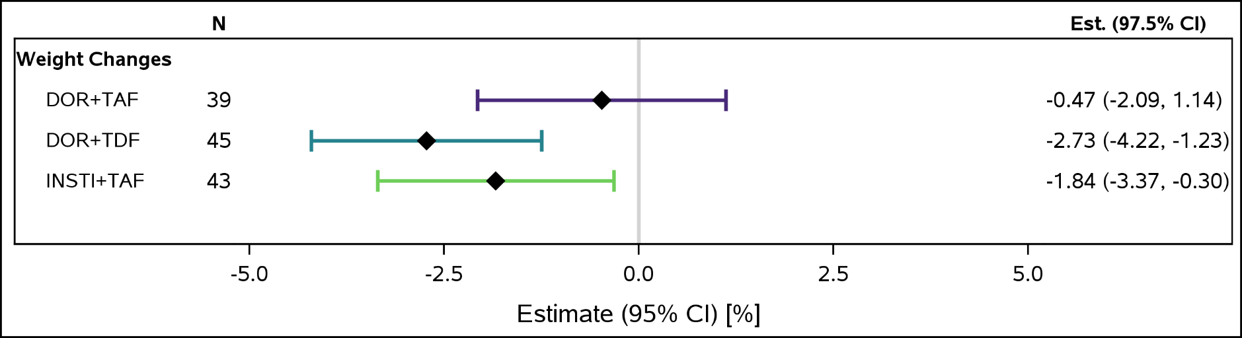
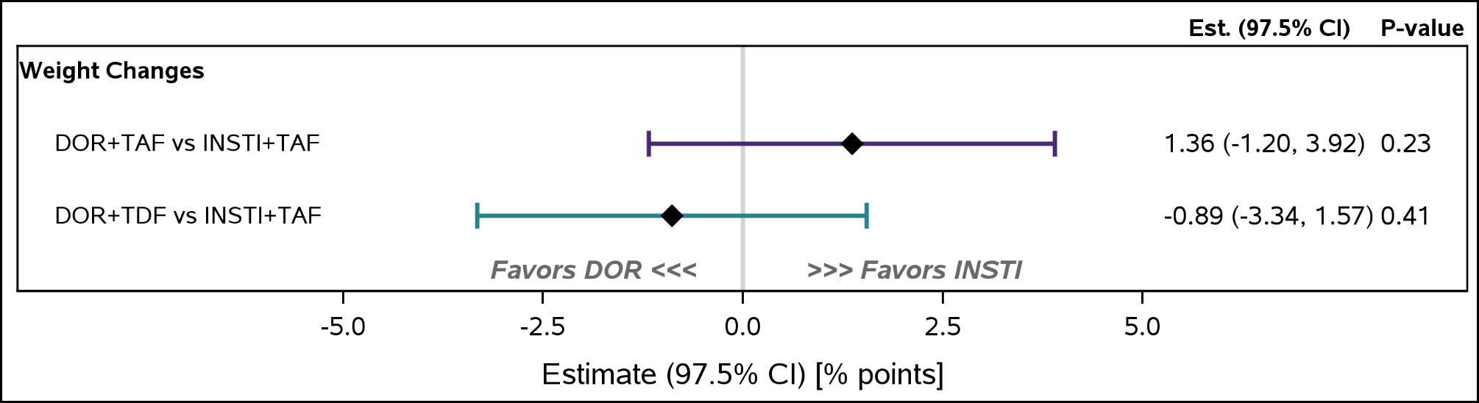

ACTG A5391: Doravirine for Obese Persons on Integrase Inhibitors and Tenofovir Alafenamide
22
Within Arm Weight Change at 48 weeks:
All study arms lost weight. There was no evidence that a switch to DOR affected 48-week changes in weight compared to continued INSTI + TAF/FTC
97.5% confidence intervals were
<5 percentage points.
Estimated Mean Treatment Differences between Arms:
Subgroup analyses were similar for women, Black individuals, and those with greater early-ART weight gain

Slide 23
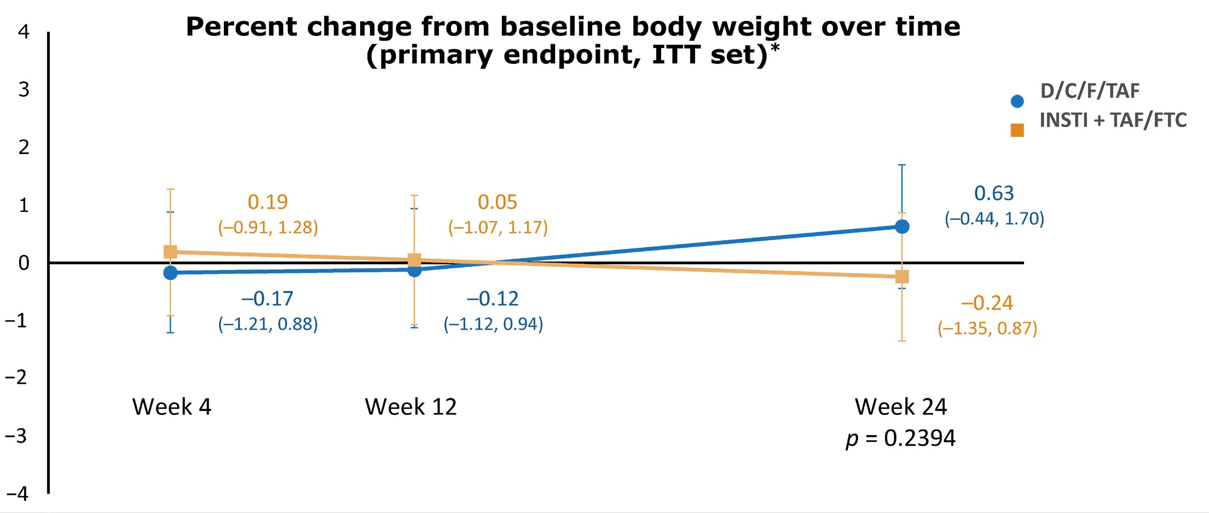
DEFINE Study: Switch from INSTI/TAF/FTC to DRV/cTAF/FTC
23
24-week, 2-arm, open label, randomized ART switch study
Percent Change from Baseline Body Weight Over Time
DRV/c + TAF/FTC
INSTI + TAF/FTC
Immediate Switch: DRV/COBI/FTC/TAF
People With HIV with ≥10% weight gain within 1 year of starting INSTI + TAF
Continue INSTI + TAF Regimen
Week 4
Week 12
Week 24
p=0.24
Short WR, et al. Open Forum Infect Dis. 2023.

Slide 24
Our Understanding of Weight Gain and ART has Changed over Time
24
Weight Promoting
ART-related Weight Change
Weight Neutral
Return to Health
Pre-ART
Body Weight
Early INSTI and TAF Weight Studies

Slide 25
Our Understanding of Weight Gain and ART has Changed over Time
25
Weight Promoting
ART-related Weight Change
BIC DTG TAF ABC
Weight Neutral
Weight Neutral
Return to Health
ART-related Weight Change
Return to Health
Pre-ART
Body Weight
EFV TDF
Cobi? AZT
Weight Suppressing
Pre-ART
Body Weight
Early INSTI and TAF Weight Studies
Current Understanding of ART Agents and weight

Slide 26
Therapeutic Options to Reduce Weight and VAT in HIV: Dietary Intervention
26
Structured weight loss intervention:
A 1000 kcal/day energy deficit based on estimated energy requirement of 20 HIV+ women
Meal replacement used for 2 meals/day, and subjects were instructed to eat a third meal each day containing regular food
After targeted 6%–8% weight-loss was achieved, dietary intake was adjusted to maintain a stable body weight for 2 weeks
Total body weight reduction of 8% (108 to 100 kg)
VAT reduction of 14% (1164 to 997 cm³)
Insulin levels reduced 11%, but no change in triglycerides or LDL
Findings suggest dietary intervention can reduce VAT volume in People With HIV
Reeds DN, et al. Obesity (Silver Spring), 2017.

Slide 27






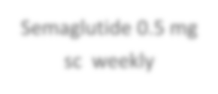




Semiglutide for Metabolic-Associated Steatotic Liver Disease: ACTG A5371 (SLIM LIVER)
27
A phase IIb, single-arm, open-label, pilot study of the effects of semaglutide on weight and MRI-proton density fat fraction (MRI-PDFF)-quantified intrahepatic triglyceride (IHTG) content
Inclusion Criteria
Adult People With HIV on suppressive ART
Elevated minimum waist circumference
-WC≥95 cm / WC 94≥cm
Insulin resistance or pre-diabetes
≥5% IHTG on MRI-PDFF
Semaglutide 0.25 mg sc weekly
Semaglutide 0.5 mg sc weekly
Semaglutide 1.0 mg sc weekly
Visit Week
0
2
4
24
MRI-PDFF
Lake JE, CROI 2024 Abstract 159
MRI-PDFF

Slide 28
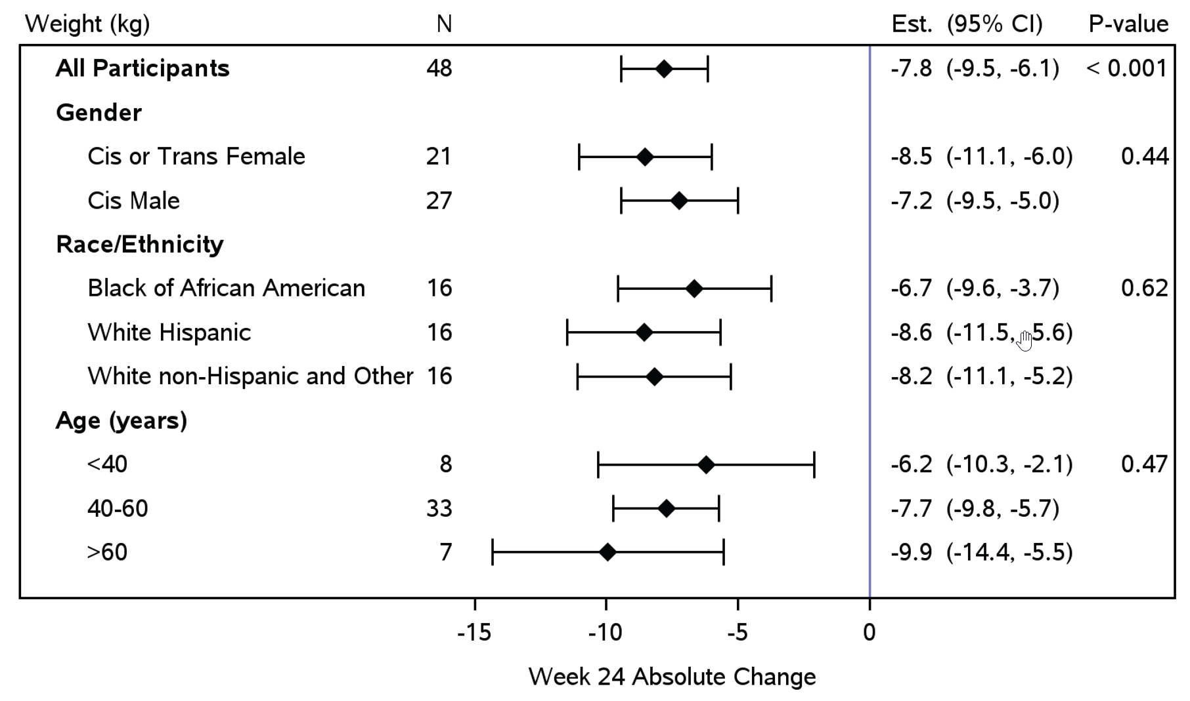
Semiglutide for Metabolic-Associated Steatotic Liver Disease: ACTG A5371 (SLIM LIVER)
28
Mean weight loss was 7.8 kg over 24 weeks with semaglutide
Greater reductions in weight were observed among: Women, Whites (Hispanic and non-Hispanic), and age >40 years (NS).
Separate RCT of semaglutide vs. placebo in 108 People With HIV with lipohypertrophy found a 19% reduction in total body fat, but a 31% reduction in visceral fat
Week 24 Absolute Change (kilograms)
1) Lake JE, CROI 2024 Abstract 159. 2) Eckard AR, Lancet Diabetes Endo. 2025

Slide 29
Metabolic-dysfunction Associated Steatotic Liver Disease (MASLD)
29

Slide 30
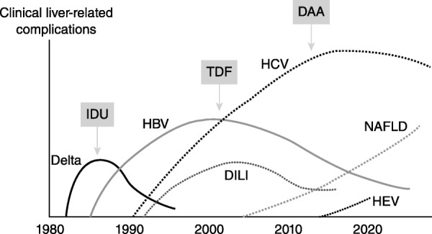
Changing Epidemiology of Liver Disease in Persons with HIV
30
MASLD
Sherman KE, et al. Hepatol Commun. 2017;1:987-1001.

Slide 31
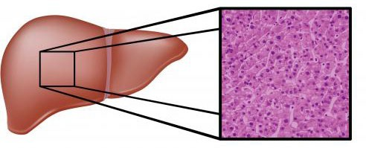
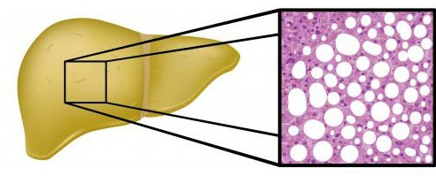
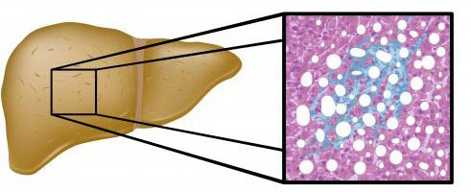
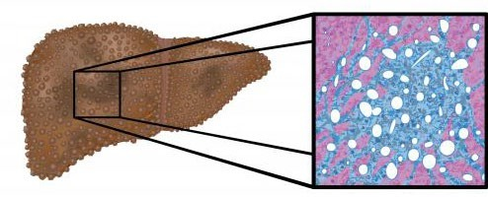
Stages of Metabolic-dysfunction Associated Steatotic Liver Disease
31
Steatohepatitis (MASH)
Normal Liver
Steatosis
Cirrhosis
Lipid accumulation Impaired fatty acid transport
Necroinflammation Oxidative stress Collagen deposition
Dense fibrosis Apoptotic/necrotic cell death Hepatocellular cancer risk
MASLD is characterized by hepatic steatosis affecting >5% of hepatocytes and >=1 metabolic condition
MASLD is highly prevalent in People With HIV (40-55% in the US) and a high risk of clinically significant fibrosis (10-15%)
The leading cause of unexplained liver enzyme elevations in People With HIV (up to 65% of such cases)
1) Gawrieh S, et al. Aliment Pharmacol Ther. 2024;59:666-679. 2) European AIDS Clinical Society Guidelines, October 2025 update.

Slide 32
Current Association Guidelines for MASLD Screening
32
The American Association for the Study of Liver Diseases (AASLD) does not recommend population-based screening for MASLD.
Individuals with clinically-suspected MASLD (obesity and metabolic risk factors) should have primary fibrosis risk assessment with FIB-4 score (FIB-4 = Age ([years] x AST [U/L]) / platelet [10⁹/L] x ALT [U/L]); >1.3 is concerning.
High-risk individuals, such as those with diabetes, medically complicated obesity, family history of cirrhosis, or more than mild alcohol consumption, with MASLD should be screened for fibrosis.
The 2025 European AIDS Clinical Society (EACS) guidelines recommend MASLD screening in People With HIV with exposure to d-drugs, elevation of ALT, overweight/obesity or metabolic syndrome.
1) Rinella ME, et al. Hepatology. 2) EASL-EASD-EASO Clinical Practice Guidelines. J Hepatol. 2016. 3) European AIDS Clinical Society Guidelines, October 2025 update.

Slide 33
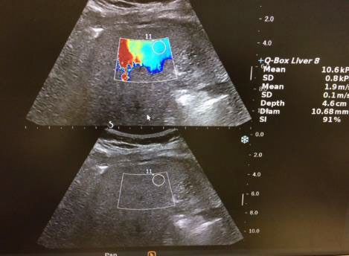
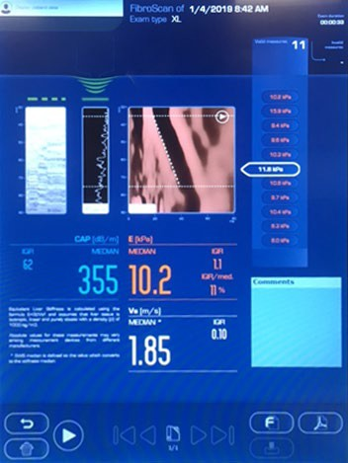
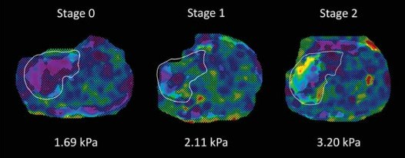
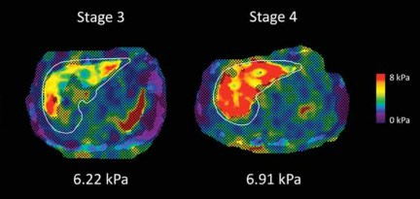
Liver Fibrosis Screening Options
33
2D Shear Wave Elastography
Vibration-Controlled Transient Elastography
Magnetic Resonance Liver Elastography

Slide 34
MASLD in HIV: Further Evaluation and Treatment
34
In People With HIV, a primary goal in evaluating suspected MASLD is to screen (case-find) for advanced liver fibrosis in at-risk individuals (higher risk of malignancy and liver-related mortality).
Diagnosis of MASH (steatohepatitis) requires a liver biopsy with steatosis, hepatocyte ballooning, and lobular inflammation.
ART regimens with minimal metabolic impact should be prioritized.
Caloric restriction of 500–1,000 kcal/day with a goal of 7–10% weight loss in people with central obesity and/or overweight.
150–200 minutes per week of moderate-intensity aerobic exercise combined with resistance training, performed in 3–5 sessions per week.
European AIDS Clinical Society Guidelines, October 2025 update.

Slide 35
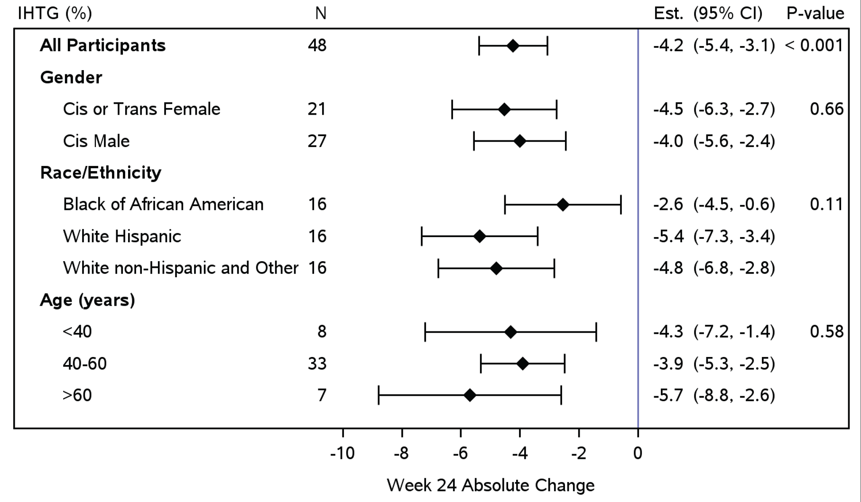
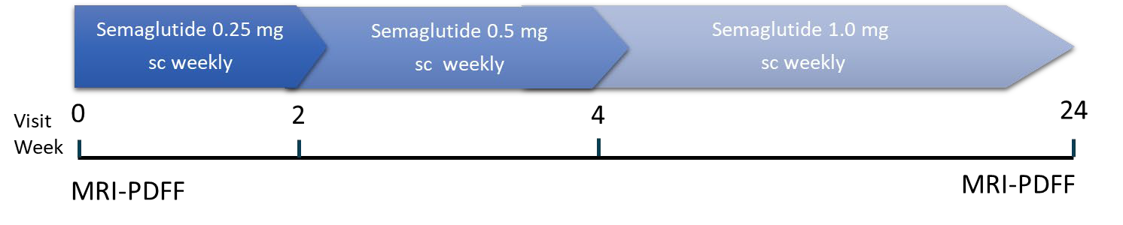
Semiglutide for Metabolic-Associated Steatotic Liver Disease: ACTG A5371 (SLIM LIVER)
35
58% of SLIM-LIVER
participants had a ≥30%
relative reduction in IHTG
29% of participants had complete MASLD resolution (absolute IHTG <5%)
Week 24 Absolute Change (% IHTG)
Lake JE, CROI 2024 Abstract 159.

Slide 36
Key Points on Metabolic-dysfunction Associated Steatotic Liver Disease
36
MASLD is emerging as the most common cause of severe liver injury or failure in People With HIV.
MASLD is seen in 40-55% US People With HIV, and 10-15% have clinically significant fibrosis.
Consider screening those with exposure to d-drugs, high ALT, overweight/obesity, metabolic syndrome, or increased visceral fat.
Mild fibrosis can be reversed.
Diet and exercise are the main therapies, but GLP-1RA treatment appears highly effective.

Slide 37
Diabetes Mellitus
37

Slide 38
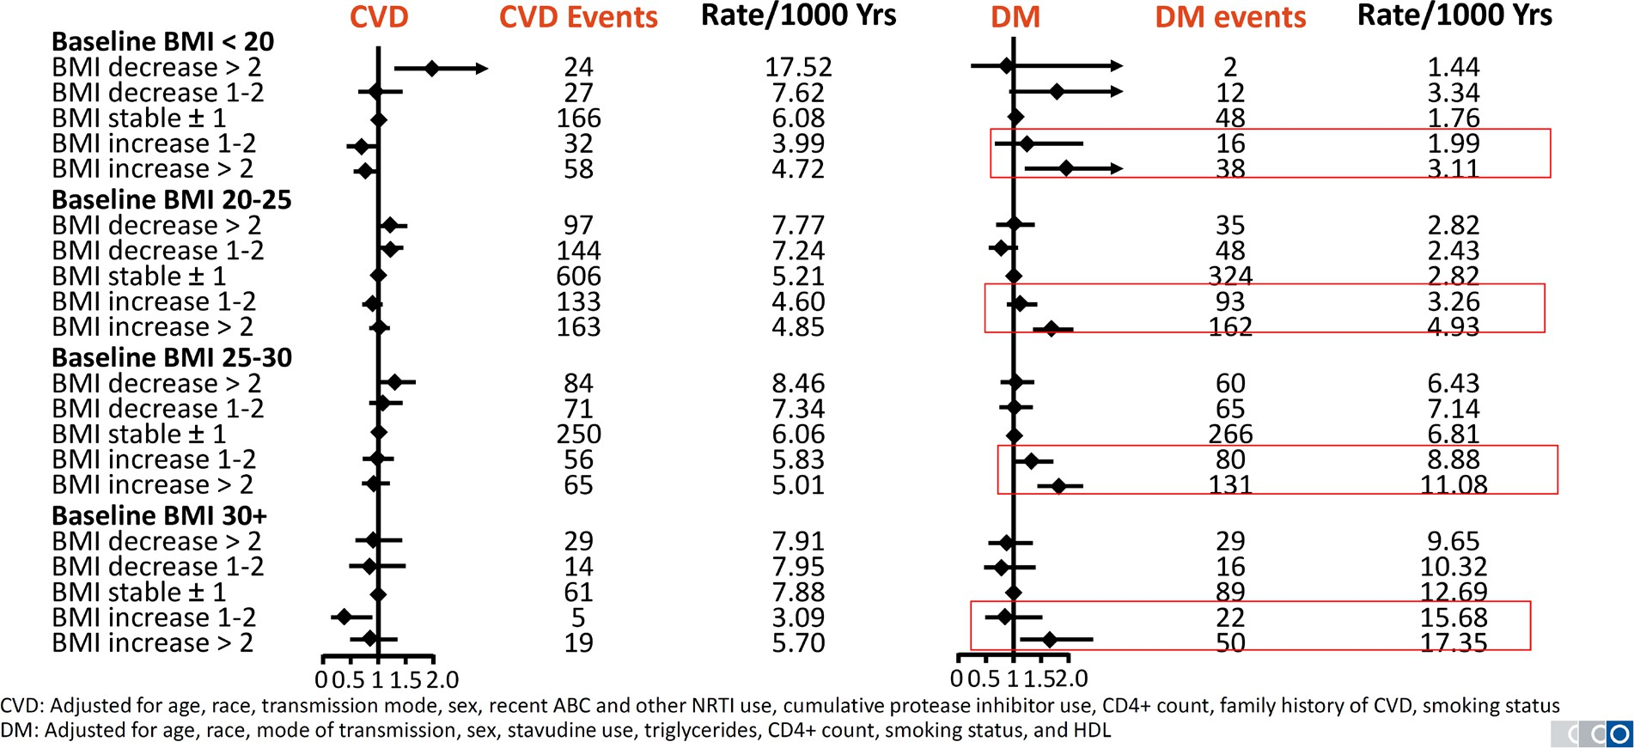
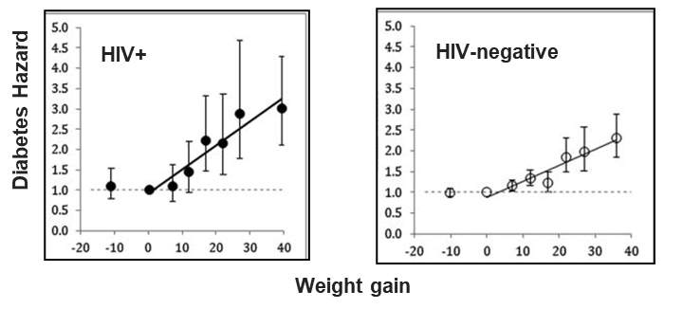
Higher Risk of Incident Diabetes after Weight Gain on ART…. and Compared to People without HIV
38
D:A:D Cohort: A 1-2 unit BMI gain on treatment confers a significant risk of incident diabetes (irrespective of pre-ART weight)
VACS Cohort: Incremental weight gain on ART raises diabetes risk ~2-fold compared to similar HIV-negative controls

Slide 39
Challenges Diagnosing Diabetes in Treated HIV
39
Hemoglobin A1c >6.5%, a fasting blood glucose >126 mg/dL, or a 2-hour oral glucose tolerance test (OGTT) value >200 mg/dL all used for diabetes mellitus screening.
In People With HIV, HbA1c may be falsely low and affected by anemia, accelerated red blood cell turnover, use of PIs and older NRTIs, and low CD4 count.
HIVMA guidelines: fasting glucose at the time of HIV diagnosis, before starting ART, and every 6–12 months thereafter.
OGTT is “gold standard” and can be used to confirm the fasting blood glucose in cases where risk is high (e.g., concern for diabetic complications).
1) HIVMA/IDSA Primary Care Guidance 2024 update. 2) Monrow A et al. Clin. Inf. Dis. 2015.

Slide 40
Key Points on Diabetes and Insulin Sensitivity
40
Weight gain confers a greater risk of a new diabetes diagnosis in People With HIV compared to those without HIV (likely linked to ectopic fat).
HbA1c can be artificially low in People With HIV; consider fasting glucose measurements, or ‘gold standard’ oral glucose tolerance test
Switching off INSTI and TAF regimens does not appear to improve weight or insulin sensitivity at the aggregate level (tailor decisions to your patients)

Slide 41
Cardiovascular Disease
41

Slide 42
Cardiovascular Disease Screening in Treated HIV
42
Cardiovascular disease (CVD) risk is ~1.5–2× higher in People With HIV vs the general population, driven by chronic immune activation/inflammation, dyslipidemia, ART interactions, and traditional risk factors (smoking, HTN, diabetes).
Be proactive with screening, risk discussion, and earlier preventive therapies (e.g., statins).
At entry to care:
  Fasting lipids, fasting glucose (preferred over HbA1c)
  BMI & waist circumference (>40 inches for men, >35 inches for women defines MetS)
  Kidney function & albuminuria
  Family history of premature ASCVD
  Assess ART regimen for metabolic effects and drug–drug interactions (especially with statins)
HIVMA/IDSA Primary Care Guidance 2024 update.

Slide 43
Cardiovascular Disease Screening in Treated HIV
43
Longitudinal follow-up:
Lipids annually (at least), and 4-12 weeks after a change in lipid therapy.
Fasting glucose or HbA1c annually (at least – assess concordance for each individual)
ASCVD 10-year risk calculation.
LDL-C above goal despite maximally tolerated statin: consider ezetimibe, then PCSK9 inhibitors per general ACC/AHA pathways.
Abacavir association with MI risk remains debated; consider overall risk profile and alternatives when feasible.
Aspirin is generally NOT recommended for routine primary prevention; reserve for select high-risk adults with low bleeding risk.
1) HIVMA/IDSA Primary Care Guidance, 2024. 2) AHA/ACC Guideline on the Primary Prevention of Cardiovascular Disease, 2019, 3) AHA/ACC Guideline on the Management of Blood Cholesterol, 2018. 4) ACC ECDP on Role of Nonstatin Therapies for LDL-C Lowering, 2022

Slide 44
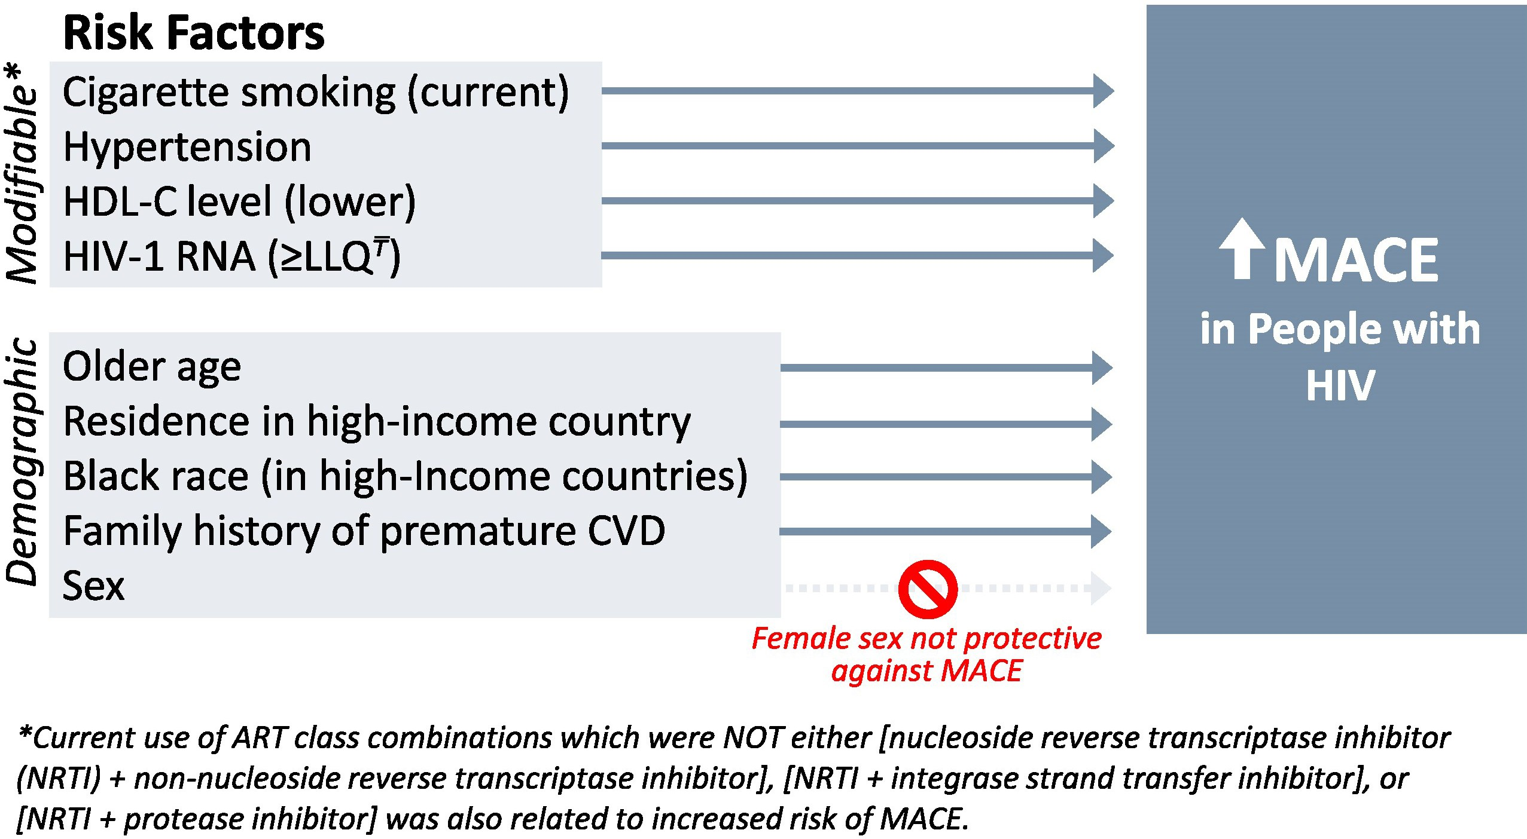
Cardiovascular Disease Drivers in REPRIEVE
44
REPRIEVE (n≈7,769):
Pitavastatin 4 mg daily reduced major adverse CV events by ~35% vs placebo over median ~5 yrs in People With HIV with low–intermediate risk.
Grinspoon S, et al. Clin Inf. Dis., 2025

Slide 45
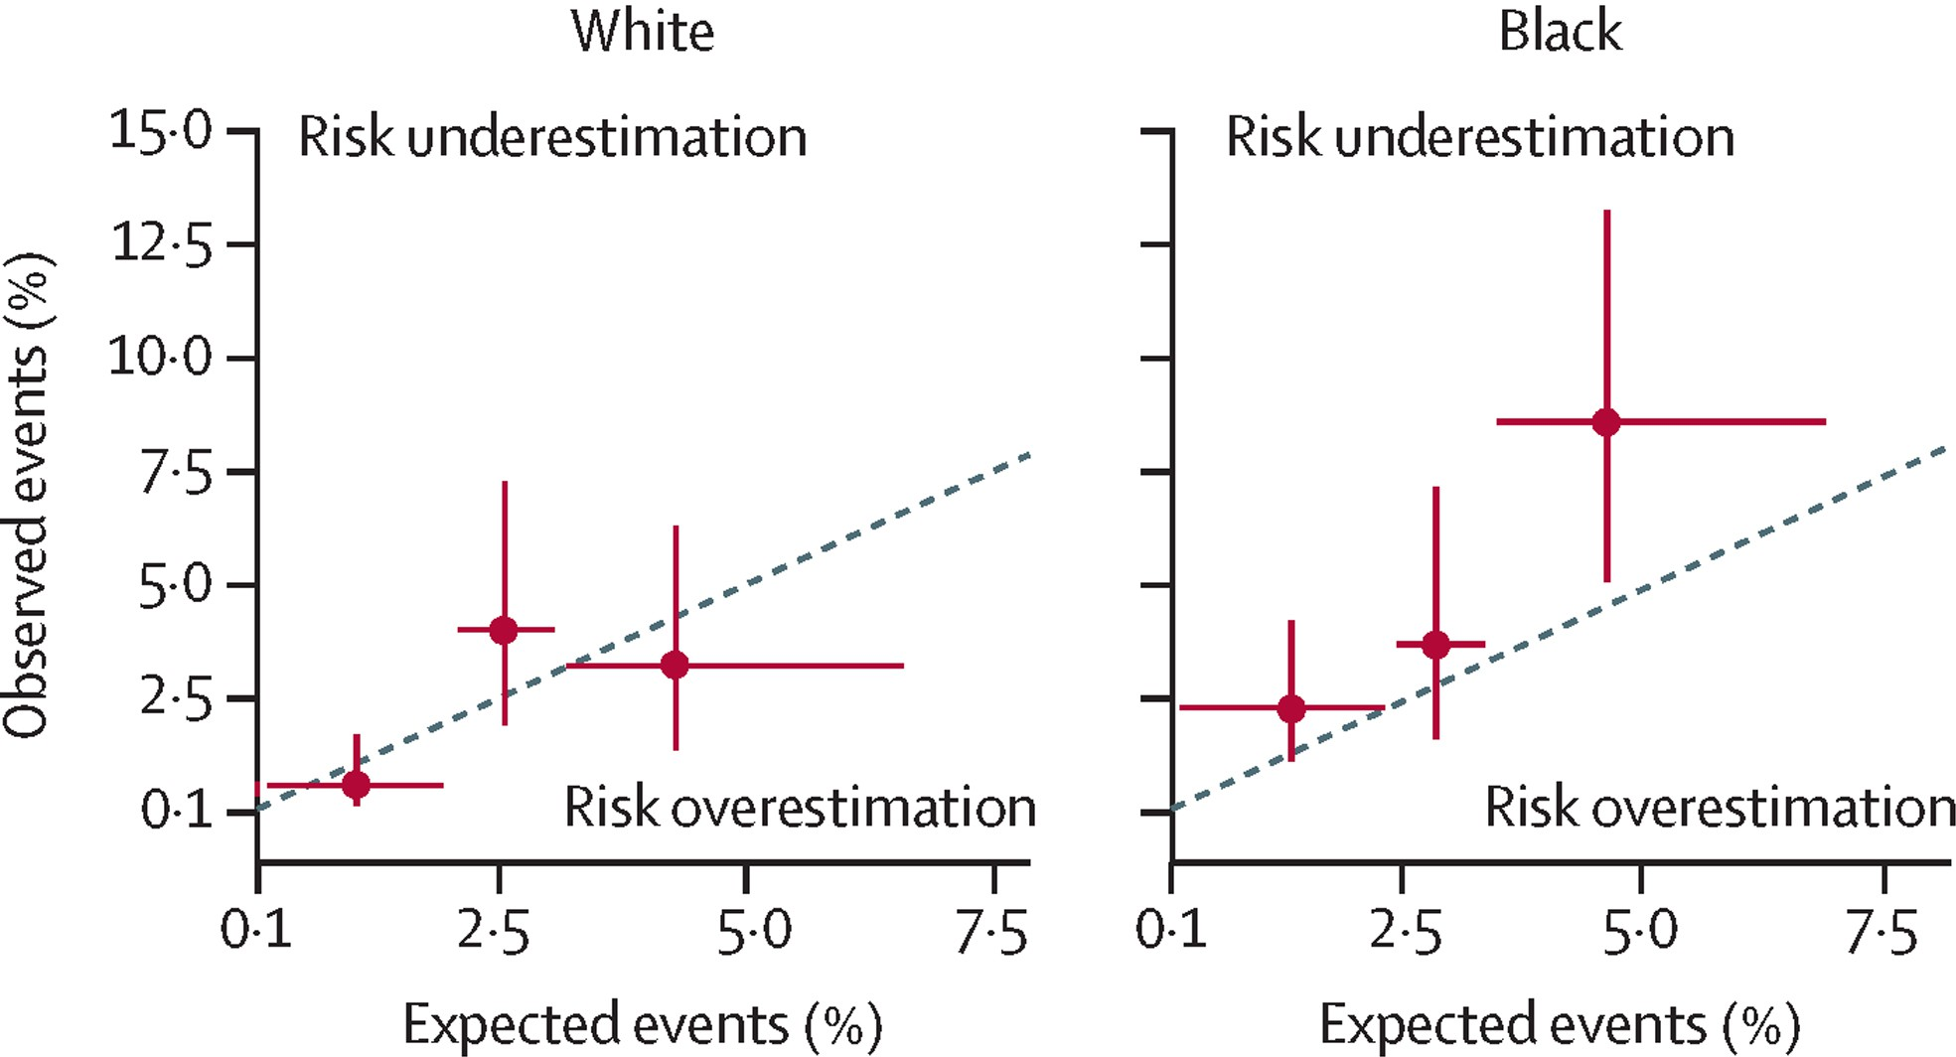
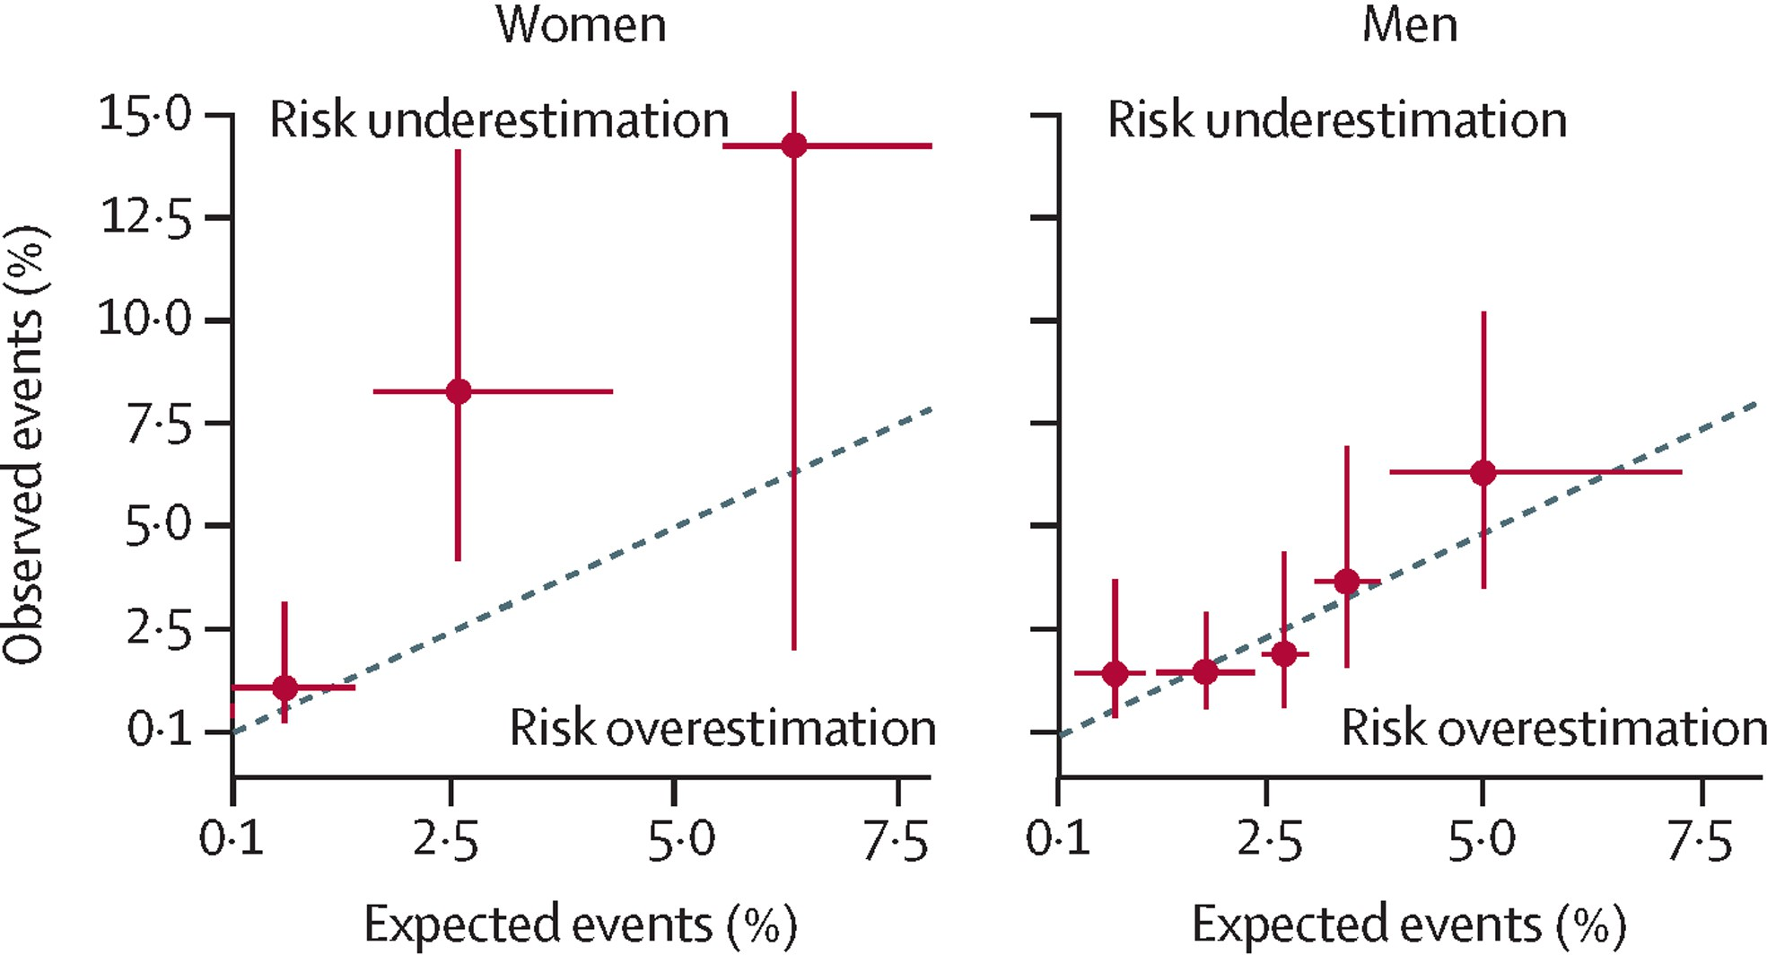
Performance of Existing CVD Risk Models In People With HIV
45
Atherosclerotic cardiovascular disease (ASCVD) pooled cohort equations (PCE) risk scores were compared to participants in the placebo arm of REPRIEVE.
Substantial underprediction occurred in high-income countries.
Calibration of PCE risk scores achieved by multiplying the score by 2.8 in Black women, 2.6 in non-Black women, and 1.25 in Black men.
Traditional ASCVD calculators are not reliable in People With HIV in the United States
Grinspoon S, et al. The Lancet HIV, 2025

Slide 46
2025 U.S. HIV guidance (NIH/DHHS) reflecting REPRIEVE
46
Age 40–75, 10-yr ASCVD risk ≥20%: high-intensity statin (Atorvastatin 40-80mg, Rosuvastatin 20-40mg).
Risk 5–20%: at least moderate-intensity statin (Pitva 4mg, Atorva 20mg, Rosuva 10mg).
Risk <5%: consider moderate-intensity statin if risk enhancers present:
  Prolonged HIV viremia and/or delayed ART initiation
  low current or nadir CD4 count (<350 cells/mm³)
  Non-adherence
  Lipodystrophy/lipoatrophy
  Metabolic syndrome or fatty liver disease
  Coinfection with hepatitis C
  Prior or current exposure to ARVs cardiometabolic toxicity (e.g., abacavir, ritonavir-boosted lopinavir, ritonavir-boosted darunavir, and older PIs)
NIH/DHHS, Guidelines for the Use of Antiretroviral Agents in Adults and Adolescents With HIV, 9/2025 update

Slide 47
Key Points on Cardiovascular Disease
47
CVD risk is ~1.5–2× higher in People With HIV vs the general population, and needs proactive screening, risk discussion, and earlier preventive therapies.
ASCVD risk calculators substantially underestimate CVD risk in People With HIV in the United States, especially for Black (2.8-fold) and non-Black (2.6-fold) women.
2025 DHHS Guidelines recommend statins for nearly all People With HIV over age 40, including those with <5% risk and one of several ‘risk enhancers’.

Slide 48
Take Aways on Cardiometabolic Comorbidities in People With HIV
48
Individuals with HIV are more prone to cardiometabolic comorbidities – modern ART has not eliminated the excess risk.
There is substantial geographic and socioeconomic overlap in the HIV and cardiometabolic disease epidemics.
People With HIV do not need to be obese by BMI criteria to have obesity-related conditions due to alterations in fat distributions.
Be vigilant and proactive – adverse cardiometabolic outcomes are the leading health threat in our patients in the modern ART era.

Slide 49

Thank you!
49

