Slide 1
Food is Medicine – Supplemental Benefits to Improve Patient Engagement and Clinical Outcomes
Kentucky AETC
Dr. Alison Gustafson, PhD, MPH, RD
Department of Dietetics and Human Nutrition
University of Kentucky

Slide 2
Disclosures
This program is supported by the Health Resources and Services Administration (HRSA) of the U.S. Department of Health and Human Services (HHS) under grant number TR7HA53203-01-00 as part of an award totaling $5.7m. The contents are those of the author(s) and do not necessarily represent the official views of, nor an endorsement, by HRSA, HHS, or the U.S. Government. For more information, please visit HRSA.gov.
“Funding for this presentation was made possible by cooperative agreement TR7HA53203-01-00 from the Health Resources and Services Administration HIV/AIDS Bureau. The views expressed do not necessarily reflect the official policies of the Department of Health and Human Services nor does mention of trade names, commercial practices, or organizations imply endorsement by the U.S. Government. Any trade/brand names for products mentioned during this presentation are for training and identification purposes only.”
This content is owned by the AETC and is protected by copyright laws. Reproduction or distribution of the content without written permission of the sponsor is prohibited and may result in legal action.

Slide 3
Disclosures
All planners, faculty, and others in control of educational content are required to disclose all their financial relationships with ineligible companies within the prior 24 months. An ineligible company is defined as one whose primary business is producing, marketing, selling, re-selling, or distributing healthcare products used by or on patients. Financial relationships are relevant if the educational content an individual can control is related to the business lines or products of the ineligible company.
None of the planners, faculty, and others in control of educational content for this educational activity have relevant financial relationship(s) to disclose with ineligible companies.
The material presented in this course represents information obtained from the scientific literature as well as the clinical experiences of the speakers. In some cases, the presentations might include discussion of investigational agents and/or off-label indications for various agents used in clinical practice. Speakers will inform the audience when they are discussing investigational and/or off-label uses.
Disclosure of a relationship is not intended to suggest or condone commercial bias in any presentation, but it is made to provide participants with information that might be of potential importance to their evaluation of a presentation.

Slide 4
Disclosures
The Health Resources and Services Administration (HRSA), Department of Health and Human Services (HHS) provided financial support for this project. The award provided 100% of total costs. The contents are those of the author. They may not reflect the policies of HRSA, HHS, or the U.S. Government.

Slide 5

Continuing Education Credits
In support of improving patient care, this activity has been planned and implemented by the University of Kentucky and Moses/Weitzman Health System, Inc. and its Weitzman Institute and is jointly accredited by the Accreditation Council for Continuing Medical Education (ACCME), the Accreditation Council for Pharmacy Education (ACPE), and the American Nurses Credentialing Center (ANCC), to provide continuing education for the healthcare team.
This series is intended for Dentists, Nurses, Nurse Practitioners, Pharmacists, Physicians, Physician Assistants, Psychologists, Registered Dietitians, and Social Workers.
Please complete the survey and claim your post-session certificate on the Weitzman Education Platform after today’s session.
Please note: Pharmacists must claim credits within two week’s following today’s session or we will not be able to award ACPE credits.

Slide 6
Disclosures
With respect to the following presentation, the following disclosures have been made:
  Robert C. Parrish (Moderator) - Stockholder: Abbvie, Abbott, Johnson & Johnson
Speakers are obligated to disclose any products which are off-label, unlabeled, experimental, and/or under investigation (not FDA approved) and any limitations on the information presented, such as data that are preliminary or that represent ongoing research, interim analyses, and/or unsupported opinion
The views expressed in this presentation are those of the presenter and may not reflect official policy of Moses/Weitzman Health System.
All disclosures of potential relevant financial relationships have been reviewed and mitigated through Moses/Weitzman Health System’s accreditation review process.

Slide 7
AETC Program National Centers and HIV Curriculum
National AETC Support Center (NASC) – serves as the central web –based repository for AETC Program training and capacity building resources; its website includes a free virtual library with training and technical assistance materials, a program directory, and a calendar of trainings and other events. Learn more: https://aidsetc.org/
National Clinical Consultation Center (NCCC) – provides free, peer-to-peer, expert advice for health professionals on HIV prevention, care, and treatment and related topics. Learn more: https://nccc/ucsf.edu or call 844-ASK-NCCC
National HIV Curriculum (NHC) – provides ongoing, up –to-date HIV training and information for health professionals through a free, web –based curriculum; also provides free CME credits, CNE contact hours, CE contact hours, and maintenance of certification credits. Learn more: www.hiv.uw.edu

Slide 8
Learning Objectives
    Explain how food is medicine is a unique program targeting food and nutrition security
    Understand how tailored food is medicine programs can improve clinical outcomes and patient engagement
    Describe how the referral process is key for uptake of food is medicine programs

Slide 9
How Many people are familiar with food is medicine programs?
Click on poll
Provide responses live

Slide 10
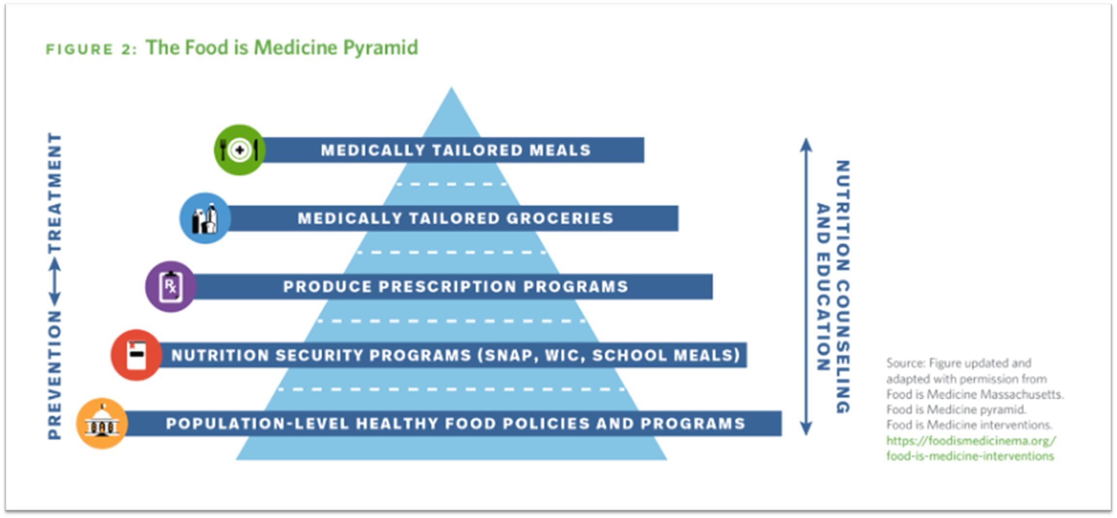
Definition of Food is Medicine

Slide 11
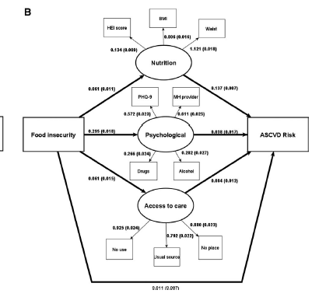

Slide 12
Research Results to Date for People With HIV
Intervention conducted among People With HIV received MTM+Grocery+Nurition counseling for 6months
  Lower odds of hospitalization
  Food security
  Depressive symptoms
  Antiretroviral therapy adherence
Source
  Kartika Pallar, et al J Infectious Disease, 2025, March 17

Slide 13
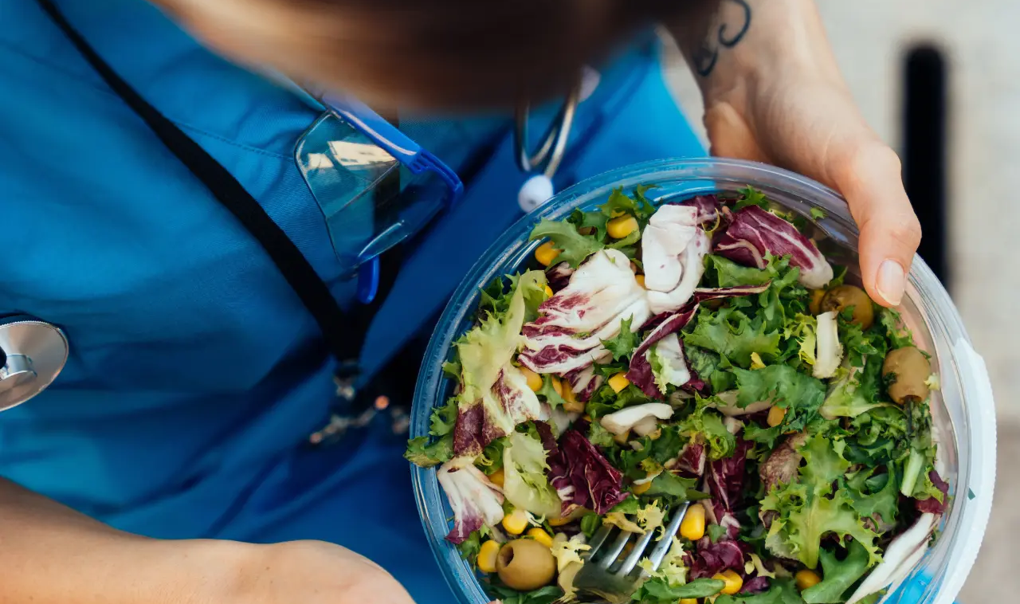
Research Results to Date for other Key Groups
Several RCT have indicated no change in hemoglobinA1C
Large scale studies have indicated improvement in hospitalizations and ER visits
    Can both be true?
    Sources:(Seligman, Angell et al. 2025); (Doyle, Alsan et al. 2024); (Hager, Du et al. 2023)

Slide 14
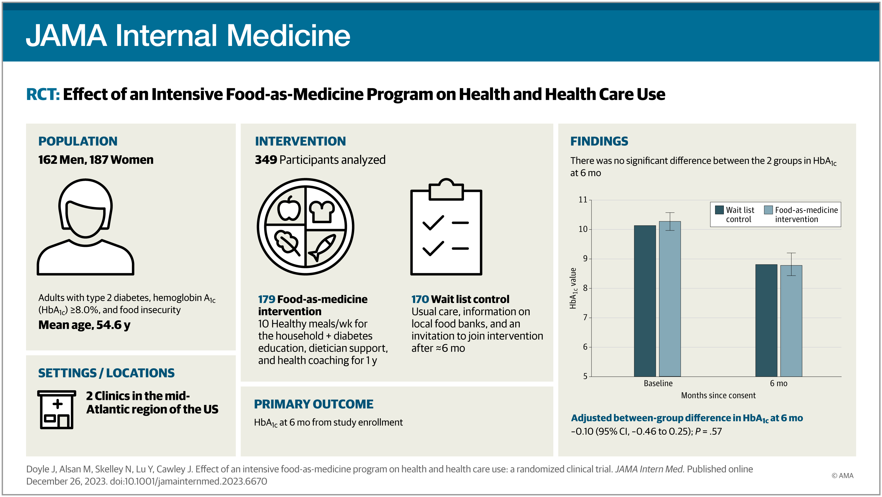

Slide 15

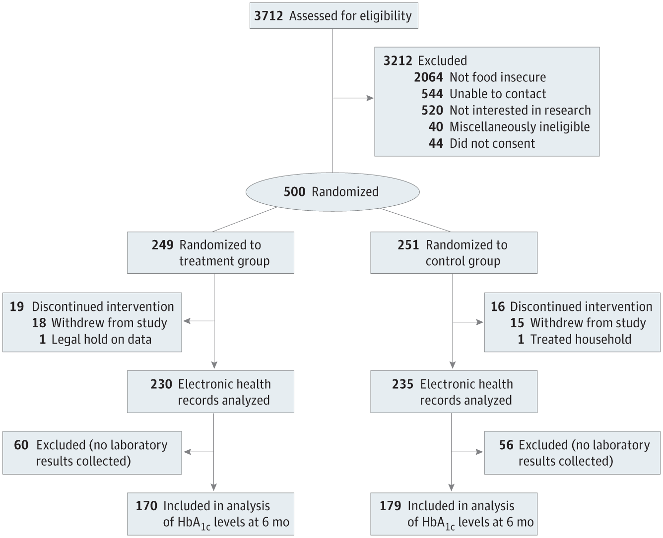
From: Effect of an Intensive Food-as-Medicine Program on Health and Health Care Use: A Randomized Clinical Trial
JAMA Intern Med. 2024;184(2):154-163. doi:10.1001/jamainternmed.2023.6670
Figure Legend:
CONSORT Diagram All patients allocated to the treatment group were advised by the food-as-medicine program at the beginning of their study participation, with varying levels of engagement. All patients allocated to the control group were contacted approximately 6 months later to begin the program, also with varying levels of engagement. Treated household refers to 1 patient who was discovered after randomization to be living with another patient and had been already receiving food. HbA_{1c} indicates hemoglobin A_{1c}.

Slide 16
How do we go from clinical trials to engagement with healthcare providers and insurance?

Slide 17
‘Food Is Medicine’ In The US: A National Survey Of Public Perceptions Of Care, Practices, And Policies
Fewer than half of respondents said that they received clear food- and nutrition-related advice from their primary health care providers, but a majority expressed interest in participating in Food Is Medicine interventions.
More than two-thirds felt that Medicare and Medicaid should help pay for Food Is Medicine programs in health care, and more than half said that private insurance should do so.
These results suggest a need for increased nutrition-related training of health care professionals, development of Food Is Medicine accreditation standards for health care organizations, and new regulatory incentives and contract requirements for Medicare Advantage and Medicaid managed care plans to encourage Food Is Medicine interventions in care delivery
(Ridburg, R et al Health Affairs March 12, 2025)

Slide 18
Policy Context
Centers for Medicare and Medicine
  Mandated screening for food insecurity as part of Social Determinant of Health (SDoH) in 2022
  Limited training and solutions for referral for resources
1115 Medicaid Waivers/In Lieu of Service
  Several States have implemented Waivers/ILOS to develop and test food is medicine programs
    There remains barriers to implementation, billing, and tracking
Make America Healthy Again
  Initiatives and funding for evaluation but not for actual program implementation

Slide 19











REFERRAL HUB
Centralization of Healthcare by Food System™
Assess constraints and preferences
Monitor progress and tracking
Completion and Reimbursement
Connect
Screen and Refer
Alliance team complete further screening questions to determine appropriate food as medicine package based on patient needs, location, and preferences.
Alliance team completes enrollment steps in the appropriate food as medicine package to allow patients to be connected to appropriate plan.
Alliance team captures patient health information (PHI) from providers to be used in tracking progress and evaluation of health outcomes.
As food as medicine programs are completed Alliance staff audit and invoice MCO’s for reimbursement that is sent back to food as medicine providers.
Patients are screened for food security among healthcare providers and referred for further enrollment steps.

Slide 20

Screening Questions to Allocate Participants into FIM program – Step 1 and Step 2
Do you have a working kitchen?
Do you prefer to cook your own meals?
Do you have reliable transportation?
Management of condition

Slide 21
Food is Medicine Data Tracking – Step 3
Medically Tailored Meals (10-14 meals per week delivered)
Best for high need patients with unmanaged conditions and limited cooking abilities.
Medically Tailored Meal Kits (Meal box 5 meals per week delivered) Best for patients with managed conditions but would need assistance with meal planning and transportation.
Grocery Rx in-store ($100 lean protein, F/V, dairy, nuts, legumes) Best for a majority of patients with managed conditions, prefer to choose their own food, and ability to shop and prepare foods.
Grocery Rx on-line ($100 lean protein, F/V, dairy, nuts, legumes)
Same as in-store but have transportation as a barrier.
All programs include nutrition counseling with an RD, case management check-ins, welcome materials, off boarding materials, and a help line.

Slide 22
Food is Medicine Program Enrollment Step 4
PHI data captured through KHIE
Food as Health as a covered entity allows for PHI to be captured
Reminders to visit Doctor
Text message and phone calls to schedule check-up appointments within 6 months
Monthly Report
Reports provide engagement metrics and adherence to program
Program Report
Healthcare providers received evaluation reports on patients
The system allows for a robust Food is Medicine program to relieve pain points and improve patient outcomes.

Slide 23





Our program results to date
We have partnered with 6 healthcare networks in our state for referral services (UofL, ARH, Ukhealthcare, Owensboro, Norton, Advent Health)
We have served about 800 Medicaid Adults with either Grocer Rx, MTM, or Meal Kits across Kentucky through various funding sources (grants, contracts, and gift support)
Key Results have indicated that referral and enrollment steps are critical for success of these programs.
Participants Enrolled in these programs report improved clinical outcomes, engagement, and general satisfaction with the program.

Slide 24
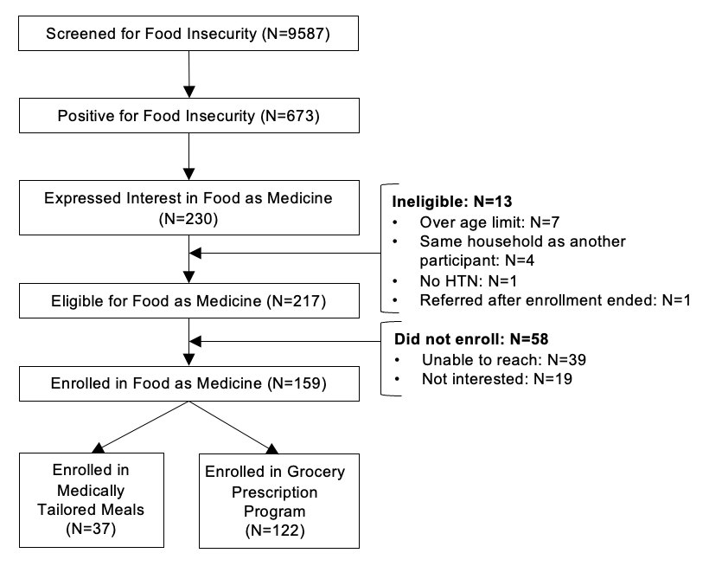

Slide 25
Partnership with Bluegrass Care Clinic
1. BCC identifies eligible patients and sends name to Food as Health Team
2. FAH team completes enrollment steps and patients receive either Grocery Rx in-store or on-line
3. FAH conducts data tracking during program (viral load and Part C eligibility)
4. FAH manages day to day operations of FIM program (RD counseling, case management, text messages)
5. FAH team reports back on summary of program during the year

Slide 26
Questions
Questions | Response Options
What makes Food is Medicine Programs different then hunger relief programs? | Tailored food to address nutrition security and diet-sensitive chronic disease There is no difference They are similar to hunger relief and I don’t understand the difference
How do food is medicine programs improve clinical outcomes? | By targeting food insecurity and nutrition security By utilization of tailored food input which address inflammation, blood pressure, blood glucose, and other metabolic markers Reducing resource constraints to allow for reduced stress All of the above
Explain why referral process is key for uptake in Food is Medicine programs? | I am not sure Patients trust their medical provider and are more likely to enroll if they are invited Medical providers need to be trained on referral steps to ensure patients needs are met B and C

Slide 27
Thank you to Blue Grass Care Clinic and AETC
Alison Gustafson, PhD, MPH, RD
Director Food as Health Program at UKHealthcare
Questions are welcome

