Slide 1
Anal Cancer Screening:
Getting in through the Backdoor
Marwan Haddad MD, MPH, AAHIVS
Medical Director, Center for Key Populations
Community Health Center, Inc., Connecticut

Slide 2
Disclosures
This program is supported by the Health Resources and Services Administration (HRSA) of the U.S. Department of Health and Human Services (HHS) under grant number TR7HA53203-01-00 as part of an award totaling $5.7m. The contents are those of the author(s) and do not necessarily represent the official views of, nor an endorsement, by HRSA, HHS, or the U.S. Government. For more information, please visit HRSA.gov.
“Funding for this presentation was made possible by cooperative agreement TR7HA53203-01-00 from the Health Resources and Services Administration HIV/AIDS Bureau. The views expressed do not necessarily reflect the official policies of the Department of Health and Human Services nor does mention of trade names, commercial practices, or organizations imply endorsement by the U.S. Government. Any trade/brand names for products mentioned during this presentation are for training and identification purposes only.”
This content is owned by the AETC and is protected by copyright laws. Reproduction or distribution of the content without written permission of the sponsor is prohibited and may result in legal action.

Slide 3
Disclosures
All planners, faculty, and others in control of educational content are required to disclose all their financial relationships with ineligible companies within the prior 24 months. An ineligible company is defined as one whose primary business is producing, marketing, selling, re-selling, or distributing healthcare products used by or on patients. Financial relationships are relevant if the educational content an individual can control is related to the business lines or products of the ineligible company.
None of the planners, faculty, and others in control of educational content for this educational activity have relevant financial relationship(s) to disclose with ineligible companies.
The material presented in this course represents information obtained from the scientific literature as well as the clinical experiences of the speakers. In some cases, the presentations might include discussion of investigational agents and/or off-label indications for various agents used in clinical practice. Speakers will inform the audience when they are discussing investigational and/or off-label uses.
Disclosure of a relationship is not intended to suggest or condone commercial bias in any presentation, but it is made to provide participants with information that might be of potential importance to their evaluation of a presentation.

Slide 4
Disclosures
The Health Resources and Services Administration (HRSA), Department of Health and Human Services (HHS) provided financial support for this project. The award provided 100% of total costs. The contents are those of the author. They may not reflect the policies of HRSA, HHS, or the U.S. Government.

Slide 5
AETC Program National Centers and HIV Curriculum
National AETC Support Center (NASC) – serves as the central web –based repository for AETC Program training and capacity building resources; its website includes a free virtual library with training and technical assistance materials, a program directory, and a calendar of trainings and other events. Learn more: https://aidsetc.org/
National Clinical Consultation Center (NCCC) – provides free, peer-to-peer, expert advice for health professionals on HIV prevention, care, and treatment and related topics. Learn more: https://nccc/ucsf.edu or call 844-ASK-NCCC (844-275-6222)
National HIV Curriculum (NHC) – provides ongoing, up –to-date HIV training and information for health professionals through a free, web –based curriculum; also provides free CME credits, CNE contact hours, CE contact hours, and maintenance of certification credits. Learn more: www.hiv.uw.edu

Slide 6

Overcoming Barriers
Identifying who needs screening
Sensitive/invasive examination
Time constraints/competing priorities
HRA availability

Slide 7

Case Study
64 yr old Hispanic man who has sex w men with HIV comes for routine follow up visit.
HIV: diagnosed in 1999, CD4 nadir 150, viral load <20 copies/mL.
PMH: Hypertension, hyperlipidemia, glucose intolerance
Medications: Biktarvy, Lisinopril-HCTZ, Atorvastatin
STD history: syphilis, treated in 2017; urethral gonorrhea twice (in 2017 and in 2019); genital wart treated in his 20s with no recurrence
Sexual history: sex with men only; married for 15 years with occasional outside partners, last encounter 1 month ago; engages in insertive and receptive oral and anal sex without condom use.
HPI: missed Biktarvy x past 2 days due to pharmacy delay; BP 150/90 in office; feeling achy, mild runny nose, thinks it is a cold/allergies, worried it is the atorvastatin; he is due for labs and refills.

Slide 8
Case Study
His risk of anal cancer is
  Increased because he has a history of genital warts
  Increased because of his HIV status
  The same as the general population
  Decreased because of his age
  Decreased because he is on successful ART which also suppresses the HPV virus.

Slide 9

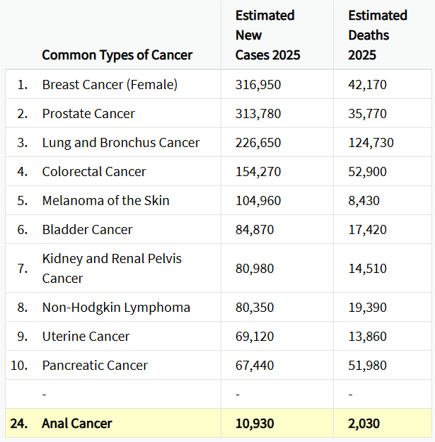
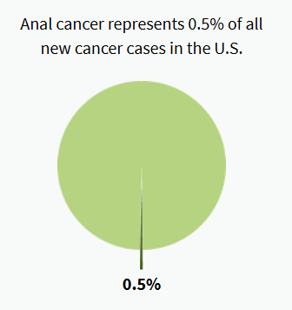
2025 U.S. Cancer Incidence and Mortality
Anal Cancer — Cancer Stat Facts

Slide 10
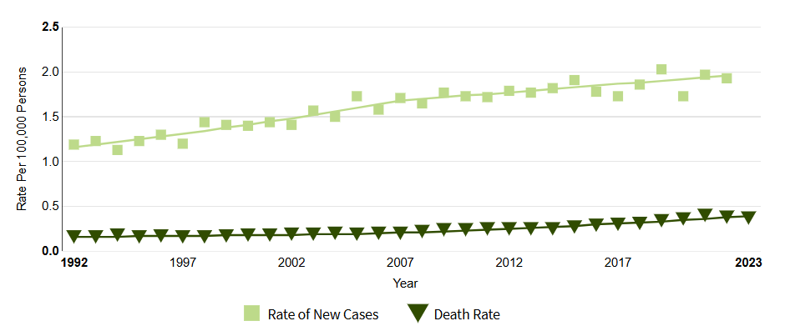
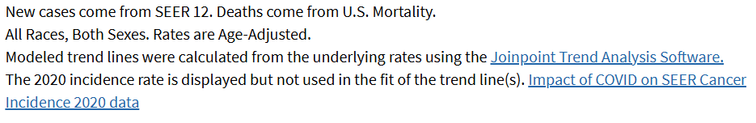

Epidemiology of Anal Cancer in the U.S.
Anal cancer incidence and mortality have been rising.
Anal Cancer — Cancer Stat Facts

Slide 11
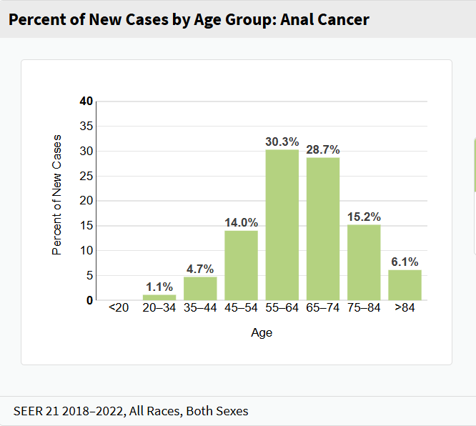
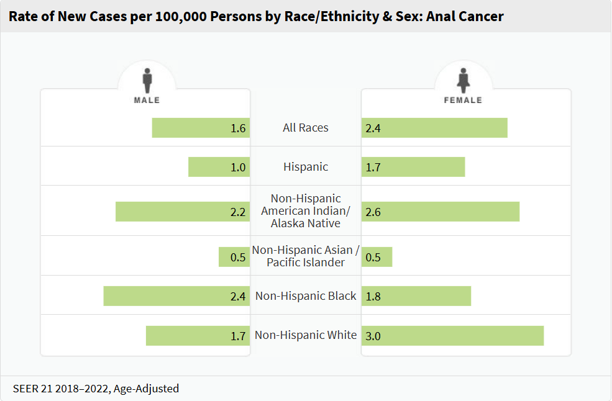
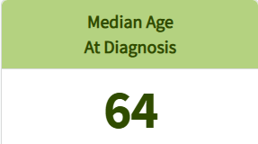
Anal Cancer by Race/Ethnicity, Sex, and Age
Anal Cancer — Cancer Stat Facts

Slide 12
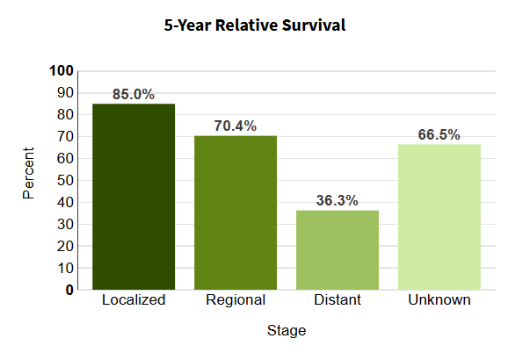
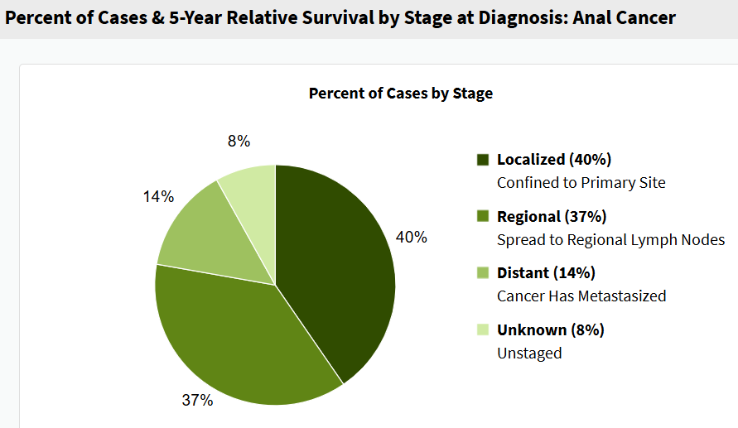
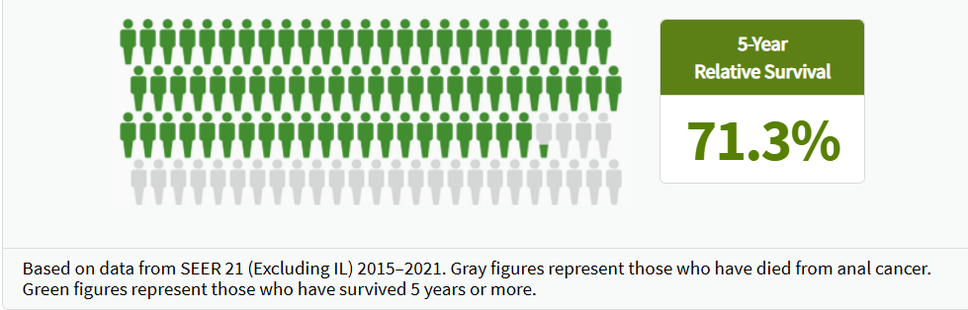
Survival by Stage

Slide 13
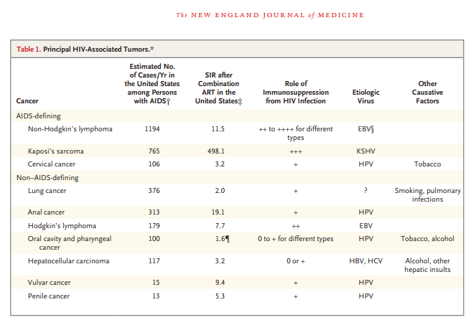
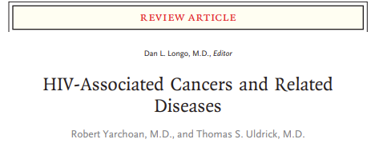
Yarchoan R, Uldrick TS. HIV-Associated Cancers and Related Diseases. N Engl J Med. 2018 Mar 15;378(11):1029-1041. doi: 10.1056/NEJMra1615896. PMID: 29539283; PMCID: PMC6890231.
Notes:
Standardized incidence ratio

Slide 14
Incidence Rates of Anal Cancer
Risk Category | Incidence Rate (cases per 100 000 py)
General population | 1-2
MSM with HIV | 85
<30 years of age | 16.8
≥60 years of age | 107.5
Non-MSM Males with HIV | 32
Females with HIV | 22
MSM without HIV | 19
Vulvar cancer | 48
Cervical cancer | 9
Vaginal cancer | 10
SOTR | 13
SOTR > 10 yrs post transplant (males) | 24.5
SOTR > 10 yrs post transplant (females) | 49.6
SLE | 10
Ulcerative colitis | 6
Crohn’s disease | 3
Clifford et al. A meta-analysis of anal cancer incidence by risk group: Toward a unified anal cancer risk scale. Int J Cancer. 2021 Jan 1;148(1):38-47. doi: 10.1002/ijc.33185. Epub 2020 Jul 29. PMID: 32621759; PMCID: PMC7689909.
py, person-years; MSM, men who have sex with men; SOTR, solid organ transplant recipient; SLE, systemic lupus erythematosus

Slide 15

Identifying patients for anal cancer screening
Case by case basis
  In the exam room, during clinical visits
Daily panel management
  Using dashboards
    Include as part of pre-visit huddling or rooming process
    Typically reviewed by medical assistant or nurse
    Flags patient who is due for screening
      E.g. based on SOGI, HIV status
Population health management
  Campaign direct to patients (targeted or general outreach)
  Provide list of patients to providers and their teams

Slide 16
Case Study
His risk of anal cancer is
  Increased because he has a history of genital warts
  Increased because of his HIV status
  The same as the general population
  Decreased because of his age
  Decreased because he is on successful ART which also suppresses the HPV virus.
Yes, he is at the highest risk for anal cancer because of his HIV status as well as his sexual orientation, and his age.

Slide 17
Pathophysiology
Human papillomavirus (HPV)-associated cancer
  Most commonly caused by HPV-16 and -18
  HPV-16 is overwhelmingly the “bad guy”
    70% of cases in PWH
    85% of cases in general population
HPV enters into basement layer of anal epithelium where it sequesters itself from the immune response
As HPV moves up cell layers, it can transform neighboring cells, producing dysplasia
Area of interest: transformation zone (TZ) at squamocolumnar (SC) junction

Slide 18
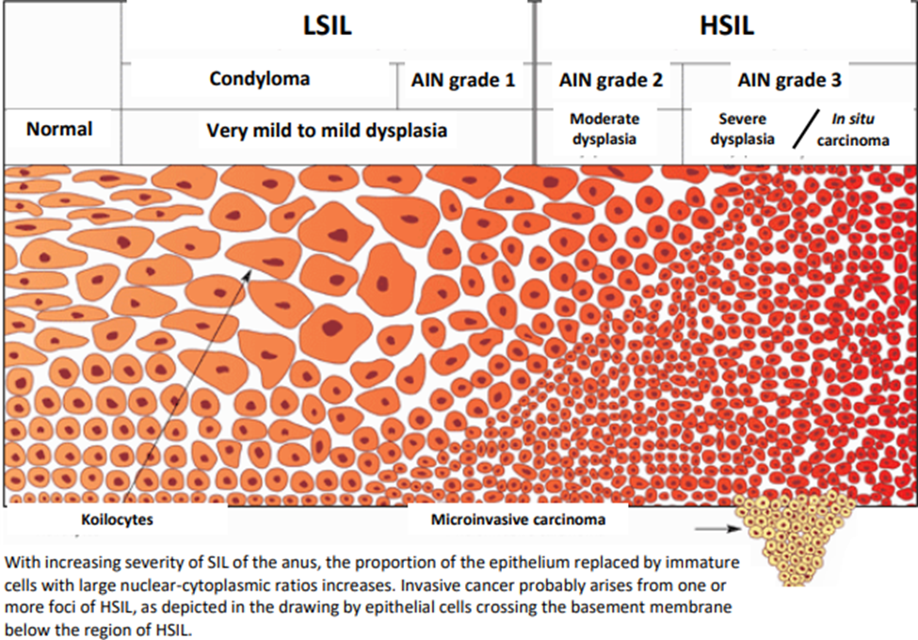
AIN: anal intraepithelial neoplasia
LSIL: low grade squamous intraepithelial lesion
HSIL: high grade squamous intraepithelial lesion

Slide 19

Clinical Presentation
Can be asymptomatic.
Rectal bleeding is the most common initial symptom.
Other symptoms: anorectal pain; sensation of a rectal mass, pruritus ani, abnormal anal discharge.
Anal cancer more likely to be palpable than LSIL/HSIL.

Slide 20
Case Study
Given his increased risk for anal cancer, you would recommend
  Digital anal rectal examination only
  Anal pap smear with cytology testing only
  Anal pap smear with hrHPV testing only
  Anal pap smear with cytology and hrHPV co-testing
  High resolution anoscopy

Slide 21
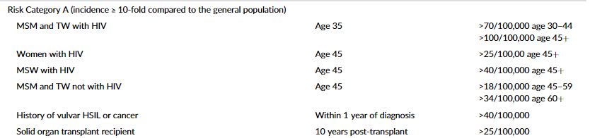
International Anal Neoplasia Society: Anal Cancer Risk Category A
International Anal Neoplasia Society's consensus guidelines for anal cancer screening - Stier - 2024 - International Journal of Cancer - Wiley Online Library

Slide 22
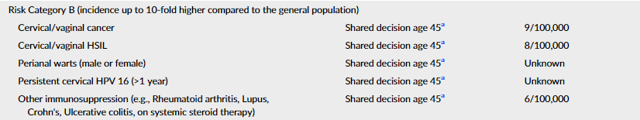

International Anal Neoplasia Society: Anal Cancer Risk Category B
International Anal Neoplasia Society's consensus guidelines for anal cancer screening - Stier - 2024 - International Journal of Cancer - Wiley Online Library

Slide 23
International Anal Neoplasia Society: Anal Cancer Screening Tests
International Anal Neoplasia Society's consensus guidelines for anal cancer screening - Stier - 2024 - International Journal of Cancer - Wiley Online Library

Slide 24
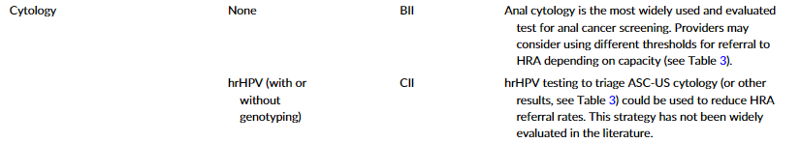
International Anal Neoplasia Society: Anal Cancer Screening Tests
International Anal Neoplasia Society's consensus guidelines for anal cancer screening - Stier - 2024 - International Journal of Cancer - Wiley Online Library

Slide 25
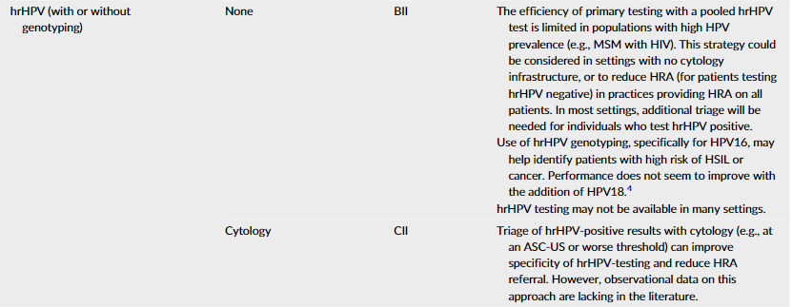
International Anal Neoplasia Society: Anal Cancer Screening Tests
International Anal Neoplasia Society's consensus guidelines for anal cancer screening - Stier - 2024 - International Journal of Cancer - Wiley Online Library

Slide 26
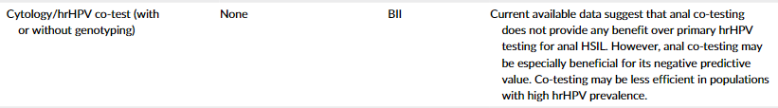
International Anal Neoplasia Society: Anal Cancer Screening Tests
International Anal Neoplasia Society's consensus guidelines for anal cancer screening - Stier - 2024 - International Journal of Cancer - Wiley Online Library

Slide 27
Preferred Type of Anal Cancer Screening
Digital anal rectal exam (DARE) on every patient being screened.
Cytology is preferred screening test, especially in populations with high HPV prevalence (e.g. MSM with HIV).
Can add high-risk HPV (hrHPV) testing either as co-testing or as subsequent test if cytology comes back as atypical squamous cells of undetermined significance (ASC-US) or LSIL to help guide management.
  If available, can order hrHPV with genotyping (to rule out HPV16).
hrHPV testing alone is an acceptable option, though limited efficiency in patients with high HPV prevalence, such as MSM with HIV.

Slide 28
Case Study
Given his increased risk for anal cancer, you would recommend
  Digital anal rectal examination only
  Anal pap smear with cytology testing only
  Anal pap smear with hrHPV testing only
  Anal pap smear with co-testing cytology and hrHPV
  High resolution anoscopy

Slide 29
Case Study
You know you should proceed with anal pap smear. Which of the following would you choose to do:
  Postpone the procedure until another visit because of time constraints (managing adherence, BP, muscle aches).
  Refer him to colorectal surgery/GI to conduct the pap smear.
  Proceed with pap smear, asking medical assistant to set up and chaperone (so what if you are already 46 minutes behind, whose counting?).
  Have him self-collect the sample at the end of the visit with medical assistant handing him how-to instructions.
  Bring him back to see your nurse for self-collection.

Slide 30
Overcoming Barriers
Identifying who needs screening
Sensitive/invasive examination
Time constraints/competing priorities
HRA availability

Slide 31
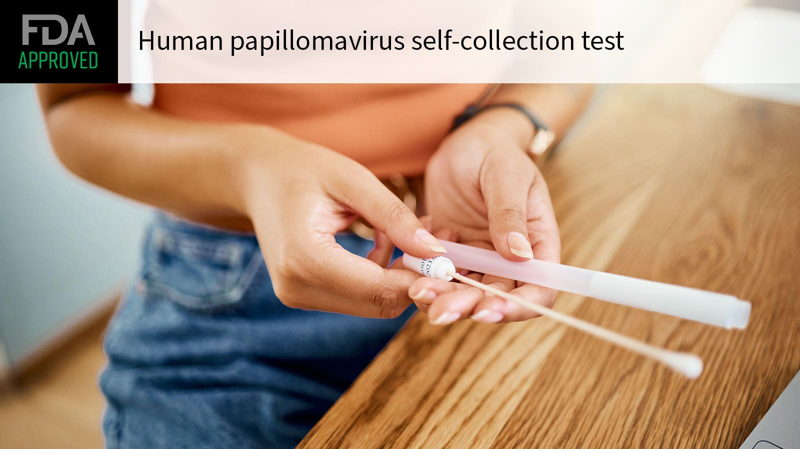
Self- vs. Clinician-Collected Specimens
FDA-approved
  Self collection for vaginal swabs for STIs
  Self collection for HPV for cervical cancer
    Not in HIV
Generally accepted but not FDA-approved
  Self collection for rectal chlamydia and GC
Self collection for anal cancer screening??

Slide 32
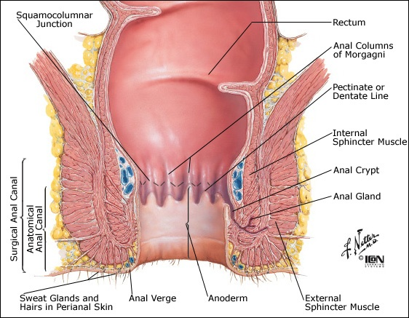
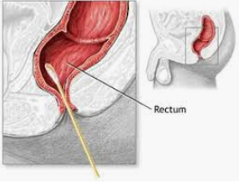
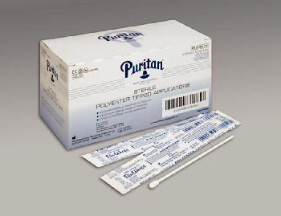
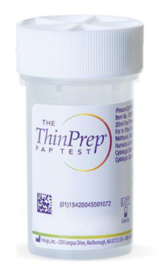
Clinician-Collected Anal Pap Technique
No douching, enemas or receptive anal intercourse 24 hours prior.
Use a polyester dacron swab. Lightly moisten with tap water. Do not use lubricant.
Insert swab into anal canal at least 5 cm just past anal verge, angling toward umbilicus. Goal is to sample TZ/SC junction.
Rotate swab while maintaining pressure to walls in circular (“cork screw”) motion. Count 10-20 secs while withdrawing swab.
Immerse in liquid pap solution and label as ANAL pap smear.

Slide 33
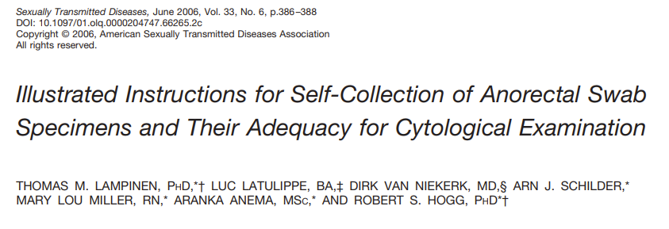
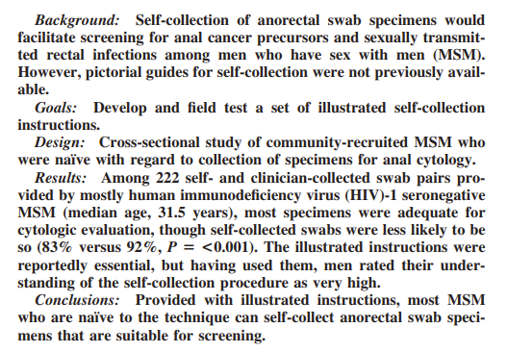
N=222 MSM, majority HIV neg
Each received self and clinician collected swabs
Most specimens adequate for cytology evaluation with self collection less likely to be (83% vs 92%)
Lampinen TM, Latulippe L, van Niekerk D, Schilder AJ, Miller ML, Anema A, Hogg RS. Illustrated instructions for self-collection of anorectal swab specimens and their adequacy for cytological examination. Sex Transm Dis. 2006 Jun;33(6):386-8. doi: 10.1097/01.olq.0000204747.66265.2c. PMID: 16543863.

Slide 34
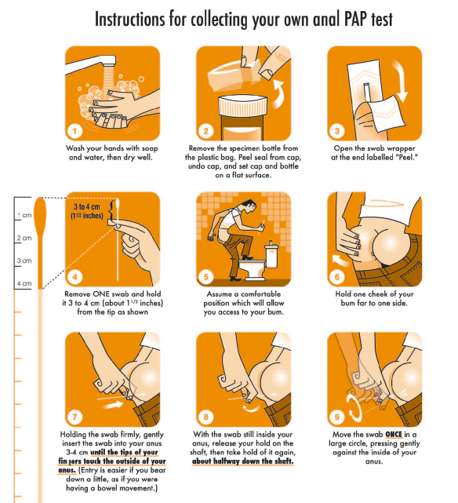
Patient-Collected Anal Pap Technique
Lampinen TM, Latulippe L, van Niekerk D, Schilder AJ, Miller ML, Anema A, Hogg RS. Illustrated instructions for self-collection of anorectal swab specimens and their adequacy for cytological examination. Sex Transm Dis. 2006 Jun;33(6):386-8. doi: 10.1097/01.olq.0000204747.66265.2c. PMID: 16543863.

Slide 35
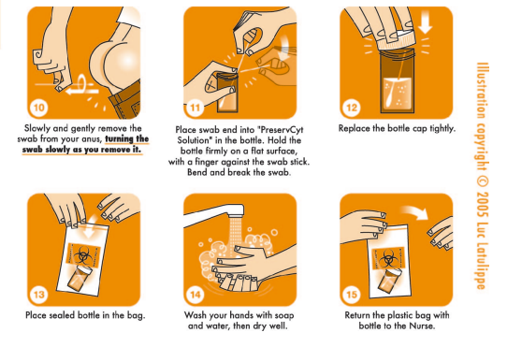
Patient-Collected Anal Pap Technique
Lampinen TM, Latulippe L, van Niekerk D, Schilder AJ, Miller ML, Anema A, Hogg RS. Illustrated instructions for self-collection of anorectal swab specimens and their adequacy for cytological examination. Sex Transm Dis. 2006 Jun;33(6):386-8. doi: 10.1097/01.olq.0000204747.66265.2c. PMID: 16543863.

Slide 36
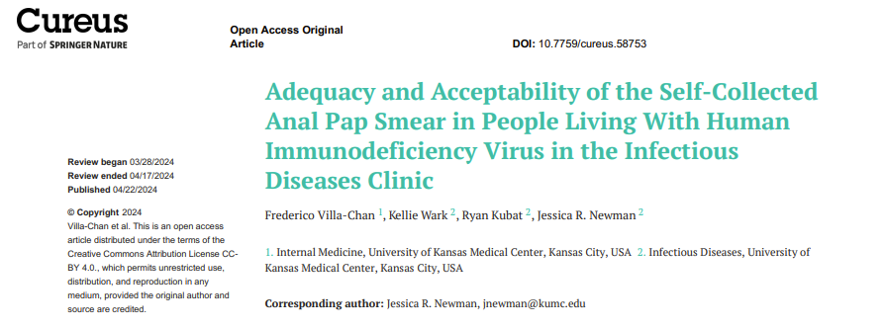
Patient survey:
  63% more satisfied with process because of SC, 33% no preference;
  63% agreed to test because of SC citing privacy and less discomfort
Provider survey (n=21):
  90% satisfied with SC
  86% comfortable with offering SC
  76% favored SC, 19% no preference
Single center, observational study, ID clinic, Oct-Dec 2021
N=60 males with HIV, median 44 60% white, 30% black, 7% Hispanic
75% (45/60) self-collected
No difference in adequacy for cytology interpretation
  SC: 35/45 or 78% adequate
  PC: 10/15 or 67% adequate
Villa-Chan F, Wark K, Kubat R, Newman JR. Adequacy and Acceptability of the Self-Collected Anal Pap Smear in People Living With Human Immunodeficiency Virus in the Infectious Diseases Clinic. Cureus. 2024 Apr 22;16(4):e58753. doi: 10.7759/cureus.58753. PMID: 38779240; PMCID: PMC11110946.

Slide 37
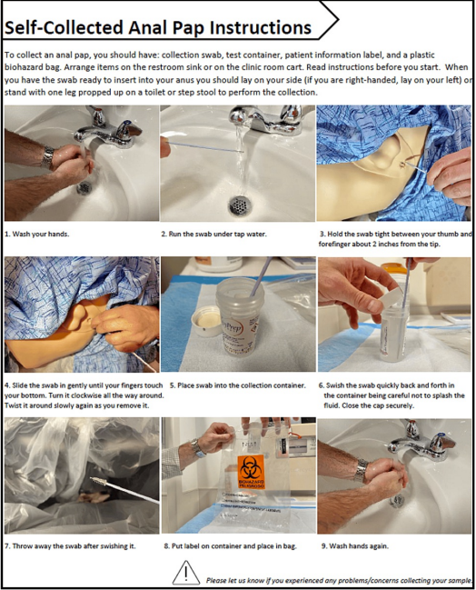
Patient-Collected Anal Pap Technique
Villa-Chan F, Wark K, Kubat R, Newman JR. Adequacy and Acceptability of the Self-Collected Anal Pap Smear in People Living With Human Immunodeficiency Virus in the Infectious Diseases Clinic. Cureus. 2024 Apr 22;16(4):e58753. doi: 10.7759/cureus.58753. PMID: 38779240; PMCID: PMC11110946.

Slide 38
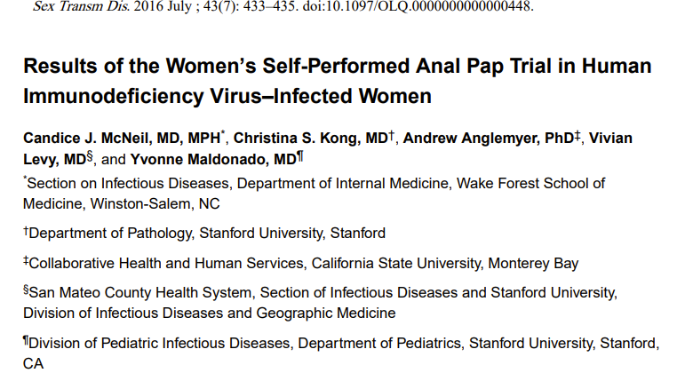
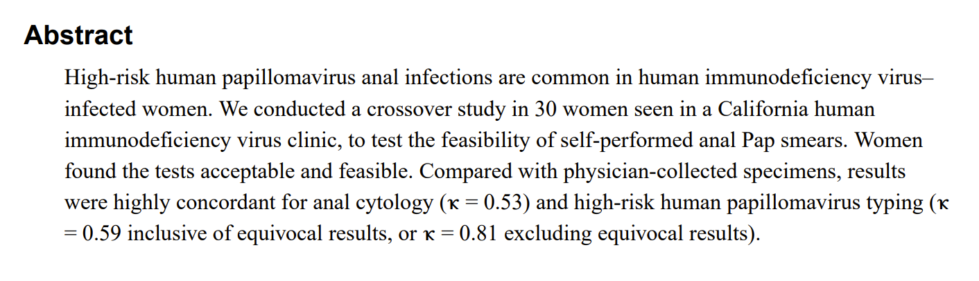

Slide 39
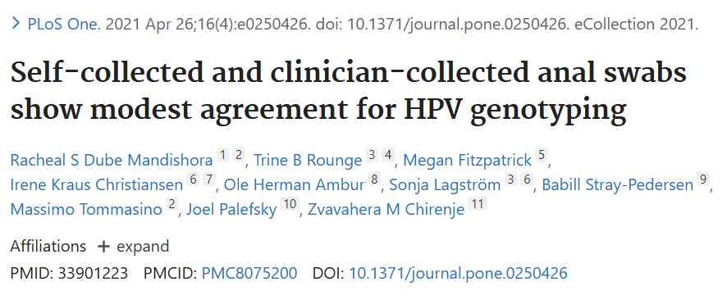
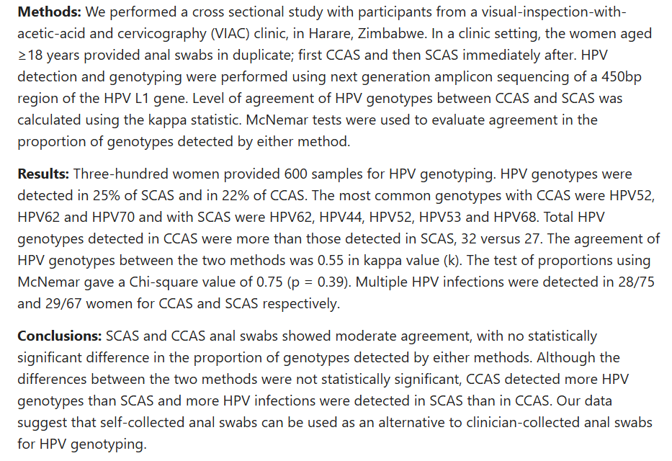
N=300 women in Zimbabwe, ~50% with HIV
Duplicate collection: clinician- then self- swab.
Examined level of agreement of HPV genotypes
Showed moderate agreement with statistically significant difference

Slide 40
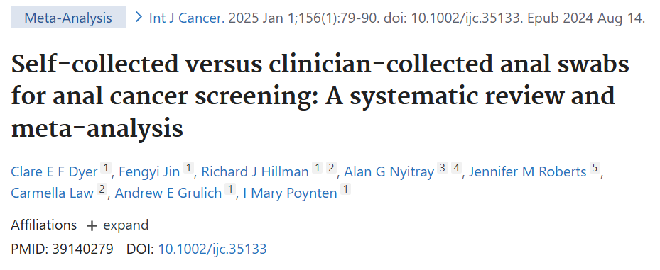
Searched publications through June 2023.
  Included if data on HPV testing, cytology testing, or acceptability for both self- and clinician- collected swabs
N= 13 papers describing 10 studies

Slide 41
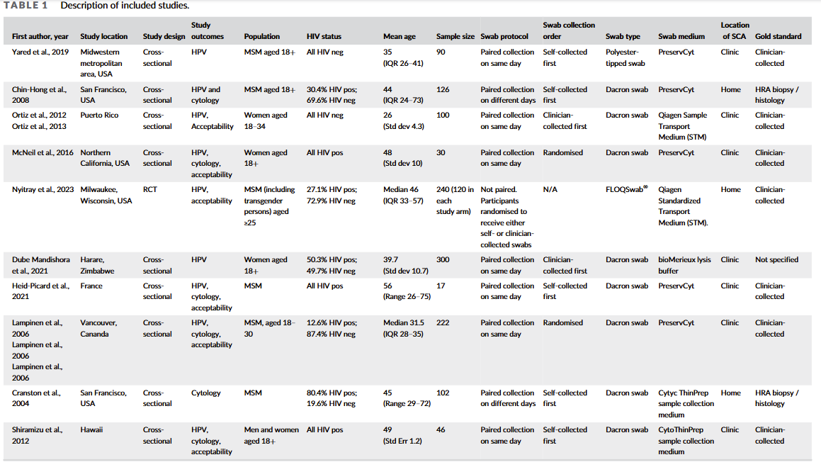

Slide 42
Summary of Results:
  Comparable adequacy for HPV testing
  Self collection slightly lower adequacy for cytology
  No significant difference in prevalence for any hrHPV, any HPV, HPV 16 or any cytological abnormality.
  Larger studies are required.
  Bottom Line: Self collection gives equivalent sample adequacy for HPV testing, and about 10% inferior adequacy for cytological testing.

Slide 43

HPV/STI Nursing Visit
Provider-directed and/or patient-directed
  Standing orders for patient-directed visit
  Billable visits
Provides support to clinicians and patients
Nursing visits for HPV/STI screening
  Sexual history
  Specimen Collections
  Point of care testing, e.g. HIV
  Lab orders
  Vaccines
  Patient education and counseling

Slide 44
Ways to Manage Time Constraints/Invasiveness of Collection
Consider self-collection
Medial assistant-directed, at the time of rooming the patient or at end of visit
  Patients identified through pre-visit huddles/dashboards
Nurse visits
  Provider-directed
  Patient-directed/Staff-directed (with standing orders)

Slide 45
Case Study
You know you should proceed with anal pap smear. Which of the following would you choose to do:
  Postpone the procedure until another visit because of time constraints (managing adherence, BP, muscle aches).
  Refer him to colorectal surgery/GI to conduct the pap smear.
  Proceed with pap smear, asking medical assistant to set up and chaperone (so what if you are already 46 minutes behind, whose counting?).
  Have him self-collect the sample at the end of the visit with medical assistant handing him how-to instructions.
  Bring him back to see your nurse for self-collection.

Slide 46
Case Study
He agrees with self collection and the medical assistant provides the instructions at the end of the visit and sends off the specimen. You order cytology and hrHPV co-testing.
Results come back as LSIL with hrHPV positive (genotype is NOT HPV16).
You do not have HRA easily accessible in your area.

Slide 47
Case Study
What would you recommend as next steps for LSIL with hrHPV+, not HPV16 (limited HRA availability)?
    Reassure since it is LSIL and not HPV-16, no treatment nor repeat testing required.
    Reassure but tell him repeat anal pap smear in 1 year.
    Refer for HRA anyway and see if you can provide transportation for him to get to the specialist 2 hours away.

Slide 48
Overcoming Barriers
Identifying who needs screening
Sensitive/invasive examination
Time constraints/competing priorities
HRA availability

Slide 49
International Anal Neoplasia Society: Management of Results
International Anal Neoplasia Society's consensus guidelines for anal cancer screening - Stier - 2024 - International Journal of Cancer - Wiley Online Library

Slide 50
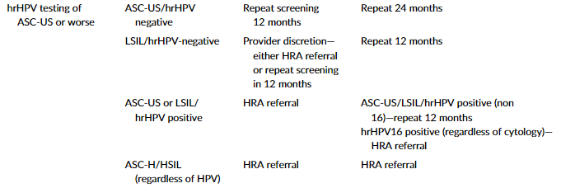
International Anal Neoplasia Society: Management of Results
International Anal Neoplasia Society's consensus guidelines for anal cancer screening - Stier - 2024 - International Journal of Cancer - Wiley Online Library

Slide 51
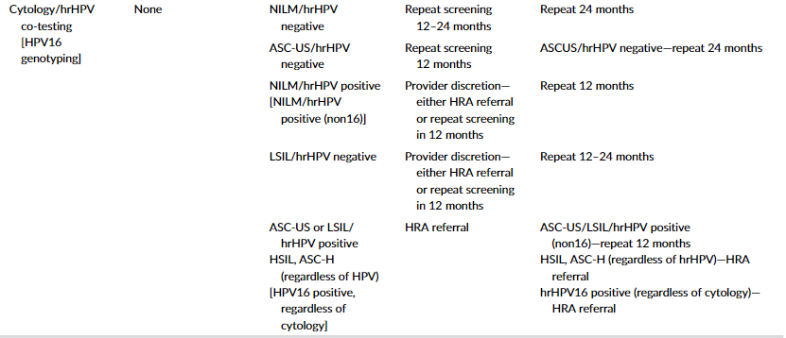
International Anal Neoplasia Society: Management of Results
International Anal Neoplasia Society's consensus guidelines for anal cancer screening - Stier - 2024 - International Journal of Cancer - Wiley Online Library

Slide 52
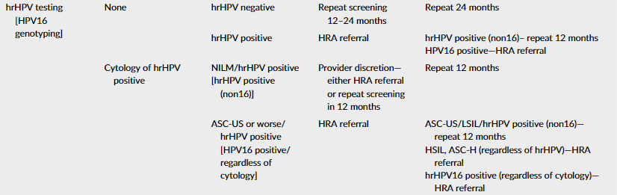
International Anal Neoplasia Society: Management of Results
International Anal Neoplasia Society's consensus guidelines for anal cancer screening - Stier - 2024 - International Journal of Cancer - Wiley Online Library

Slide 53
HRA Referral Readily Available
Type of Test | Result |  | Management
Cytology only | Negative |  | Repeat 1 yr
 | ASC-US or worse |  | HRA
hrHPV only | Negative |  | Repeat 1-2 yrs
 | Positive |  | HRA
Co-testing | Negative | HPV - | Repeat 1-2 yrs
 |  | HPV + | HRA or repeat 1 yr
 | ASC-US | HPV - | Repeat 1 yr
 |  | HPV + | HRA
 | LSIL | HPV - | HRA or repeat 1 yr
 |  | HPV + | HRA
 | HSIL or ASC-H | HPV - | HRA
 |  | HPV + | HRA
hrHPV-16 | Positive |  | HRA
ASC-H: atypical squamous cells cannot exclude high grade; ASC-US: atypical squamous cells of undetermined significance; hr: high risk; HPV: human papilloma virus; HRA: high resolution anoscopy; HSIL: high grade squamous intraepithelial lesion; LSIL: low grade squamous intraepithelial lesion

Slide 54
HRA Referral NOT Readily Available
Type of Test | Result |  | Management
Cytology only | Negative |  | Repeat 1-2 yrs
 | ASC-US/LSIL |  | Repeat 1 yr
 | HSIL/ASC-H |  | HRA
hrHPV only | Negative |  | Repeat 2 yrs
 | Positive |  | HPV non-16: repeat 1 yr HPV16: HRA
Co-testing | Negative | HPV - | Repeat 2 yrs
 |  | HPV + | Repeat 1 yr
 | ASC-US | HPV - | Repeat 2 yrs
 |  | HPV + | Repeat 1 yr
 | LSIL | HPV - | Repeat 1-2 yrs
 |  | HPV + | Repeat 1 yr
 | HSIL or ASC-H | HPV - | HRA
 |  | HPV + | HRA
hrHPV-16 | Positive |  | HRA
ASC-H: atypical squamous cells cannot exclude high grade; ASC-US: atypical squamous cells of undetermined significance; hr: high risk; HPV: human papilloma virus; HRA: high resolution anoscopy; HSIL: high grade squamous intraepithelial lesion; LSIL: low grade squamous intraepithelial lesion

Slide 55
Case Study
What would you recommend as next steps for LSIL with hrHPV+, not HPV16 (limited HRA availability)?
    Reassure since it is LSIL and not HPV-16, no treatment nor repeat testing required.
    Reassure but tell him repeat anal pap smear in 1 year.
    Refer for HRA anyway and see if you can provide transportation for him to get to the specialist 2 hours away.
If HRA is readily available, then the recommendation would have been to send for HRA.

Slide 56
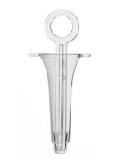
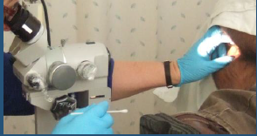
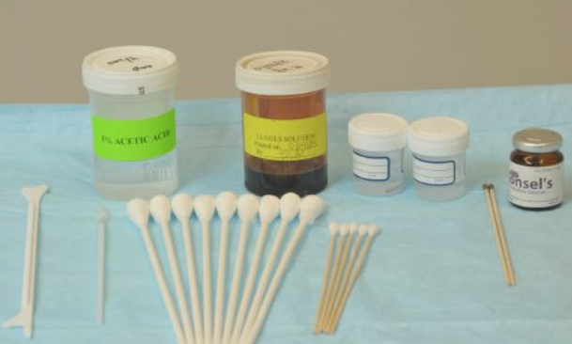
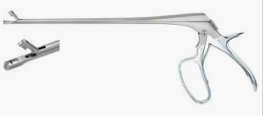
High Resolution Anoscopy (HRA)
Performed by colorectal, GI, ID, GYN specialists.
Anoscope is inserted into anus and obturator removed to visualize anal canal under colposcope.
5% acetic acid applied to visualize full SC junction/TZ.
Lugol’s solution applied.
Biopsies of abnormal appearing tissue collected (with Tischler forceps) as anoscope is slowly withdrawn.

Slide 57
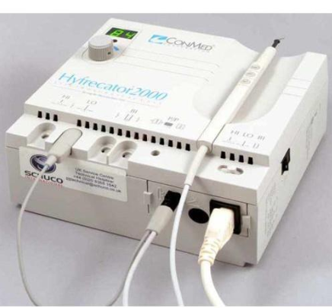
Treatment
Anal Squamous Intraepithelial Lesions
  Topical therapy (for small lesions)
    Trichloroacetic acid (TCA): clinician-applied
    5% Fluorouracil (5FU): patient-applied
    Imiquimod: patient-applied
  Ablative therapy
    Hyfrecation/electrocautery ablation
    Infrared coagulation (IRC)
    Radiofrequency ablation (RFA)
Anal cancer
  Chemoradiotherapy
  +/- Local tumor resection

Slide 58
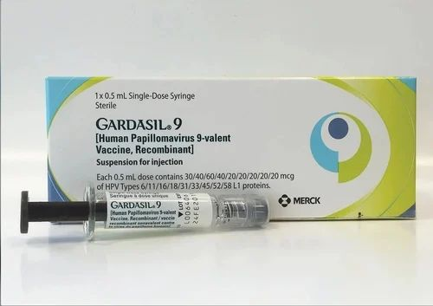
HPV Prevention
VACCINATE!
Three-dose 9vHPV vaccine schedule at 0, 1-2, and 6 months.
  For everyone ages 15-26 and those who are immunocompromised including people with HIV ages 27-45.
  Under age 15, two-dose schedule at 0 and 6-12 months is followed.

Slide 59

Thank you!
Marwan Haddad
haddadm@chc1.com

