Slide 1
Challenging HIV and Co-STI Cases
Dr. Hillary Reno, MD, PhD, FIDSA
Washington University in St. Louis
Dr. Michelle Collins-Ogle, MD, FAAP, FPIDS
Albert Einstein College of Medicine

Slide 2
Case 1
Do I really need three-site screening for gonorrhea and chlamydia?

Slide 3
STI Cases
Michelle Collins-Ogle, MD
Associate Professor of Pediatrics, Division of Infectious Diseases
Medical Director, MAYS Clinic
Annual Kentucky AETC Conference March 27 , 2026

Slide 4
Financial Disclosures
I have no financial disclosures
I will not discuss off label use of anti infective medication

Slide 5
Case #1 Jordan
21 y/o cisgender male who presents to CHAM ER with fatigue, generalized body aches, bleeding per rectum and abdominal pain which started 3-4 weeks prior to admission. He reports the pain somewhat responds to acetaminophen. Crampy lower abdominal pain 7/10 for 3 days, rectal bleeding and diarrhea; chills with night sweats and weight loss.
no vomiting, no rash, no lymphadenopathy, no recent travel or animal exposure
In ER, afebrile, thin, Abdomen soft, mild RLQ tenderness, no masses. Exam is otherwise unremarkable
PMhx: Torsion of the left testicle
STI Hx: No previous dx. STI
ID Consulted

Slide 6
Case #1 Jordan
Sexual Hx: +MSM / Vers condomless sex with male
Does not use condoms
Recently had a “hook-up” with a new male partner about 1 month prior to onset of symptoms.
Recent Hx:
About 1 month prior to this presentation, he was seen at an urgent care clinic was initially diagnosed with HIV 6/25, but did not initiate ARV treatment. He reports STI testing was negative.

Slide 7
Case #1 Jordan: Diagnostic Evaluation
CBC: WBCs 6.8 N64%L24%, Hb 11.1 PLT 545
CRP 17.1 ALT 60 AST 29 , total protein 7.7 and albumin 3.4
UA clear and culture in process
Abdominal Ultrasound: appendix is not identified. Appendicitis cannot be excluded, bladder wall thickening and hyperemia, and large amount of free fluid with debris surrounding the bladder, 1.8 cm x 0.7 cm x 0.4 cm avascular hypoechoic cystic appearing structure in the right lower quadrant

Slide 8
Case #1 Jordan: CT Scan
Abdominal CT scan:
  Moderate loculated abdominopelvic ascites with peritoneal thickening and wall enhancement, concerning for peritonitis. Left paracolic gutter soft tissue thickening and infiltration measuring up to 1.7 cm diameter c/o peritoneal carcinomatosis is suspected
  Irregular wall thickening of the rectum with hyperenhancement, Enlarged mesorectal and IMA nodes
  Mildly enlarged retroperitoneal and mesenteric nodes bilaterally.
  Mild wall thickening of the large and small bowel loops, likely reactive due to peritonitis
  Hepatosplenomegaly, no liver lesions, no appendicitis, no cholecystitis , no free air, no obstruction
Unremarkable CT chest and neck

Slide 9


Slide 10
Case #1 Jordan: Additional history and workup
HIV-1 PCR 47,481 CD4 634
Syphilis, Mycoplasma gentalium, Hep B and Hep C -ve
Urine and throat N. gonorrhea -ve C. trachomatis -ve
Quantiferon –ve , GPP –ve

Slide 11
Case #1 Jordan: Hospital course
S/p IR Omental biopsy ?Colonoscopy
Cultures No growth on primary plates, subculture of broth grew Staphylococcus epidermides. No fungal element no AFB
UW bacterial fungal AFB PCR is pending
Rectal N. gonorrhea +ve C. trachomatis +ve
Completed 7 days of doxycycline
7 days IV ceftriaxone
On Biktarvy
Clinically improved, Repeat Ultrasound: Small Amount of Fluid In The Pelvis, significantly reduced

Slide 12
Bacterial Panperitonitis caused by Neisseria Gonorrhea
Yosuke Baba, Shigeki Matsubara, Tetsuo Tsunoda, Megumi Kondo, Shizuo Machida, Mitsuaki Suzuki

Slide 13
Neisseria Gonorrhoeae Spontaneous Bacterial Peritonitis
George Mwandia ,RyanQ.Simon, Hari Polenakovik, and Katelyn J. Booher Wright State University Boonshoft School of Medicine, Department of Infectious Diseases, Weber CHE Building, 2nd Floor E Apple St. Dayton, Dayton, OH 45409-2902, USA
The patient is a 48-year-old sexually active female with decompensated cirrhosis secondary to alcohol and chronic hepatitis B on entecavir, hypertension, coronary artery disease, and hyperlipidemia. She was admitted with a one week history of progressively worsening abdominal pain and distension associated with fevers and chills. There was no dysuria, frequency, dyspareunia, vaginal discharge, or history of sexually transmitted infection.

Slide 14
Incidence, Mortality Rates, and Length of Stay in Patients with Spontaneous Bacterial Peritonitis
and Concomitant HIV in U.S. Hospitalized Patients, 2006-2012
Lance McLeroy, MD, Brandon Wuerth, MD, Jeremy Sullivan, Don C. Rockey, MD. Medical University of
South Carolina, Charleston, SC.

Slide 15
Gonococcal peritonitis
Rare occurrence but may be more common in special populations, MSM
May be more common in MSM with HIV
Seek and Ye shall find….
This case illustrates the importance of obtaining a sexual history
3 site STI testing - even in cisgender women

Slide 16
Case 2
I have a patient with urethral gonorrhea and persistent symptoms after treatment.
What do I do now?

Slide 17

STI Cases
Hilary Reno, MD PhD FIDSA
Professor of Medicine and Public Health
Washington University School of Medicine

Slide 18
Disclosures
Dr. Reno has no relevant financial interests to disclose.
Funding: Roche, Inc, consultant and educator (active)
Hologic grant to Wash U (ended 2024)
WashU ICTS
CDC DSTDP
St. Louis County DPH
NIH
Yes, I still see patients!

Slide 19
Case: Elliot
24 yo man presents to STI clinic with cloudy discharge x 4 days. Some mild dysuria. He takes HIV PrEP. No other complaints.
Partners: He has sex with cisgender men
Practices: He reports oral sex and receptive anal sex.
Past hx: was last tested for STIs 6 months prior with a urine test.
Pregnancy planning: N/A
Prevention: He rarely uses barrier protection
Exam: mucopurulent discharge from penile urethral
Testing is sent (urine/rectal/pharyngeal NAATs) and he is given Ceftriaxone 500 mg IM x 1 and doxycycline 100 mg PO BID x 7 days.

Slide 20
Case #1: Elliot
Testing results show that he has urethral and pharyngeal gonorrhea.
What are the next steps in his care?

Slide 21
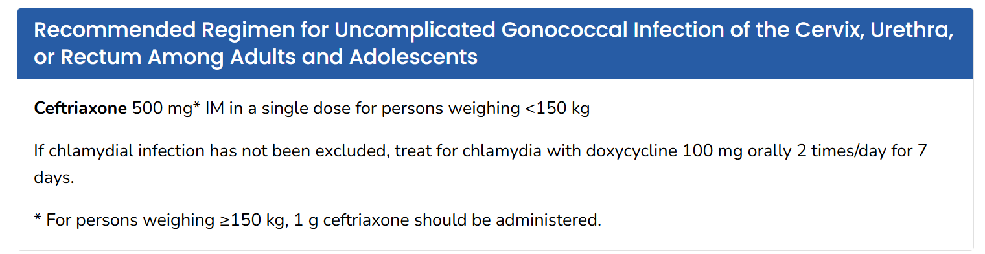
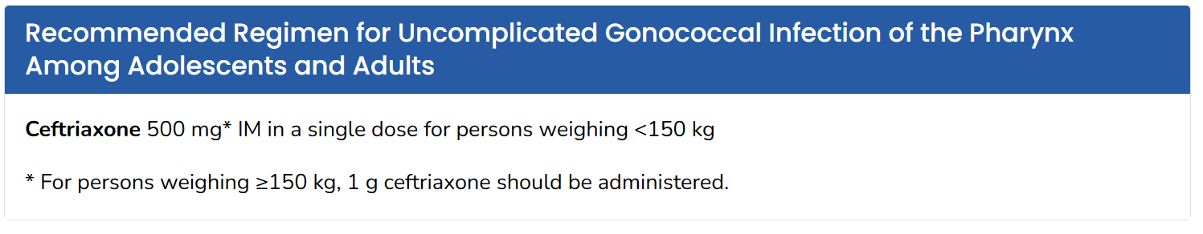
Management

Slide 22
Additional scenarios
What if ceftriaxone is not available?
  Cefixime 800 mg PO x 1 dose and a test of cure * (in 14 days)
  What about zoliflodacin or gepotidacin?
When should he be retested?
  3 months with STI and HIV testing detects new STIs in people. Retesting is not a test of cure.
How should his partners be managed?
  Options: EPT for GC via shared decision making, encourage full testing
*Test of Cure: within 14 days to see if treatment was effective.

Slide 23
Case: Elliot
About 10 days after treatment, he returns to clinic with continued cloudy discharge.
He is tested again for gonorrhea, chlamydia, and also for Mycoplasma genitalium. His urine NAAT is again positive for gonorrhea. All other testing is negative.
What do we do now?

Slide 24
Case: Elliot
At what point are you concerned about AMR gonorrhea?
Were treated with recommended ceftriaxone
Did not have additional sexual contact
Still have + culture or NAAT
You can resend NAAT or culture
If positive, contact CCN or CDC
They will recommend retreatment

Slide 25

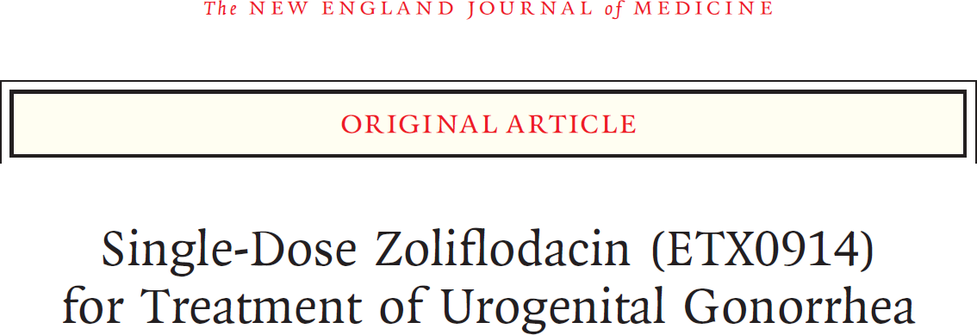
New treatments for GC
Blujepa (gepotidacin) 3g PO Q12H x 2 doses
Nuzolvence (zoliflodacin) 3 g of granules dissolved in water PO X 1

Slide 26
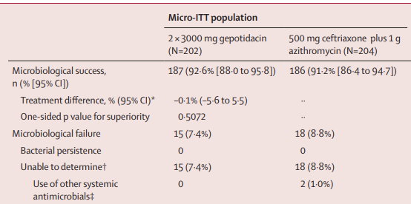

Slide 27
Spiropyrimidinetrion antimicrobial agent
Acts by inhibiting “microbial biosynthesis by arresting the cleaved covalent gyrase complex and the formation of fused circular DNA required for biosynthesis.”
Treatment with ceftriaxone 500 mg IM x 1 or zoliflodacin 2 g PO or 3 g PO x 1
dose.
AKA “Zoli”

Slide 28
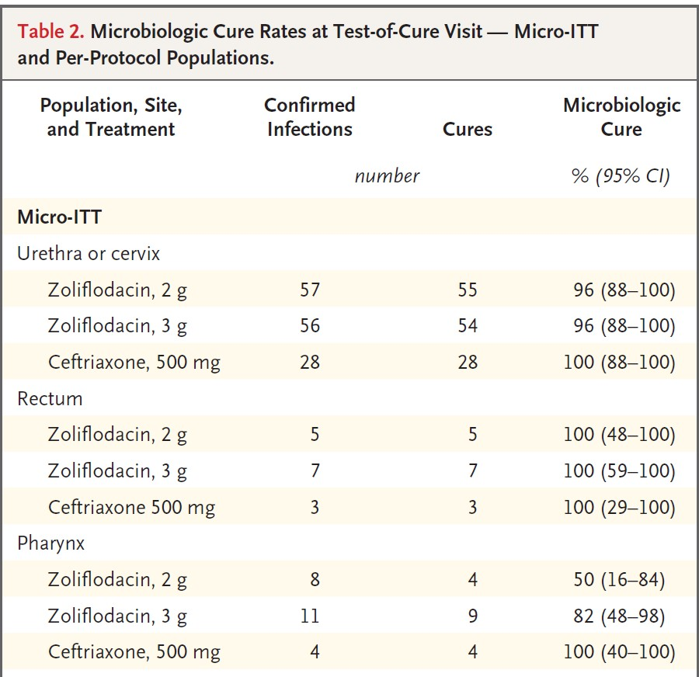

Slide 29
Case 3
My patient continues to have positive testing for Mycoplasma genitalium. Help!

Slide 30
Case # 3: Cathy lives in the BRONX
22-year-old cisgender woman who presents for prenatal care at 7 weeks gestation.
Her pap/culture +trichomonas and +m. genitalium. She was treated now with 3X azithromax but M. genitalium persists. She denies vaginal discharge or cervicitis, or lower pelvic pain.
“As you know, the alternative treatments for M. genitalium are not recommended in pregnancy and this seems like an incidentally found infection, not clinical. I was inclined to wait until postpartum to treat her further.”
I was wondering if you could shed any light from the pediatric perspective? Is there any concerns from your end or recommendations for treatment during labor itself?
Partners: Information not obtained, vaginal receptive / oral **
Past history: Has had one pap smear a few years ago
Physical exam is normal.

Slide 31
Case # 3: Cathy
Narrative Review. Medicine®
A review on effect and treatment of perinatal Ureaplasma urealyticum colonization/infection in neonates
Mengmeng Zhang, MSca , Yingjie Wang, MSca, Yuqian Wang, MSca, Junli Liu, MSca, Yanhong Wang, MScb, Li Zhang, MSca,*

Slide 32
A review on effect and treatment of perinatal Ureaplasma urealyticum colonization/infection in neonates

Slide 33
Case # 3: Cathy pregnant with M. genitalium
What would you do?
A. Oral Moxifloxacin 400 mg daily x 7 days
B. Doxycycline 100 mg twice daily x 7 days followed by Moxifloxacin
C. Doxycycline 100 mg twice daily x 7 days follow by Azithromycin
D. Wait until she delivers, then treat

Slide 34
ORIGINAL STUDY
Prevalence and Factors Associated With Mycoplasma genitalium Infection in At-Risk Female Adolescents in Bronx County, New York
Menezes, Melissa E. MD∗,†; Silver, Ellen J. PhD†,‡; Goldstein, D. Yitzchak MD†,§; Collins-Ogle, Michelle D. MD†,¶; Fox, Amy S. MD†,§; Coupey, Susan M. MD∗,†
Sexually Transmitted Diseases 50(10):p 635-641, October 2023. | DOI: 10.1097/OLQ.0000000000001840
Of 153 participants mean age 18.07 ± 1.68 years
58% self-identified as Hispanic, 27% Black, 64% straight/heterosexual, 27% bisexual, 1% gay/lesbian, 29% reported a prior STI diagnosis.
Prevalence of M. genitalium was 11.1% (17/153)
    13 of 17 were asymptomatic, 2 of 17 had pelvic inflammatory disease (PID), 3 of 17 coinfected with chlamydia or gonorrhea.
    Prevalence of chlamydia was 6.6% and of gonorrhea 2.6%. A logistic regression model indicated independent associations of bisexual orientation versus all other orientations (adjusted odds ratio [aOR], 4.80; 95% confidence interval [CI], 1.38–16.67), self-reported prior STI (aOR, 3.83; 95% CI, 1.10–13.37), and self-reported prior PID (aOR, 9.12; 95% CI, 1.02–81.72) with higher odds of M. genitalium infection.

Slide 35
Case # 3: Cathy
Resistance-Guided Therapy
      1. Doxycline 100 mg PO twice daily x 7 days (followed by Azithromycin or Moxifloxacin)
      2. If macrolide sensitive: Azithromycin 1 g on day 1, followed by 500 mg daily x 3 days
    3. If Macrolide resistant / unknown: Moxifloxacin 400 mg daily x 7 days
    Test of cure 2-3 weeks after completing oral therapy
    Management for Cathy: Moxifloxacin 400 mg x 10 days

Slide 36
Mycoplasma genitalium treatment considerations in pregnancy
Doxycycline - No, just no! Particularly after 13-15 weeks
      Risk of fetal tooth discoloration, enamel hypoplasia
      Potential stunted bone growth
Moxifloxacin - Generally not recommended (Cathy is 7 wks)
      Potential risk of joint / cartilage damage in fetus
      discouraged because of theoretical risks seen in amimal models and data in humans is limited but in these situations, the benefits outweigh the risks.

Slide 37
Case 4
A young woman is being seen in our clinic for STI screening. How do I ensure a comprehensive evaluation for syphilis?

Slide 38
Case: Julie
25-year-old woman has no symptoms. She denies any rash, vulvar lesions, ulcers, vaginal discharge but just wants testing.
Partners: She reports 2 cisgender male sexual partners in the last 3 months,
Past history: Has had one pap smear a few years ago
Practices: “You know, sex”
Pregnancy planning: “Oh no, I don’t want to get pregnant”
Protection: uses condoms occasionally
Physical exam is normal.

Slide 39
Case: Julie
Her RPR is reactive at 1:256, with reactive TP-PA, nonreactive HIV test, negative G/C NAAT. You call the health department, and she has no previous RPRs on file. When you do a neuro review of systems, she states that she has been having some vision changes which she describes as floaters and double vision at times, and that she has had a headache more frequently within the last week which she attributed to stress. The rest of her neuro ROS is benign.
What should you do?
1 shot 2.4 million units Bicillin as outpatient
3x weekly 2.4 million units Bicillin as outpatient
Admit for LP and IV Penicillin G for 2 weeks
Admit for IV Penicillin G for 2 weeks without LP

Slide 40

Is anyone using rapid testing for syphilis?

Slide 41

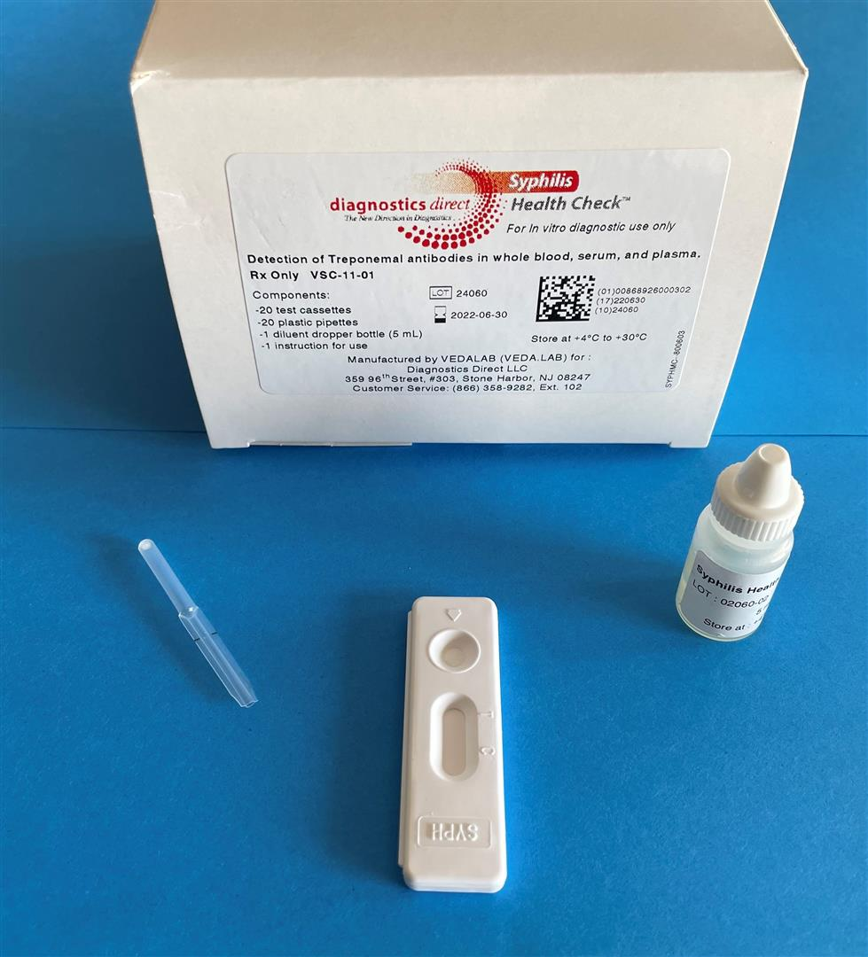




Background – Syphilis Health Check™ (SHC)
Image Source: Diagnosticsdirect2u.com
First FDA approved POC syphilis test
Detects IgM/IgG to T. pallidum using protein A conjugate to create Ag/Ab complex
10 minutes (Result valid for 5 min)
30-month shelf life
$200/kit ($10/test), $29/controls
Bristow CC, Klausner JD, Tran A. Clinical Test Performance of a Rapid Point-of-Care Syphilis Treponemal Antibody Test: A Systematic Review and Meta-analysis. Clin Infect Dis. 2020 Jun 24;71(Suppl 1):S52-S57. doi: 10.1093/cid/ciaa350. PMID: 32578863; PMCID: PMC7312211.
Notes:
Now, to give additional details for the FDA approved POC syphilis tests. The Syphilis Health Check is the first FDA approved POC syphilis test. It detects IgM and IgG to T pallidum using protein A conjugate and creates an antigen-antibody complex. It is treponemal only, so cannot determine between new versus past syphilis infection.
It is quick test; it takes 10 minutes to perform, and results are valid for 5 minutes. The shelf-life is 30 months and the cost is about 200/kit. And the controls are 27-49 dollars. The controls need to be performed pretty regularly; per the packet, some indications includ with a new user, every month, if it has been a while since one of the test performers has done the test, and then there are some other indications for using the controls.

Slide 42
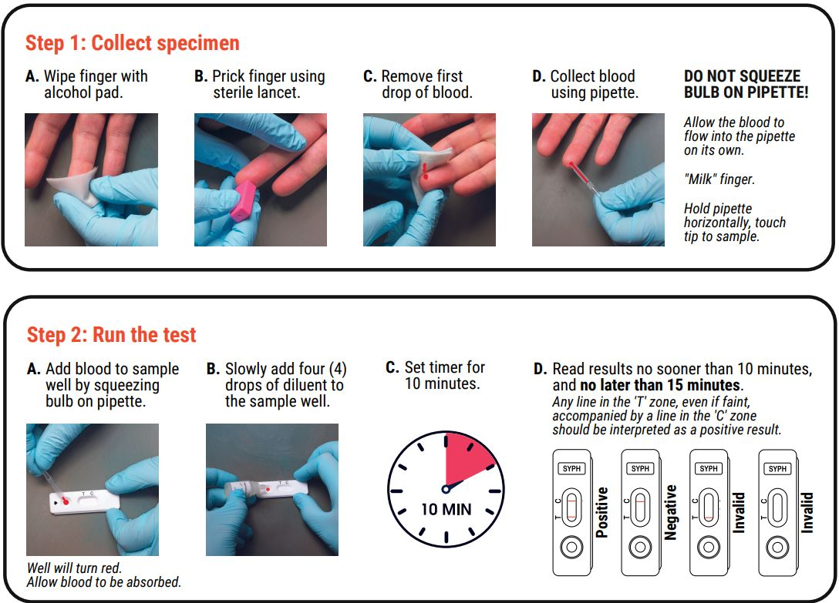
Syphilis Health Check™ (SHC)
SHC Package insert: downloadhttps://www.diagnosticsdirect2u.com/downloadmanager/download.aspx?id=1.aspx (diagnosticsdirect2u.com)
Notes:
This is how it is performed, pretty simple You prick the finger, use the pipette to collect the blood, drop it onto the test and then add the diluent to the sample well and set a timer for 10 minutes. After 10 minutes, you have 5 minutes to read the result, which might be challenging if you’re in a busy clinic. And through Ina’s experience using the SHC, sometimes a ghost line appears after that 5 minute period, making it look like a positive test.

Slide 43
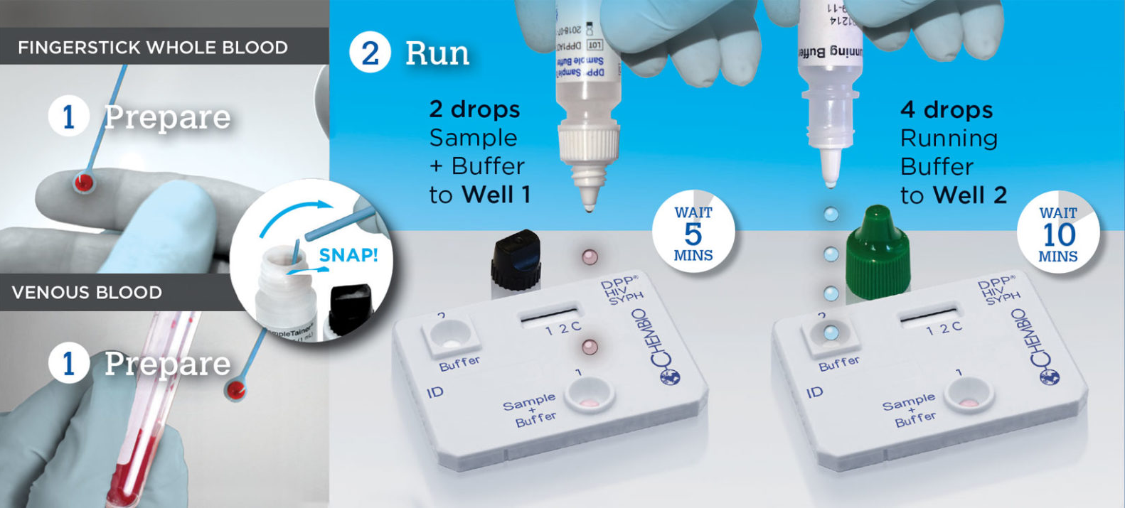
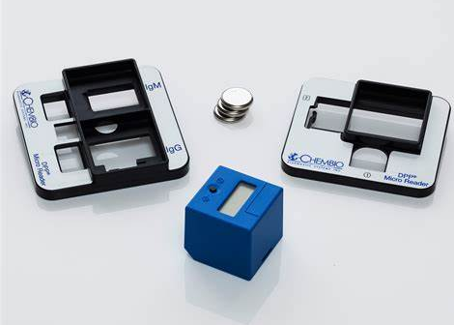
Background – Chembio DPP® HIV/Syphilis
Detects IgM/IgG to T. pallidum using protein A conjugate to create Ag/Ab complex
15 minutes (Result valid for 15 min)
24-month shelf life
$286/kit, $75/controls, $499/microreader (good for 3000 tests)
Created by Hopkins
from the Noun Project
Information & Photos sourced from https://chembio.com/wp-content/uploads/2020/10/dpp-hiv-syph-protocols-2048x715.jpg
Notes:
Chembio Dual Path Platform HIV-Syphilis received FDA approval at the end of 2020. The mechanism of action is similar. This test takes 15 minutes versus the 10 minutes for the SHC and is slightly more complicated. The test is valid for a longer time, 15 minutes, and Chembio requires an automated reader, seen in the bottom picture, that allows ease of interpretation. The shelf-life is shorter than the SHC at 24 months (versus 30) and the cost is somewhat similar but maybe cheaper for the tests, but the controls are more expensive.

Slide 44
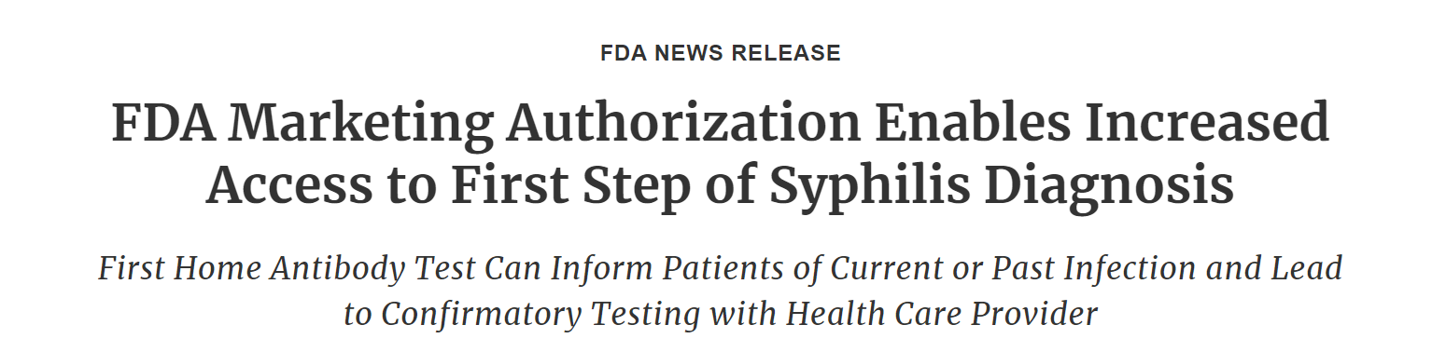

Drop of blood
Trep Ab
15 min
Results at home

Slide 45
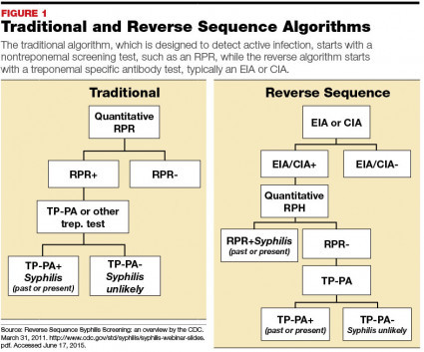
Syphilis testing:
Straight from the 1900s
False positive RPR
Pregnancy
IV (intravenous) drug use
TB (Tuberculosis)
Chronic liver disease
Vaccinations (including COVID)
Endocarditis

Slide 46

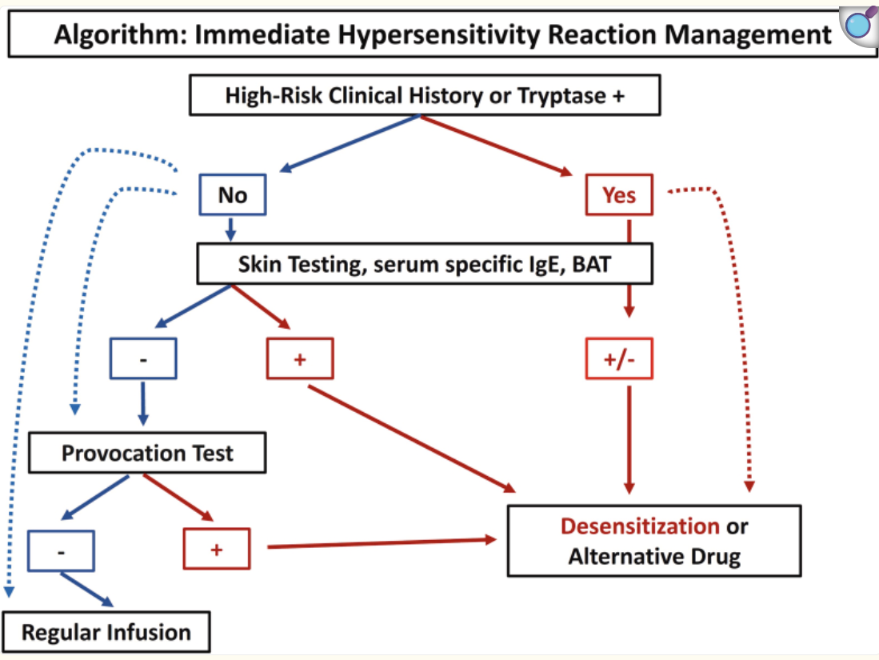
Clinical challenges
Penicillin allergies are a barrier
10% people have pen allergy but when tested only 1% have a reaction
Penicillin allergy delabeling is needed!
An allergist may be needed
He J, et al. Quality and Consistency of Penicillin Allergy Delabelling Guidelines: A Systematic Review. Clin Exp Allergy. 2026 Mar 6.
Gehlen B, et al. Effectiveness and safety of algorithm for treating pregnant women with syphilis and history of immediate allergy to penicillin. J Allergy Clin Immunol Glob. 2025 Sep 26;4(4):100572.

Slide 47
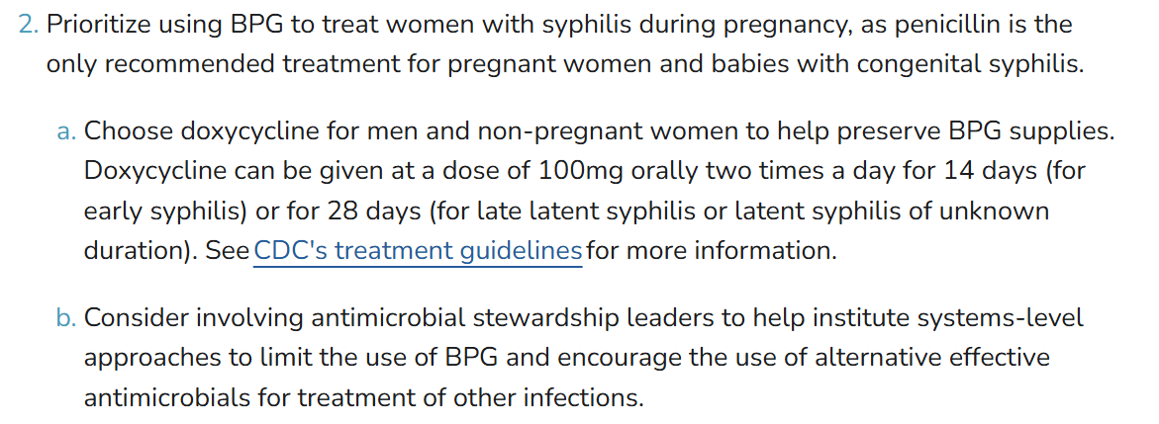
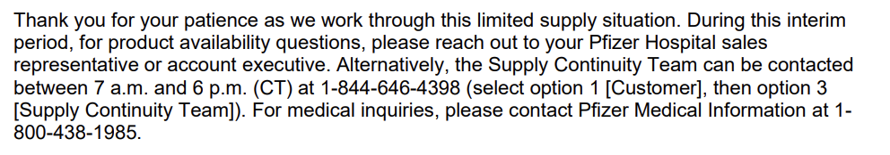
Guidance for the shortage (CDC and Pfizer)

Slide 48
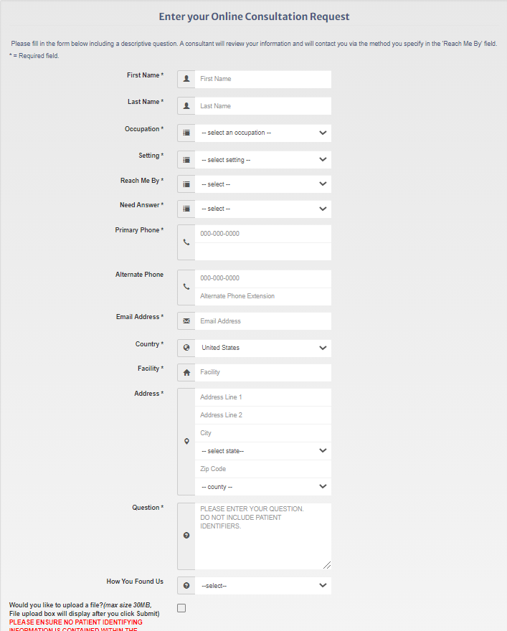
For further training and/or technical assistance requests:
https://stdccn.org

Slide 49
No-cost online clinical consultation on the prevention, diagnosis, and treatment of STIs by your Regional PTC Clinical Faculty.
www.STDCCN.org

Slide 50
References:
CDC STI Treatment Guidelines, MMWR 2021
CDC STD Laboratory Guidelines 2014
Bamberger DM, Graham G, Dennis L, Gerkovich MM. Extragenital Gonorrhea and Chlamydia Among Men and Women According to Type of Sexual Exposure. Sex Transm Dis. 2019 May;46(5):329-334
Bachmann et al. CID 2015:61 (S8)
Manhart LE, et al. Mycoplasma genitalium in the US (MyGeniUS): Surveillance Data From Sexual Health Clinics in 4 US Regions. Clin Infect Dis. 2023 Nov 17;77(10):1449-1459
Kissinger P et al. Lancet Infect Dis 2018; 18: 1251–59

