Slide 1
Hepatitis C in Pregnant Women and Infants
Dr. Audrey Lloyd, MD
Assistant Professor of Medicine
University of Alabama at Birmingham
Southeast AETC

Slide 2
Disclosures
This program is supported by the Health Resources and Services Administration (HRSA) of the U.S. Department of Health and Human Services (HHS) under grant number TR7HA53203-01-00 as part of an award totaling $5.7m. The contents are those of the author(s) and do not necessarily represent the official views of, nor an endorsement, by HRSA, HHS, or the U.S. Government. For more information, please visit HRSA.gov.
“Funding for this presentation was made possible by cooperative agreement TR7HA53203-01-00 from the Health Resources and Services Administration HIV/AIDS Bureau. The views expressed do not necessarily reflect the official policies of the Department of Health and Human Services nor does mention of trade names, commercial practices, or organizations imply endorsement by the U.S. Government. Any trade/brand names for products mentioned during this presentation are for training and identification purposes only.”
This content is owned by the AETC and is protected by copyright laws. Reproduction or distribution of the content without written permission of the sponsor is prohibited and may result in legal action.

Slide 3
Disclosures
All planners, faculty, and others in control of educational content are required to disclose all their financial relationships with ineligible companies within the prior 24 months. An ineligible company is defined as one whose primary business is producing, marketing, selling, re-selling, or distributing healthcare products used by or on patients. Financial relationships are relevant if the educational content an individual can control is related to the business lines or products of the ineligible company.
None of the planners, faculty, and others in control of educational content for this educational activity have relevant financial relationship(s) to disclose with ineligible companies.
The material presented in this course represents information obtained from the scientific literature as well as the clinical experiences of the speakers. In some cases, the presentations might include discussion of investigational agents and/or off-label indications for various agents used in clinical practice. Speakers will inform the audience when they are discussing investigational and/or off-label uses.
Disclosure of a relationship is not intended to suggest or condone commercial bias in any presentation, but it is made to provide participants with information that might be of potential importance to their evaluation of a presentation.

Slide 4
Disclosures
The Health Resources and Services Administration (HRSA), Department of Health and Human Services (HHS) provided financial support for this project. The award provided 100% of total costs. The contents are those of the author. They may not reflect the policies of HRSA, HHS, or the U.S. Government.
Dr. Lloyd’s institution receives grant funding from Gilead Services Inc to support universal community Hepatitis C testing.

Slide 5
AETC Program National Centers and HIV Curriculum
National AETC Support Center (NASC) – serves as the central web –based repository for AETC Program training and capacity building resources; its website includes a free virtual library with training and technical assistance materials, a program directory, and a calendar of trainings and other events. Learn more: https://aidsetc.org/
National Clinical Consultation Center (NCCC) – provides free, peer-to-peer, expert advice for health professionals on HIV prevention, care, and treatment and related topics. Learn more: https://nccc/ucsf.edu or call 844-ASK-NCCC
National HIV Curriculum (NHC) – provides ongoing, up –to-date HIV training and information for health professionals through a free, web –based curriculum; also provides free CME credits, CNE contact hours, CE contact hours, and maintenance of certification credits. Learn more: www.hiv.uw.edu

Slide 6
Learning Objectives
Name at least 3 ways in which hepatitis C negatively affects pregnant women and their infants, especially in your state.
List 3 ways in which treatment for hepatitis C in pregnant and postpartum women has become more accessible.
Explain 3 barriers still keeping pregnant and postpartum women from accessing hepatitis C care in your area of practice.
Apply the information in this talk to identify 1-2 interventions which could improve access to hepatitis C cure in this population. These can be from strategies shown to improve care outcomes in other marginalized and vulnerable populations.

Slide 7
Hepatitis C (HCV) Epidemiology
Learning Objective
1. Name at least 3 ways in which hepatitis C negatively affects pregnant women and their infants, especially in your state

Slide 8
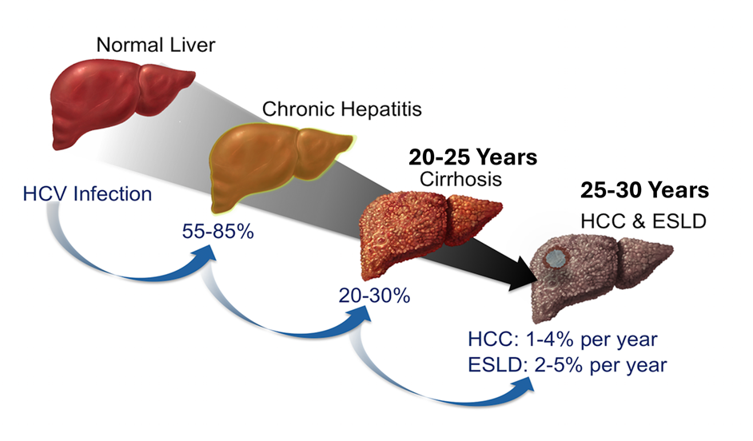
Hepatitis C Virus (HCV)
Natural history of untreated HCV infection
Bloodborne RNA Virus – Family Flaviviradae
Usually asymptomatic
Cirrhosis, End Stage Liver Disease (ESDL), cancer, death
Estimated to cost the US $10 BILLION per year
11,000 Deaths in 2023
Can Be CURED
David H. Spach, Natural History of Untreated Hepatitis C Infection University of Washington Hepatitis C Online https://www.hepatitisc.uw.edu/go/test-cure/natural-history-epidemiology/core-concept/all#natural-history
Notes:
Zoom questions prior to this slide
With the advent of a safe and effective cure for Hepatitis C (HCV), rates of Hepatitis C in pregnant women have
Continued to increase
Started to decline
Stayed about the same
There is too little HCV in pregnant women to be sure

Slide 9
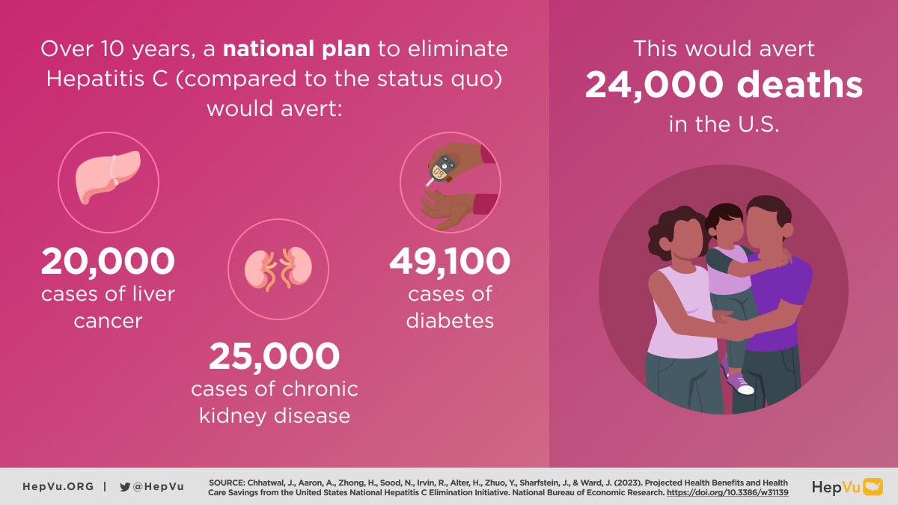
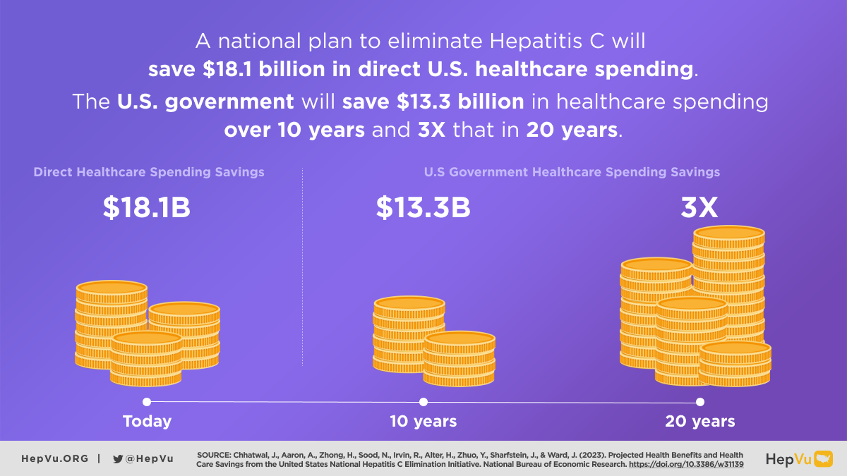
Elimination is the Goal!
Viral Hepatitis National Strategic Plan.
Eliminate HCV in the US by 2030.
We are not on track.
Chhatwal et al. National Bureau of Econnomic Research. 2023
HepVu https://hepatitiselimination.hepvu.org/

Slide 10
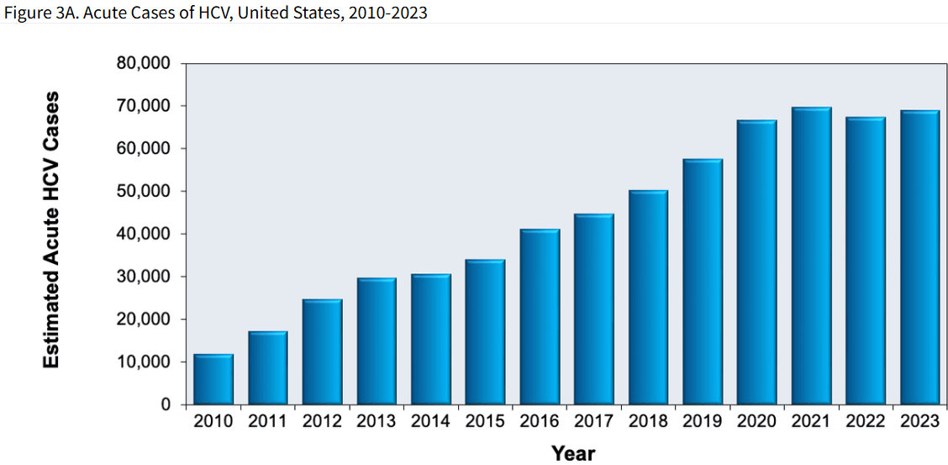
Hepatitis C Trends in the US
Notes:
While deaths from HCV have been declining thanks to safe and effective cure through Direct Acting Antivirlas or DAA’s
Cases of Hepatitis C are likely continuing to increase largely through the opioid epidemic.

Slide 11
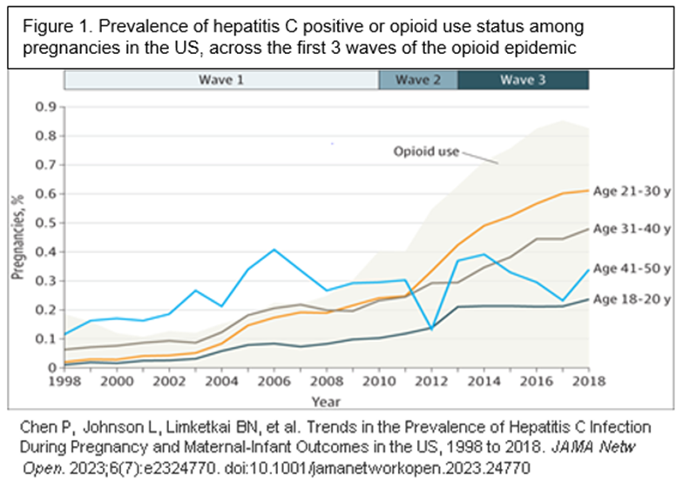
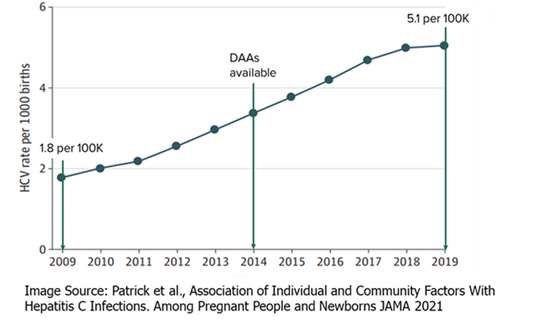
HCV is an Emerging Epidemic in Pregnancy
HCV rates have increased 16-fold in pregnant people since 1998.
Continue to rise despite a safe well tolerated cure (DAA’s).
Strongly linked to the opioid epidemic and injection drug use.
0.51% of pregnancies.

Slide 12
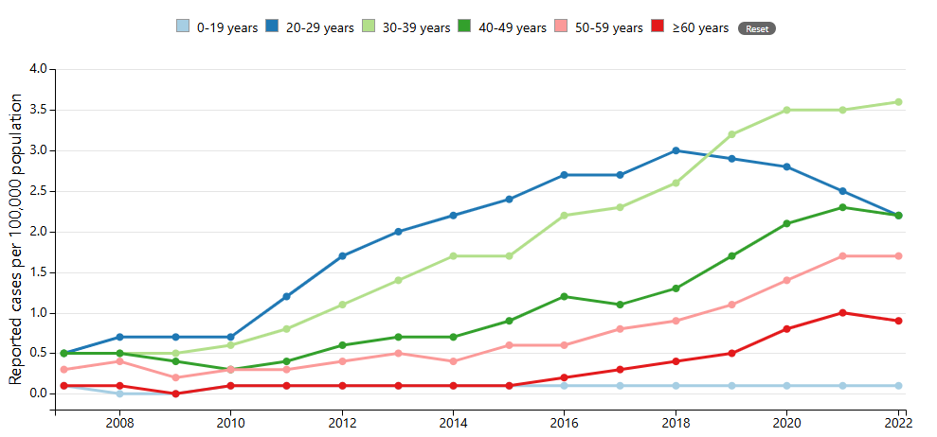
Changing Epidemiology and Transmission
Prior to 1992, transfusions were the main source of HCV infection in the US.
      Seen in the “Baby Boomers”
Now transmission occurs most commonly by percutaneous exposure to blood.
    Injection Drug Use (IDU)
    Incarceration
    Tattooing in unregulated places
    Sexual Contact- especially receptive anal sex
Persons aged 20-39 years have the highest incidence of acute HCV infection.
Image Source: CDC Viral Hepatitis https://www.cdc.gov/hepatitis/statistics/2020surveillance/hepatitis-c/figure-3.4.htm

Slide 13
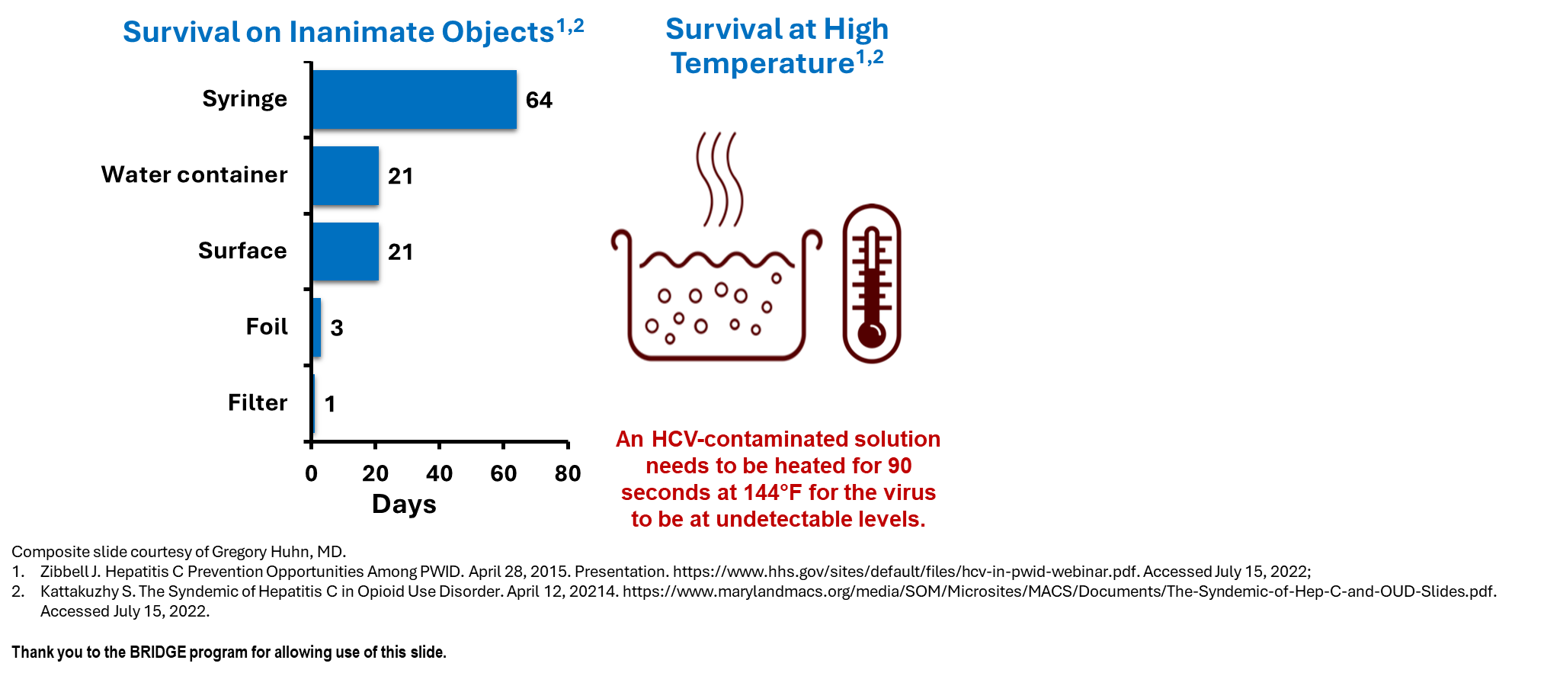
Transmission Continued
HCV is well suited to spread with injection drugs use.
Injection equipment can also be contaminated.

Slide 14
HCV Screening in Pregnancy
Learning Objective
1. Name at least 3 ways in which hepatitis C negatively affects pregnant women and their infants, especially in your state

Slide 15

New Screening Guidelines!
New Recommendations!
Universal screening for all pregnant women with each pregnancy*
Universal screening for adults 18 years and older*
  Previously risked based until April, 2020
Additional one-time screening
          People with HIV
People who ever injected drugs and shared needles, syringes, or other drug preparation equipment, including those who injected once or a few times many years ago
People with selected medical conditions, including:
people who ever received maintenance hemodialysis
people with persistently abnormal ALT levels
Prior recipients of transfusions or organ transplants, including before 1992
*except in settings where the prevalence of HCV infection (HCV RNA‑positive/detected) is less than 0.1%*
Bhattacharya, D et al AASLD-IDSA HCV Guidance Panel, Hepatitis C Guidance 2023 Update CID, 2023
Panagiotakopoulos, L et al., J Womens Health, 2024

Slide 16
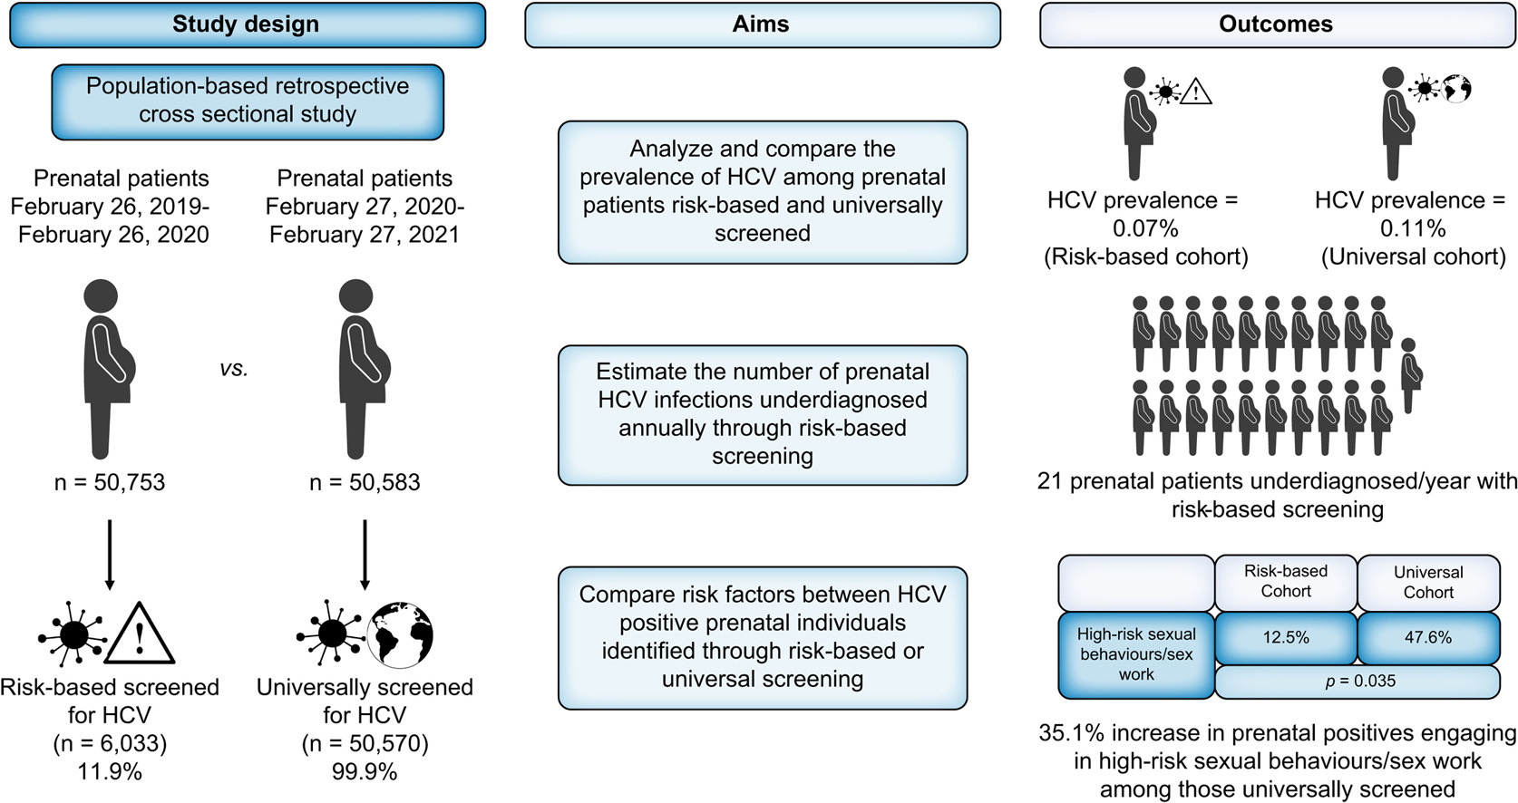
Risk-Based vs Universal Screening
Alberta Canada able to increase HCV screening in pregnancy from 11.9% to 99.9%
Risk based screening still misses at risk individuals
Thompson, L et al. J of Hepatology. 2023

Slide 17
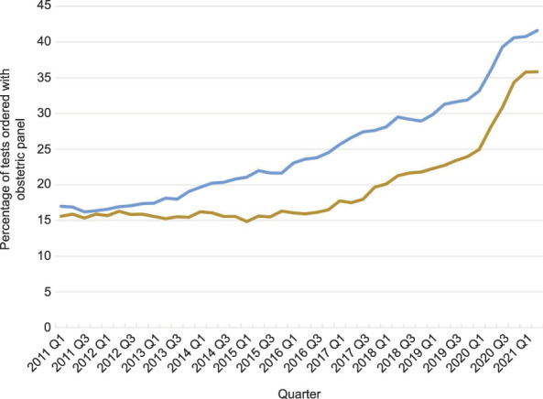
Universal Testing Continued
Pregnant persons with an obstetric panel test combined with hepatitis C virus antibody screens (percentage), by commercial insurance (blue line) and Medicaid insurance (brown line): quarter (Q) 1 2011 through Q2 2021.
Kaufman et al. 2022
Evaluated 5,048,428 pregnant women aged 15-44 with an obstetrics panels from Quest Diagnostics
Increased HCV testing rates significantly
○16.6% in 2011 to 40.6% in 2021
Still significant gap in testing especially in women with Medicaid
Kaufman et al. Obstet Gynecol 2022.

Slide 18
Impact of HCV on Pregnancy
Learning Objective
1. Name at least 3 ways in which hepatitis C negatively affects pregnant women and their infants, especially in your state
Notes:
Add in a question here.
HCV during pregnancy has been associated with increased risk of
Chorioamnionitis
Preterm labor
Intrahepatic cholangitis of pregnancy

Slide 19
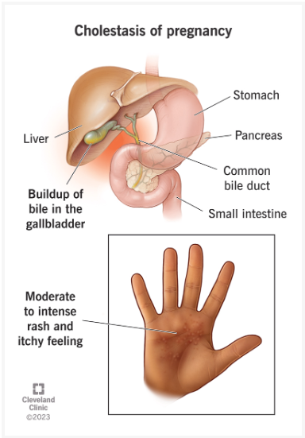
Hepatitis C and Pregnancy
Intrahepatic cholestasis of Pregnancy
  Bile flow slows, causing bile acids to build up in the blood and skin
  Severe itching, increased preterm birth, and infant mortality
Increased risk in women with HCV
  OR of 20.4
Sarkar, M Et al. Hepatology. 2021
Wijarnpreecha K et al. Clin Res Hepatol Gastroenterol 2017
Flemming JA et al. Gastroenterology 2020
Image source Cleveland Clinic https://my.clevelandclinic.org/health/diseases/17901-cholestasis-of-pregnancy

Slide 20
Hepatitis C and Pregnancy
Stokkeland et al. 2017
  Pregnancy outcomes in 5000 women with viral hepatitis
  Increased rates of smoking and alcohol use
  Increased risk of premature birth and late neonatal death (aRR 3.79)
Piffer et al. 2021
  45,493 women 177 with HCV abs
  Increased rates of ICP, low birth weight (OR 2.23), preterm delivery (OR 1.99), fetal hospitalization (OR 4.6), and stillbirth (OR 3.7)
Cheedella et al. 2025
  904 pregnancies with OUD enrolled in integrated Addiction and OB clinic
    404 women with HCV antibody
      140 with viremia
    Found no association with preterm birth and HCV viremia

Slide 21
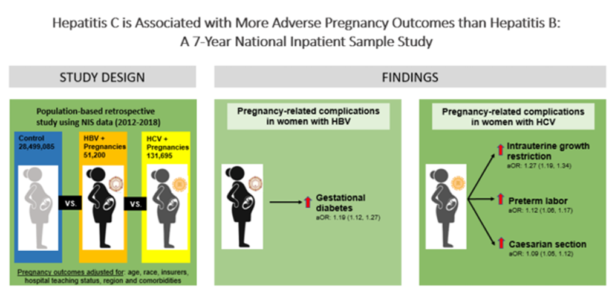
HCV and Pregnancy Outcomes
Chen et al. 2022
National Inpatient Sample 2012-2018
  28,681,980 admissions
  51,200 Hepatitis B (HBV)
  131,695 HCV
  HCV with
    IGR
    Preterm labor
    Caesarian section
Chen et al. Hepatol Commun. 2022

Slide 22
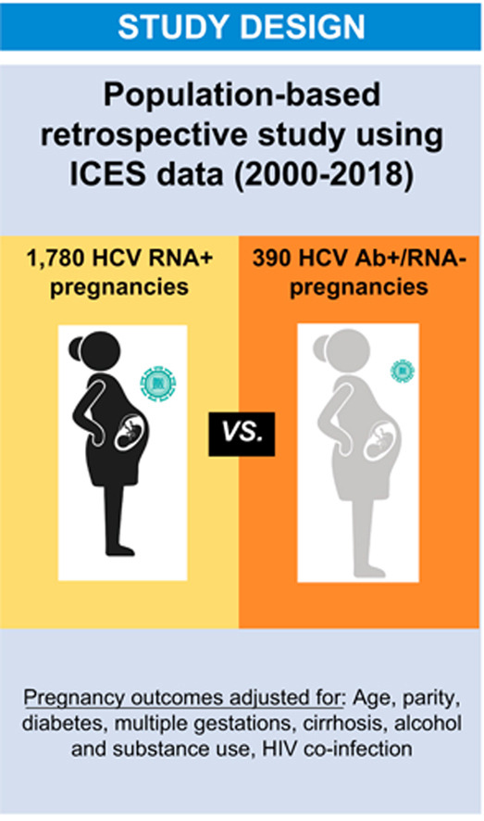
Hepatitis C Viremia and Pregnancy Outcomes
Kushner, 2022
Compared outcomes from pregnant women with only HCV Antibody to pregnant women with HCV RNA+ (HCV exposure only to active infection)
Increased Risk with HCV RNA +
  ICP (OR 4.55)
  Preterm delivery (OR 1.84)
  Postpartum hemorrhage (OR 1.78)
Decreased risk
  Gestational (DM 0.71)
Kushner T, J of Hepatology 2022

Slide 23
Hepatitis C and Stigma
Report feeling scared (80%), shame, (66.7%) and stigmatization (60%) surrounding HCV diagnosis
Reluctance to share their diagnosis
Scared it would negatively affect future pregnancies (83.3%)
Fears of transmission due to pregnancy and breastfeeding
  Even reported fears of transmitting to their older children
“Keep razors/nail clippers to myself. Locked them up.”
“Need to be extremely careful when taking care of children, specifically during my period because of blood.”
Notes:
Women of childbearing age
All reported access to treatment was very important or extremely important

Slide 24
HCV Treatment in Pregnancy and Postpartum Period
Learning Objectives:
2. List 3 ways in which treatment for hepatitis C in pregnant and postpartum women has become more accessible.
3. Explain 3 barriers still keeping pregnant and postpartum women from accessing hepatitis C care in your area of practice.

Slide 25
HCV Can Be Cured!
SVR = sustained virologic response = undetectable virus
SVR12 = SVR at ≥12 weeks after completion of HCV treatment = CURE
Evolution of HCV Treatment
1968ª
1998
2001
2002
2011
Present
SVR12 = HCV cure
SVR Rate, %
  Very difficult to tolerate,
  lots of side effects

Slide 26


State of Medicaid Access to HCV Treatment
Overall Grades 3/2026
Center for Health Law and Policy Innovation & National Viral Hepatitis Roundtable, Hepatitis C: State of Medicaid Access (2025), www.stateofhepc.org

Slide 27
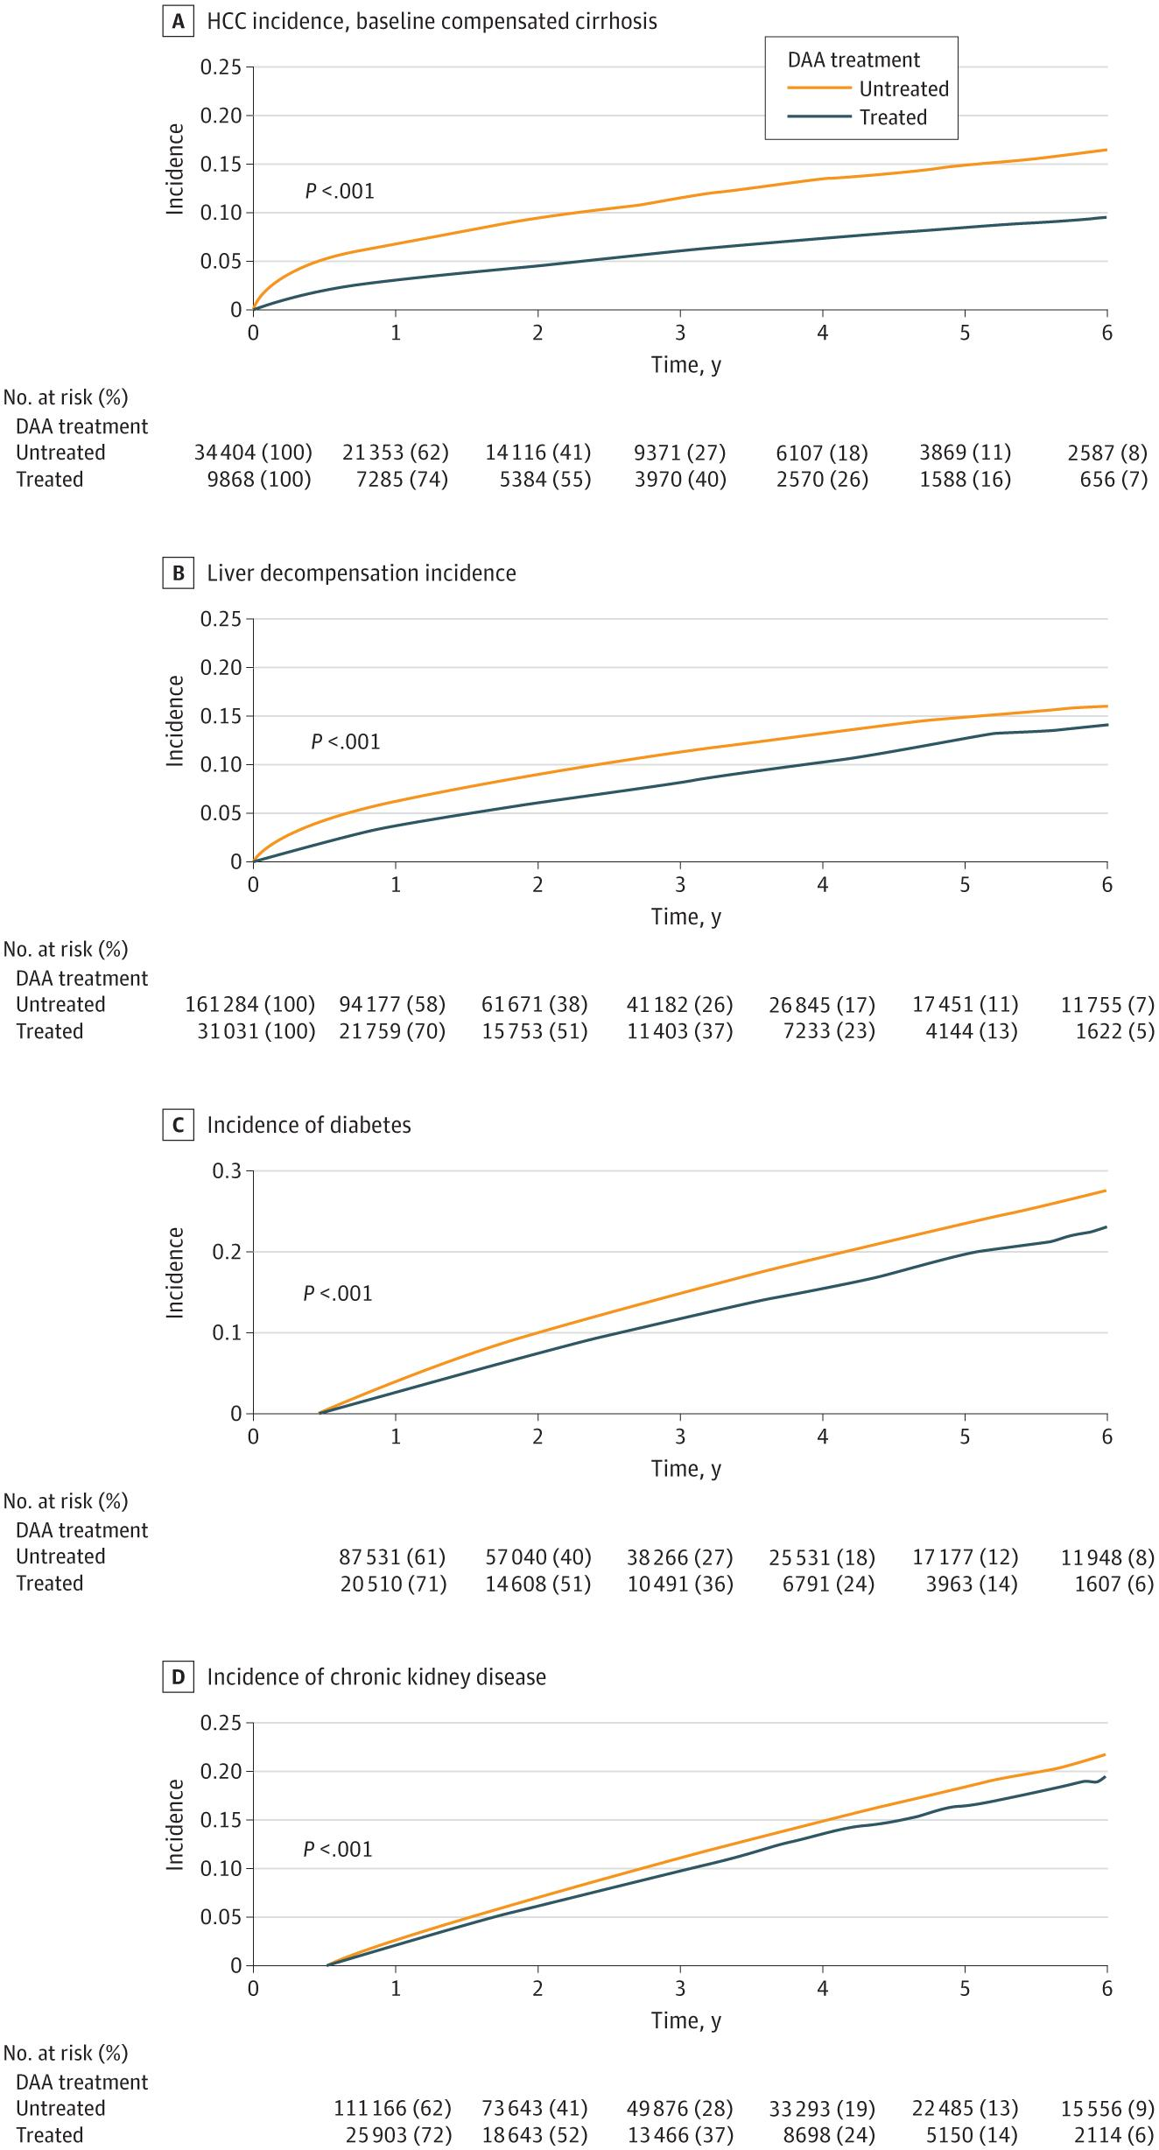
HCV Treatment is Safe and Effective
Direct Anti-Antivirals (DAAs) are >95% effective
Excellent tolerability
  Discontinuation rate <10% and grade 3/4 adverse events <1%
  Do not require lab monitoring
Reduce all cause mortality
Falde-Nwulia, O et al. Ann Intern. 2017
Solomon, S et al. Lancet Gastro Hep. 2022
Chien et al. JAMA Intern Med. 2023

Slide 28
Treatment is recommended for ALL PATIENTS with chronic HCV infection, except those with short life expectancies that cannot be remediated by treating HCV, by liver transplantation, or by other directed therapy. Patients with a short life expectancy owing to liver disease should be managed in consultation with an expert.
--AASLD/IDSA Guidance
Rating: Class I, Level A
Substance use, including active injection drug use,
is NOT a contraindication for HCV treatment.

Slide 29
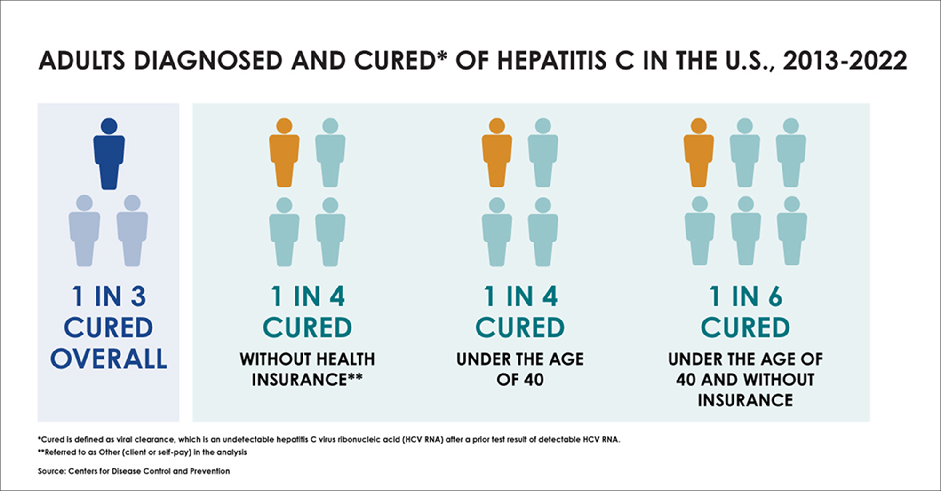

Slide 30
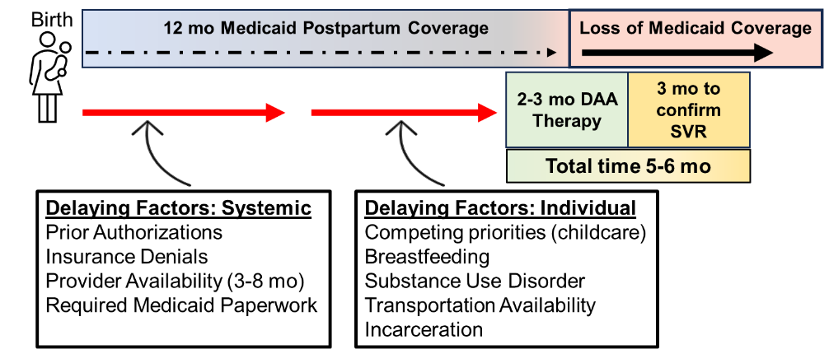
Pregnancy is an Opportunity!
Universally screened for HCV
Increased contact with healthcare
Postpartum Medicaid coverage for 12 months post-delivery
  76-90% of women with HCV
  Previously stopped after 60 days in some states
Manufacturer assistance program (MAP)- cover low income at 100%
Women are not getting to HCV care
Time of increased motivation!
Women want to be treated!
Patrick et al. JAMA Health Forum. 2021
Mitchell M, Severtson SG, Latimer, W. AM J Drug Alcohol Abuse. 2008
Yee et al. PLOS One. 2022
Notes:
Discuss especially true in states without Medicaid expansion

Slide 31
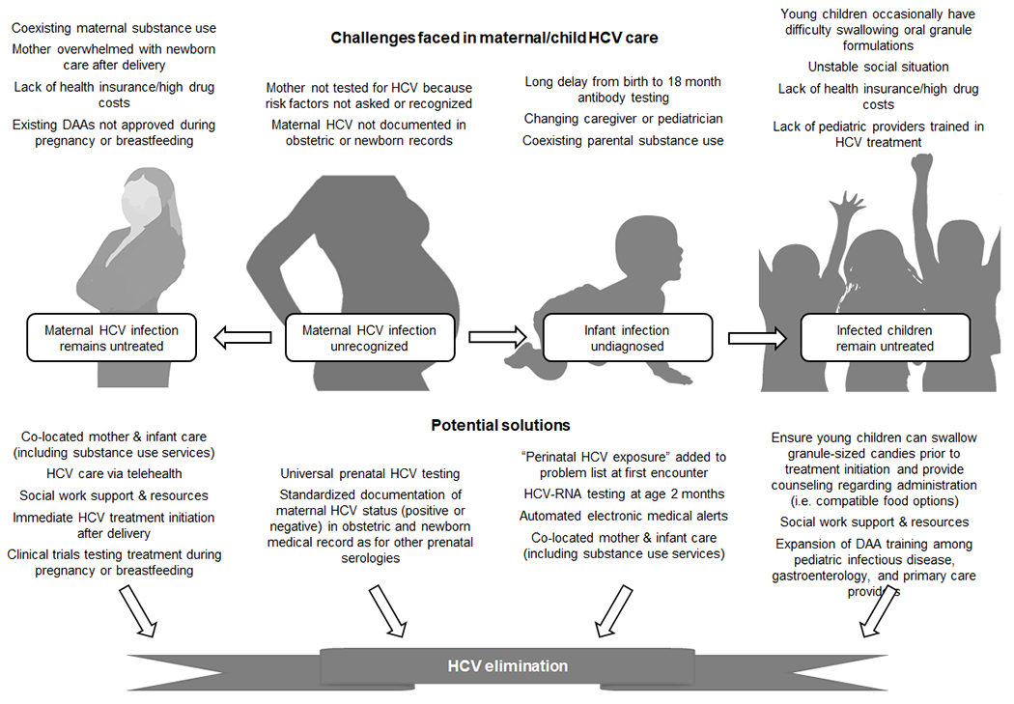
Honegger, J and Gowda, C. Curr Opin Infect Dis. 2022

Slide 32
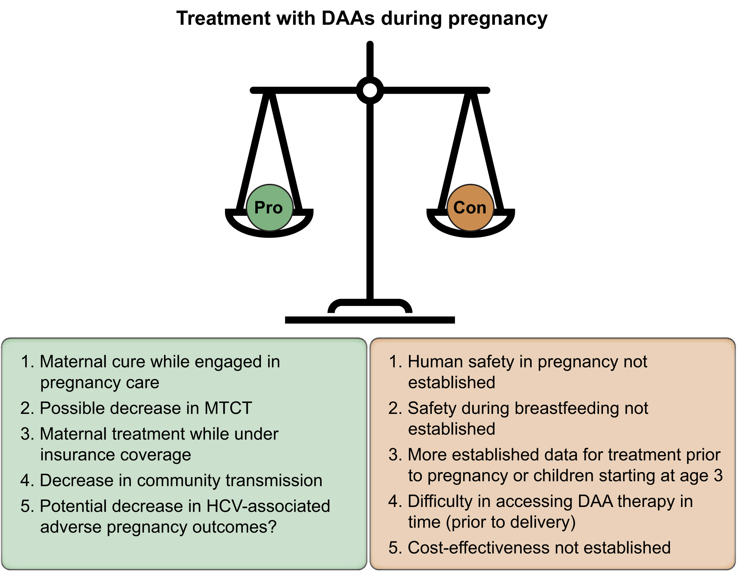
HCV Treatment During Pregnancy
AASLD/IDSA
  “…on an individual basis after a patient-physician discussion about the potential risks and benefits”
Society for Maternal-Fetal Medicine
  “… only be initiated in the setting of a clinical trial during pregnancy”
If a patient becomes pregnant on DAA therapy, counseled in risk vs benefits in a shared decision-making framework.
Kushner, T and Reau, N J of Hepatology, 2021

Slide 33
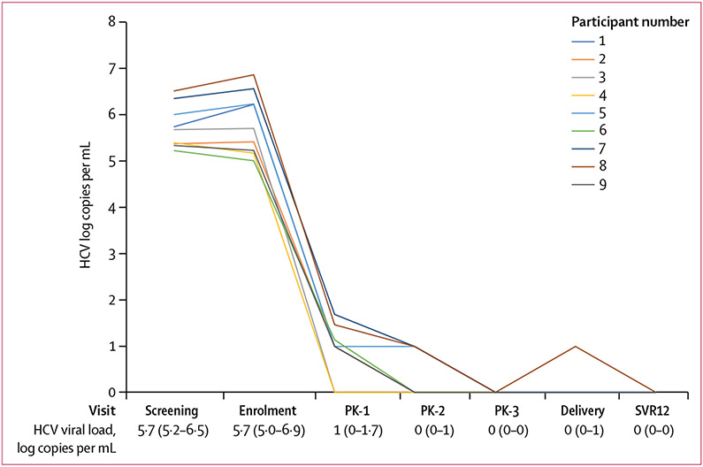
HCV Treatment and Pregnant People
Most studies are case reports or case series
Chappell et al. CROI 2019
  Ledipasvir/Sofosbuvir safety and virologic response in pregnancy
  All 9 who completed medication and delivered achieved SVR 12
  9 infants with no adverse events
Chappell et al. Lancet Microbe. 2020

Slide 34
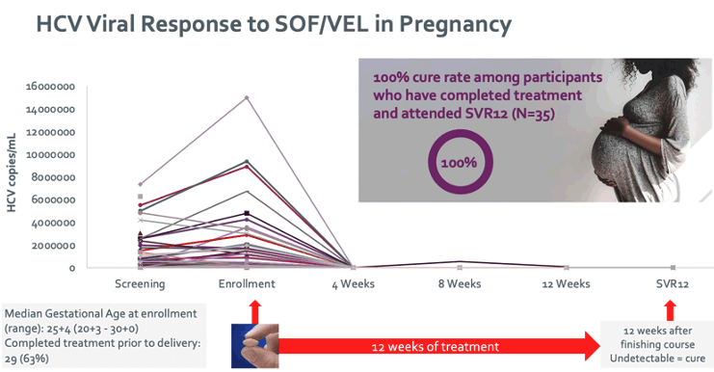
Storc Trial – Sofosbuvir/Velpatasvir (SOF/VEL) Treatment of Chronic Hepatitis C During Pregnancy
Phase 4 multicenter single arm study of SOF/VEL during pregnancy
  Recruitment is almost completed
  Goal to recruit 100 patients
2024 update: 100% women who completed SOF/VEL and attended appointment were cured n=35
Chappell et al The Liver Meeting AASLD 2024

Slide 35
Potential Solutions in the Postpatum HCV treatment
Learning Objective
4. Apply the information in this talk to identify 1-2 interventions which could improve access to hepatitis C cure in this population. These can be from strategies shown to improve care outcomes in other marginalized and vulnerable populations.

Slide 36
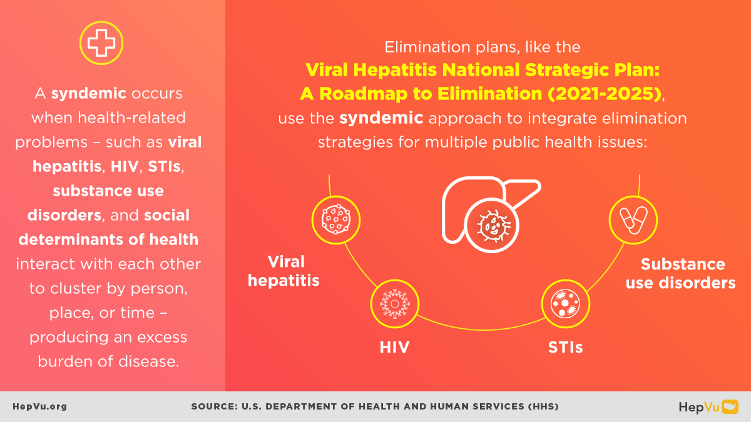
This is a Tough Problem

Slide 37
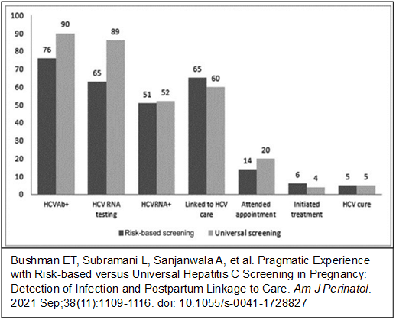
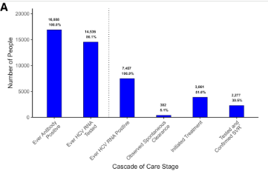
Postpartum Women are Not Being Linked to HCV Care
Predicted probability of receiving any HCV follow-up visit or DAA medication within 6 months of delivery is only 6% among those with SUD and HCV
Treatment uptake is 1.1%, 2.5%, and 5.2% at 1, 2, and 5 years after diagnosis
UAB treating around 9% of postpartum women
Multiple missed opportunities for linkage
Mendlowitz A et al. CID 2025
Jarlenski M et al. Obstetrics and Gynecology 2022.
Mendlowitz A et al. CID 2025

Slide 38
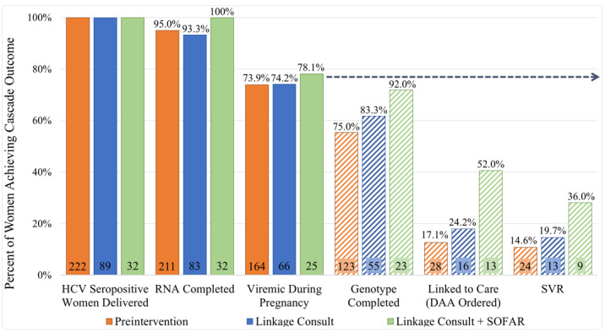
Possible Solutions: Integrated Care
Epstein et al. 2021
Supporting Our Families through Addiction and Recovery (SOFAR) program N=25
  Multidisciplinary Co-located Care Clinic
  Postpartum maternal and pediatric care
Consultation N=66
164 delivered pre-intervention
SVR rates increase from 14.6% to 19.7% to 36%
Epstein et al. Hepatol Commun 2021

Slide 39
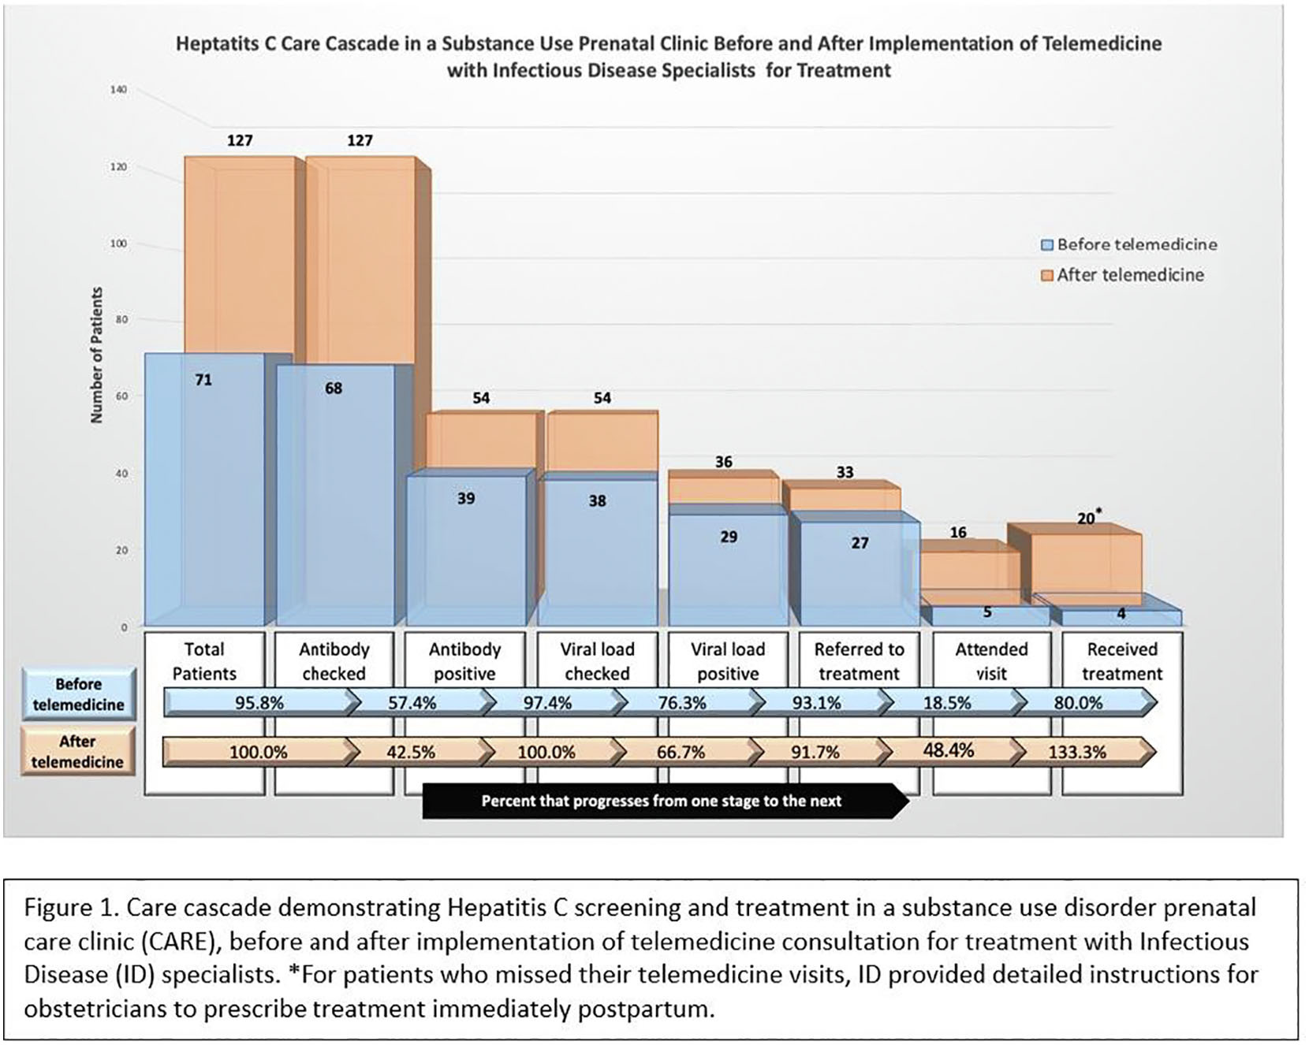
Possible Solutions: Telehealth
Has been shown to be safe in the general population and postpartum women
Trammel et al. 2023
  36 women linked to HCV care through telemedicine
  Infectious Diseases telehealth visits for postpartum women with HCV
  Visit attendance increased from 17.2% to 41.7% (p=0.03)
  DAA prescription from increased 13.8% to 55.6% (p=0.04)
Still a significant gap
Frye et al. 2024
  Telehealth for HCV during COVID with a general population
  Cure rates (SVR12) were >95% on ITT analysis
Trammel et al. AJOG. 2023

Slide 40
Possible Solutions: Integrated Care and Telehealth
Cheedalla et al. 2023
Co-located SUD and Obstetrics program
Linkage to care team linked HCV viremic mother with Infectious Diseases (ID) Specialist through telemedicine
Improved DAA prescription from 0% (0/26) to 44% (15/34)
Obtaining labs and imaging was a barrier only 55% (19/34)

Slide 41
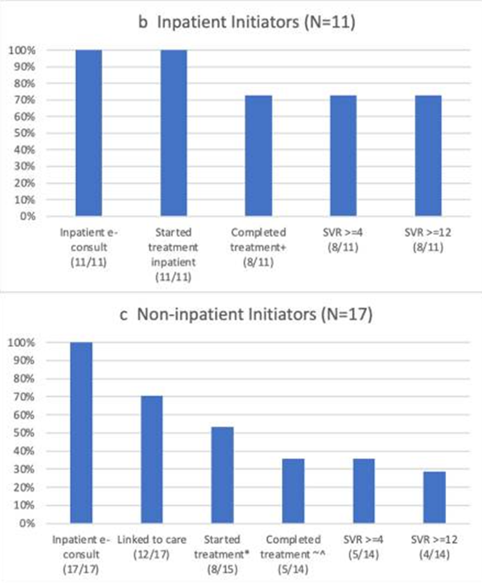
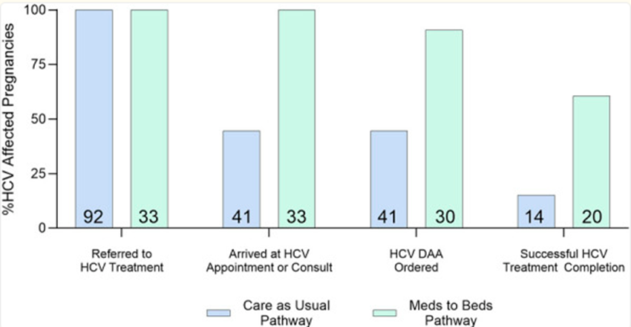
Possible Solutions: Inpatient e-consults
University of North Carolina
99 treatment as usual outpatient referral
33 Inpatient consultation
  Higher rates of DAA completion 66.7% vs 34%
  Increased odds of completing treatment overall
55% of outpatients did not show for their appointment
Increased odds of completion if started inpatient
Mcrary et al. J Gen Intern Med. 2023
McCrary at al. O&G Open 2025.

Slide 42
HCV in Infants and Children
Learning Objectives
1. Name at least 3 ways in which hepatitis C negatively affects pregnant women and their infants, especially in your state
4. Apply the information in this talk to identify 1-2 interventions which could improve access to hepatitis C cure in this population. These can be from strategies shown to improve care outcomes in other marginalized and vulnerable populations.

Slide 43
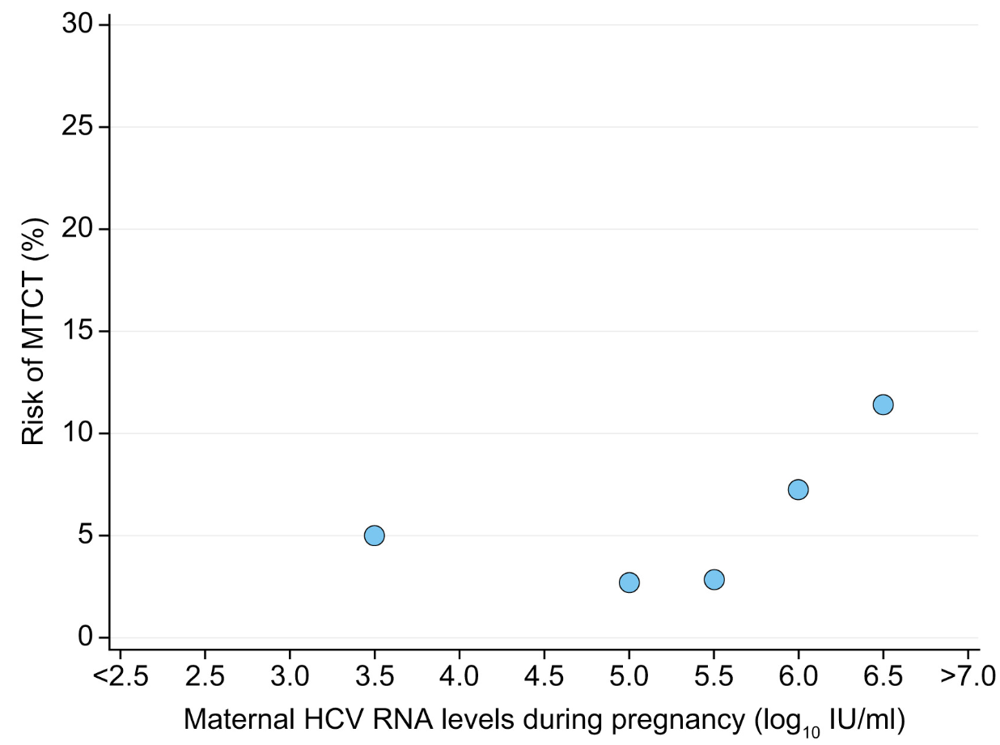
Perinatal Transmission
Benova et al. 2014
  Meta-analysis of 109 articles in 2014
  Rate of perinatal transmission of 5.8%
  Increased to 10.8% with HIV co-infection
Kushner et al. 2022
  Smaller cohort, 3.5% HCV transmission
  Transmission odds increased 3.38 times with HCV RNA ≥6 log₁₀
Increased risk with prolonged rupture of membranes, maternal blood exposure, IV drug use
Discourage fetal scalp monitors or use of methods that increase vaginal/perineal lacerations
Estimated 1,700 perinatal infections yearly in the US
Benova et al. 2014
Kushner et al. Hepatol Commun. 2022
Ly et al. Ann Int Med 2017
Notes:
MTCT is the most common cause of HCV in children

Slide 44
New Guidelines for Testing Infants
Previously antibody-based testing with reflex HCV RNA at 18 months
  Maternal antibody can persist for up to 18 months
  Left a large gap from delivery to testing
Now recommend HCV RNA testing
  Screen as early as 2 months
Can treat as early as 3 years old!
Panagiotakopoulos et al. MMWR, 2023

Slide 45
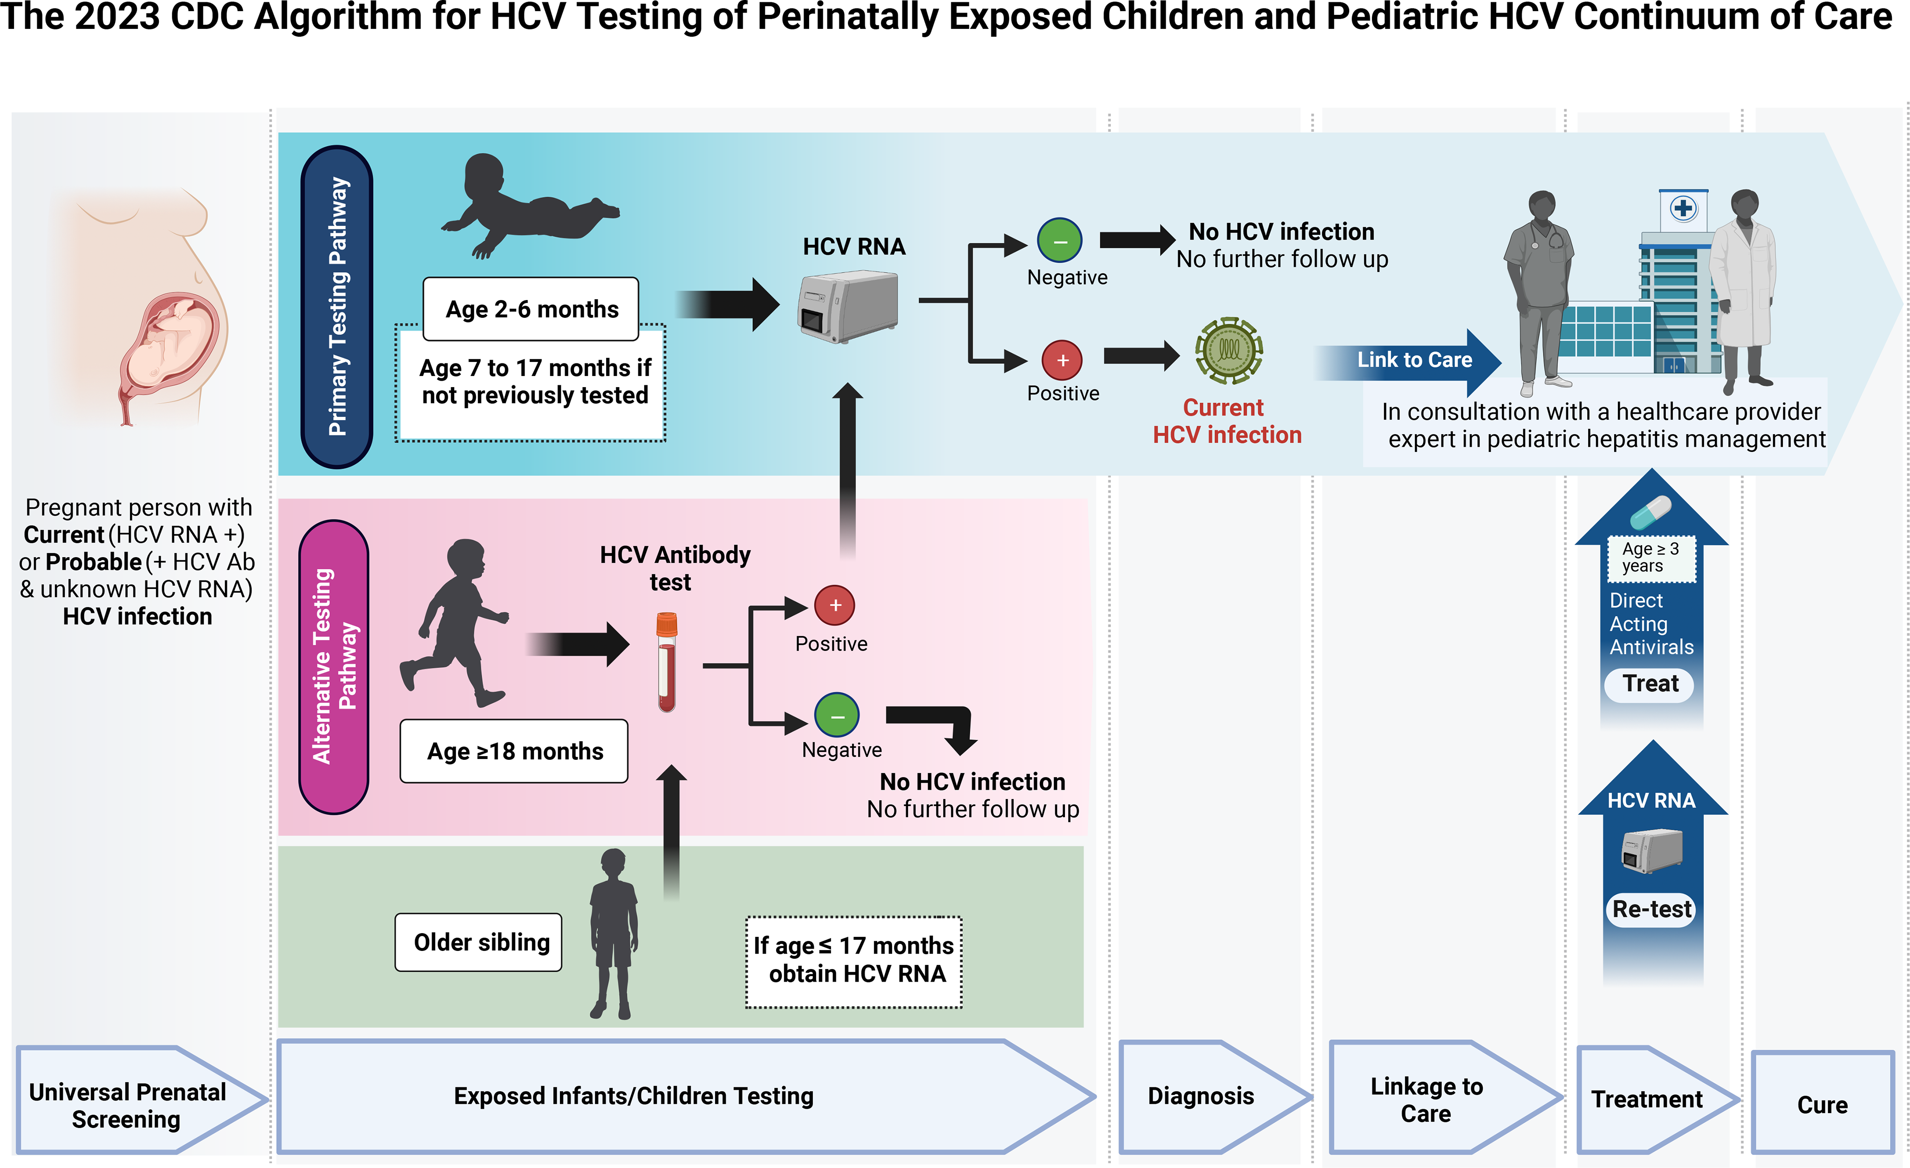
Saleh E. Jhaveri, R. Pediatrics Perspectives. 2023

Slide 46
Honegger, J and Gowda, C. Curr Opin Infect Dis. 2022

Slide 47
We Are Not Screening Infants for HCV
Woodworth et al. 2024
Retrospective 2018 to 2020
803 exposed infants in multiple states
50% tested by 24 months
Newton et al. 2024- The Surveillance for Emerging Threats to Pregnant People and Infants Network
Seven US jurisdictions (Georgia, Los Angeles County, Massachusetts, NYC, New York State, Pennsylvania, Tennessee) data on HCV RNA detected during or within 1 year before pregnancy
2,266 exposed infants
18% tested appropriately
Only 2% found to have HCV
Kushner et al. 2022
1,780 women
Only 29% of infants screened
Chappell et al. 2018
Retrospective 2006-2014 with 1043 HCV-infected
  Only 31% received well-child services (323/1025)
  Only 30% of those were screened for HCV (96/323)
Lopata et al. 2020
Only 23% of 4072 infants exposed to HCV were tested
White, HIV co-infection more likely to be tested
Kushner T, J of Hepatology 2022
Chappell C et al., Pediatrics 2018
Newton et al. EID 2024
Woodworth et al. 2024
Lopata et al. Pediatrics 2020

Slide 48
Integrated Care Improves Screening
Epstein et al. 2018
10-year cohort of 879 women with opioid use disorder from an obstetric clinic serving women with substance use disorders
  404 infants born to HCV seropositive women
  68% tested for HCV at least once
  45% completed AAP recommend screening
  2.8% diagnosed with HCV
Epstein et al. Hepatol Commun 2018

Slide 49
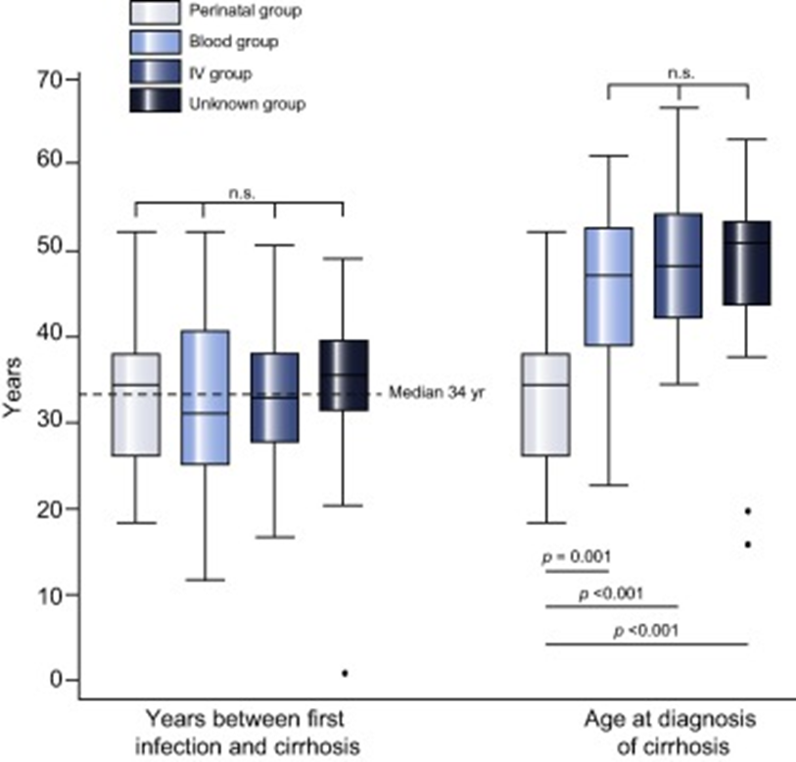
Long-term Effects of Untreated HCV in Children
Bortolotti et al. 2008
332 HCV RNA +
  1.8% progressed to decompensated cirrhosis over 10 years
European Pediatric Hepatitis C Virus Network
266 with perinatal HCV followed for 4 years
  10% hepatomegaly
  Abnormal ALT (OR 4.17)
Modin et al. 2019
Retrospective review of 1,049 people infected with HCV in childhood in UK
Up to a third had evidence of cirrhosis
Approximately 34 years to cirrhosis
Perinatal infections were diagnosed with cirrhosis at a younger age
Bortolotti et al. Gastroenterology. 2008
European Pediatric Hepatitis C Virus Network CID. 2005
Modin et al. J Hepatol. 2019

