Slide 1
The Grady HIV Prevention Program:
Building a Sustainable, EHR-Integrated Model for Accessible HIV Prevention
Meredith Lora, MD
Emory University at Grady Health System
Southeast AETC

Slide 2
Disclosures
This program is supported by the Health Resources and Services Administration (HRSA) of the U.S. Department of Health and Human Services (HHS) under grant number TR7HA53203-01-00 as part of an award totaling $5.7m. The contents are those of the author(s) and do not necessarily represent the official views of, nor an endorsement, by HRSA, HHS, or the U.S. Government. For more information, please visit HRSA.gov.
“Funding for this presentation was made possible by cooperative agreement TR7HA53203-01-00 from the Health Resources and Services Administration HIV/AIDS Bureau. The views expressed do not necessarily reflect the official policies of the Department of Health and Human Services nor does mention of trade names, commercial practices, or organizations imply endorsement by the U.S. Government. Any trade/brand names for products mentioned during this presentation are for training and identification purposes only.”
This content is owned by the AETC and is protected by copyright laws. Reproduction or distribution of the content without written permission of the sponsor is prohibited and may result in legal action.

Slide 3
Disclosures
Meredith Lora receives research related effort from Viiv Healthcare and Gilead Sciences, both paid to Emory University
Meredith Lora receives royalties from UpToDate for peer review activities
This presentation does not include investigational agents or off-label indications for agents used in clinical practice

Slide 4
Disclosures
The Health Resources and Services Administration (HRSA), Department of Health and Human Services (HHS) provided financial support for this project. The award provided 100% of total costs. The contents are those of the author. They may not reflect the policies of HRSA, HHS, or the U.S. Government.

Slide 5
AETC Program National Centers and HIV Curriculum
National AETC Support Center (NASC) – serves as the central web –based repository for AETC Program training and capacity building resources; its website includes a free virtual library with training and technical assistance materials, a program directory, and a calendar of trainings and other events. Learn more: https://aidsetc.org/
National Clinical Consultation Center (NCCC) – provides free, peer-to-peer, expert advice for health professionals on HIV prevention, care, and treatment and related topics. Learn more: https://nccc/ucsf.edu or call 844-ASK-NCCC
National HIV Curriculum (NHC) – provides ongoing, up –to-date HIV training and information for health professionals through a free, web –based curriculum; also provides free CME credits, CNE contact hours, CE contact hours, and maintenance of certification credits. Learn more: www.hiv.uw.edu

Slide 6
Learning Objectives
By the end of this session, each participant will be able to:
Describe the mission, guiding principles, and evidence-based strategies used to build the Grady PrEP Program, giving an overview of its development and community context.
Analyze at least three structural barriers to PrEP access addressed by the program, using examples of EHR integration, task shifting, and workflow redesign presented during the session.
Explain how 340B infrastructure and team-based care were leveraged to support scalability and financial sustainability, based on the operational framework discussed.
Outline the key operational steps required to transition from an oral-only PrEP model to inclusion of long-acting injectable PrEP, using the Grady implementation process as a case example.
Summarize program growth and outcome metrics that demonstrate impact and sustainability, given the program data shared in the session.

Slide 7
Royalty-Free Images Resource Links
AETC NCRC Flickr
National Institute of Allergy and Infectious Diseases (NIAID) Flickr Stream
The Noun Project (icons and photos)
Pexels (photos)
Pixabay
Public Health Image Library (CDC)
Unsplash
Wikimedia Commons
Royalty-free images are digital images that can be used for commercial and personal purposes without paying a fee for each use. They are a cost-effective solution for those who need high-quality visuals but don't have the budget to commission custom photography or purchase rights-managed images. With royalty-free images, you can download and use the image multiple times without worrying about any additional fees. Here are some helpful links that you can use for royalty-free images.

Slide 8
Which best describes your PrEP program?
No PrEP program
Oral PrEP Program
Oral + LA PrEP
LA PrEP but operational challenges

Slide 9
What is your biggest barrier to scale?
Word cloud

Slide 10
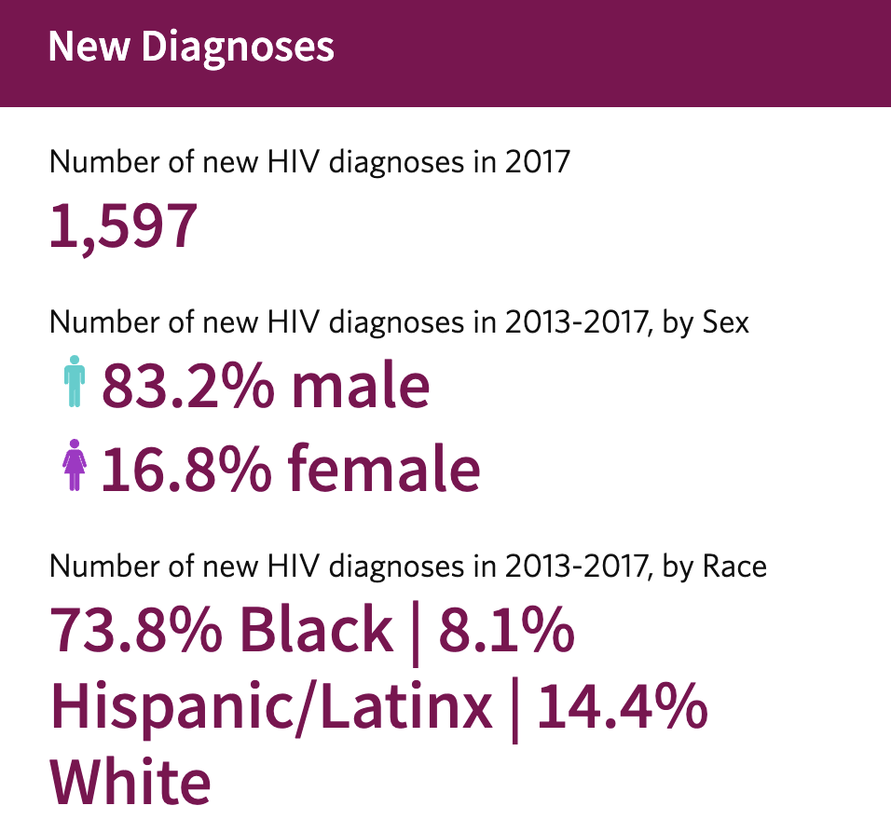
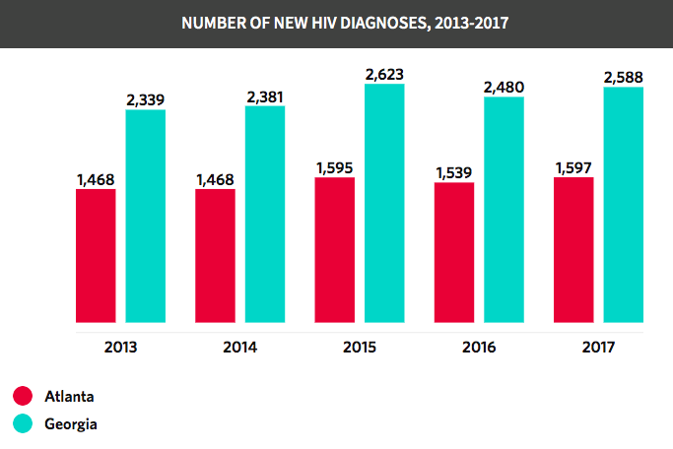
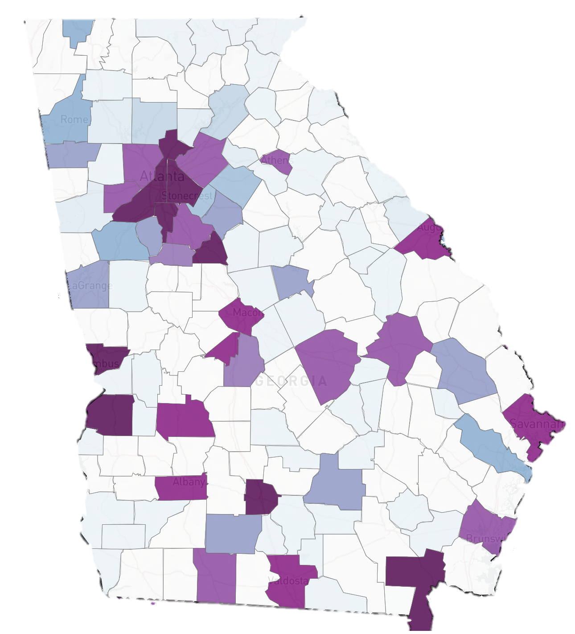
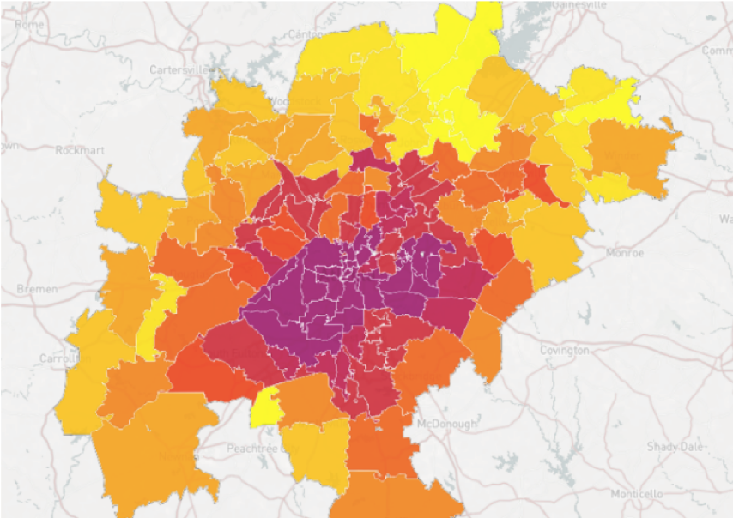
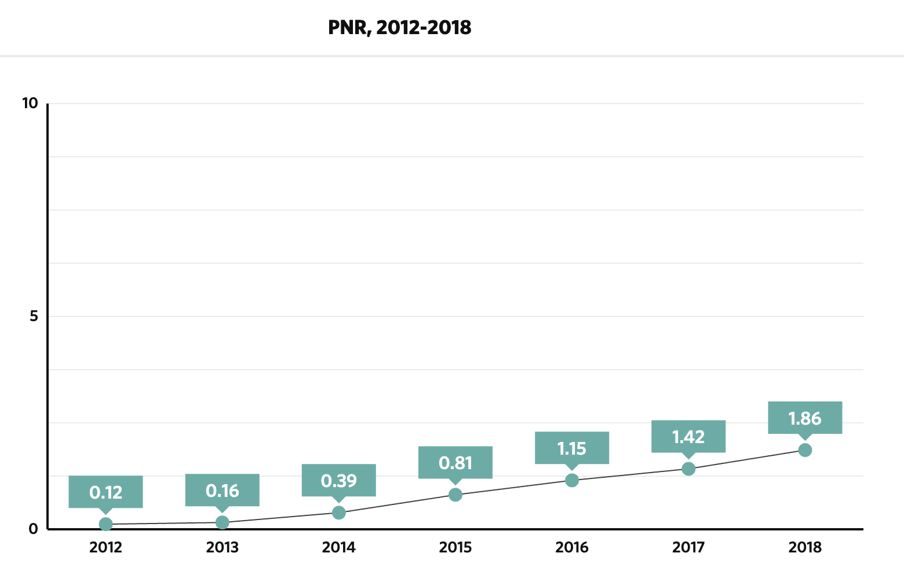
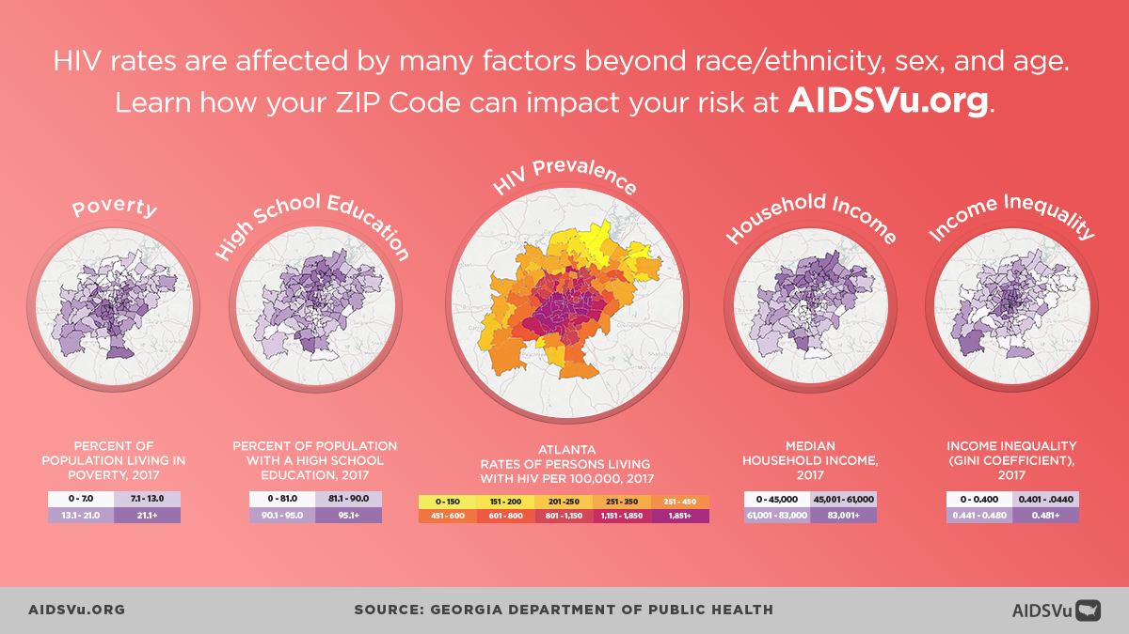
Why we built the GHS PrEP Program
New York City PNR: 9.9
Atlanta PNR: 2.5
Notes:
Rising HIV incidence in Atlanta
Limited PrEP penetration in high-need populations
Grant-dependent models were unstable
Traditional clinic structures limited access

Slide 11
PREP disparities
….not getting to those who need it most

Slide 12
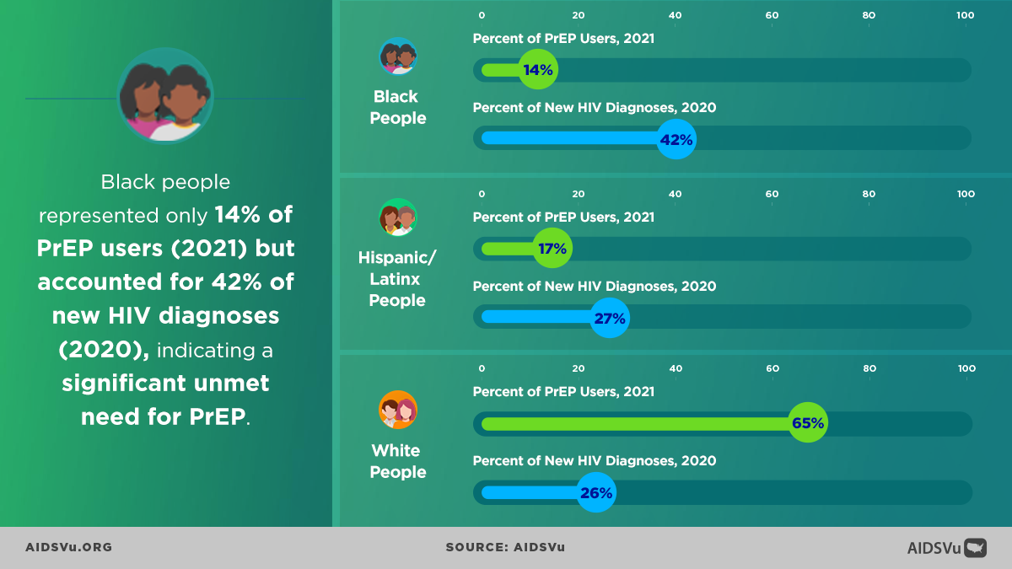
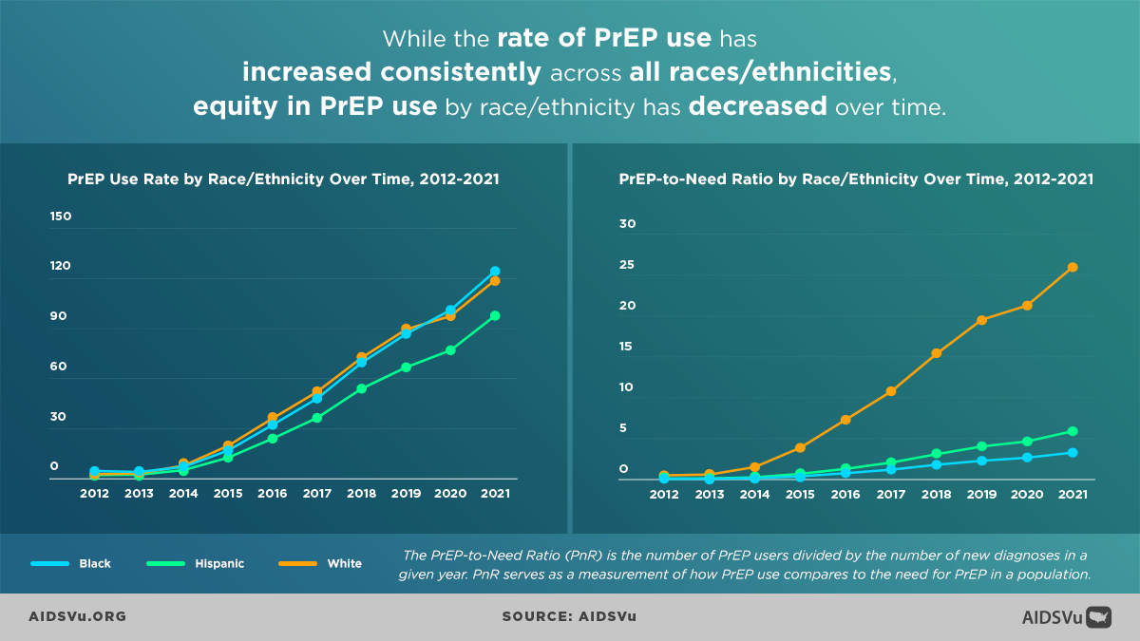
Racial disparities in PrEP use
While the rate of PrEP use has increased consistently across all races/ethnicities, equity in PrEP use by race/ethnicity has decreased over time
Black people accounted for 42% of new HIV diagnoses yet represent only 14% of PrEP Users – PrEP is not getting to those who need it most

Slide 13
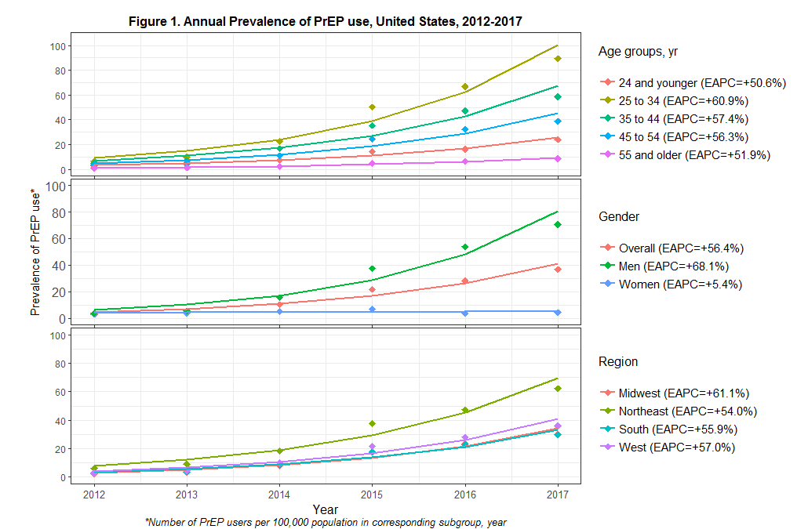
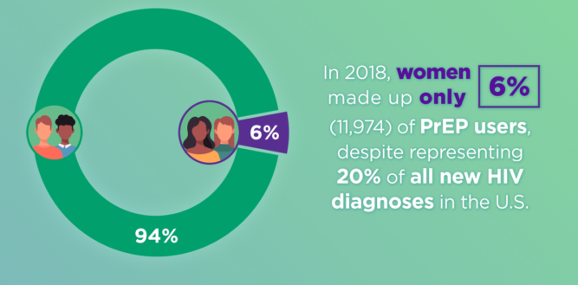
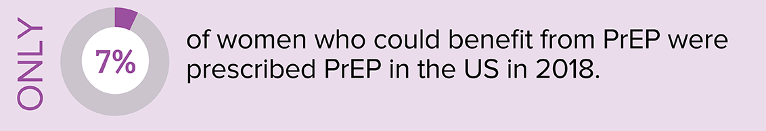
Gender Disparities in PrEP Use
PrEP Use by Gender, US, 2012-2017

Slide 14
Barriers to PrEP Uptake and persistence
Lack of time/competing priorities
Fear/shame/stigma.
Many people who contract HIV do not have “high risk” behaviors
Individual factors
Provider factors
Low risk perception →
“I don’t need PrEP”
PrEP is often offered based on sexual behaviors alone
Stigma around sexuality and sexual orientation extends to PrEP.
Community factors
“High risk” messaging around PrEP worsens PrEP stigma
PrEP stigma limits its use.
“I’m not out there like that”
Structural determinants of health and limited access
to care drive HIV risk
System factors
Limited access to care → limited access to PrEP

Slide 15
GHS PrEP Program Mission
Expand equitable access to HIV Prevention
Eliminate structural barriers to PrEP (cost, access, stigma)
Deliver PrEP outside traditional clinical settings
Build sustainability without grant dependence
De-medicalize operations and align with community needs

Slide 16
De-medicalized, gain-framed approach
Flexible, no-cost PrEP access
Population health infrastructure
Gain-framed, empowering messaging
Hybrid-intake visits
Digital follow-up options
Task shifting
Rx delivery
No cost meds and services
Digital follow up options
Team-based care
EHR-integrated tracking report/dashboard
Intensive PrEP navigation
Team-based care

Slide 17
Grady PrEP Program
De-medicalized, gain-framed approach
Cantos et al, AIDS and Behavior 2025

Slide 18

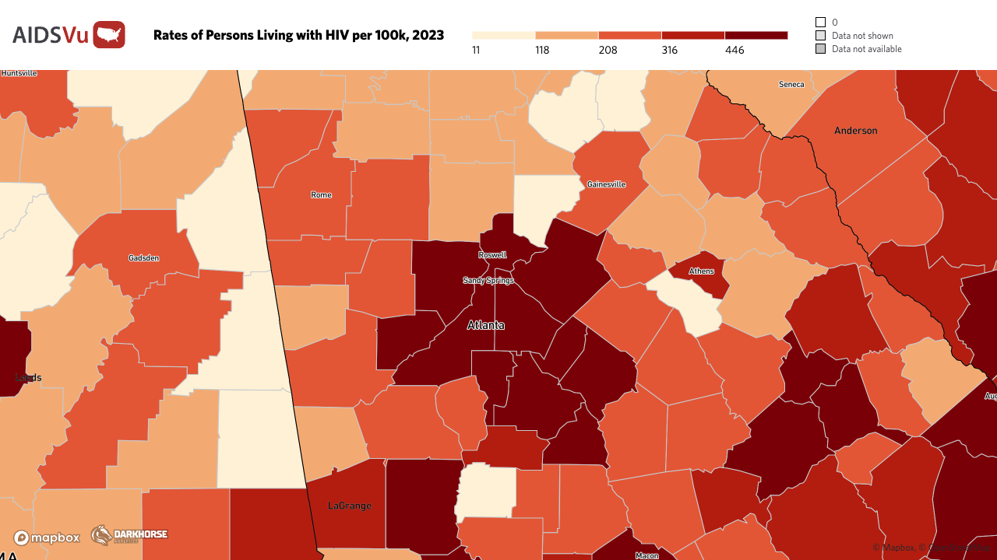

Challenges in risk assessment
Perceived risk
Complex interplay of social, structural, network, and behavioral factors that are hard to identify at the point of care
Sexual network factors
  People With HIV with non-suppressed HIV in sexual network increases per-act risk
Social determinants of health:
  Poverty/Geography → Poor healthcare access
Same sex behaviors not disclosed to partner or clinician
Sexual behavior stigmatized as “promiscuous”
Actual risk

Slide 19
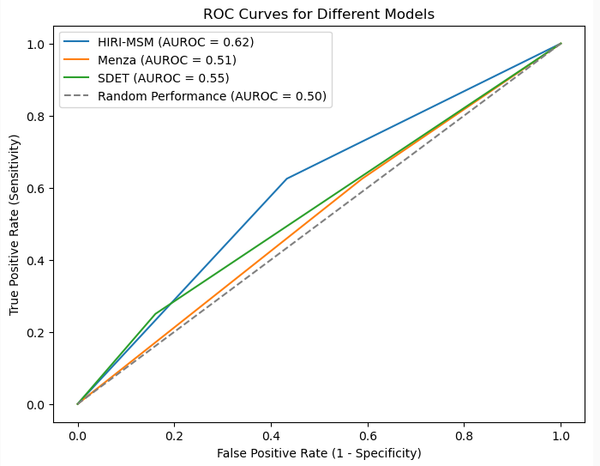
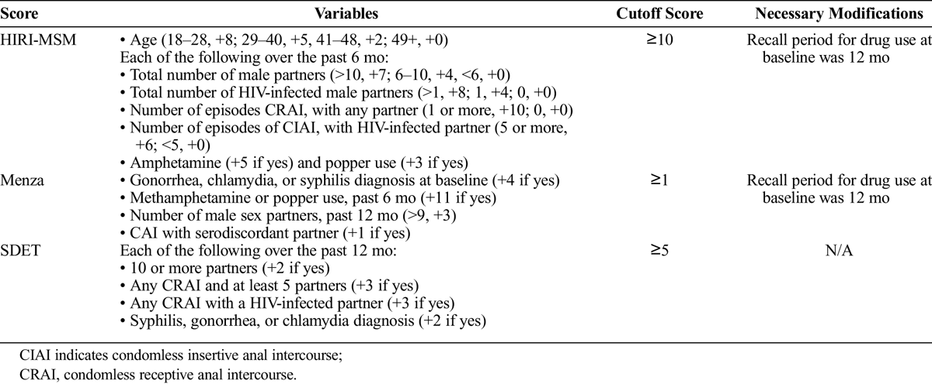
Previous HIV Risk scores failed to predict HIV in
Men having Sex with Men in Atlanta, Georgia
Scores focused on behavioral factors
Notes:
Why this project is important: people who need to be on PrEP are not on it

Slide 20
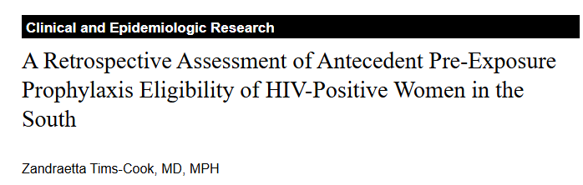
HIV risk in women
Cisgender women account for a growing proportion of new HIV diagnoses, with Black women disproportionately affected.
Many women lack identifiable behavioral risk factors prior to diagnosis, which affects risk assessment and PrEP counseling.
Survey of 102 women dx with HIV in Atlanta:
65% reported having only one partner at the time of HIV diagnosis
64% of women reported having a longitudinal sexual relationship with their partner from whom they acquired HIV
90% unaware of partner HIV status
90% unaware of partner’s bisexual status

Slide 21
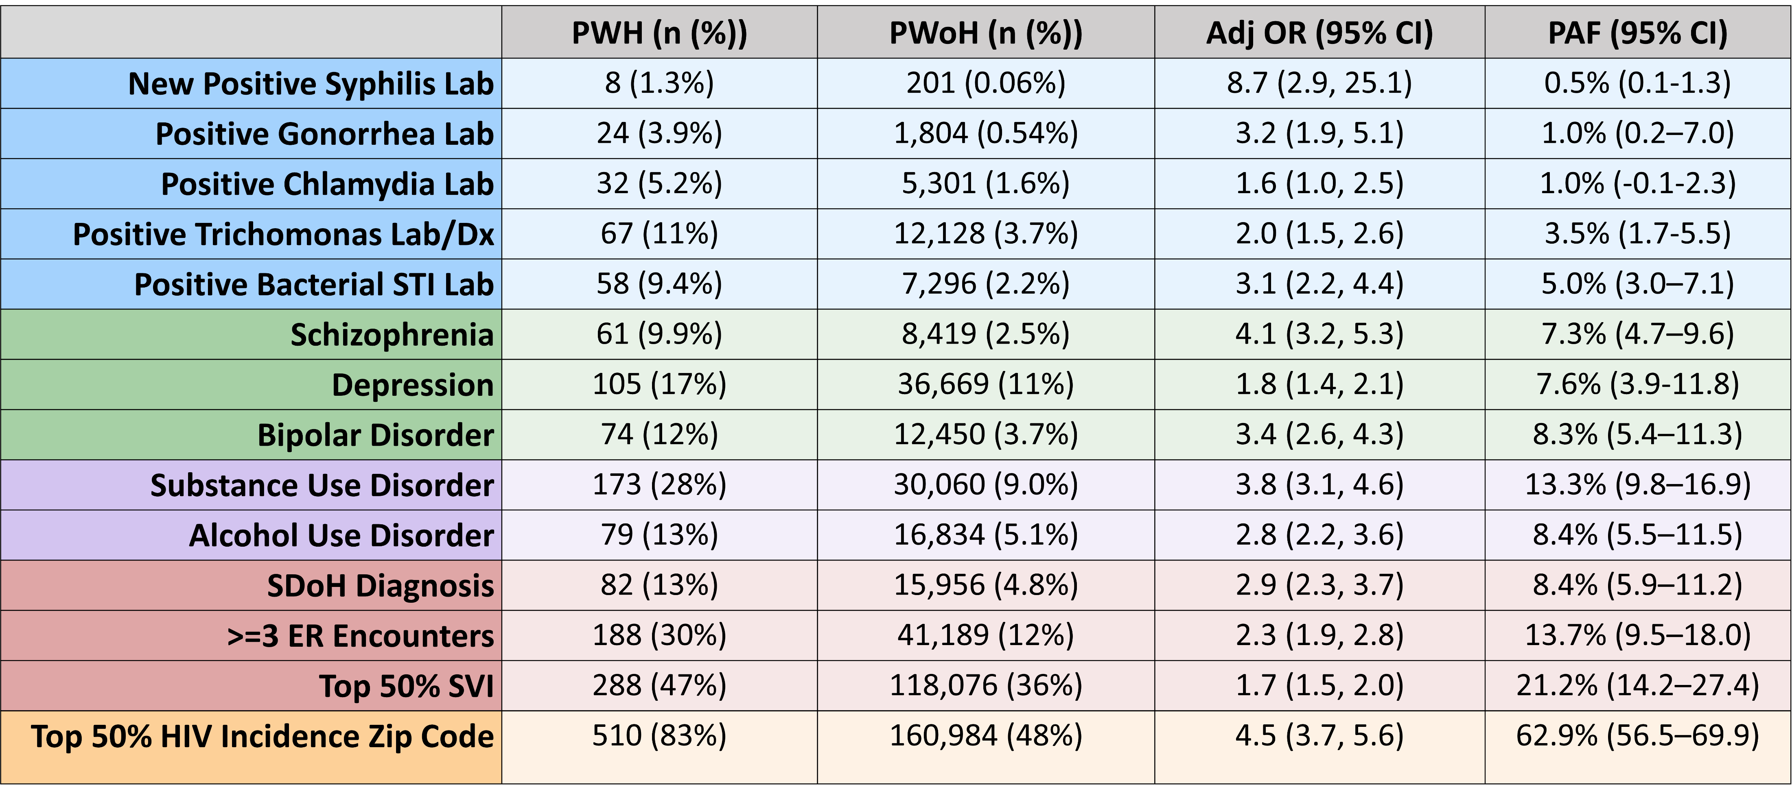
Comparing Behavioral and Socio-Structural Exposures for Women’s HIV Prevention in the Urban South
To quantify the impact of behavioral and socio-structural risk factors on HIV risk among women at Grady Health System (GHS) in Atlanta, Georgia. ​
Cohort Characteristics: Of 333,263 women, 617(0.19%) were newly diagnosed with HIV. People with HIV (PWH) were predominately Black (89%) with mean age 41 years.

Slide 22
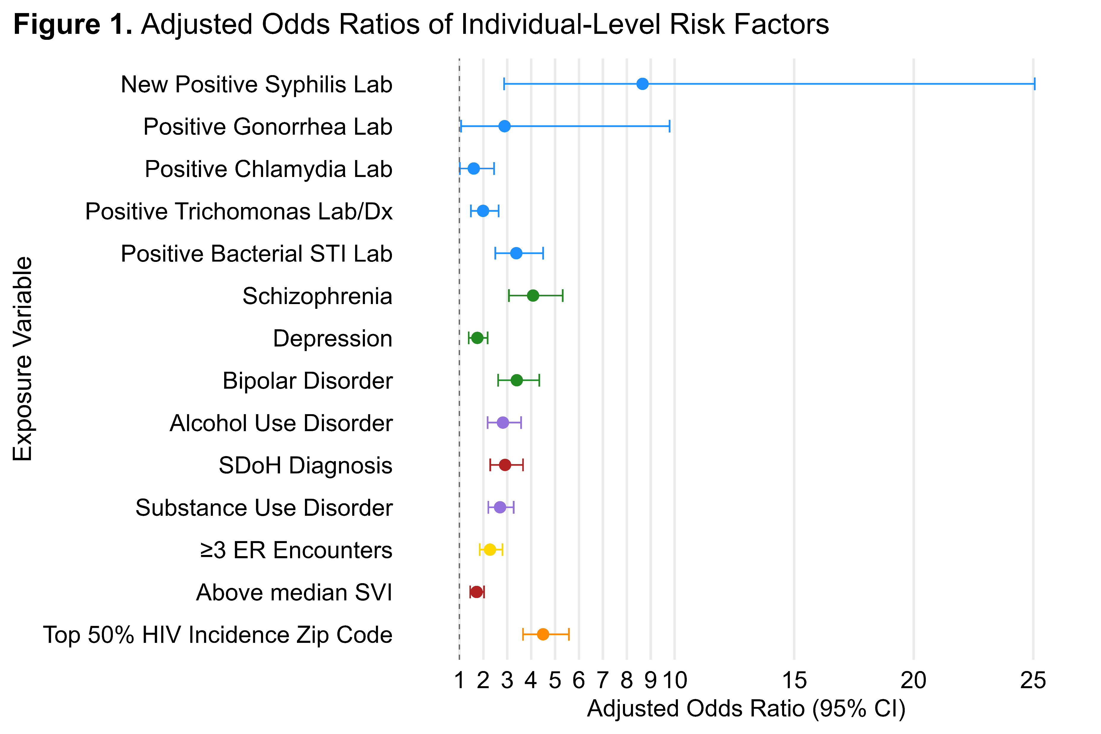
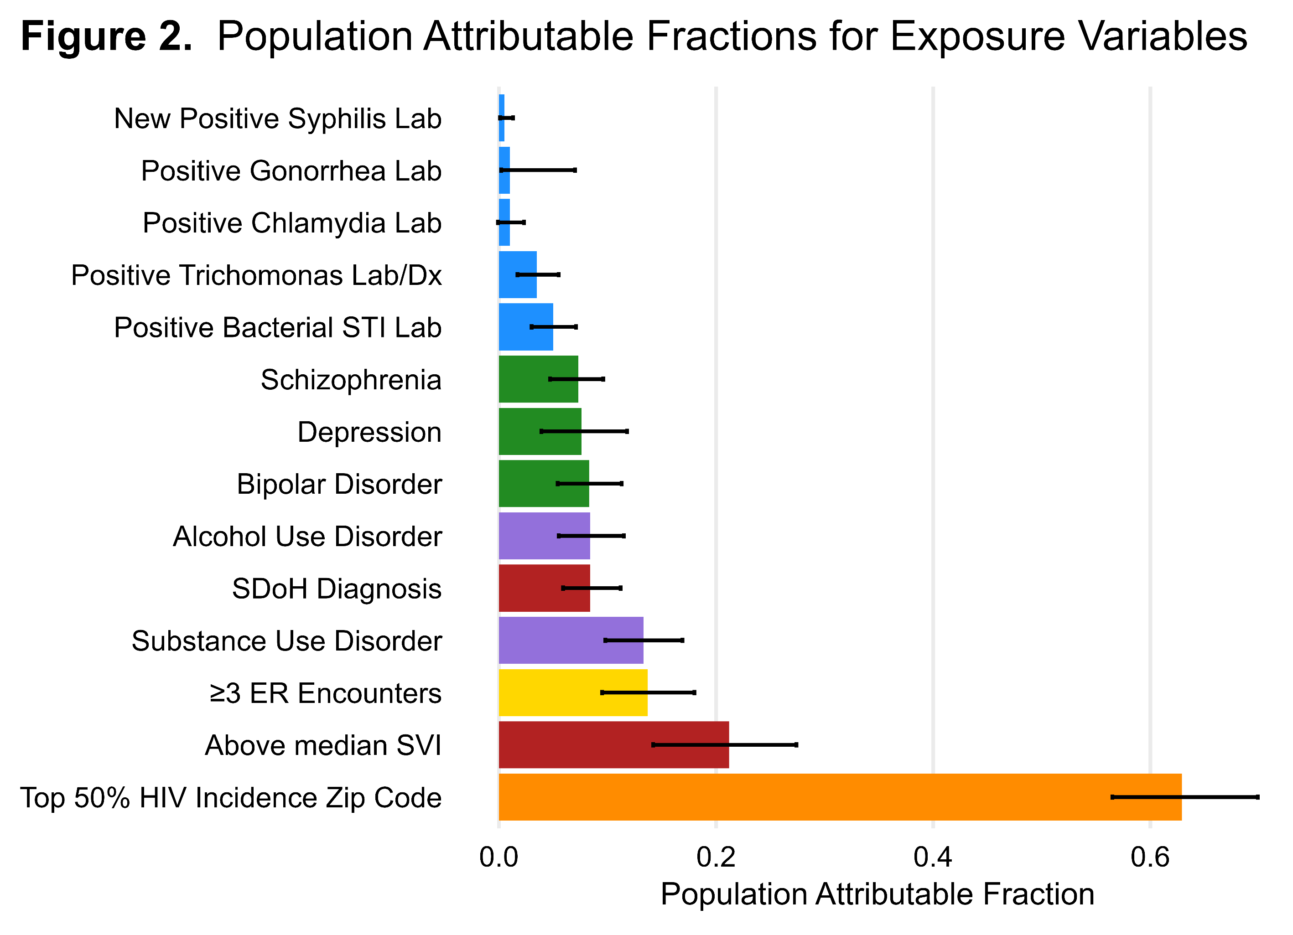
Comparing Behavioral and Socio-Structural Exposures for Women’s HIV Prevention in the Urban South
STIs were strongly associated with individual HIV risk but were uncommon; socio-structural factors were prevalent and accounted for greater estimated population-level impact.

Slide 23
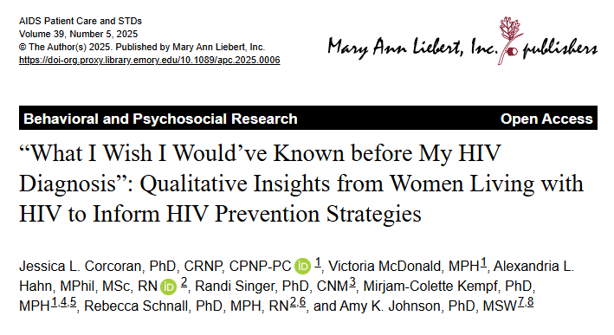
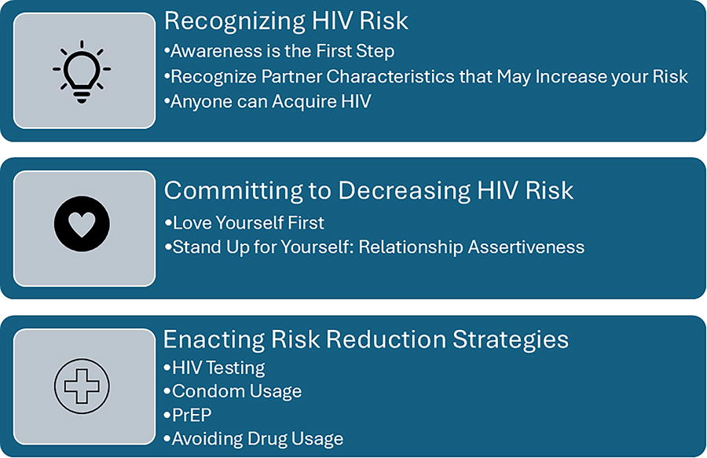
HIV risk in women
Corcoran JL. AIDS Patient Care STDS. 2025 May;39(5):203-212. doi: 10.1089/apc.2025.0006.

Slide 24
PREP for your community
Requires an empowering, gain framed approach

Slide 25

Who would benefit from PrEP?

Slide 26



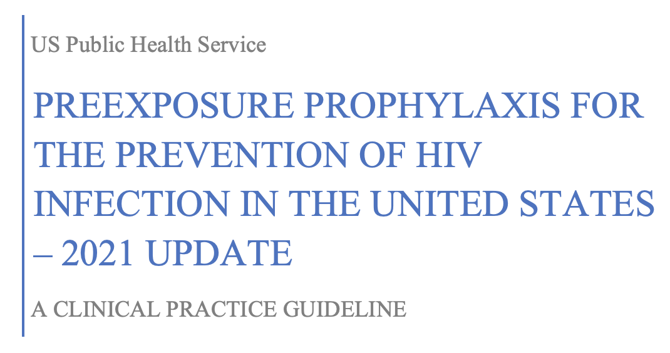
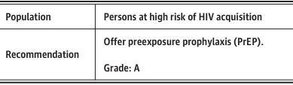
PrEP is for Everyone
Offer PrEP to all sexually active adults (Grade IIIb)

Slide 27





CDC Guidelines - HIV Risk Assessment
CDC Guidelines Recommend PrEP for:
Anyone who has been sexually active in the last 6 months who:
Inconsistent condom use or unknown partner status
OR
Sexual partner with HIV (esp if high/unknown viral load)
Discuss PrEP with everyone else
ALWAYS prescribe PrEP if requested!
OR
Recent bacterial STI
Must account for epidemiologic and partner factors

Slide 28
Changing your messaging around PrEP to EMPOWERMENT
PrEP helps you feel safe and healthy and can decrease worrying about getting HIV
What doesn’t work?
RISK based messaging. It increases stigma and just doesn’t work for primary prevention, especially in young people
PrEP puts YOU IN CONTROL of staying HIV negative.
You will get HIV if you don’t ……
Being on PrEP does NOT mean you are "out there" or promiscuous. It is a PERSONAL CHOICE if you want an extra layer of protection.
Your behaviors are RISKY
Golub HIVR4P 2018

Slide 29


Grady PrEP Program
Flexible, no-cost PrEP access

Slide 30
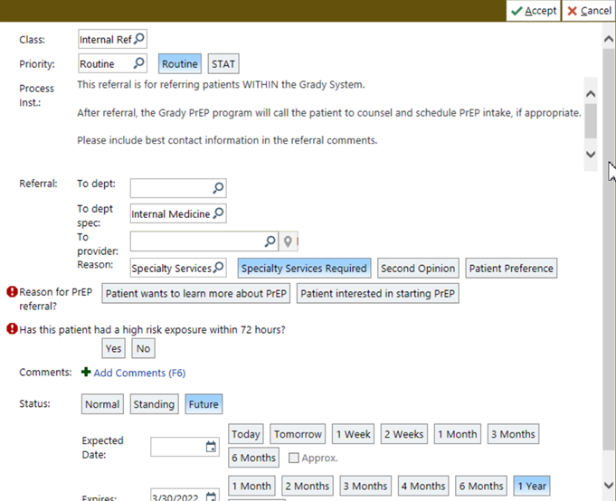


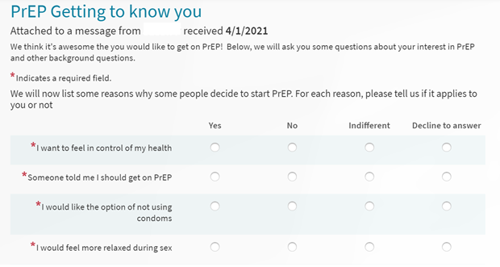



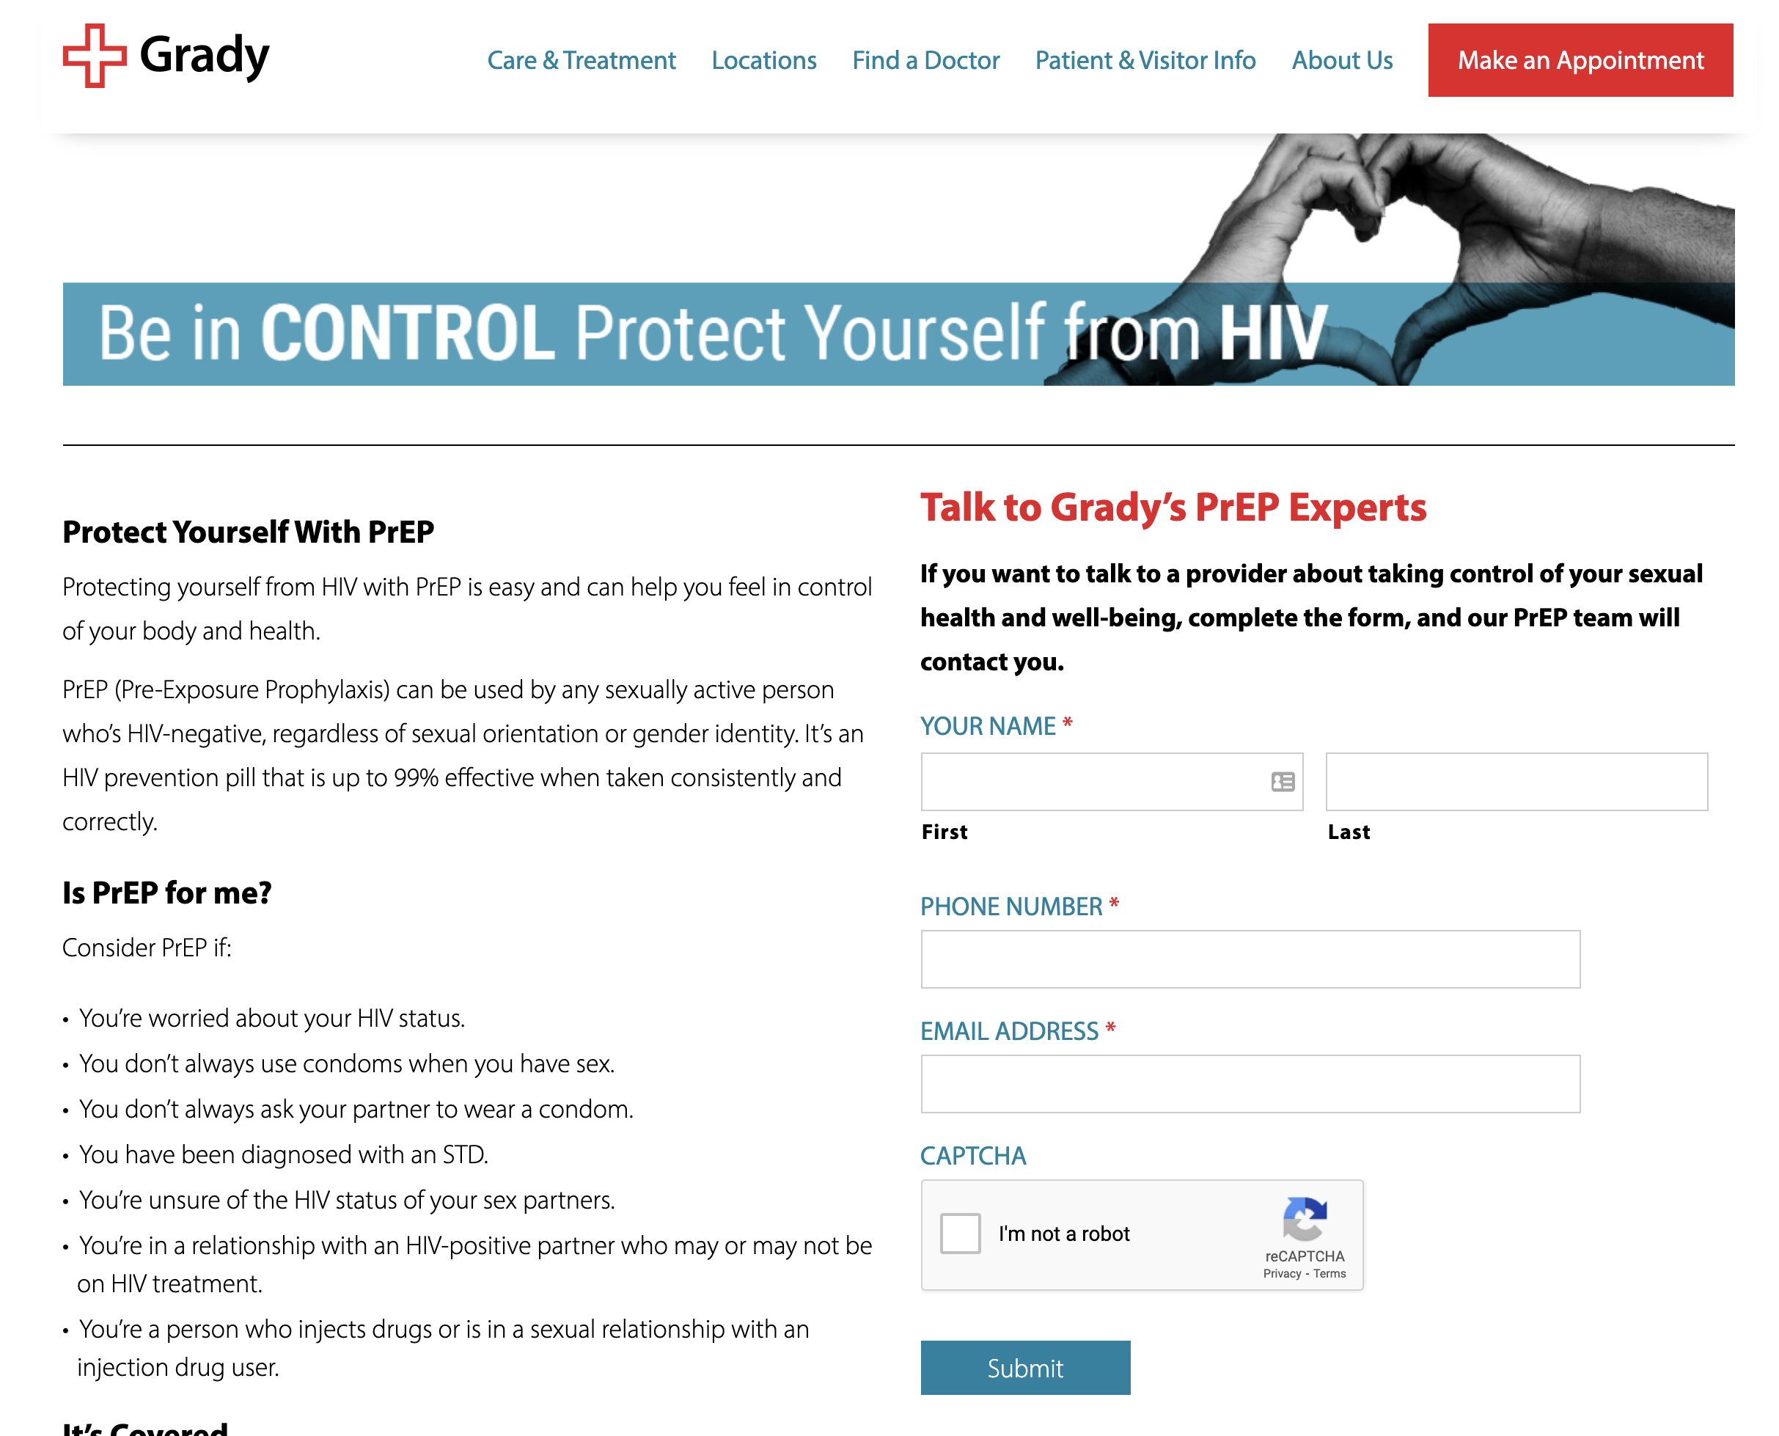

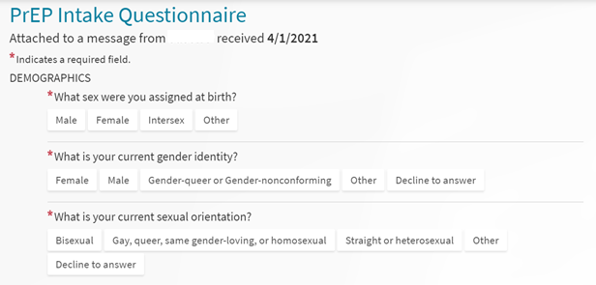


Grady PrEP Care Delivery Model
E referrals or Self-Referral
Expedited registration and intake
Virtual Quarterly monitoring and partnership
Virtual registration
Payor assessment and intake questionnaires
MAC assessment
Med access pathway
Quarterly Phone Calls or patient portal questionnaires
Flexible Lab Visit with Self Swab for STIs, Home based testing pending
Linkage to other health and wellness needs
Navigator outreach for patients with greater needs patients and those lost to follow up
Pop-up clinics
INTAKE
Adherence and risk reduction counseling
Same Day PrEP
Medication Delivery

Slide 31


Grady PrEP Care Delivery Model
E referrals or Self-Referral
Expedited registration and intake
Virtual Quarterly monitoring and partnership
Virtual registration
Payor assessment and intake questionnaires
MAC assessment
Med access pathway
Quarterly Phone Calls or patient portal questionnaires
Flexible Lab Visit with Self Swab for STIs, Home based testing pending
Linkage to other health and wellness needs
Navigator outreach for patients with greater needs patients and those lost to follow up
Pop-up clinics
INTAKE
Adherence and risk reduction counseling
Same Day PrEP
Medication Delivery

Slide 32


Flexible delivery model comparison
TRADITIONAL
VS
FLEXIBLE
In-person
Visits
Virtual or in-person
Provider interview and counseling
Intake
Intake questionnaire + Team counseling
Pickup
Medications
Delivery
Clinic laboratory
Monitoring
Walk in lab visits at any satellite lab
Phone
Communication
Messaging – portal, text messaging

Slide 33
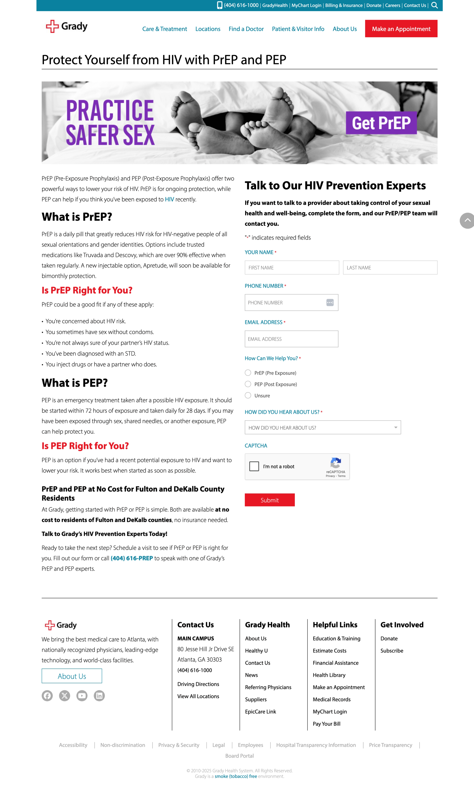
De-medicalized, easy community access: self-referral from website
Sends email to getprep@gmh.edu when user clicks “Submit”

Slide 34
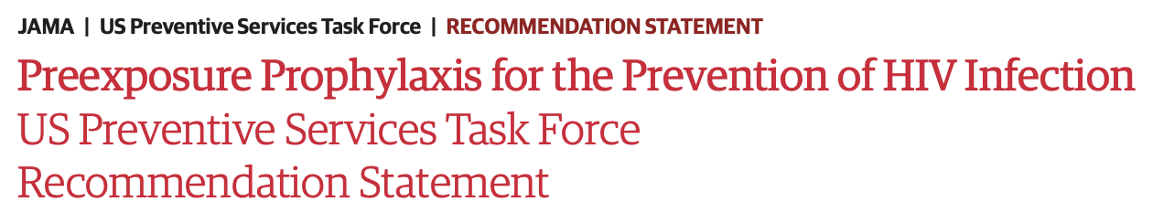

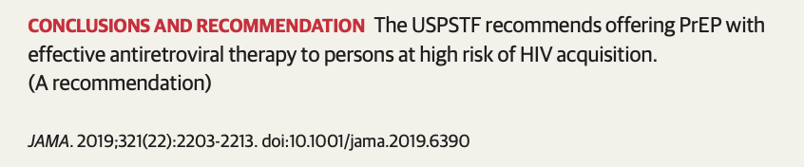
Identify non-grant revenue streams
Flexible, no-cost PrEP access
ACA law: no-cost sharing

Slide 35
Use team-based care to enhance persistence and streamline infrastructure
Flexible, no-cost PrEP access

Slide 36
Incorporate a population-health infrastructure to enhance uptake and persistence, and support flexible programming
De-medicalized, gain-framed approach
Flexible, no-cost PrEP access
Population health infrastructure

Slide 37
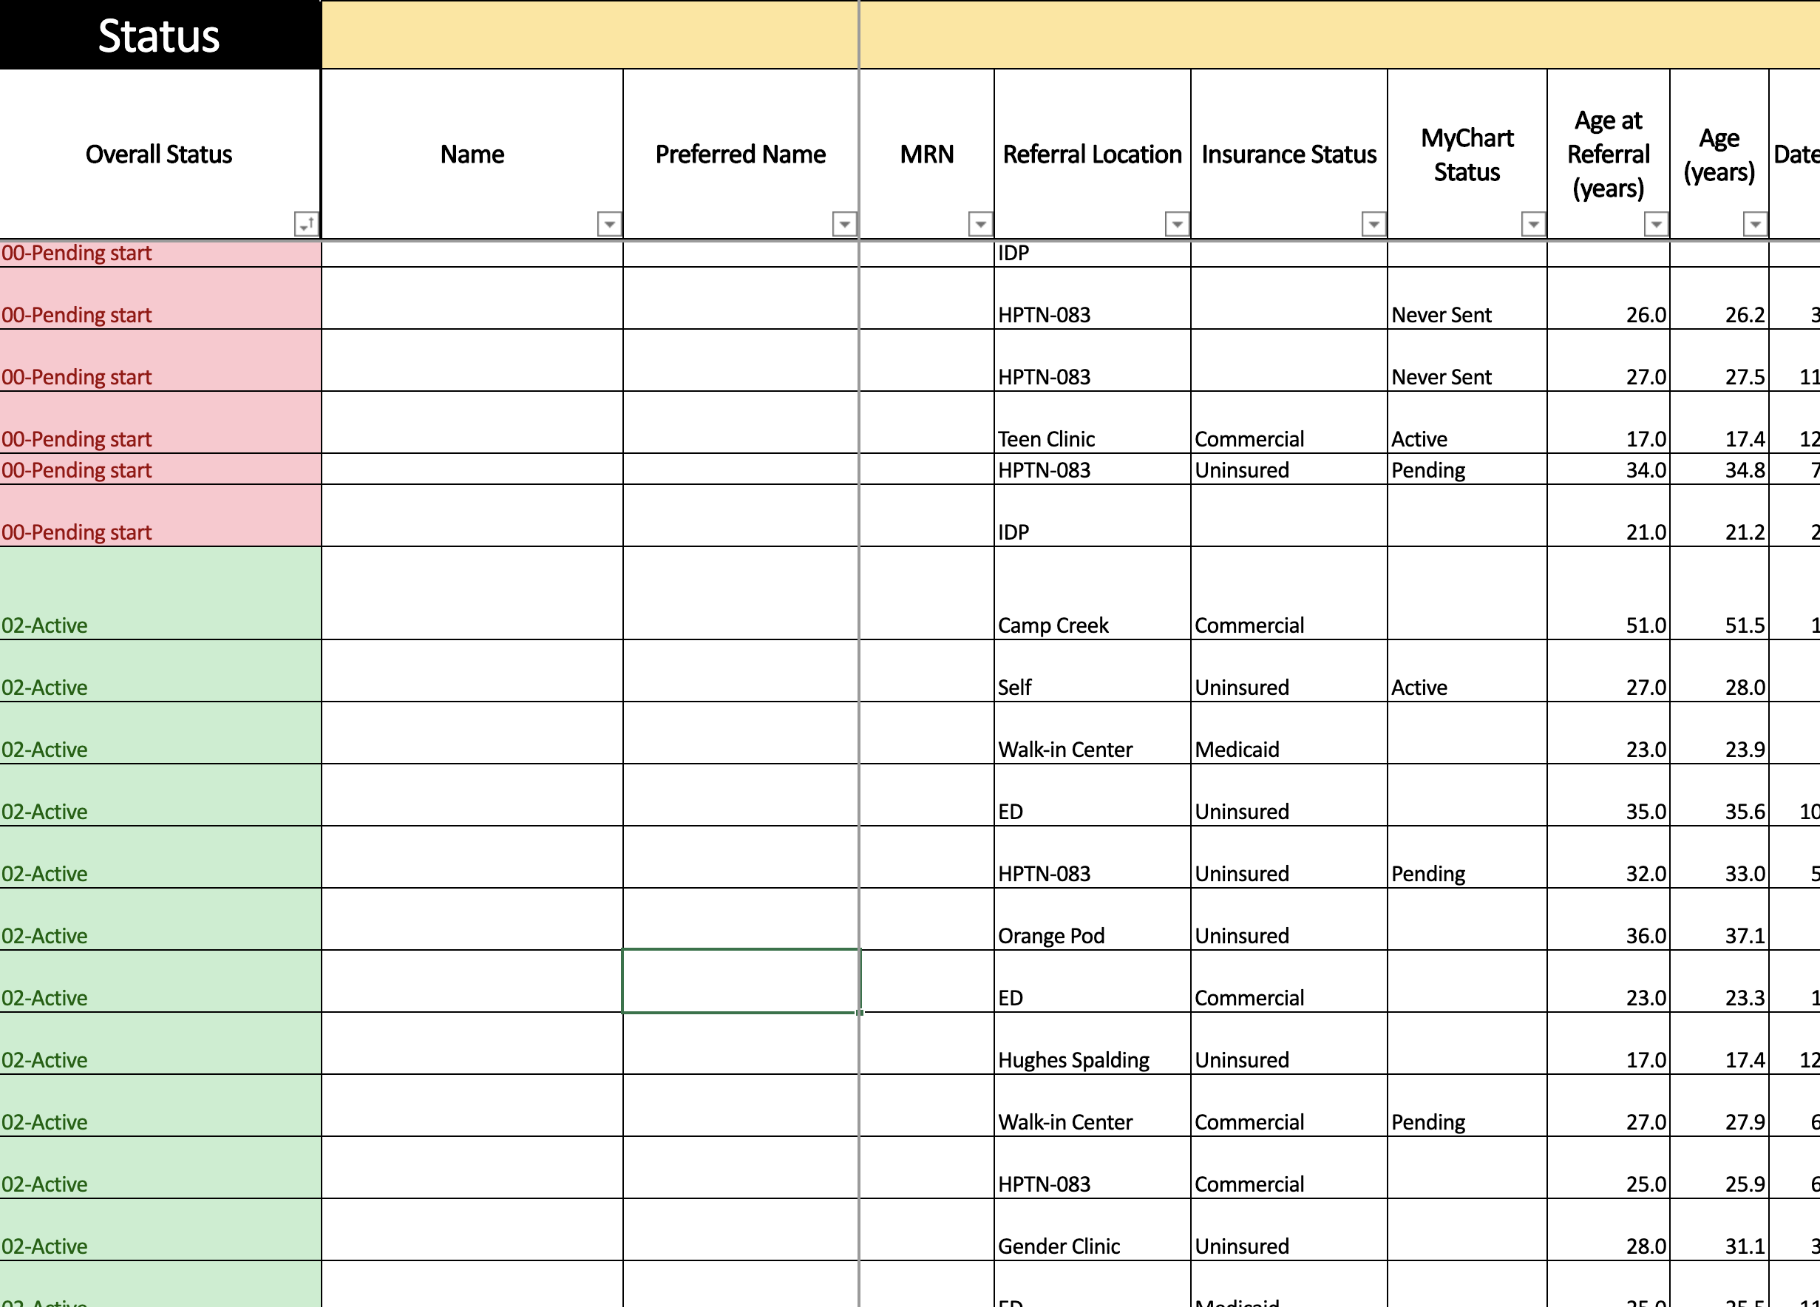
Incorporate a population-health infrastructure to enhance uptake and persistence, and support flexible programming
Notes:
Add in pop health infrastructure

Slide 38
Does the model work?
…Did the oral PrEP model deliver its intended outcomes?

Slide 39
PrEP at Grady: PrEP Uptake Rates
Baseline Demographics:
77.5% Black or African American
Gender Identity:
56% cisgender men
28% cisgender women
13% transgender women
Risk factors:
15.7% STIs in last 6 months
11.2% transactional sex
Black Race (0.3, 0.1-0.8) and
heterosexual women (0.4, 0.2-0.7)
associated with lower odds of linkage
Cantos et al, AIDS and Behavior 2025

Slide 40
PrEP Retention
Median Time on PrEP
Grady PrEP: 332 days | Local cohort: 171 days
Lower age, heterosexual women and heterosexual men associated with lower odds of retention at 6 and 12 months.
Race had no association with retention at 6 or 12 months.
3 seroconversions (1 on PrEP with low adherence, 2 after discontinuing PrEP)
Cantos et al, AIDS and Behavior 2025

Slide 41
PrEP at Grady: Stratified care continuum
 | Overall | Same gender loving cis-men | Heterosexual cis-men | Heterosexual cis-women | Transgender women
PrEP linkage | 72.1% (289/401) | 85.6% (137/160) | 68.2% (30/44) | 64.9% (61/94) | 90.7% (49/54)
PrEP prescription | 88.6% (256/289) | 89.7% (123/137) | 83.3% (25/30) | 77% (47/61) | 95.9% (47/499)
6-month retention | 75.4% (169/224) | 87% (92/105) | 60% (12/20) | 67.4% (29/43) | 72.7% (32/44)
12-month retention | 40.6% (78/192) | 65% (58/88) | 16.7% (3/18) | 25.6% (10/39) | 28.2% (11/39)
Cantos et al, AIDS and Behavior 2025

Slide 42
PrEP at Grady: Analysis of Patient Satisfaction
Satisfaction Themes | Theme-related quotes
Program Themes
Efficient, easy Process | “One of the things I really like the PrEP program is that it is straightforward. I don't feel like anyone is wasting my time…”
No-cost services
Accessibility | “Again, it has been the convenience of it all and the proactiveness of the staff. It is very convenient”
Staff Themes
Frequent communication | “The whole team has always been calling me, following up with me, concerned about me….
Kind staff → made patients feel taken care of | “[the provider] was so warm and inviting…made you feel important, noticed.”
Non-stigmatizing care | “…considered me [for PrEP] without judgment or stipulations or questions asked. Just wanted to help.”
Post Intake Exit Interview
93% very satisfied
7% somewhat satisfied
82% will “definitely continue care at Grady PrEP”
77% would “definitely recommend GHS PrEP Program” to others.
Cantos et al, AIDS and Behavior 2025

Slide 43


Expanding GHS PrEP to include long-acting PrEP

Slide 44
Grady LA PrEP Program: 2022-2025
2022 Launched LA PrEP Program within GHS PrEP
Initiated ~300 individuals on CAB-LA
Mix of commercially insured, publicly insured and uninsured individuals
~75% persistent on LA PrEP after initiation
94% on-time injections across all individuals on LA PrEP
Financially sustainable to support expansion of team and services
.

Slide 45



GHS LA PrEP Program: key components of scalability and sustainability
Team-based program with task shifting and integration into existing clinical spaces
Cross-trained team with clear task delineation
EHR-Integrated Tracking and care coordination
Population health tracking enables intensive patient navigation
Medication procurement support
Integrated infrastructure for medication access management

Slide 46
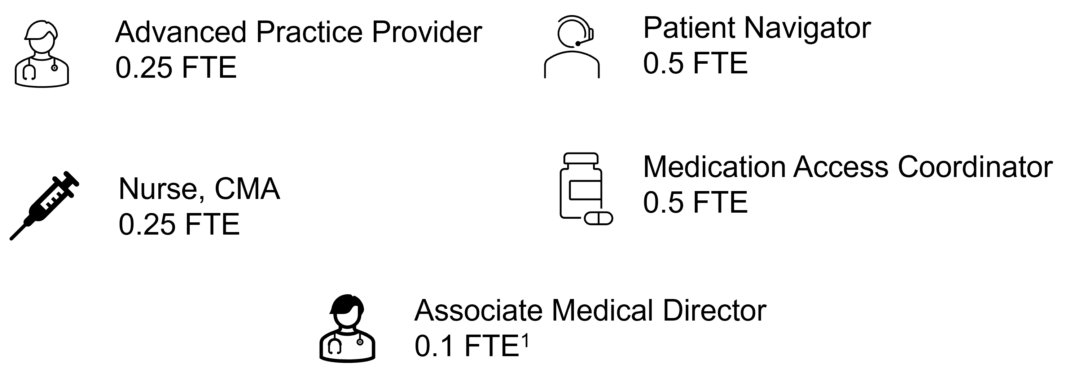
Early Implementation Staffing
  Revenue at outset may not be self-sustaining
  Task shifting is key
LA PrEP Program started with 1.6 FTE distributed among 5 roles

Slide 47




Collaboration and Resource Sharing
X Clinic
Y Clinic
LA PrEP Team
Z Clinic
¹ Full-time equivalent

Slide 48
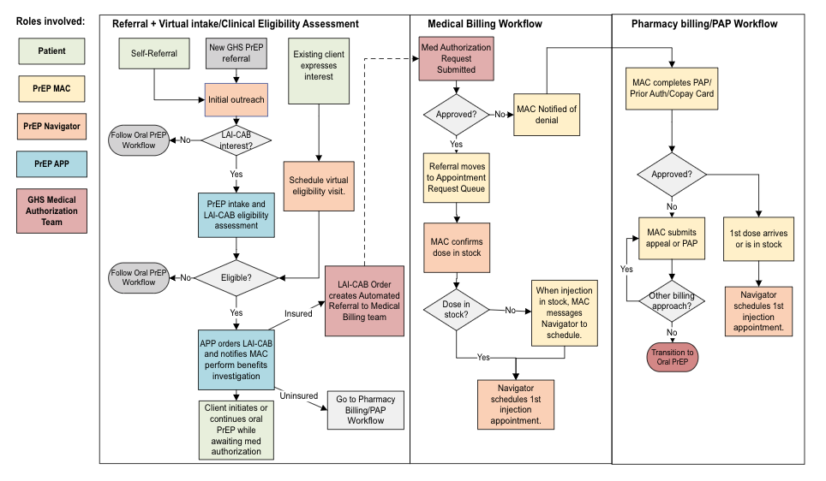
Team-based approach to complex logistics
Protocol key points
LA PrEP Intake and Eligibility Assessment is conducted virtually If there is no recent HIV testing available for review, lab walk in.
Benefits investigation on Viiv Portal to anticipate reimbursement/approval
Scheduled once dose in stock
NP Performs first LA PrEP Injection, CMA performs all following

Slide 49
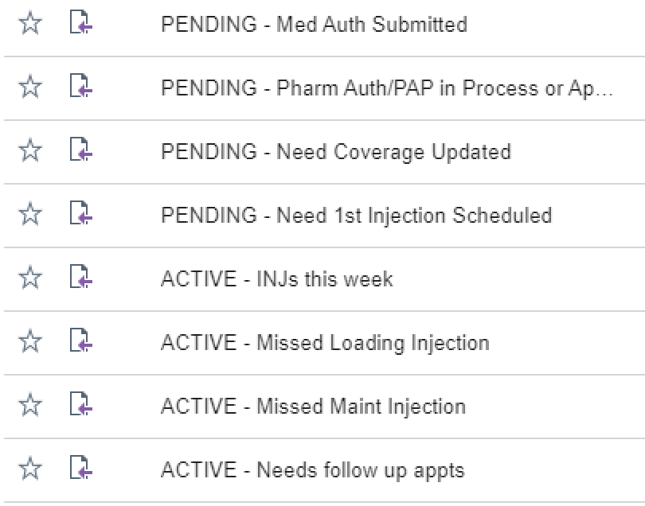


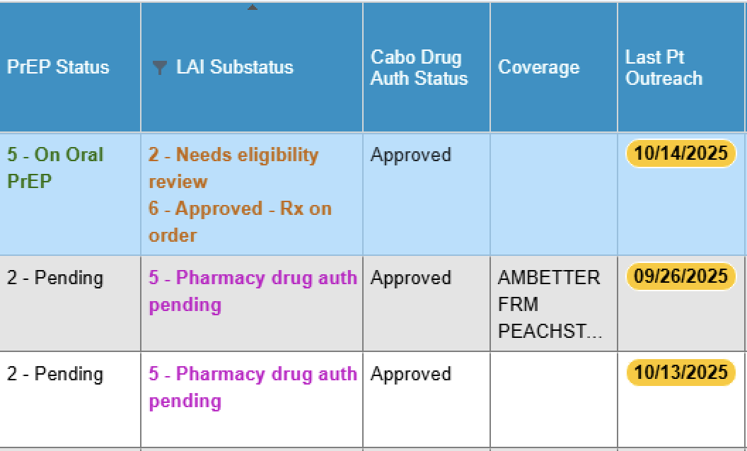
Streamlined task identification for MAC and Navigator
Notes:
We have specific view into every single step into referral – intiitation – maintenance –
Real time review of patients across the continuum, identify bottlenecks or risk for harm at each step.
Also enables touch points and feeling like you are part of a team when you are on long acting PrEP

Slide 50
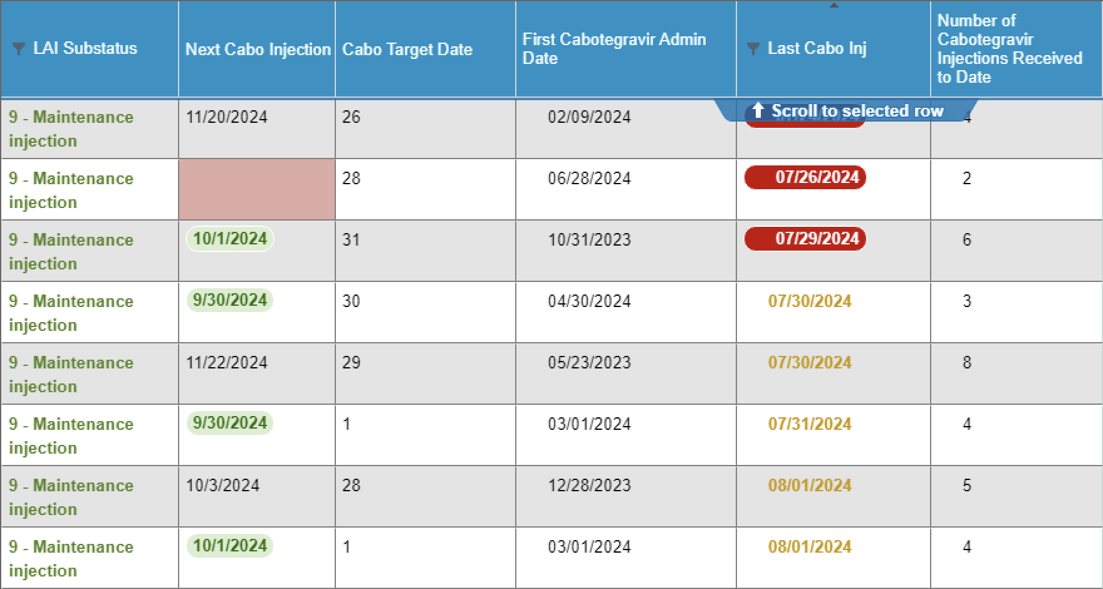
Population Health: Integrated tracking mechanism includes LAI PrEP
Four key integrated fields significantly enhance tracking after initiation. Enables team-based outreach for upcoming or missed visits.

Slide 51



Financially Sustainable Team Growth
Early Implementation Staffing​
Current Staffing​
Associate Medical Director
0.1 FTE
Associate Medical Director
0.2 FTE
Patient Navigator
0.5 FTE
Patient Navigator
1 FTE
Advanced Practice Provider
0.25 FTE
Advanced Practice Provider
0.5 FTE
Medication Access Coordinator
0.5 FTE
Medication Access Coordinator
0.5 FTE
Nurse, CMA
0.25 FTE
Nurse, CMA
1 FTE
Revenue at this point should be self-sustaining

Slide 52
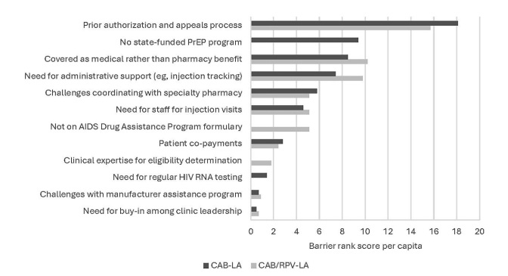
Largest Barrier Remains Procurement/Reimbursement
"We urge health insurers to offer the flexibility for LAIs for HIV … prevention to be covered under either pharmacy or medical benefits to facilitate access regardless of the size or type of clinic or practice setting" - IDSA 2025
Marcus J, Kelley C, Collins L, Colasanti J. CID 2025

Slide 53
Outsourcing the complexity to 340B Third-Party Administrator
TPA / Model | Fit for Small Orgs | Data Access & Integration | Pharmacy Flexibility | Scalability & Fit for Long-Acting Model | Support establishing 340B status?
CaptureRx | ✅ | Strong APIs, easy EMR linkage | Broad local network | Excellent – proven interop | ✅
PharmaForce | ✅ | High transparency, customizable exports | Multiple partners | Excellent – adaptable | ~
SunRx | ~ | Solid dashboards, less API depth | Multiple | Good – widely adopted | ✅
Remy Healthcare | ✅ | Integrated reporting; small-scale flexibility | Moderate network | Good – boutique and responsive | ~
Walgreens 340B Complete | ❌ | Closed system; limited data sharing | Walgreens pharmacies only | Fair – turnkey but not interoperable | ❌
What are 340B TPAs?
  Data and compliance hubs that manage 340B drug claims behind the scenes.
What do they do?
  Match + reconcile prescriptions to eligible visits for 340B pricing.
  Handle the admin side —inventory, audits, and reporting to stay HRSA-compliant.
  Bridge systems between clinics, pharmacies, and wholesalers.
  Return savings to covered entities to fund patient programs.
Notes:
Covered entity owns the 340B benefit.
The clinic or hospital buys the drug at the 340B ceiling price. The insurer (or patient) pays the usual higher reimbursement.
The margin between those two is the 340B savings.Contract pharmacy (Walgreens) gets a cut.
Walgreens charges dispensing and/or admin fees.
With Walgreens’ “340B Complete,” you don’t get to pick a different TPA—so the entity pays Walgreens’ rates for both filling scripts and managing compliance.Entity keeps the rest.
After Walgreens takes its slice, the covered entity gets the remaining savings. Those dollars are supposed to fund patient care, sliding-scale programs, outreach, etc.
Independent TPAs like CaptureRx, PharmaForce, Aventi, MediraRx, Remy, and SunRx offer flexible alternatives to vertical models such as Walgreens’ 340B Complete. They tend to let covered entities keep a larger share of the discount, support broader pharmacy access—and enable you to tailor the program more directly around compliance and community mission.

Slide 54
GHS PrEP Program: take-home points
Building PrEP infrastructure matters more than building a PrEP clinic.
De-medicalized, gain-framed, low-barrier models improve linkage and patient experience in safety-net settings.
EHR-integrated population health tools enable scalable follow-up, retention tracking, and re-engagement.
340B-supported financing can sustain oral and long-acting PrEP without grant dependence.
Long-acting PrEP does not solve access barriers — strong operational infrastructure does.

Slide 55
Three Column Layout
Text
  Bullet 1
    Bullet 2
      Bullet 3
Text
  Bullet 1
    Bullet 2
      Bullet 3
Text
  Bullet 1
    Bullet 2
      Bullet 3

Slide 56
Four Column Layout
Text
  Bullet 1
    Bullet 2
      Bullet 3
Text
  Bullet 1
    Bullet 2
      Bullet 3
Text
  Bullet 1
    Bullet 2
      Bullet 3
Text
  Bullet 1
    Bullet 2
      Bullet 3

Slide 57
Table Example
Resistance considerations | ART options
if resistance to 3TC/FTC but no INSTI resistance | Boosted PI + 2 NRTIs (at least 1 active) DTG + 2 NRTIs (include at least 1 active) Boosted PI + INSTI
if EVG or RAL resistance +/- 3TC/FTC resistance | Boosted PI + 2 NRTIs (at least 1 active) DTG BID (if HIV is sensitive to DTG) + 2 active NRTIs DTG BID (if HIV is sensitive to DTG) + boosted PI (BIC not recommended – no data)

Slide 58
Table Example
Resistance considerations | ART options
if resistance to 3TC/FTC but no INSTI resistance | Boosted PI + 2 NRTIs (at least 1 active) DTG + 2 NRTIs (include at least 1 active) Boosted PI + INSTI
if EVG or RAL resistance +/- 3TC/FTC resistance | Boosted PI + 2 NRTIs (at least 1 active) DTG BID (if HIV is sensitive to DTG) + 2 active NRTIs DTG BID (if HIV is sensitive to DTG) + boosted PI (BIC not recommended – no data)

