Slide 1

Integrating Treatment for Substance Use Disorders and HIV
Sandra A. Springer, MD
Professor of Medicine
Department of Internal Medicine,
Section of Infectious Diseases
Yale School of Medicine
New Haven, CT

Slide 2
Disclosures
This program is supported by the Health Resources and Services Administration (HRSA) of the U.S. Department of Health and Human Services (HHS) under grant number TR7HA53203-01-00 as part of an award totaling $5.7m. The contents are those of the author(s) and do not necessarily represent the official views of, nor an endorsement, by HRSA, HHS, or the U.S. Government. For more information, please visit HRSA.gov.
“Funding for this presentation was made possible by cooperative agreement TR7HA53203-01-00 from the Health Resources and Services Administration HIV/AIDS Bureau. The views expressed do not necessarily reflect the official policies of the Department of Health and Human Services nor does mention of trade names, commercial practices, or organizations imply endorsement by the U.S. Government. Any trade/brand names for products mentioned during this presentation are for training and identification purposes only.”
This content is owned by the AETC and is protected by copyright laws. Reproduction or distribution of the content without written permission of the sponsor is prohibited and may result in legal action.

Slide 3
Disclosures
All planners, faculty, and others in control of educational content are required to disclose all their financial relationships with ineligible companies within the prior 24 months. An ineligible company is defined as one whose primary business is producing, marketing, selling, re-selling, or distributing healthcare products used by or on patients. Financial relationships are relevant if the educational content an individual can control is related to the business lines or products of the ineligible company.
None of the planners, faculty, and others in control of educational content for this educational activity have relevant financial relationship(s) to disclose with ineligible companies.
The material presented in this course represents information obtained from the scientific literature as well as the clinical experiences of the speakers. In some cases, the presentations might include discussion of investigational agents and/or off-label indications for various agents used in clinical practice. Speakers will inform the audience when they are discussing investigational and/or off-label uses.
Disclosure of a relationship is not intended to suggest or condone commercial bias in any presentation, but it is made to provide participants with information that might be of potential importance to their evaluation of a presentation.

Slide 4
Disclosures
The Health Resources and Services Administration (HRSA), Department of Health and Human Services(HHS) provided financial support for this project. The award provided 100% of total costs. The contents arethose of the author. They may not reflect the policies of HRSA, HHS, or the U.S. Government.
Dr Springer reported receiving noncash provisions of study drugs or testing equipment from Cepheid, Roche Holding AG, Alkermes, Inc, Indivior PLC, and Braeburn Pharmaceuticals, Inc. She reported serving as a consultant to Alkermes, Inc and Gilead Sciences; and she is on the scientific advisory committee for Eli Lilly and Company.

Slide 5
AETC Program National Centers and HIV Curriculum
National AETC Support Center (NASC) – serves as the central web –based repository for AETC Program training and capacity building resources; its website includes a free virtual library with training and technical assistance materials, a program directory, and a calendar of trainings and other events. Learn more: https://aidsetc.org/
National Clinical Consultation Center (NCCC) – provides free, peer-to-peer, expert advice for health professionals on HIV prevention, care, and treatment and related topics. Learn more: https://nccc/ucsf.edu or call 844-ASK-NCCC (844-275-6222)
National HIV Curriculum (NHC) – provides ongoing, up –to-date HIV training and information for health professionals through a free, web –based curriculum; also provides free CME credits, CNE contact hours, CE contact hours, and maintenance of certification credits. Learn more: www.hiv.uw.edu

Slide 6
Learning Objectives
After attending this presentation, learners will be able to:
  Screen for substance use disorders (SUDs) in HIV prevention and treatment settings
  Describe how to initiate medication treatment for opioid and alcohol use disorders and contingency management to treat stimulant use disorders
  Initiate plans to help patients with SUDs and HIV stay retained in care

Slide 7
Outline
Overview of the epidemiology of substance use and Substance Use Disorders (SUDs) in the United States and their impact on HIV
Review of current screening and diagnostic measures for SUDs
Review current & promising treatment options for SUDs
Review novel ways to overcome barriers to help persons with SUDs start PrEP / ART including long-acting formulations and retain in care

Slide 8

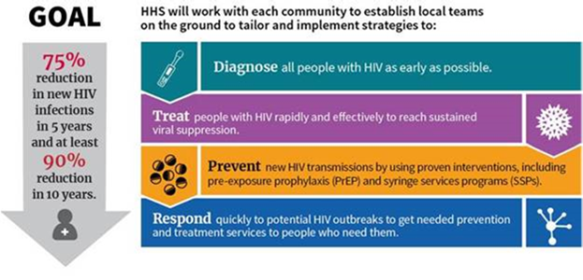
The U.S. Ending the HIV Epidemic (EHE) Plan: Supported by Years of Evidenced Based Science
Did Not Include Implementation Plans nor Integration of SUD Treatment
TEST
TREAT
PREVENT
RESPOND
Notes:
That brings me to discuss the bold goal of the federal US government to end the HIV epidemic, by reducing the number of new infections by 90% over the next decade. To do this, efforts are needed to improve the HIV treatment cascade in terms of early diagnosis, uptake of ART and sustained adherence to limit onward transmission.

Slide 9
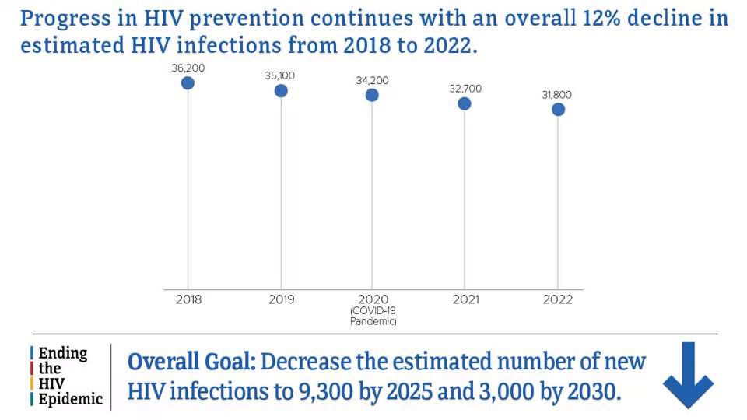

We are not on target to reach our goals
The U.S. is Not Reaching Our Goal
Notes:
https://www.hiv.gov/hiv-basics/overview/data-and-trends/statistics
Accessed 1.25.2026****
People who inject drugs accounted for 7% (2,300) of the 31,800 estimated new HIV infections in 2022. Men who inject drugs accounted for 4% (1,300) of estimated new HIV infections, while women who inject drugs accounted for 3% (1,000) of estimated new HIV infections. Among people who inject drugs, no changes were detected in the estimated annual number of HIV infections in 2022, compared with 2018.

Slide 10
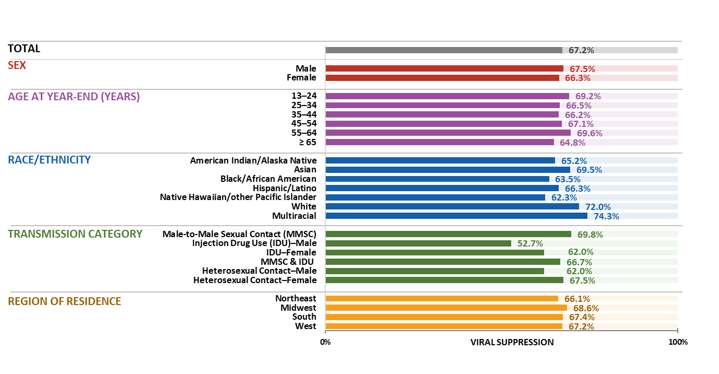

Viral suppression during 2023 among persons living with diagnosed HIV, by selected characteristics—United States
Only 67% of People With HIV were virally suppressed
Note. Data are presented for persons aged ≥ 13 years by year-end 2023. Hispanic/Latino persons can be of any race.
Notes:
In the United States, 67.2%. of 1,076,732 persons aged ≥ 13 years living with diagnosed HIV at year-end 2023 had viral suppression at their most recent test.
Highest percentages—males, persons aged 55–64 years, multiracial persons, persons with HIV attributed to male-to-male sexual contact, and persons currently residing in the Midwest
Lowest percentages —females, persons aged 35–44 years, Native Hawaiian/other Pacific Islander persons, and males with HIV attributed to injection drug use, and persons currently residing in the Northeast
Note.
For additional data, see Tables 4a and 4b in the report HIV Surveillance Supplemental Report: Monitoring Selected National HIV Prevention and Care Objectives by Using HIV Surveillance Data United States and 6 Territories and Freely Associated States, 2023 at https://www.cdc.gov/hiv-data/nhss/national-hiv-prevention-and-care-outcomes.html.
Data have been statistically adjusted to account for missing transmission category.
Use caution when interpreting data for American Indian/Alaska Native and Native Hawaiian/other Pacific Islander persons due to small numbers.
For more information on data sources, data collection and reporting practices, and case definitions, see the National HIV Surveillance System (NHSS) Technical Notes, available at https://www.cdc.gov/hiv-data/nhss/index.html.
For more information on viral suppression, see the Technical Notes, available at https://www.cdc.gov/hiv-data/nhss/national-hiv-prevention-and-care-outcomes.html.
Data for all figures are available at https://www.cdc.gov/hiv-data/nhss/national-hiv-prevention-and-care-outcomes.html.

Slide 11
Advances in PrEP:
Cost and Coverage of Long-Acting PrEP
Tenofovir/Emtricitabine
TAF/Emtricitabine
Cabotegravir inj
Lenacapavir inj
$
$$
$$$
$$$$
1 Pill a day
One Injection
every 2 months
One injection
every 6 months
2012
2019
2021
2025
Notes:
We have better and better regimens however cost is higher.
Truvada $2000/ month x 12
Descovy without insurance 2300/ month x 12
Cabotegravir 3700/ injection x 6
Lenacapavir $14,000/ injection x 2
In our Texas ACTION sites, many wanted LAI PrEP but they could not have due to lack of insurance.

Slide 12
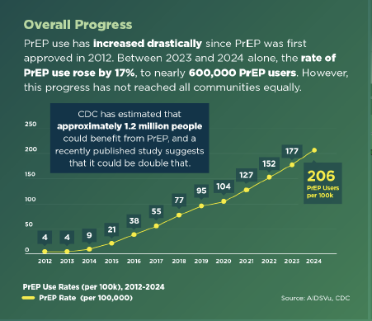
The U.S. is not meeting its PrEP Targets
About 600,000 PrEP users Nationally as of 2024,
  BUT…..
2.25 million people could benefit from PrEP¹
1. Kourtis et al. Annals Of Epidemiology. 2025; 106; 48-54.
Notes:
Why?
There are disparities for PrEP just like ART and V/s – geographic constraints- southern states highest HIV rates but lowest PrEP uptake: racial/ ethnic minorities (Black and Hispanic populations less likely to receive PrEP but higher HIV prevalence than whites and women not receiving PrEP (9%) compared to men ( 91%); nor Persons who use drugs and those involved in criminal legal settings ARE NOT being offered PrEP - all high need populations
Education about PrEP poor
Lack of Insurance to obtain PrEP in many states
Risk perception not in line with Risk … next slide

Slide 13
Persons with HIV (PWH) have a Higher Prevalence of Drug Use Disorders than Persons Without HIV (PWOH)
*Drug Use Disorder here excludes Cannabis Use Disorder
West B et al. Journal of Substance Use & Addiction Treatment. Volume 164. 2024
Notes:
Data come from the National Survey on Drug Use and Health (NSDUH),
an annual cross-sectional survey sponsored by the Substance Abuse and Mental Health Services Administration
five years of NSDUH data from 2015 (n =57,146), 2016 (n =56,897), 2017 (n =56,276), 2018 (n =56,313), and 2019 (n =56,136) to increase the sample size of individuals who reported their HIV status (N =282,768). exclude data from 2020 onward due to changes in sampling procedures. For this study, restricted the sample to adults aged 18 and older (n =214,505) and excluded children 12–17 (n =68,263), as they have distinct substance use and clinical needs. excluded n =117 adults with “Blank (No answer)” or “Bad data” for HIV status. The weighted prevalence of past-year SUD was 18.6 % among PWH, 7.8 % among adults who were HIV-negative, and 7.5 % among adults whose HIV status was unknown. To focus on SUD, which is a clinical indication of treatment need, excluded 192,222 adults who did not meet past-year DSM-IV criteria for SUD. final unweighted sample included 22,166 adults in the 2015–2019 NSDUH with a past- year SUD who responded to the HIV status question (Fig. 1).
Data on weighted characteristics of the 21,166 individuals aged 18 years and older with SUD in this study, stratified by HIV status group are in Table 1. A total of 0.5 % of the weighted sample were PWH, 0.8 % were HIV status unknown, and 98.6 % reported they are non-PWH.
In the past year, a majority of PWH with a SUD met the criteria for alcohol use disorder (56.6 %) or other drug use disorder (58.5 %) and 23.1 % had a cannabis use disorder (Table 1). Among people with unknown HIV status, 64.1 % reported alcohol use disorder, 26.0 % had a cannabis use disorder, and 34.3 % had another drug use disorder. Over a third of PWH and those with unknown status reported having two or more SUDs (39.4 % of PWH and 34.4 % for HIV status unknown).
AUD DUD (excluding cannabis )
PWH 56.6% 58.5%
Unknown status 64.1% 34.3%
PWOH 75% 20.6%
Prevalence of any past-year SUD treatment was 24.2 % among PWH, 17.3 % among those who reported their HIV status as unknown, and 10.3 % among individuals without HIV. Past-year specialty SUD treatment utilization was also low across groups: 17.8 % for PWH, 10.9 % for those with HIV status unknown, and 7.2 % for individuals without HIV. Only 12.4 % of PWH, 3.7 % of those with unknown HIV status, and 4.9 % of non-PWH indicated a perceived

Slide 14
PrEP Prescription Low among PWUD in the United States
Only 1 in 500 persons without HIV with opioid and or stimulant use disorder received a PrEP prescription (TDF/FTC only *)
  MarketScan Commercial Claims & Encounters Database
  Commercially insured (did not include Medicaid/ uninsured*)
  N=547,709 persons with opioid and stimulant use disorders included
  Years 2010-2019
Streed CG et al. JAMA Netw Open. 2022; 5(7).
Notes:
Streed CG, Morgan JR, Gai MJ, Larochelle MR, Paasche-Orlow MK, Taylor JL. Prevalence of HIV Preexposure Prophylaxis Prescribing Among Persons With Commercial Insurance and Likely Injection Drug Use. JAMA Netw Open. 2022;5(7):e2221346. doi:10.1001/jamanetworkopen.2022.21346
Cross sectional study used deidentified data from MarketScan Commercial Claims and Encounters Database to identify sample of commercially insured persons without HIV but with opioid and/ or stimulant use disorder including PWID from January 1, 2010- December 31, 2019 .Data analyzed from 11/1/2020 to 7/1/2021
Question What is the prevalence of HIV preexposure prophylaxis (PrEP) among commercially insured persons with opioid and/or stimulant use disorder by injection drug use (IDU) status?
Findings In this cross-sectional study of 547 709 commercially insured persons with opioid and/or stimulant use disorder, including 110 592 persons with evidence of IDU, 0.09% of the population overall and 0.15% of those with evidence of IDU received a PrEP prescription.
Meaning In this study, HIV PrEP delivery for persons with substance use disorder, including those who inject drugs, remained low.
547, 709 persons with opioid and or stimulant use disorder and of them 20.2% had evidence of IDU
Only 508 received PrEP ( Truvada) !!!!!!
Translated to only 1 in 500 persons with OUD and or stimulant use disorder eligible for PrEP ( via Sex or sharing IDU works) received PrEP prescription.
Do not forget not just IDU but condomless sex are risks and need to be asked.. PrEP offered to all including LAI PrEP…..

Slide 15
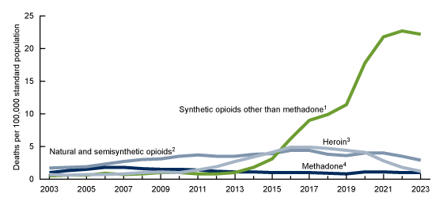
Age-adjusted rate of drug overdose deaths involving opioids, by type of opioid: United States, 2003–2023
Garnett MF, Miniño AM. Drug overdose deaths in the United States, 2003–2023. NCHS Data Brief, no 522. Hyattsville, MD: National Center for Health Statistics. 2024.

Slide 16
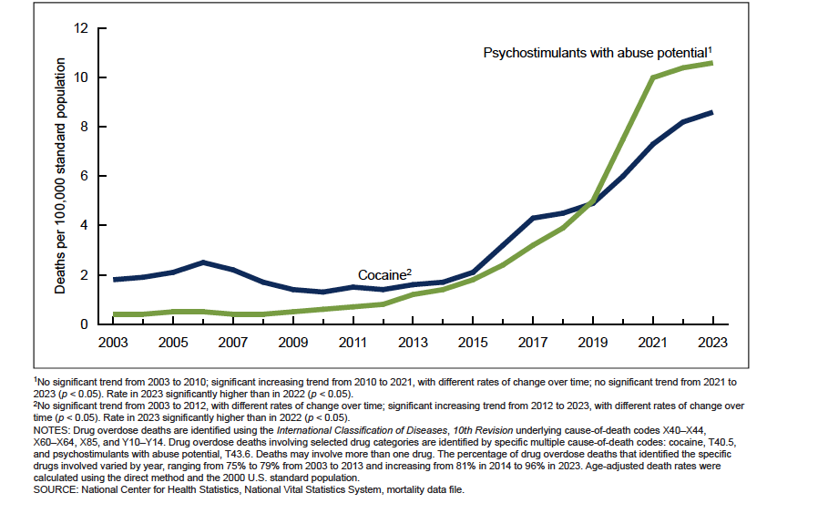
Age-adjusted rate of drug overdose deaths involving stimulants, by type of stimulant: United States, 2003–2023
Notes:
Garnett MF, Miniño AM. Drug overdose deaths in the United States, 2003–2023. NCHS Data Brief, no 522. Hyattsville, MD: National Center for Health Statistics. 2024. DOI: https://dx.doi.org/10.15620/cdc/170565.

Slide 17




Drug And Alcohol use Increases Risk of HIV Transmission & Interrupts the HIV Continuum of Care
Opioid
Alcohol
Increase Sexual Risk & IDU Risk
Reduce ART Adherence,
Increase Viral Load
Cocaine
Methamphetamine
Progression to AIDS/ Increased risk of transmission to uninfected
1. Kurma et al., 2015; 2. Mehta et al., 2014; 3. Shoptaw, 2013; 4.Wechsberg et al., 2011; 5.Altice et al. Lancet 2010; 6.Azar et al. 2010; 7.Springer et al, CID, 2011
* Slide: Nabila El-Bassel, PhD

Slide 18
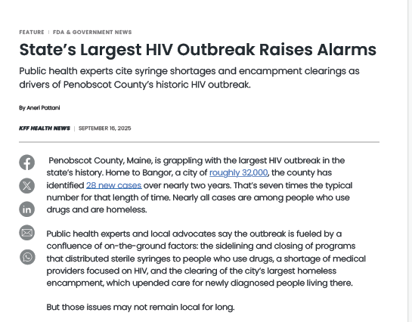
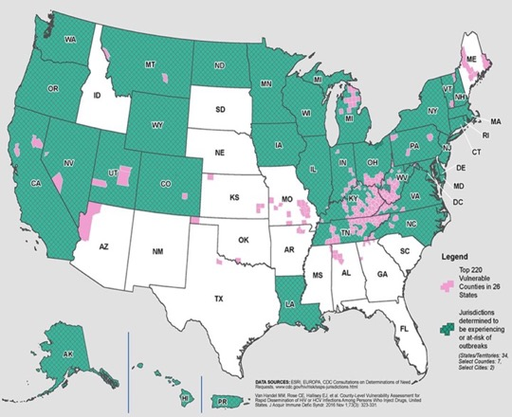
HIV outbreaks are Increasing among
Persons who use Drugs (PWUD)
King County, WA. 27 HIV cases from IDU 2018 (286% increase from 2017)
Lowell and Lawrence, MA, 129 HIV cases PWID from 2015-2018 (2012-2014, entire Mass had 123 IDU cases)
Bangor, Maine
Scott County, IN 215 HIV cases 2014-2015
& Expanded to to Portland, ME
Multnomah County, OR. 42 HIV cases mostly IDU in 2018-2019 (200% increase from 2016-2017)
Philadelphia, PA, 59 HIV Cases from IDU in 2018 (60% increase from 2016)
Cabell County WV, 55 HIV Cases from IDU in 2019 thru June (588% increase from 2016) – as of 9/9/19, up to 76 cases
PWUD are not receiving PrEP
Or SUD tx
Notes:
Not only are people dying directly from the harms of overdose but also acquiring HIV and other infectious diseases after we had a complete reduction in new HIV cases occurring among PWUD in our original HIV epidemic in the late 1980s fueled by injection of heroin and cocaine but due to SSPs, methadone, RWCA and HAART we had a reduction… but all along we never really figured out how to integrate HIV and SUD prevention and treatmeny services.

Slide 19
Steps to Integrate SUD with HIV Care
Screen and Diagnose SUD
Provide Treatment (Medications, Behavioral Health)
Help retain in treatment/Overcome Barriers
1
2
3

Slide 20
Screen & Diagnose SUD

Slide 21
IDENTIFY: DSM-5 SUD Diagnostic Criteria
Diagnosis: ≥ 2 symptom criteria within a 12-mos period
Severity: Mild 2-3 symptoms: Moderate 4-5 symptoms: Severe 6 or more symptoms
Category | Criteria
Loss of control | *Opioids are often taken in larger amounts or over a longer period than was intended There is a persistent desire or unsuccessful efforts to cut down or control opioid* use A great deal of time is spent in activities necessary to obtain the opioid, use the opioid, or recover from its effects Craving, or a strong desire or urge to use opioids
Social problems | Recurrent opioid use resulting in a failure to fulfill major role obligations at work, school, or home Continued opioid use despite having persistent or recurrent social or interpersonal problems caused or exacerbated by the effects of opioids Important social, occupational, or recreational activities are given up or reduced because of opioid use
Risky use | Recurrent opioid use in situations in which it is physically hazardous Continued opioid use despite knowledge of having a persistent or recurrent physical or psychological problem that is likely to have been caused or exacerbated by the substance
Pharmacologic problems | Exhibits tolerance: need for a larger amount to achieve desired effect or diminished effect with same amount Exhibits withdrawal: occurrence of a characteristic opioid withdrawal syndrome or continued use of opioids or closely related substances to avoid withdrawal symptoms
American Psychiatric Association. (2013). Opioid Use Disorder. In Diagnostic and statistical manual of mental disorders (5th ed.). Arlington, VA: American Psychiatric Publishing.
*Substitute the substance for where opioid is
Notes:
DSM=Diagnostic Statistical Manual (basically the ‘bible’ for diagnosis of all psychiatric disorders )
Here I put in opioids for drug asked but you can put in any type of drug, e.g. cocaine, methamphetamine, alcohol, cannabis… same symptoms for all forms of SUD
Diagnosis of an SUD is 2 or more symptoms
Severity is based on number of symptoms
FDA approved medications for OUD require a moderate to severe diagnosis of OUD to prescribe so that is why severity is important!

Slide 22
Screening/Diagnostic Tools For SUD
1.The Tobacco, Alcohol, Prescription medication, and other Substance use (TAPS) Tool | TAPS 1 is 4 item screener and if positive goes to TAPS 2 for DSM 5 SUD diagnosis | McNeely J, Wu L, Subramaniam G, Sharma G, Cathers LA, Svikis D, et al.Performance of the Tobacco, Alcohol, Prescription Medication, and Other Substance Use (TAPS) Tool for Substance Use Screening in Primary Care Patients.Ann Intern Med. 2016;165:690-699. doi: 10.7326/M16-0317. https://nida.nih.gov/taps2/
2. Drug Abuse Screening Test (DAST) | 10 items, no information about drug of concern | Skinner, H. A. (1982). "The drug abuse screening test." Addict Behav 7(4): 363-371.
3. Substance Use Brief Screen (SUBS) | 4 items, preliminary testing in primary care | McNeely J, Strauss SM, Saitz R, Cleland CM et al. A Brief Patient Self-administered Substance Use Screening Tool for Primary Care: Two-site Validation Study of the Substance Use Brief Screen (SUBS). Am J Med. 2015 Jul;128(7):784.e9-19. PMCID: PMC4475501.
4. Rapid Opioid Use Disorder (ROUDA) and Rapid Stimulant Use Disorder (RSUDA) ⁵ | Both 8 items. Diagnose DSM-5 moderate to severe OUD and StUD. Can be administered by non-clinician. Validated to MINI. | Di Paola, A., Farabee, D. and Springer, S.A. (2023), Validation of Two Diagnostic Assessments for Opioid and Stimulant Use Disorder for Use by Non-Clinicians. Psych Res Clin Pract, 5: 78-83.
5. Michigan Alcohol Screening Test (MAST) | 10 items, severity measure | Storgaard H, Nielsen SD, Gluud C. The validity of the Michigan Alcoholism Screening Test (MAST). Alcohol Alcohol. 1994 Sep;29(5):493-502. PMID: 7811333.
6. Alcohol Use Disorders Identification Test (AUDIT ) or AUDIT-C | 10 items, well-validated for AUDIT; 3 items For AUDIT-C | Saunders, J. B., et al. (1993). "Development of the Alcohol Use Disorders Identification Test (AUDIT): WHO Collaborative Project on Early Detection of Persons with Harmful Alcohol Consumption--II." Addiction 88(6): 791-804.
Notes:
Appendix Table 1. Screening Tools for Substance Use Disorders
1. McNeely J, Wu L, Subramaniam G, Sharma G, Cathers LA, Svikis D, et al.Performance of the Tobacco, Alcohol, Prescription Medication, and Other Substance Use (TAPS) Tool for Substance Use Screening in Primary Care Patients.Ann Intern Med. 2016;165:690-699. doi: 10.7326/M16-0317. https://nida.nih.gov/taps2/
2. Skinner, H. A. (1982). "The drug abuse screening test." Addict Behav 7(4): 363-371.
3. McNeely J, Strauss SM, Saitz R, Cleland CM, Palamar JJ, Rotrosen J, Gourevitch MN. A Brief Patient Self-administered Substance Use Screening Tool for Primary Care: Two-site Validation Study of the Substance Use Brief Screen (SUBS). Am J Med. 2015 Jul;128(7):784.e9-19. doi: 10.1016/j.amjmed.2015.02.007. Epub 2015 Mar 10. PMID: 25770031; PMCID: PMC4475501.
5. Di Paola, A., Farabee, D. and Springer, S.A. (2023), Validation of Two Diagnostic Assessments for Opioid and Stimulant Use Disorder for Use by Non-Clinicians. Psych Res Clin Pract, 5: 78-83. https://doi.org/10.1176/appi.prcp.20230022
5.. Storgaard H, Nielsen SD, Gluud C. The validity of the Michigan Alcoholism Screening Test (MAST). Alcohol Alcohol. 1994 Sep;29(5):493-502. PMID: 7811333.
6. Saunders, J. B., et al. (1993). "Development of the Alcohol Use Disorders Identification Test (AUDIT): WHO Collaborative Project on Early Detection of Persons with Harmful Alcohol Consumption--II." Addiction 88(6): 791-804.

Slide 23
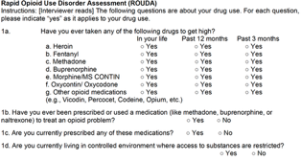
OPIOID USE DISORDER (OUD)
DSM- 5 Validated Rapid Opioid Use Disorder Diagnostic Tool: ROUDA
ROUDA: Validated for DSM‐5 moderate‐to‐severe opioid use disorder
Non-clinicians can administer
Rapid DSM-5 diagnosis of OUD in < 5 minutes!
Can lead to immediate treatment with MOUD!
If interested in Use Contact Sandra.springer@yale.edu
Di Paola, A., Farabee, D. and Springer, S.A. (2023), Validation of Two Diagnostic Assessments for Opioid and Stimulant Use Disorder for Use by Non-Clinicians. Psych Res Clin Pract, 5: 78-83.

Slide 24
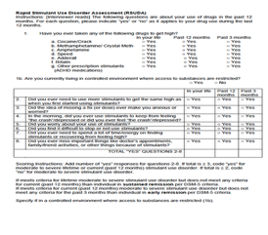
STIMULANT USE DISORDER (StUD)
DSM- 5 Validated Rapid Stimulant Use Disorder Diagnostic Tool: RSUDA
RSUDA:
Validated to DSM‐5 moderate to severe stimulant use disorder
Non-clinicians can administer
Rapid DSM-5 diagnosis in < 5 minutes!
Can lead to immediate treatment access
If interested in Use Contact Sandra.springer@yale.edu
Di Paola, A., Farabee, D. and Springer, S.A. (2023), Validation of Two Diagnostic Assessments for Opioid and Stimulant Use Disorder for Use by Non-Clinicians. Psych Res Clin Pract, 5: 78-83.

Slide 25
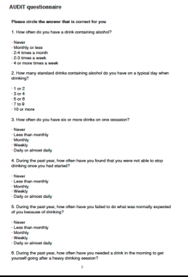
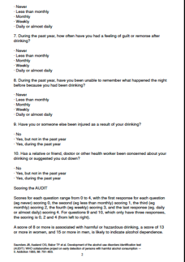
Alcohol Use Disorders Identification Test (AUDIT)
Harmful drinking = score of 8 or >
Moderate to Severe AUD:
Women 13 or >
Men 15 or >
Saunders, J. B., et al. (1993). "Development of the Alcohol Use Disorders Identification Test (AUDIT): WHO Collaborative Project on Early Detection of Persons with Harmful Alcohol Consumption--II." Addiction 88(6): 791-804.
Notes:
full AUDIT below cited.
Saunders, J. B., et al. (1993). "Development of the Alcohol Use Disorders Identification Test (AUDIT): WHO Collaborative Project on Early Detection of Persons with Harmful Alcohol Consumption--II." Addiction 88(6): 791-804.
The AUDIT can give you scores for severity of AUD:
A score of 8 or more = harmful drinking
A score of 13 or more in women or 15 or more in men = moderate to severe AUD

Slide 26
SUD Treatment

Slide 27
FDA-Approved Medications for Opioid Use Disorder (MOUD)
 | Methadone | Buprenorphine | Extended-release Naltrexone
Mechanism of Action | Full μ agonist | Partial μ agonist, Partial κ antagonist | Full μ antagonist
Delivery | Oral | Sublingual, film, injection* | Injection
Frequency | Daily | Daily oral; weekly/monthly injection; | monthly
Setting | Licensed drug treatment program | PCC/HIV care setting | PCC/HIV care setting
Other | Highly structured due to safety concerns. OD potential Interacts with some ARVs Reduces HIV Risk Behaviors | No interactions with ARVs Reduces HIV Risk Behaviors Reduces OD Improves HIV Viral Suppression (VS) | Also treats Alcohol Use Disorders No overdose or diversion concerns Reduces HIV Risk Behaviors Reduces Overdose Improves VS*^{2,3}
Notes:
These are 3 pharmacotherapies that have been FDA approved in the United States for treatment of opioid use disorders and in this table I show the differences in mechanism of action and delivery . Also in the U.S. , all of the treatments except for methadone can be given in HIV treatment centers or primary care offices as denoted in the setting.
Of note , A depot formulation of an opioid receptor antagonist, naltrexone (oral approved 1984 , ReVia®) was approved in 2006 for treatment of alcohol use disorder and for opioid use disorder in 2010..
Of note Revia is NOT currently used in the U.S. for opioid use disorder any longer due to following: .
ReVia has not reduced recidivism, retention, : poor compliance so passive-compliance formulations developed (1)
Vivitrol FDA-approved 2006 for Alcohol dependence (effective for prevention of relapse to alcohol use)
FDA-approved in 2010 for Opioid dependence
Ref: Minozzi SCochrane Database Syst Rev 2006; 1: CD001333

Slide 28
Long-Acting Injectable (LAI) Forms of Buprenorphine May Improve Adherence
Form of LA- Buprenorphine | Induction | How to Administer & Location | Dose | Frequency | Outcomes | Special Issues
Sublocade | Can do one dose of SL bupe 4-8mg and then 300 mg injection same day and administer 2nd 300mg dose in 1 week | Sub-Cutaneous (SC) injection Upper Arm/ Thigh/Buttock/ Abdomen | 300mg, 100mg | Monthly | ⬇Use | REMS Refrigeration
Brixadi | Naïve of SL BUP or switch from SL BUP can be done same day | SC injection Upper Arm/ Thigh/Buttock/ Abdomen | 8/16/24/32 mg weekly -64/96/128 mg monthly | Weekly or monthly | ⬇Use | REMS
Notes:
Risk Evaluation and Mitigation Strategy ( REMS) : Sublocade and Brixadi all require REMS pharmacies to store med and dispense
Brixadi available 9/2023.
Sublocade:
What is the REMS (Risk Evaluation and Mitigation Strategy) Program?
A REMS is a strategy to manage known or potential risks associated with a drug, and is required by the Food and Drug Administration (FDA) to ensure that the benefits of the drug outweigh its risks.. SUBLOCADE/BRIXADI is available only through a restricted distribution program called the REMS Program because of the risk of serious harm or death that could result from intravenous self-administration.
What are the REMS program requirements?
All healthcare settings and pharmacies that dispense SUBLOCADE/BRIXADI must be certified in the REMS program
Healthcare providers, healthcare settings, and pharmacies must obtain SUBLOCADE/BRIXADI through a restricted distribution program
Which healthcare settings MUST BE certified in the REMS program?
All healthcare settings and pharmacies that dispense SUBLOCADE/BRIXADI must be certified. Examples of healthcare settings include: group practice, independent practice, institution, Department of Defense (DoD) facility, outpatient clinic, hospital, Veterans Administration (VA) facility, opioid treatment program (OTP), closed healthcare system, other healthcare setting.

Slide 29
The Stage of OUD Helps to Know When and How to Start Buprenorphine
Person currently reporting use of opioids in opioid withdrawal
Needs Buprenorphine immediately to alleviate withdrawal
Person reporting opioid use but not in withdrawal
Will Need Buprenorphine soon … when start withdrawal (* COWS 4 or greater)
Person not actively using and at risk of relapse (e.g., release from prison, confined setting)
Start buprenorphine to prevent relapse
Treat craving
-Low dose of buprenorphine
-Go slow – may take 2 weeks or 4 weeks to get to adequate dose… monitor craving 1-10 scale until get to at least 16 mg daily / start LAI bupe
Or start now and maintain the opioid and build up the buprenorphine and then stop the opioid… don’t need to go into withdrawal
Or Start Buprenorphine (LAI) when not in withdrawal or mild withdrawal (Monitor*)
Notes:
Can discuss more in breakout sessions

Slide 30
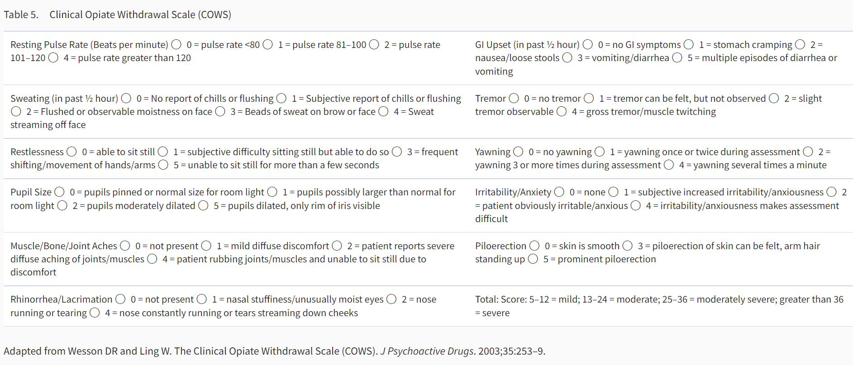
Assess for Opioid Withdrawal
Clinical Opioid Withdrawal Scale (COWS)
Notes:
COWS is a free assessment tool that you can download on your phone or put in your Electronic medical record or on a tablet have a nurse or other administer to assess level of opioid withdrawal in a patient who has been using opioids . The level of withdrawal can tell you if safe to start buprenorphine in a patient who is actively using opioids. For those who have opioid use disorder but are currently not using such as persons who have been in detox facilities/ or prisons – they will not be in withdrawal and thus you just need to start buprenorphine to prevent craving and relapse but start slower to get to a level of at least 8 mg -16 mg for them . In persons who are actively using and in withdrawal you can go much faster in induction of buprenorphine dose and possibly get up to max dose of 16-24 mg in same day. You follow their withdrawal symptoms should decrease and ask them if they are craving opioids scale of 1-10 just like a pain scale and craving should decrease as well. Also can start safely same day LAI Buprenorphine ( sublocade or brixadi in a person who used fentanyl even) usually get COWS to 4 or higher (however there is data to support not in withdrawal). Also can start while a person on opioids still and just start low dose bupe, maintain the opioid then at 5-7 days drop the opioid . All forms of MOUD reduce craving.

Slide 31
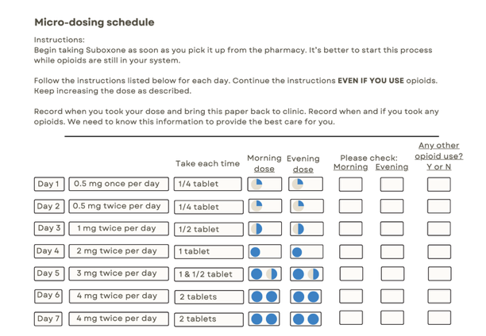
Buprenorphine induction while on opioid agonists
Sample of a patient hand-out using 2mg-0.5mg SL Tablets

Slide 32
Safe to Start High Dose LAI Buprenorphine In Persons With OUD Actively Using Fentanyl
Buprenorphine in weekly and monthly LAI has been found to be safe to start in persons with OUD using fentanyl without precipitating withdrawal
Shared decision making is essential to understand withdrawal potential and how to manage
D’Onofrio G et al. JAMA Network Open. 2023;2024.
Seval N… Springer S. JAMA Network Open 2025.
Shiwach R et al. JAMA Network Open. 2025.(x2)
Springer SA. JAMA Network Open 2025
Notes:
Shiwach R, Le Foll B, Alho H, Dunn KE, Strafford S, Zhao Y, Dobbins, R. Selecting extended-release buprenorphine doses to treat high -risk opioid use in the fentanyl era. JAMA Network Open. 2025 (November) In Press.
Springer SA. Is it safe to start high dose extended-release buprenorphine in persons who use fentanyl? JAMA Network Open. 2025 (November), In Press.
Gregory C, Yadav K, Linders J, Sikora L, Eagles D. Incidence of buprenorphine- precipitated opioid withdrawal in adults with opioid use disorder: A systematic review. Addiction. 2025;120(1):7-20.
Springer SA. Commentary on Gregory et al.: Fear of precipitated opioid withdrawal should not prevent buprenorphine initiation. Addiction. 2025 Jan;120(1):21-22. doi: 10.1111/add.16701. Epub 2024 Nov 4. PMID: 39494653; PMCID: PMC11645183.
Shiwach R, Le Foll B, Alho H, Dunn KE, Strafford S, Zhao Y, Dobbins RL. Rapid vs Standard Induction to Injectable Extended-Release Buprenorphine: A Randomized Clinical Trial. JAMA Netw Open. 2025 Oct 1;8(10): e2537319. doi: 10.1001/jamanetworkopen.2025.37319. PMID: 41085986; PMCID: PMC12522003.
Seval N, Roth P, Frank CA, Di Paola A, Litwin AH, Vander Wyk B, Neirinckx V, Schlossberg E, Lawson P, Strong M, Schade MA, Nunez J, Levin FR, Brady KT, Nunes EV, Springer SA. Initiating Injectable Buprenorphine in People Hospitalized With Infections: A Randomized Clinical Trial. JAMA Netw Open. 2025 May 1;8(5): e2513000. doi: 10.1001/jamanetworkopen.2025.13000. PMID: 40445619; PMCID: PMC12125644.
D'Onofrio G, Herring AA, Perrone J, Hawk K, Samuels EA, Cowan E, Anderson E, McCormack R, Huntley K, Owens P, Martel S, Schactman M, Lofwall MR, Walsh SL, Dziura J, Fiellin DA. Extended-Release 7-Day Injectable Buprenorphine for Patients With Minimal to Mild Opioid Withdrawal. JAMA Netw Open. 2024 Jul 1;7(7): e2420702. doi: 10.1001/jamanetworkopen.2024.20702. PMID: 38976265; PMCID: PMC11231806. The overall incidence of precipitated withdrawal in the group with COWS scores of 4 to 7 was low (only 2 of 63 precipitated withdrawal patients) compared with 5 of 37 in the group with COWS scores of 0 to 3. Additional research is needed to clearly delineate the association between COWS scores and tolerance of buprenorphine initiation, particularly at the very low range. This is consistent with the same group’s recent publication of a study of 1200 patients in a clinical trial receiving either extended- release buprenorphine (COWS score of >4) or sublingual buprenorphine, which found that there were few patients with precipitated withdrawal (<1%), despite a high prevalence of fentanyl use.(8 below) Given the low rate of precipitated withdrawal in COWS scores of 4 to 7 (3.2%), eligibility criteria to include patients with COWS scores of 4 to 7 were expanded in an ongoing randomized clinical trial, Emergency Department-Initiated BUP Validation, comparing standard sublingual dosing with extended-release buprenorphine in rates of continued engagement in treatment by including those presenting with COWS scores of 4 to 7.
D’Onofrio G, Hawk KF ,Perrone J, et al. Incidence of precipitated withdrawal during a multisite emergency department-initiated buprenorphine clinical trial in the era of fentanyl. JAMA Netw Open. 2023;6(3):e236108. doi: 10.1001/jamanetworkopen.2023.6108

Slide 33
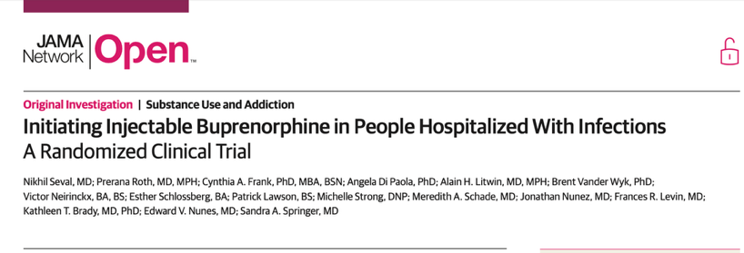
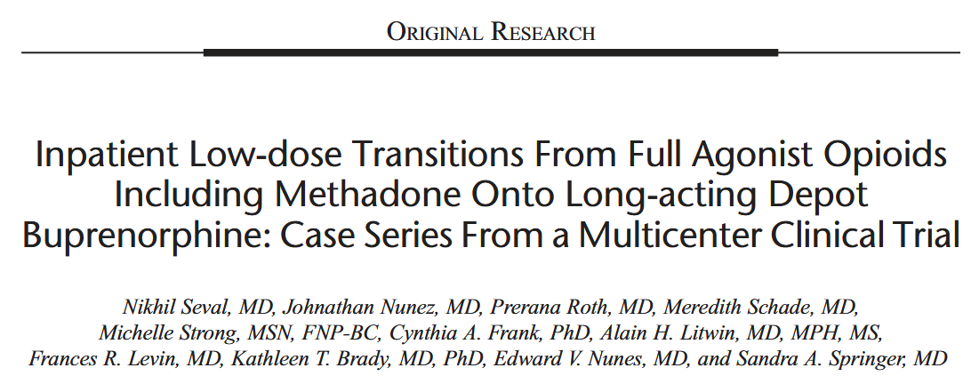
COMMIT study
Seval et al. JAMA Network Open. 2025
Seval et al. J Addict Med 2023

Slide 34
Rapid Vs. Standard induction to Extended-Release Buprenorphine (XR-BUP) Injection
Notes:
To compare the effectiveness and safety of rapid induction (RI; single 4-mg dose of buprenorphine-naloxone) vs SI (≥7 days of buprenorphine-naloxone) followed by extended-release buprenorphine injection.
Eligibility: negative pregnancy test result or COWS score ≥8
A total of 149 of 474 participants (31.4%) in the RI and 64 of 255 participants (25.1%) in the SI arm had AEs associated with opioid withdrawal symptoms up to injection 2 (Table 3); these AEs were more common in the fentanyl-positive vs fentanyl-negative subpopulation. The most common AEs associated with opioid withdrawal symptoms were nausea, anxiety, restlessness, and vomiting (eTable in Supplement 1).
Similar percentages of participants (53 [11.2%] in the RI arm vs 29 [11.4%] in the SI arm) had a COWS total score increase from before transmucosal buprenorphine of 6 or more during the 5 hours after transmucosal buprenorphine on the most recent induction day. All but 4 of these participants had a positive qualitative UDS result for fentanyl.

Slide 35
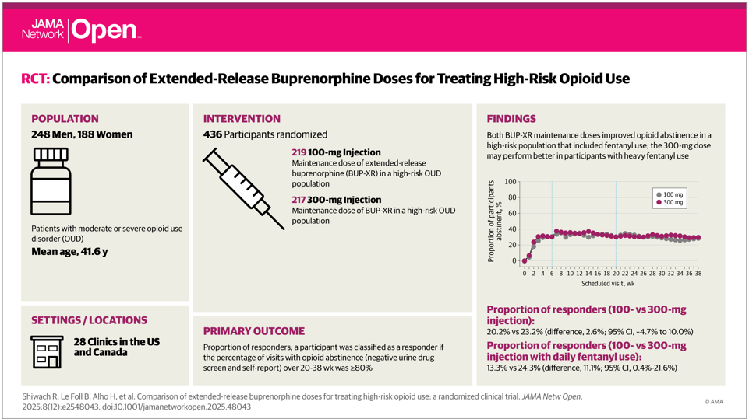

Slide 36
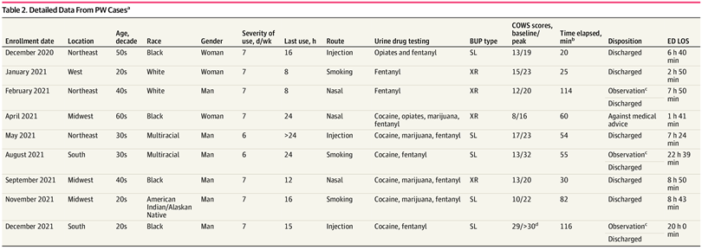
ED-initiated XR-buprenorphine multisite RCT of 1200 patients, the incidence of precipitated withdrawal was less than 1% (N=9)
D’Onofrio G, et al. JAMA Netw Open. March 2023.
Notes:
In a multisite ED-initiated buprenorphine trial of 1200 patients, the incidence was less than 1%.
COWS 4 or greater
Patients are observed in the ED for 2 hours after receiving XR-BUP and discharged with a follow-up appointment for comprehensive addiction treatment within 7 days.
In this study, 28 EDs participated from June 30, 2020, to October 26, 2022. Patients were randomized to standard sublingual buprenorphine inductions or extended-release buprenorphine and were observed for 2 hours. PW was defined⁵ a priori and was considered when a marked escalation in objective COWS scores (score ≥5) occurred, requiring additional buprenorphine and ancillary medications, often within 2 hours of buprenorphine administration.”
Of the 1200 patients, only nine had precipitated withdrawal. Details of their care are in this table and really are notable for a significant amount of heterogeneity among those experiencing withdrawal. Including no clear association with race, gender, time since last use, Routes of use, etc, etc. In addition, time from bup dose to PW development varied. One thing you can see though is that once it developed, the ED LOS was fairly significant.
D’Onofrio G, Hawk KF, Perrone J, et al. Incidence of Precipitated Withdrawal During a Multisite Emergency Department–Initiated Buprenorphine Clinical Trial in the Era of Fentanyl. JAMA Netw Open. 2023;6(3):e236108. doi:10.1001/jamanetworkopen.2023.6108
Methods: “Twenty-eight geographically diverse EDs participated from June 30, 2020, to October 26, 2022.Patients were randomized to standard sublingual buprenorphine inductions or extended-release buprenorphine and were observed for 2 hours. PW was defined⁵ a priori and was considered when a marked escalation in objective COWS scores (score ≥5) occurred, requiring additional buprenorphine and ancillary medications, often within 2 hours of buprenorphine administration.”
All patients experiencing PW were discharged after symptoms resolved, with 1 self-directed discharge. Follow-up rates at 7 days after the ED visit were 86%.

Slide 37
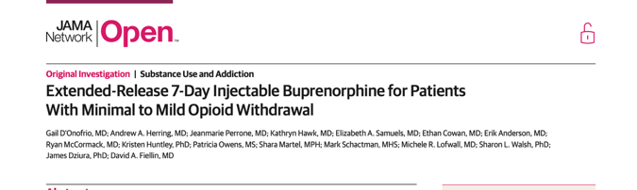
Eligibility: OUD , UTOX positive opioids; COWS < 8 (minimal to mild withdrawal***)
Exclusions: UTOX + positive for methadone , opioid overdose, pregnant, suicidal, on opioids for pain, or on MOUD in the past 7 days
Received the weekly form of 24mg of Brixadi (equivalent to 16 mg of TM bupe)
Primary outcome: # with a 5 point or greater increase in COWS score within 4 hours of the Brixadi; or transitioned to moderate or greater withdrawal ( cows 13 or greater within 4 hours of XR bupe) or experienced precipitated withdrawal within 1 hour of XR bupe
D’Onofrio, JAMA Network. Open. 2024
Notes:
with a urine point-of-care toxicology test positive for opioids, had a COWS score less than 8 (denoting minimal to mild withdrawal), and were able to speak English. Patients were excluded if their urine was positive for methadone or if they presented after an opioid overdose, were pregnant, were actively suicidal, required opioids for pain, or were enrolled in OUD treatment receiving medications in the past 7 days. Patients with a positive fentanyl test only were enrolled based on clinician assessment,
75 patients with COWS scores of 0 to 7 (13 with COWS scores of 0-3 and 62 with COWS scores of 4-7) were enrolled from July 13, 2020, to April 4, 2021. As 83% of the patients enrolled had a COWS score between 4 and 7, the decision was made to continue enrolling an additional 25 patients with COWS scores of 0 to 3 from April 5, 2021, to May 25, 2023. Compensation included gift cards provided for enrollment ($100), 1- to 7-day telephone assessments ($50), and the 7-day follow-up ($50), with a maximum of $200.
patients received a 24-mg dose of CAM2038, equivalent to 16 mg of buprenorphine daily. They remained in the ED for 4 hours after injection to observe for worsening or precipitated withdrawal. Ancillary medications for specific symptoms were available per protocol. Patients were referred to community-based programs or clinicians for ongoing OUD treatment as usual for each site.
The primary outcomes assessing feasibility include the number of participants who (1) experienced a 5-point or greater increase in the COWS score within 4 hours of extended-release buprenorphine injection or (2) transitioned to moderate or greater withdrawal (defined as COWS scores of 13) within 4 hours of the extended-release buprenorphine injection or (3) experienced precipitated withdrawal within 1 hour of the extended-release buprenorphine injection.
ten patients (10.0% [95% CI, 4.9%-17.6%]) experienced a 5-point or greater increase in COWS scores within 4 hours of the extended-release buprenorphine injection. Of those, 7 (7.0% [95% CI, 2.9%-13.9%] of the total sample) transitioned to moderate or greater withdrawal, defined as COWS scores of 13 or greater within 4 hours of the extended-release buprenorphine injection and experienced precipitated withdrawal in the 4 hours after injection, which included 2 of 63 patients (3.2%)withaCOWSscoreof4to7and5of37(13.5%)withaCOWSscoreof0to3.Only2ofthe7 patients (2.0% [95% CI, 0.2%-7.0%]) who developed precipitated withdrawal did so within 1 hour of injection.27 The 7 patients who experienced precipitated withdrawal tested positive for fentanyl (Table 2), as did 70% of all enrolled patients (Table 1). However, of note, 63 patients using fentanyl underwent uneventful inductions.

Slide 38
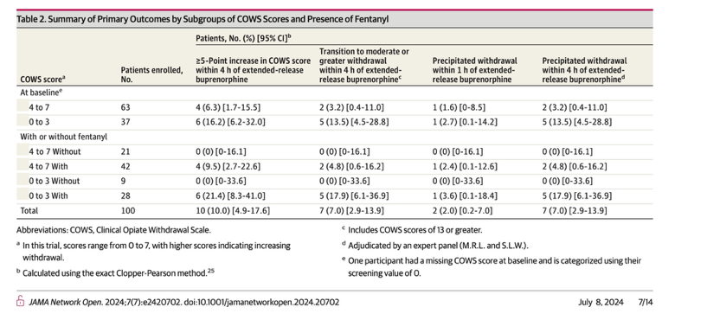
Few Precipitated withdrawal events
63 patients using fentanyl underwent uneventful inductions.
Notes:
ten patients (10.0% [95% CI, 4.9%-17.6%]) experienced a 5-point or greater increase in COWS scores within 4 hours of the extended-release buprenorphine injection. Of those, 7 (7.0% [95% CI, 2.9%-13.9%] of the total sample) transitioned to moderate or greater withdrawal, defined as COWS scores of 13 or greater within 4 hours of the extended-release buprenorphine injection and experienced precipitated withdrawal in the 4 hours after injection, which included 2 of 63 patients (3.2%)with a COWS score of 4to7 and 5 of 37(13.5%)with a COWS score of 0 to 3.Only 2 of the 7 patients (2.0% [95% CI, 0.2%-7.0%]) who developed precipitated withdrawal did so within 1 hour of injection. The 7 patients who experienced precipitated withdrawal tested positive for fentanyl (Table 2), as did 70% of all enrolled patients (Table 1). However, of note, 63 patients using fentanyl underwent uneventful inductions.

Slide 39
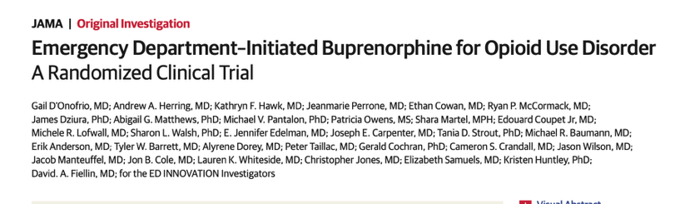
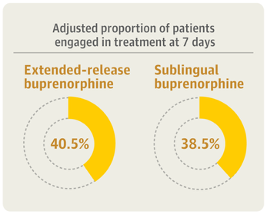
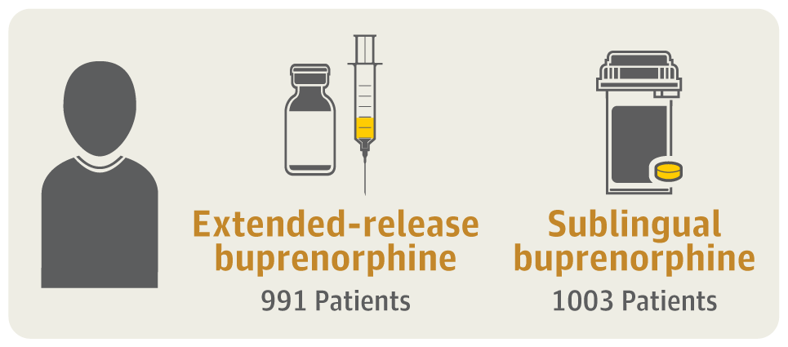
2025
Precipitated opioid withdrawal was less than 1.0%:
6 (0.6%) XR-BUPE and 8 (0.8%) SL BUPE.
Notes:
Question Does 7-day extended-release injectable buprenorphine compared with sublingual buprenorphine improve treatment engagement at 7 days?
Findings In this multicenter randomized trial of 1994 adult patients presenting to the emergency department with untreated opioid use disorder and a Clinical Opiate Withdrawal Scale (COWS) score of 4 or higher, 40.5% in the extended-release group and 38.5% in the sublingual buprenorphine group were in treatment at 7 days, demonstrating no significant difference between groups.
Meaning A 7-day extended-release injectable preparation of buprenorphine does not improve treatment engagement.
Abstract
Importance Extended-release injectable buprenorphine may expand the reach of initiating medications for opioid use disorder in high-risk and hard-to-reach individuals who visit the emergency department (ED) and can be administered in low levels of withdrawal.
Objective To compare the effect of ED-initiated 7-day extended-release injectable buprenorphine vs sublingual buprenorphine on treatment engagement at 7 days.
Design, Setting, and Participants Multicenter randomized clinical trial enrolling adult patients presenting to the ED with untreated opioid use disorder and a Clinical Opiate Withdrawal Scale (COWS) score of 4 or higher across 29 EDs in the US from July 12, 2020, to August 21, 2024. Final follow-up was completed on October 24, 2024.
Interventions Patients were randomized to receive a 24-mg injection of extended-release buprenorphine (equivalent to 16 mg/d) or sublingual buprenorphine, which included either self-administration instructions if the COWS score was less than 8 or administration of 8 mg of sublingual buprenorphine in the ED if the COWS score was 8 or higher. All sublingual buprenorphine group patients received a 7-day prescription for 16 mg/d. Both groups were provided referral for ongoing medication with a scheduled appointment within 7 days.
Main Outcomes and Measures Engagement in opioid use disorder treatment on day 7 was the primary outcome. Secondary outcomes included engagement at 30 days, precipitated withdrawal and overdose events, craving scores, days of illicit opioid use, and patient satisfaction with treatment.
Results Among 2000 patients randomized, 6 who were enrolled twice were excluded, resulting in 991 in the extended-release group and 1003 in the sublingual group. The median age was 37 (IQR, 30-47) years, 68% were male, 31% had an initial COWS score of 4 to 7, and 76% tested positive for fentanyl. The adjusted proportion of engagement in opioid use disorder treatment at 7 days was 40.5% with extended-release buprenorphine vs 38.5% with sublingual buprenorphine (adjusted difference, 1.6%; 95% CI, −2.8% to 6.0%). Engagement at 30 days was similar, with adjusted proportions of 43.8% with extended-release buprenorphine vs 44.9% with sublingual buprenorphine (adjusted difference, −1.5%; 95% CI, −6.2% to 3.2%). Precipitated withdrawal was rare: 6 (0.6%) with extended-release buprenorphine and 8 (0.8%) with sublingual buprenorphine. Overdose events within 30 days occurred in 18 participants (2.3%) in each group. Patients receiving extended-release buprenorphine reported lower mean craving scores at 7 days vs those receiving sublingual buprenorphine (scale, 0-100; mean score, 26.5 vs 30.2, respectively; adjusted mean difference, −3.85; 95% CI, −7.08 to −0.63), fewer days of illicit opioid use in the past 7 days (adjusted ratio of means, 0.77; 95% CI, 0.68-0.95), and better treatment satisfaction scores (scale, 1-5; adjusted mean difference, 0.13; 95% CI, 0.01-0.25).
Conclusions and Relevance No difference was detected in opioid use disorder treatment engagement on day 7 between the 7-day extended-release and sublingual buprenorphine groups. Both buprenorphine formulations were well tolerated; precipitated withdrawal was rare despite a high prevalence of fentanyl.

Slide 40
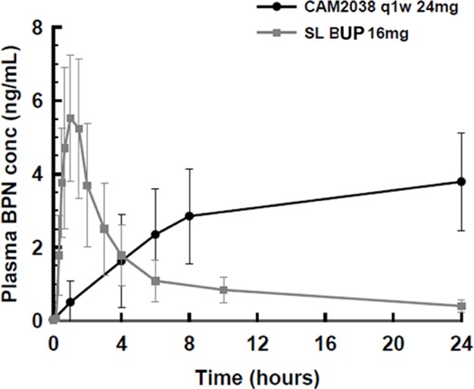
Plasma concentration-time curves of BUP 16 mg TM vs single dose 24 mg CAM2038 (Brixadi 7daydose)
Linear plasma concentration-time curves of buprenorphine after a single dose of 16 mg sublingual buprenorphine and a single dose of 24 mg subcutaneous CAM2038
D'Onofrio G et al. Early emergency department experience with 7-day extended-release injectable buprenorphine for opioid use disorder. Acad Emerg Med. 2023 Dec;30(12):1264-1271. doi: 10.1111/acem.14782. Epub 2023 Aug 22. PMID: 37501652; PMCID: PMC10822018.
Notes:
Despite rapid absorption, SL-BUP has low bioavailability (40%), which is why relatively large doses are needed to achieve therapeutic plasma concentrations.²² Once in plasma and bound to the μ-opioid receptor, buprenorphine has a slow rate of dissociation producing a prolonged duration of action as compared to other opioids.²³ It has a large volume of distribution, high protein binding¹⁷and reaches its peak plasma concentration in ~60 minutes after administration, yet there is wide inter-individual variation in both rate of absorption and peak plasma concentrations.¹⁸After 60 minutes, plasma concentrations drop quickly but with a 32-hour terminal half-life, buprenorphine remains available for binding to the μ-receptor for a prolonged period, albeit at decreasing concentrations.²⁴ (Figure 1)

Slide 41
Opioid Precipitated Withdrawal (PW) Management
Worsening withdrawal, defined as no improvement in withdrawal symptoms or any increase in COWS is treated with additional SL-BUP,
symptomatic treatment with ancillary medications,
  acetaminophen and non-steroidal anti-inflammatory agents for myalgias and pains,
  dicyclomine for abdominal pain,
  loperamide for diarrhea,
  ondansetron, prochlorperazine or promethazine for nausea and
  clonidine for elevated blood pressure, heart rate or restlessness.
  Treatment of nausea and vomiting with sedating antiemetics such as promethazine, may have dual benefit in patients who might be agitated.
When PW occurs, it is treated with high-dose buprenorphine (SL-BUP up to 16–24mg, with additional dosing as needed)
Small doses of benzodiazepines, such as 2mg of lorazepam may be used if anxiety is a prominent symptom.

Slide 42
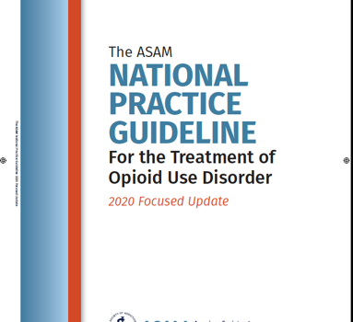
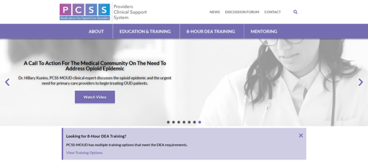
Resources for Diagnosis and Treatment of OUD
https://www.asam.org/quality-care/clinical-guidelines/national-practice-guideline
https://pcssnow.org
Notes:
https://www.asam.org/quality-care/clinical-guidelines/national-practice-guideline
https://pcssnow.org

Slide 43
Treatment of Alcohol Use Disorder
Medication Treatment:
Goal is to reduce craving and amount of alcohol use
Abstinence is not necessarily the goal
Alcohol Withdrawal Risk Assessment:
Behavioral Treatment:
Low risk Drinking
Clinical Institute Withdrawal Assessment of Alcohol Scale, Revised (CIWA)-Ar
*If history of prior withdrawal symptoms that include delirium/seizures, then refer to inpatient detoxification first!
Cognitive Behavioral Therapy
12-step programs (e.g. AA),
Individual Counseling
Notes:
Sullivan, J.T.; Sykora, K.; Schneiderman, J.; Naranjo, C.A.; and Sellers, E.M. Assessment of alcohol withdrawal: The revised Clinical Institute Withdrawal Assessment for Alcohol scale (CIWA-Ar). British Journal of Addiction 84:1353-1357, 1989
The ASAM Clinical Practice Guideline on Alcohol Withdrawal Management. Journal of Addiction Medicine14(3S):1-72, May/June 2020.

Slide 44
FDA-Approved Medication Treatments for Alcohol Use Disorders (AUD)
 | Naltrexone | Extended-Release Naltrexone (XR-NTX) | Acamprosate | Disulfiram
Mechanism of Action | Full μ antagonist | Full μ antagonist | Blocks N-methyl D-aspartate receptors | Inhibits acetaldehyde dehydrogenase
Delivery | Oral | IM | Oral | Oral
Frequency | 50mg Daily | 380 mg q4 weeks* | 2 tablets, 3 times day | Daily
Other | Poor adherence Good efficacy; | Also treats OUD; no diversion; no dependence or respiratory depression increased adherence over oral naltrexone | Not proven to be better than NTX; compliance issues; can be used with buprenorphine or methadone | Poor compliance poor efficacy High level of monitoring needed for toxicity side effects (Vfib etc)
Anton et al. , COMBINE study, JAMA 2006; 2. Garbutt et al. JAMA, 2005.
Notes:
Prevalence rates of AUDs ≈2-4x greater in HIV+ persons (10%)(compared to HIV- ≈ 4.65%)
ETOH increases HIV-risk taking behaviors (sexual and IDU)
ETOH results in poor adherence to ART and increased VL and decreased CD4
ETOH accelerates liver disease in HIV+ (direct, ART toxicity, HCV)
Azar, Springer et al. DAD 2010.
Hendershot et al, JAIDS 2009
Grant, B.F., et al, Drug Alcohol Depend, 2004
Samet et al, 2007
Palepu & Tyndall 2003

Slide 45
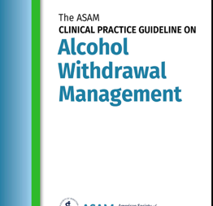
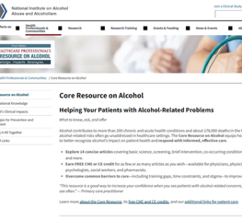

Resources for Alcohol Withdrawal and Alcohol Use Disorder Management
The ASAM Clinical Practice Guideline on Alcohol Withdrawal Management
Journal of Addiction Medicine14(3S):1-72, May/June 2020.doi:10.1097/ADM.0000000000000668
National Institutes of Alcohol Abuse and Alcoholism (NIAAA) https://www.niaaa.nih.gov/health-professionals-communities/core-resource-on-alcohol
Substance Abuse and Mental Health Services Administration (SAMHSA) https://library.samhsa.gov/sites/default/files/sma15-4907.pdf
Notes:
The ASAM Clinical Practice Guideline on Alcohol Withdrawal Management
Journal of Addiction Medicine14(3S):1-72, May/June 2020.
doi: 10.1097/ADM.0000000000000668
https://www.niaaa.nih.gov/health-professionals-communities/core-resource-on-alcohol
https://library.samhsa.gov/sites/default/files/sma15-4907.pdf

Slide 46
Stimulant Use Disorder Treatment
Currently there are no FDA-approved medications for treatment of stimulant use disorder
Behavioral treatments are the recommended treatment:
  Most effective has been Contingency Management (CM) programs that can reduce stimulant use^{1,2}
  Original voucher or incentive-based CM also has alternative “fishbowl method” to reduce stimulant use.
1. Petry NM. Psychiatrist. 2011; 35 (5) :161-163; 2. Brandon S et al. JAMA Open Network 2021.4(5)
Notes:
Contingency management - In contingency management interventions for substance misuse treatment, urine samples are collected multiple times each week (to detect brief periods of abstinence) and abstinence is reinforced each time negative samples are submitted. The reinforcers are monetary based and consist of vouchers, analogous to a clinic-managed bank account,² or a prize draw with prizes ranging from US$1 to 100 in value.³ Importantly, in effective contingency management interventions, the magnitude of reinforcement provided (voucher amounts or draws for prizes) increases with sustained periods of abstinence.
Petry NM. Contingency management: what it is and why psychiatrists should want to use it. Psychiatrist. 2011 May;35(5):161-163. doi: 10.1192/pb.bp.110.031831. PMID: 22558006; PMCID: PMC3083448.

Slide 47
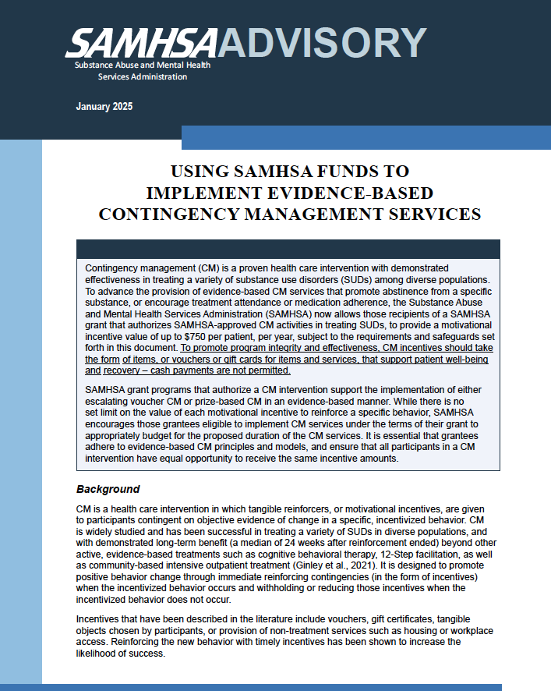

SAMHSA’s Guidance on
Contingency
Management

Slide 48

Mobile Technology to Provide Individualized Contingency Management
Dynamicare
https://www.dynamicarehealth.com
Notes:
https://www.dynamicarehealth.com
The DynamiCare app has LIVE Guides (persons patients can literally talk to!) who provide CM. Guides are certified health coaches or peer support specialists who are matched with participants during onboarding, post-randomization. Licensed addiction clinicians train and supervise Guides in Dynamicare (DCH)’s CM and community reinforcement processes, with formal policies/procedures, written scripts, and measurement-based care structured checklists. Guides offer individual weekly phone or secure video chats and unlimited personalized texting during business hours. Guides proactively contact participants at least monthly and whenever lapses or disengagements are noted. During the calls, Guides review test results and attendance, help set recovery goals and track progress, assist with community connections, provide encouragement, and assign self-guided therapy modules.
The DynamiCare app removes the burden of frequent, in-person urine testing by providing patients rapid, saliva tests that patients self-administer through the app. CM reinforcement is contingent on testing negative for illicit substances assessed using Premier Biotech’s OralTox rapid saliva 9-panel test (cocaine, amphetamine, methamphetamine, benzodiazepines, opiates, fentanyl, methadone, buprenorphine and oxycodone). The product has FDA 510(k) clearance⁶⁴ and is sensitive to cocaine (20ng/mL threshold) and methamphetamine (50 ng/mL). Manufacturer testing reports no false negatives at concentrations 50% above the sensitivity threshold, and no false negatives in phosphate-buffered saline.
Patients receive alerts at random times (adjusted to fit their work/sleep schedule) to perform a saliva test within a 4-hour window. Patients record a selfie video of themselves performing the test through the app (with on-screen instructions). The video uploads to DCH for verification (high-speed manual review). Saliva tests use immuno-assay strips with rapid color change, visible over video, indicating positive/negative results (see image). Along with saliva tests, DCH provides patients with a reloadable smart debit card for incentive delivery. Patients use the card like a Visa debit card – but it has numerous relapse protections: blocking access to bars, liquor stores, casinos, cash withdrawals, etc. Financial rewards deposit promptly onto the card with verification of each positive behavior (see image). Patients enter their treatment and recovery-related appointments into the app, which issues appointment reminders and automatically tracks attendance using GPS (incentivized through CM, GPS is only activated at the time of the appointment). They can also access a library of 100 self-guided therapy modules that take 2-4 minutes to complete and that are at the 7th grade or lower reading level, which teach evidence-based techniques such as cognitive behavioral therapy (CBT) and community reinforcement approach (CRA). Participants can view their progress on the History screen, which they can choose to share with family or supporters via the DCH web-based Supporter Portal by signing a release of information form in the app.
Sandra Springer and Ank Nijhawan (MPIs) have NIDA funded R61/ R33 ( RESTORE Project) funded by NIDA 2025-2030 to evaluate impact of Dynamicare on PrEP and ART initiation in persons with stimulant use disorders (through reducing stimlulant use) at risk living with HIV in the CJS in TX and CT.

Slide 49
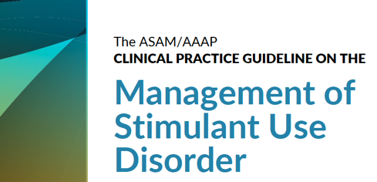
Resource for Treating
Stimulant Use Disorders
https://www.asam.org/quality-care/clinical-guidelines/stimulant-use-disorders
Notes:
https://www.asam.org/quality-care/clinical-guidelines/stimulant-use-disorders

Slide 50
Cocaine Use Use Disorder (CUD) Pharmacotherapies (not FDA approved)
Medication | Mechanism of Action | Results | ASAM | Can treat Co-occurring disorders
Bupropion | Dopamine & Norepinephrine Reuptake inhibitor | Mixed Evidence Not superior to placebo on abstinence at end of treatment 2 RCTS was superior to placebo w/ 3 or more weeks abstinence | Consider for use in those with cocaine use disorder and co-occurring disorders | FDA approved for Major Depression & Tobacco use Disorder
Topiramate | Anticonvulsant, Blocks Voltage-dependent NA channels, Increase GABA receptor activity, Antagonizes Na Glutamate receptors, etc | Mixed evidence MA- Higher rate of continuous cocaine abstinence over 3 wks compared to placebo | Side effects cognitive & paresthesia, appetite suppression Consider for those with AUD and Cocaine use Disorder | FDA Approved for Epilepsy & migraine Can reduce alcohol use
https://www.asam.org/quality-care/clinical-guidelines/stimulant-use-disorders

Slide 51
Amphetamine-Type Stimulant Use Disorder (ATS) Pharmacotherapies (not FDA approved)
Medication | Results | ASAM Recs | Can treat Co-occurring disorders
Bupropion | Not effective alone for Amphetamine Type Stimulant Use Disorder (ATS) | Could consider for those who use less than 18 days/ month and have tobacco use | Major Depressive Disorder Tobacco Use Disorder
Bupropion and XR-Naltrexone | Reduced amphetamine type stimulant use 1 open label study 1 RCT | Consider for those with ATS and Major Depressive Disorder / AUD /Tobacco use Disorder (TUD) high doses of bupropion ( 450 mg XR formulation) used in the studies XR-NTX FDA approved for q4 weeks in AUD and OUD but RCT used q3 weeks | XR-NTX FDA approved for OUD and AUD
Topiramate | Mixed evidence 2 RCTS showed reduction in ATS compared to placebo 1 RCT did not improve abstinence | Side effects have to be monitored (see cocaine use disorder table) Can consider in those with ATS and AUD | Epilepsy , Migraine
Mirtazapine | Mixed MA and SR showed no reduction in ATS use 2 placebo controlled RCTS showed small reductions in ATS use also reduction in sexual risk behaviors ( both studies in MSM) | Consider in those with co-occurring depression | Major Depressive Disorder
https://www.asam.org/quality-care/clinical-guidelines/stimulant-use-disorders

Slide 52
Emerging Treatment for SUDs:
GLP1 RAs
Notes:
Much research on GLP1 RAs on reducing use of nicotine, alcohol, opioids, cocaine and amphetamine in rodent models; small human RCT in persons with AUD and retrospective review of persons with OUD … will show
Thought is reward pathway mediated by Dopamine that is involved with addiction is impacted with GLP1… reduce craving, use etc….
Human Trials ongoing…. (MANY!)

Slide 53
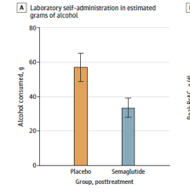
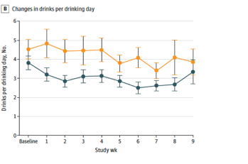
GLP1s As Potential Treatment for AUD
Phase 2 double blind parallel-arm RCT of N=48 non-treatment seeking adults with AUD
Semaglutide (0.25mg/ wk x 4 wks , 0.5mg/wk x 4 wks, 1.0mg x 1wk or placebo weekly
Primary outcome was amount of alcohol consumed
P=0.01
P=0.04
Hendershot C et al. JAMA Psychiatr. 2025
Notes:
Phase 2 double-blind, randomized, parallel-arm trial involving 9 weeks of outpatient treatment in the US from September 2022 to February 2024.
N=48 non–treatment-seeking participants with AUD were randomized.
Participants received semaglutide (0.25mg/week for 4 weeks, 0.5mg/week for 4 weeks, and 1.0mg for 1 week) or placebo at weekly clinic visits.
The primary outcome was laboratory alcohol self-administration, measured at pretreatment and posttreatment (0.5mg/week).
Low-dose semaglutide reduced the amount of alcohol consumed during a posttreatment laboratory self-administration task, with evidence of medium to large effect sizes for grams of alcohol consumed (β, −0.48; 95%CI, −0.85 to −0.11; P = .01) and reduced drinks per drinking day but not by calendar day or number of drinking days
Semaglutide treatment did not affect average drinks per calendar day or number of drinking days,
but significantly reduced drinks per drinking day (β, −0.41; 95%CI, −0.73 to −0.09; P = .04) and
weekly alcohol craving (β, −0.39; 95%CI, −0.73 to −0.06; P = .01),
also predicting greater reductions in heavy drinking over time relative to placebo (β, 0.84; 95%CI, 0.71 to 0.99;P = .04).

Slide 54
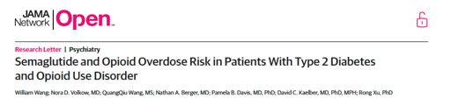
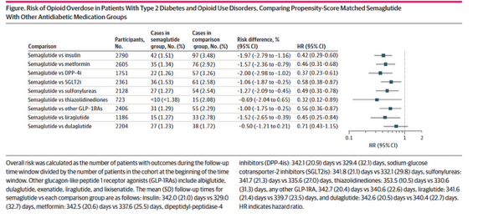
GLP1 RAs May Reduce Overdose Risk In Persons with T2DM and OUD
Wang W, Volkow N et al. JAMA Network Open. 2024. 7 (9)
Notes:
From NIDA staff including Dr. Nora Volkow , Director of NIDA and NIDA staff performed analyses:
33,000 people with OUD and T2DM, Propensity matched scores
Semaglutide versus other treatments for T2DM in persons with OUD and T2DM (ICD 10 codes identified )
Showed marked risk reduction in overdose ….
Ongoing RCTs of GLP1 in persons with OUD ( on different forms of MOUD) etc being conducted now to see if GLP1 reduce opioid use, overdose and improve retention on MOUD… results hope to be in by 2027…..

Slide 55
Treatment of SUD Improves Viral Suppression in People with HIV

Slide 56
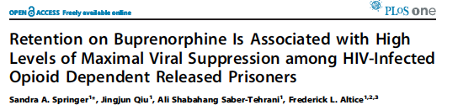
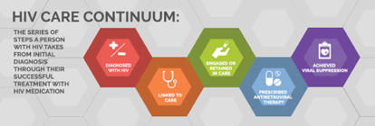
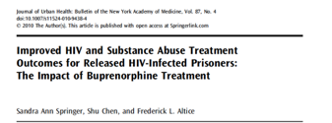
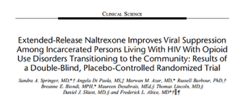
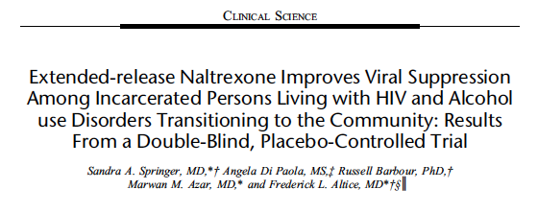
Integration of HIV Treatment & Medication Treatment for OUD & AUD Improves Viral Suppression
Medication Treatment for Substance use Disorder =
Treatment as Prevention

Slide 57
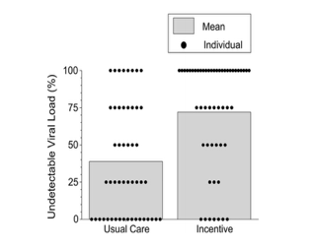
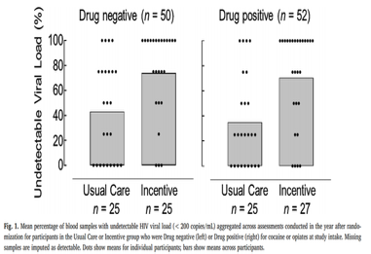
Contingency Management Improves HIV Viral Suppression
Silverman K et al AIDS Behav. 2019. 23(9):2337-2346.
Pollock S et al., Drug Alcohol Depend. 2020 Jul 1;212:108000.
Notes:
Silverman et al:
This study assessed the effects of financial incentives in suppressing viral load. People living with HIV with detectable viral loads (N = 102) were randomly assigned to Usual Care or Incentive groups. Incentive participants earned up to $10 per day for 2 years for providing blood samples that showed either reduced or undetectable viral loads. This report presents data on the 1st year after random assignment. Incentive participants provided more (adjusted OR = 15.6, CI 4.2-58.8, p < 0.001) blood samples at 3-month assessments with undetectable viral load (72.1%) than usual care control participants (39.0%). We collected most blood samples. The study showed that incentives can substantially increase undetectable viral loads in people living with HIV. Financial incentives for suppressed viral loads could contribute to the eradication of the HIV/AIDS epidemic.
Pollock et al> extension of Silverman et al.
Among participants who used cocaine or opiates, Incentive participants (n=27) provided more (OR:4.0, CI: 1.6-10.3, p=.004) blood samples with an undetectable viral load (69%) than Usual Care participants (n=25; 41%). Among participants who did not use cocaine or opiates, Incentive participants (n=25) provided more (OR:4.1, CI: 1.5-10.7, p=.005) blood samples with an undetectable viral load (78%) than Usual Care participants (n=25; 36%). Effects of incentives did not differ by drug use (OR: 1.0, CI:0.3-4.0, p=.992).

Slide 58
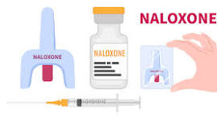
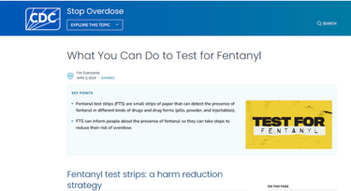
Overdose Prevention
  Naloxone Prescriptions
  Provide training on how to recognize overdose & administer naloxone for patients and their loved ones/ friends/partners
  Drug Testing Strips (fentanyl and xylazine)
  SSPs
  Safe injection education

Slide 59
Retain in Care: Overcome Barriers

Slide 60
Patient Choice And Shared-Decision Making is Essential
What do they want?
Where do they want to receive it?
How do they want to receive it?

Slide 61
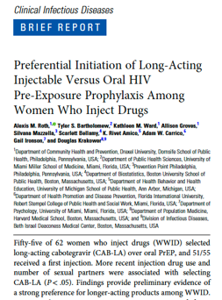
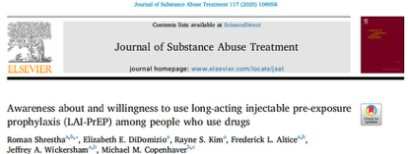
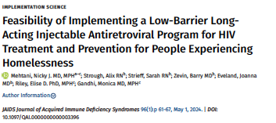
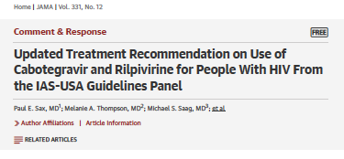
Long-Acting Injectable (LAI) Forms of PrEP and ART for PWUD

Slide 62
Baseline Interest in LAI PrEP In PWUD involved with CJS (N=601)
N=199
(33%)
NIDA U01DA053039. (PIs) Springer (contact) , Nijhawan, Knight
Springer et al. BMC Infect Dis. 2022 Apr 15;22(1):380
Notes:
All Persons who used opioids and or stimulants, all involved with CJS ( prison/ jail/ community supervision) all either with HIV or at risk for HIV and if HIV negative at baseline had to meet CDC PrEP eligibility in CT and TX. Multisite Randomized controlled trial comparing Mobile health unit or Patient navigator linkage to clinic on primary outcome of PrEP / ART initiation based on HIV status at basleine. 97% were HIV negative and hence PrEP eligible.
note that of the full cohort (N=601), there were 367 who were not interested in PrEP at all. 35 who did not have an answer recorded, and 199 who said "yes, I am interested." Of these, there were 78 who preferred a daily pill vs. the 121 who preferred an injection.
TX participants who wanted LAI PrEP could not access due to lack of insurance. CT could due to Medicaid.

Slide 63




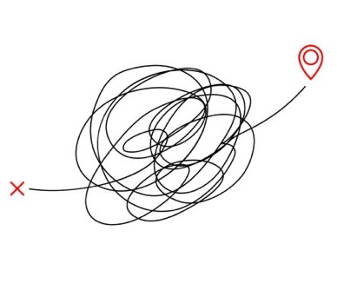
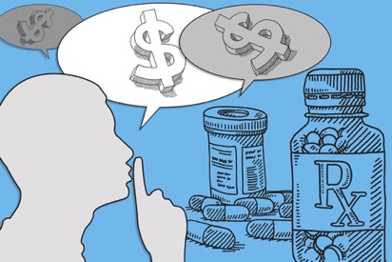
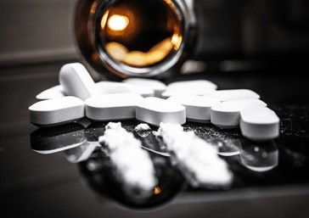




Overcome Barriers to Access SUD and HIV Prevention & Treatment for PWUD
Lack of transportation: URBAN and RURAL settings
Housing instability
Poverty
Lack of Insurance
Lack of communication (cell phones)
Lack of personal identification
Substance use that interferes with healthcare
Mental illness
Lack of ability to find pharmacy, pay for medications or pharmacy may not carry meds
Stigma
Difficulty identifying where to go or who to go to….

Slide 64




First Legalized Mobile Retail Pharmacy and Clinic In the United States to Overcome Barriers
Retail Pharmacy
Mobile Health Unit (MHU)
Medications:
  Non-specialty + specialty
  ART/PrEP ( LAI & Oral)
  MOUD (Buprenorphine)
  Psychiatric illness
  Antibiotics
  Diabetes, Hypertension etc.
  Vaccinations
Other pharmacy services provided in MHU
Primary Clinical care
Screening for substance use disorders (alcohol, opioid, and stimulant)
Mental health
Rapid testing for HIV and Hepatitis C
Social services
Mobile Pharmacy and Clinic
NIDA Avant Garde Award: DP1DA056106, 2022-2027
PI: Sandra Springer, MD
Springer SA. J Gen Intern Med. 2023 Sep;38(12):2816-2818. PMID: 37002460; PMC10506995.
Tarfa A, …. Springer SA. OFID. 2025

Slide 65
Legislation to Legalize Mobile Pharmacies in CT Was Required
14 June 2022
Avant Garde awarded 6/14/2022
June 2022
Informed that a mobile pharmacy not allowed under state regulations
June 2022
Oct. 2022
Support from YNHH Governmental Relations Office and Yale Office of Federal and State Relations
Jan. 2023
Senator Maroney sponsored new bill that included proposed legislation that Dr. Springer & Collaborators helped write
8 Feb. 2023
Public testimony by Dr. Springer to General Law Committee
9 Feb. 2023
Legislation passed by General Law Committee and sent to Senate and House for vote
Mar. 2023
Met with YNHH Pharmacy Leadership to forge partnership with retail pharmacy
May 2023
30 May 2023
SB 1102 AN ACT CONCERNING PHARMACIES AND PHARMACISTS passed through CT Senate and House
7 June 2023
SB 1102 signed by CT Governor Lamont
Support from CT Department of Consumer Protection Division of Drug Control (DDC) for changing the legislation
Signed Letter of Intent from YNHH Pharmacy Leadership
1 July 2023
Mobile retail pharmacies legal in CT !
?!!
Notes:
SB 1102 AN ACT CONCERNING PHARMACIES AND PHARMACISTS:
234 Sec. 3. (NEW) (Effective July 1, 2023) (a) (1) A pharmacy may apply to the department, in a form and manner prescribed by the commissioner, to operate a mobile pharmacy in a temporary location for the purpose of: (A) Conducting (i) a temporary clinic, (ii) a vaccination event, or (iii) an opioid antagonist training and prescribing event; or (B) serving a community that may not have adequate access to such pharmacy's services.
Any licensed pharmacist may order, and administer to a patient, an HIV-related test if:
The pharmacist is employed by a certified pharmacy/hospital and completed any required trainings
The patient is 18+ OR 12-17 and has parental/guardian consent or is emancipated

Slide 66



The Benefits of a Mobile Pharmacy Clinic
Meeting people where they are….

Slide 67
Diverse Population Reach
N=1091
46.0%
Women
37.5%
Hispanic
24.6%
Black
42.7%
Unstably housed/unhoused
Age​ (Median), IQR​
52.3 Years​; 38, 62
41.5% Uninsured
48.9% Medicaid
NIDA Avant Garde Award: DP1DA056106, 2022-2027
PI: Sandra Springer, MD
Data from December 13, 2023- January 14, 2026*

Slide 68
Appointments - Medical Needs
Appointments | N=1448 | (%)
Appointment Type
Medical Services or Support Only | 1394 | 96.3
Socio-Economic Services or Support Only | 7 | 0.5
Both Medical & Socio-Economic Services or Support | 17 | 1.2
Not Disclosed or Other | 30 | 2.1
Appointment Mode
In Person | 1209 | 83.5
Telehealth –Phone Only | 20 | 1.4
Telehealth –Video & Audio | 207 | 14.3
Not Identified | 12 | 0.8
Purposes of Appointments (can have multiple reasons) | N =1662 | (%)
MOUD related visit | 254 | 17.5
Other SUD related visit | 27 | 1.9
HIV care visit | 16 | 1.1
PrEP visit | 38 | 2.6
Hepatitis C care | 77 | 5.3
STI related visit | 12 | 0.8
Primary Care | 836 | 57.7
Mental Health care | 184 | 12.7
OB/Gyn care | 17 | 1.2
Glucose follow-up | 14 | 1.0
Blood pressure follow up | 60 | 4.1
Vaccination | 34 | 2.3
Specialty care | 21 | 1.5
Other medical care | 68 | 4.7
Data from December 13, 2023- January 14, 2026*

Slide 69

Patient Preferences: What do people want?
December 13, 2023- January 14, 2026*

Slide 70
3,394 Prescriptions Dispensed by Medical Condition:
Medical Purpose of drug | N | %
Hypertension | 450 | 13.3
HIV treatment (ART) | 42 | 1.3
HIV Prevention (PrEP) | 49 | 1.4
Hepatitis C | 29 | 0.9
Diabetes | 715 | 21.1
Vaccination | 125 | 3.7
Alcohol Use (AUD) | 41 | 1.2
Opioid Use (OUD) | 66 | 1.9
Anxiety | 203 | 6.0
PTSD | 25 | 0.7
Other Mental Health | 434 | 12.8
Asthma | 49 | 1.4
Acid Reflux | 56 | 1.6
Medical Purpose of drug | N | %
Skin Rash | 16 | 0.5
Gynecological | 48 | 1.4
Pain | 167 | 5.7
Pulmonary conditions | 100 | 3.5
Infections | 55 | 1.9
Gastrointestinal | 106 | 3.0
Dermatology | 24 | 0.8
STI treatment/ prevention | 12 | 0.3
Cardiovascular Conditions | 82 | 2.4
Hyperlipidemia | 187 | 5.0
Smoking cessation | 36 | 1.1
Weight loss | 43 | 1.3
Other | 232 | 6.8
Data from December 13, 2023 – January 14, 2026

Slide 71
HIV Testing and Treatment on the Mobile Pharmacy Clinic (MPC)
Total with HIV
14 (1.3%)
On ART through MPC
12 (85.7%)
Previous HIV
10 (0.9%)
4 (0.4%)
Rapid HIV tested
445 (40.8%)
New HIV diagnosis
(6 – LAI ART, Cabenuva)
*4 new HIV diagnoses August 2025 to January 2026 started on same day ART. 1 person refuses ART. 1 person on ART through another provider
Data through July 2025
NIDA Avant Garde Award: DP1DA056106, 2022-2027
PI: Sandra Springer, MD

Slide 72
HIV testing and PrEP
Rapid HIV tested
445 (40.8%)
Non-reactive tests
441 (99.1%)
114 (10.4%)
On PrEP through MPC
27 (23.7%)
PrEP Eligible
(12 LAI PrEP and 15 oral)
Lenacapavir and Cabotegravir PrEP injections in < 1 hour****
Data through January 14, 2026

Slide 73
PrEP Initiation: Patient Choice on the Mobile Pharmacy Clinic
PrEP initiators
N=24
*3 new additional Oral PrEP & 1 LAI PrEP since Abstract
LAI Lenacapvir
N=2
Choice of PrEP
Oral PrEP
N=12
LAI Cabotegravir
N=10
Median months on PrEP
1 (IQR 1-4)
2 (IQR 1-3.5)
Shenoi S, Di Paola A, Frank CA, Tarfa A, Brooks R, Schulthies A & Springer SA. Community based PrEP Delivery in Urban US Settings: the First US Mobile Retail Pharmacy. IDWeek 2025. Atlanta GA, October 22, 2025, Oral Abstract.
NIDA DP1DA056106, Sandra Springer, MD
Notes:
Shenoi S, Di Paola A, Frank CA, Tarfa A, Brooks R, Schulthies A & Springer SA. Community based PrEP Delivery in Urban US Settings: the First US Mobile Retail Pharmacy. IDWeek 2025 Atlanta GA, October 22, 2025, Oral Abstract.

Slide 74




PrEP: Lenacapavir (LEN) On the Mobile Pharmacy and Clinic (MPC)!
Time to receipt … <30 minutes!
HIV rapid tests negative, PrEP eligible
2 Patients chose every 6-month LEN INJ
Electronically prescribed by APRN On MPC
Dispensed from mobile pharmacy on MPC
Administered on MPC
ONE STOP SHOP
Springer et al. CROI 2026. Late –Breaker #1075.
Funding: NIDA DP1DA056106, Sandra Springer, MD
Notes:
Springer SA. NIDA DP1DA056106

Slide 75
Other Resources

Slide 76

2025 Manuscript Mobile Pharmacy and Clinic Pilot Findings
Tarfa A, Di Paola A, Frank CA, Schultheis AM, Brooks R, Shenoi SV, Springer SA. Pilot Findings From the First Legalized Mobile Retail Pharmacy Clinic in the United States for Infectious Disease Treatment and Prevention Tailored to Reach People Who Use Drugs. Open Forum Infect Dis. 2025 Apr 24;12(4):ofaf200. doi: 10.1093/ofid/ofaf200. PMID: 40276721; PMCID: PMC12019630.
CopyDownload .nbib
PMID: 40276721

Slide 77







On the IAS-USA Website:
MATE ACT Free CME Webinars:
HIV and SUD
*(MATE Act = Medication Access & Training Expansion)
A ONE TIME 8-HOUR TRAINING IS REQUIRED FOR ALL PRACTIONERS WHO HAVE A DEA REGISTRATION (CONTROLLD SUBSTANCE LICENSE)
Notes:
The Medication Access and Training Expansion (MATE Act) requires all DEA-registered practitioners to complete a total of eight hours of training on the treatment and management of patients with opioid or other substance user disorders. The deadline for satisfying this training requirement is the date of the practitioner's next scheduled DEA registration submission (initial registration or renewal registration). This course bundle totals over eight hours and can be utilized to satisfy the MATE Act training requirement.

Slide 78
National Substance Use Warmline
Cost-free, confidential clinician-to-clinician tele-consultation
Staffed by addiction medicine and HIV specialist physicians, clinical pharmacists, and advanced practice nurses
9:00 AM – 8:00 PM Eastern Time Monday – Friday
(855) 300-3595 | Submit cases online
https://nccc.ucsf.edu/clinician-consultation/substance-use-management/
The National Clinician Consultation Center is supported by the Health Resources and Services Administration (HRSA) of the U.S. Department of Health and Human Services (HHS) as part of an award totaling $2,397,604 with 0% financed with non-governmental sources.

Slide 79


HIV Prevention and Treatment Guidelines that include SUD Management
DHHS
IAS-USA
Updated: September 25, 2025
Gandhi RT, et al. JAMA. 2024. [Published online Dec 1, 2024]
Notes:
Gandhi RT, Landovitz RJ, Sax PE, et al. Antiretroviral drugs for treatment and prevention of HIV infection in adults: 2022 recommendations of the International Antiviral Society-USA Panel. JAMA. 2025; 333(7):609-628. doi:10.1001/jama.2024.24543. [epublished online December 1, 2024]
DHHS: https://clinicalinfo.hiv.gov/en/guidelines/adult-and-adolescent-arv
Updated: September 25, 2025

Slide 80

Acknowledgements
*
*
THE PARTICIPANTS!
The InSTRIDE Research Team*
NIH: NIDA, NIAAA, NCATs
CT Dept of Health: Marianne Buchelli, Susan Major , Ramon Rodriguez-Santana
Community Partners: Jill Corbin and St. Vincent DePaul, Wheeler Clinic, McCall Behavioral Health, Liberation Programs, Staywell Health Clinic, Mayors’ offices and law enforcement in Waterbury, Hartford, Norwich, New Haven, Bridgeport, Aisling McGuckin RN, MSN-MPH (Dept of public Health, Waterbury)
YNHH Pharmacy: Osama Abdelghany, PharmD (Executive Director Oncology) and our other pharmacy partners
CT Department of Consumer Protection, Drug Division: Rod Marriott, PharmD
YNHH Investigational Drug Services: Prashant Patel, PharmD
Yale Legal Counsel: Joanna L. Cohen (Associate General Counsel) and Rosina Mummolo (Assistant General Counsel)
Yale University Office of Federal and State Relations: Richard Jacob (Associate Vice President for Federal and State Relations) and Jillian Jackson (Associate Director for State Relations)
CT Senator James Maroney who supported change in legislation through the General Law Committee
CT Governor Lamont

Slide 81

Question-and-Answer Session
Thank you!
https://medicine.yale.edu/lab/springer/
Sandra.springer@yale.edu

