Slide 1
Care of Pregnant People with HIV: Preventing Perinatal Transmission
L. Beth Gadkowski MD MPH MS
Clinical Associate Professor
University of Florida, Gainesville
Faculty, North Florida AETC

Slide 2
Disclosures
This program is supported by the Health Resources and Services Administration (HRSA) of the U.S. Department of Health and Human Services (HHS) under grant number TR7HA53203-01-00 as part of an award totaling $5.7m. The contents are those of the author(s) and do not necessarily represent the official views of, nor an endorsement, by HRSA, HHS, or the U.S. Government. For more information, please visit HRSA.gov.
“Funding for this presentation was made possible by cooperative agreement TR7HA53203-01-00 from the Health Resources and Services Administration HIV/AIDS Bureau. The views expressed do not necessarily reflect the official policies of the Department of Health and Human Services nor does mention of trade names, commercial practices, or organizations imply endorsement by the U.S. Government. Any trade/brand names for products mentioned during this presentation are for training and identification purposes only.”
This content is owned by the AETC and is protected by copyright laws. Reproduction or distribution of the content without written permission of the sponsor is prohibited and may result in legal action.

Slide 3
Disclosures
All planners, faculty, and others in control of educational content are required to disclose all their financial relationships with ineligible companies within the prior 24 months. An ineligible company is defined as one whose primary business is producing, marketing, selling, re-selling, or distributing healthcare products used by or on patients. Financial relationships are relevant if the educational content an individual can control is related to the business lines or products of the ineligible company.
None of the planners, faculty, and others in control of educational content for this educational activity have relevant financial relationship(s) to disclose with ineligible companies.
The material presented in this course represents information obtained from the scientific literature as well as the clinical experiences of the speakers. In some cases, the presentations might include discussion of investigational agents and/or off-label indications for various agents used in clinical practice. Speakers will inform the audience when they are discussing investigational and/or off-label uses.
Disclosure of a relationship is not intended to suggest or condone commercial bias in any presentation, but it is made to provide participants with information that might be of potential importance to their evaluation of a presentation.

Slide 4
Disclosures
The Health Resources and Services Administration (HRSA), Department of Health and Human Services (HHS) provided financial support for this project. The award provided 100% of total costs. The contents are those of the author. They may not reflect the policies of HRSA, HHS, or the U.S. Government.

Slide 5
Disclosures
The Health Resources and Services Administration (HRSA), Department of Health and Human Services (HHS) provided financial support for this project. The award provided 100% of total costs. The contents are those of the author. They may not reflect the policies of HRSA, HHS, or the U.S. Government.

Slide 6
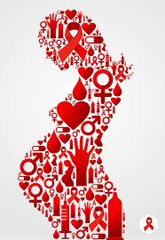
Objectives
Recognize risks for perinatal HIV transmission
Describe elements of patient centered, team based, treatment and delivery plans to prevent perinatal HIV transmission
Describe guidance to support breastfeeding in people with HIV

Slide 7
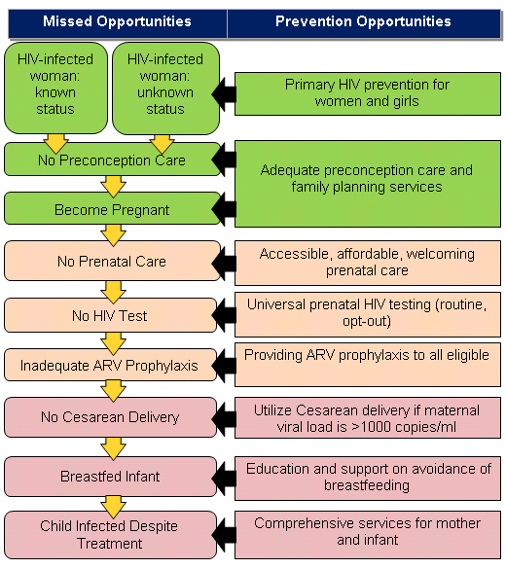
https://www.cdc.gov/hiv/group/gender/pregnantwomen/emct.html
Notes:
An estimated 1.3 million women living with HIV become pregnant each year

Slide 8
Risk of HIV in Pregnancy < 1% if…
Suppressive ART throughout pregnancy
C-section and IV zidovudine if indicated
Postnatal infant antiretroviral prophylaxis
Avoidance of breastfeeding
Connor EM et al. N Engl J Med.1994;331:1173-80.
Kourtis AT et al. JAMA. 2001,285;709-12.

Slide 9
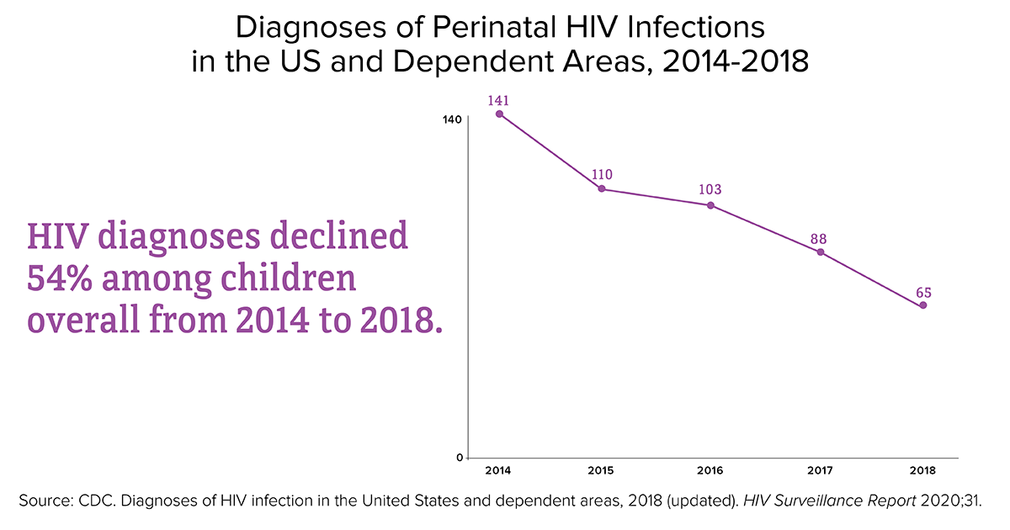
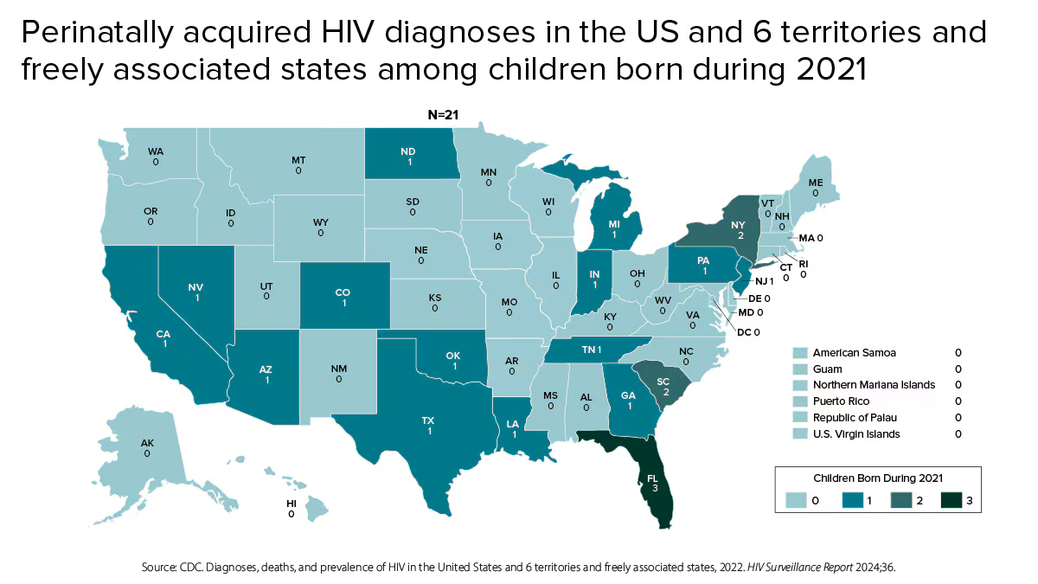
Goal:
<1 case of perinatal HIV /100000 live births
perinatal HIV transmission rate of <1%
https://www.cdc.gov/hiv/group/gender/pregnantwomen/index.html
Notes:
Last data presented from
CDC was in 2024, regarding 2018-2022
2019 achieved the goal of US elimination goals

Slide 10
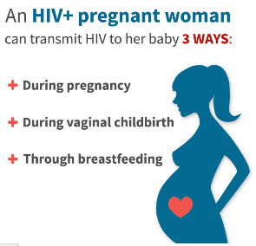
HIV Transmission from Mother to Baby
25% risk of perinatal transmission in absence of therapy
  20% before 36 weeks
  50% between 36 weeks and delivery
  30% active labor and delivery
Less than 1% risk if
  Suppressive antiretroviral therapy (ART) throughout pregnancy
  Postnatal infant antiretroviral prophylaxis
  C-section & zidovudine (AZT) if indicated
  Avoidance of breastfeeding
Connor EM et al. N Engl J Med.1994;331:1173-80.
Kourtis AT et al. JAMA. 2001,285;709-12.
Notes:
Risk is 25-42%

Slide 11
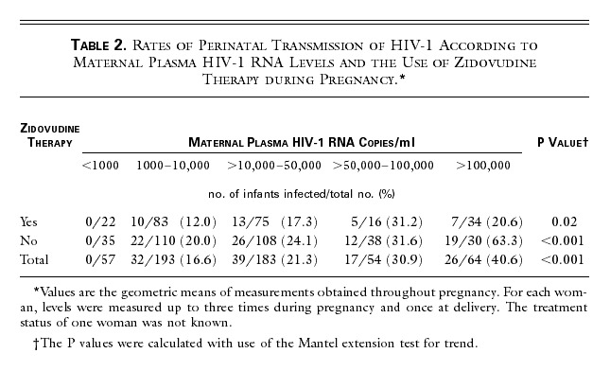
Viral Load During Pregnancy is the Strongest Predictive Factor for Transmission
Garcia et al NEJM 1999 PMID 10432324
Notes:
This is data from a study published by the Women and Infants Transmission study looking at the outcomes of about 550 mother-baby pairs at 8 US sites from 1990-1995. Maternal HIV RNA was obtained 3 times during pregnancy and at delivery and showed that in PACTG 076 or treated with AZT after 1994 analyzed separately from women on AZT for other reasons. Women with higher viral loads were more likely to transmit HIV infection. In this study, women with an HIV viral load less than 1000 did not transmit HIV to their infants.

Slide 12
Screening for HIV in Pregnancy

Slide 13
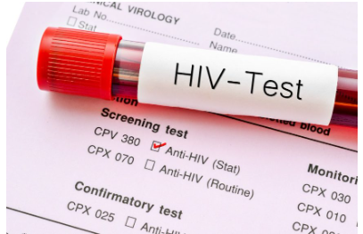
Screening for HIV
At presentation for pregnancy care
Repeat in 3rd trimester (<36 weeks)
If at risk of acquiring HIV during pregnancy
Area/hospital with high number of people with HIV
Transactional sex
Drug use
Sex partner with HIV
New sex partner or more than 1 sex partner
Suspected or diagnosed sexually transmitted infection
At labor and delivery if HIV status is unknown
As mandated by law
https://www.clinicaladvisor.com/home/topics/hiv-aids-information-center/hiv-screening-at-25-years-optimal-for-outcomes-cost/
https://clinicalinfo.hiv.gov/en/guidelines/perinatal
Notes:
Universal opt out HIV screening
Consider retesting at 28 weeks at same time as syphlilis testing
All people presenting for pregnancy care should be screened for HIV. A second HIV test during the third trimester (prior to 36 weeks gestation) is recommended for pregnant people with negative results on their initial HIV test who are at risk of acquiring HIV during pregnancy including those engaging in transactional sex, use intravenous drugs or have sex partners who do, have a sex partner with HIV, have a new sex partner or more than 1 sex partner during the pregnancy, are suspected or diagnosed with a sexually transmitted infection during this pregnancy if mandated by law or have signs or symptoms of acute HIV.
Testing in labor and delivery is indicated if
Prior negative HIV test(s) but mother at high risk for HIV acquisition
Ongoing illicit drug use
New STD diagnoses during pregnancy
Sex partners have HIV infection
Exchange sex for money or drugs
New or more than one sex partner during the current pregnancy
Teenage mother
Labor and delivery tests should be rapid with results available within 1 hour.
People who are breastfeeding should also be tested for HIV if they develop signs or symptoms of acute HIV. When acute HIV infection is suspected, a plasma HIV RNA test should be sent as well because virologic tests can detect the presence of HIV approximately 5 days earlier than the antigen/antibody combination immunoassay.

Slide 14
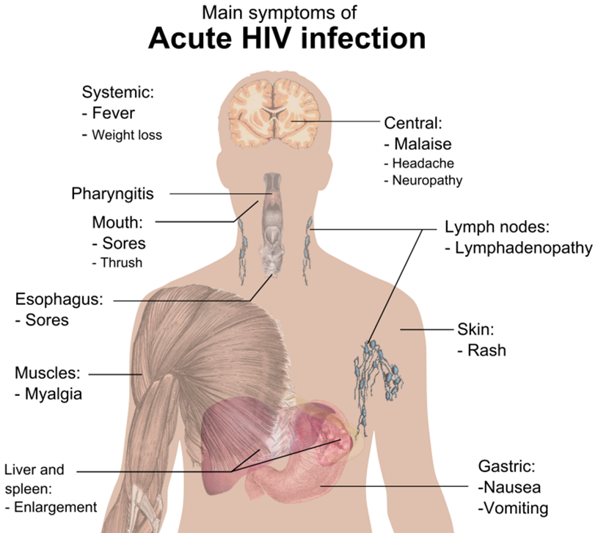
Missed Opportunities for HIV Prevention in Perinatal Care Settings in the United States
HIV risk awareness among women is low
HIV risk for women is challenging to identify and define in clinical practice
Partner testing is not routine
Pre-exposure prophylaxis remains underutilized, especially during pregnancy and breastfeeding
Pollock et al. (2021) Front Reprod Health 3:1-7
Notes:
It is easy enough to test people with o
Implementation studies regarding testing for partners are lacking
pt out testing but need to identify individuals who remain at risk for ongoing HIV acquisition
The aware study is current

Slide 15
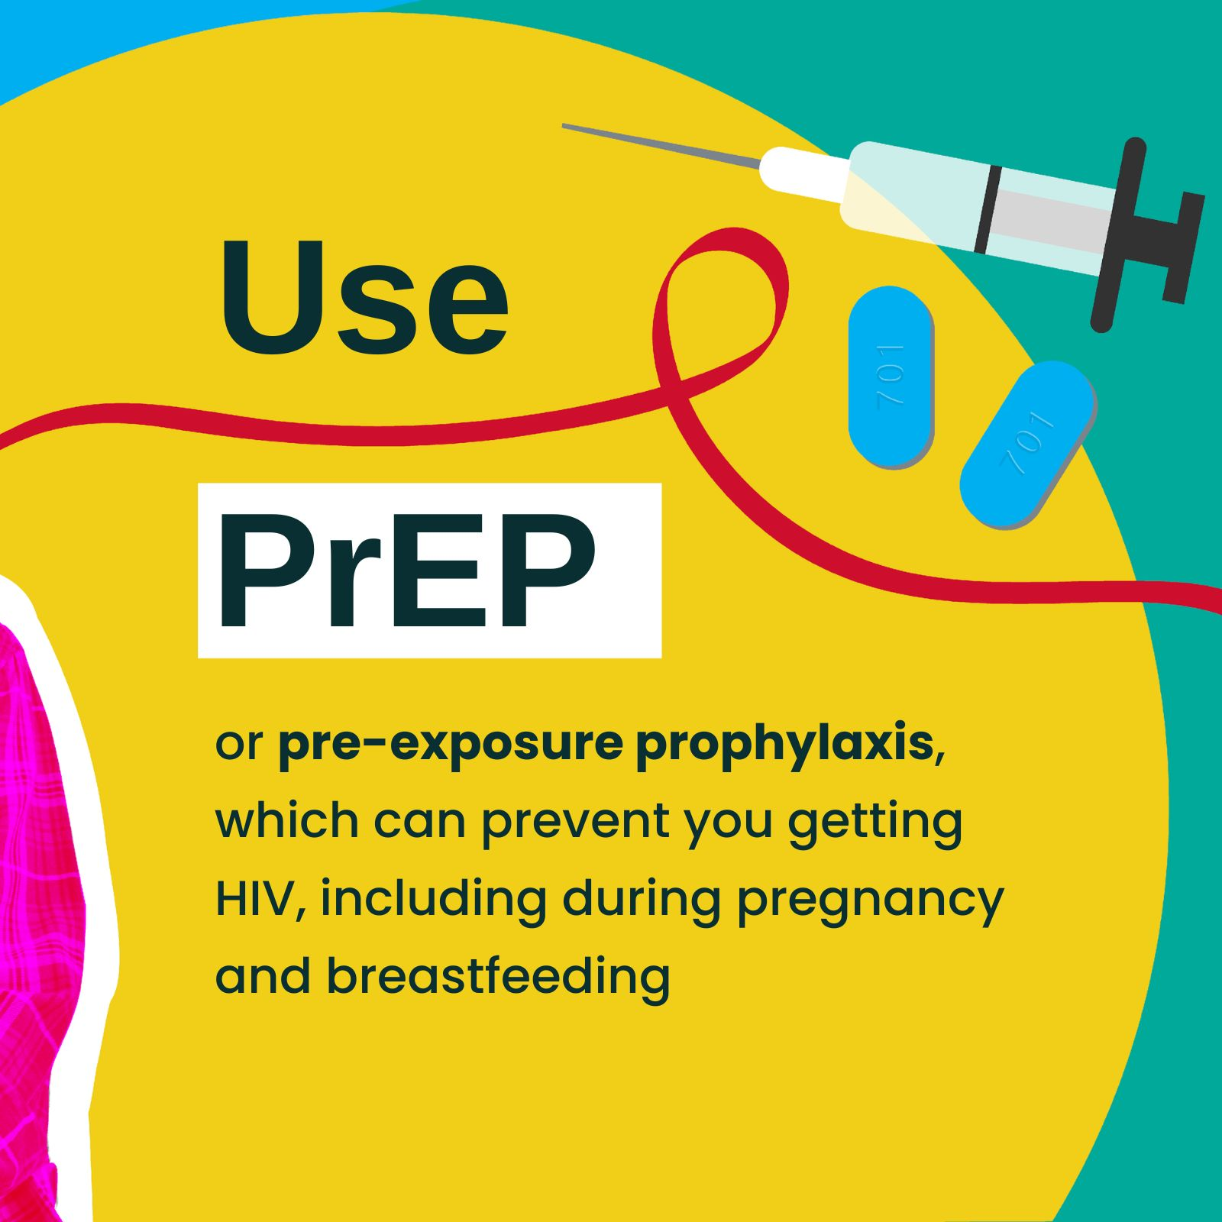
Pre-exposure Prophylaxis (PrEP)
Tenofovir disoproxil fumarate/emtricitabine (TDF/FTC) is the only FDA-approved PrEP option with known safely and efficacy data during pregnancy and breastfeeding
HPTN 084 OLE showed consistent maternal and pregnancy outcomes in women using cabotegravir-LA for PrEP vs TDF/FTC
PURPOSE 1 study showed safety of Lenacapavir in pregnancy, breastfeeding
Delany-Moretlwe S et al. IAS 7/24/2024
Bekker LG et al. IAS, abstract OAC0505, 2025
Notes:
The HPTN 084 trial is a phase III double blind superiority trial designed to evaluate the safety and efficacy of the long-acting injectable cabotegravir for HIV prevention administered every eight weeks compared to daily oral TDF/FTC tablets (200 mg/300 mg) in 3,224 cisgender women who are at increased risk of HIV acquisition. The trial design included an oral lead-in phase to assess tolerability to cabotegravir before administering the IM injection. HPTN 084 opened to enrolment in November 2017 and is being conducted at research centres in Botswana, Kenya, Malawi, South Africa, Eswatini, Uganda, and Zimbabwe. Cabotegravir long-acting was found to be superior to daily oral FTC/TDF in preventing HIV acquisition in the trial population. The most common adverse reactions (all grades) observed in at least 1% of participants receiving cabotegravir long-acting were injection site reactions, diarrhoea, headache, fatigue, sleep disorders, nausea, dizziness, abdominal pain, vomiting, myalgia, and rash.
Bekker LG et al. Inclusion of pregnant and lactating people in the PURPOSE 1 study: efficacy, safety, and pharmacokinetics. 13th International AIDS Society Conference on HIV Science, Kigali, abstract OAC0505, 2025.

Slide 16
Care for the Pregnant Person with HIV

Slide 17
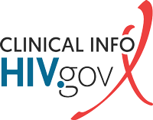
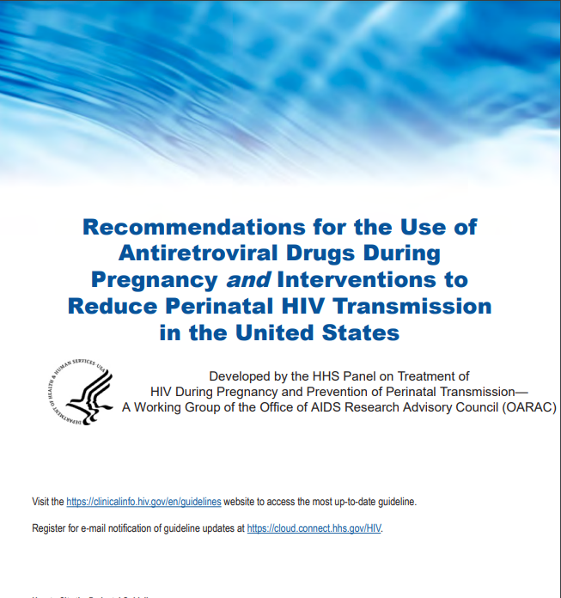

https://clinicalinfo.hiv.gov/en/guidelines
Last update: June 12, 2025

Slide 18
Perinatal Antiretroviral Therapy
Start as soon as possible
  Earlier viral suppression = reduced risk of transmission to the fetus
  Modify therapy later if needed
  Goal: Maintain HIV viral load level below the limit of detection during and after pregnancy
  “PrEP” for the fetus
https://clinicalinfo.hiv.gov/sites/default/files/guidelines/documents/PerinatalGL.pdf
Notes:
Selection of ARV drugs should be individualized according to the pregnant person’s ARV history, results of drug-resistance testing, and presence of comorbidities. In general, people who are already on a fully suppressive regimen when pregnancy occurs should continue their regimens. The Panel classifies ARV drugs for use in people who are pregnant or trying to conceive as preferred, alternative, insufficient data to recommend, not recommended except in special circumstances, and not recommended: PreP fo rhte infact—
There is no evidence that pregnancy decreases the efficacy of ART regimens recommended during pregnancy.^{[52,197]}
The efficacy of ART in preventing maternal–fetal transmission is primarily through lowering plasma HIV-1 RNA but also due to PrEP for the infant. The mechanism by which infant PrEP is effective is through ARV agents crossing the placenta, resulting in adequate systemic concentrations in the infant. This is especially important at the time of delivery when the infant is exposed to maternal blood and genital tract secretions. Because it is unclear what HIV-1 RNA level may be considered “safe” from concerns about transplacental transmission, all pregnant women with HIV should be offered ART.

Slide 19
French Perinatal Cohort: Update
14630 HIV-infected mother-infant pairs
2000 to 2017
Pregnant people received ART, delivered live-born children with determined HIV status, and did not breastfeed
Sibiude et al. CID 2023:76 (1 February)
Notes:
Mandelbrot L, et al. Clin Infect Dis, 2015 Dec 1;61(11):1715-25. was 2000 to 2011
2000-2005, 2006-20010, 2011-2017

Slide 20
French Perinatal Cohort: Update
5482 children born to mothers on ART prior to conception, ART throughout pregnancy, HIV viral load < 50 copies/mL at delivery, no breastfeeding
    No HIV transmission
Regardless of viral load at birth, risk of transmission varied based on when ART was started
    ART prior to conception 0.14%
    ART started in first trimester 0.52%
    ART started in second trimester 0.75%
    ART started in third trimester 1.67%
Notes:
In this study, the overall rate of perinatal transmission was 0.7%, but in those who had virologic suppression prior to conception, throughout pregnancy and who had an HIV viral load < 50 copies/mL at delivery, there was no HIV transmission.
Regardless of the viral load at birth, the risk of transmission varied based on when antiretroviral therapy was started and was highest in those who started antiretroviral therapy in the second and third trimesters. It is currently recommended that pregnant people with HIV receive treatment throughout pregnancy, rather than waiting to start after the first trimester as was sometimes done in the past.

Slide 21

Medications in Pregnancy
What does this mean for the pregnant person?
  May have to take higher doses or take ART more often to get appropriate blood and placental levels
Many physical changes occur in pregnancy that affect drug pharmacokinetics
  Decrease in serum proteins
  Increased plasma volume
  Increase in kidney filtration
  Delayed stomach emptying
Notes:
Do we have data that support a particular regimen that helps prevent transmission

Slide 22
Preferred Initial Therapy for Antiretroviral Naïve Pregnant People
2 NRTIs
+
INSTI
Tenofovir + (emtricitabine or lamivudine)
Dolutegravir
Bictegravir
NRTI = Nucleoside Reverse Transcriptase Inhibitor
INSTI = Integrase Strand Transfer Inhibitor
DHHS Perinatal Guidelines Available at https://clinicalinfo.hiv.gov/en/guidelines/perinatal. March 17, 2022.

Slide 23
What to Start if Acute HIV in Pregnancy
Prior Exposure to CAB-LA for PrEP
Darunavir/r twice daily + (TDF or TAF) + (emtricitabine or lamivudine)
Baseline genotype needs to include integrase resistance testing

Slide 24
Antiretroviral Therapy in Pregnancy
Key Points
In most cases, people who present for obstetric care on fully suppressive HIV therapy should continue their current regimen
Use the same regimens for nonpregnant adults in pregnant people when sufficient data suggests appropriate drug exposure, efficacy, and safety
Note: there are often incomplete data on safety of HIV drugs in pregnancy
https://clinicalinfo.hiv.gov/en/guidelines/perinatal

Slide 25
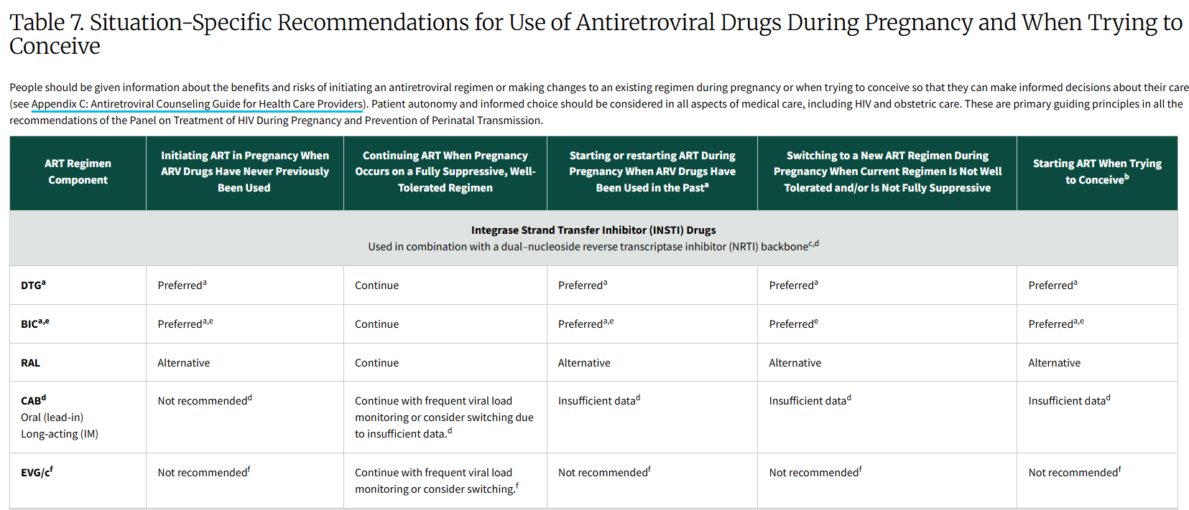
https://clinicalinfo.hiv.gov/en/guidelines/perinatal/recommendations-arv-drugs-pregnancy-situation-specific-conceive-full. Accessed: 3/2/26

Slide 26

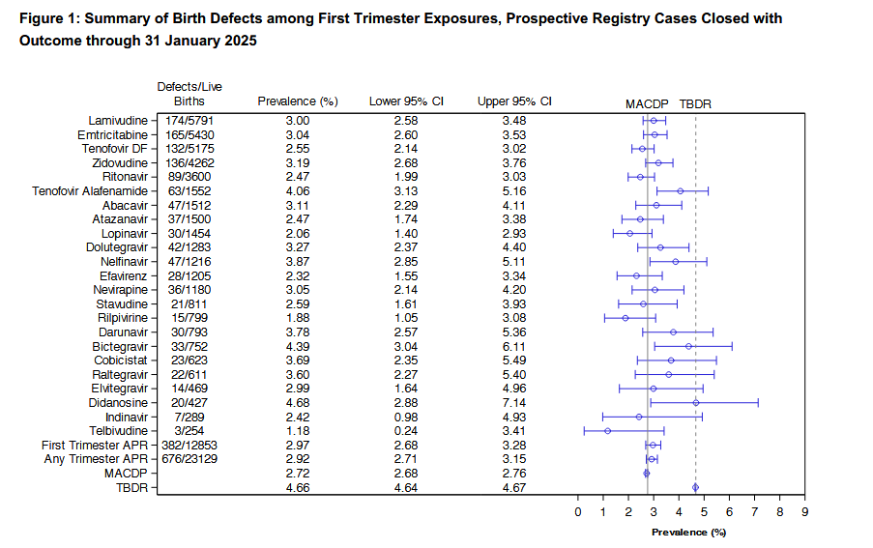
https://apregistry.com/forms/interim_report.pdf Accessed: 9/30/2025
Notes:
Prospective, voluntary, confidential registry formed to detect any major teratogenic effects related to antiretroviral therapy received at time of conception throughout pregnancy

Slide 27
Monitoring of HIV During Pregnancy
HIV viral load testing
  Initial visit
  2-4 weeks after starting or changing ART
  Monthly until HIV viral load is below limit of detection of test (“undetectable”)
  Every 3 months during pregnancy
  34-36 weeks’ gestation to inform delivery decisions
Antiretroviral resistance testing
  Prior to starting ART if never on treatment
  Prior to changing regimen if HIV RNA above threshold
  for resistance testing (> 500 to 1,000 copies/mL)
HIV Perinatal Guidelines. Available at clinicalinfor.hiv.gov. Accessed 3/3/2026

Slide 28
CD4 Monitoring During Pregnancy
Measure at initial visit with review of prior CD4 counts
If ART ≥ 2 years, consistent viral suppression and CD4 consistently ≥ 300 | CD4 count does not need to be rechecked this pregnancy
If on ART < 2 years, or CD4 < 300, inconsistent adherence, or detectable HIV viral load | Monitor CD4 count every 3 months during pregnancy
If ART < 2 years, CD4 ≥ 300 | Monitor CD4 count every 6 months
HIV Perinatal Guidelines. Available at clinicalinfor.hiv.gov. Accessed 3/3/2026.

Slide 29
What if virologic suppression is not attained?
Test for drug resistance
Assess drug adherence, tolerability, dosing, potential problems with absorption, lack of attention to food requirements
Consider ART modification
Adherence to ART, labs and appointments (both OB and HIV care) are critical to success in preventing mother to child transmission!
HIV Perinatal Guidelines. Available at clinicalinfor.hiv.gov. Accessed 3/3/2026

Slide 30
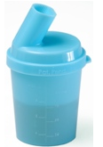
Alternative ART Administration Methods
Nause and vomiting of pregnancy may necessitate crushing/dissolving pills
Based on case reports/case series:
  BIC/TAF/FTC: may be dissolved or crushed
  TAF/FTC: may be crushed
  TDF/FTC: may be crushed
  DTG: may be split in half and both halves taken immediately, or may be carefully crushed and added to a small amount of semi-solid food or liquid, consume immediately
https://www.hivclinic.ca/main/drugs_extra_files/Crushing%20and%20Liquid%20ARV%20Formulations.pdf

Slide 31
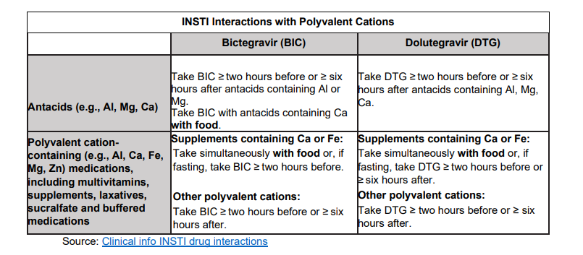
https://www.floridahealth.gov/wp-content/uploads/2025/06/TestAndTreatGuidanceOctober2023.pdf

Slide 32
Virologic Failure Near Delivery
HIV RNA > 1,000 copies/mL or unknown viral load
  Scheduled cesarean section at 38 weeks
  Intravenous zidovudine
    2 mg/kg dose followed by a continuous infusion of 1 mg/kg/hour until delivery (minimum of three hours)
      Some providers would give IV zidovudine if last HIV viral load > 50 or any concern for non-adherence
HIV Perinatal Guidelines. Available at clinicalinfor.hiv.gov. Accessed 3/3/2026

Slide 33
Case
Kelly is a 32-year-old woman, with perinatally-acquired HIV, well-controlled on BIC/TAF/FTC, pregnant with her first child
She understands that the baby will be given prophylactic ART upon delivery
She would like to breastfeed her child as she knows that “breast is best” but is concerned about possible risk of HIV transmission through breastfeeding.
How do you advise her?
Notes:
Breastfeeding provides numerous health benefits to both the infant (e.g., reduction in asthma, gastroenteritis, and otitis media) and the parent (e.g., reduction in hypertension; type 2 diabetes; and breast and ovarian cancers).²¹
Extensive research showing that breast milk is the best food for most babies, protecting a growing baby's health while satisfying all of their nutritional needs
Infant: lower risk of: asthma, obesity, type 1 diabetes, severe lower respiratory disease, otitis media, sudden infant death syndrome, gastrointestinal infections, necrotizing enterocolitis
Lactating parent: lower risk of: hypertension, type 2 diabetes and breast and ovarian cancers

Slide 34
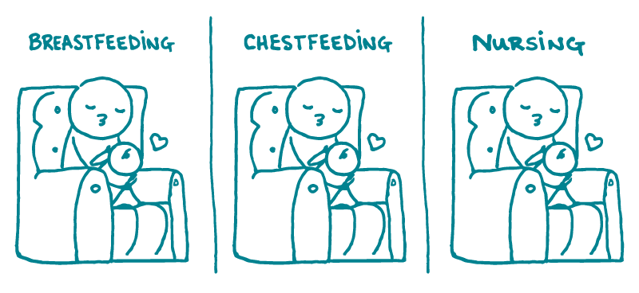
Breastfeeding/Chestfeeding
Feeding an infant with the lactating parent’s own milk—whether directly or with expressed milk

Slide 35
Risk of HIV transmission via breastfeeding?
Without maternal antiretroviral therapy (ART) or infant antiretroviral prophylaxis→15-20% over 2 years
Achieving and maintaining viral suppression (through ART) during pregnancy and postpartum decreases breastfeeding transmission risk to less than 1 %
DHHS Perinatal Guidelines Available at https://clinicalinfo.hiv.gov/en/guidelines/perinatal. Accessed 2/18/26
Notes:
Infant Feeding Basics: For Women Living with HIV in the US
Factors that INCREASE RISK of
passing HIV to baby while
breastfeeding
- Detectable viral load
- Lower T-cell count
- Length of breastfeeding (the
longer a woman breastfeeds,
the higher the risk)
- Newly diagnosed (if a woman
gets HIV while pregnant or
breastfeeding)
- Breast infection or cracked/
bleeding nipples
- And in resource-limited settings
with women NOT on ARVs,
mixed feeding of breast milk plus
other liquids or food.
World Health Organization, American Academy of Pediatrics, and Centers
for Disease Control recommend that women with HIV in the United States
DO NOT breastfeed to prevent passing HIV to their baby.
However, many women have questions about infant-feeding options and
may consider breastfeeding.
It is important to understand the risks and the benefits of breastfeeding,
as well as other options for feeding. Talk to your medical provider to get
the support and care you need to make an informed decision that is best
for you, your baby, and your family.
Factors that LOWER bu t DO
NOT ELIMINAT E the e RISK
of passing HIV to baby while
breastfeeding
- Undetectable viral load
- Antiretroviral medications
(both mother and baby)
- Prevention of breast infections
(contact a lactation consultant
or breastfeeding support)
Breastfeeding WITHOUT antiretroviral-
ral medications (ARVs) has a 14%
risk of transmission for women diag-
nosed with HIV pre-pregnancy. The
risk is 25-30% for women who ac-
quire HIV during pregnancy or lac-
tatio

Slide 36
2023 Guidelines:
Provide evidence-based, patient centered counseling to support shared-decision making about infant feeding as early as possible in pregnancy, throughout pregnancy and postpartum
  Infant feeding options that eliminate the risk of HIV transmission are formula and pasteurized donor human milk
  Fully suppressive antiretroviral therapy during breastfeeding decreases breastfeeding transmission risk to less than 1% but not zero
  Individuals with HIV on with a sustained undetectable viral load on ART who desire to breastfeed should be supported in that decision
DHHS Perinatal Guidelines Available at https://clinicalinfo.hiv.gov/en/guidelines/perinatal. Accessed 2/18/26
Notes:
Have you thought about how you would like to feed your baby? Formula feeding eliminates the risk of HIV transmission through breastmilk. Less than 1 of 100 breastfed infants would be expected to acquire HIV through breastmilk when the breastfeeding parent is taking ART and has an undetectable viral load, but the risk is not zero. What information can I provide to help you decide?”
Viral load consistently suppressed during pregnancy (at a minimum during the third trimester) and at time of delivery

Slide 37
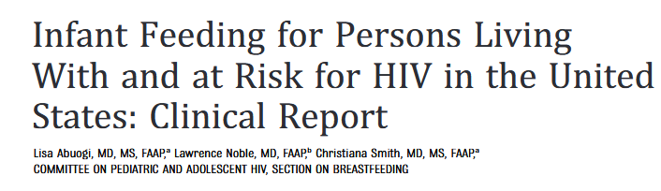

The American Academy of Pediatrics recommends that for people with HIV in the United States, avoidance of breastfeeding is the only infant feeding option with 0% risk of HIV transmission.
However, people with HIV may express a desire to breastfeed, and pediatricians should be prepared to offer a family-centered, nonjudgmental, harm reduction approach to support people with HIV on ART with sustained viral suppression below 50 copies per mL who desire to breastfeed.
Pediatric health care professionals who counsel people with HIV who are not on ART or who are on ART but without viral suppression should recommend against breastfeeding.
Abuogi L et al Pediatrics. 2024 Jun 1;153(6):e2024066843
Pediatrics (2024) 153 (6)
Notes:
Low rates of serious adverse events for infants’ exposure to ART through breast milk
Low rates of serious adverse events for infants who receive extended ART prophylaxis

Slide 38

Team Approach to Management of Breastfeeding
Coordination of care for parent and infant
  Maternity care provider
  HIV provider
  Infant provider
  Pediatric HIV provider
  Lactation consultant
  Social worker
  Perinatal case manager
  Peer
Coordination of services
  Mental health and substance use disorder treatment, if needed
  Intimate partner violence support services
  Public assistance programs
DHHS Perinatal Guidelines Available at https://clinicalinfo.hiv.gov/en/guidelines/perinatal. Accessed 5/5/24
Notes:
f a parent decides to breastfeed, several measures should be taken to reduce the possibility of HIV transmission. Care of the parent and infant should be coordinated prior to delivery among the maternity care provider, HIV provider, infant provider, lactation consultant, and social worker, all of whom may need education about new approaches to infant feeding among people with HIV.

Slide 39
Testing of Lactating Parent During Breastfeeding
Continue to encourage adherence to ART, sustained viral suppression
Monitor viral load every one to two months during breastfeeding
Develop contingency plan in case viral load becomes detectable (quantifiable but <200 copies/ml)
One approach to detectable viral load:
  Stop breastfeeding
  Address any concerns for adherence
  Alternative feeding options while repeating viral load
DHHS Perinatal Guidelines Available at https://clinicalinfo.hiv.gov/en/guidelines/perinatal. Table 12. Accessed 3/3/2026
Notes:
No data exist to inform the appropriate frequency of viral load testing for the breastfeeding parent. One ap-
proach is to monitor the plasma viral load of the parent every 1 to 2 months during breastfeeding

Slide 40
Temporary Modification or Cessation of Breastfeeding
Alternative feeding options:
  Give previously expressed/stored milk from when viral load was undetectable
  Pump and flash-heat expressed milk before feeding to infant
  Provide replacement feeding with formula or pasteurized donor human milk
If repeat viral load undetectable, restart breastfeeding
DHHS Perinatal Guidelines Available at https://clinicalinfo.hiv.gov/en/guidelines/perinatal. Accessed 5/5/24
Notes:
Given the sensitivity of HIV RNA
assays, the level of detectable viral load above which
breastfeeding should be stopped and additional infant
antiretroviral prophylaxis should be started is a mat-
ter of clinical judgment and review of viral load trends.
Consultation with an expert or the national perinatal
HIV/AIDS hotline (888-448-8765) is recommended.

Slide 41
Infant ART Prophylaxis Options
For newborns born at ≥ 37 weeks gestation at low risk of HIV acquisition during breastfeeding:
    Zidovudine (ZDV) for 2 weeks
    Zidovudine (ZDV) for 2 weeks, followed by Nevirapine for 6 weeks after cessation of breastfeeding
There is currently no expert consensus regarding use of extended ART prophylaxis during breastfeeding
DHHS Perinatal Guidelines Available at https://clinicalinfo.hiv.gov/en/guidelines/perinatal Table 12. Accessed 3/3/26
Notes:
The Panels could not reach a consensus on recommendations for infant prophylaxis while breastfeeding. Most Panel members agree on adopting the BHIVA recommendation of only 2 weeks of infant ZDV in this scenario. However, several Panel members prefer to extend the duration of ZDV prophylaxis to 4 to 6 weeks. Alternatively, some Panel members recommend 6 weeks of NVP, as currently recommended by WHO for breastfeeding infants at low risk of HIV transmission in resource limited countries. Some others opt to continue NVP dosing throughout breastfeeding.
Maternal ARV therapy taken during breastfeeding and sustained maternal VL suppression (<50 copies) at least three months prior to delivery
Provider and patient are confident that maternal ART adherence will be maintained during breastfeeding
Taken together, existing data support the efficacy of maternal ART during breastfeeding with documented sustained viral suppression to prevent postnatal transmission of HIV, suggesting that the recommended management of 2 weeks of ZDV prophylaxis for infants at low risk of in utero or intrapartum exposure is appropriate for breastfed infants when sustained maternal HIV RNA levels of <50 copies/mL have been achieved. This approach is currently recommended by the British HIV Association (BHIVA).⁴⁷

Slide 42
Recommended Testing of Infant During Breastfeeding
For infant with low-risk perinatal HIV exposure:
  Sustained viral suppression (<50 copies/ml) from 20 weeks of gestation through delivery
  Viral load (VL) testing at:
    Birth
    14–21 days
    1–2 months
    4–6 months
Obtain VL test between 1- to 2-month and 4- to 6-month time points if the gap between tests is > 3 months
If breastfeeding > 6 months of age, VL should be performed every 3 months during breastfeeding.
VL should also be performed at 4-6 weeks, 3 months, and 6 months after cessation of breastfeeding
DHHS Perinatal Guidelines Available at https://clinicalinfo.hiv.gov/en/guidelines/perinatal. Accessed 3/3/2026

Slide 43
The Fourth Trimester: Postpartum Care
The 12 weeks postpartum are referred to as “the fourth trimester”
Address the following
  Mood and emotional wellbeing
  Infant care and feeding
  Sleep, fatigue and physical recovery from birth
  Sexuality, contraception, birth spacing
  Chronic disease management and coordination of care with PCP
  Health Maintenance
Women living with HIV are often lost to HIV follow-up during this time period
https://www.acog.org/clinical/clinical-guidance/committee-opinion/articles/2018/05/optimizing-postpartum-care
Notes:
By analyzing data from a single healthcare system in which HIV primary care, specialized HIV/obstetric care, and pediatric care for HIV exposed infants occurs in close geographic proximity, we showed, despite minimization of operational barriers that may be expected from co-located services [43], women in our study still experienced poor transition from obstetric to HIV primary care, similar to observations from US sites with varying structures of care [10, 12]. A recent single center report from South Carolina showed that HIV-centered prenatal care, in which HIV-trained obstetric providers provide care in a model that integrates services in one location, was associated with improved maternal virologic control during pregnancy and postpartum [44], but not improved HIV follow-up care in the 12 months postpartum, suggesting, consistent with our findings, that additional steps are likely needed across diverse care settings to improve long-term outcomes [45]. Such steps may need to also include policy changes, such as addressing insurance coverage gaps parental leave policies that particularly impact women with chronic health conditions during the postpartum period.
The American College of Obstetricians and Gynecologists (ACOG) recently highlighted the importance of the postpartum period and transition to primary care in a set of new guidelines, stressing the need for an individualized spectrum of follow-up over the initial twelve weeks postpartum [9]. With 50% of pregnancy related mortality and morbidity occurring in the postpartum period, it is critical to engage women in their postpartum healthcare plan during the prenatal period. This includes identifying a primary care and other providers, scheduling follow-up prior to delivery, choosing contraception, and counseling on the effects and complications of pregnancy on postpartum physical and mental health, as well as chronic conditions, such as hypertension, diabetes, mood disorders, among others. Interventions occurring during the prenatal period have been shown to improve postpartum care for women with several health conditions, including gestational diabetes [35], pregnancy-induced hypertension [39], depression [40], intravenous drug use [41], and tobacco use [42], further supporting the notion that pregnancy and the early postpartum period (the “4th trimester”) provide an opportunity to develop and implement interventions for chronic diseases requiring close follow-up, including HIV.

Slide 44
Summary
Recognizing HIV infection in people who are pregnant is critical for protection of the pregnant person’s health and to prevent transmission to the baby
Viral load during pregnancy is best predictor of HIV transmission
There are multiple effective, safe and well tolerated options for antiretroviral treatment in pregnancy
Support before, throughout, and after pregnancy is critical for the health of people with HIV and their babies

Slide 45
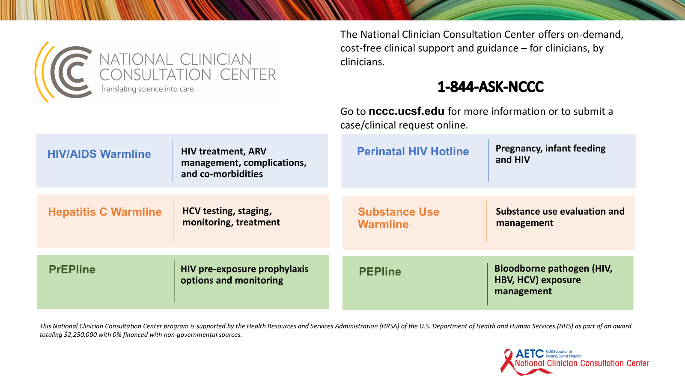

Slide 46

How to Support ART Adherence and Engagement
Screen and provide support for postpartum depression and other mental health conditions
These are highly prevalent among new parents and may affect ART adherence
Postpartum depression occurs more frequently in individuals with HIV compared to those without HIV
DHHS Perinatal Guidelines Available at https://clinicalinfo.hiv.gov/en/guidelines/perinatal. Accessed 2/20/26

Slide 47
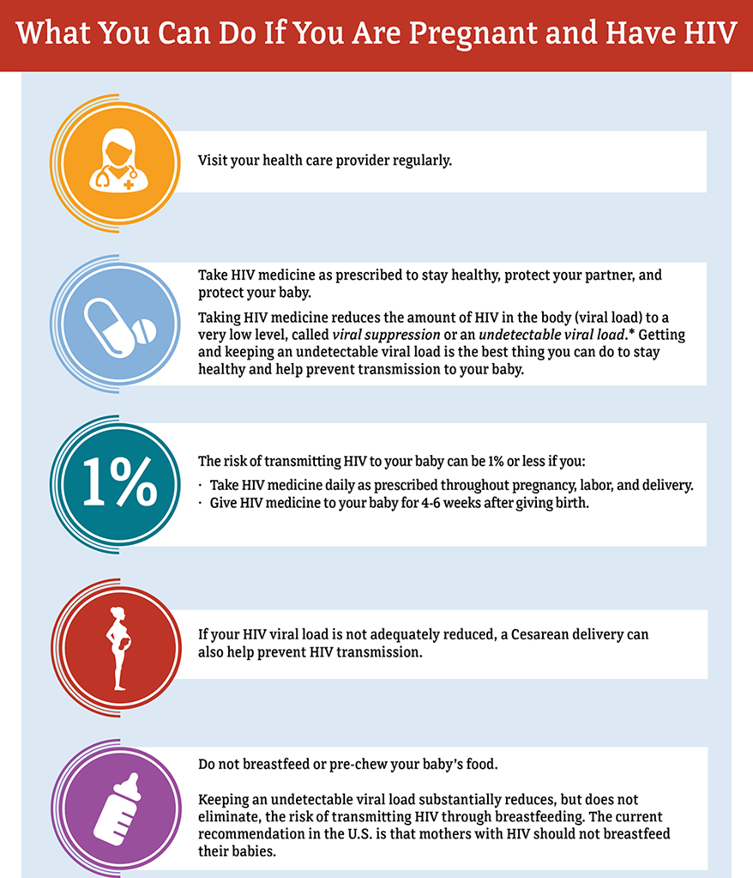
Support Pregnant People with HIV
Help Them Stay in Care and on Therapy
Coordination of services helps:
  Care providers – co-locate if possible
    OB, primary care, HIV care, pediatric HIV provider
  Mental health and substance use disorder treatment, if needed
  Intimate partner violence support services
  Public assistance programs
  Perinatal coordinator, case manager, peer, and/or support groups
Involve their support system if patient allows!
Be available

Slide 48
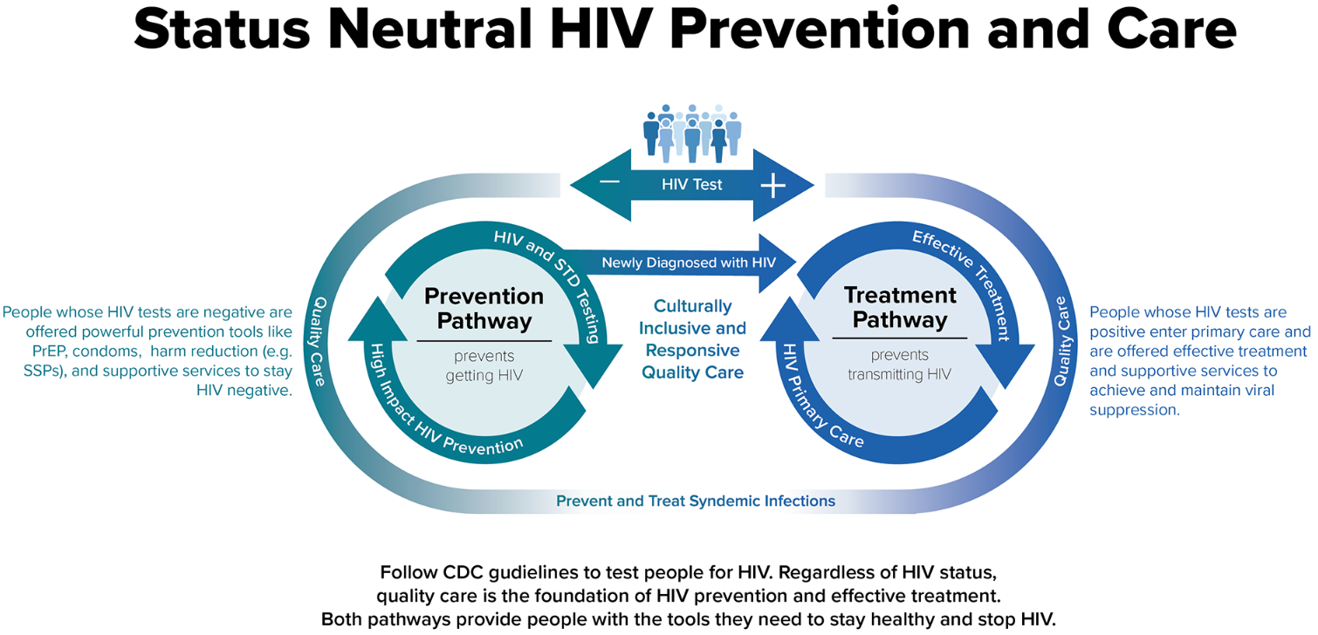
CDC.gov. Issue Brief: Status Neutral HIV Care and Service Delivery Eliminating Stigma and Reducing Health Disparities. CDC.gov/hiv/pdf/policies/issue-brief/Issue-Brief-Status-Neutral-HIV-Care.pdf.Accessed 10/2/22.
Notes:
The status neutral approach aims to improve care and service provision and eliminate structural stigma by meeting people where they are and offering a whole person approach to care, putting the needs of the person ahead of their HIV status. Stigma is a major barrier to people seeking prevention and care for HIV and STIs. Some clinics are rebranding themselves as sexual health clinics combining HIV and STI funding to deliver comprehensive care that links people to healthcare services like STI screening, substance use disorder treatment, mental health, housing, financial assistance, and psychosocial support in addition to HIV treatment and prevention.

Slide 49
Safety of ART in Breastfeeding
Low rates of serious adverse events for infants’ exposure to ART through breast milk
Low rates of serious adverse events for infants who receive extended ART prophylaxis
DHHS Perinatal Guidelines Available at https://clinicalinfo.hiv.gov/en/guidelines/perinatal. Accessed 3/2/2026
Notes:
An infant who acquires HIV while breastfeeding is at risk for developing ARV drug resistance due to subtherapeutic drug levels in breast milk.^{60,7}

Slide 50
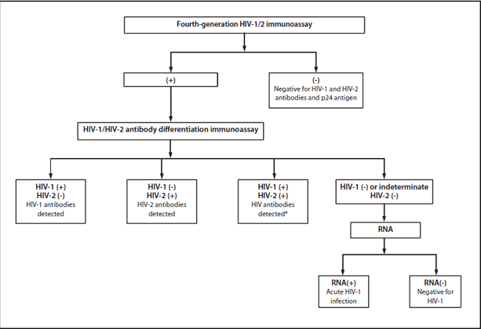
HIV Testing Algorithm
  https://www.cdc.gov/mmwr/preview/mmwrhtml/mm6224a2.htm
Notes:
Test has a sensitivity and specificity of close to 100% with chronic HIV infection
Patients who undergo HIV antibody testing should ideally gain an understanding of its ramifications through pretest and posttest counseling, although counseling is not required by the CDC, and absence of counseling should not be construed as an impediment to screening. Contraindications to HIV screening would be the inability of the patient to understand the implications of the result because of cognitive impairment, acute psychosis, and major depression or suicidality.
If concern for acute infection add on viral load
Shands doe the 4th generation combination antigen/antibody ELISA on Abbot Architect. If positive do the biorad differentiation assay. If that’s positive they stop there—if negative, or indeteterminat they do the NAAT. Currently takes a fair amount of time for the VL to come back but changing to a different reference lab in February that will hopefully have a shorter turn around time.

Slide 51
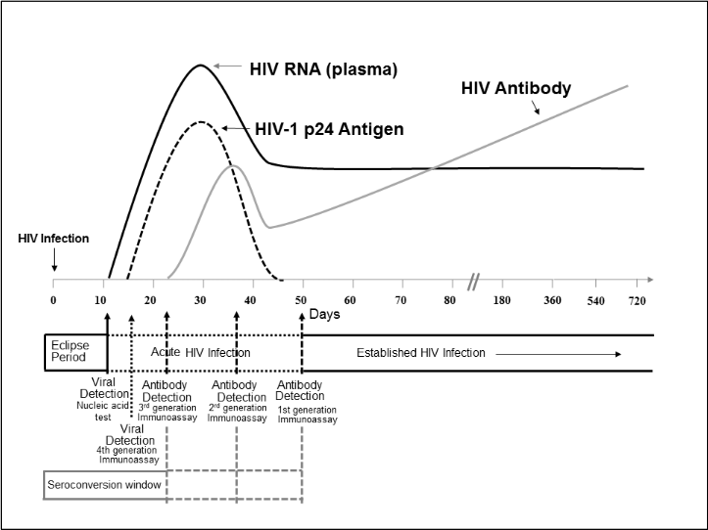
Sequence of Appearance of Lab Markers of HIV-1 Infection
Branson BM, et al. Laboratory Testing for the Diagnosis of HIV Infection: Updated Recommendations. CDC.gov. June 27, 2014.
Available at http://stacks.cdc.gov/view/cdc/23446..
Notes:
Lab markers of HIV-1 infection appear at different time points. Our ability to diagnose HIV infection depends on the diagnostic assay used the time from HIV infection. The HIV viral load becomes positive in 10-15 days from infection. The p24 antigen, a viral core protein that appears in the blood as the viral RNA rises following HIV infection, becomes positive at 15 to 20 days. Therefore, for patients in whom a diagnosis of acute HIV infection is being considered, ordering both an HIV viral load as well as 4th generation AG/Ab test may increase detection of acute infection.

Slide 52
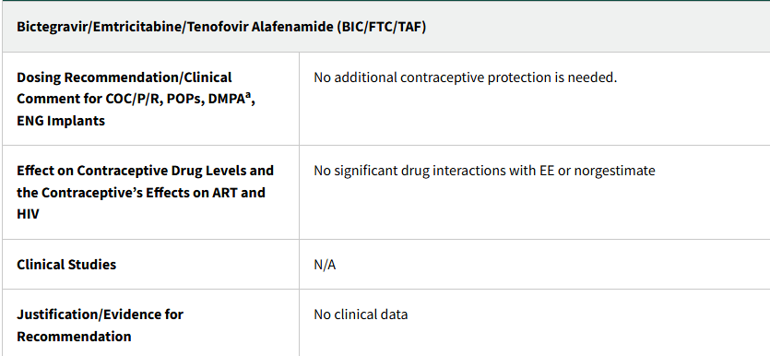
Family Planning Conversations
Women with HIV can use all available contraceptive methods, including hormonal contraception
DHHS Perinatal Guidelines Table 3 Available at https://clinicalinfo.hiv.gov/en/guidelines/perinatal. Accessed 2/18/2026.
Notes:
Integrating comprehensive family planning and preconception care into all health care visits, but should get special attention during routine prenatal and postpartum visits. Lack of breastfeeding is associated with earlier return of fertility. Ovulation returns as early as 6 weeks postpartum, and it can occur earlier in some people, even before resumption of menses, putting them at risk of pregnancy soon after delivery. If a long-acting reversible contraceptive (LARC)—such as an injectable, implant, or intrauterine device (IUD)—is desired by the patient, it should be inserted before hospital discharge or during the routine postpartum visit. If the insertion of a LARC is postponed until the postpartum visit, intramuscular depot medroxyprogesterone acetate (DMPA-IM) is a contraceptive option that can be given to avoid unplanned pregnancy in the interim, particularly if the postpartum appointment is missed or delayed. Interpregnancy intervals of <18 months have been associated with an increased risk of poor perinatal and maternal outcomes in women without HIV. Table 3 in the perinatal guidelines gives information about potential drug-drug interactions that should be considered when determining contraception in people with HIV on antiretroviral therapy.

Slide 53

Screening for HIV
If signs or symptoms of acute HIV, obtain
  4th generation Ag/Ab test AND
  HIV RNA PCR --quantitative
Partners of all pregnant people should be referred for HIV testing when their status is unknown
https://commons.wikimedia.org/wiki/File:Symptoms_of_acute_HIV_infection.svg

Slide 54
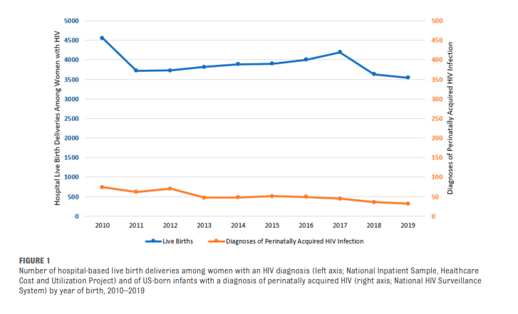
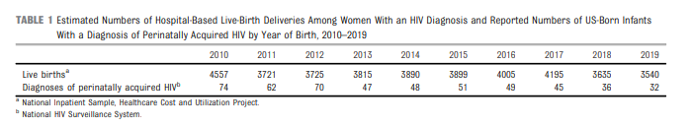
PEDIATRICS Volume 151, number 5, May 2023:e2022059604
Notes:
<1 case of perinatal HIV per 100000 live births, perinatal HIV transmission rate of <1%

Slide 55
Question
True or False. PrEP is safe to use during pregnancy.
True
False

Slide 56
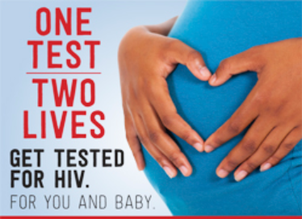
Question
When should pregnant people be screened for HIV?
At entry into care for pregnancy
Anytime they have any signs or symptoms suggestive of acute HIV
In the 3rd trimester if at risk of HIV acquisition
All of the above

