Slide 1
How Far We Have Come:
Reflections on a Career in HIV Care
Ernie-Paul Barrette, MD, FIDSA, FACP
Professor of Medicine
Division of Infectious Diseases
Washington University School of Medicine
Southeast AETC

Slide 2
Disclosures
This program is supported by the Health Resources and Services Administration (HRSA) of the U.S. Department of Health and Human Services (HHS) under grant number TR7HA53203-01-00 as part of an award totaling $5.7m. The contents are those of the author(s) and do not necessarily represent the official views of, nor an endorsement, by HRSA, HHS, or the U.S. Government. For more information, please visit HRSA.gov.
“Funding for this presentation was made possible by cooperative agreement TR7HA53203-01-00 from the Health Resources and Services Administration HIV/AIDS Bureau. The views expressed do not necessarily reflect the official policies of the Department of Health and Human Services nor does mention of trade names, commercial practices, or organizations imply endorsement by the U.S. Government. Any trade/brand names for products mentioned during this presentation are for training and identification purposes only.”
This content is owned by the AETC and is protected by copyright laws. Reproduction or distribution of the content without written permission of the sponsor is prohibited and may result in legal action.

Slide 3
Disclosures
All planners, faculty, and others in control of educational content are required to disclose all their financial relationships with ineligible companies within the prior 24 months. An ineligible company is defined as one whose primary business is producing, marketing, selling, re-selling, or distributing healthcare products used by or on patients. Financial relationships are relevant if the educational content an individual can control is related to the business lines or products of the ineligible company.
None of the planners, faculty, and others in control of educational content for this educational activity have relevant financial relationship(s) to disclose with ineligible companies.
The material presented in this course represents information obtained from the scientific literature as well as the clinical experiences of the speakers. In some cases, the presentations might include discussion of investigational agents and/or off-label indications for various agents used in clinical practice. Speakers will inform the audience when they are discussing investigational and/or off-label uses.
Disclosure of a relationship is not intended to suggest or condone commercial bias in any presentation, but it is made to provide participants with information that might be of potential importance to their evaluation of a presentation.

Slide 4
Disclosures
The Health Resources and Services Administration (HRSA), Department of Health and Human Services (HHS) provided financial support for this project. The award provided 100% of total costs. The contents are those of the author. They may not reflect the policies of HRSA, HHS, or the U.S. Government.
Speaker has nothing to disclose.

Slide 5
AETC Program National Centers and HIV Curriculum
National AETC Support Center (NASC) – serves as the central web –based repository for AETC Program training and capacity building resources; its website includes a free virtual library with training and technical assistance materials, a program directory, and a calendar of trainings and other events. Learn more: https://aidsetc.org/
National Clinical Consultation Center (NCCC) – provides free, peer-to-peer, expert advice for health professionals on HIV prevention, care, and treatment and related topics. Learn more: https://nccc/ucsf.edu or call 844-ASK-NCCC (844-275-6222)
National HIV Curriculum (NHC) – provides ongoing, up –to-date HIV training and information for health professionals through a free, web –based curriculum; also provides free CME credits, CNE contact hours, CE contact hours, and maintenance of certification credits. Learn more: www.hiv.uw.edu

Slide 6
Objectives:
Review the timeline of the early HIV pandemic
Discuss the early treatments of HIV
Discuss my experience taking care of AIDS and HIV in the 1990’s

Slide 7
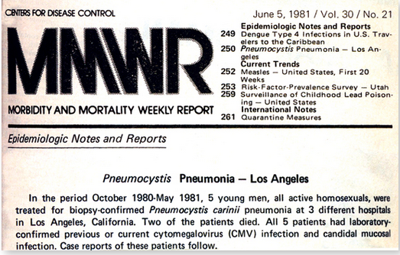
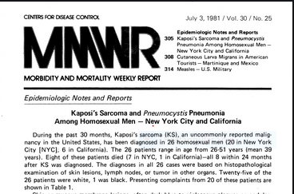

Slide 8
Retrovirus
discovered
LAV, HTLV-1
First drug
Licensed
AZT
1981 1983 1985 1987 1989 1990
100,000 Cases in US
First Guideline on Prevention
Of Transmission of HIV to
Health Care Workers
First Reports
of PCP, KS
FDA licenses
first HIV test

Slide 9
1986 Medical School 1990
Retrovirus
discovered
LAV, HTLV-1
First drug
Licensed
AZT
1981 1983 1985 1987 1989 1990
100,000 Cases in US
First Guidelines Prevention
Of Transmission of HIV to
Health Care Workers
First Reports
of PCP, KS
FDA licenses
first HIV test

Slide 10
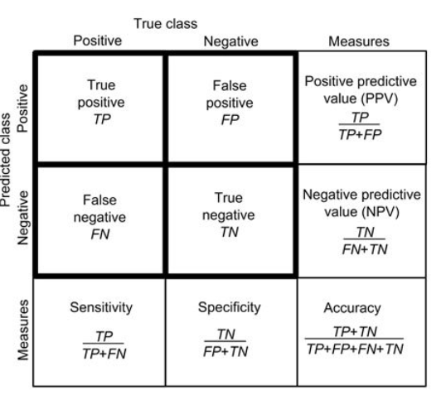

Slide 11
Premarital HIV Testing
Illinois and Louisiana adopted mandatory HIV testing
Illinois: 1/1/1988, repealed 9/1989
HIV Elisa: sensitivity 99%, specificity 99.8%
Estimated <15% positive test results were true positive
Licenses in Illinois dropped 14% and increased in IN, MO, WI
Pub Health and Law 1991;81:650
JAMA 1987;258:1757

Slide 12
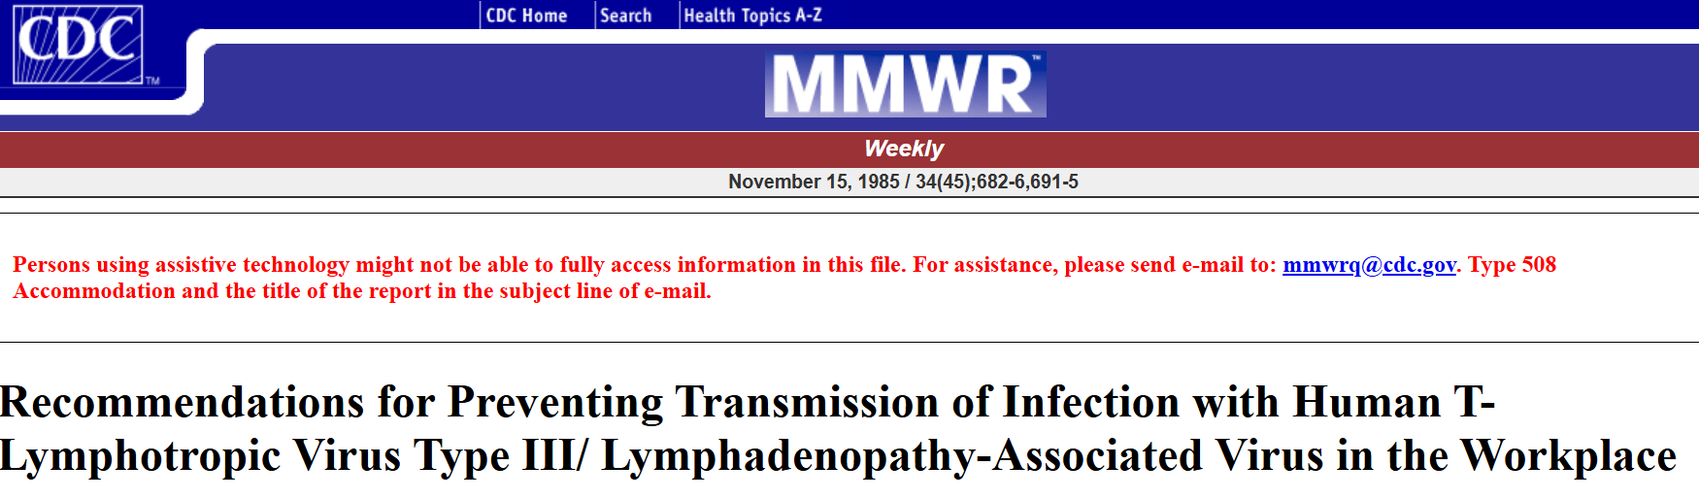

Slide 13



Slide 14
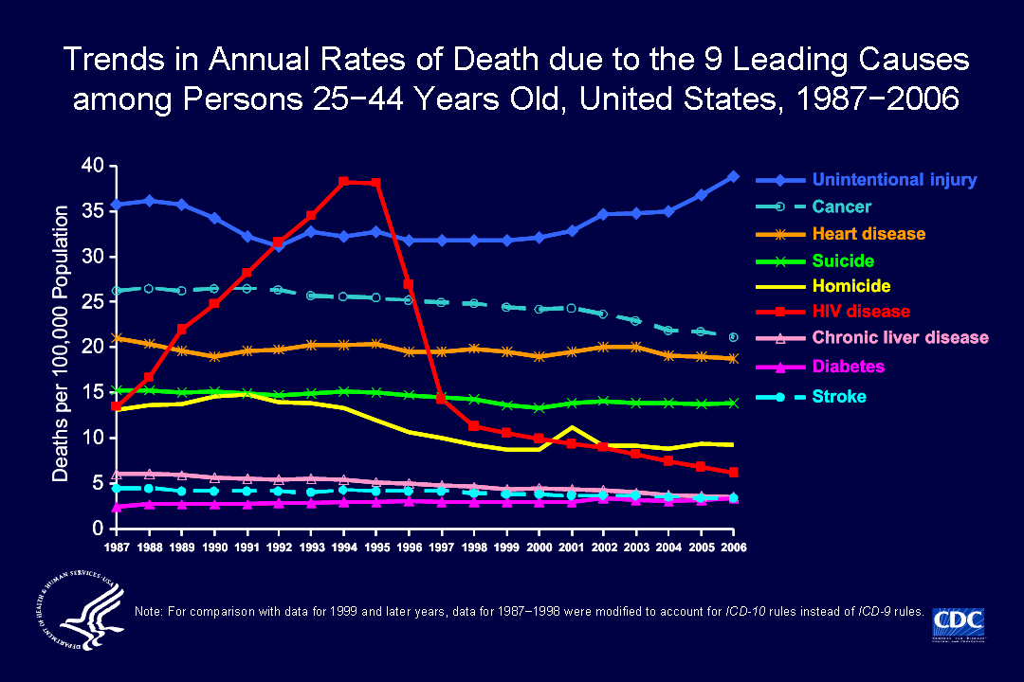

Slide 15
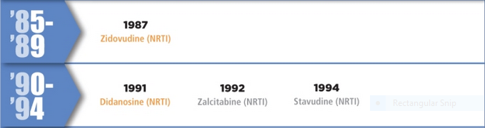
Debate on how to use the NRTI’s
Sequential or in combination
Adverse effects: severe anemia, pancreatitis, lactic acidosis
ACTG 0175: AZT vs
AZT + ddI vs
AZT + ddC

Slide 16

1995: First protease inhibitor approved
1996: First non-nucleoside reverse transcriptase inhibitor approved
HAART: Combination of PI or NNRTI and two NRTI’s
1996: FDA approves viral load test
1998: Genotype approved

Slide 17
AZT 300 mg bid 2 pills
ddI 200 mg bid without food 2 pills
Saquinavir 1,200 mg tid with food 18 pills

Slide 18


Slide 19
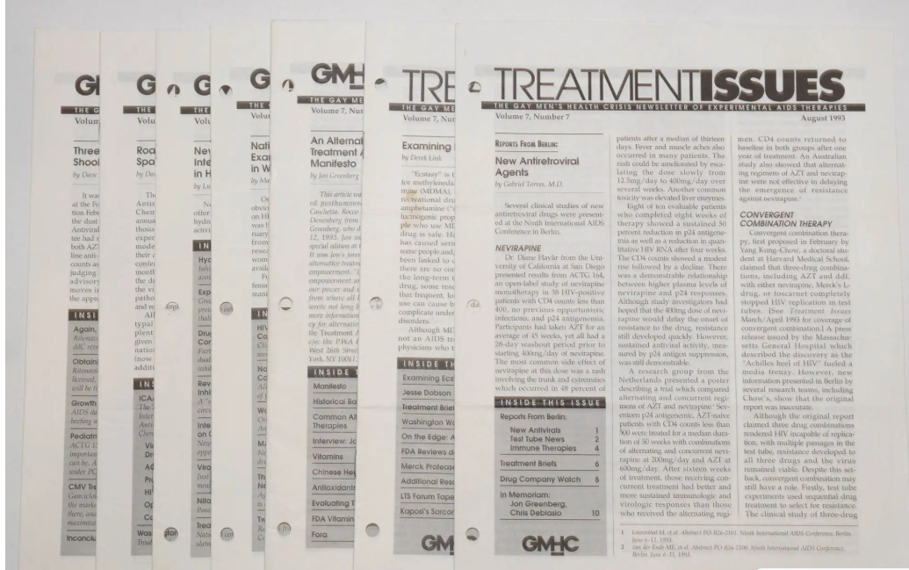

Slide 20
Early PI’s: marked hyperlipidemia, hypertriglyceridemia
Ritonavir: 300 mg bid titrate to 600 mg bid
Diarrhea 68%, Nausea 57%, Vomiting 32%
Indinavir: Renal stones > 10%
Nelfinavir: Diarrhea 20%
Nevirapine: Black box warning for fatal hepatotoxicity and skin reactions

Slide 21
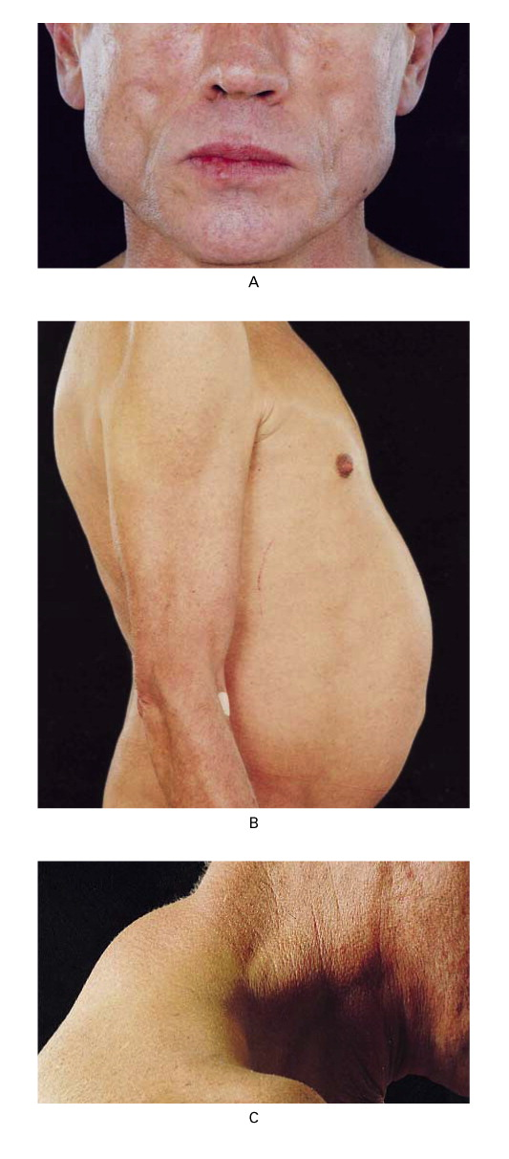
HIV Lipoatrophy/Lipodystrophy
Due to Thymidine analogue NRTI
Stavudine >> Zidovudine

Slide 22
Abacavir Hypersensitivity Syndrome
8% in US whites, 2.5% US African Americans
Fever, Constitutional symptoms, GI symptoms, +/- Rash
HLA B57:01 Screening test

Slide 23
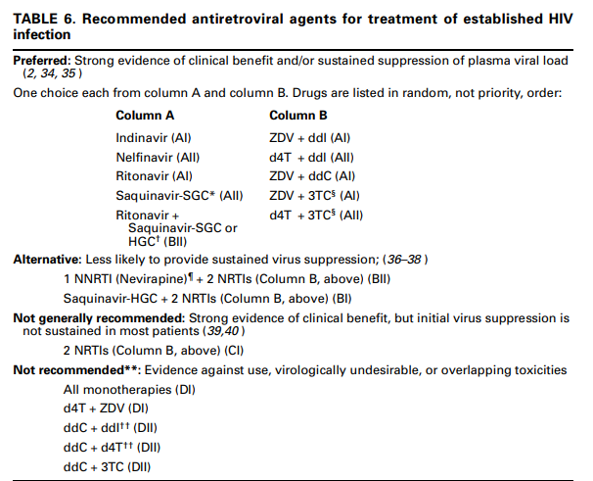
DHHS ART Guidelines for Treatment of HIV 1998 (First!)

Slide 24
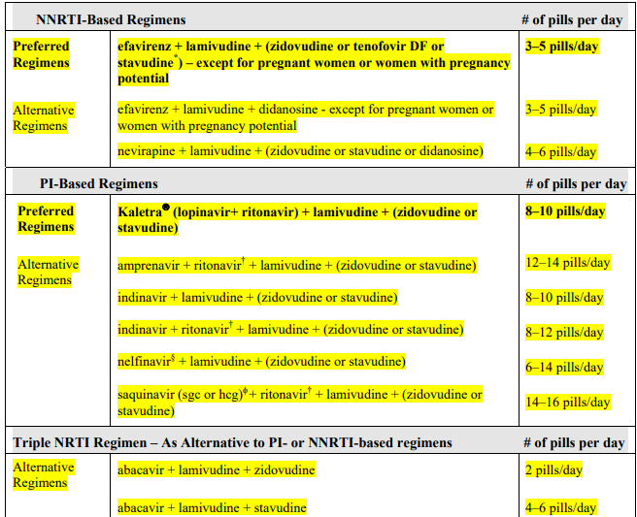
DHHS ART Guidelines for Treatment of HIV 2003

Slide 25
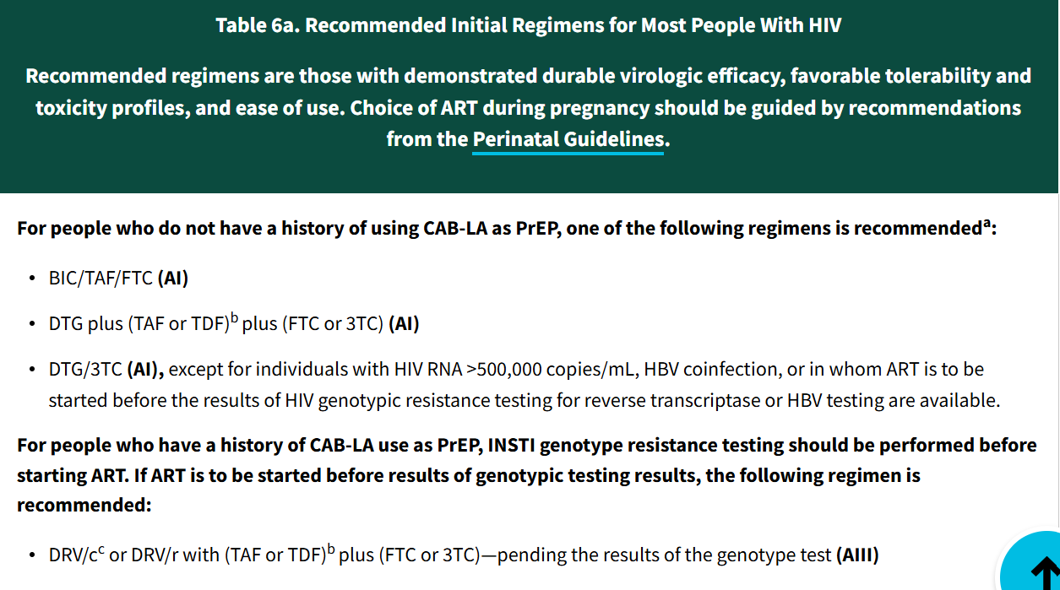

Slide 26
Debate on whom to treat?
Symptomatic AIDS/Advanced HIV Infection
Asymptomatic HIV Infection

Slide 27
DHHS ART Treatment Guidelines: Asymptomatic Patients
1998:
    Treatment should be offered but some experts would observe
2001:
    CD4 <350 or HIV RNA >55,000 - Treatment should be offered
    CD4 >350 and HIV RNA <55,000 – Many experts would defer therapy and observe
    CD4 >350 and HIV RNA >55,000 – Some experts would recommend treatment

Slide 28
DHHS ART Treatment Guidelines: Asymptomatic Patients
2009:
    ART recommended for those with CD4 350 – 500
    50% of the panel recommended those with CD4 >500 start ART
2012:
    ART recommended for all with HIV

Slide 29
HIV Testing and Western Blot
CD4
HIV Viral load
HIV Resistance Testing

Slide 30
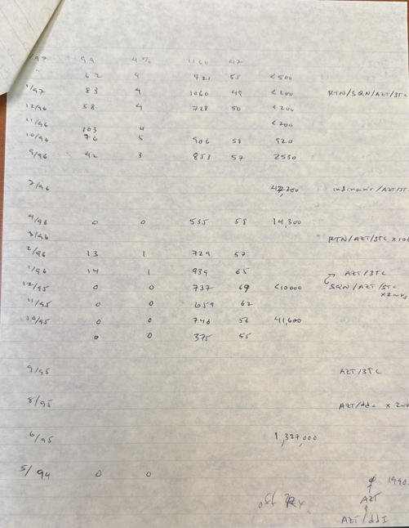
CD4 CD4% HIV RNA ART

Slide 31
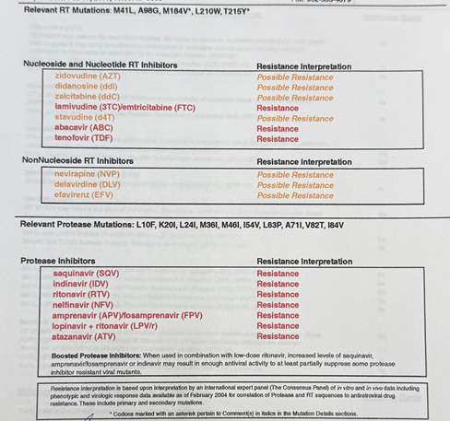

Slide 32
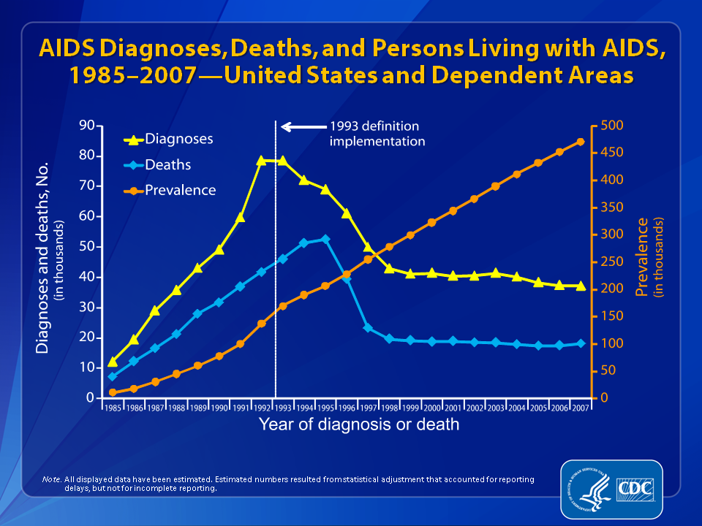

Slide 33
AIDS-Defining Opportunistic Illnesses in US,
HIV Outpatient Cohort Study,1994–2007
Pneumonia
Source: Buchacz K, et al. AIDS. 2010;24:1549-59.

Slide 34

STR 2006
First single tablet regimen (STR)
Atripla: efavirenz/emtricitabine/tenofovir disoproxil fumarate

Slide 35
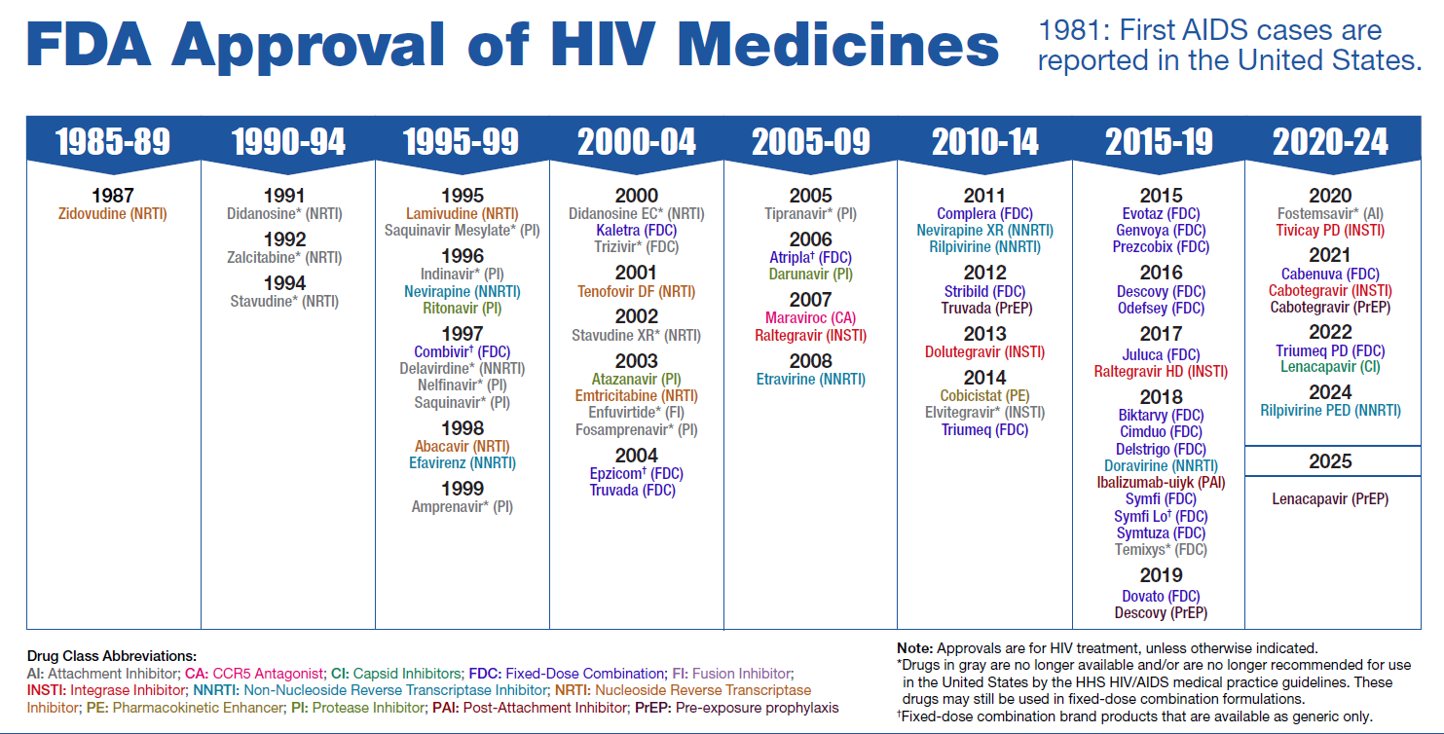

Slide 36
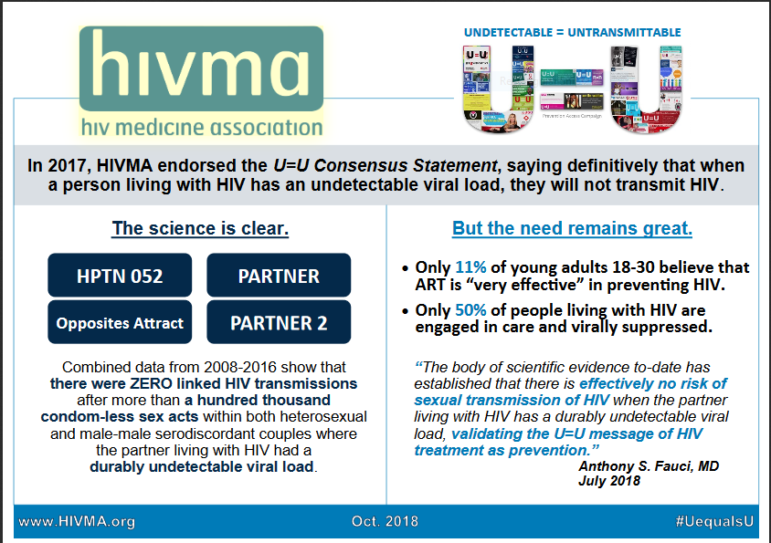

Slide 37
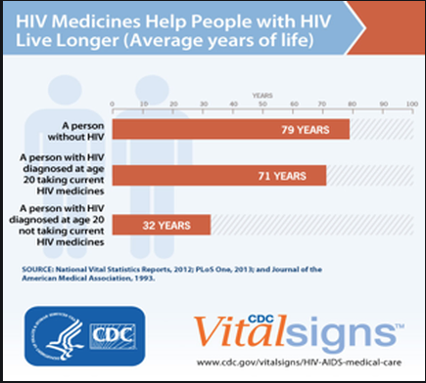

Slide 38
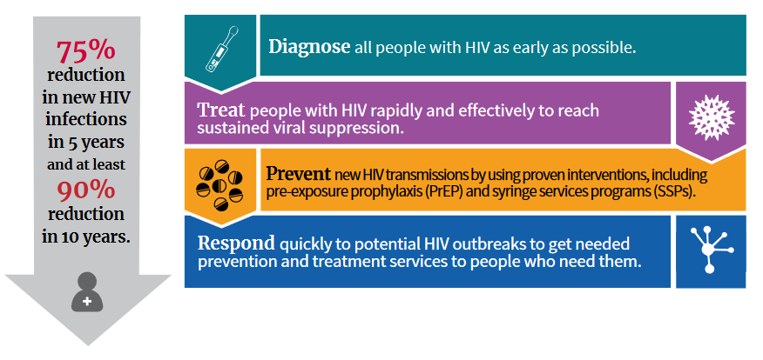
EHE: Ending the HIV Epidemic

Slide 39
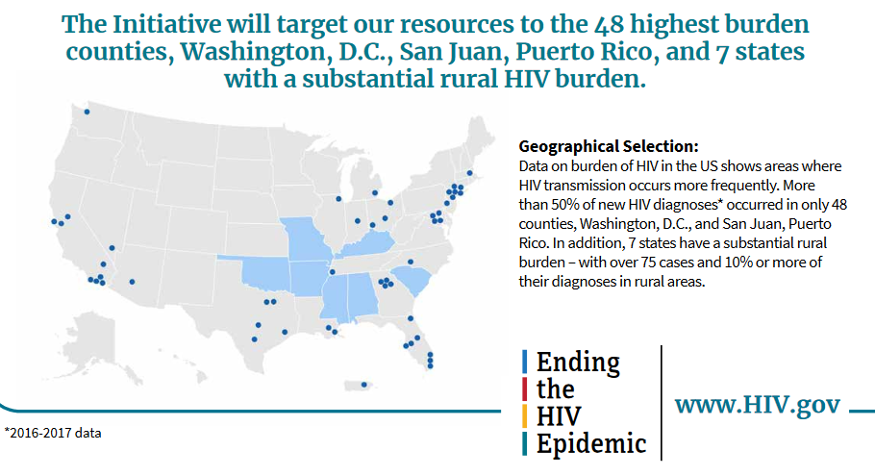

Slide 40



Slide 41



Slide 42



