Slide 1
Skin Disease in Patients Living with HIV
Carrie Kovarik, MD
Professor of Dermatology, Dermatopathology and Infectious Disease
University of Pennsylvania

Slide 2
Disclosures
This program is supported by the Health Resources and Services Administration (HRSA) of the U.S. Department of Health and Human Services (HHS) under grant number TR7HA53203-01-00 as part of an award totaling $5.7m. The contents are those of the author(s) and do not necessarily represent the official views of, nor an endorsement, by HRSA, HHS, or the U.S. Government. For more information, please visit HRSA.gov.
“Funding for this presentation was made possible by cooperative agreement TR7HA53203-01-00 from the Health Resources and Services Administration HIV/AIDS Bureau. The views expressed do not necessarily reflect the official policies of the Department of Health and Human Services nor does mention of trade names, commercial practices, or organizations imply endorsement by the U.S. Government. Any trade/brand names for products mentioned during this presentation are for training and identification purposes only.”
This content is owned by the AETC and is protected by copyright laws. Reproduction or distribution of the content without written permission of the sponsor is prohibited and may result in legal action.

Slide 3
Disclosures
All planners, faculty, and others in control of educational content are required to disclose all their financial relationships with ineligible companies within the prior 24 months. An ineligible company is defined as one whose primary business is producing, marketing, selling, re-selling, or distributing healthcare products used by or on patients. Financial relationships are relevant if the educational content an individual can control is related to the business lines or products of the ineligible company.
None of the planners, faculty, and others in control of educational content for this educational activity have relevant financial relationship(s) to disclose with ineligible companies.
The material presented in this course represents information obtained from the scientific literature as well as the clinical experiences of the speakers. In some cases, the presentations might include discussion of investigational agents and/or off-label indications for various agents used in clinical practice. Speakers will inform the audience when they are discussing investigational and/or off-label uses.
Disclosure of a relationship is not intended to suggest or condone commercial bias in any presentation, but it is made to provide participants with information that might be of potential importance to their evaluation of a presentation.

Slide 4
Disclosures
The Health Resources and Services Administration (HRSA), Department of Health and Human Services (HHS) provided financial support for this project. The award provided 100% of total costs. The contents are those of the author. They may not reflect the policies of HRSA, HHS, or the U.S. Government.

Slide 5
AETC Program National Centers and HIV Curriculum
National AETC Support Center (NASC) – serves as the central web –based repository for AETC Program training and capacity building resources; its website includes a free virtual library with training and technical assistance materials, a program directory, and a calendar of trainings and other events. Learn more: https://aidsetc.org/
National Clinical Consultation Center (NCCC) – provides free, peer-to-peer, expert advice for health professionals on HIV prevention, care, and treatment and related topics. Learn more: https://nccc/ucsf.edu or call 844-ASK-NCCC
National HIV Curriculum (NHC) – provides ongoing, up –to-date HIV training and information for health professionals through a free, web –based curriculum; also provides free CME credits, CNE contact hours, CE contact hours, and maintenance of certification credits. Learn more: www.hiv.uw.edu

Slide 6
Learning Objectives
By the end of this session, each participant will be able to:
    Identify common infectious, inflammatory, and neoplastic skin manifestations in people living with HIV in the modern ART era.
    Recognize skin conditions that have strong associations with specific risk factors, such as a low CD4 count nadir, cigarette smoking, or specific demographics.
    Discuss how immunosenescence can play a role in skin disease related to HIV.
    Explain which skin conditions may be treated differently in people with HIV.

Slide 7
Skin Disease in Patients Living with HIV
Prevalence of Dermatologic Conditions in PLWH Today
Specific diseases:
Malignancy
  HPV related
  Kaposi sarcoma
Infectious
  Warts/condyloma
  Herpes simplex
Inflammatory
  Atopic dermatitis
  Hidradenitis/follicular occlusion

Slide 8
Longitudinal cohort study of patients with skin disease in post-ART era
Incidence declined from 2011-2024 across all categories (infectious, inflammatory, and malignant)
Higher skin disease risk: lower CD4 count nadir, older age, public insurance, and prior opportunistic infections
Notes:
Categories: infectious (463 to 41), inflammatory (306 to 62), and malignant (31 to 6) cases per 1000 (all P <.0001).

Slide 9
Cumulative incidence of dermatologic conditions 2011-2024
Infection most common
HPV/HSV
HPV SCC

Slide 10
Cumulative incidence of dermatologic conditions 2011-2024
Cutaneous Malignancy
  HPV associated SCC (1st)
    Anal/genital cancer
    SCC of non-genital sites
  Kaposi Sarcoma (2nd)

Slide 11
Cumulative incidence of dermatologic conditions 2011-2024
Infectious
  Fungal
    Dermatophytes (1st)
    Candida
  Viral
    HSV (2nd)
    HPV (3rd)
  Bacterial
    Staph
    Syphilis

Slide 12
Cumulative incidence of dermatologic conditions 2011-2024
Inflammatory
  Follicular disorders
    Hidradenitis
  Red/Scaly
    Seborrheic dermatitis
    Atopic Dermatitis
    Psoriasis
    Drug eruptions
  Itch/prurigo

Slide 13
Human Papillomavirus

Slide 14
Human Papillomavirus
Genital condyloma
Genital malignancy
HPV of other sites
Vaccines

Slide 15
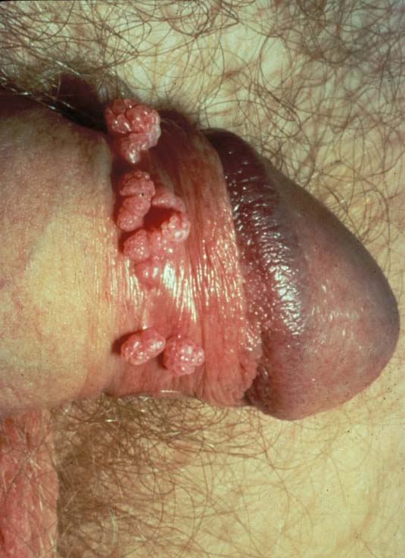
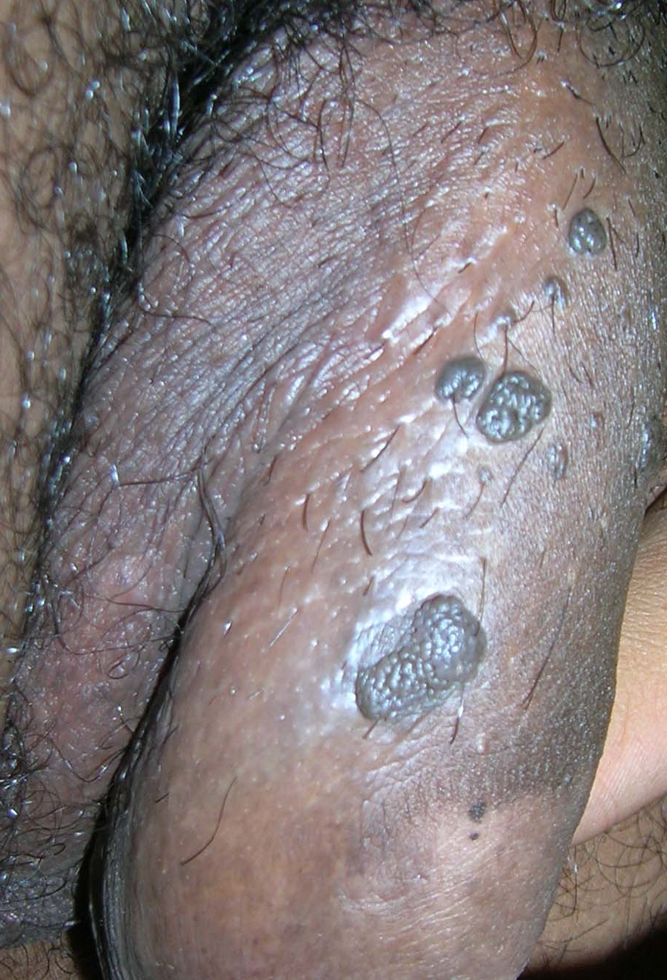
Condyloma
HIV-induced immunosuppression leads to higher rates of persistent, multiple, and high-risk HPV infections, increasing the risk of malignant transformation in these warts.
Treatment is important!

Slide 16
Condyloma
Treatment options
Destructive methods
Cryotherapy
Shave/curette (biopsy)
Podophyllin 20-25% (podofilox 0.5%)
+ HPV targeted treatment (through immune system or directly)
Imiquimod
Sinecatechins
Cidofovir (topical/IL)

Slide 17
Issues affecting treatment
Immune status
Smoking
Adherence
Health Literacy/ understanding of treatment
Emotional impact
Extent/size of warts
Location of warts
General health
Failure of previous treatments
Privacy considerations
Treatment options
Destructive methods
Cryotherapy
Shave/curette (biopsy)
Podophyllin 20-25%
+ HPV targeted treatment (through immune system or directly)
Imiquimod
Sinecatechins
Cidofovir (topical/IL)
Counseling is a big part of treatment!

Slide 18
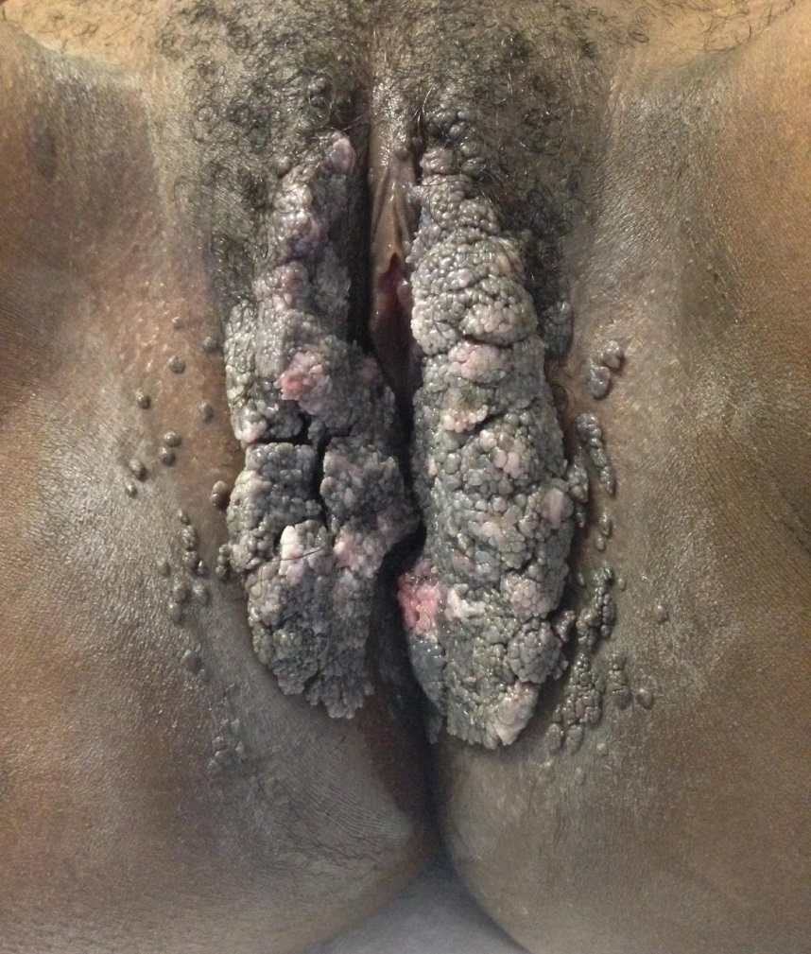
21yo HIV positive female on HAART (CD4 183) with genital warts not responding to cryotherapy
** Low threshold for biopsy
Botswana-UPenn Partnership in conjunction with MoH Dermatology Clinics, Dr. Tori Williams

Slide 19
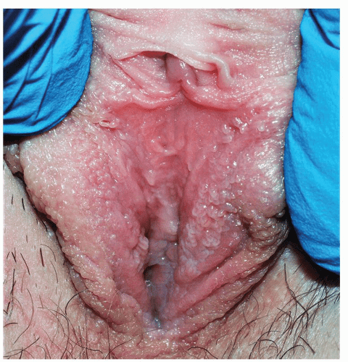
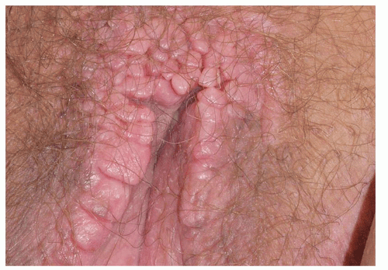
Condyloma Mimics
Vulvar Vestibular Papillomatosis
Lichen Simplex Chronicus
https://obgynkey.com/skin-colored-disorders/

Slide 20
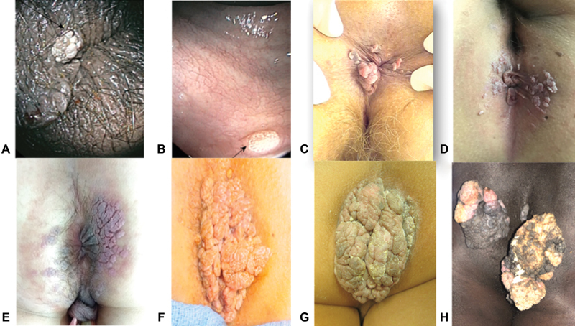
Perianal
Condyloma:
High risk of
Malignant
Transformation
Treatment is
Essential!!
Clin Colon Rectal Surg 2019 Sep; 32(5): 347–357

Slide 21
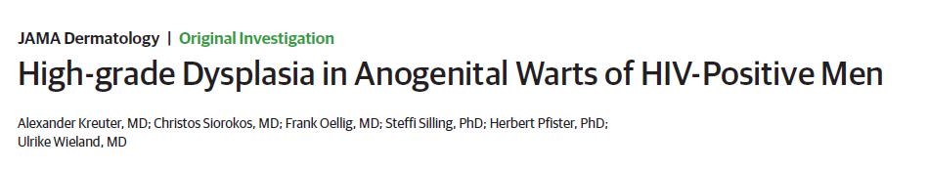
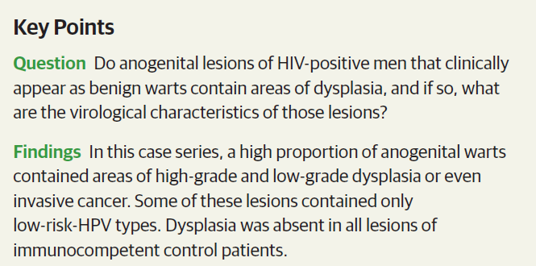

Slide 22
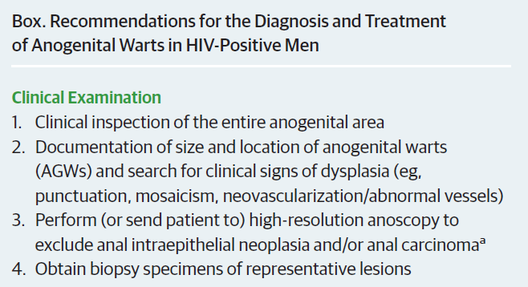
Destructive methods as tolerated: cryotherapy, podophyllin
Imiquimod as field therapy

Slide 23
HPV-related
Genital Malignancy

Slide 24
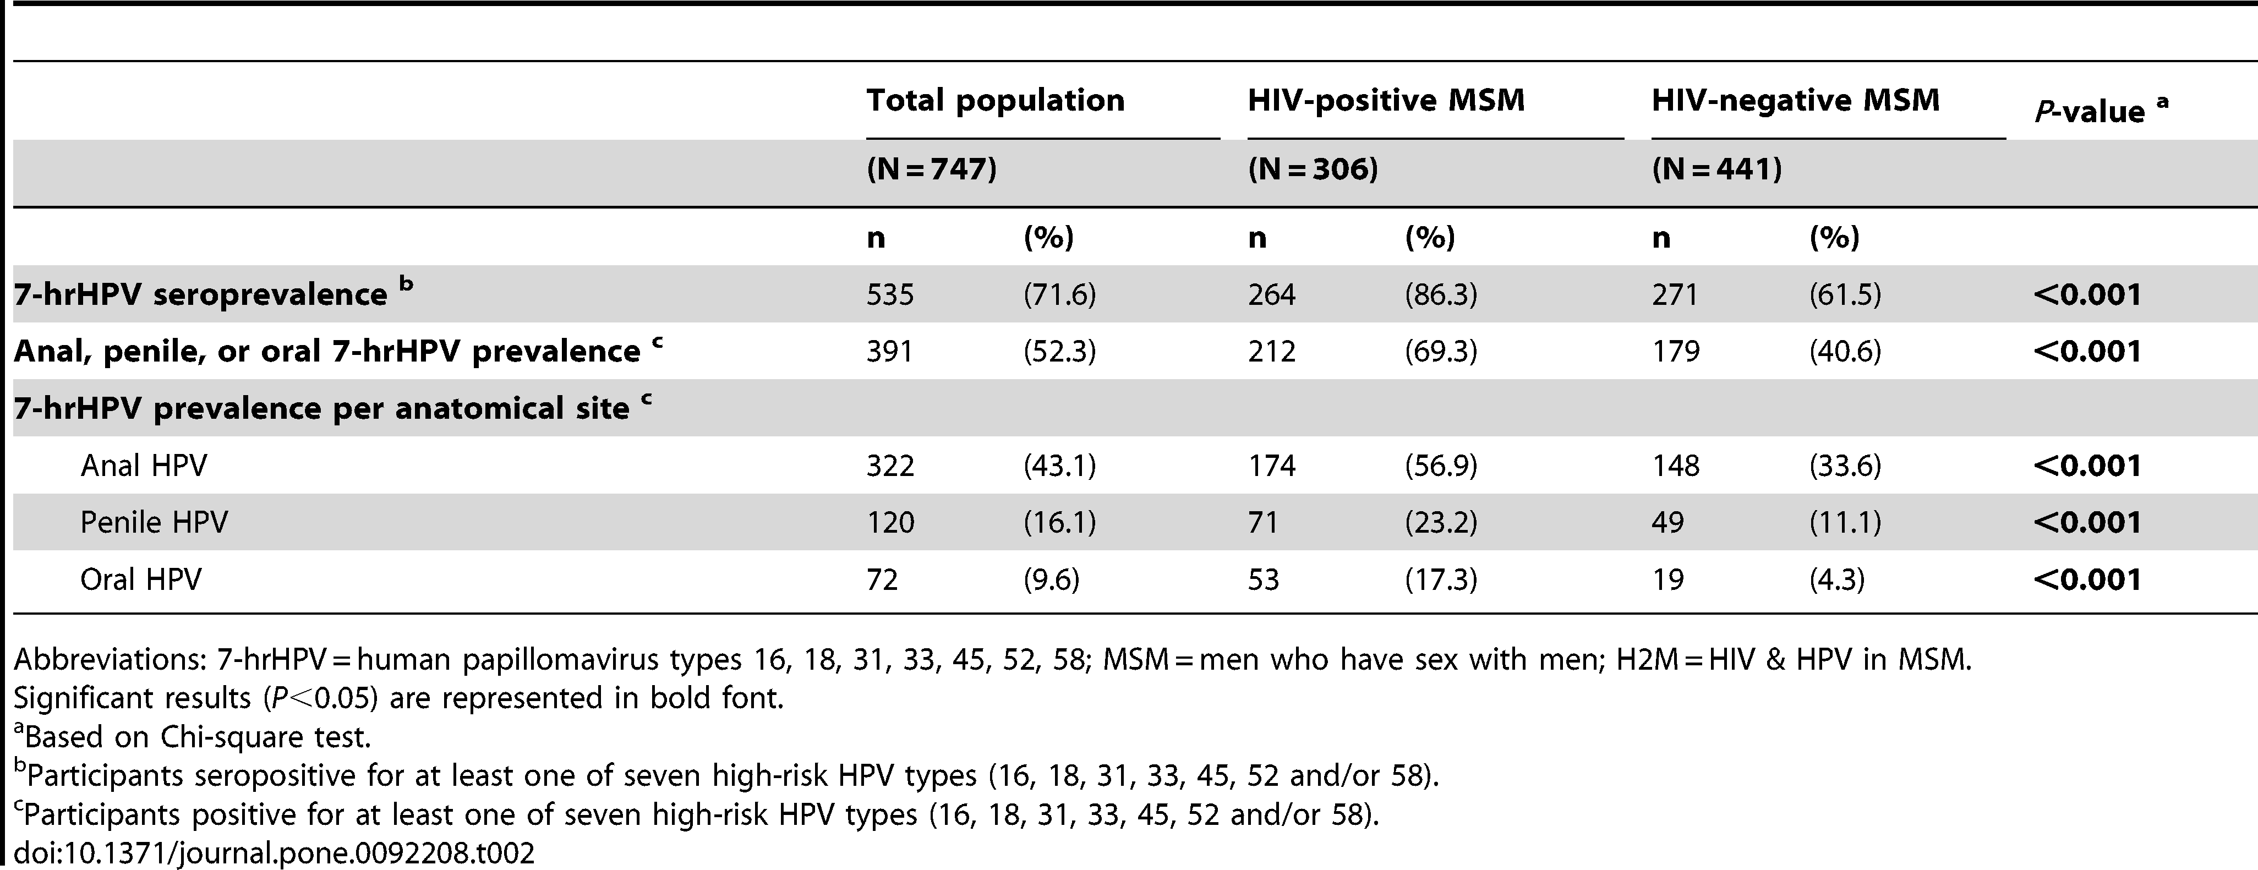
 | HIV pos men who have sex with men (N=306) | HIV neg men who have sex with men (N=441)
Anal HPV | 174 (56.9%)* | 148 (33.6%)
Penile HPV | 71 (23.2%)* | 49 (11.1%)
Oral HPV | 53 (17.3%)* | 19 (4.3%)
*P<0.001
Significantly higher anal, penile, and oral HPV in HIV positive men who have sex with men vs HIV negative men who have sex with men.

Slide 25
Low current CD4 count was significantly associated with HPV16 infection and HSIL+ in all HIV-positive men who have sex with men

Slide 26
HPV-related
Penile Malignancy

Slide 27
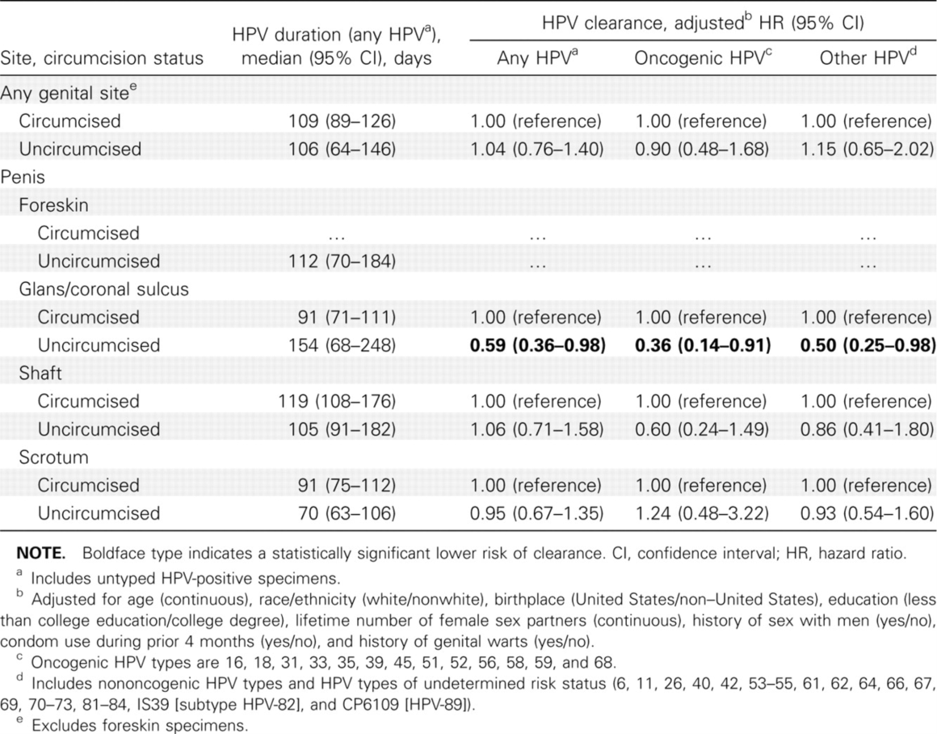
Clearance of HPV infection, including infection with oncogenic types, is slower in the glans/coronal sulcus of the penis of uncircumcised men than circumcised men.
From: Reduced Clearance of Penile Human Papillomavirus Infection in Uncircumcised Men
J Infect Dis. 2010;201(9):1340-1343. doi:10.1086/651607
J Infect Dis | © 2010 by the Infectious Diseases Society of America
Notes:
Table 1 Duration and Clearance of Genital Human Papillomavirus (HPV) Infection in Men (n=357), by Circumcision Status—Hawaii, 2004–2008
27

Slide 28
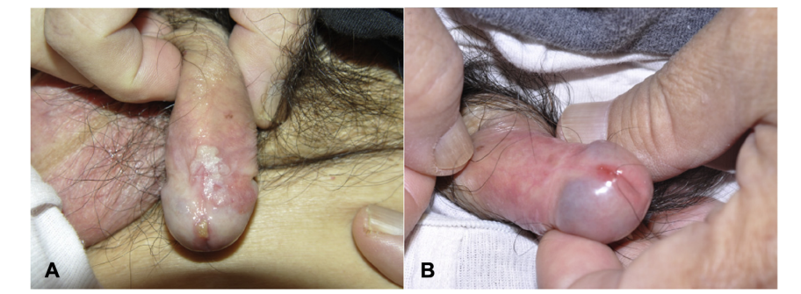
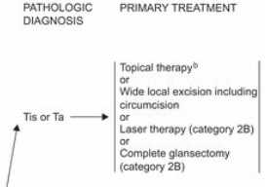
Penile squamous cell
carcinoma in situ
This patient was treated with combo imiquimod and cryotherapy.
NCCN Clinical Practice Guidelines in Oncology:
Penile Cancer, Version 1.2013
JAAD Case Rep. 2017 Nov; 3(6): 546–549.

Slide 29
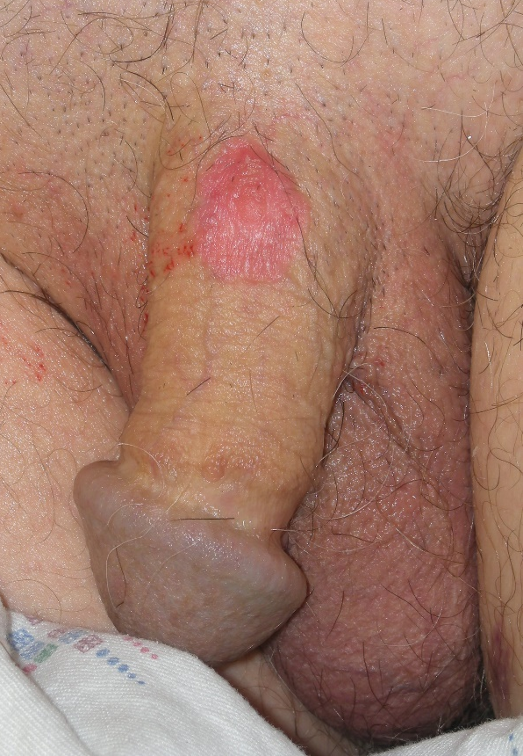
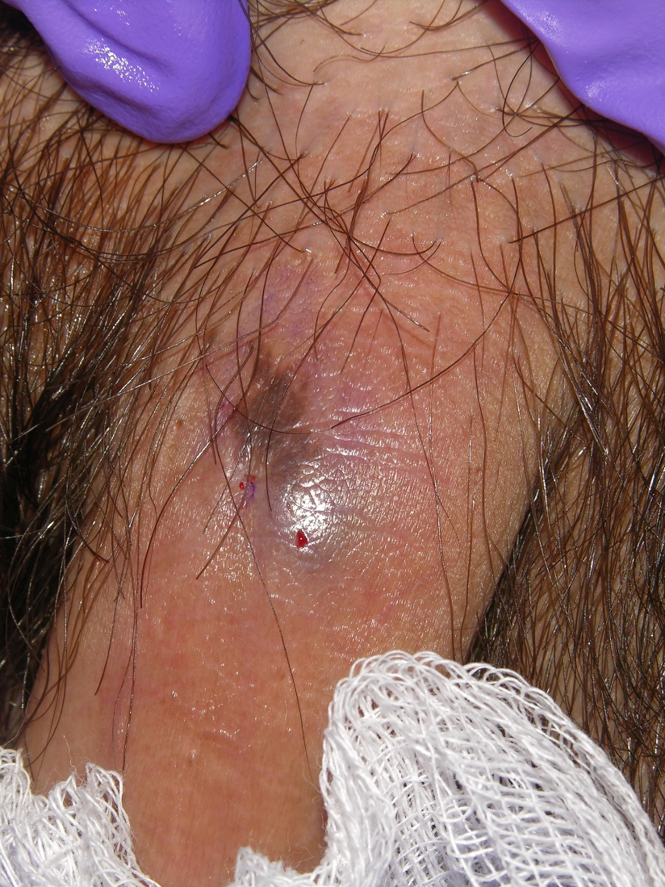
Penile squamous cell carcinoma in situ

Slide 30
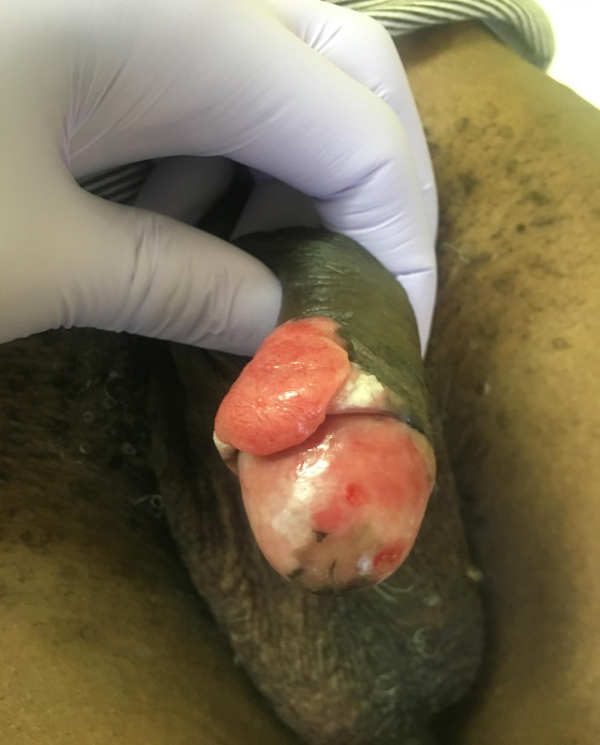
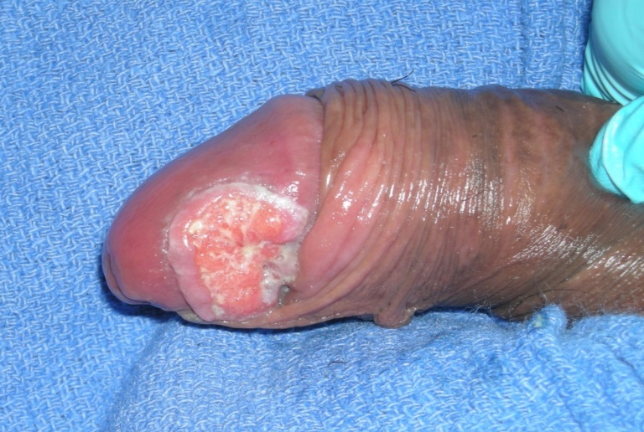
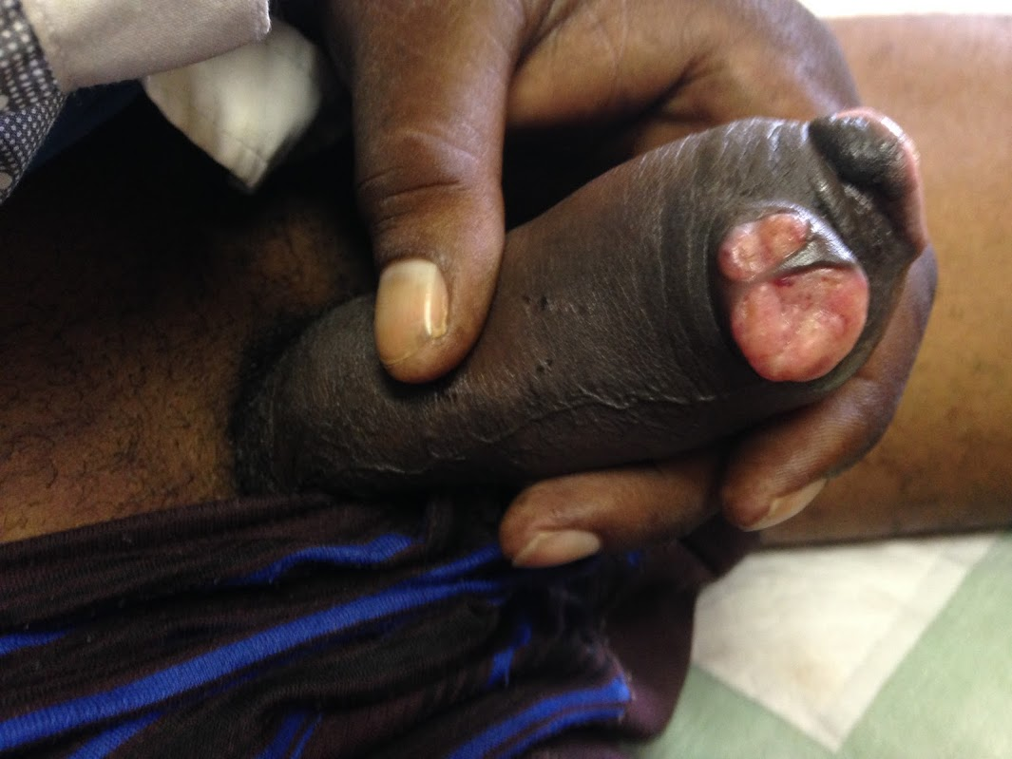
53yo HIV(+) with CD4 count 600's & a few month history of friable nodular exophytic penile plaque with surrounding verrucous change
Botswana-UPenn Partnership in conjunction with
MoH Dermatology Clinics, Dr. Tori Williams
Invasive Squamous Cell Carcinoma

Slide 31
HPV-related
Vulvar Malignancy

Slide 32
Vulvar (VIN2+)
Vaginal (ValN2+)
Anal (AIN2+)
Women with cervical HPV16 infection had increased risk of VIN2+ (a), VaIN2+ (b) and AIN2+ (c) compared with hrHPV neg women.
Gynecol Oncol. 2020 Jan 30.

Slide 33
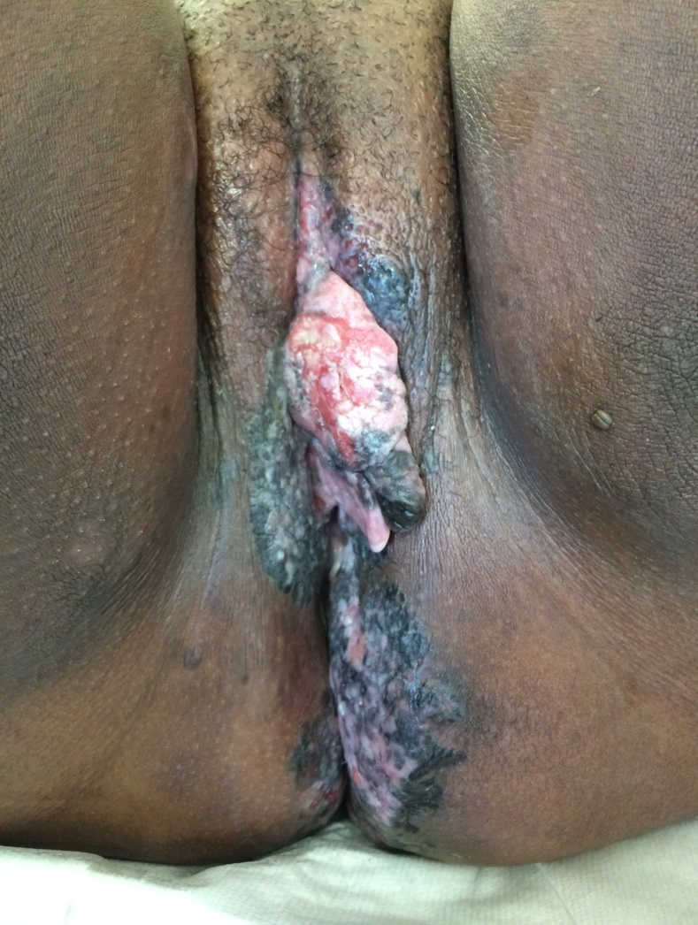
41 yo female HIV + (CD4 952) with large verrucous macerated plaque
SCCIS and SCC
Currently, NCCN does
not include Tis (in situ) in the treatment guidelines like they do for in situ penile cancer.
Botswana-UPenn Partnership in conjunction with MoH Dermatology Clinics, Dr. Tori Williams

Slide 34
HPV-related
Anal Malignancy

Slide 35
HIV+ Men who have sex w men (vs HIV (-) MSM)
Anal HPV is nearly ubiquitous (93%)
High-risk HPV prevalence (74% vs 37%)
Anal cancer incidence (45.9 vs 5 cases/100 000 PY)
Rates of anal HSIL in HIV infected TGW are at least as high as in HIV-infected men who have sex with men
Notes:
Anal HPV is nearly ubiquitous in HIV+ MSM (93%), with
High-risk HPV prevalence = 73.5% for HIV-pos MSM
High-risk HPV prevalence = 37.2% for HIV-neg MSM
Anal cancer is rare in gen population (1–2 cases/100 000 PY), but burden is much higher among MSM
Anal cancer incidence HIV-neg MSM = 5 cases/100 000 PY
Anal cancer incidence HIV-pos MSM = 45.9 cases/100 000 PY

Slide 36
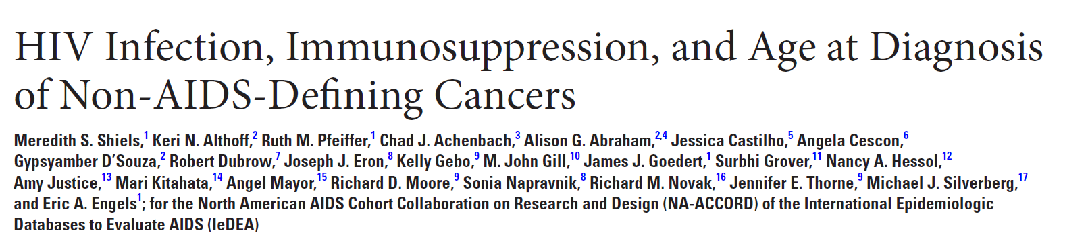
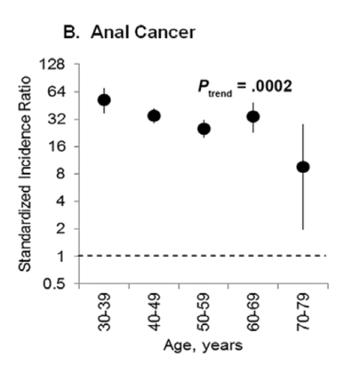
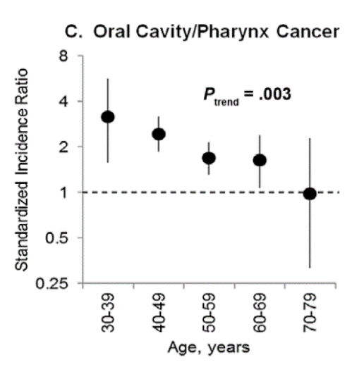
Younger ages at diagnosis were observed for people with HIV compared with general population for lung, anal, oral cavity/pharynx, kidney cancers and myeloma

Slide 37
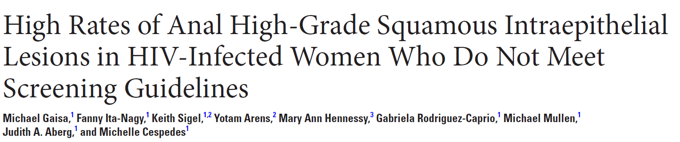


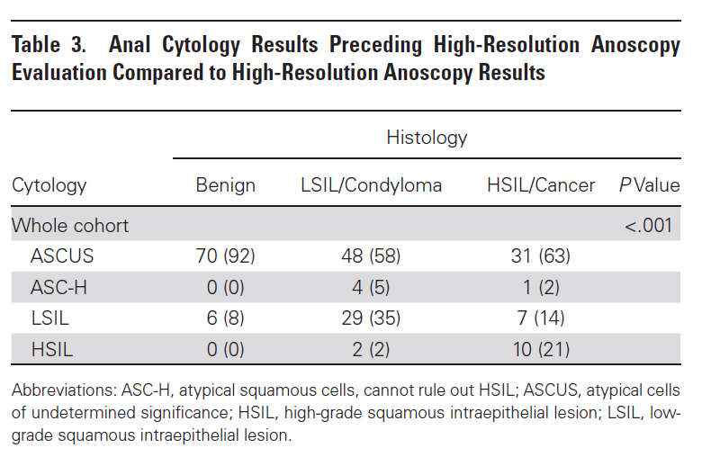
745 HIV+ women: screened: 15-39% abnormal anal cytology
HSIL found in 18-26% of anal biopsies
Cigarette smoking > doubled HSIL risk.
Neither meeting criteria for screening nor history of receptive anal sex was significantly associated with HSIL.

Slide 38
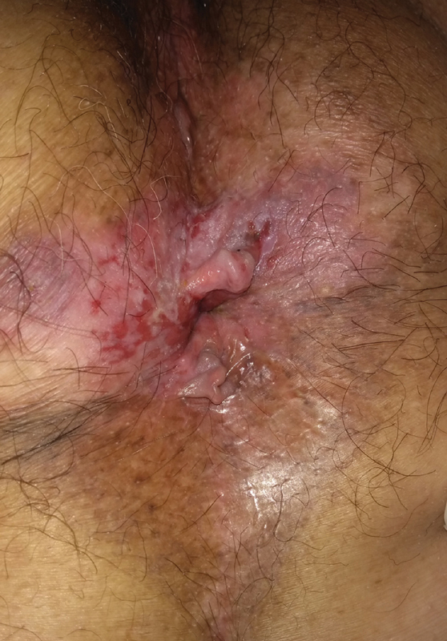
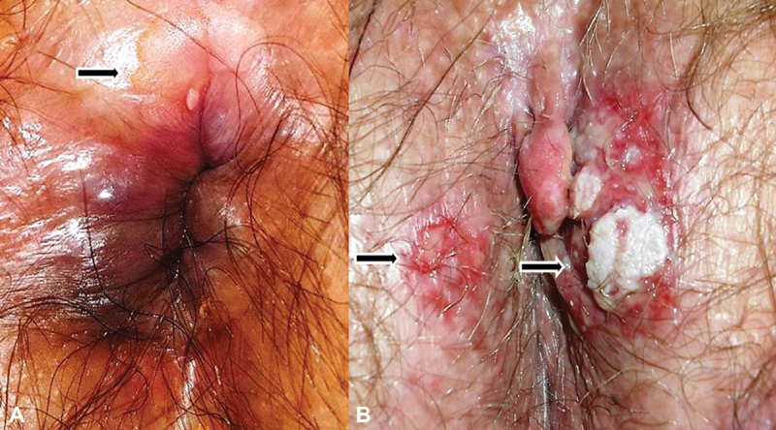
Perianal intraepithelial neoplasia
Clin Colon Rectal Surg 2019 Sep; 32(5): 347–357

Slide 39
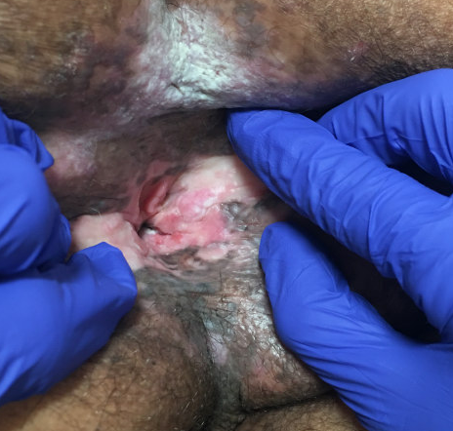
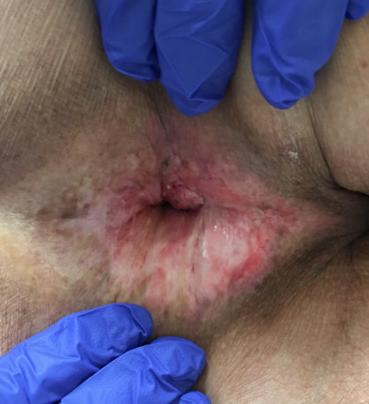
HIV positive male, 50s, VL suppressed, CD4> 800, (CD4 nadir<200)
Invasive SCC - Perianal

Slide 40
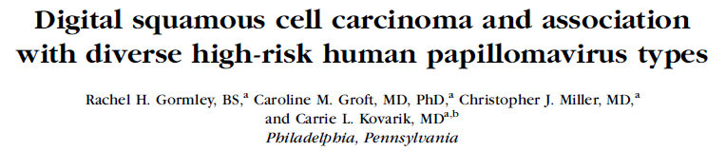
J Am Acad Dermatol. 2010 Jun 26.
Notes:
40

Slide 41
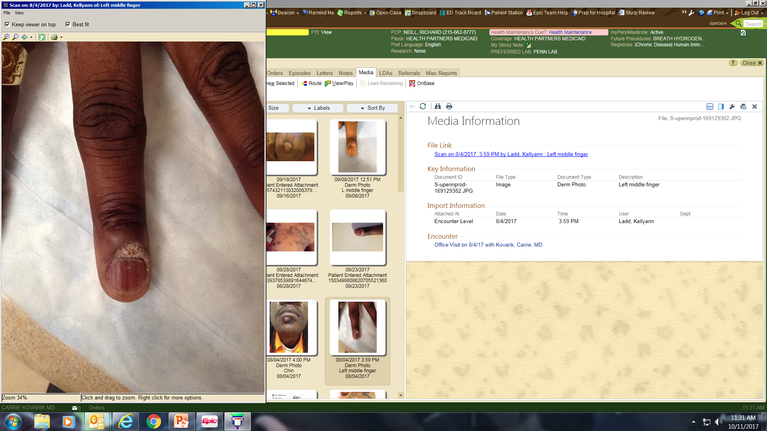
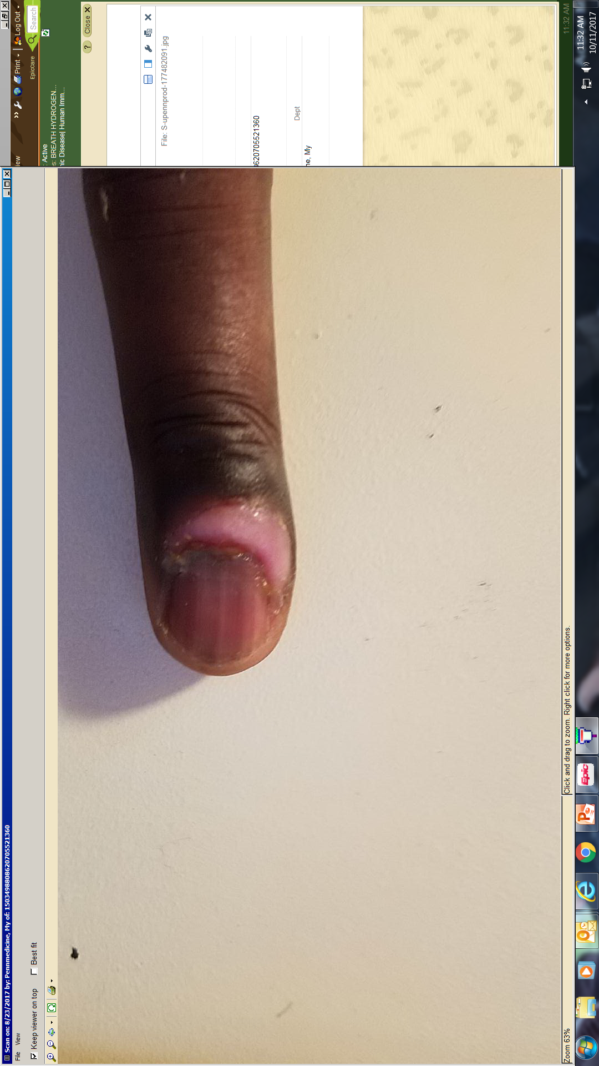
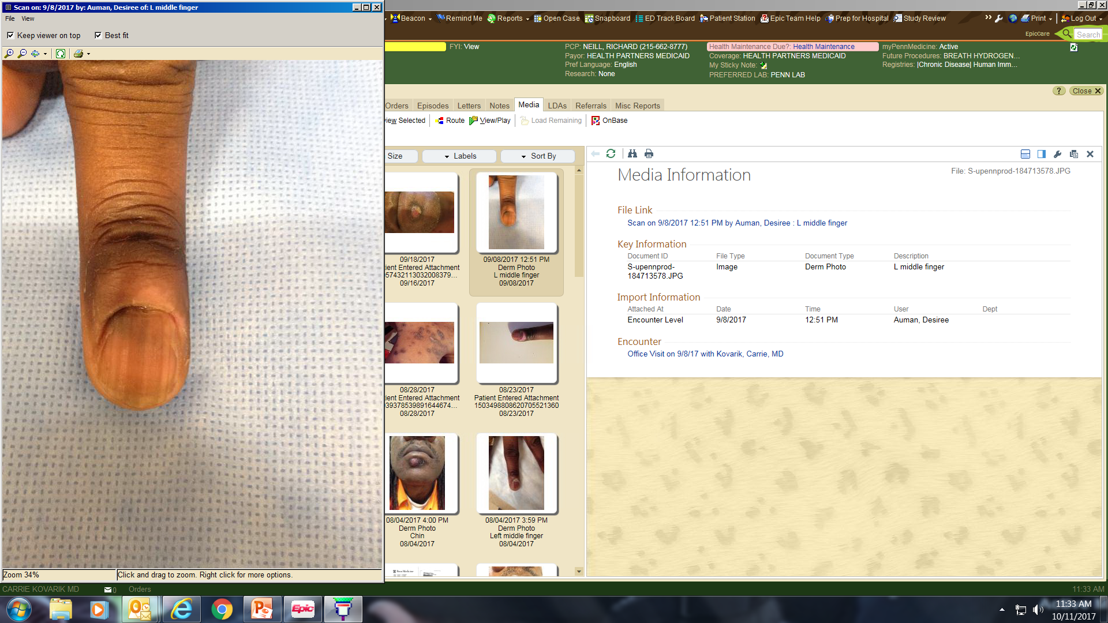
SCCIS
IL Cidofovir 15 mg/mL

Slide 42
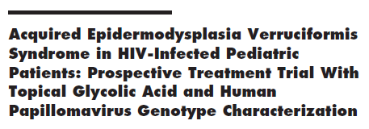
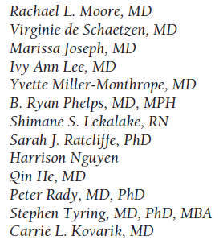
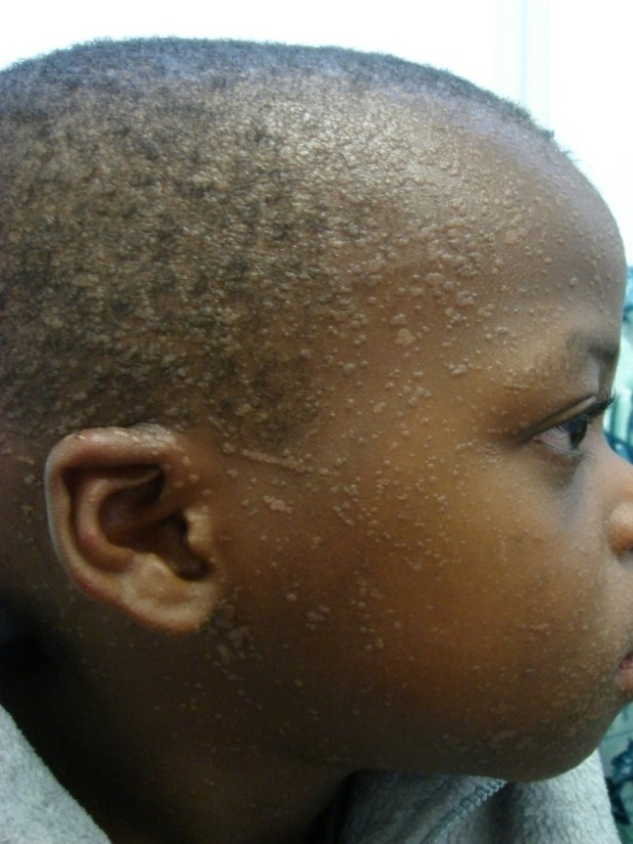
EDV-like flat warts
EDV is a rare heritable disease characterized by warts that display a high rate of progression to SCC on sun-exposed sites, and strong predisposition to infection by b-HPVs (HPV 5 and 8 predominate).
Two EV genes (EVER1 and EVER2) identified
HIV may predispose a certain population of HIV patients to this type of wart infection

Slide 43
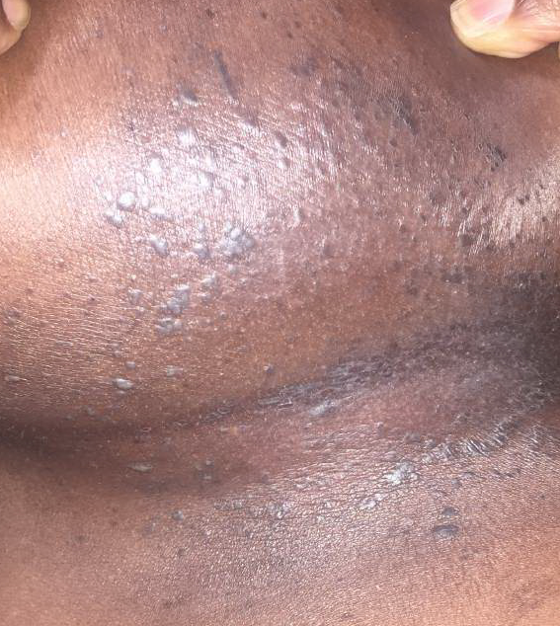
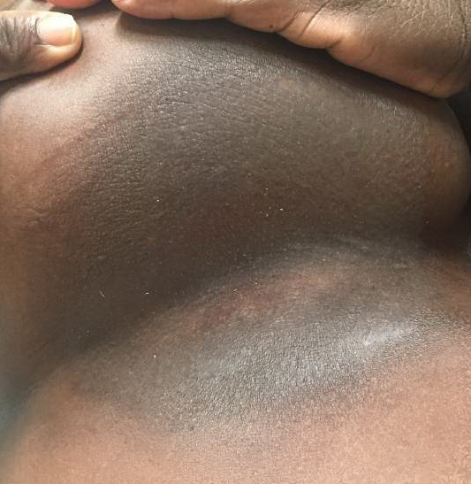
These flat warts
became SCCIS,
responded to
imiquimod

Slide 44
Vaccines

Slide 45
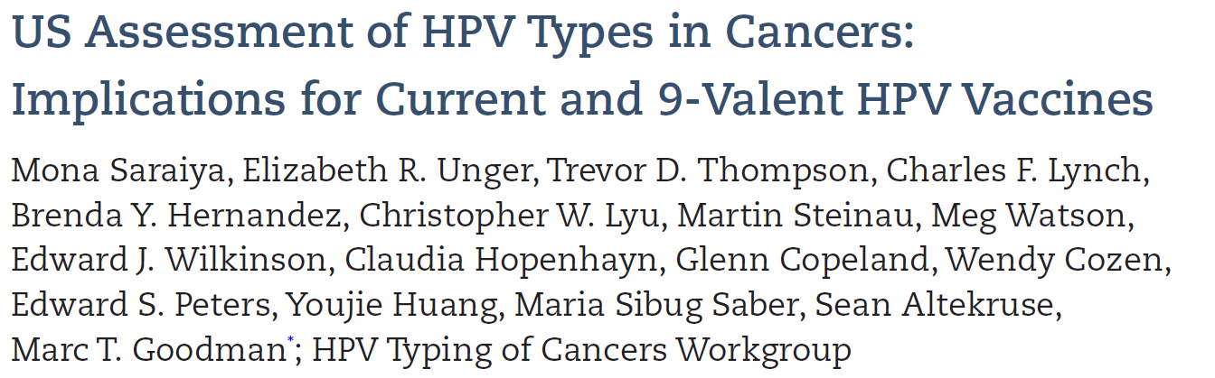
HPV 16/18 vaccine potentially prevents the majority of invasive cancers: cervical (66.2%), anal (79.4%), oropharyngeal (60.2%), and vaginal (55.1%) cancers, as well as many penile (47.9%), vulvar (48.6%): 24,858 cases annually.
The 9-valent vaccine also targeting HPV 31/33/45/52/58 may prevent an additional 4.2% to 18.3% of cancers: 3,944 cases annually.
Younger age at diagnosis was associated with higher HPV 16/18 prevalence (for most cancers).

Slide 46
Kaposi Sarcoma in People With HIV

Slide 47
Kaposi Sarcoma in People Living with HIV
Some antiretroviral treated people with HIV develop Kaposi's sarcoma despite long-term suppression of HIV replication.
US Veteran cohort (1999-2015):
  risk of KS as compared to uninfected patients >50-fold in people with HIV despite long-term viral suppression (≥2 years)
  and >500-fold in those with early suppression (<2 years)*
Immunosenescence is associated with KS in antiretroviral treated HIV infection
Other factors: iatrogenic immunosuppression, persistent HHV8 VL, change in ART, history of or current low CD4/high VL
AIDS. 2013 Jul 17;27(11):1735–1742.
*Ann. Intern. Med. 2018;169:87–96.

Slide 48
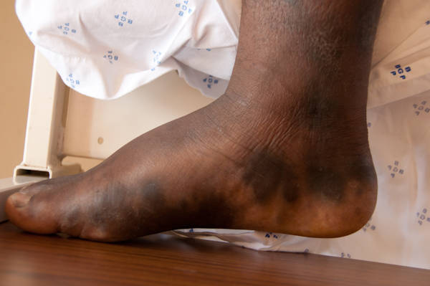
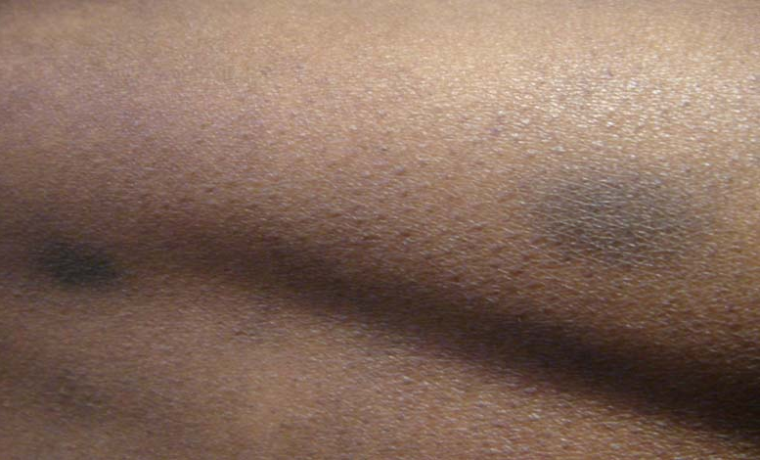
Kaposi Sarcoma in People with HIV

Slide 49
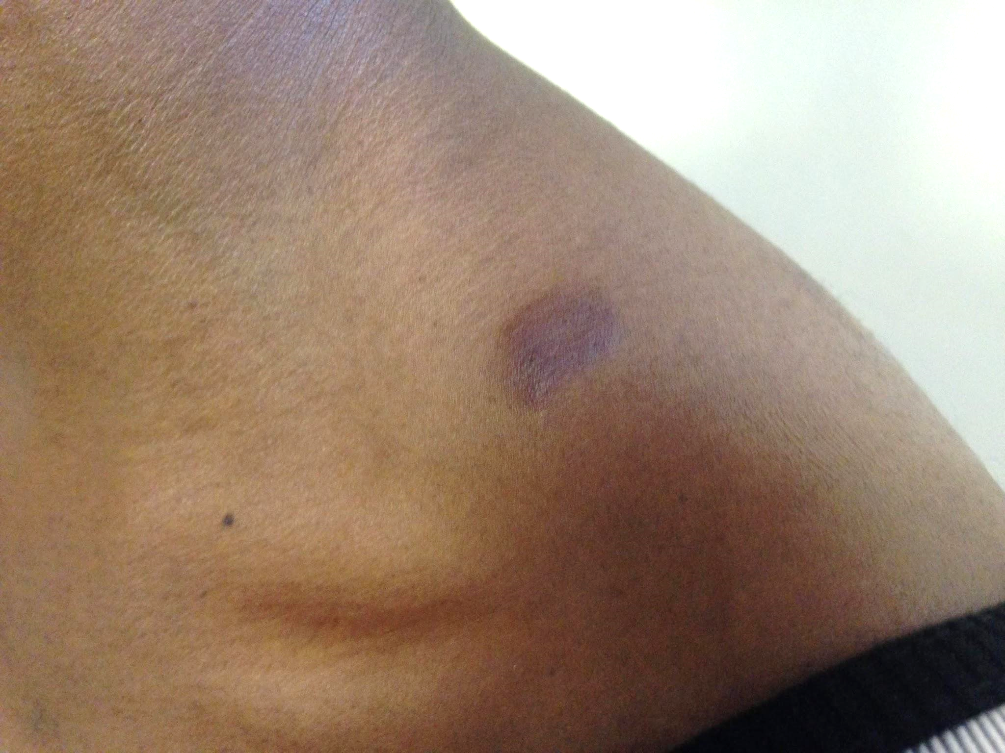
36F recently diagnosed with HIV (CD4 330) and taking ART, presenting with a 5 month history of lesions on the face and trunk
+ weight loss
Denies cough, fever, chest pain, joint pain, diarrhea, hematochezia, emesis
CXR which was reportedly normal
**Always check LNs and oral exam

Slide 50
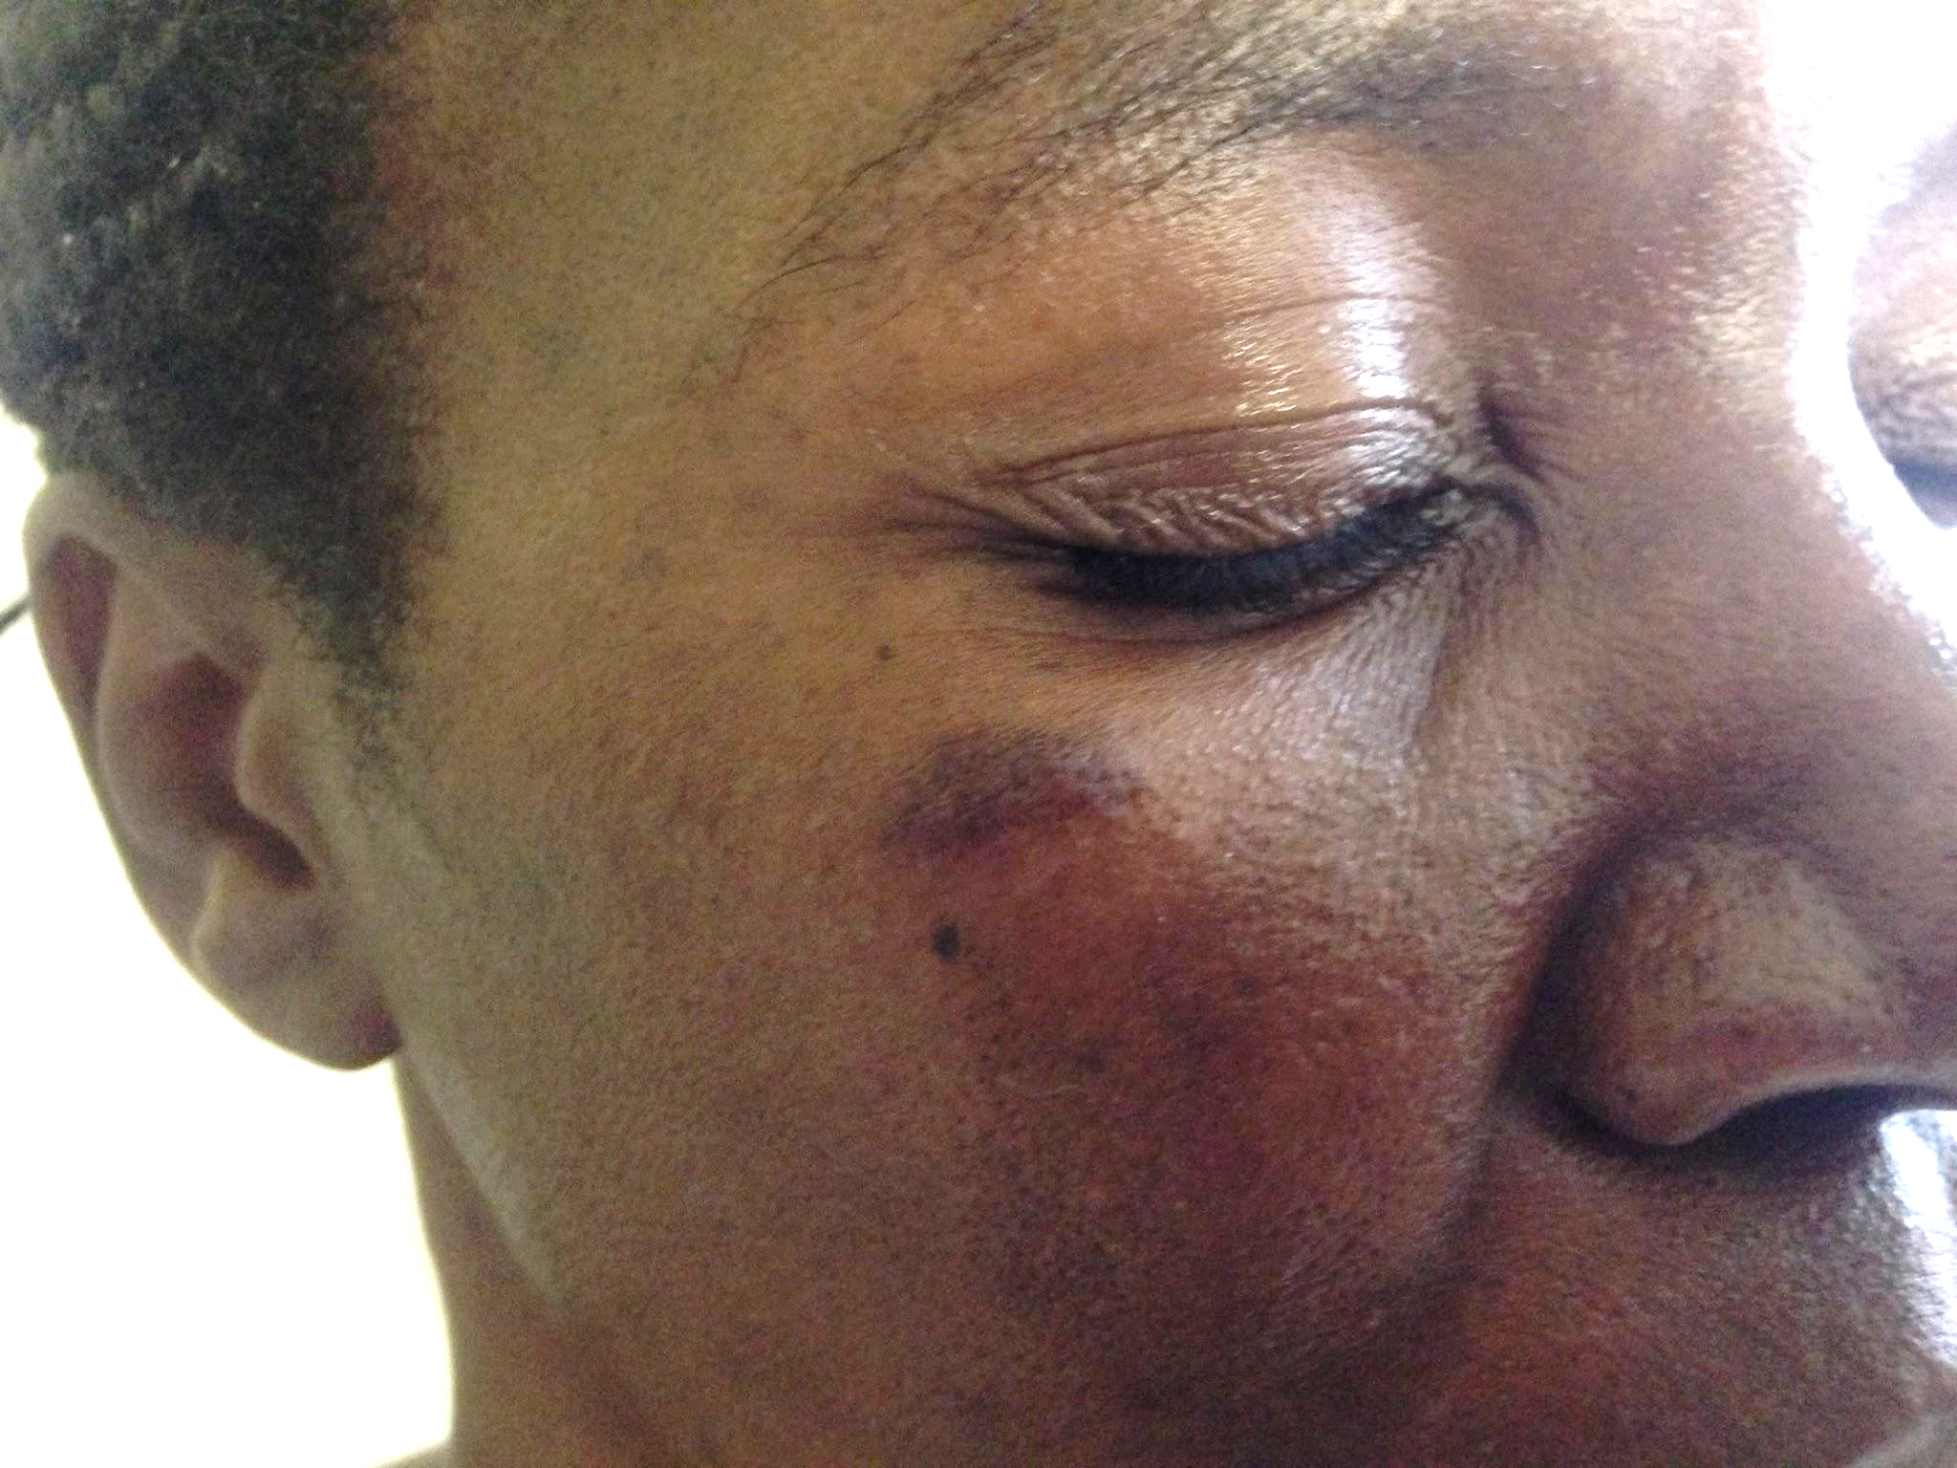
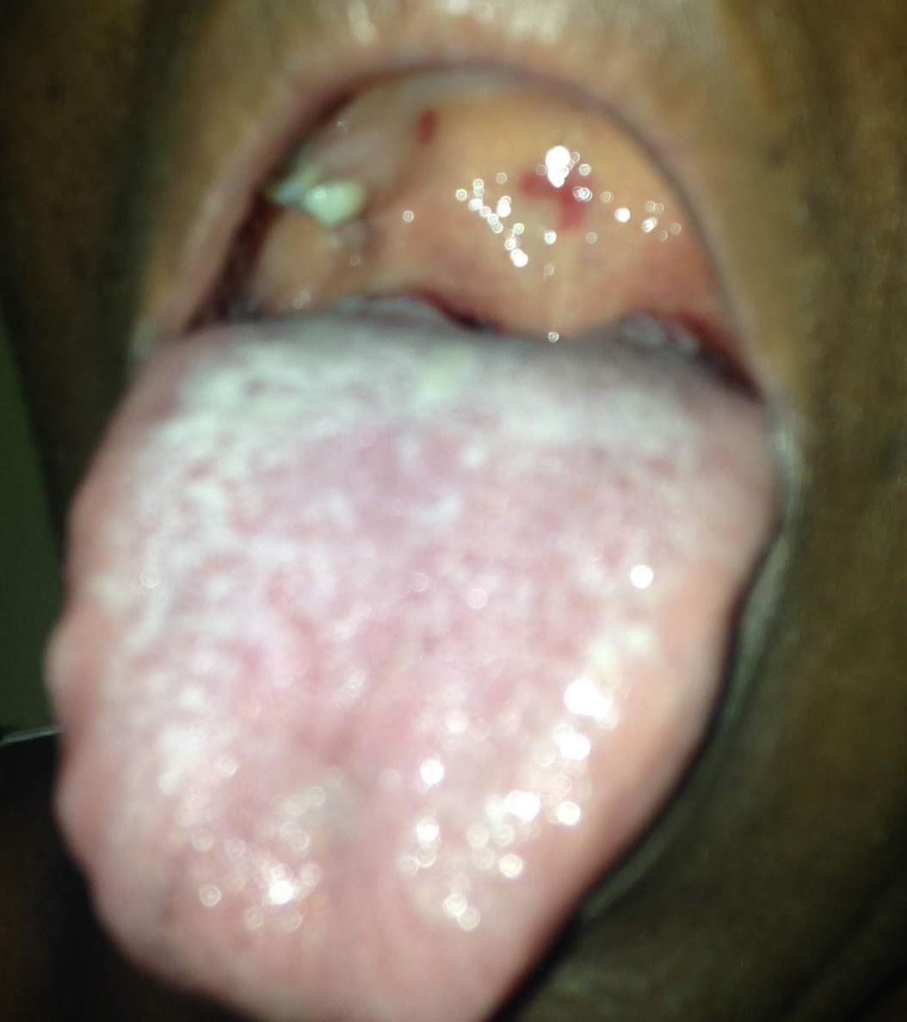
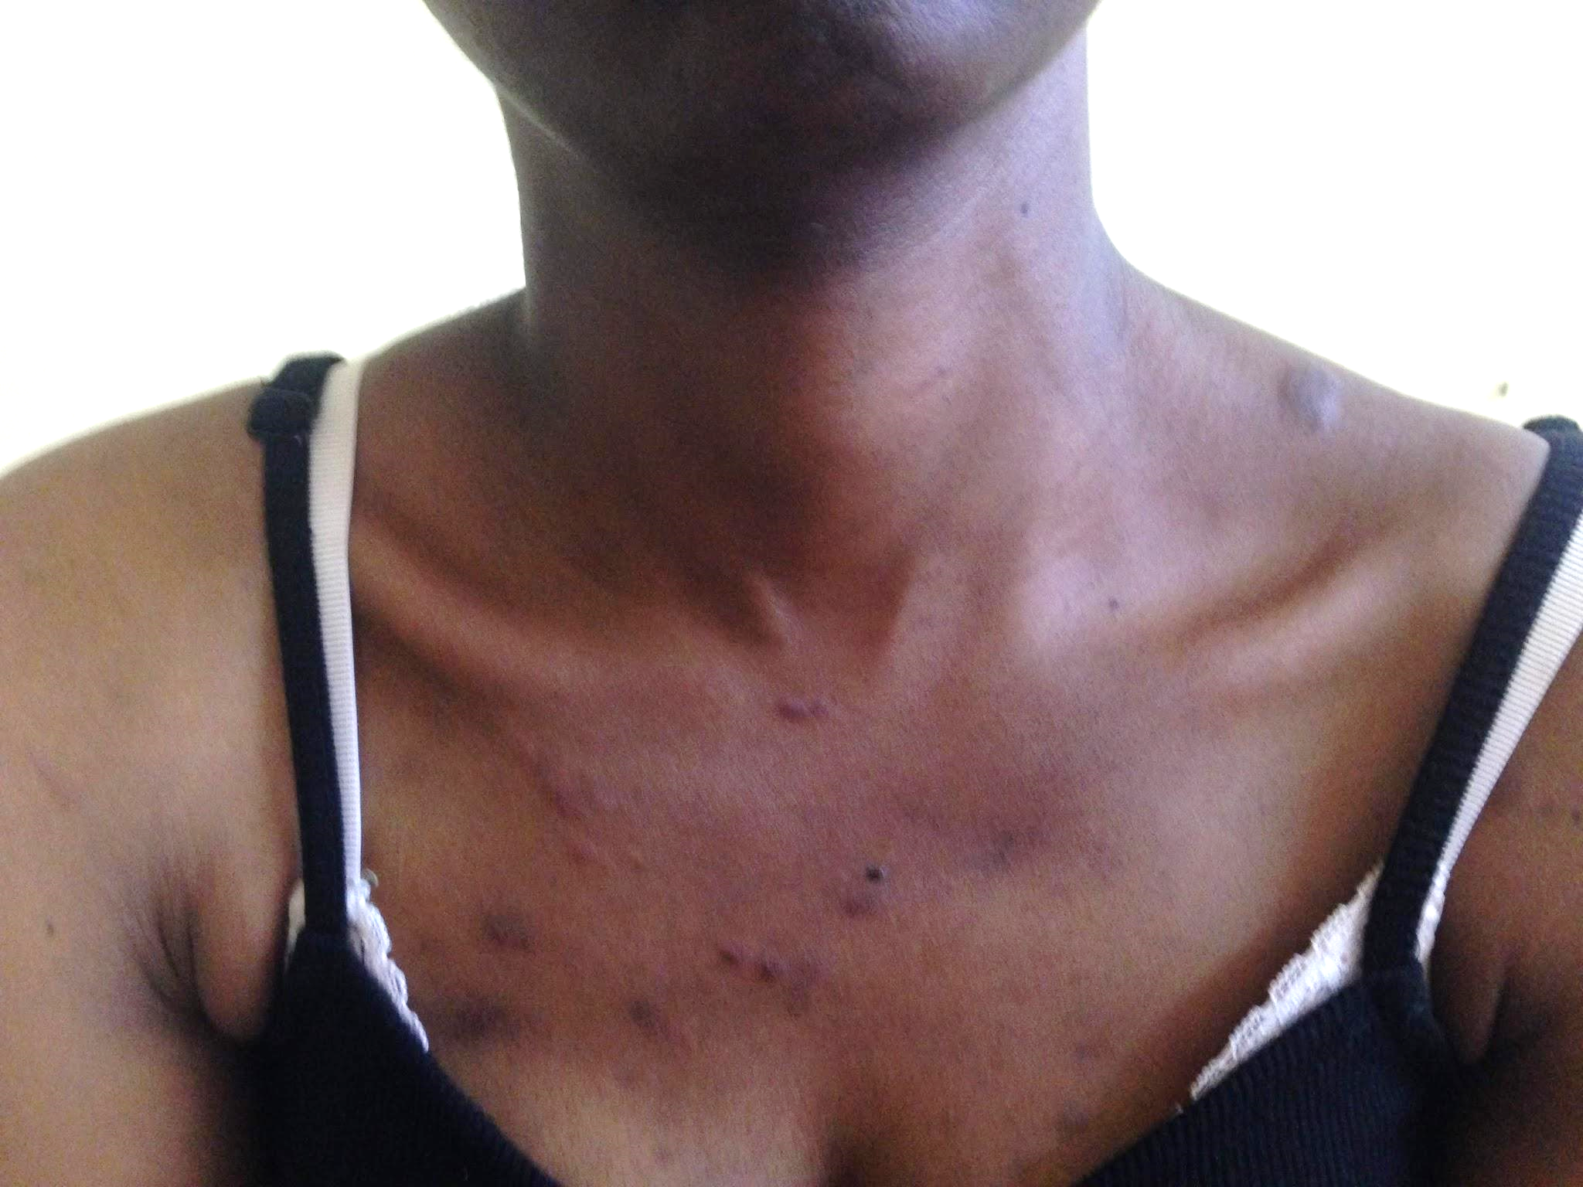
Biopsy: Kaposi Sarcoma

Slide 51
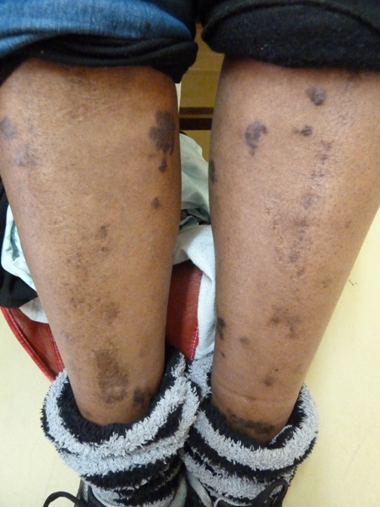
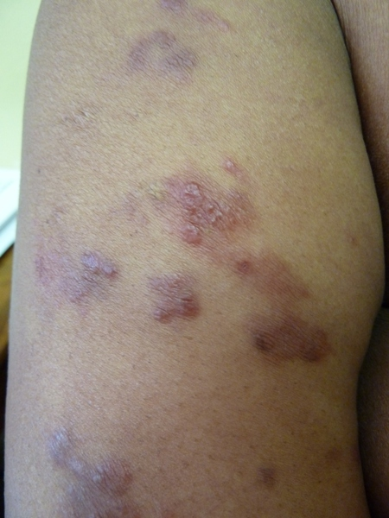
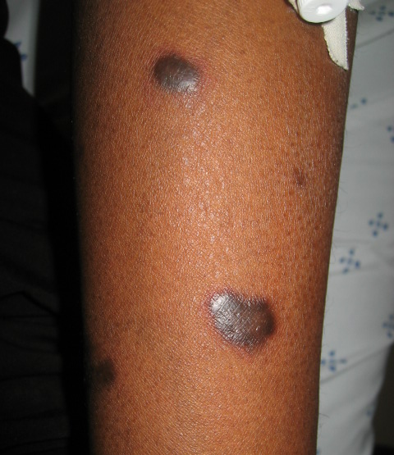
Kaposi Sarcoma in People with HIV

Slide 52
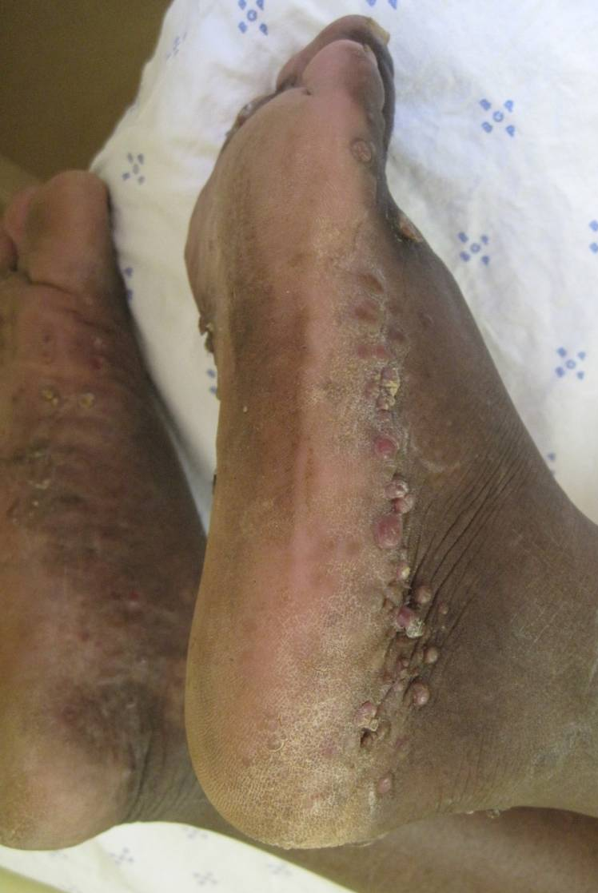
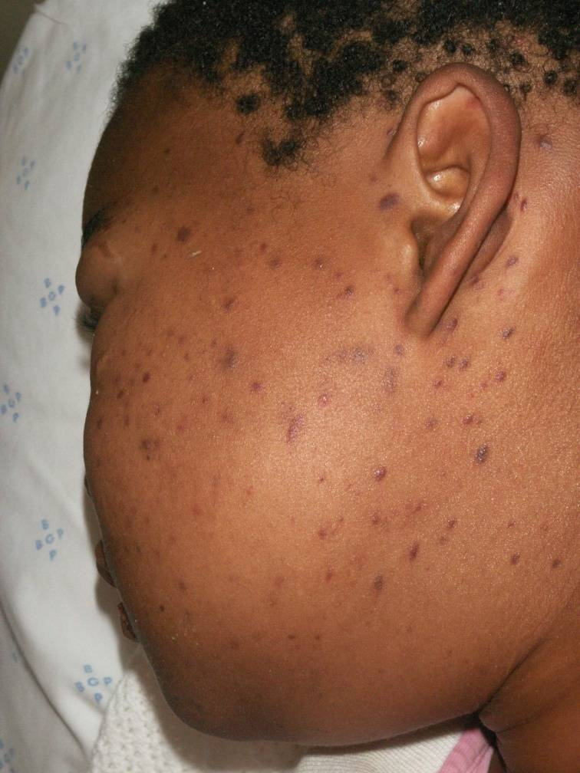
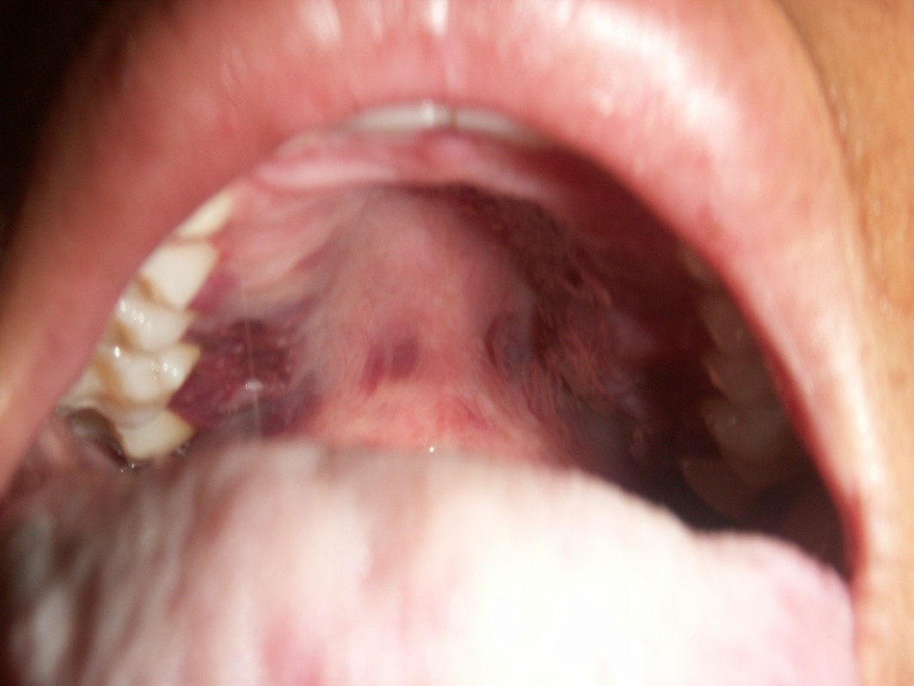
Kaposi Sarcoma in People with HIV

Slide 53



Kaposi Sarcoma in People with HIV

Slide 54
Risk Factors for Internal Kaposi Sarcoma
Risk Factor | Significance
Cutaneous KS | Only independent clinical factor significantly related to GI-KS on multivariable analysis
Oral KS | Correlated with a 75% likelihood of having gastrointestinal lesions
CD4 count < 100 cells/µL | Advanced internal disease is strongly linked to the severity of the patient's immune deficiency
HIV VL ≥10,000 copies/mL | Advanced internal disease is strongly linked to the severity of the patient's immune deficiency
**Note: Internal involvement often lacks clear clinical signs (78.8%)
PLoS One. 2012;7(11):e46967.

Slide 55
HHV8+ Patient , Infected with HIV
HIV diagnosed early
Allowed to progress
May develop KS,
start treatment
(chemo/targeted therapy)
CD4 drops < 150
Started on ART
Start ART
May develop KS,
(within 2 years)
start treatment
Doing well
Iatrogenic immunosuppression, immunosenescence, high HHV8 VL, progression of HIV
CD4 increases
Doing well
KS develops years later

Slide 56
Herpes Simplex Virus in People with HIV

Slide 57
Herpes Simplex Virus in People with HIV
Most often presents as painful genital, anal, oral erosions, ulcers or non-healing areas of skin
People with HIV may have more frequent, severe or prolonged outbreaks, especially with low CD4/non-suppressed VL
Higher rates of acyclovir resistance and verrucous lesions

Slide 58


Genital Gluteal HSV

Slide 59


Condyloma and Herpes

Slide 60

Herpes Simplex Virus
Diagnosis with PCR from skin lesion
Treatment (acyclovir-sensitive)
  Episodic:
    First: Valacyclovir 1 gm orally 2 times/day for 7–10 days
    Valacyclovir 1 gm orally once daily for 5 days
  Suppressive
    Valacyclovir 1 gm orally once a day OR
    Valacyclovir 500 mg orally once a day (for less frequent outbreaks)

Slide 61


Resistant HSV: treatment
response to IL cidofovir

Slide 62



Verrucous HSV – acyclovir resistant

Slide 63



Verrucous HSV – acyclovir resistant

Slide 64



Other HSV in People with HIV

Slide 65
Atopic Dermatitis in People with HIV

Slide 66
Eczematous Dermatitis in People with HIV
True exacerbation of atopic dermatitis
  History of atopic dermatitis in childhood (atopic triad)
  Often in classic distribution (flexural areas, neck)
Atopic-like dermatitis in patients with low CD4 counts
  Occurs abruptly with decreasing CD4 count
  Refractory to treatment

Slide 67


Atopic Dermatitis
Contributed by Dr. Robert Lee
Notes:
More chronic lesions with lichenification and dyspigmentation

Slide 68



Eczematous dermatitis

Slide 69

Eczematous hand dermatitis

Slide 70


Diffuse Atopic-like dermatitis of HIV

Slide 71
Treatment
Confirm diagnosis
Optimize ART
Basic skin care/ avoid allergens
Topical steroid ointments (soak and smear)
Antibacterial wash/antibiotics/cultures
Phototherapy
Dupilumab: monoclonal antibody (targeting IL-4Rα)

Slide 72
Hidradenitis/Follicular occlusion in People with HIV

Slide 73


Hidradenitis
Chronic recurrent, deep-seated nodules, abscesses, and interconnecting sinus tracts in the intertriginous areas, leading to scarring and drainage

Slide 74


Hidradenitis
Chronic recurrent, deep-seated nodules, abscesses, and interconnecting sinus tracts in the intertriginous areas, leading to scarring and drainage

Slide 75
Treatment
Topicals: antiseptic washes, antibiotics (mupirocin, clindamycin)
Surgery: de-roofing procedures, excision
Lifestyle: smoking reduction (quitting smoking significantly decreases the risk of HS), weight loss
JAMA Dermatol
Published Online: August 21, 2024
2024;160;(10):1056-1065.

Slide 76


Antibiotics: Moderate evidence for the use of doxycycline, dapsone and TMP-SMX
Antiandrogens: Metformin and spironolactone may be used, and the choice depends on the presence of metabolic syndrome
Biologics: It is suggested that adalimumab and infliximab be used cautiously in this group. No data on anti-IL-17 and anti-IL-12/23 biologics in HIV are available. These agents should be considered only in well-controlled HIV cases. ** Data are limited

Slide 77

Folliculitis/Furunculosis – likely Bacterial
Culture if possible
Likely due to Staph/MRSA
Oral Antibiotics
If MRSA is recurrent, will need eradication strategy

Slide 78
Thank you

