Slide 1
Management of Syphilis in Pregnancy
Hilary Reno MD, PhD, FIDSA
Professor, Washington University
St. Louis STI/ HIV Prevention Training

Slide 2
Disclosures
This program is supported by the Health Resources and Services Administration (HRSA) of the U.S. Department of Health and Human Services (HHS) under grant number TR7HA53203-01-00 as part of an award totaling $5.7m. The contents are those of the author(s) and do not necessarily represent the official views of, nor an endorsement, by HRSA, HHS, or the U.S. Government. For more information, please visit HRSA.gov.
“Funding for this presentation was made possible by cooperative agreement TR7HA53203-01-00 from the Health Resources and Services Administration HIV/AIDS Bureau. The views expressed do not necessarily reflect the official policies of the Department of Health and Human Services nor does mention of trade names, commercial practices, or organizations imply endorsement by the U.S. Government. Any trade/brand names for products mentioned during this presentation are for training and identification purposes only.”
This content is owned by the AETC and is protected by copyright laws. Reproduction or distribution of the content without written permission of the sponsor is prohibited and may result in legal action.

Slide 3
Disclosures
All planners, faculty, and others in control of educational content are required to disclose all their financial relationships with ineligible companies within the prior 24 months. An ineligible company is defined as one whose primary business is producing, marketing, selling, re-selling, or distributing healthcare products used by or on patients. Financial relationships are relevant if the educational content an individual can control is related to the business lines or products of the ineligible company.
None of the planners, faculty, and others in control of educational content for this educational activity have relevant financial relationship(s) to disclose with ineligible companies.
The material presented in this course represents information obtained from the scientific literature as well as the clinical experiences of the speakers. In some cases, the presentations might include discussion of investigational agents and/or off-label indications for various agents used in clinical practice. Speakers will inform the audience when they are discussing investigational and/or off-label uses.
Disclosure of a relationship is not intended to suggest or condone commercial bias in any presentation, but it is made to provide participants with information that might be of potential importance to their evaluation of a presentation.

Slide 4
Disclosures
The Health Resources and Services Administration (HRSA), Department of Health and Human Services (HHS) provided financial support for this project. The award provided 100% of total costs. The contents are those of the author. They may not reflect the policies of HRSA, HHS, or the U.S. Government.

Slide 5
AETC Program National Centers and HIV Curriculum
National AETC Support Center (NASC) – serves as the central web –based repository for AETC Program training and capacity building resources; its website includes a free virtual library with training and technical assistance materials, a program directory, and a calendar of trainings and other events. Learn more: https://aidsetc.org/
National Clinical Consultation Center (NCCC) – provides free, peer-to-peer, expert advice for health professionals on HIV prevention, care, and treatment and related topics. Learn more: https://nccc/ucsf.edu or call 844-ASK-NCCC (844-275-6222)
National HIV Curriculum (NHC) – provides ongoing, up –to-date HIV training and information for health professionals through a free, web –based curriculum; also provides free CME credits, CNE contact hours, CE contact hours, and maintenance of certification credits. Learn more: www.hiv.uw.edu

Slide 6
Objectives
Review current state of syphilis in the US
Discuss management and prevention of syphilis in pregnancy
Review current challenges and frequent questions with syphilis

Slide 7
Syphilis in US

Slide 8
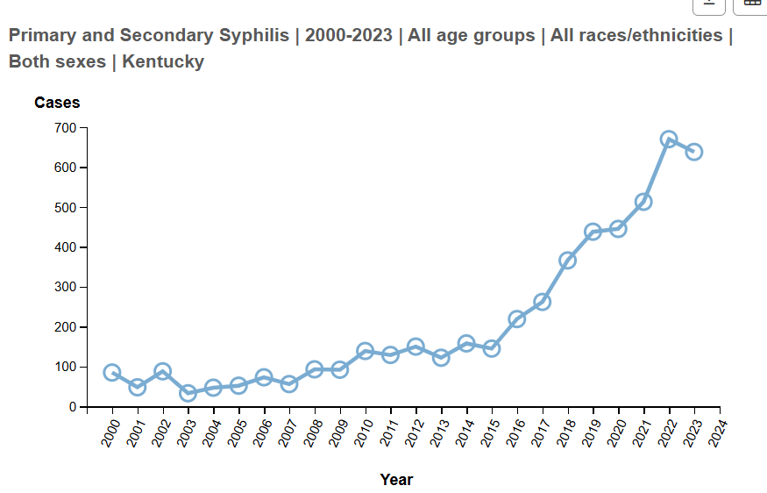
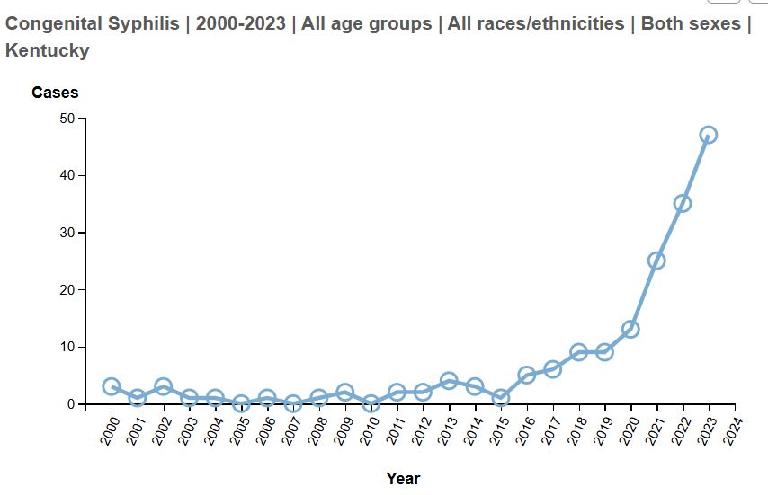
Syphilis in Kentucky

Slide 9
Clinical challenges

Slide 10
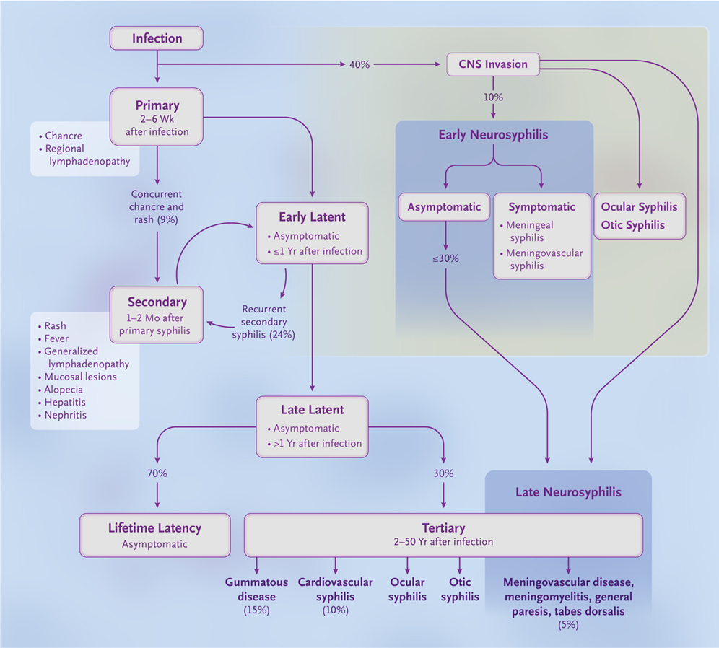
Natural History of Syphilis
Sexual transmission (only occurs in early stages)
Risk of infection after 1 exposure: 40%
Index patient is most contagious during 1º and 2º stage, less so in early latent stage
Vertical transmission (may occur during any stage)
~80% transmission in the early stages
~10% transmission in the late stages
Rarely, transmission may occur through blood transfusions and organ transplantations
Patients who are reinfected may not manifest any signs or symptoms
N Engl J Med 2020;382:845-854.

Slide 11
Pregnancy & Syphilis
Pregnant patients transmit infection to the fetus through (1) hematogenous infection of the placenta followed by seeding of the amniotic fluid or (2) intrapartum after contact with lesions
Early syphilis is associated with spontaneous abortion; risk of fetal death increased 32X if infection is untreated in the mother
Outcomes of Untreated Pregnant Patients:
  Intrauterine growth restriction
  Stillbirth (4%)
  Preterm birth
  Congenital infection and anomalies
  Neonatal death

Slide 12
Questions to Ask all (pregnant) Patients
Neurosyphilis
  Have you experienced recent/different headaches? Weakness? New seizures?
  Have you experienced difficulties with gait? Memory?
  Do you feel (or were you told) that your personality has changed?
Ocular Syphilis
  Have you experienced recent blurry/loss of vision? Pain or redness in the eyes? Do you see floaters or flashing lights?
Otic Syphilis
  Have you experience new onset hearing loss? Tinnitus? Vertigo?
Most of these clinical manifestations are NOT specific for syphilis. You’ll need to use your judgment to determine whether they are due to syphilis. It is all about PRETEST PROBABILITY (like everything else in Medicine)

Slide 13
Congenital Syphilis (CS)
Stafford NEJM 2024
Infection of the fetus in utero CAN OCCUR DURING ANY STAGE OF SYPHILIS IN THE MOTHER:
  50-70% transmission risk if early syphilis; 15% if late syphilis
Infection in the fetus tends to occur AFTER the 4th month of gestation
Ultrasonography is the most used method to examine a fetus for evidence of CS. Abnormalities may be detected after 18 weeks of gestation. The lack of abnormalities does not rule out CS (15% of infants may be born with CS having had a normal US)
Early detection and appropriate treatment before the 3rd trimester allow ultrasonographic abnormalities to resolve prior to delivery
Up to 16% of newborns with CS were born to treated mothers who demonstrated appropriate serological response before delivery

Slide 14
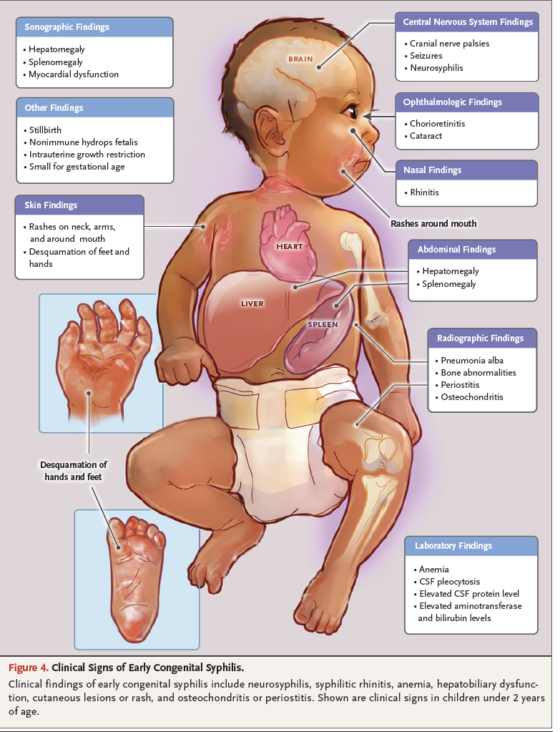
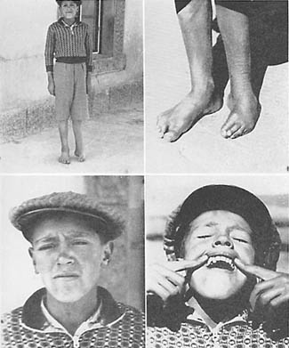
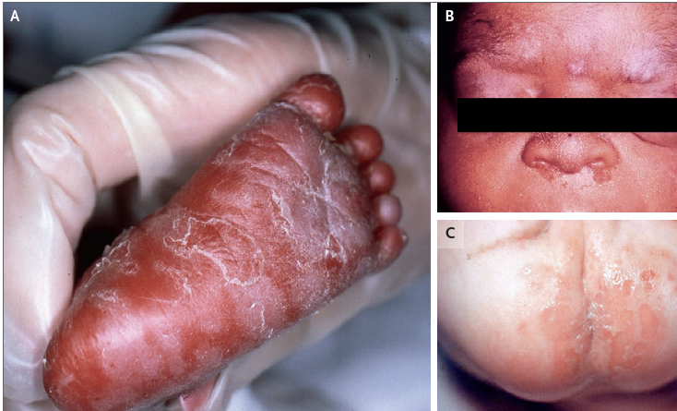
Early & Late Manifestations of Congenital Syphilis
Early Manifestations
Late Manifestations
Bony abnormalities in the midline face and lower extremities
Hutchinson’s teeth (notched, diastematic teeth)
Ocular abnormalities
Sensorineural hearing loss
CDC
Stafford NEJM 2024

Slide 15
Screening and Prevention

Slide 16
Clinical Keys for Syphilis Control
Screening: Detect asymptomatic syphilis
Partner management: Limit spread of syphilis, educate, link to other services
Treatment: To cure syphilis and establish syndemic based care

Slide 17

Screening recommendations
CDC: MMWR Vital Signs published in Nov 2023, discussed the rates of CS in the US and noted that screening should be based on individual factors and baseline rates compared to the Healthy People 2030 goal of < or = to 4.6 cases of primary/ secondary syphilis in women age 15-44 per 100,000
ACOG: Updated April 2024: Non-risk-based screening→ universal 3x screening in pregnancy

Slide 18
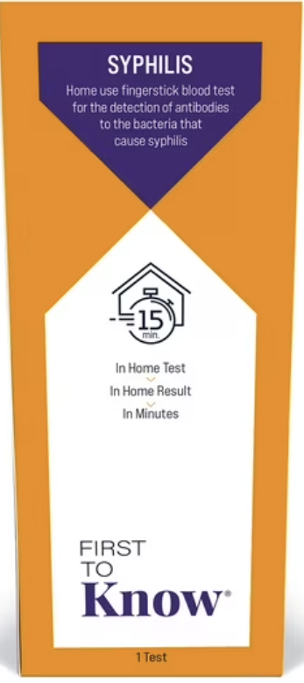
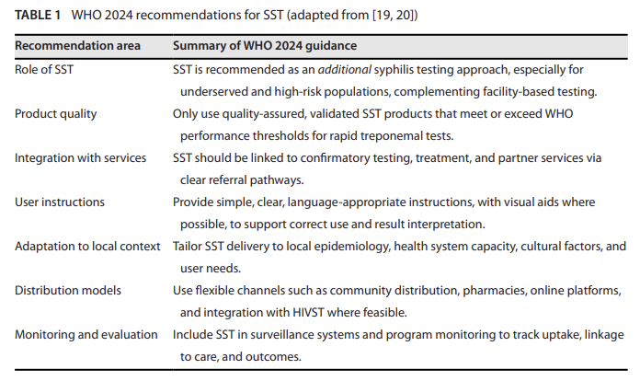
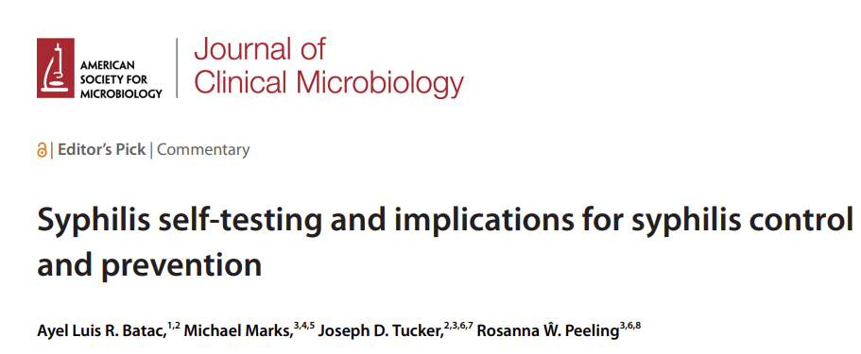
Screening
First home test for syphilis: Trep Ab $25-$30

Slide 19
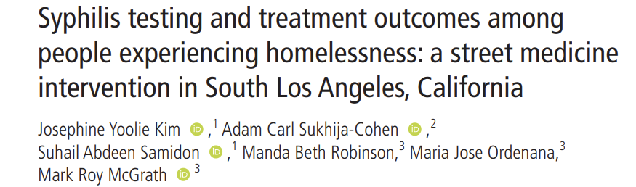
Street Med team tested 99 people in LA, 37% were positive, 94% of diagnoses were late latent.
Diagnosis was most likely in those identifying as female.
Accessible, community based STI care models are important to reach populations,

Slide 20
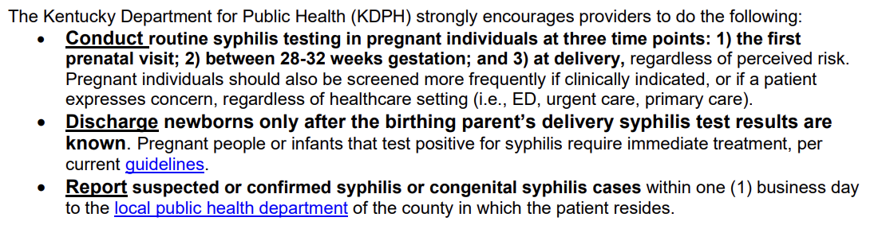
Specific screening recommendations

Slide 21
Partner services for syphilis
What is the evidence: Systematic review
Type of study | Number of papers | Key finding/ information
Cross sectional | 35 | Over time, you see the emergence of reports of electronic notification of partners DIS make a difference; e-notification is successful NNTI varies: MS Syphilis services: 2267 partners→ 696 new syphilis NNTI=2, 24 new HIV NNTI=64 (Avoundjian 2019) NC Syphilis services: NNTI 6.9 HIV NNTI 43 (Samoff 2017)
RCTs | 3 | See slide
Literature review | 3 | old
Mixed methods | 5
Qualitative | 3
Reports | 4
Guideline/ recommendation | 2 | From the CDC 1991 and 2008

Slide 22
Partner Services for syphilis
CDC “ strongly” recommends partner services for early syphilis (2008)
Larger cross-sectional studies demonstrate that most HDs conduct partner notification (PN) for syphilis (Golden 2003, Cope 2022) with 45% of LHDs in high-rate areas providing serologic testing in the field in pre-COVID years (2015-2017) (Cuffe 2021)
Some cost information is available, and PN is thought to be cost efficient
Use of text notification is reported and there is one scoping review of technology in PN (Kachur 2018)
In person interviews resulted in better metrics for ES in Seattle except no difference in infected partners treated (Heumann 2017)

Slide 23
Partner Services for syphilis
RCTs
Peterman 1997: 3 approaches had similar success locating and treating partners
optimal strategy depended on location; no diff in partners treated with or without DIS
Brewer 2005: cues during interviewing can increase #partners elicited
Kerani 2025: contacted men and asked them to recall what PM services they received, if any.
No diff in partners notified by recall bias, large % of people declined to participate

Slide 24
Partner Services for syphilis
DIS is under utilized by clinicians; DIS are a resource
  There is a role for the clinician to discuss notifying partners with patient.
  PM for MSM with low partner index is limited in some locations, so again, talking to patients may be helpful.
  Trang Nguyen paper shows declines in outcomes in PS over time. Trends in epi in San Fran
Things that may help → Testing in field, treatment in field (RNs)—Louisiana program.

Slide 25
Treatment of Syphilis

Slide 26
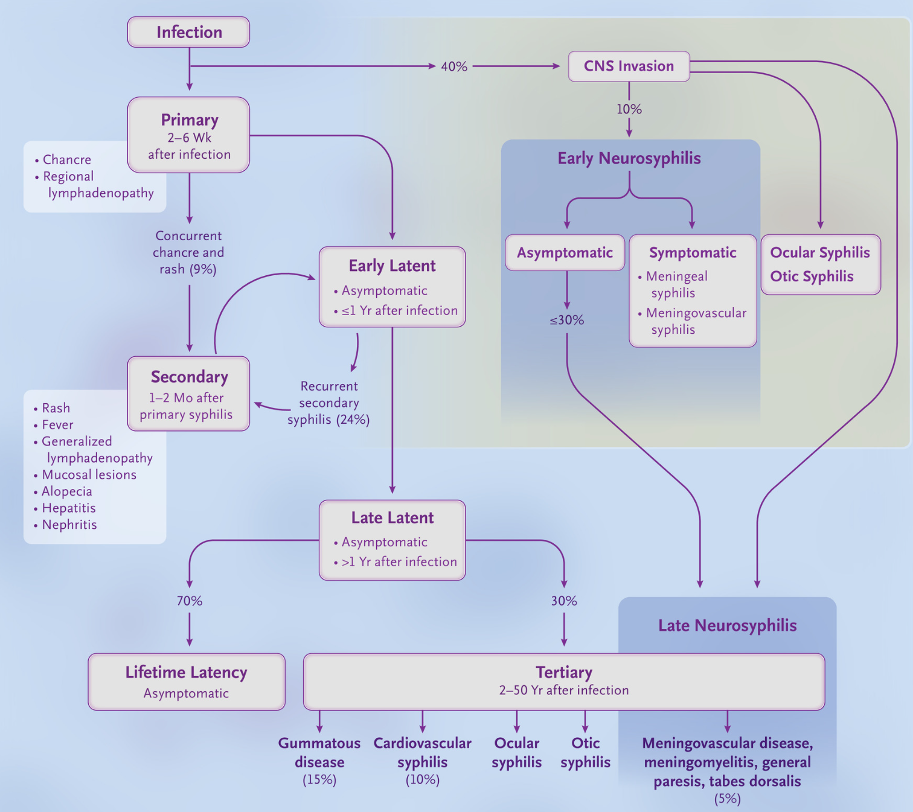
One shot of penicillin
Treatment of Syphilis
Who MUST be treated with Bicillin?
  Pregnant people
  Alternatives for treating neurosyphilis have little evidence of efficacy.
10-14 days of IV penicillin
Ghanem KG, Ram S, Rice PA. The Modern Epidemic of Syphilis. N Engl J Med. 2020;382(9):845-854. doi:10.1056/NEJMra1901593
Three shots of penicillin, qweek

Slide 27
Therapy for
Syphilis
N Engl J Med 2020;382:845-854.
Parenteral penicillin G is the drug of choice for all stages of syphilis
It is the ONLY therapy with documented efficacy for neurosyphilis or for syphilis during pregnancy
Data on doxycycline are more limited but suggest excellent efficacy in non-pregnant adults with early and late latent infections.

Slide 28
Jarisch-Herxheimer Reaction
Self-limited reaction to syphilis treatment, seen more commonly with treatment of early stages.
Characterized by fever, malaise, nausea/vomiting, sometimes with chills and exacerbation of rash.
Occurs within 24 hours after therapy and resolves within 24 hours.
Warn patient that it is NOT ALLERGIC reaction.
Can be treated with symptomatic support.
Pregnant women should be aware that it may precipitate early labor and to notify obstetrician or go to ER is problems occur.

Slide 29
What if they are late for a subsequent BPG dose?
Pharmacology data suggest that an interval of 10-14 days between doses might be acceptable before starting over for non-pregnant adults (we usually use a 10-day cutoff).
If the patient is pregnant, adhere strictly to the weekly dose regimen. The 2021 Guidelines suggest that up to 9 days between doses is reasonable.
  For example, a pregnant woman gets her first dose of BPG on Monday. Her next dose is scheduled for next Monday (i.e., in 7 days). If the patient comes in on Thursday (i.e., 10 days after her first dose), start the regimen over again.

Slide 30
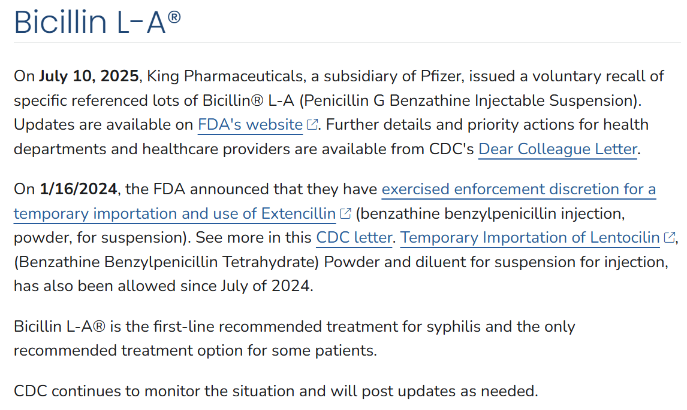

Slide 31
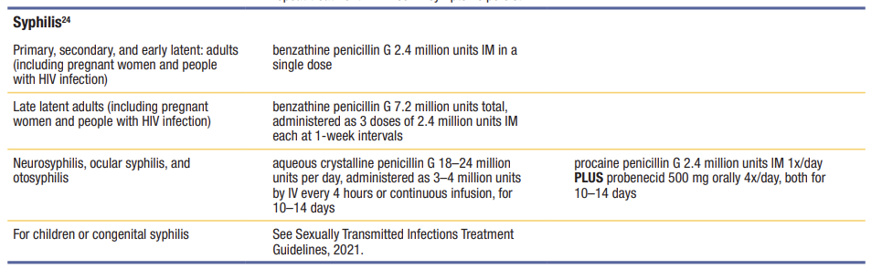
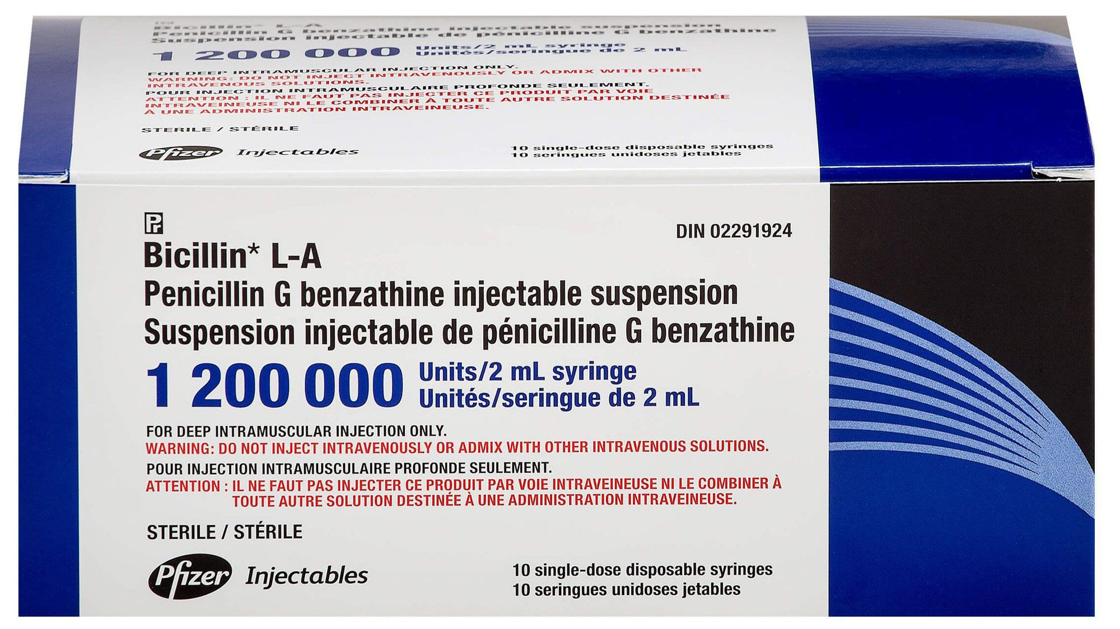
Penicillin G Benzathine

Slide 32
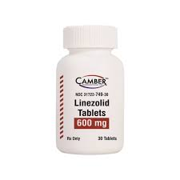
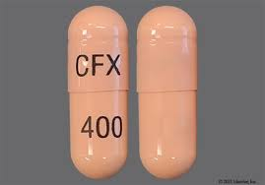
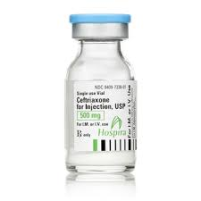
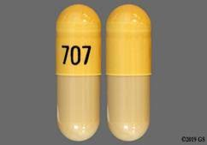
Alternative treatments
Cefixime
Doxycycline

Slide 33
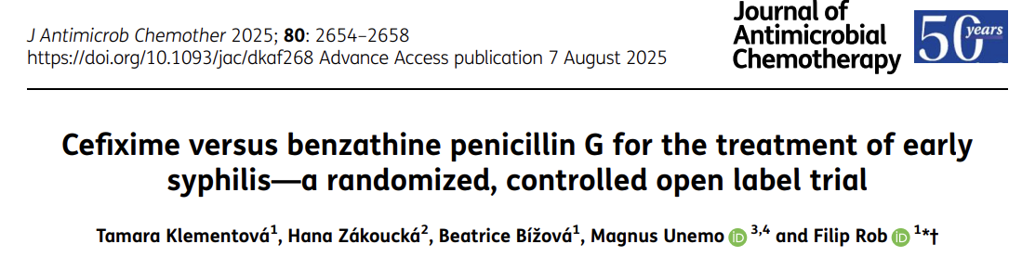
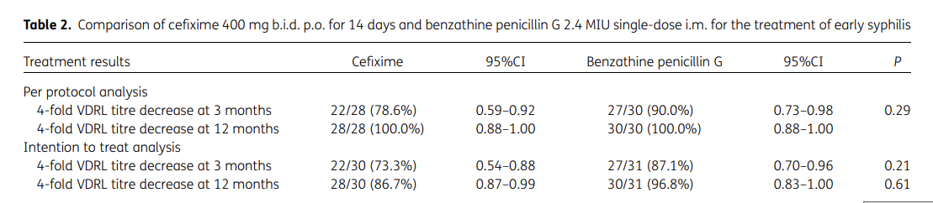
Latest information on syphilis management

Slide 34
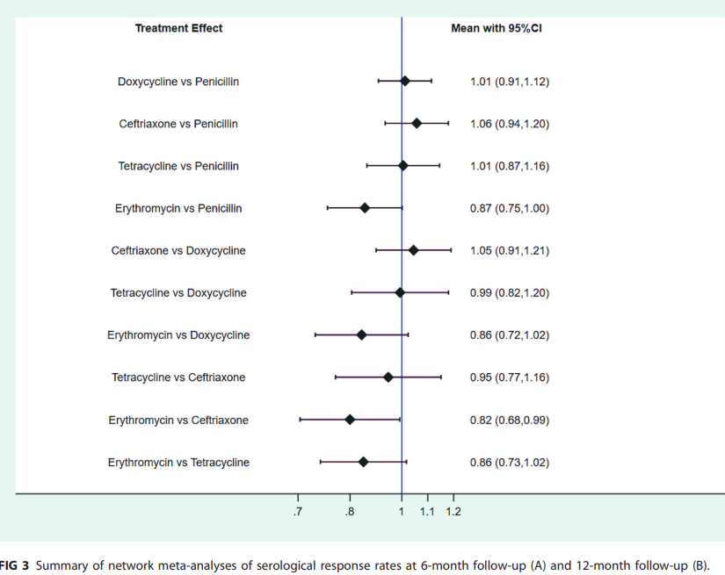
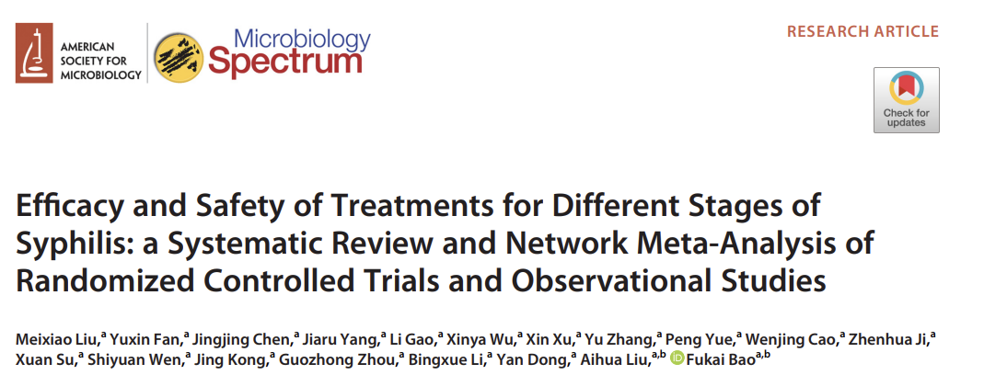

Slide 35
Once you treat someone, what should you do if their titers don’t respond appropriately?

Slide 36
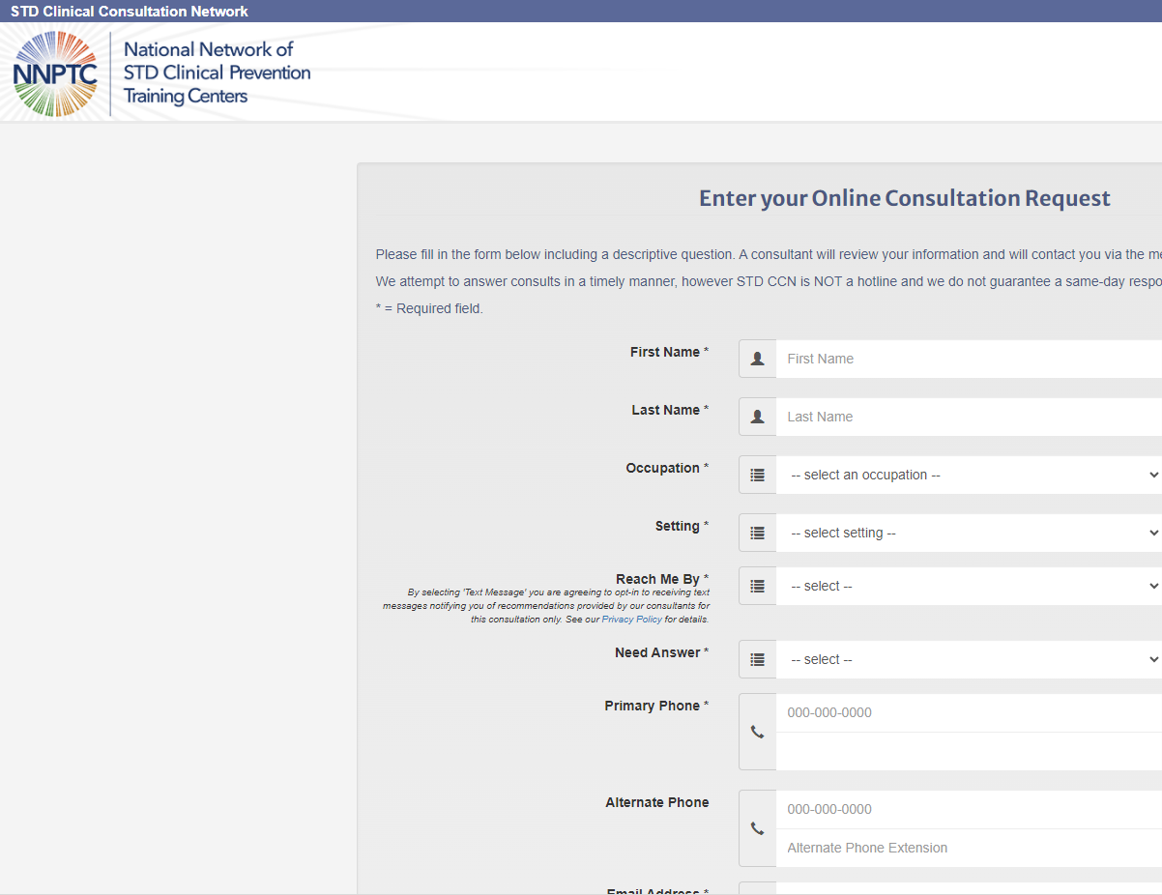
Remember: Consultations are available via the Clinical Consult Network!
www.stdccn.org
Find training at
preventiontraining.wustl.edu

