Slide 1
Updates on Tuberculosis Treatment
Moises A. Huaman, MD MSc
Associate Professor of Medicine
Division of Infectious Diseases
University of Cincinnati
KY AETC, Lexington, KY
March/2026

Slide 2


This conference is supported by the Health Resources and Services Administration (HRSA) of the U.S. Department of Health and Human Services (HHS) as part of an award totaling $3,822,166 with 50 percentage financed with nongovernmental sources. The contents are those of the author(s) and do not necessarily represent the official views of, nor an endorsement, by HRSA, HHS or the U.S. Government.

Slide 3
Disclosures
This program is supported by the Health Resources and Services Administration (HRSA) of the U.S. Department of Health and Human Services (HHS) under grant number TR7HA53203-01-00 as part of an award totaling $5.7m. The contents are those of the author(s) and do not necessarily represent the official views of, nor an endorsement, by HRSA, HHS, or the U.S. Government. For more information, please visit HRSA.gov.
“Funding for this presentation was made possible by cooperative agreement TR7HA53203-01-00 from the Health Resources and Services Administration HIV/AIDS Bureau. The views expressed do not necessarily reflect the official policies of the Department of Health and Human Services nor does mention of trade names, commercial practices, or organizations imply endorsement by the U.S. Government. Any trade/brand names for products mentioned during this presentation are for training and identification purposes only.”
This content is owned by the AETC and is protected by copyright laws. Reproduction or distribution of the content without written permission of the sponsor is prohibited and may result in legal action.

Slide 4
Disclosures
All planners, faculty, and others in control of educational content are required to disclose all their financial relationships with ineligible companies within the prior 24 months. An ineligible company is defined as one whose primary business is producing, marketing, selling, re-selling, or distributing healthcare products used by or on patients. Financial relationships are relevant if the educational content an individual can control is related to the business lines or products of the ineligible company.
None of the planners, faculty, and others in control of educational content for this educational activity have relevant financial relationship(s) to disclose with ineligible companies.
The material presented in this course represents information obtained from the scientific literature as well as the clinical experiences of the speakers. In some cases, the presentations might include discussion of investigational agents and/or off-label indications for various agents used in clinical practice. Speakers will inform the audience when they are discussing investigational and/or off-label uses.
Disclosure of a relationship is not intended to suggest or condone commercial bias in any presentation, but it is made to provide participants with information that might be of potential importance to their evaluation of a presentation.

Slide 5
Faculty Disclosures
The Health Resources and Services Administration (HRSA), Department of Health and Human Services(HHS) provided financial support for this project. The award provided 100% of total costs. The contents are those of the author. They may not reflect the policies of HRSA, HHS, or the U.S. Government.​
​
PI for grants/contracts to UC/UCH with NIH, Insmed, AN2 Therapeutics, AstraZeneca, Gilead

Slide 6
AETC Program National Centers and HIV Curriculum
National AETC Support Center (NASC) – serves as the central web –based repository for AETC Program training and capacity building resources; its website includes a free virtual library with training and technical assistance materials, a program directory, and a calendar of trainings and other events. Learn more: https://aidsetc.org/
National Clinical Consultation Center (NCCC) – provides free, peer-to-peer, expert advice for health professionals on HIV prevention, care, and treatment and related topics. Learn more: https://nccc/ucsf.edu or call 844-ASK-NCCC (844-275-6222)
National HIV Curriculum (NHC) – provides ongoing, up –to-date HIV training and information for health professionals through a free, web –based curriculum; also provides free CME credits, CNE contact hours, CE contact hours, and maintenance of certification credits. Learn more: www.hiv.uw.edu

Slide 7
Objectives
Upon completion of this educational activity, you will be able to:
Recognize updated recommendations on the treatment of drug-susceptible and multidrug-resistant TB disease.
Identify current preferred regimens for the treatment of TB infection, with a focus on people with HIV.
Briefly discuss vaccines and long-acting injectables as novel TB prevention strategies under investigation.

Slide 8

Introduction:
It is estimated that “TB has killed around one in seven people who’ve ever lived”
Dr. Peter Mugyenyi about HIV/AIDS (also applies for TB): “Where are the drugs? The drugs are where the disease is not”… “And where is the disease? The disease is where the drugs are not”
“I started writing about TB because I wanted to understand how an illness could quietly shape so much of human history. But along the way, I learned that TB is both a form and expression of injustice”
March 2025

Slide 9
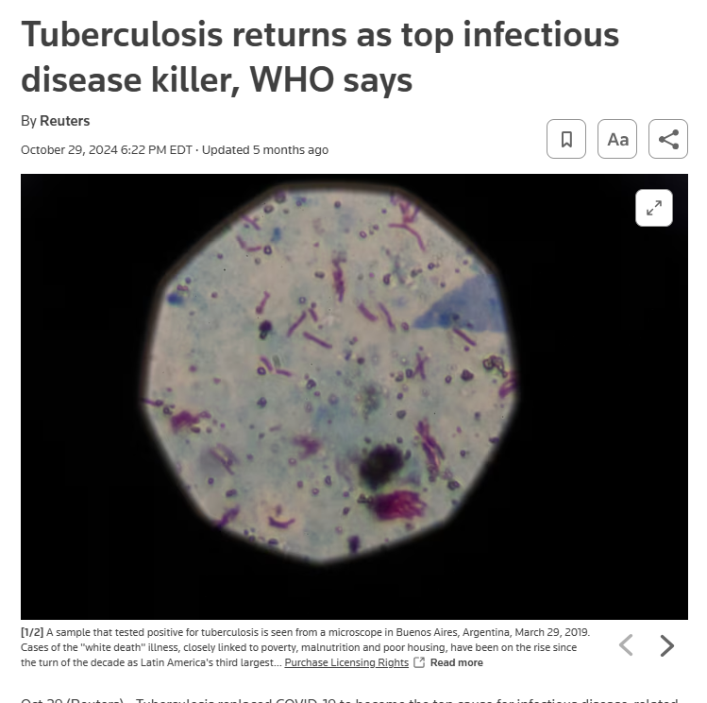
https://www.reuters.com/business/healthcare-pharmaceuticals/tuberculosis-returns-top-infectious-disease-killer-who-says-2024-10-29/

Slide 10
Case
24 y.o. male, recently moved to Cincinnati from a TB-prevalent country to attend graduate school.
Previously healthy, normal weight.
Develops productive cough, fever, night sweats, weight loss over a 2-month period.
Seen in student health and referred to the TB clinic for work-up of possible TB.

Slide 11
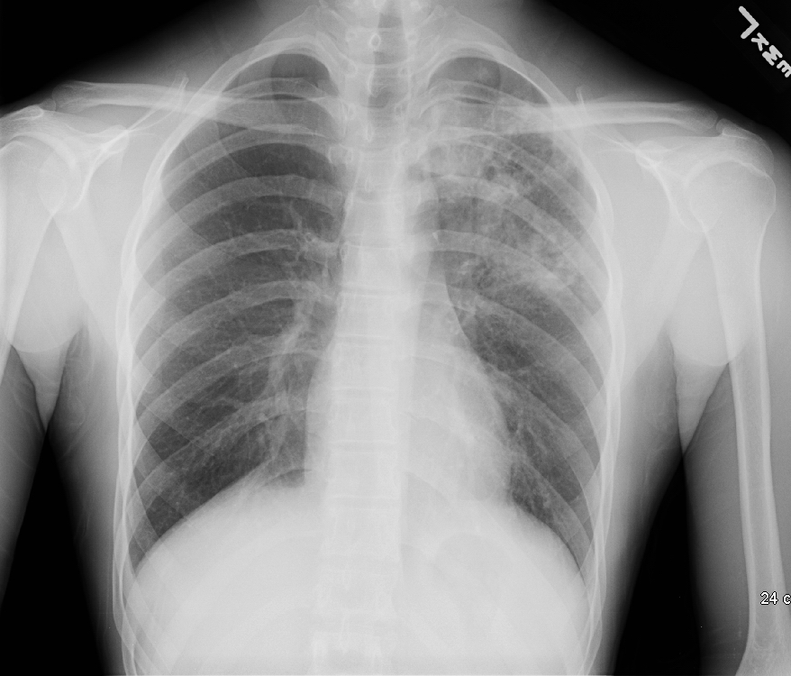

Left upper lobe infiltrate

Slide 12
CID 2016

Slide 13
First line anti-TB drugs for active TB
“RIPE” regimen for drug-susceptible active TB
Usual TB treatment duration is 6 months
  Intensive phase (2 months): rifampin, isoniazid, pyrazinamide, ethambutol + pyridoxine
  Continuation phase (4 months): rifampin, isoniazid + pyridoxine
Ethambutol can be stopped if Mtb isolate is susceptible to rifampin, isoniazid, pyrazinamide
Duration of TB treatment may be extended in certain situations (e.g. cavitary disease/high infection burden, disseminated TB, meningitis, osteomyelitis)

Slide 14
Hypothetical model of TB therapy
Bacillary burden
A
Bactericidal and sterilizing activity
Pop. A: rapidly multiplying (caseum) INH>>RIF>>EMB
Pop. B: slowly multiplying (acidic) PZA>>RIF>>INH
Pop. C: sporadically multiplying RIF>>INH
B
C
0
1
2
3
4
5
6
Months of TB treatment
Adapted from Isman, A Clinician’s Guide to TB, 2000

Slide 15
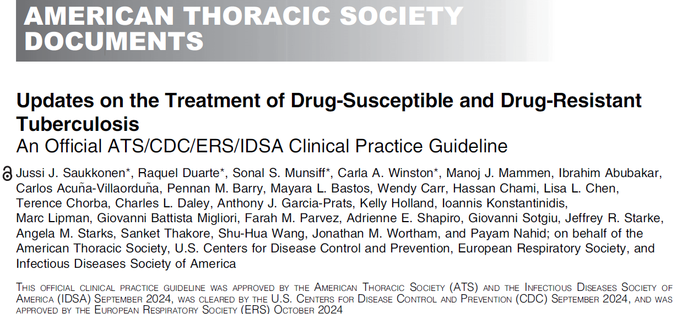

Slide 16
Highlights of Updated Recommendations – DS-TB
Am J Respir Crit Care Med Vol 211, Iss 1, pp 15–33, Jan 2025
Adults and adolescents with drug-susceptible pulmonary TB disease can be treated in four months instead of six
The panel recommends two months of isoniazid (H), rifapentine (P), pyrazinamide (Z), moxifloxacin (M), followed by two months of isoniazid, rifapentine, and moxifloxacin (2HPZM/2HPM) for people aged 12 years or older
Most children with non-severe TB disease can be treated in four months instead of six
The panel recommends two months of isoniazid (H), rifampin (R), pyrazinamide (Z), and ethambutol (E), followed by two months of isonaizid and rifampin (2HRZE/2HR) for children and adolescents between three months and 16 years of age with non-severe pulmonary TB disease.

Slide 17
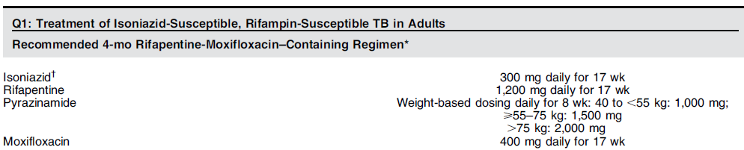
People aged ≥12 y/o with DS-TB PTB can be treated with a 4-month regimen of 2HPZM/2HPM
Recommendation 1: In people aged 12 years or older with drug-susceptible pulmonary tuberculosis, we conditionally recommend the use of a 4-month regimen of isoniazid, rifapentine, moxifloxacin, and pyrazinamide (conditional recommendation, moderate certainty of evidence)
Am J Respir Crit Care Med Vol 211, Iss 1, pp 15–33, Jan 2025

Slide 18
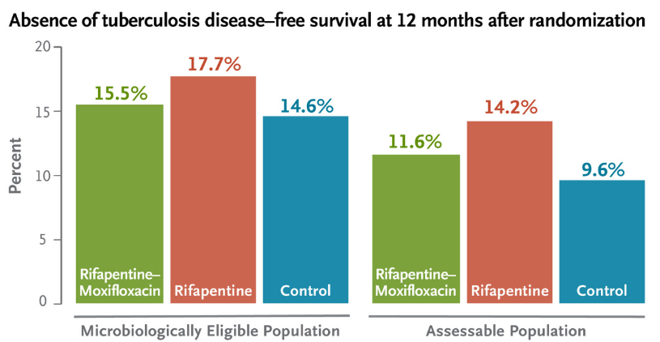
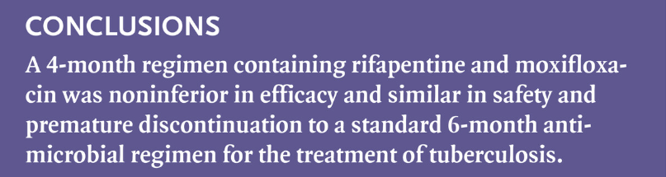
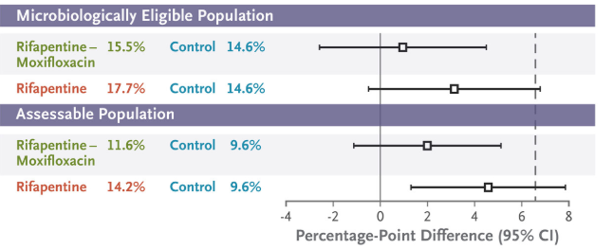
Study 31/A5349: Four-month rifapentine-moxifloxacin regimen
Design: non-inferiority phase 3 RCT
Population: 2516 participants with TB (13 countries; 34 sites)
If HIV, CD4≥100, on EFV-based ART
Primary outcome: survival free of tuberculosis at 12 months
Results: Rifapentine-moxifloxacin regimen (2HPZM/2HPM) was noninferior to 6 months of standard RIPE (2HRZE/4HR). Grade 3 adverse events were similar
~40% had cavitation ≥4cm
~96% smear positive
Dorman SE et al. NEJM 2021

Slide 19
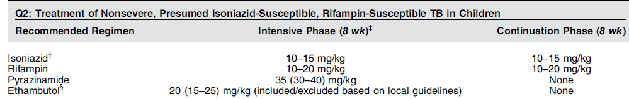
Children and adolescents with nonsevere TB can be treated with a 4-month regimen of 2HRZ(E)/2HR
Recommendation 2: In children and adolescents between 3 months and 16 years of age with nonsevere TB (without suspicion or evidence of multidrug-resistant [MDR]/rifampin-resistant [RR]-TB), we recommend the use of a 4-month treatment regimen of 2HRZ(E)/2HR rather than the 6-month drug-susceptible TB regimen of 2HRZ(E)/ 4HR (strong recommendation, moderate certainty of evidence)
Am J Respir Crit Care Med Vol 211, Iss 1, pp 15–33, Jan 2025

Slide 20
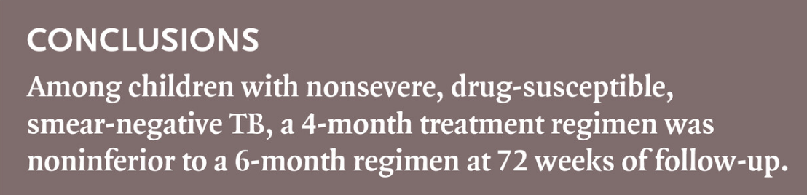
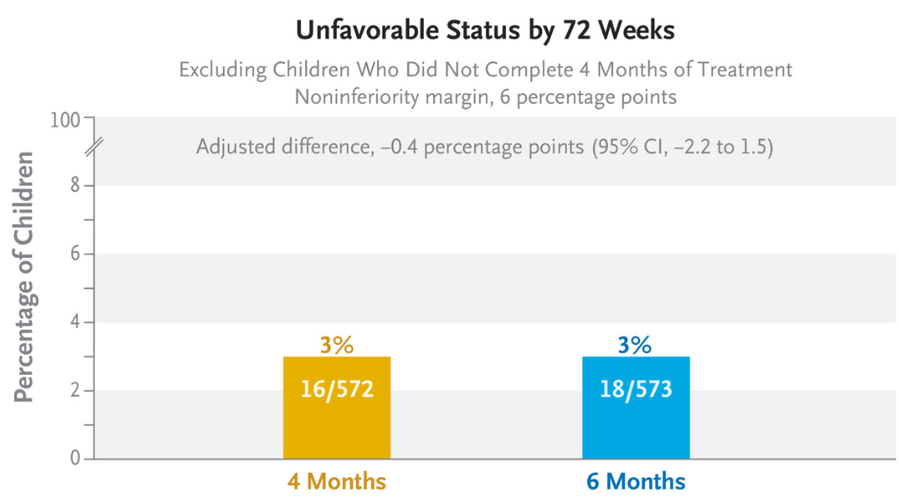
SHINE trial: Shorter treatment for minimal TB
Design: non-inferiority phase 3 RCT
Population: 1204 children ≤16 years of age with smear-negative TB (India and sub-Saharan Africa)
Primary outcome: unfavorable status by 72 weeks (defined as treatment failure or change, loss to follow-up during treatment, TB recurrence or death)
Results: 4-month regimen (2HRZE/2HR) was noninferior to 6-month standard regimen (2HRZE/4HR). Grade 3 adverse events were similar
~11% PWH
Turkova A et al. NEJM 2022

Slide 21
MDR-TB in the US
Approximately 1.5% of all TB cases (102 MDR-TB cases in 2019)
73% of cases attributed to reactivation, 18% previous TB disease, 7% recent transmission
Mortality during MDR-TB treatment has decreased from 31% (1993-2002) to 11% (2003-2013)
  DOT increased from 74% to 95% and was protective against all-cause mortality
Salinas JL et al. CID 2017; 65(11):1924–6; Chen MP et al. IJTLD 2020; 24(1):92-99; Schwartz NG et al. MMWR 2020; 69(11): 286-289

Slide 22
Molecular Detection of Drug Resistance (MDDR)
Resistance to INH + RIF = MDR-TB
?Resistance to INH + RIF + FQ= pre-XDR-TB
11

Slide 23
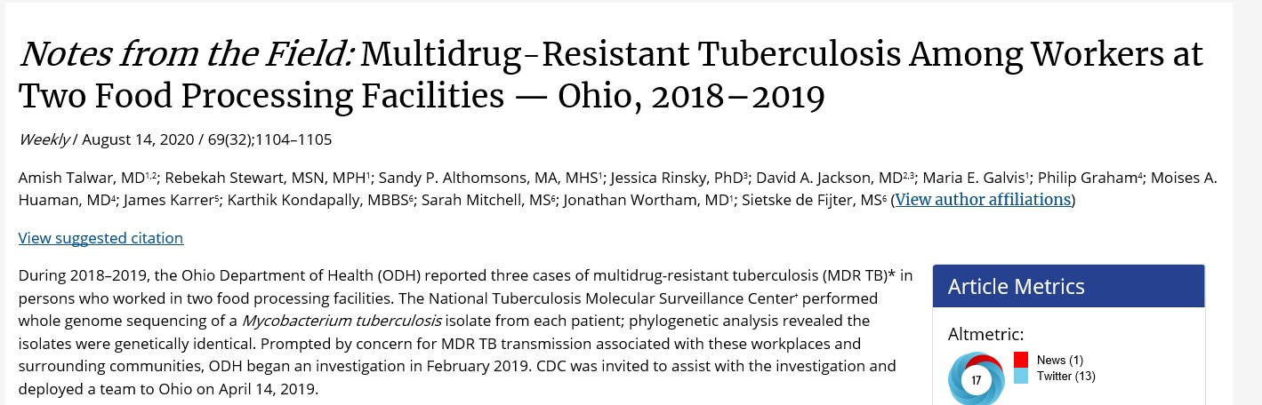
MDR-TB Cluster in Ohio

Slide 24
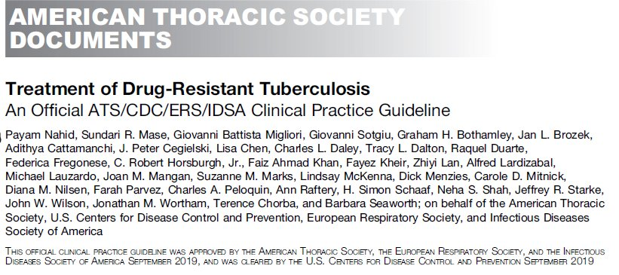
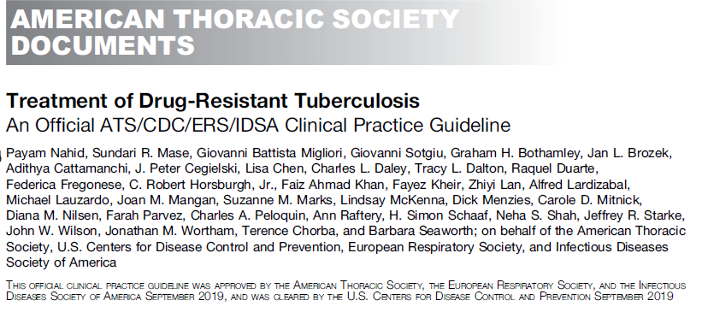
AJRCCM 2019

Slide 25
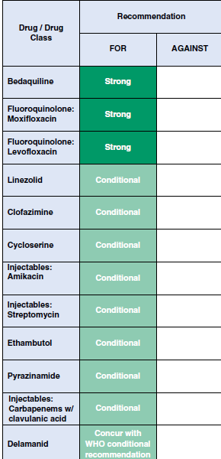
Drug resistant TB
MDR-TB: MTB resistant to isoniazid and rifampin
Pre-XDR-TB: MDR/RR-TB also resistant to any fluoroquinolone
XDR-TB: MDR/RR-TB resistant to any fluoroquinolone and at least one additional Group A drug (second-line drug)
2019 guidelines:
  Management of drug-resistant TB may need second-line anti-TB drugs and/or surgical resection
  Total MDR TB treatment duration: 15–21 months after culture conversion (15–24 months if pre-XDR-TB or XDR-TB)
  6-month BPaL (bedaquiline, pretomanid, linezolid) mentioned

Slide 27
Highlights of Updated Recommendations – MDR/RR-TB
Am J Respir Crit Care Med Vol 211, Iss 1, pp 15–33, Jan 2025
New all-oral regimens for multidrug- and rifampin-resistant TB disease shorten treatment duration from fifteen months to six months
The panel recommends a six-month treatment regimen (BPaLM) of bedaquiline (B), pretomanid (P), linezolid (L), and moxifloxacin (M) for people aged 14 years or older with rifampin-resistant, fluoroquinolone-susceptible pulmonary TB disease
The panel recommends a six-month treatment regimen (BPaL) of bedaquiline (B), pretomanid (P), and linezolid (L) for people aged 14 years or older with rifampin-resistant pulmonary TB disease and fluoroquinolone resistance or intolerance
These regimens are also treatment options for people with an intolerance of rifampin

Slide 28
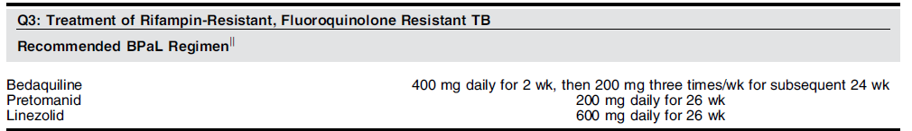
People aged 14 years or older with rifampin-resistant, fluoroquinolone-resistant PTB disease can be treated with BPaL
Recommendation 3: In adolescents aged 14 and older and adults with rifampin-resistant pulmonary TB with resistance or patient intolerance to fluoroquinolones, who either have had no previous exposure to bedaquiline and linezolid or have been exposed for less than 1 month, we recommend the use of the 6-month treatment BPaL regimen, rather than more than 15-month regimens (strong recommendation, very low certainty of evidence)
Am J Respir Crit Care Med Vol 211, Iss 1, pp 15–33, Jan 2025

Slide 29
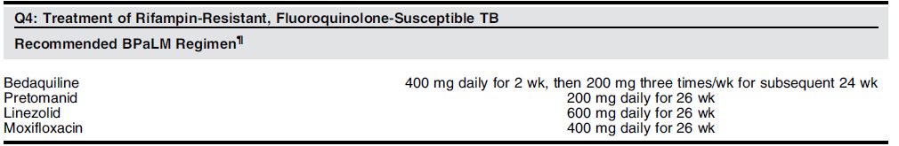
People aged 14 years or older with rifampin-resistant, fluoroquinolone-susceptible PTB disease can be treated with BPaLM
Recommendation 4: In adolescents aged 14 and older and adults with rifampin resistant, fluoroquinolone-susceptible pulmonary TB, we recommend the use of a 6-month BPaLM treatment regimen, rather than the 15-month or longer regimens in patients with MDR/RR-TB (strong recommendation, very low certainty of evidence)
Am J Respir Crit Care Med Vol 211, Iss 1, pp 15–33, Jan 2025

Slide 30
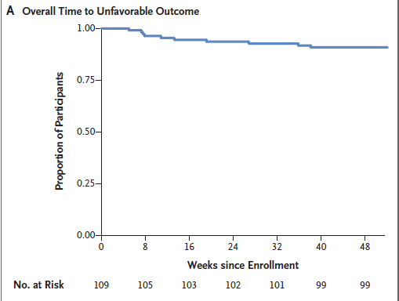
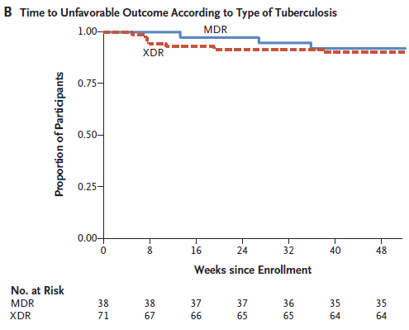
BPaL (Bedaquiline, Pretomanid, Linezolid)
The Nix trial
Of 109, 98 (90%) had a favorable outcome
Only 10% had unfavorable outcome defined as treatment failure (bacteriologic or clinical) or relapse within 6 months of treatment completion
Side effects from linezolid were common (81% peripheral neuropathy; 48% myelosuppression), but manageable with dose reductions or interruptions
Conradie F et al. NEJM 2020

Slide 31
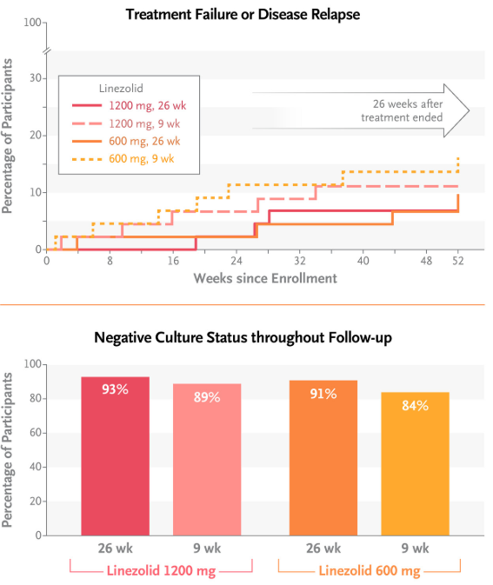
Linezolid dosing in the BPaL regimen
The ZeNix Trial
Conradie F et al. NEJM 2022

Slide 32
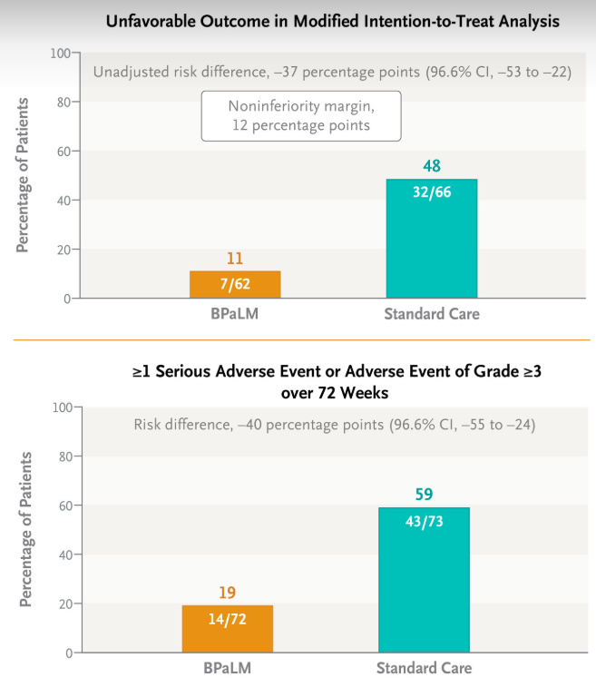
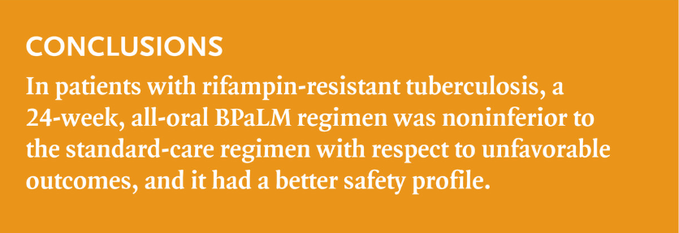
TB-PRACTECAL: 24-week all-oral regimen for MDR/RR-TB
Design: non-inferiority phase 2/3 RCT
Population: 301 ≥15 years of age with MDR/RR-TB (Belarus, South Africa, Uzbekistan)
Comparator: long standard of care
Primary outcome: unfavorable status by 72 weeks (composite of death, treatment failure, treatment discontinuation, lost to follow-up, TB recurrence)
Results: BPaLM was noninferior long standard of care
PWH 33% - 41% in each group
Nyang’wa BT et al. NEJM 2022

Slide 33
BPaL: response to treatment
Prior to starting BPaL regimen
4 months on BPaL regimen

Slide 34
Bedaquiline
Diarylquinoline approved by FDA in 2013
Inhibits mycobacterial ATP synthase
Bactericidal to actively replicating and non-replicating mycobacteria
  Bactericidal and sterilizing activity in murine model
No cross-resistance with RIPE, amikacin, moxifloxacin
Few reports of cross-resistance with clofazimine
Dose: 400 mg po qdaily x 2 weeks, followed by 200 mg TIW for total 24 weeks (some experience with longer courses)
Potential side effects: QTc prolongation, hepatitis, nausea, joint pain, headache, elevated amylase, rash

Slide 35
Linezolid
Oxazolindinone that inhibits bacterial protein synthesis (prevents fusion 30S and 50S ribosomal units)
It also binds to human mitochondria and inhibits protein synthesis, which is mechanism of toxicity in humans
Bactericidal activity primarily against actively replicating mycobacteria
Dose: 1,200 mg/day, but clinical experience with lower doses (300 – 600 mg Qdaily) that result in lesser toxicity: ZeNix trial – 600 mg/daily
Potential side effects: myelosuppression, diarrhea, nausea, optic and peripheral neuropathy
Should be used with B6 supplementation

Slide 36
Pretomanid
Developed by TB Alliance; “preto” prefix honors Pretoria, South Africa
Nitroimidazooxazine that inhibits mycolic acid synthesis, also acts as a respiratory poison against non-replicating bacteria under anaerobic conditions
Dose: 200 mg po Qdaily
Potential side effects: QTc prolongation, electrolyte disturbances, hepatitis, lipase elevation
Need to advise patients of reproductive toxicities seen in animal studies (testicular atrophy and impaired fertility in male rats), as effects on human male fertility have not been adequately evaluated

Slide 37
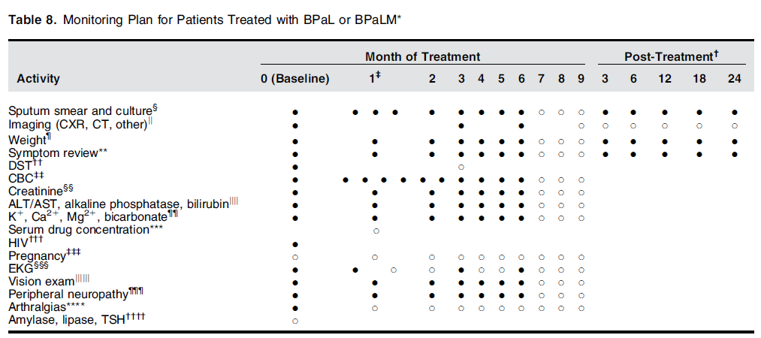
Am J Respir Crit Care Med Vol 211, Iss 1, pp 15–33, Jan 2025

Slide 38
Highlights of Updated Recommendations
Am J Respir Crit Care Med Vol 211, Iss 1, pp 15–33, Jan 2025
Adults and adolescents with drug-susceptible pulmonary TB disease can be treated in four months instead of six
The panel recommends two months of isoniazid (H), rifapentine (P), pyrazinamide (Z), moxifloxacin (M), followed by two months of isoniazid, rifapentine, and moxifloxacin (2HPZM/2HPM) for people aged 12 years or older
Most children with non-severe TB disease can be treated in four months instead of six
The panel recommends two months of isoniazid (H), rifampin (R), pyrazinamide (Z), and ethambutol (E), followed by two months of isonaizid and rifampin (2HRZE/2HR) for children and adolescents between three months and 16 years of age with non-severe pulmonary TB disease.
New all-oral regimens for multidrug- and rifampin-resistant TB disease shorten treatment duration from fifteen months to six months
The panel recommends a six-month treatment regimen (BPaLM) of bedaquiline (B), pretomanid (P), linezolid (L), and moxifloxacin (M) for people aged 14 years or older with rifampin-resistant, fluoroquinolone-susceptible pulmonary TB disease
The panel recommends a six-month treatment regimen (BPaL) of bedaquiline (B), pretomanid (P), and linezolid (L) for people aged 14 years or older with rifampin-resistant pulmonary TB disease and fluoroquinolone resistance or intolerance
These regimens are also treatment options for people with an intolerance of rifampin

Slide 39
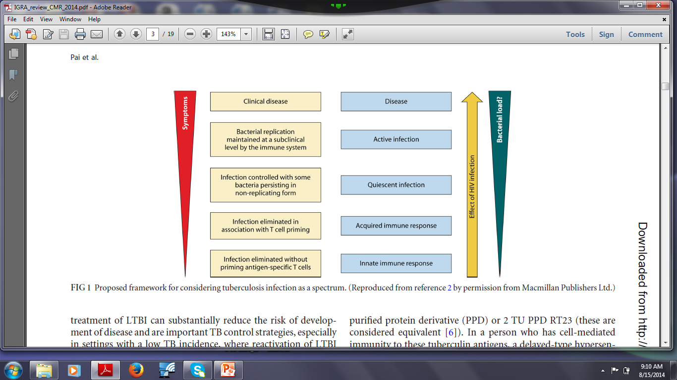

M. tuberculosis infection has a wide spectrum

Slide 40
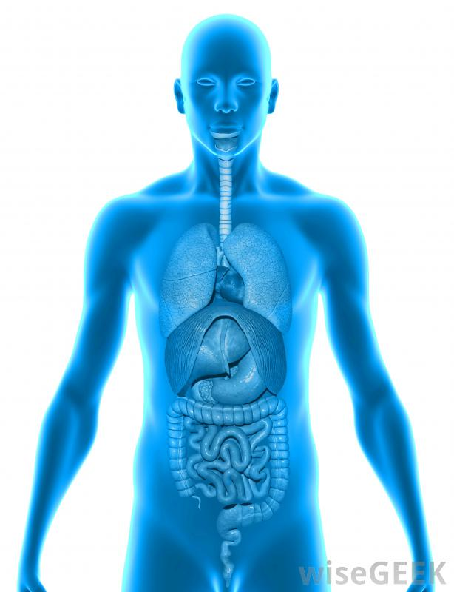
Reactivation: “one bad granuloma is all it takes”

Slide 41
Treatment regimens for TB infection (LTBI)
Drugs | Duration | Dose | Frequency | Total doses
Isoniazid and Rifapentine (3HP) | 3 months | INH 900 mg max dose Rifapentine 750 mg if 32-50 kg; 900 mg if > 50 kg | Once weekly | 12
Rifampin (4R) | 4 months | 600 mg (10 mg/kg) | Daily | 120
Isoniazid and Rifampin (3HR) | 3 months | INH 300 mg (5 mg/kg) RIF 600 mg (10 mg/kg) | Daily | 90
Isoniazid (6H) | 6 months | 300 mg (5 mg/kg) 900 mg (15 mg/kg) | Daily Twice weekly* | 180 52
Isoniazid (9H) | 9 months | 300 mg (5 mg/kg) 900 mg (15 mg/kg) | Daily Twice weekly* | 270 76
*Intermittent regimens must be provided by directly observed therapy (DOT) in which a health care worker observes the ingestion of medication
https://www.cdc.gov/tb/topic/treatment/ltbi.htm
Sterling TR et al. MMWR 2020. LTBI treatment guidelines

Slide 42
Treatment Regimens for TB infection (LTBI)
Efficacy of isoniazid monotherapy in preventing TB cases is between 60% - 90% (~90% if good adherence to treatment)
Rifamycin-based regimens (such as 3HP and 4R) have similar efficacy (non inferior) to isoniazid monotherapy, and are shorter, associated with better adherence rates, and lower rates of hepatotoxicity
https://www.cdc.gov/tb/topic/treatment/ltbi.htm
Huaman & Sterling. Clin Chest Med 2019
Sterling TR et al. MMWR 2020
WHO guidelines

Slide 43
TB-CHAMP and V-QUIN: Levofloxacin for MDR-TB contacts
VQUIN (Vietnam); n=2,041; Levofloxacin vs placebo (IRR 0.51; 95% CI 0.18 – 1.47, p=0.21)
TB-CHAMP (South Africa); n=922 children. Levofloxacin vs placebo (HR 0.44; 95% CI 0.15-1.25; p=0.121)
Meta-analysis using data from both trials, levofloxacin significantly reduced the risk of TB by 60% by 54 weeks (HR 0.4 (0.17-0.90)).
  Levofloxacin was safe and there was no indication of tendinitis, arthralgia, and arthritis in children. However, in adults, there was a higher risk of tendinitis, arthralgia and arthritis and more treatment discontinuation due to levofloxacin
TB Union Conference, Nov 2023; NEJM 2024; NEJM Evid 2025

Slide 44
TB infection (LTBI) in People with HIV
Progression from latent TB infection (LTBI) to TB disease is more frequent
  Up to 10% per year (vs. 10% lifelong without HIV)
Risk of TB disease increases shortly after HIV infection, even before CD4 count drops <500
Persons on ART who achieve virologic response still at higher risk of TB disease compared to general population

Slide 45
TB Infection (LTBI) in People with HIV in the US
When to test?
  At time of diagnosis, regardless of additional risk factors
  Retest once CD4 >200 if initial CD4 <200
  Annual testing for those at risk of exposure
How to test?
  TST (≥5 mm after 48-72 hours considered positive)
  IGRA (i.e., QuantiFERON®-TB, T SPOT®.TB)
  IGRA has higher specificity, especially if prior BCG vaccine
  TST and IGRA at same time not recommended in the US
What to do if TST or IGRA positive?
  Need to rule out active TB disease
  Screening for symptoms (i.e. cough of any duration) and CXR

Slide 46
3HP in People with HIV not on ART
Treatment arm | N | # TB cases | Cumulative TB rate | Difference in TB rate | Upper bound of 95% CI (%)
9H | 193 | 6 | 1.25 | -2.49 | 0.60
3HP | 206 | 2 | 0.39
Among HIV-infected persons with high CD4 counts and not on ART
  3HP had higher treatment completion rates than 9H
  3HP was at least as well-tolerated as 9H
    Significantly lower risk of hepatotoxicity
  3HP as effective as 9H (i.e., non-inferior)
  Limitations: small sample size, open-label study, unable to receive ART in first 90 days
Sterling TR et al. CROI 2014. Abstract 817

Slide 47
Preferred regimens for treatment of TB infection (LTBI) in PWH
Drugs | Duration | Dose | Frequency | Total doses
Isoniazid and Rifapentine* | 3 months | INH 900 mg max dose Rifapentine 750 mg if 32-50 kg; 900 mg if > 50 kg | Once weekly | 12
Isoniazid and Rifampin | 3 months | INH 300 mg (5 mg/kg) RIF 600 mg (10 mg/kg) | Daily | 90
*Rifapentine (3HP) is recommended only for virally suppressed patients receiving an efavirenz-, raltegravir-, or once-daily dolutegravir-based ARV regimen
When using rifampin, either dose adjustment or substitution of key ARVs may be needed (see Table in next slide)
DHHS O/I guidelines, TB, updated May 2024

Slide 48
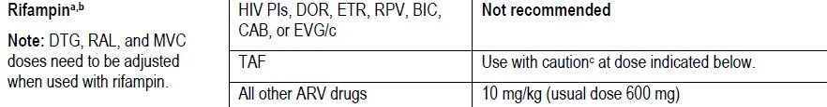
Preferred regimens for treatment of TB infection (LTBI) in people with HIV
Drugs | Duration | Dose | Frequency | Total doses
Isoniazid and Rifapentine | 3 months | INH 900 mg max dose Rifapentine 750 mg if 32-50 kg; 900 mg if > 50 kg | Once weekly | 12
Isoniazid and Rifampin | 3 months | INH 300 mg (5 mg/kg) RIF 600 mg (10 mg/kg) | Daily | 90
DHHS O/I guidelines, TB, updated May 2024

Slide 49
Alternative regimens for treatment of TB infection (LTBI) in people with HIV
Drugs | Duration | Dose | Frequency | Total doses
Isoniazid | 6-9 months | 300 mg (5 mg/kg) 900 mg (15 mg/kg) | Daily | 180-270
Rifampin | 4 months | 600 mg (10 mg/kg) | Daily | 120
Isoniazid and rifapentine | 1 month | INH 300 mg Rifapentine: <35kg: 300 mg 35-45 kg: 450 mg >45 kg: 600 mg | Daily | 28
BRIEF TB/A5279 trial (Swindells S et al. NEJM 2019; n=3,000 PLWH; ART=EFV or NVP-containing regimens; 1HP was not inferior to 9H
A5372 PK study (Podany et al. CID 2024): OK to use dolutegravir with 1HP, but need to increase dolutegravir dose to 50 mg twice daily
DHHS O/I guidelines; ART guidelines updated 9/2024

Slide 50
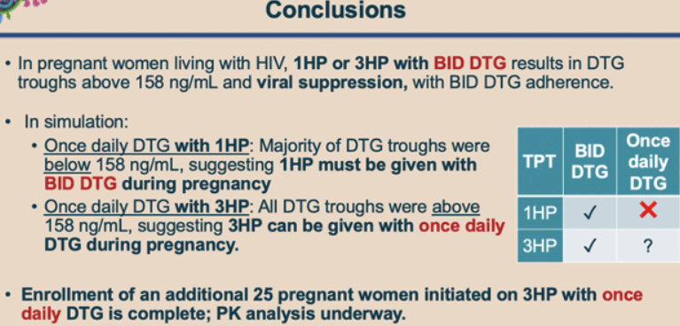
DOLPHIN Moms: PK and HIV suppression with dolutegravir and 1HP or 3HP in pregnancy. Jyoti S. Mathad et al. CROI 2025
https://www.natap.org/2025/CROI/croi_125.htm

Slide 51
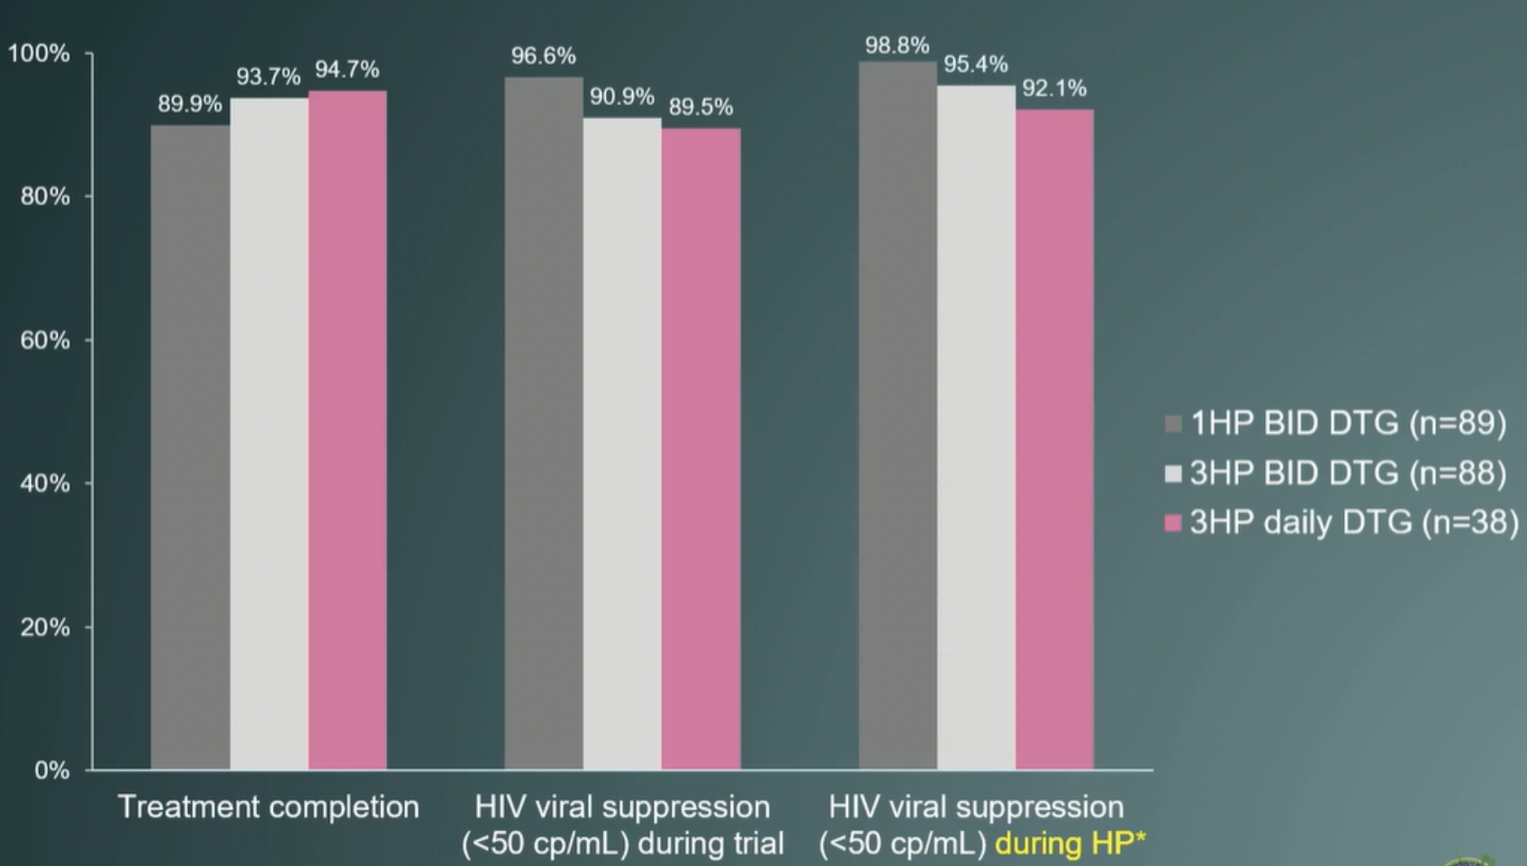
CROI 2026 OA-147: DOLPHIN-Moms
Results:
  3HP + QD DTG resulted in median DTG troughs >158 ng/mL
    Similar to data from non-pregnant adults
  >90% of women maintained viral suppression on 3HP with good safety profile
    3HP arms (BID & QD) lower than in 1HP arm (BID)
  Treatment completion highest in 3HP + QD DTG (95%), 3HP + BID DTG (94%), 1HP + BID DTG (90%)
Conclusions: 3HP is a safe and effective TPT regimen without dose adjustments of DTG for pregnant women.
  BID DTG safe for both 1HP and 3HP; 1HP with OD DTG not investigated in this study
Mathad JS, et al

Slide 52
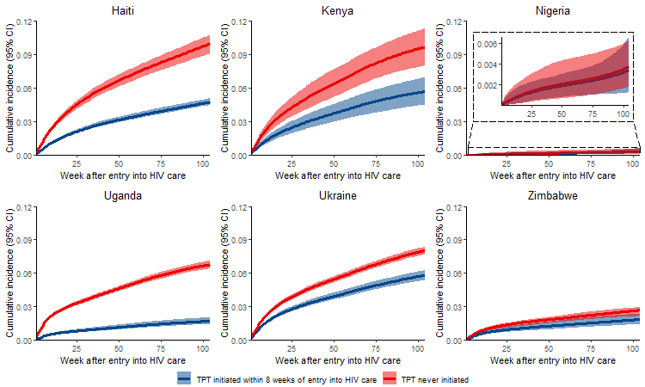
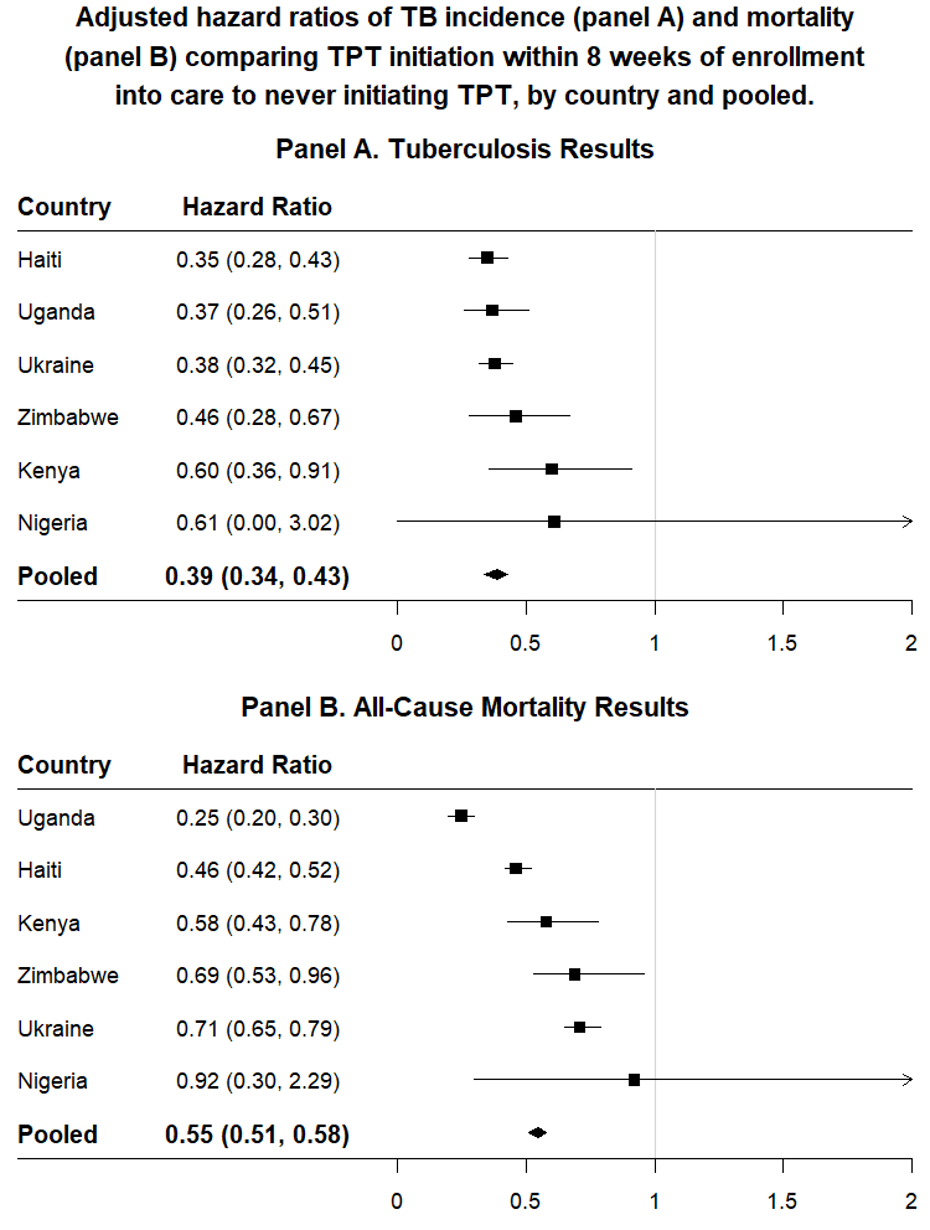
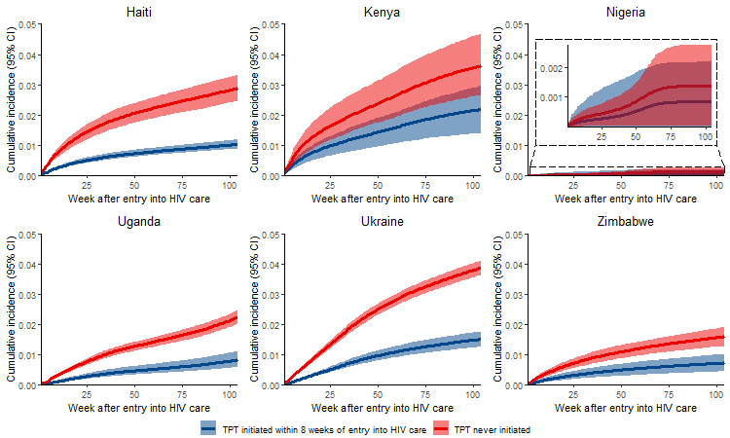
CROI 2026 P-771 Programmatic Effectiveness of TB Preventive Treatment for PWH: A Target Trial Emulation
Objective: Examine programmatic effectiveness of TPT among PWH in high TB burden settings
Design: Clinical trial emulation to estimate TPT effectiveness among PWH initiating ART 2018-2021
Population: Individual-level programmatic data from 6 PEPFAR-supported countries
Outcomes: Two-year TB incidence and all-cause mortality
  Results adjusted by year, age, sex, CD4 count, WHO clinical state, ART adherence, TB symptoms
Results:
Conclusion: Initiating TPT within 8 weeks of entering HIV care was associated with a 61% reduction in TB incidence and 45% reduction in mortality. These findings reinforce support for TPT as an essential component of HIV care, even in an era of universal test-and-treat and newer ART
(A) TB
(B) Mortality
Shah S, et al
Notes:
Effectiveness of TPT in real-world settings can be examined using routinely collected clinical data, but study design must address known biases of observational data
A target trial framework can minimize these biases by defining parameters of a hypothetical clinical trial and aligning observational data to these criteria

Slide 53
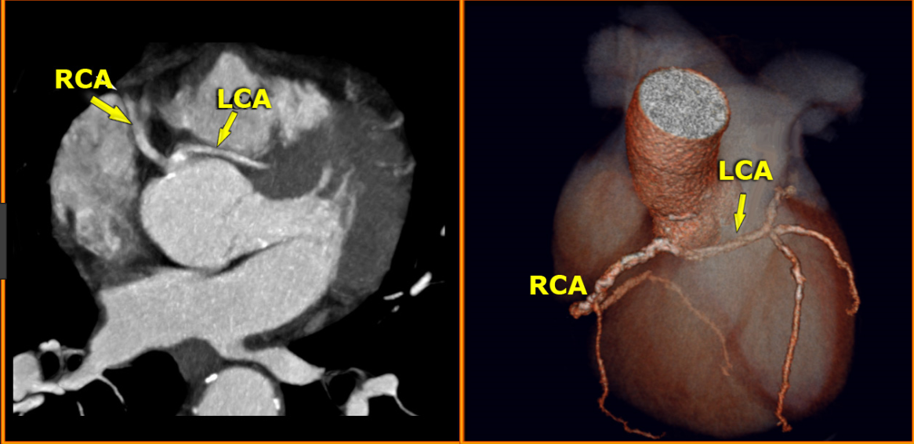
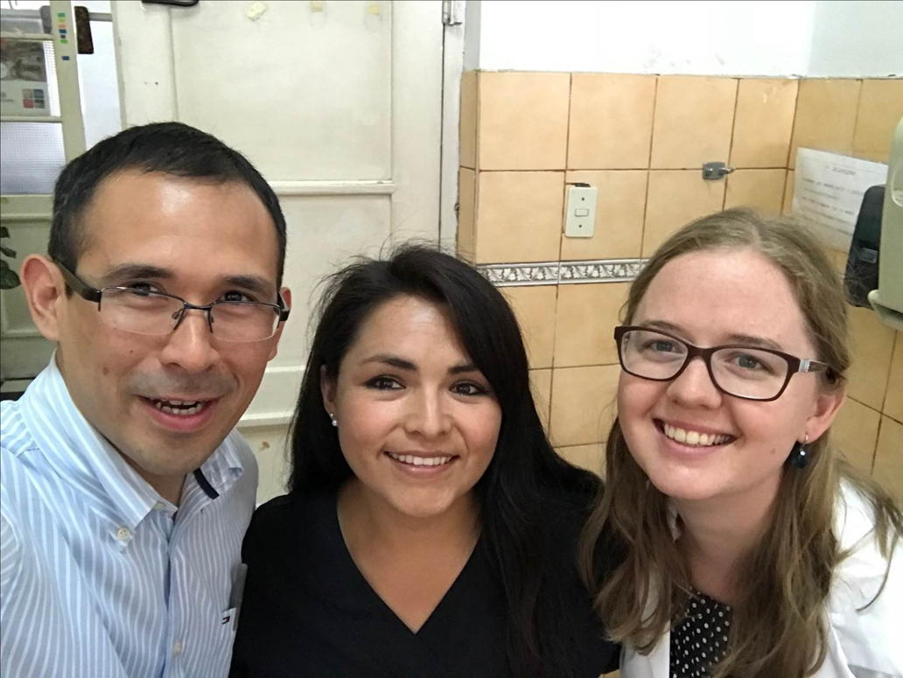
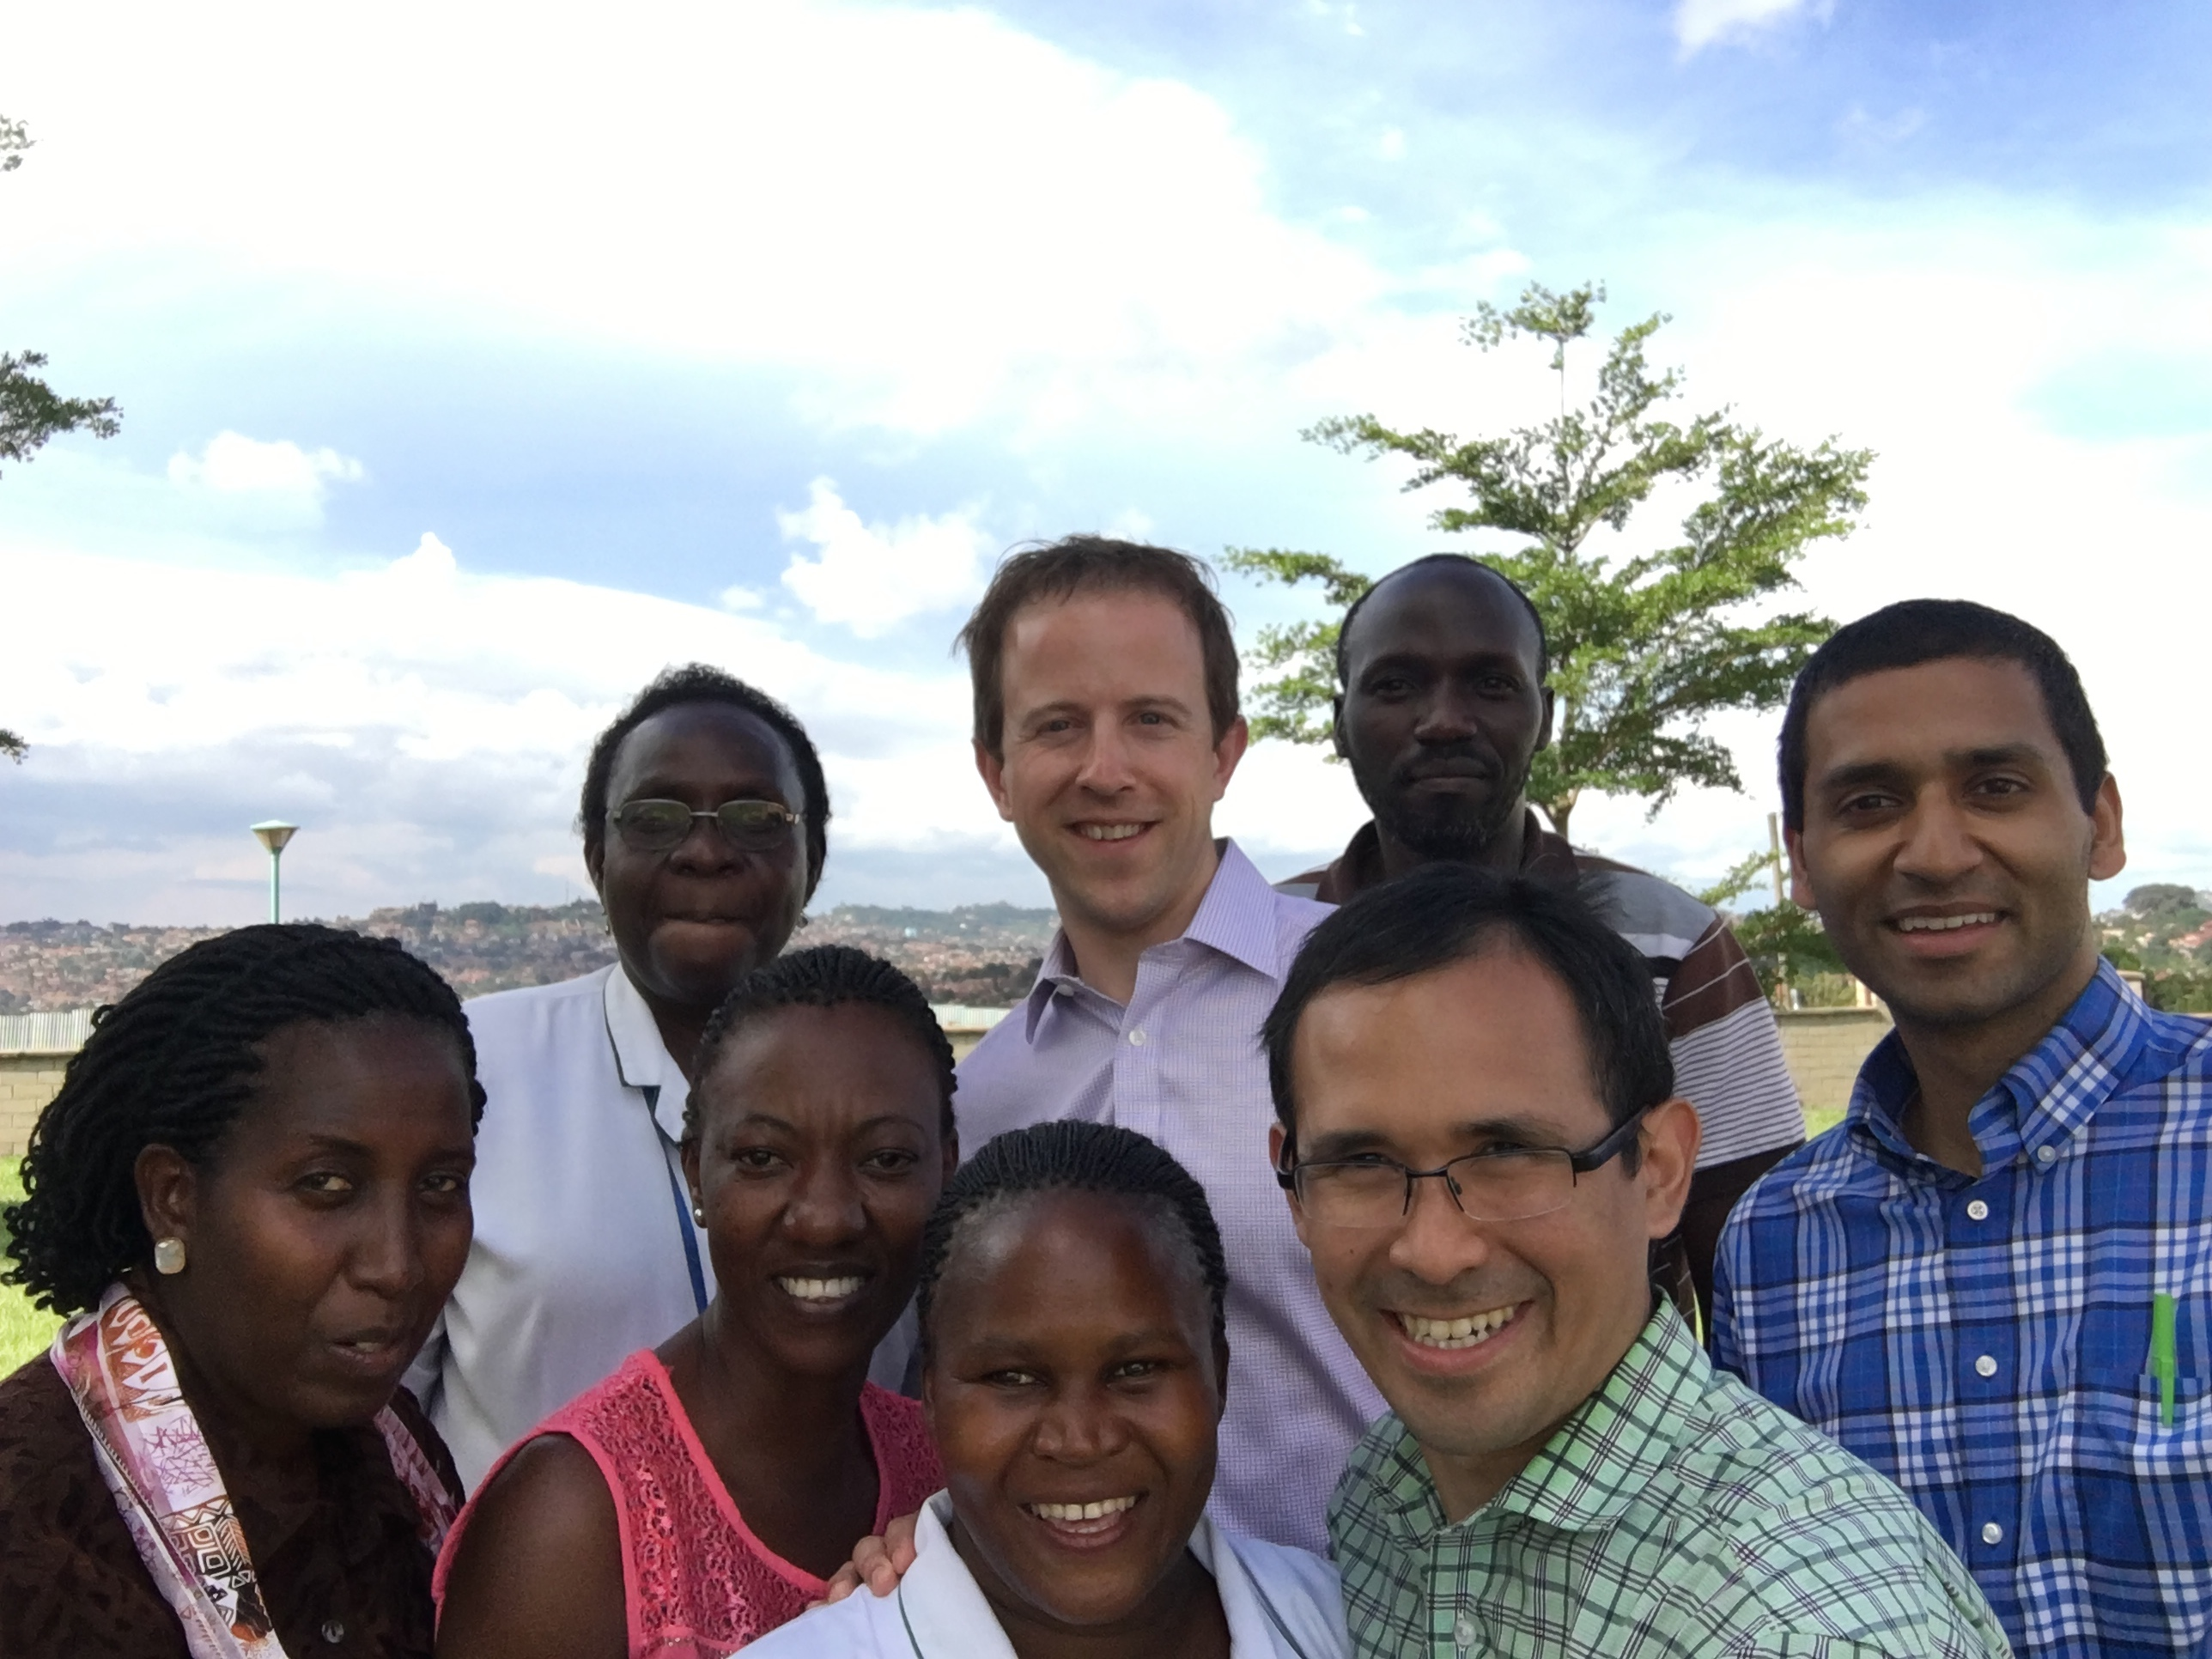
TB infection (LTBI) and Subclinical Coronary Atherosclerosis
Coronary Arteries Anatomy: CCTA
Lima, Peru and Kampala, Uganda
QFT and CCTA on adults ≥40 years of age
Lo J et al. Lancet HIV 2015

Slide 54
TB infection (LTBI) and Subclinical Coronary Atherosclerosis
Lima, Peru and Kampala, Uganda
QFT and CCTA on adults ≥40 years of age
9.7%
% with Obstructive CAD
3.3%
No AMI
n= 110
QFT(+)
n= 94
n= 113
LTBI was associated with obstructive CAD after adjusting for ASCVD risk score, HIV status, and study site (adjusted OR, 4.96; 95% CI, 1.05–23.44; p=0.043)
QFT TB Ag-Nil, IFNg = OCAD 4.7 (0.49–8.3) vs. non-OCAD 0.43 (0.01–2.7); p=0.011
Huaman et al. Clin Infect Dis 2021

Slide 55
TB infection and Incidence of Hypertension
Northwestern Medicine Enterprise Data Warehouse (Chicago, 2000 – 2020)
2679 TBI and 2506 TBI-free controls (matched by age, sex, race, geographic region)
People with TB infection had a significantly higher risk of developing hypertension than controls without TB infection (HR, 2.0; 95% CI,1.6–2.5; P<0.001)
Mandieka E et al. J Am Heart Assoc 2020

Slide 56
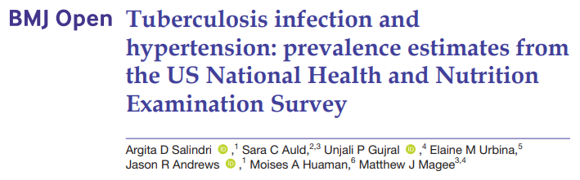
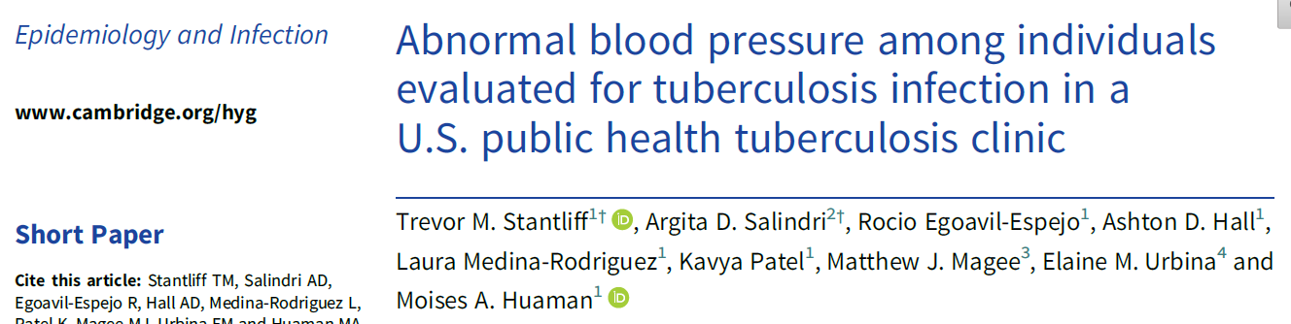
Hypertension is common among people with TB infection

Slide 57
TB infection and Incidence of Diabetes mellitus
VA cohort; 2000 - 2015
574,113 eligible patients; 2,535,149 person-years of follow-up after TB testing
6.6% had TB infection
DM incidence rate was greater in patients with TB infection compared with those without (HR; 1.4, 95% CI 1.3–1.4). Increased DM incidence in TB infection persisted after adjustment for covariates (aHR; 1.2, 95% CI 1.2–1.3)
Magee MJ et al. Diabetes Care 2022

Slide 58
The Concept of TB infection is Changing
  Homogeneous state
  Small Mtb burden
  Dormant, non-replicating, metabolically quiescent bacilli
  Caseous granulomas
  Confined to lungs and/or related lymphatic tissue
  Minimal host-pathogen interactions
Heterogeneous state
Variable host-pathogen interactions
May not only lead to active TB, but also contribute to the development of chronic diseases

Slide 59
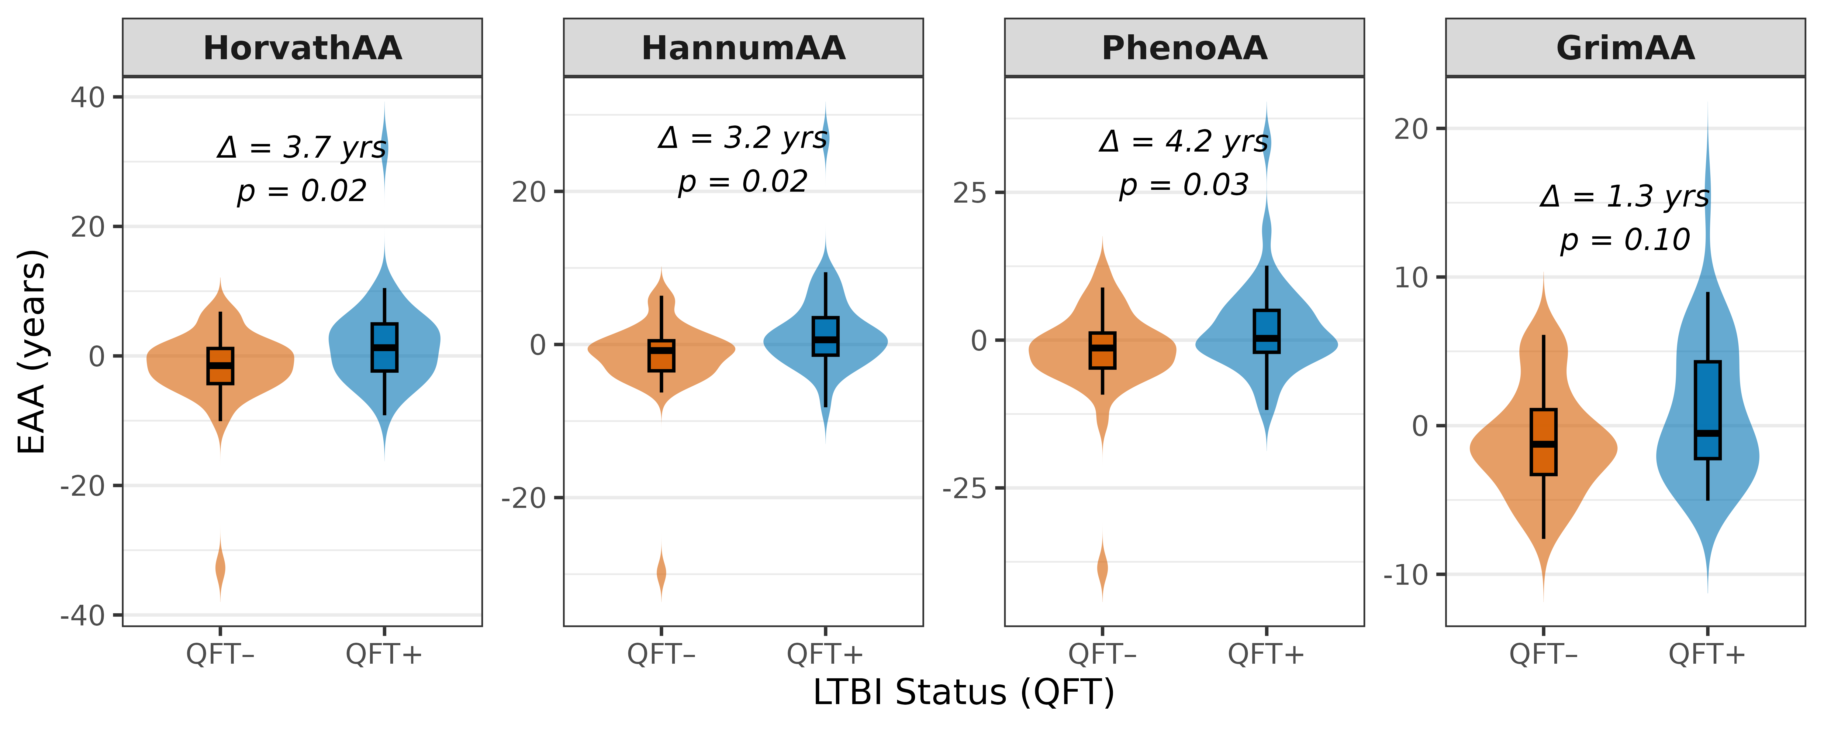
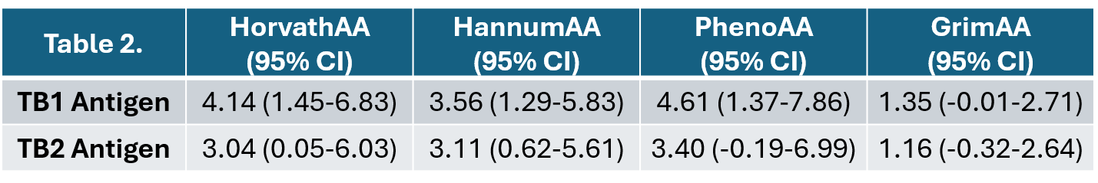
CROI 2026 P-764 Tuberculosis Infection Associated with Increased Epigenetic Aging
Characteristics | QFT- (n=38) | QFT+ (n=37)
Male (%) | 11 (28.9) | 16 (43.2)
Age, year (mean (SD)) | 43.16 (15.02) | 43.11 (14.61)
TB1 Antigen, IU/ml (mean (SD))* | 0.12 (0.19) | 1.75 (1.88)
TB2 Antigen, IU/ml (mean (SD))* | 0.10 (0.15) | 1.51 (1.80)
Body mass index, kg/m² (mean (SD)) | 26.72 (4.89) | 27.09 (5.28)
Smoking status (%) | -- | --
Current smoker | 12 (31.6) | 14 (37.8)
Former smoker | 3 (7.9) | 2 (5.4)
Never smoker | 23 (60.5) | 21 (56.8)
Objective: Determine whether TB infection is associated with accelerated epigenetic aging
Design: Cross-sectional study comparing epigenetic aging between QFT+ and QFT- (people without HIV)
Population: Adult household contacts in Tbilisi, Georgia
Outcome: Age acceleration, calculated as the difference between DNAm age (DNA Methylation Age Calculator) and chronological age
Conclusion: Epigenetic Age Acceleration (EAA) observed among QFT+ household contacts across multiple clocks, compared to QFT-
People with TB infection showed signs of faster-than-normal aging in their bodies. This suggests that TB may speed up overall biological aging and lead to related health problems
All linear regression models were adjusted for sex
Fernandes Gyorfy M, et al

Slide 60

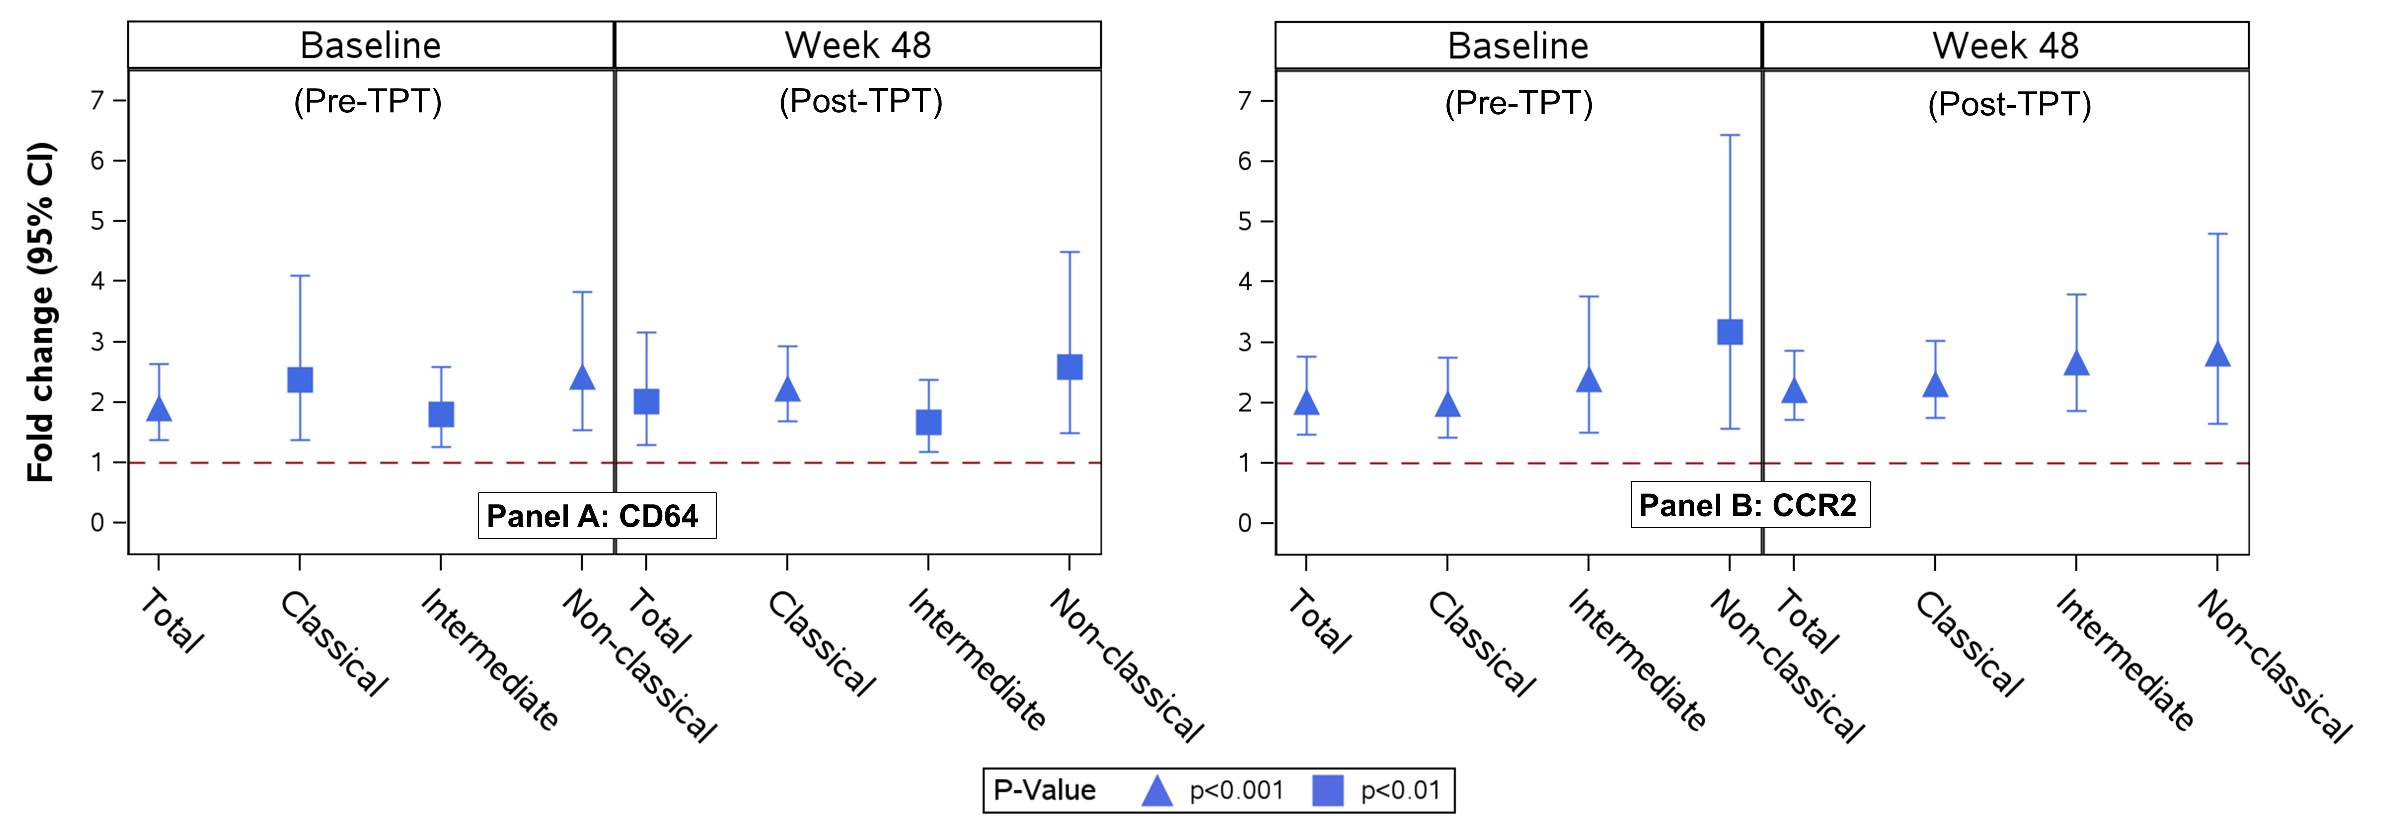
Monocyte Activation in People with HIV and Latent
Tuberculosis Co-Infection in the ACTG A5279/BRIEF TB trial
People with HIV with evidence of latent TB co-infection exhibited monocyte alterations indicative of persistent activation and tissue migration before and after TB preventive therapy
Findings suggest that people w HIV and LTBI co-infection may have persistent monocyte activation, which could contribute to the development of inflammation-driven comorbidities
Figure. Fold change comparisons of monocyte MFI of CD64 (Panel A) and CCR2 (Panel B) between TST/IGRA-positive (evidence of LTBI) and TST/IGRA-negative groups, adjusted by age, sex at birth, country, CD4 count
Huaman MA et al. OFID 2026

Slide 61
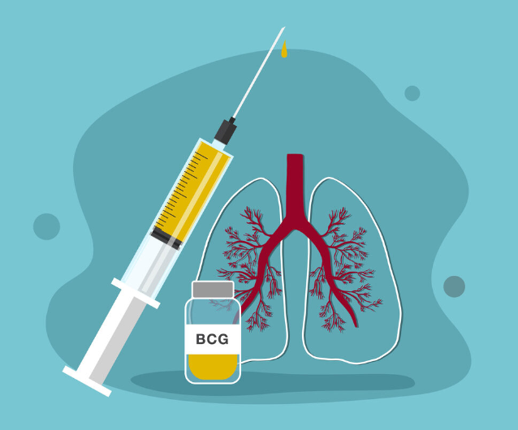
Final frontier of TB prevention/elimination: TB Vaccines?

Slide 62
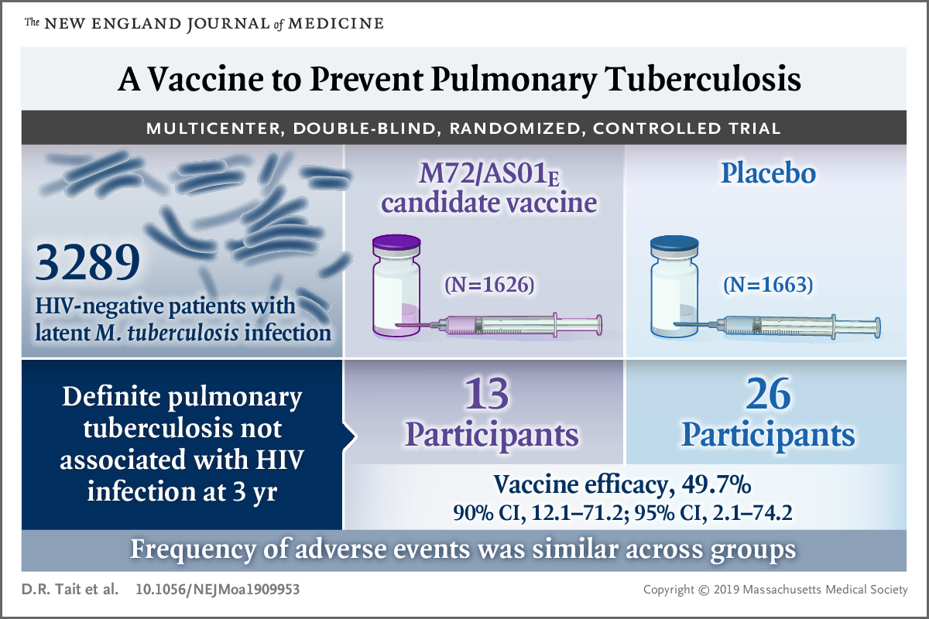
TB Vaccine Candidates: M72/AS01_{E}
Van Der Meeren O et al NEJM 2018; Tait DR et al. NEJM 2019

Slide 63
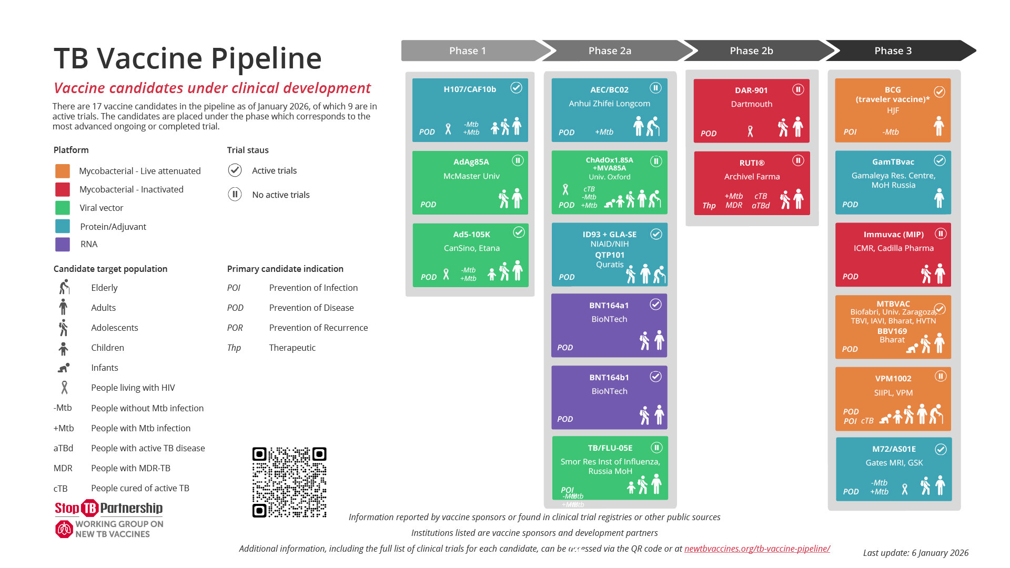

Slide 64
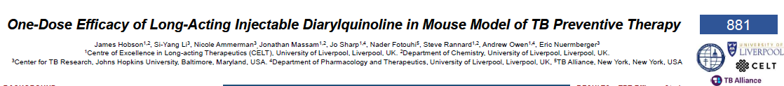
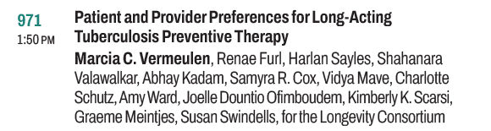
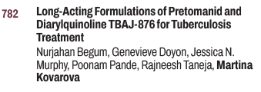
Long-Acting Formulations for TB Prevention & Treatment
CROI 2024; 2025; 2026

Slide 65
Take-home messages
TB is back the top infectious disease killer worldwide
Shorter 4-month regimens are available for individuals with drug-susceptible pulmonary TB
  2HPZM/2HPM for adults and adolescents
  2HRPZ/2HR for children with non-severe PTB
Bedaquiline-based regimens are the standard of care for multidrug-resistant/rifampin-resistant TB (BPaL; BPaLM)
Rifapentine-based regimens for TB prevention are available and may be used with dolutegravir-containing ART in PWH (3HP: DTG qd; 1HP: DTG bid)
Vaccine candidates and long-acting injectables for TB prevention are under investigation

Slide 66
Thank you!
Questions?

