Slide 1

Improving Provider Self-Efficacy on Pediatric Car Seat Referrals
Seren Carpenter, DNP, APRN, PNP-PC & Becky Jenshke, MSN, APRN, PNP-PC

Slide 2

Background
The Problem
  MVCs are the #1 cause of death in children ≥4 years; 450 children 10 killed and ~80,000 injured annually in the U.S. (DeGeorge et al., 2020; Macy et al., 2025)
Car Seats Save Lives
  ↓ mortality: 71% in infants, 54% ages 1–4, 45% ages ≥5 (DeGeorge et al., 2020)
  ↓ intracranial injury by 69% (Park et al., 2018)
  ↓ serious injury surgery in high-risk crashes (Santos et al., 2024)
The Gap
  >54% of pediatric MVC patients are inappropriately restrained; up to 99% in some age groups (Alligood et al., 2025; Truong et al., 2013)

Slide 3
Significance
Impact of Improper Restraint:
↑ injury severity, ↑ surgeries, ↑ complications, ↑ mortality (Alligood et al., 2025)
Disparities:
Highest death rates in Indigenous and Black children
Lower-opportunity neighborhoods → higher odds of improper restraint (Shaw et al., 2022; Alligood et al., 2025)
Why This Matters:
AAP recommends car seat guidance at every well-child visit
Lack of knowledge is the #1 barrier
Caregiver interventions improve use (Durbin Hoffman, 2018; Truong et al., 2013; Sartin et al., 2019)

Slide 4
The Problem
The original car seat flyer was last updated in 2024, and since then information from community partners has changed.
Providers do not have access to an updated list of community partners who offer car seat technicians.

Slide 5
Project Aims
Our project aims to:
Update the list of car seat resources in the greater Hartford area
Educate providers on the updated resources and referral process
Increase provider knowledge and self-efficacy of car seat referral processes for CHC Hartford patients

Slide 6
Methods
Design: Pre-Post Quality Improvement
Setting: Outpatient pediatric primary care clinic
Intervention: Provider Lunch & Learn education session
  Supportive material was presented: A physical updated Car Seat Resource flyer, as well as physical copies of referral forms.
Sample: 6 CHC Hartford Providers, including 2 NP students
Data Measurement & Collection: Pre/Post survey for providers

Slide 7
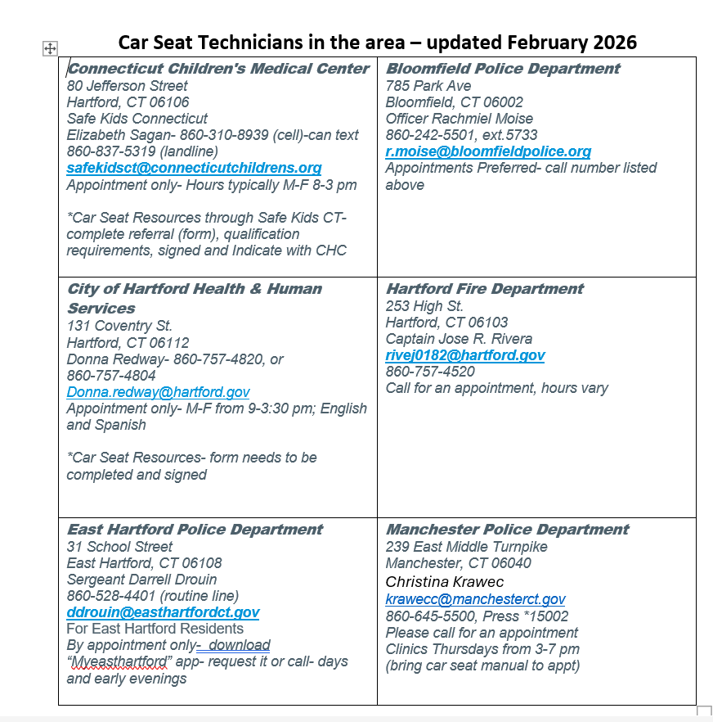

Slide 8
Results/Findings
Pre-survey: n=8
Post survey: n=7
Measure | Pre (% Agree/Strongly Agree) | Post (% Agree/Strongly Agree)
Identifying families needing resources | 25% | 100%
Counseling families | 25% | 100%
Knowledge of referral resources | 25% | 100%
Completing referral process | 0% | 100%
Adequate time to discuss car seat referrals | 0% | 14%
Likelihood to refer families | 50% | 100%

Slide 9
Conclusion & Future Implications
The Lunch & Learn session with providers increased their immediate self – efficacy regarding car seat resources and referral topics. However, many providers still did not think that they had adequate time to address car seats during Well Child Checks.
It would be more efficient if there was a standardized, formal referral process for car seat checks (like there is for specialist referrals) instead of different referral processes for each community resource.
Providers mentioned during the Lunch & Learn session that it would be beneficial to have a specific shared drive for Hartford providers to easily access these forms online.
Next steps: Measuring family outcomes vs provider self-efficacy, for example how many flyers were given out?/ how many referrals were made?/how many followed through and went to car seat technicians?
Next Step/direction: Adding Car Seat to template and measuring outcomes of providers accesses and educated families about car seat importance and safely
It would be helpful to add car seat-related questions to the WCC template- to access proper use

Slide 10
References
Alligood, D. M., Pilarski, M. D., Laurendeau, M. V., et al. (2025). Paediatric motor vehicle collisions in an urban setting: Assessing restraint use and socioeconomic disparities across trauma centres. Injury Prevention, Advance online publication. https://doi.org/10.1136/ip-2025-045803
Anderson, D. M., Peterson, R. W. (2023). Rear-facing child safety seat effectiveness: Evidence from motor vehicle crash data. Injury Prevention, 29(4), 320–326. https://doi.org/10.1136/ip-2022-044815
DeGeorge, K. C., Neltner, C. E., Neltner, B. T. (2020). Prevention of unintentional childhood injury. American Family Physician, 102(7), 411–417.
Durbin, D. R., Hoffman, B. D. (2018). Child passenger safety. Pediatrics, 142(5), e20182461. https://doi.org/10.1542/peds.2018-2461
Macy, M. L., Pollock, B., Kendi, S., et al. (2025). Multimodal intervention and child passenger safety guideline adherence in young children: A sequential, multiple-assignment, randomized clinical trial. JAMA Network Open, 8(9), e2533912. https://doi.org/10.1001/jamanetworkopen.2025.33912
Park, G. J., Ro, Y. S., Shin, S. D., et al. (2018). Preventive effects of car safety seat use on clinical outcomes in infants and young children with road traffic injuries: A 7-year observational study. Injury, 49(6), 1097–1103. https://doi.org/10.1016/j.injury.2018.04.001
Santos, J., Grigorian, A., Schellenberg, M., et al. (2024). Safety/booster seats in pediatric motor vehicle crashes: Public health concern. The American Journal of Emergency Medicine, 76, 180–184. https://doi.org/10.1016/j.ajem.2023.11.053
Sartin, E., Bell, T. R., McDonald, C. C., Mirman, J. H. (2019). Assessment of caregiver-targeted interventions for use of motor vehicle passenger safety systems for children: A systematic review and meta-analysis. JAMA Network Open, 2(10), e1914180. https://doi.org/10.1001/jamanetworkopen.2019.14180
Shaw, K. M., West, B., Kendi, S., Zonfrillo, M. R., Sauber-Schatz, E. (2022). Urban and rural child deaths from motor vehicle crashes: United States, 2015–2019. The Journal of Pediatrics, 250, 93–99. https://doi.org/10.1016/j.jpeds.2022.07.001
Truong, W. H., Hill, B. W., Cole, P. A. (2013). Automobile safety in children: A review of North American evidence and recommendations. The Journal of the American Academy of Orthopaedic Surgeons, 21(6), 323–331. https://doi.org/10.5435/JAAOS-21-06-323

