Slide 1
Vaccination Hesitancy:
Tdap
CHC New London:
Kelly Ho
Karen Li
Notes:
Hello everyone. My name is **** and along with my co-resident ****, we are excited to present our Quality Improvement project, which focused on addressing vaccination hesitancy and increasing adult Tdap uptake right here at our CHC New London site.

Slide 2
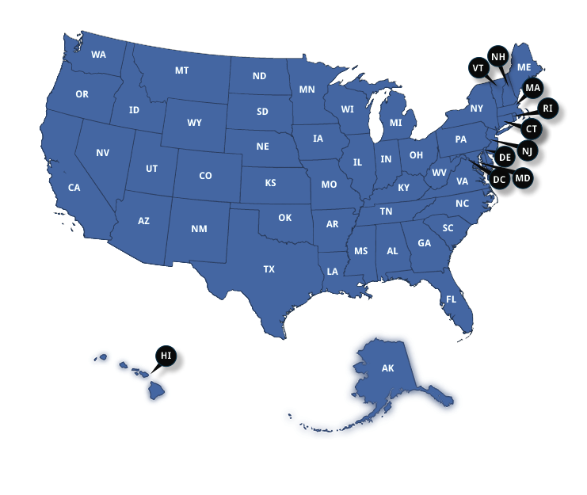
Current Data
~30%
of adults aged 19-64 received Tdap
60%
is the CDC target goal for eligible adults
Demographic Disparities: Data indicates significant racial and ethnic gaps, with White adults showing higher vaccination rates than Black, Hispanic, and Asian populations.
Recommendation: One dose of Tdap for all adults, followed by Tdap boosters every 10 years.
The Compliance Gap: The CDC target is 60% compliance for eligible adults; current Tdap-specific rates are currently at half of that national goal.
Notes:
To understand why this project is a priority, we have to look at the current data.
According to the most recent CDC data, only about 30% of adults aged 19 to 64 have actually received their Tdap booster.
We also see significant disparities in the data. Vaccination rates vary by age and ethnicity, with White adults consistently showing higher uptake than Black, Hispanic, and Asian populations. This highlights a clear need for targeted outreach. While the Advisory Committee on Immunization Practices—or ACIP—recommends that every adult get at least one Tdap dose followed by boosters, we are currently at only half of the CDC’s 60% compliance goal, and this is why our project aims to bridge this gap through direct, pre-visit education.

Slide 3
Central Question
Why Do We Care?
The Central Question: "Why is our adult population significantly under-vaccinated for Tdap, and how can we bridge the 10-year awareness gap to prevent outbreaks in our community?"
The Urgency:
The "School-Age" Misconception: Adults often believe childhood vaccines provide lifelong protection, leaving them unknowingly vulnerable.
Community Protection: Adults are the primary reservoir for Pertussis. Boosting parents/grandparents protects infants.
The Care Gap: Unlike pediatrics, adult care lacks a rigid schedule; pre-visit strategies are needed to capture rare "well-visit" windows.
Vaccine Hesitancy: Patients need time to process risks/benefits. Handouts empower them for informed discussion with providers.
Notes:
The central question is why do we care?
The "School-Age" Misconception: Most adults (18–65) mistakenly believe that Tdap protection from their childhood series is lifelong. Without a proactive intervention, this population remains unknowingly vulnerable to Tetanus and Pertussis.
Community Protection: Adults are the primary reservoir for Pertussis (Whooping Cough). Working on this now is critical to protect vulnerable infants—who are too young to be vaccinated—by ensuring the adults around them (parents, teachers, and grandparents) are boosted are very important.
The Care Gap: Unlike pediatric care, which has a rigid vaccine schedule, adult preventive care is often fragmented. Although we encourage a annual physical for all the adults but not everyone are following the schedule, and they only come to the clinic as needed. If we do not implement a pre-visit strategy now, we continue to miss the rare "well-visit" opportunities where adult prevention is the focus.
Vaccine Hesitancy: Many patients are hesitant to accept Tdap vaccines which often due to the lack of sufficient time to process, understand the risk/benefit profile, and prepare questions during a time-constrained appointment and lack of educational strategy to empower patients with knowledge ahead of time, ensuring they arrive prepared for acceptance and discussion.

Slide 4
Aim Statement
Global Aim: Achieve a 20% increase in Tdap booster administration for the 18–65 age group within the 6-month project period at CHC New London.
Patient Experience: Patient is feeling more prepared to a more efficient clinical encounter, reducing the time the provider spends on basic education.
Provider Experience: Ensuring all the eligible adults (18–65) are identified and educated before the exam starts. This aims to reduce the clinician’s counseling time during the visit, allowing for more complex clinical discussions while maintaining high-quality preventive care."
Notes:
Now, let’s look at our Global Aim. Our primary performance goal is to achieve a 20% increase in Tdap booster administration for the 18 to 65 age group within this 6-month project period at CHC New London.
But beyond the numbers, we are also focused on the quality of the clinical encounter.
From the Patient Experience perspective, we want patients to feel better prepared for their visit. By providing information early, we reduce the time they spend receiving basic education while on the exam table, making the encounter more efficient.
From the Provider Experience side, the goal is to ensure all eligible adults are identified and educated before the exam even starts. This directly aims to reduce the clinician’s counseling time during the visit. By handling the 'basics' beforehand, it allows us as providers to engage in more complex clinical discussions while still maintaining a high standard of preventive care".
Team Specific Goal:
Increase the acceptance rate of targeted vaccines by 15 percentage points in the cohort that received the proactive educational handout compared to the control cohort (6 months before the project launch).
Decrease the explicit refusal rate for targeted services by 10 percentage points in the intervention cohort compared to the control cohort (6 months before the project launch).
Patient Experience:
Patient is feeling more prepared to a more efficient clinical encounter, reducing the time the provider/RN spends on basic education.
Current Process Steps (for Comparison)
First Step: Patient arrives for the current visit.
Last Step: Provider/RN/MA discusses preventive service at the beginning or the end of the appointment. Patient accepts or refuses.
Revised Process Steps (Intervention)
First Step: PSA/MA identifies patient is eligible for a target service at their next visit.
Next step: PSA/MA provides the low-literacy educational handout with a standardized, brief script.
Next step: Patient reviews information over the next weeks/months.
Last step: Patient arrives at the next appointment. The provider/RN conducts a discussion based on the patient’s pre-existing knowledge and prepared questions, leading to acceptance or refusal.
Areas of Exclusion:
Detailed medical conversations regarding contraindications or complex risk assessments remain the sole responsibility of the clinical provider (MD, DO, NP, PA) and are not a function of the PSA/RN/MA intervention

Slide 5
Influencing Strategy
C = Current
D = Desire
Stakeholder | Current Stance | Desired Behaviors | Short Term Concerns | Short Term Wins
MA | Neutral | Check Tdap status and hand out materials | "Will this make me fall behind schedule?" | Receiving a "Thank you"
Providers | Moderately supportive | Confirms the patient read the handout and orders the shot immediately. | "I don't have 5 minutes to argue with a vaccine-hesitant adult." | Entering a room where the patient says, "I'm ready for that Tdap shot."
Patients | Hesitant | Consent during visit | Lack of prepareness | Empowerment
Notes:
Moving to our stakeholders, we recognized that the success of this workflow depends on the 'buy-in' of the entire team. We categorized our team into three key groups and developed specific strategies to move them toward our desired outcomes.
For our Medical Assistants: They currently hold a neutral stance. Their primary concern is, understandably, 'Will this make me fall behind schedule?'. To address this, we have asked our Senior MA to demonstrate how the screening and handout process takes less than 20 seconds. The 'win' here is the immediate positive feedback—receiving a 'thank you' from a patient who feels cared for.
For our Providers: They are already moderately supportive but worry about spending extra time arguing with vaccine-hesitant adults within a 20 min visit. Our strategy is to show them the 'win': walking into a room where the patient says, 'I’m ready for that Tdap shot', which will safe our time as a provider.
For our patients. Obviously they are intially lack of the knowledge of the importance of receiving tdap vaccines. Using our strategy of pre-visit education can empowered them to receive the vaccine

Slide 6
Measurement
Materials
Method
- Inability to easily track education delivery
- Educational handout text is too high-literacy/complex.
- No standardized protocol for pre-visit education.
- Lack of timely data feedback on acceptance/refusal rates.
- Handout lacks clear, impactful visuals.
- Education provided only during the visit (time-pressured).
-Acceptance/Refusal not systematically recorded in the EHR/chart
- Handout not given until patient receives the vaccine
-Lack of standardized scripting for staff.
Tdap vaccine hesitancy
- High patient volume/wait times limit staff ability to deliver handout proactively.
- Patient health literacy barriers.
- EHR system does not easily flag patients eligible for the handout.
- Patient cultural/religious beliefs leading to hesitancy.
- Clinical culture prioritizes acute care over preventive outreach.
- No integration to print or send targeted handout automatically.
- Most adults mistakenly believe that Tdap protection from their childhood series is lifelong
Environment
People
Technology

Slide 7
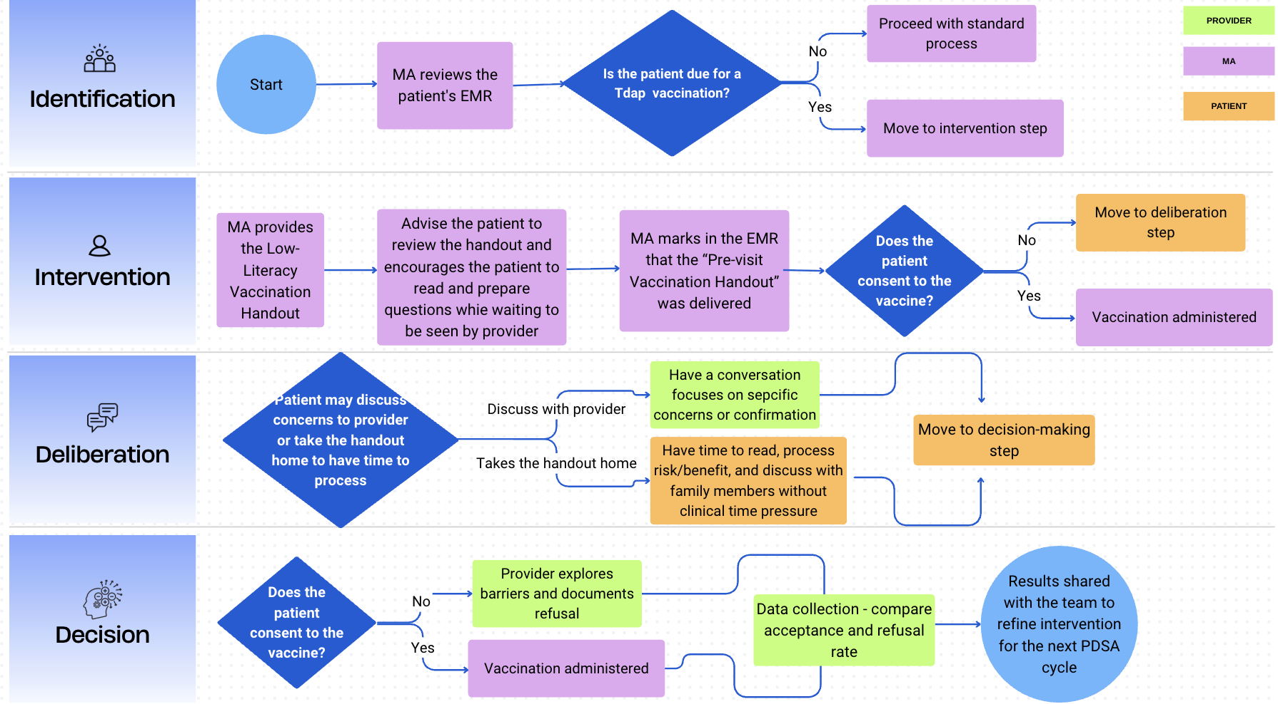
Process Flowchart

Slide 8
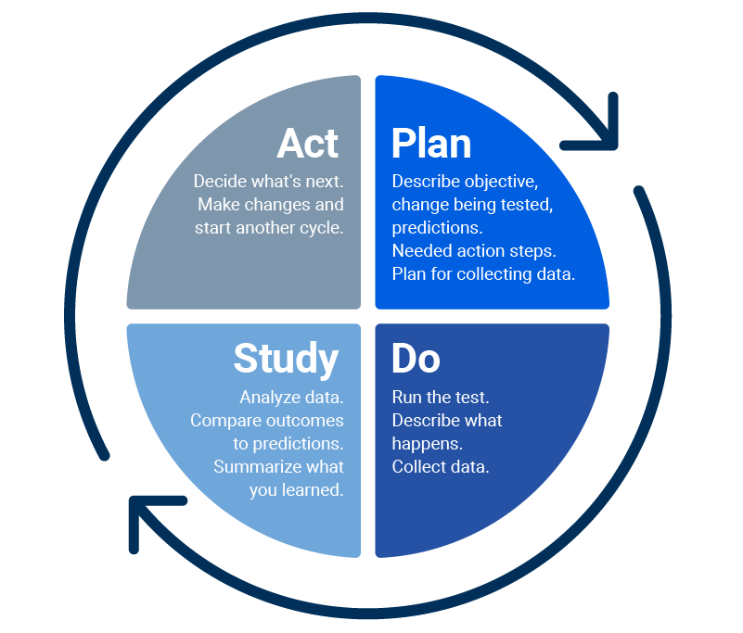
PDSA
AIM:
To test if the pre-visit Tdap educational handout can increase awareness and uptake among adults (18-65).
Describe your first test of change: | Person Responsible
Tdap handout delivery during the rooming process for all adult patients (18-65) seen by one specific provider. | MA
PLAN:
List the task needed to set up this test of change | Person Responsible
Draft & Print Handouts: Print 50 copies of the low-literacy Tdap handout. Daily List Prep: Highlight all patients aged 18-65 on the daily schedule who are overdue for Tdap. Data Record: Place a simple "Yes/No" check-sheet at the room to track handouts given. | MA
Predict what will happen when the test is carried out |  | Measures to determine if prediction succeeds | Person (s) Responsible for Collection of Data
"We predict the MA will be able to deliver the handout to at least 80% of eligible patients without falling behind schedule." "We predict that at least 50% of patients who receive the handout will mention it or ask a question about Tdap when the provider enters the room." |  | Process Measure: Handout Delivery Rate Outcome Measure: Acceptance Rate Balancing Measure: Time added to the rooming process (Self-reported by the MA). | MA & Provider
Notes:
To put our theories into practice, our primary aim for this test was to see if a pre-visit handout could actually move the needle on awareness and uptake.
For this initial test, we limited the scope to one specific provider's schedule in Pod D. The MA was responsible for three key tasks: printing 50 low-literacy handouts, highlighting eligible patients on the daily schedule, and using a simple 'Yes/No' check-sheet to track every handout given.
We made two specific predictions. First, we believed the MA could achieve an 80% delivery rate without negatively impacting clinic flow. Second, we predicted that at least half of the patients would be 'primed' by the handout and bring it up themselves when the provider entered. To verify this, we tracked our delivery rate as a process measure, the actual vaccination acceptance as our outcome, and used the MA’s self-reported rooming time as a balancing measure to ensure we weren't creating a bottleneck in the clinic."

Slide 9
Results
Initial Data Trends:
While data collection is ongoing, early indicators show that active MA initiation is the primary driver for vaccine acceptance.
The "MA Effect":
We observed a significant increase in patients saying "yes" at the visit when the MA proactively offered the Tdap, compared to the baseline period of passive screening and no EMR alerts.
Barriers & Challenges:
Staffing Transitions: Frequent changes in MA assignments required constant re-education of new staff members to maintain project momentum.
Consistency: Maintaining a steady workflow depends heavily on the individual MA’s familiarity with the project.
Key Learning:
MA-led education is more powerful than any automated alert
Notes:
"Looking at our results, although we are still in the initial data-gathering phase, the trend is very clear. We’ve noted that once the Medical Assistant initiates the offer of the Tdap vaccine, patients are far more willing to say 'yes' during that same visit. This is a huge shift from our baseline when there were no EMR alerts and MAs weren't prompted to ask.
However, we did encounter some real-world barriers. Specifically, recent changes in MA assignments meant we had to frequently 're-pitch' and re-train new staff on the project. We learned that simply asking the question makes a massive difference in public health outcomes."

Slide 10
Conclusion
Next Steps:
Formally transitioning the project framework to the incoming 2026-2027 residency cohort to ensure longitudinal tracking and continued uptake improvement.
What to do Differently:
If starting over, we would focus earlier on creating a "standardized onboarding packet" for MAs to mitigate the impact of staffing changes and seek ways to automate EMR flags to support the staff.
Advice for Future Residents:
Engage your MAs early
Build in Redundancy: Expect staffing changes. Create simple, written "one-pagers" that any new team member can follow immediately.
Start Small: Focus on one consistent interaction (like the rooming process) rather than trying to change the whole clinic at once.
Notes:
"As for next steps, we plan to pass this project on to the next residency cohort to ensure continued improvement and data tracking.
In terms of what to do differently, if we were to start this project again, we would focus more on creating a permanent support system within the EMR to help staff, especially when the team changes.
Our advice for future NP residents is this: prioritize your relationship with your MAs. We feel like they are the ones who make these projects move. Also, prepare for a simple handout by having simple, clear instructions ready for anyone new joining to our team, so they understand about our current project. Obviously, QI project just like a marathon, which we would like other sites to join us as a team in the future.

Slide 11
References
Griffin, L. B., Polnaszek, B. E., Shin, J., Clark, M. A., Lewkowitz, A. K., Amanullah, S., & Gjelsvik, A. (2025). Parental status and gender are associated with differences in Tdap vaccination rates among United States adults. Vaccine, 52, 126901. https://doi.org/10.1016/j.vaccine.2025.12690
Vaccination coverage among Adults in the United States, National Health Interview Survey, 2022. (2024, October 4). CDC. https://www.cdc.gov/adultvaxview/publications-resources/adult-vaccination-coverage-2022.html
‌

