Slide 1
QUALITY IMPROVEMENT INITIATIVE
Improving Sleep in
Community Health
WHY SLEEP?
Foundational health behavior
Drives mental health outcomes
Modifiable & treatable
Gariela Disla Suarez and Steve Li
Standardized Screening · Sleep Education · Referral Pathways
Underassessed in practice
Psychiatric NP · Quality Improvement Presentation
Notes:
Good morning everyone.
Today, we will be presenting our Quality Improvement project, which focuses on improving sleep in Community health.
Sleep is a fundamental component of overall health and well-being, yet it is often overlooked in community health settings. Our project aims to improve how sleep concerns are identified and addressed by implementing a standardized sleep screening process, providing sleep hygiene education, and helping patients develop realistic, patient-centered sleep goals. To begin, I'd like to discuss why sleep is such an important factor in behavioral health and why it deserves greater attention during psychiatric care.
Sleep is one of the most important health behaviors affecting both physical and mental well-being. It also can affect mental health outcomes and sleep issues can be modified and treated. And sleep in general can also be underaddressed in practice due to time constraints.

Slide 2
INTRODUCTION
Why Sleep Matters
in Behavioral Health
"Although sleep is a major factor affecting mental health outcomes, assessment and intervention are not always standardized."
Depression & Anxiety
ADHD & Concentration
Bidirectional relationship — poor sleep worsens symptoms; psychiatric conditions disrupt sleep architecture.
Sleep deprivation mimics and exacerbates ADHD symptoms — impaired attention, impulsivity, and executive function.
Trauma & PTSD
Emotional Regulation
Nightmares, hyperarousal, and fragmented sleep are core trauma symptoms that perpetuate the trauma cycle.
Insufficient sleep reduces prefrontal cortex function, increasing emotional reactivity and reducing distress tolerance.
Sleep Quality Improvement | Behavioral Health
Notes:
So why does sleep matter in Behavioral health? Research consistently shows that sleep disturbances are closely linked to behavioral health conditions, including depression, anxiety disorders, ADHD, trauma-related disorders, and difficulties with emotional regulation.
Poor sleep can worsen symptoms, increase stress, impair concentration, reduce energy, and negatively affect overall quality of life. Research has also shown that insomnia can significantly increase the risk of developing depression and other psychiatric conditions. Insufficient sleep reduces prefrontal cortex function, increasing emotional reactivity and reducing distress tolerance. Sleep deprivation mimics and exacerbates ADHD symptoms — impaired attention, impulsivity, and executive function.
Because sleep plays such a critical role in mental health outcomes, behavioral health providers are in a unique position to identify sleep problems early and support patients in improving sleep habits.

Slide 3
PROBLEM STATEMENT
Current Gap in Sleep Care
CURRENT GAPS
AIM STATEMENT
Sleep discussed inconsistently across providers
To improve sleep assessment and sleep-related behavioral interventions during psychiatric intake visits through standardized screening, education, and referral pathways.
Patients may not receive sleep education
Existing sleep resources are underutilized
Measurement targets include:
• % of intakes with documented sleep screening
• % receiving sleep education
• Referral utilization rate
No standardized workflow for sleep assessment
Sleep Quality Improvement | Behavioral Health
Notes:
Currently, sleep is often discussed during psychiatric intake visits; however, the depth and consistency of assessment can vary. Given the many competing priorities during an initial psychiatric evaluation, time constraints may limit the opportunity for a thorough sleep assessment and targeted sleep education.
As a result, important sleep concerns may not always be explored in a structured way, and patients may leave the visit without receiving sleep hygiene education or information about available sleep-related resources. Existing resources may be available within the organization, but without a standardized process, they may not be used consistently.
Our project is not intended to add significant time to the visit. Instead, it aims to provide providers with a simple, efficient, and standardized approach.
Our project's aim is to improve the quality and value of sleep assessment and sleep-related behavioral interventions during psychiatric intake visits by implementing a standardized process that includes screening, patient education, and referral pathways.
Measurement targets include:
• % of intakes with documented sleep screening
• % receiving sleep education
• Referral utilization rate

Slide 4
INTERVENTION
Three-Part Intervention Model
A
Standardized Sleep Assessment
B
Brief Sleep Intervention
C
Sleep Resources Provided
Average hours slept
Provide sleep education
Sleep hygiene handout
Difficulty falling asleep
Motivational interviewing techniques
Sleep consultation referral
Difficulty staying asleep
Help identify one sleep goal (e.g., consistent bedtime, reduce screen time, limit caffeine)
Sleep therapy group referral
Restfulness upon waking
Motivational interview for sleep
Current sleep habits
Sleep Quality Improvement | Behavioral Health
Notes:
To address this gap, we developed a three-part intervention model.
First, every patient will complete a brief standardized sleep screening during their initial psychiatric visit. Providers will ask questions about overall sleep quality, average hours slept, difficulty falling asleep, difficulty staying asleep, how rested the patient feels upon waking, and current sleep habits.
Second, providers will incorporate brief Motivational Interviewing techniques into the visit. Rather than simply giving advice, Motivational Interviewing encourages a collaborative conversation that helps patients identify their own reasons for change. Providers will explore sleep concerns, assess readiness for change, and help patients select one realistic and achievable sleep goal.
Examples of sleep goals may include establishing a consistent bedtime routine, reducing screen time before bed, or limiting caffeine intake later in the day.
Finally, patients will receive supportive resources, including a one-page sleep hygiene handout and referrals to additional sleep-related services when appropriate, such as a sleep consultation or sleep-focused therapy group.

Slide 5
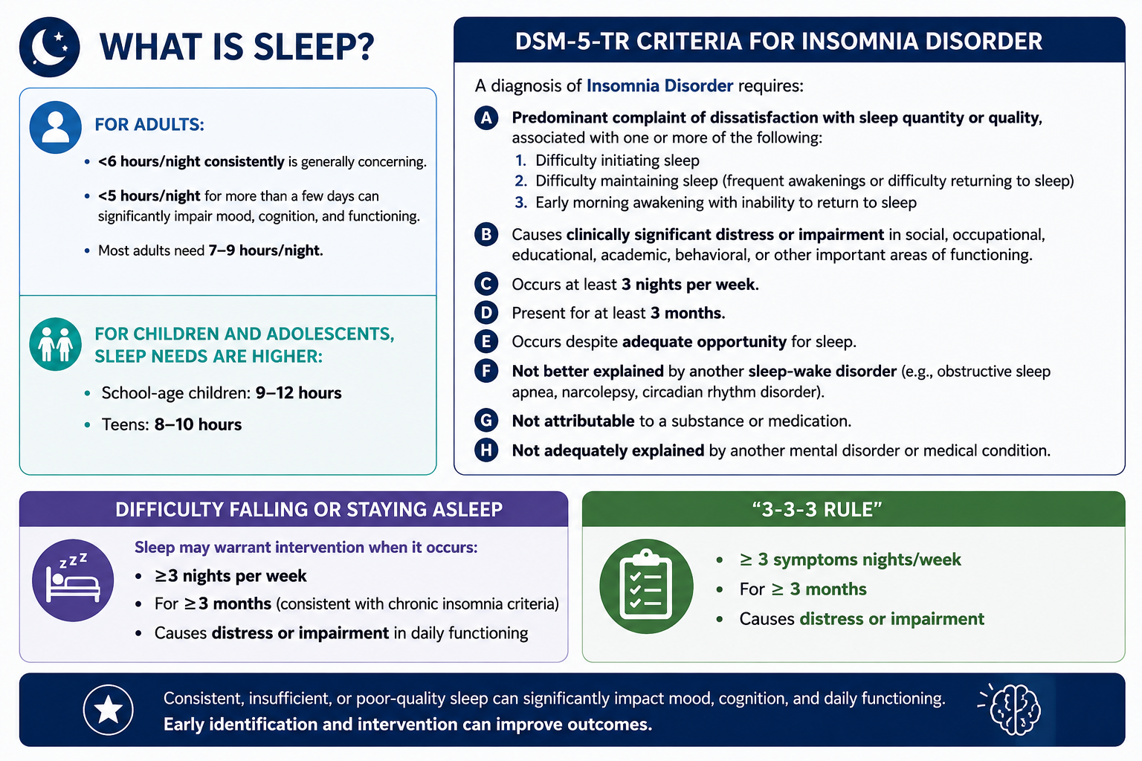
Notes:
We also wanted to take some time to define sleep. According to DSM 5 criteria for insomnia disorder,

Slide 6
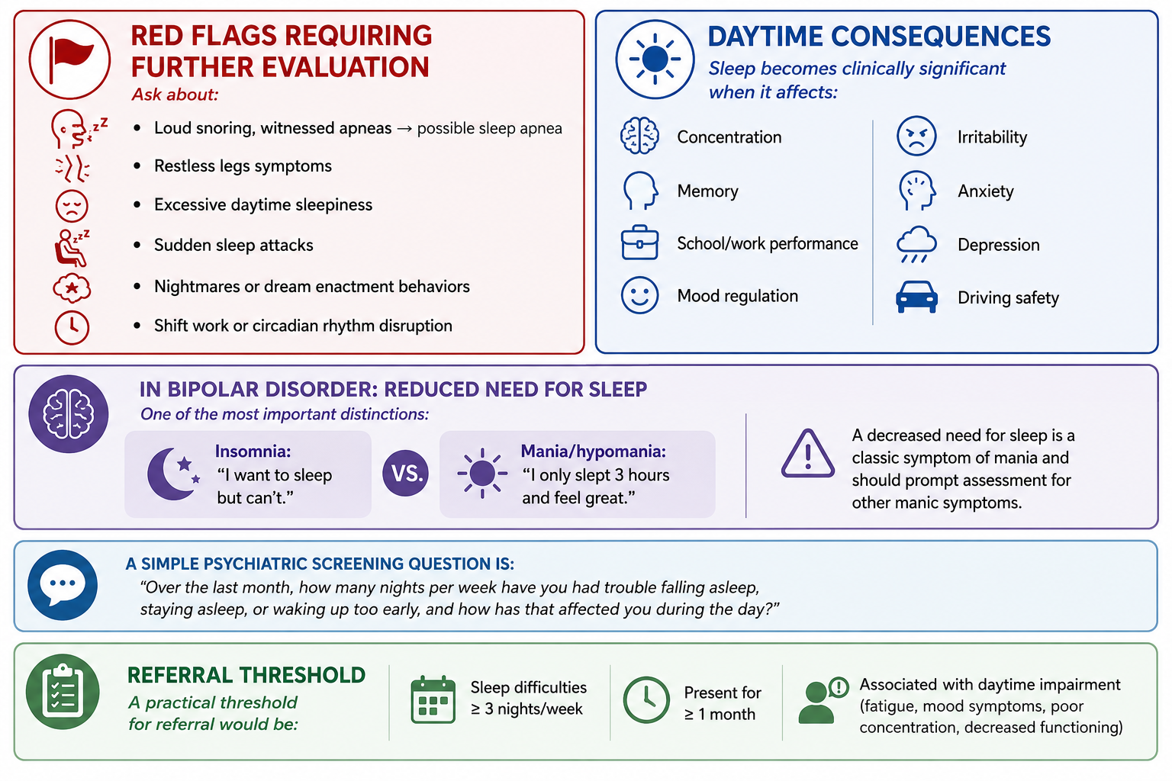

Slide 7
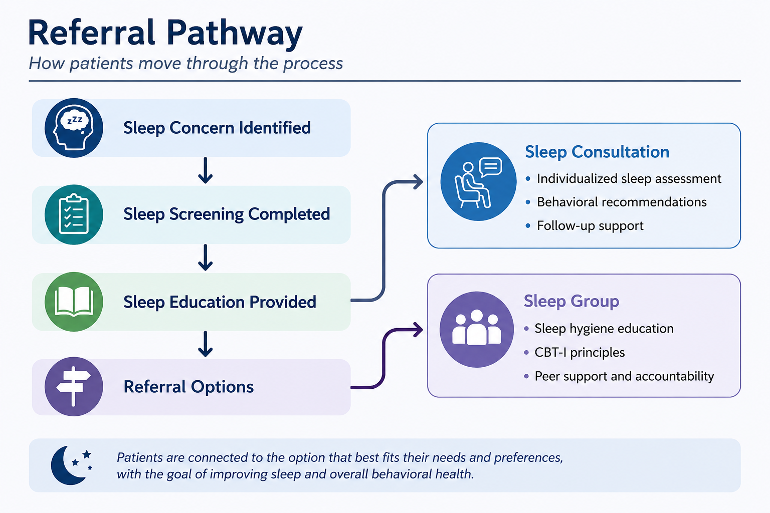

Slide 8
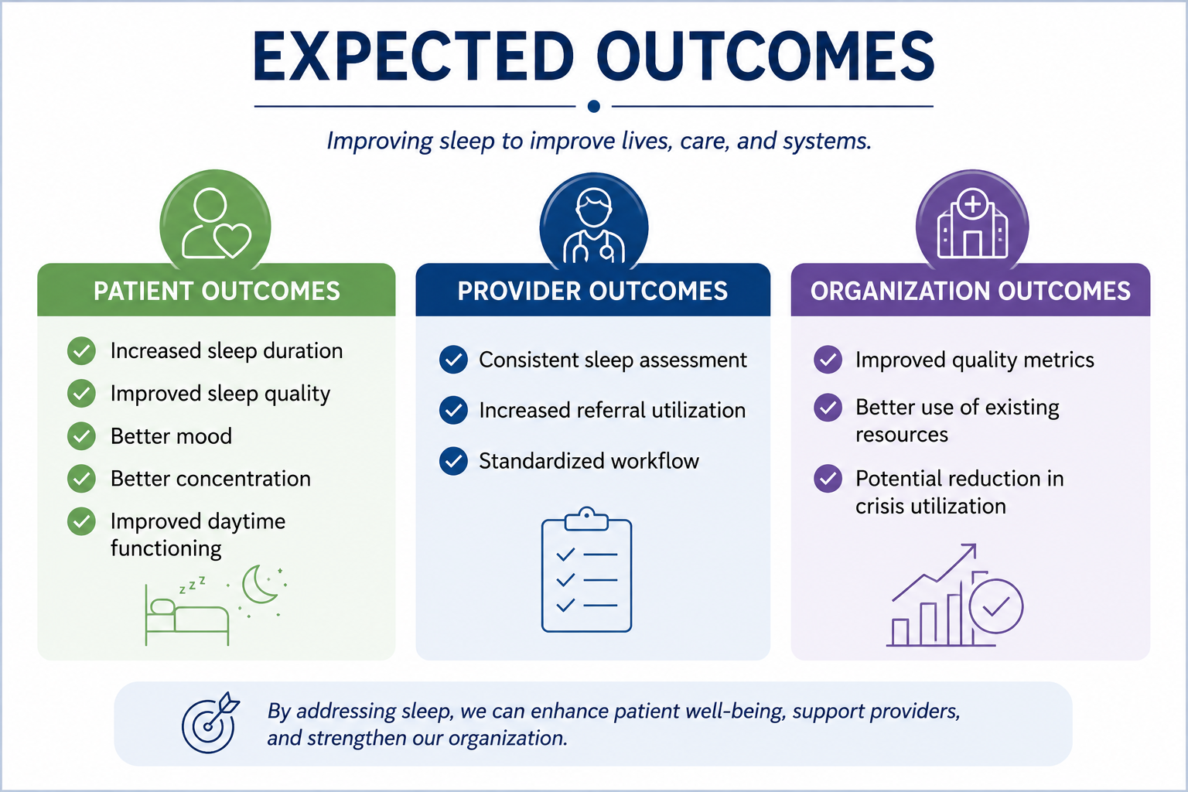

Slide 9
