Slide 1
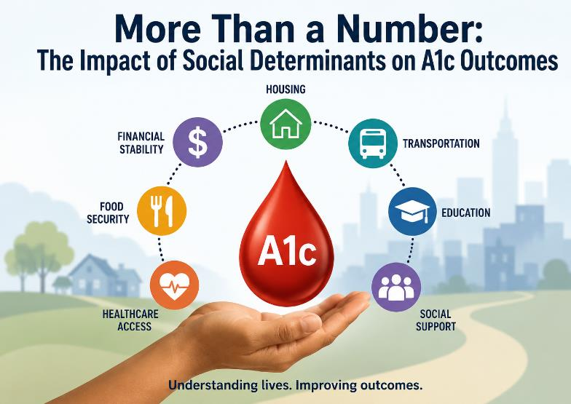
A1c & Life Circumstances: The Hidden Connection
Presented By: DePaul Community Health Center’s NP Residents: Stephanie Haiko, Paige Roberts, Krystal Rosette, Lucienne Sims
June 11, 2026

Slide 2

Understanding the Chosen Problem
Issue Overview
  The project addresses poor diabetes control among patients with Type 2 Diabetes Mellitus, specifically those with an A1c greater than 9% or who have not completed A1c testing follow up. The project aims to improve glycemic control through timely follow-up, patient education, and targeted interventions.
  Significance
  Uncontrolled diabetes increases the risk of serious complications, including cardiovascular disease, kidney failure, neuropathy, retinopathy, hospitalization, and premature death.
  Research Focus
  This project focuses on identifying barriers that contribute to poor diabetes control, including missed follow-up appointments, limited diabetes education, social determinants of health, transportation challenges, and inconsistent patient outreach. The project will evaluate whether implementing a structured follow-up process, enhanced patient engagement strategies, and care coordination interventions can reduce the percentage of patients with an A1c greater than 9% and improve overall diabetes outcomes.

Slide 3

Structured Aim Statement
Clear Objective
To reduce the percentage of patients with an A1c > 9% or untested from 35.2% to less than 30% within 6 months.

Slide 4
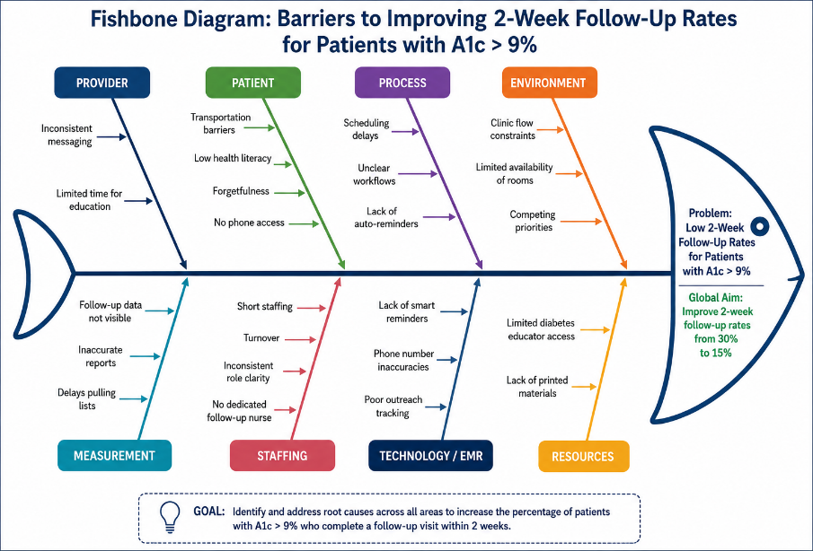
Fishbone Diagram

Slide 5
Stakeholders
Stakeholder | Role
Patients with A1c > 9 | Primary beneficiaries
Nurse Practitioners & Physicians | Treatment and follow-up management
Registered Nurses/Care Coordinators | Outreach and education
Medical Assistants | Screening and patient reminders
Scheduling Staff | Appointment access
Quality Improvement Team | Data tracking and monitoring
Diabetes Educator | Self-management support
Population Health Team | Registry management and outreach
IT/EMR Team | Reminder systems and reporting
Leadership Team | Resources and project support
Community Organizations | Address social determinants of health

Slide 6
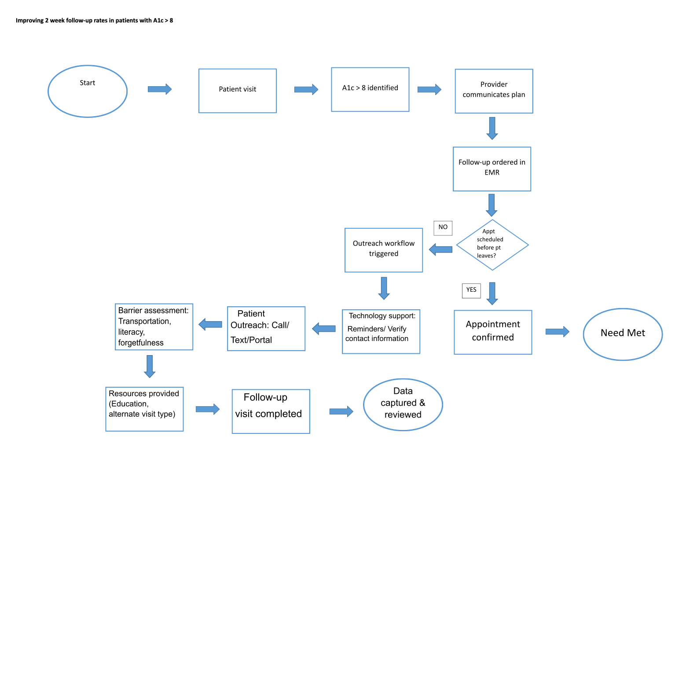
FlowChart

Slide 7
Melanie Murray, Quality Project Manager
Factor/Barrier | Description
Follow-up Appointments | Patients find returning for a 2-week follow-up time-consuming and unclear regarding costs.
Access to Fresh Produce | Economic issues and limited access to healthy food options affect adherence.
Patient Motivation | Patients want to understand benefits and may require incentives for participation.
Lab Test Compliance | DePaul patients tend to adhere to lab tests when they visit the facility.
Group Visit Attendance | Declining attendance possibly due to promotion, appointment timing, referrals, and location.
Communication Methods | Text messaging is effective; phone calls are often flagged as spam.
Provider Influence | Recommendations from PCPs increase patient participation and trust.

Slide 8

Understanding the Data Collected During Improvement Efforts
Initial Approach: surveying patients seen in clinic
Best Approach: Utilizing Azara to track measures and track patients with an A1c >9.

Slide 9
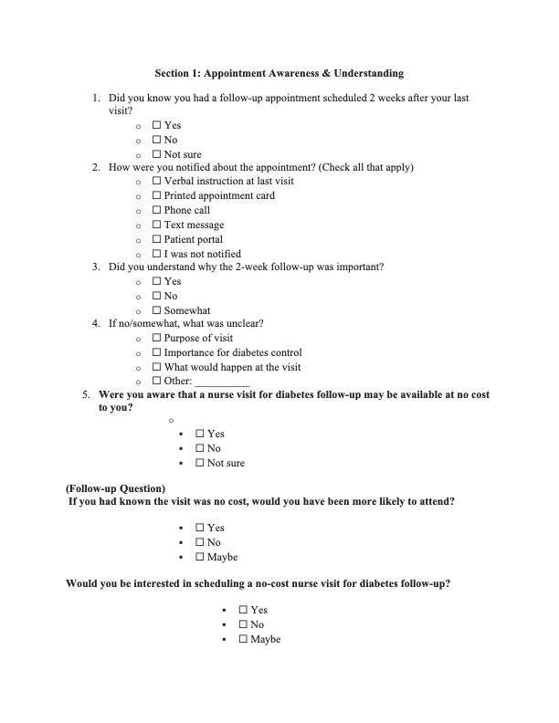
Data Collection Effort
Notes:
Low census
ICE
Not enough qualifying patients

Slide 10
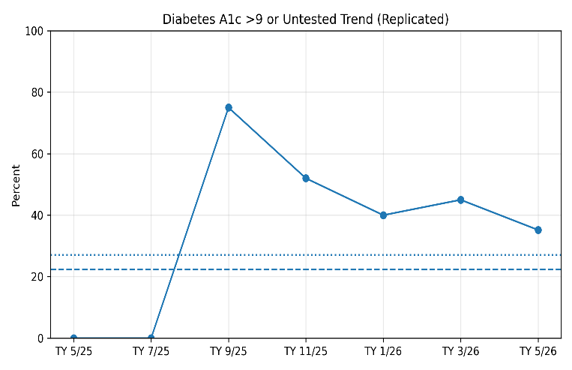
Cohort Data
Center Avg 22.4%
Network Avg 27.1%
Best Center 14.5%
NP Resident Cohort 35.2%
Notes:
Azara Healthcare is a population health management and analytics platform that integrates data from the electronic health record to support quality improvement, patient outreach, and performance reporting. It provides real-time dashboards and reports that help healthcare organizations identify care gaps, monitor clinical outcomes, and improve compliance with quality measures such as diabetes management, hypertension control, and preventive screenings.

Slide 11
Suggested Implementations for Diabetes Management
Implementation Step | Description
Implement routine SDOH screening | Screen all diabetic patients for social determinants of health (SDOH) to identify barriers to effective management.
Develop a high-risk diabetes registry | Create a registry to monitor patients with A1c levels greater than 9% for targeted interventions.
Establish follow-up call program | Set up a system to follow up with patients who have uncontrolled diabetes to improve outcomes.
Create referral process for social barriers | Standardize referrals for food insecurity and transportation issues to connect patients with support services.

Slide 12
PDSA Cycle Timeline
Plan
- Identify high risk patients.
- Call patients to identify their barriers.
- Offer solutions (transportation, free RN visits, scheduling assistance, telehealth)
Do
- Contact identified patients.
- Schedule follow up appointments.
Address barriers to care.
- Provide diabetes education.
Study
- Expected: Reduced A1c rate; improved A1c outcomes; 50% or more schedule a follow up
- Observed: More patient scheduled visits; No show rates decreased
Act
- Flexible Scheduling/telehealth
- Verify contact info r/t automated SMS reminders
- Enhanced A1c materials
- Refer to RN/Diabetes class
.

Slide 13
Key Factors Affecting Diabetes Outcomes
Factor | Impact on Outcomes | Potential Intervention | Remarks
Homelessness | Poorer diabetes control | Provide housing support or stabilization services | Critical to address basic needs first
Food Insecurity | Poor management and outcomes | Nutrition assistance programs or food support | Improves ability to follow dietary recommendations
Transportation Challenges | Missed appointments and medication adherence | Transportation services or telehealth options | Enhances access to care and medication
Medicaid Dependence | Limited access to resources | Policy advocacy to expand access | Addresses systemic barriers
Notes:
Key takeaways: Social determinants strongly influence diabetes outcomes. Patients experiencing homelessness, food insecurity, transportation challenges, and Medicaid dependence demonstrate the poorest outcomes. Targeted interventions addressing social needs may improve diabetes control more effectively than medication adjustments alone.

Slide 14

Project Results and Insights
Key Findings
  Social determinants significantly impact health outcomes, highlighting the need for holistic approaches.
  Patients with three or more chronic conditions experience increased treatment burden, competing healthcare priorities, and greater difficulty adhering to recommended diabetes follow-up visits.
Challenges Faced
  Inaccurate patient contact info, inconsistent practices across locations hindered progress, continuity of care, & decreased in-person visits also posed issues.
Success Factors & Lessons
  Collaboration, adaptability, and addressing social factors are crucial for success; continuous learning enhances project effectiveness.
Notes:
Financial hardship (can’t take time off of work; no insurance coverage)
Low health literacy, Transportation issues, Food insecurity, Fear/denial

Slide 15
Next Steps and Implications for Diabetes Care Improvement
What are the recommended next steps to improve diabetes management? | Continue routine screening for social determinants of health, expand community resource referrals, and monitor A1c outcomes quarterly.
How can we enhance patient outreach and engagement? | Strengthen patient outreach through follow-up calls, reminders, and coordinated care efforts.
What strategies can be used to refine diabetes intervention programs? | Strategies such as enhanced care coordination, routine SDOH screening, targeted patient education, medication optimization, and continuous PDSA cycles can improve patient engagement, reduce barriers to care, and ultimately improve glycemic outcomes.
Why is it important to monitor A1c outcomes regularly? | Regular monitoring helps evaluate the effectiveness of interventions and guides necessary adjustments for improved patient health.
Notes:
Free RN visits, Diabetes Education Classes (locations, times, frequency), pharmacy with lower priced medications.
Diabetes intervention programs can be refined by adopting a patient-centered, data-driven approach that addresses both clinical and social determinants of health.

Slide 16

Limited Use Despite Available Support Options
Diabetes Education classes (St. Cecelia, Carrollton, Metairie, Harvey, New Orleans East, Gentilly)
In-House Pharmacy (Highly discounted meds/delivery services)
Free Nurse Visits
Notes:
Diabetes Education classes offered at multiple sites 1-2 times per month. Led by nurses. Providers are available during the sessions. At the end of the class, behavioral health comes in and leads a group with them as well.

Slide 17
Lessons Learned and Future Strategies
Start Data Collection Early
Begin collecting baseline Social Determinants of Health (SDOH) data at the initial stages to inform planning and interventions.
Engage Stakeholders from the Beginning
Involve patients and staff early in planning discussions to identify barriers and develop effective solutions.
Prioritize High-Risk Patients
Focus initial efforts on patients with the highest risk, such as those with A1c >9% and documented social needs, to maximize impact.
Standardize Workflows and Referral Processes
Develop and finalize workflows and referral procedures prior to implementing interventions to ensure consistency and efficiency.
Allocate Extra Time for Data and Evaluation
Include additional time for collecting data and measuring outcomes to properly assess the effectiveness of the efforts.

Slide 18
Advice for Future NP Residents
Test changes on a small scale using PDSA cycles before expanding interventions.
Be flexible and willing to adjust your approach based on results.
Remember that meaningful improvement often occurs through small, incremental changes rather than one large intervention.
Engage stakeholders, including providers, staff, and patients, throughout the process.
Use available data to identify the root causes of performance gaps before implementing changes.
Start early and define a clear, measurable project goal.

Slide 19

References Overview
American Diabetes Association Professional Practice Committee. (2025). Standards of care in diabetes—2025. Diabetes Care, 48(Supplement_1). https://diabetesjournals.org/care/issue/48/Supplement_1
Devkota, B. P. (2025, October 20). Hemoglobin A1c testing. Medscape. https://emedicine.medscape.com/article/2089224-overview

Slide 20

Thank you for listening to our presentation

