Slide 1


HYPERTENSION CONTROL
A System-Level Challenge
Mary Lily Kimatu, FNP-C
Kelly Savitri, FNP-C
Eric Goldstein, FNP-C

Slide 2

HYPERTENSION CONTROL
Literature Review: Barriers to Effective BP Control
Provider-Level: Therapeutic Inertia
Failure to escalate treatment when blood pressure remains above goal despite clear clinical indications.
Occurs in 33–87% of encounters with uncontrolled BP.
Driven by concerns about side effects, competing priorities, guideline complexity, and perceived nonadherence.
The AHA identifies clinician inertia as a major contributor to poor BP control.
Patient-Level Barriers
Medication nonadherence affects ~53% of patients on multiple antihypertensives.
Barriers to additional lifestyle modification include low health literacy, stress, and limited home BP monitoring.
Health System Barriers
Lack of standardized BP measurement and treatment protocols.
Limited team-based care, clinical decision support, and hypertension registries.
Insufficient clinician feedback, QI infrastructure, and insurance reimbursement for non-physician team members.
Racial, Ethnic, and Socioeconomic Disparities
BP control lower among Black, Hispanic, and Asian adults than White adults.
Social determinants account for a substantial portion of disparities.
Persistent gaps reflect adherence barriers, environmental factors, discrimination, and structural inequities.
Notes:
Frame Kaiser as one instructive example, not the only model. The registry was foundational. Single-pill combination therapy was a key inflection point. Team-based care freed physician time and enabled systematic follow-up. Results: Kaiser nearly doubled control rates while the nation improved modestly. The safety-net adaptation proves elements can be exported. The 2025 guidelines have codified this approach. Sources: Jaffe et al., JAMA 2013; Sim et al., Can J Cardiol 2014; Harrison et al., JAMA Netw Open 2023; Fontil et al., Circ CQO 2018; 2025 AHA/ACC Hypertension Guideline.
Limited reimbursement restricts implementation of evidence-based, team-based care shown to improve blood pressure control.

Slide 3
HYPERTENSION CONTROL
Landmark Success Story: Kaiser Permanente's System Redesign
Starting Point (2001): BP control ~44% (2.3 mil. members) no standardized algorithm / performance feedback
Ground Up Redesign — Six Core Elements
1. Population-level hypertension registry — track every uncontrolled patient
2. Standardized treatment algorithm — reduced clinician-level variation
3. Single-pill combination therapy (~2004–2005) — reduce pill burden, improve adherence
4. Team-based care — pharmacists, nurses, MAs for BP checks, follow-up, and titration
5. Performance metrics with continuous feedback across all facilities
6. Targeted equity interventions — culturally tailored outreach, home BP monitoring
Results
- Kaiser Permanente BP control: 44% → 85–87% (2001–2011); national rates over same period: 55% → 64%
- Model adapted to safety-net clinics - improvement across all racial/ethnic groups; Black-White narrowed from ~5–7 to ~2–4 %
Key Point: Kaiser's advantage was data infrastructure and system redesign, not resources. These elements are exportable — 2025 AHA/ACC Guidelines formally recommend team-based care, standardized protocols, and home BP monitoring.
Notes:
Frame Kaiser as one instructive example, not the only model. The registry was foundational. Single-pill combination therapy was a key inflection point. Team-based care freed physician time and enabled systematic follow-up. Results: Kaiser nearly doubled control rates while the nation improved modestly. The safety-net adaptation proves elements can be exported. The 2025 guidelines have codified this approach. Sources: Jaffe et al., JAMA 2013; Sim et al., Can J Cardiol 2014; Harrison et al., JAMA Netw Open 2023; Fontil et al., Circ CQO 2018; 2025 AHA/ACC Hypertension Guideline.

Slide 4
HYPERTENSION CONTROL
Takeaways from 2025 Multi-Society Guidelines
Hypertension: BP ≥130/80 mmHg; Goal BP: <130/80 mmHg for most adults; SBP <120 mmHg for select high-risk patients.
Strong emphasis on lifestyle mods: DASH diet, exercise, weight loss, sodium, and alcohol reduction.
Low-risk Stage 1 HTN: Lifestyle therapy for 3–6 months before medication.
Earlier pharmacologic treatment for patients with diabetes, CKD, CVD, or elevated cardiovascular risk.
Stage 2 HTN (≥140/90): Initiate two agents, preferably as a single-pill combination.
Emphasizes accurate BP measurement, home BP monitoring, use of PREVENT cardiovascular risk calculator.
Promotes team-based care involving providers, nurses, pharmacists, and community health workers.
Updated guidance for pregnancy, older adults, and cardiovascular-kidney-metabolic health.
Developed by AHA, ACC, and partner organizations, building on successful Kaiser Permanente hypertension initiatives; endorsed by AANP, AMA, and 11 partner organizations.

Slide 5
HYPERTENSION CONTROL
HHC 2024 Performance Data
Overall hypertension control was 63.5%, exceeding the 62.0% goal.
Performance varied across teams, ranging from 58.2%–70.0%, with Blue Team and Chicopee below target and Green and Red Teams above target.
From: Medical Team Meeting quality measures (10/15/25 )

Slide 6
HYPERTENSION CONTROL
Conceptual Framework / Rationale for Our QI Project
Successful programs (e.g., Kaiser Permanente) first identified barriers before implementing change.
Barriers differ across clinics / patient populations; effective improvement begins by understanding local challenges and existing strengths.
Our Approach (PDSA – Plan • Do • Study • Act)
Plan: Developed QI-approved surveys for patients, providers, and clinical staff.
Do: Distributed surveys across HHC care teams and patients to capture multiple stakeholder perspectives.
Study: Analyzed responses to identify barriers, successful practices, and opportunities for improvement.
Act: Use findings to prioritize targeted interventions to improve hypertension control.
Transition to Results
The following survey results identify high-yield opportunities to strengthen HTN management at HHC.
Key Point: Like Kaiser Permanente, we first diagnosed our own system by listening to patients, providers, and staff before designing targeted quality improvement interventions.

Slide 7
HYPERTENSION CONTROL
Methodology
Project Design
QI project led by 3 NP residents
Surveys developed for MAs, RNs, providers, pharmacists, patients based on literature-identified barriers
Recruitment
Staff recruited via email, team meetings, and flyers
Patient surveys distributed to adults with hypertension
Data Collection
Staff surveys via SurveyMonkey
Patient surveys distributed at clinic check-in
Data collected for cross-team comparison
Tools
Project-specific surveys informed by literature on:
  Hypertension management
  Treatment adherence
  Workflow and care coordination
  Patient education

Slide 8

Patient Survey
Patient Survey Specific Methodology
Literature-based survey created based on barriers to HTN medication adherence and lifestyle change
Survey refined from 35 questions to 10 questions using QI team, provider, and dietitian feedback
Surveys translated into Spanish and Haitian Creole / reviewed by native speakers w/ medical background
Distributed across Blue, Red, and Green Teams; collected over 2 weeks.
Response data entered into Excel for analysis; no Haitian Creole responses were received.
Language comparisons excluded due to minimal difference in responses and population demographics.

Slide 9
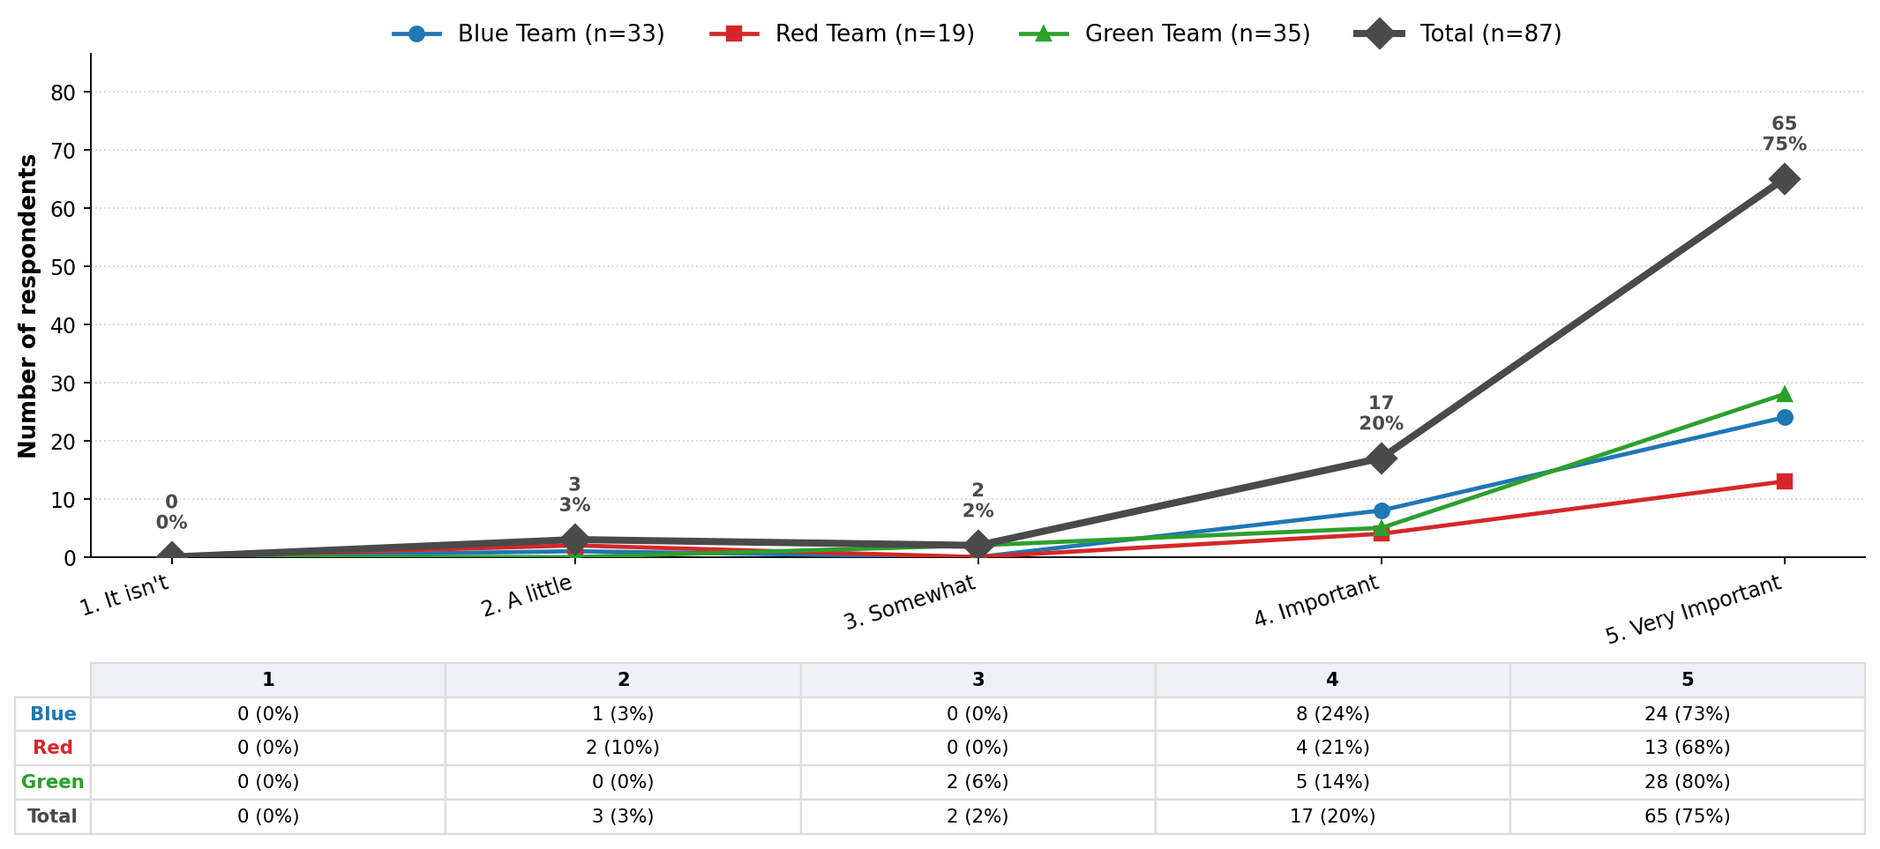
HYPERTENSION CONTROL
1. How important is keeping your blood pressure under control to your overall health?

Slide 10
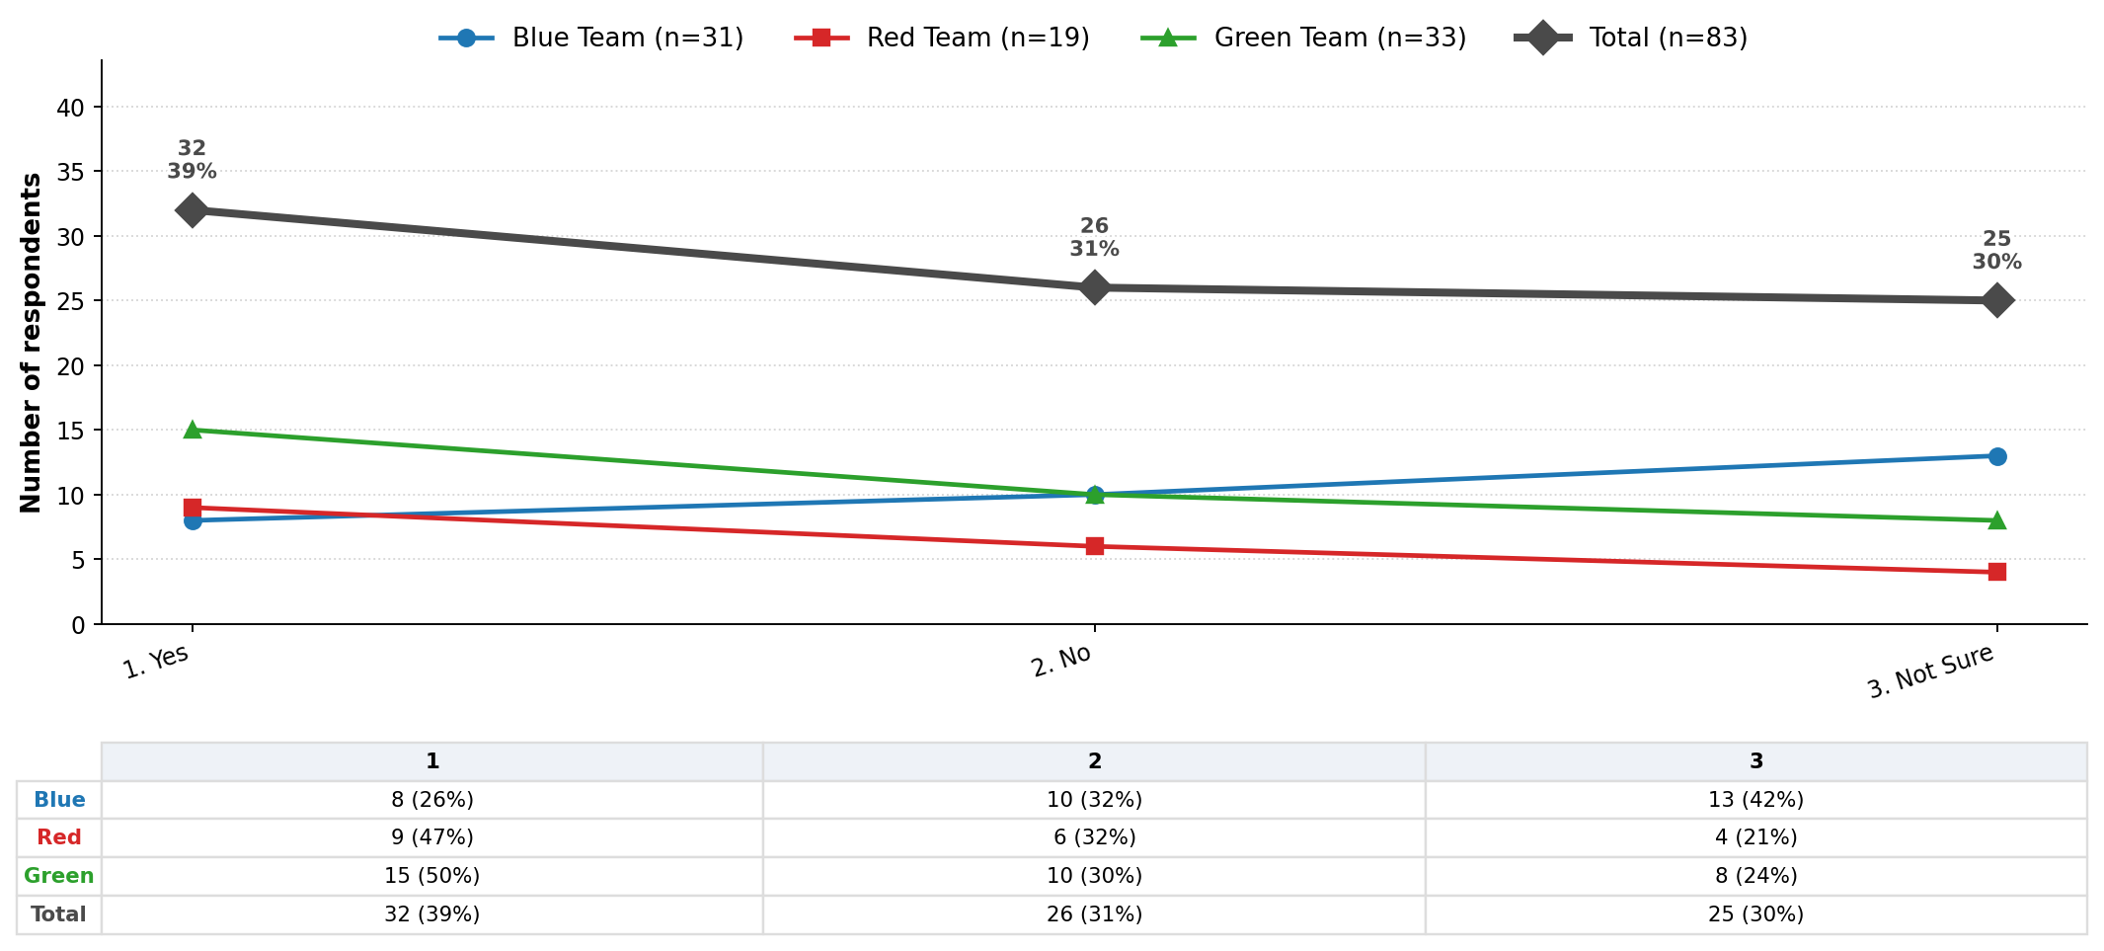
HYPERTENSION CONTROL
2. Do you know what your blood pressure goal numbers are?

Slide 11
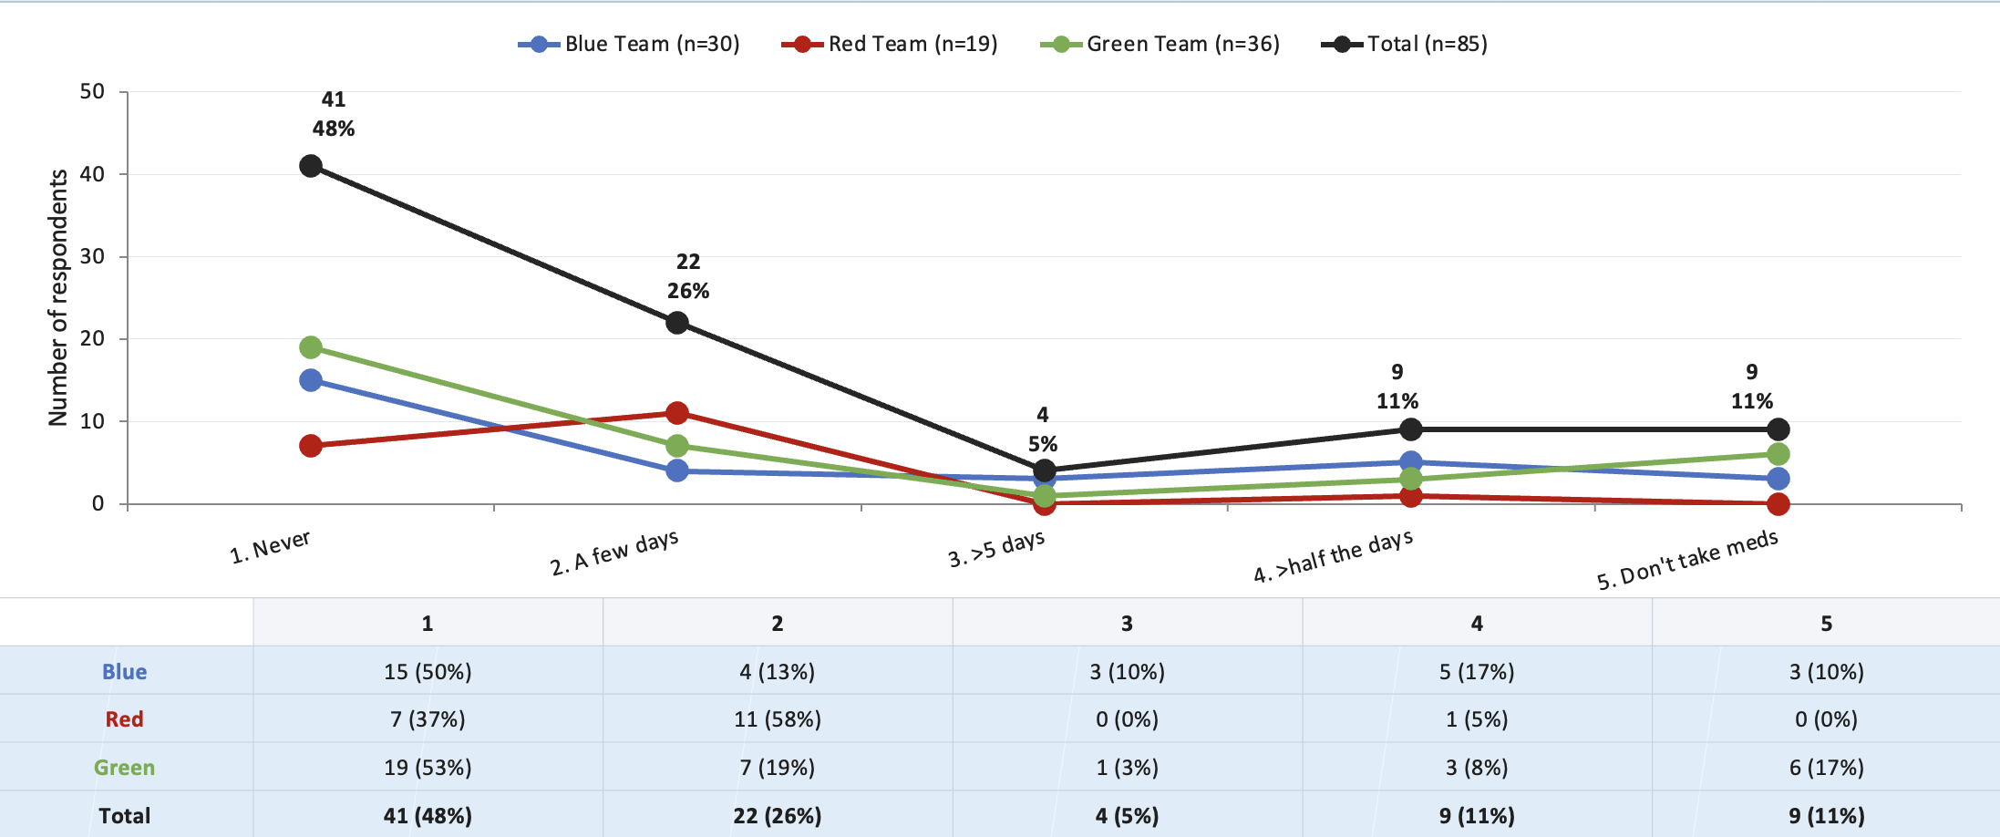
HYPERTENSION CONTROL
3. In the past month, how often did you miss taking your blood pressure medicine?

Slide 12
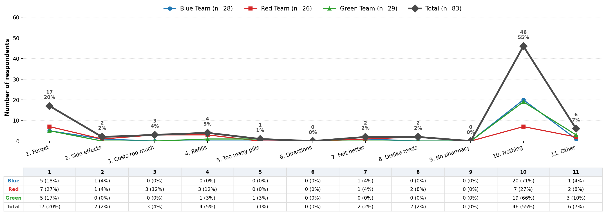
HYPERTENSION CONTROL
4. In the past 3 months, what made it hard to take your BP medicine? (Check all that apply)
Notes:
Other = Stress

Slide 13
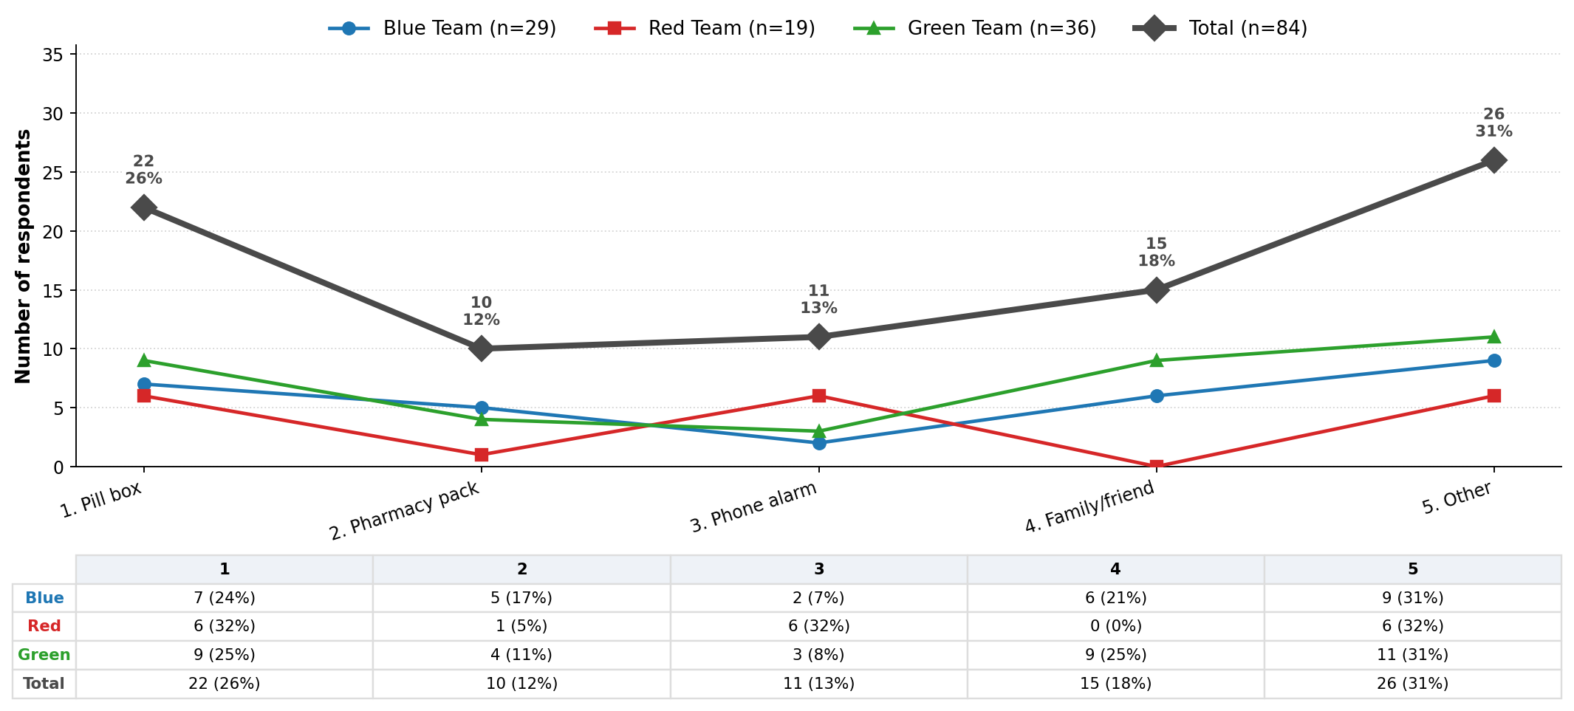
HYPERTENSION CONTROL
5. Do you use anything to help you remember to take your medicine? (Check all that apply)

Slide 14
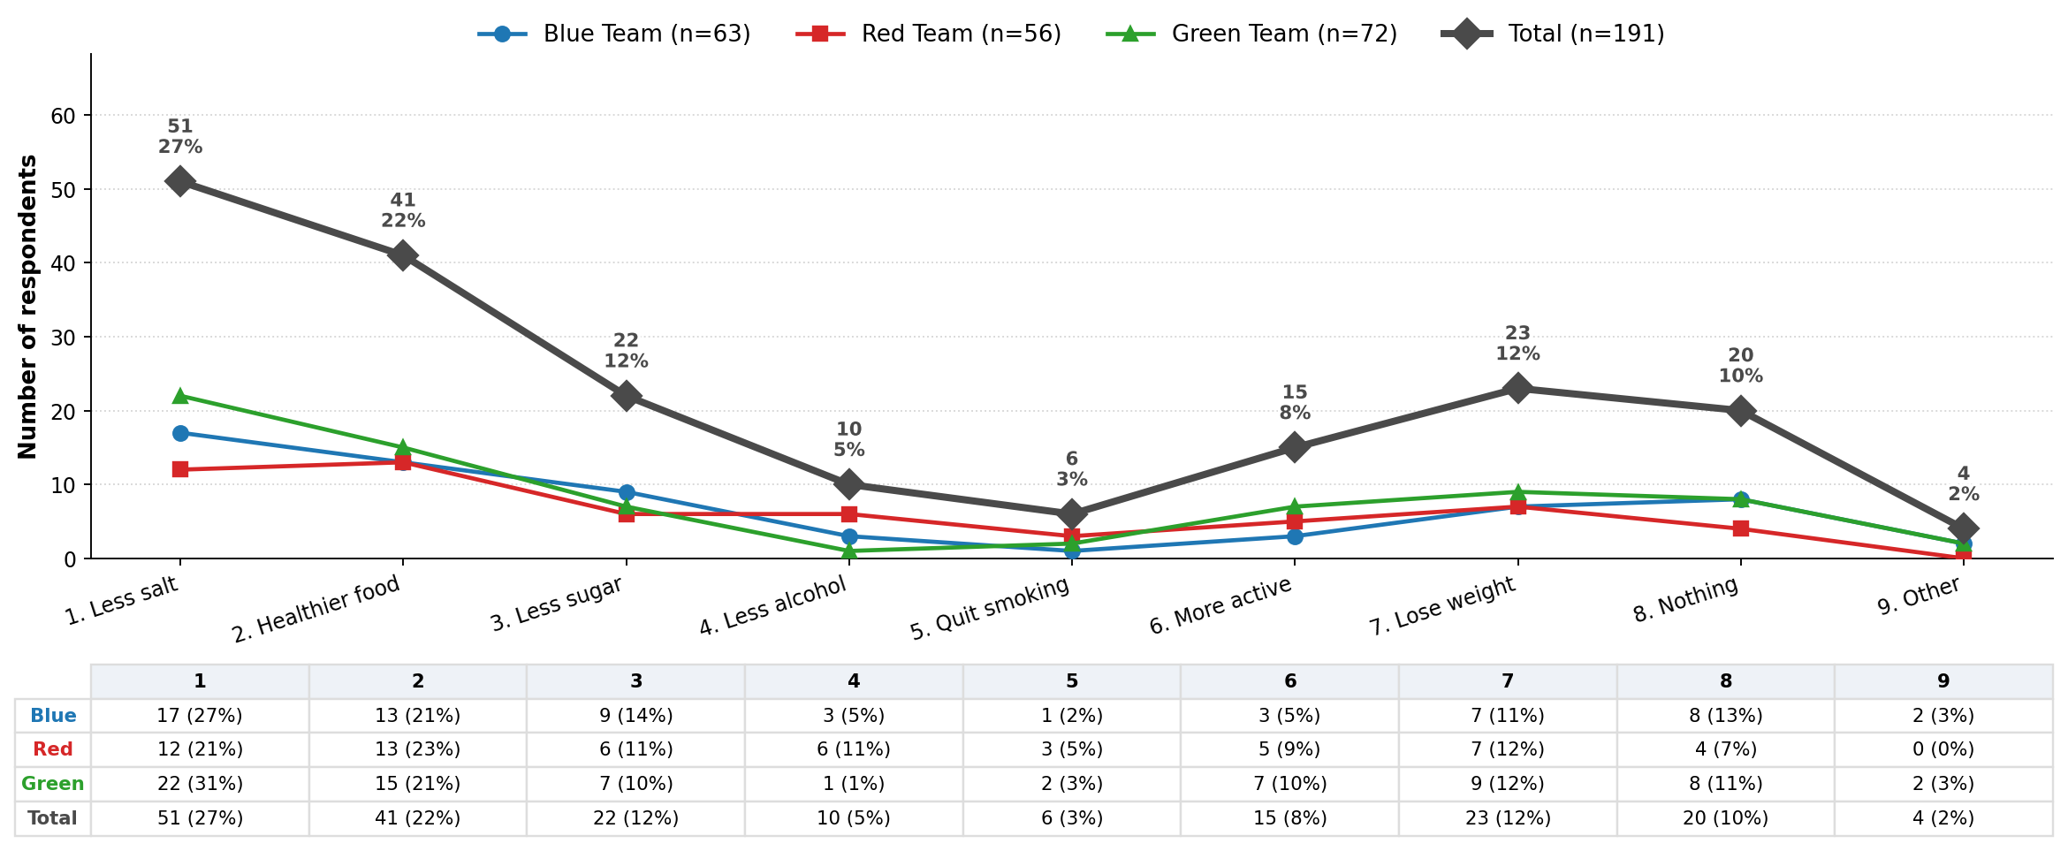
HYPERTENSION CONTROL
6. Besides your medicine, what else do you do to help lower your BP? (Check all that apply)
Notes:
2025 multi society guidelines

Slide 15
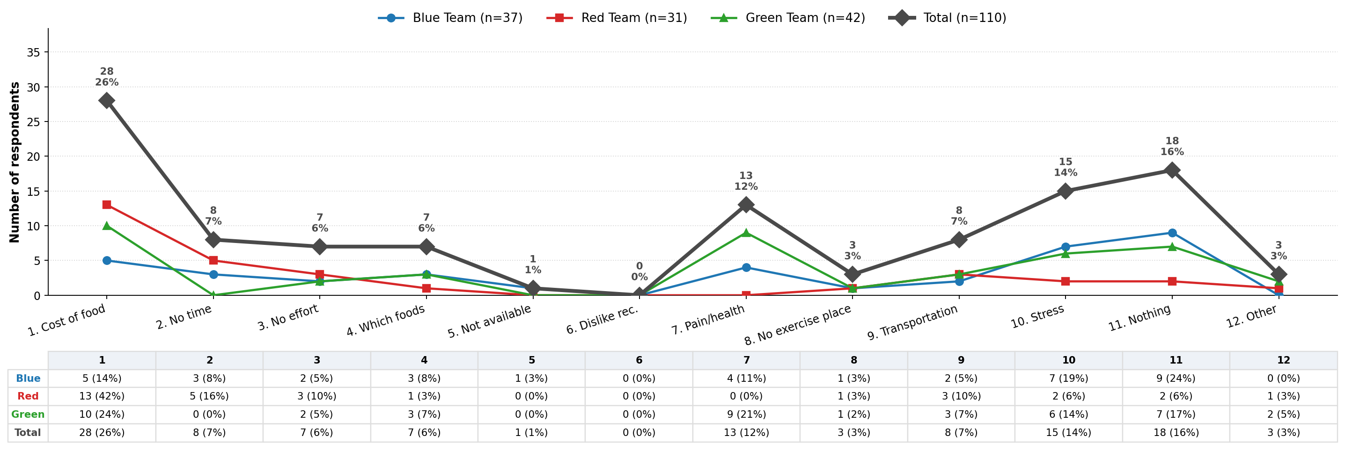
HYPERTENSION CONTROL
7. In the past 3 months, what things have made it hard to live healthy? (Check all that apply)
Notes:
Q6 Salt v Sugar
Q7 Cost, Pain, Stress

Slide 16
BLOOD PRESSURE SELF-MANAGEMENT SURVEY ANALYSIS
Can Education Predict / Affect Behavior?
Ridge-regularized logistic regression: Q1 (importance of BP control) and Q2 (knows BP goal numbers)
predicting Q3 (missed-medication frequency) and Q6 (number of other BP-lowering methods used)
n = 76 respondents

Slide 17
METHODOLOGY
Can Clinical Education Influence Patient Behavior?
EDUCATION
BEHAVIOR
PREDICTOR (Independent Variable)
OUTCOME (Dependent Variable)
Q1: How important is keeping your blood pressure under control to your overall health?
Responses (Ordinal Categories)
•Isn’t, •A Little, •Somewhat, •Important, •Very Important
Q2: Do you know what your blood pressure goal numbers are?
Responses (Ordinal Categories)
•Yes, • No, •Not Sure
Q6: Besides your medicine, what else do you do to help lower your BP?
Responses (Nominal (unranked) Categories)
•Less Salt, •Healthier Food, •Less Sugar, •Less Alcohol, •Quit Smoking, •More Active, •Lose Weight, •Other, *Nothing
Q3: In the past month, how often did you miss taking your blood pressure medicine?
Responses (Ordinal Categories)
•Never, • A few days, •> 5 days, • > half the days; *I don’t take BP meds (disqualifier)
GENERAL
SPECIFIC
Notes:
One methodological note
Standard ridge regression is most naturally applied when the outcome is continuous (or sometimes binary with regularized logistic regression). A nominal categorical outcome with multiple unordered categories is typically analyzed using multinomial logistic regression with ridge regularization rather than ordinary ridge regression. If your analysis plan uses ridge regression, it would be worth clarifying how Question 6 is being coded (e.g., as multiple binary indicators, a single multinomial outcome, or some other encoding), because that affects the appropriate terminology in the methods section.
This is an important conceptual point.
The presence of a "Nothing" response does not automatically make the variable ordinal.
Consider the following responses:
Reduced salt intake
Increased exercise
Checked blood pressure more often
Lost weight
Did nothing
The first four responses are different types of positive health behaviors. While "Did nothing" is qualitatively different, there is still no clear ordering among all five categories. For example:
Is exercising "more" behavior than reducing salt intake?
Is checking blood pressure "less" behavior than losing weight?
There is no defensible ranking, so the variable remains nominal categorical.
What "Nothing" represents
"Did nothing" is best viewed as a reference category or absence-of-behavior category within a nominal outcome.
In behavioral science terms:
The first four responses represent behavioral activation or behavior change.
"Did nothing" represents no behavior change.
The distinction is conceptual, not ordinal.
Why this matters statistically
Suppose you code the responses as:
CodeResponse1Reduced salt intake2Increased exercise3Checked BP more often4Lost weight5Did nothing
The numbers do not imply:
[
\text{Reduced salt intake} < \text{Exercise} < \text{Check BP} < \text{Lose weight} < \text{Nothing}
]
because such an ordering would be arbitrary and scientifically unjustified.
Therefore, the outcome is still nominal.
An alternative interpretation
If your primary research interest is whether education led to any action versus no action, then you could recode the outcome:
Original ResponseRecoded OutcomeReduced salt intakeAction takenIncreased exerciseAction takenChecked BP more oftenAction takenLost weightAction takenDid nothingNo action
Now the outcome becomes a binary behavioral outcome:
Action taken (1)
No action taken (0)
This is often a stronger fit with the underlying research question:
"Did patient education motivate patients to take some health-related action?"
In that formulation, "Did nothing" becomes the logical opposite of all other responses, and the outcome is no longer nominal but binary.
For your study
If Question 6 is intended to measure whether education prompted behavior change, you may want to describe it as:
A behavioral outcome assessing actions taken to improve blood pressure management. Although the response categories are nominal, the "Did nothing" category represents the absence of behavior change and may be analyzed separately or recoded into a binary outcome of action versus no action.
That wording accurately captures both the survey structure and the conceptual role of the "Nothing" response.

Slide 18
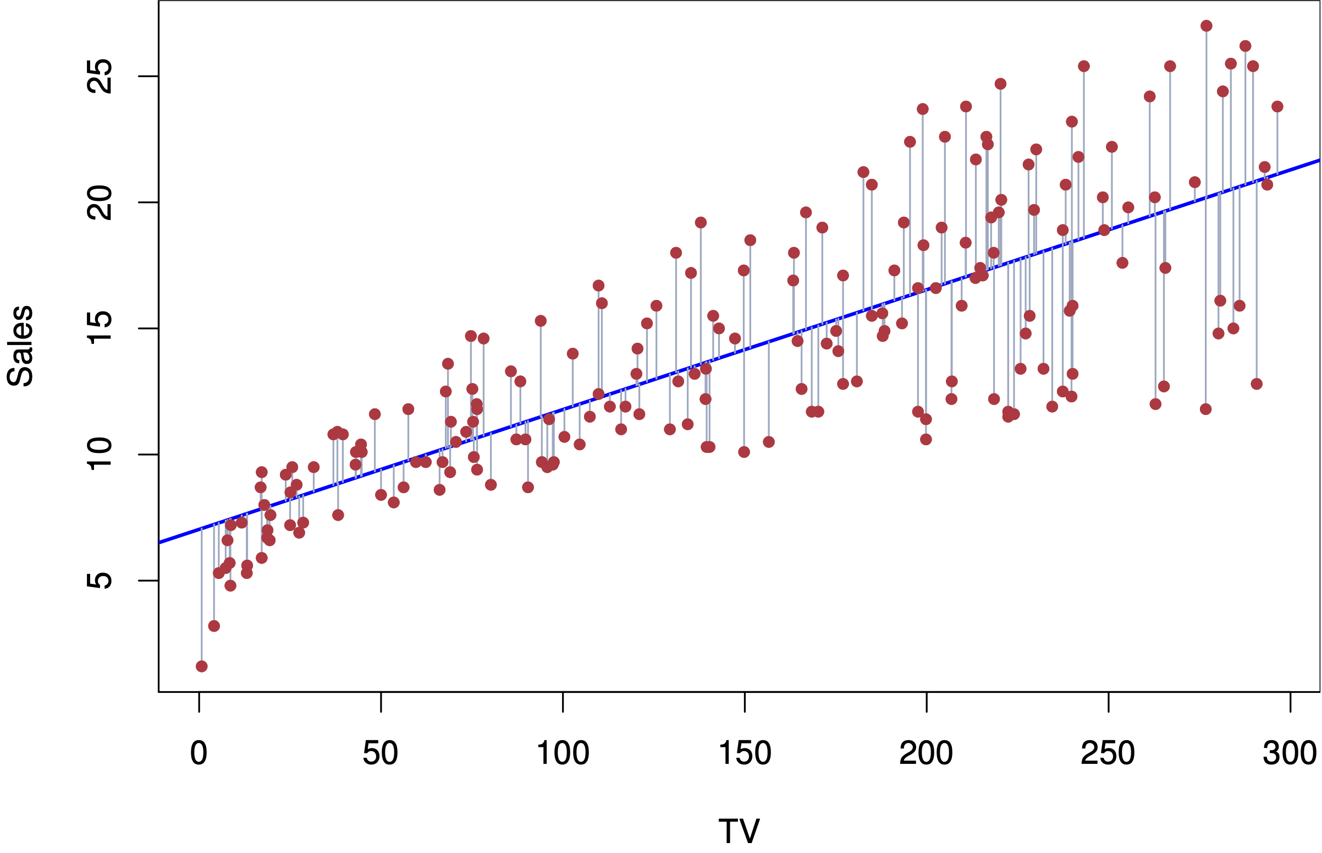
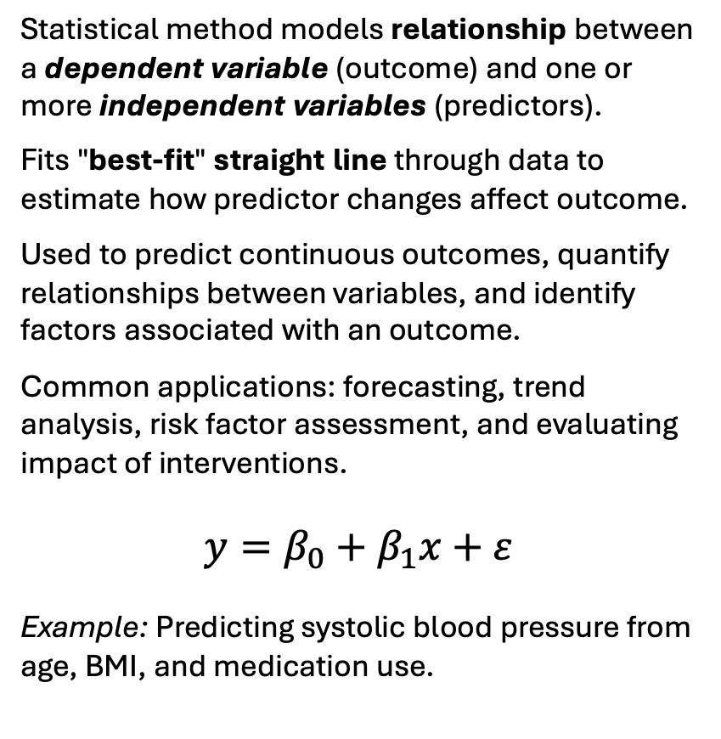
METHODOLOGY: Linear Regression
Statistical method models relationship between a dependent variable (outcome) and one or more independent variables (predictors).
Fits "best-fit" straight line through data to estimate how predictor changes affect outcome.
Used to predict continuous outcomes, quantify relationships between variables, and identify factors associated with an outcome.
Common applications: forecasting, trend analysis, risk factor assessment, and evaluating impact of interventions.
$$y=β_{0}+β_{1}x+ε$$
Example: Predicting systolic blood pressure from age, BMI, and medication use.
Example of Regression Modeling
Notes:
Thought process
Given small data sample (n=76), ordinal/categorical predictors (Q1, Q2), predicting an ordinal outcome (Q3) and a count outcome (Q6 Total) — here are 4-5 alternatives and why they fit less well:
1. Ordinary Least Squares (OLS) Linear Regression The most obvious first try. The problem: OLS assumes continuous, normally distributed outcomes. Q3 and Q6 are discrete counts/ordinal responses, so OLS can predict nonsensical values (e.g., 2.7 missed medications) and its error assumptions are violated. Ridge is just OLS with a regularization penalty — it fixes OLS's tendency to overfit with small samples like yours, making it strictly better here.
2. Logistic Regression Works well for binary outcomes (yes/no). You'd have to collapse Q3 and Q6 into two categories (e.g., adherent vs. not), which throws away information — someone who misses medications occasionally is treated the same as someone who never takes them. Only makes sense if a binary clinical cutoff is what you care about.
3. Ordinal Logistic Regression (Proportional Odds Model) This one is actually a reasonable competitor for Q3 specifically, since Q3 is ordinal. The catch: it assumes proportional odds — that the effect of Q1/Q2 is the same across every level of Q3. With n=76 and only 2 predictors, you have barely enough data to estimate this reliably, and the assumption is hard to verify. Ridge sidesteps this by making fewer structural assumptions.
4. Random Forest / Decision Tree Popular in machine learning, handles non-linearity well. But with n=76 and just 2 predictors, a tree will overfit severely — it'll memorize your 76 participants rather than learn a generalizable pattern. These models need far more data to outperform simple regression. Your R² values (~0.10–0.17) already suggest the signal is weak; a complex model would just add noise on top.
Bottom line: Ridge and Poisson are the sweet spot for your data because they're appropriate for the outcome types (regularized regression for small samples + count-appropriate error structure), make minimal assumptions, and are interpretable — which matters for a research context where you need to explain coefficients, not just predictions.

Slide 19
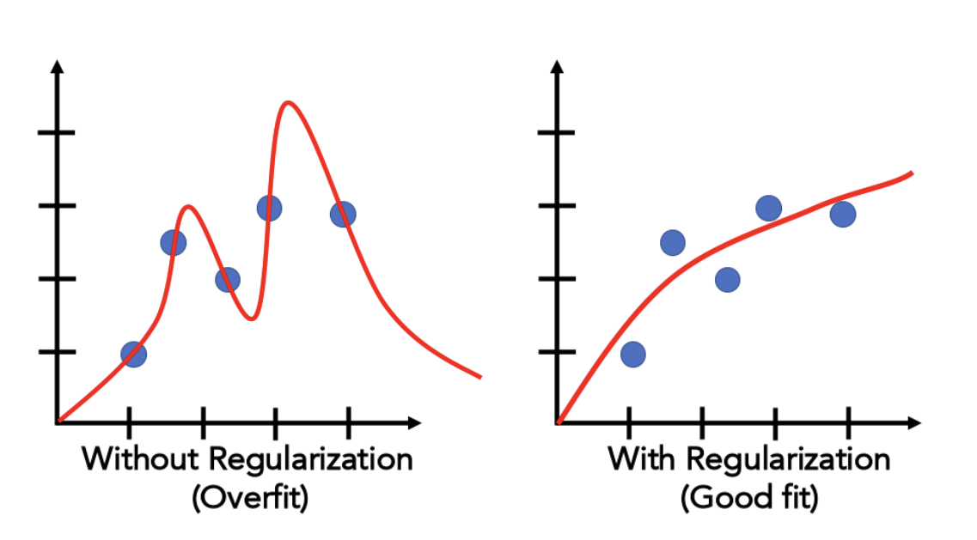
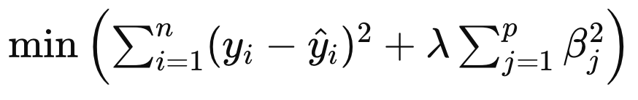
METHODOLOGY: Why Ridge Regression?
● Improves on linear regression by training on data - reducing influence of random noise, increasing prediction reliability in multivariable data sets.
● Small sample: n=76 spread across up to 8 outcome classes (Q6); some < 5 respondents. W/o regularization, coefficients can diverge toward infinity, producing unstable, untrustworthy estimates.
● Ridge adds a penalty (λ = 0.001) on the size of the non-intercept coefficients, shrinking them just enough to keep estimate finite and stable, without distorting genuine effects.
● Q2 encoded as two dummy variables (Q2_No, Q2_NotSure vs. “Yes”) so model can capture “Not Sure” as distinct, non-monotonic effect rather than forcing it onto a single ordered numeric scale.
● Penalty strength chosen (1e-3 (λ = 0.001)) via a sensitivity sweep from 1e-4 to 1.0: Results essentially unchanged below 1e-2, and only over-regularize — erasing real, significant effects — at the high end (1.0). 1e-3 sits in the stable zone for every model in this deck.
● Poisson regression combined with Ridge regression used for Q6 – because it’s a count with some sparse categories.
Ridge Regression (L2) - a Regularization Technique
β (beta) = the weights (coefficients)
λ (lambda) = ↑ penalty strength reduces weights learned from data – reducing their influence.
Goal of regularization: Improve ‘fit’ of data by increasing bias to reduce variance by adding a penalty that scales with model complexity.
Notes:
n = 76; The Ridge Regression Model we used ran the the data comparing input Q1 – Q6, Q1 – Q3, Q2 – Q6, Q2 – Q3 analyzing the data 75 times, then it applied the learning to the 76th survey participant; it learned from this and then it did this 75 more times, varying each time, which participant it acted on – in all the predictor / outcome combinations. From this, it optimized the data
Q6 (number of BP-control behaviors) is a count: Poisson Regression
0 behaviors
1 behavior
2 behaviors
3 behaviors
etc.
Therefore, Poisson regression was appropriate because the outcome is a count.

Slide 20

METHODOLOGY
Chance and the Fair Coin Toss
Chance refers to outcomes that occur randomly and cannot be predicted with certainty.
Fair Coin Example:
Heads = 50% chance
Tails = 50% chance
If a fair coin is tossed many times, heads and tails will occur about equally often.
Connection to p-values:
A p-value estimates how likely an observed result could occur by chance alone— like asking whether an unusual pattern of coin tosses might simply be random luck rather than evidence of a real effect.

Slide 21
KEY FINDININGS: Specific Education Outperformed General Education
Random Chance
McFadden’s Pseudo R² - “Is the model trustworthy?”
R² (correlation coefficient proportion of variance): how much outcome variation can be explained by the predictor(s)
0 – 5% : essentially no relationship
5 – 10% : weak, but real
10 – 20% : reasonable for survey/behavioral data
> 20% : unusually strong
Our models range 1.9–11.9% — Weak to Meaningful, never strong - typical for this kind of data.
Weak Evidence
Moderate Evidence
Suggestive Evidence
Strong Evidence
p-value - measures the probability that the relationship could have occurred by chance.
Each coefficient (e.g., Q1, or Q2_No) gets its own p-value, testing whether that specific effect could be noise.
> 0.50: Consistent with random variation
0.20 – 0.50: Weak evidence; results likely due to chance
0.10 – 0.20: Suggestive evidence, not statistically significant
p < 0.10: marginal / suggestive
p < 0.05: statistically significant — likely a real effect
p-value (probability of chance) measures how strong the evidence is that the observed relationship is real rather than due to chance.
Meaningful
Modest
Weak Value
Notes:
p-value
Interpretation
> 0.50Very consistent with random variation; little evidence of a relationship
0.20 – 0.50Weak evidence; results may easily be due to chance
0.10 – 0.20Suggestive evidence, but not statistically significant
0.05 – 0.10Moderate evidence; often described as a trend toward significance
< 0.05Statistically significant evidence of a relationship
< 0.01Strong evidence of a relationship
< 0.001Very strong evidence; highly unlikely to be due to chance

Slide 22
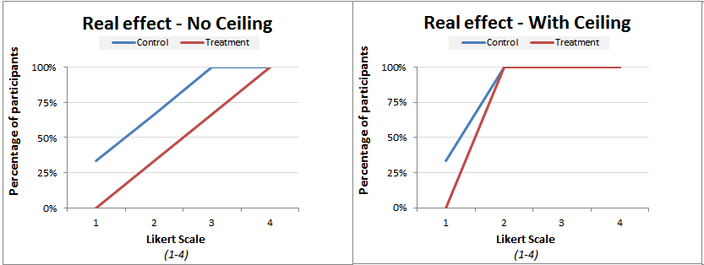
APPLIED QUESTION
Question 1 (Importance of BP Control) and CEILING EFFECT
Approximately 95% of respondents selected "Important" or "Very Important" for Question 1.
This created a ceiling effect (restricted range), with very little variation in responses across the sample.
Because nearly all participants endorsed the highest categories, Q1 had limited ability to distinguish between patients with different levels of medication adherence (Q3) or lifestyle engagement (Q6).
As a result, statistical analyses had reduced power to detect meaningful associations between Q1 and blood pressure-control behaviors.
In contrast, Question 2 (knowledge of BP goal numbers) showed greater variability and was therefore a more effective predictor of medication adherence and lifestyle modification behaviors.
Key Takeaway: When nearly everyone gives the same response, a variable loses discriminatory power and becomes less useful for predicting differences in outcomes.
9

Slide 23
HYPERTENSION CONTROL
Patient Post-Survey Thoughts
Q1's strong ceiling effect (95% positive responses), combined w/ small sample size (n=76), limited ability to detect associations between general BP awareness (Q1) and med adherence (Q3) or lifestyle behaviors (Q6).
In contrast, Q2 (knowledge of BP goal #s) showed greater variability and a clearer relationship with medication adherence (Q3), suggesting specific, actionable education may be more effective than general education.
Patients who didn’t know BP goals (Q2) more likely to miss meds (Q3)and engage in fewer BP-control behaviors (Q6).
Knowledge of BP goal numbers (Q2) associated with greater engagement in lifestyle modification (Q6).
(Q6) Reducing salt (27%) most commonly reported lifestyle intervention; eating healthy (22%) second highest – both in line with the 2025 Multi-society Guidelines. But, reducing sugar/refined carbs only (12%)—which directly addresses obesity, insulin resistance, other underlying metabolic contributors to HTN—was reported less frequently.
Most common barrier to med adherence was forgetfulness; pharm-prepackaged pill boxes appeared to be the strongest adherence measure.
Major barriers to healthy living included food cost (26%), stress (14%), and pain/poor health (12%).

Slide 24

HYPERTENSION CONTROL
Medical Assistants, Nurses, Providers, & Pharmacists

Slide 25
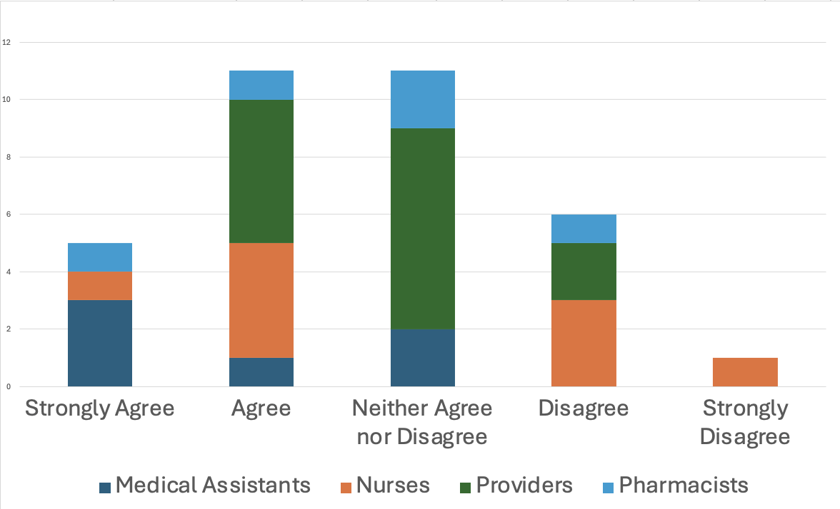
HYPERTENSION CONTROL
Results from: Medical Assistants, Nurses, Providers, & Pharmacists
The clinic has a standardized treatment protocol for hypertension that is available to me.

Slide 26
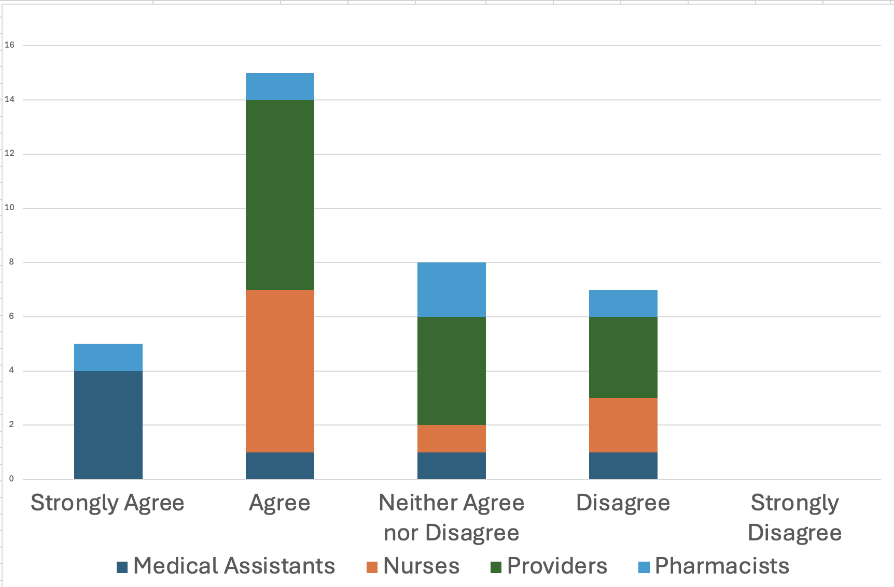
HYPERTENSION CONTROL
Results from: Medical Assistants, Nurses, Providers, & Pharmacists
Blood pressure readings in our clinic are measured accurately and consistently.

Slide 27
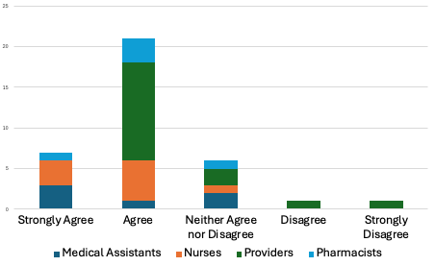
HYPERTENSION CONTROL
Results from: Medical Assistants, Nurses, Providers, & Pharmacists
Patients with uncontrolled hypertension are scheduled for a timely follow-up appointment.

Slide 28
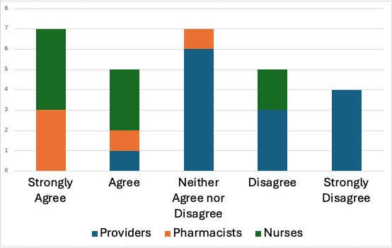
HYPERTENSION CONTROL
Results from: Medical Assistants, Nurses, Providers, & Pharmacists
I have enough time to provide education about lifestyle interventions, medication, and proper BP measurement technique.

Slide 29
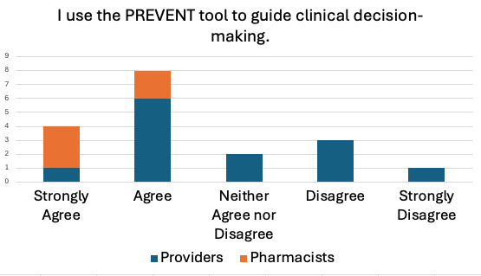
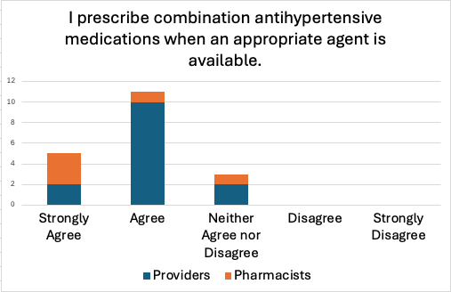
HYPERTENSION CONTROL
Results from: Providers, & Pharmacists
Both providers and pharmacists utilize the PREVENT tool.
Both providers and pharmacists utilize combination antihypertensive medications.

Slide 30
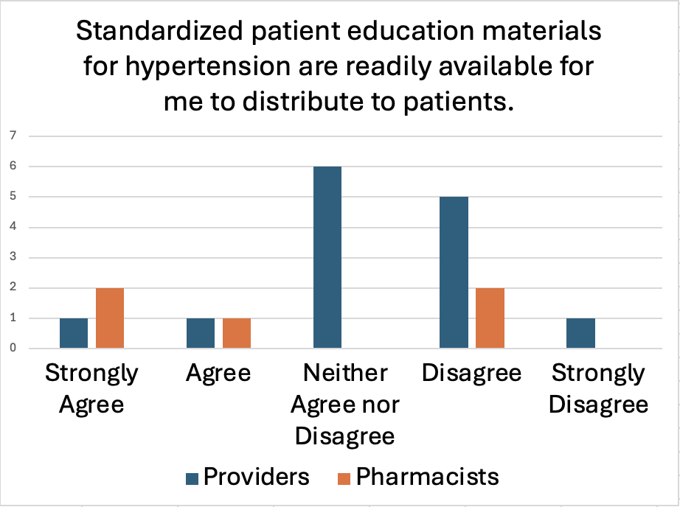
HYPERTENSION CONTROL
Results from: Providers, & Pharmacists
Most providers report a lack of standardized patient education materials for hypertension.

Slide 31
HYPERTENSION CONTROL
Results from: Nurses & Medical Assistants
Medical assistants and nurses are comfortable and confident performing medication reconciliation.

Slide 32
HYPERTENSION CONTROL
Results from: Nurses

Slide 33
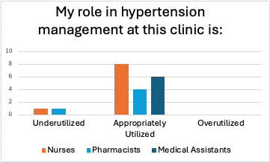
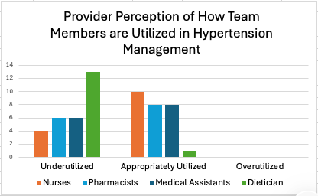
HYPERTENSION CONTROL
Results from: Medical Assistants, Nurses, Providers, & Pharmacists

Slide 34
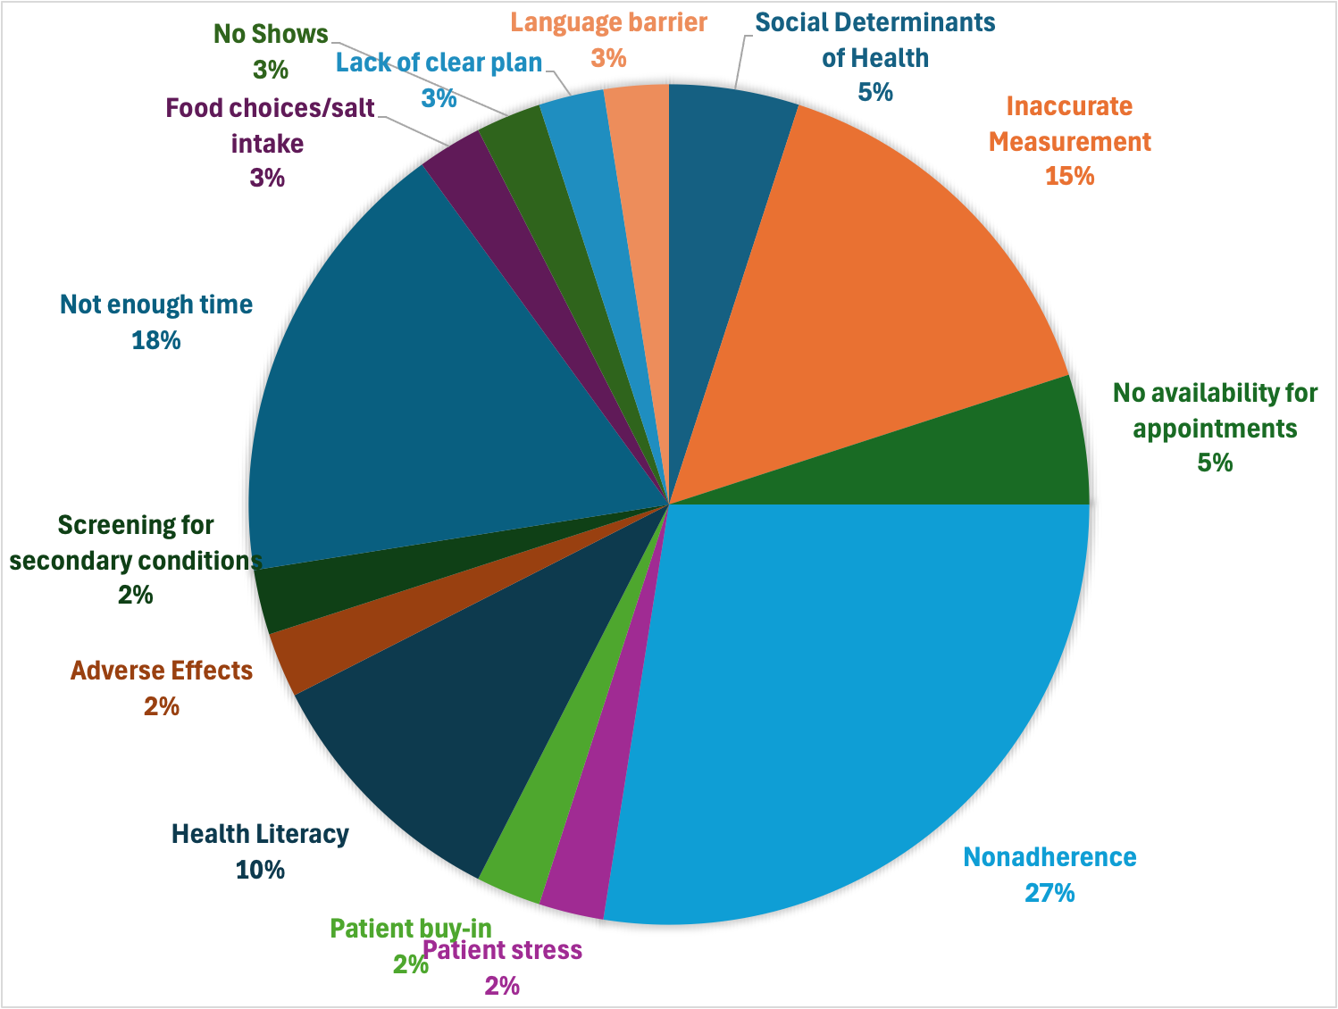
HYPERTENSION CONTROL
Results from: Medical Assistants, Nurses, Providers, & Pharmacists
What is the biggest barrier you face when managing patients with uncontrolled blood pressure?

Slide 35
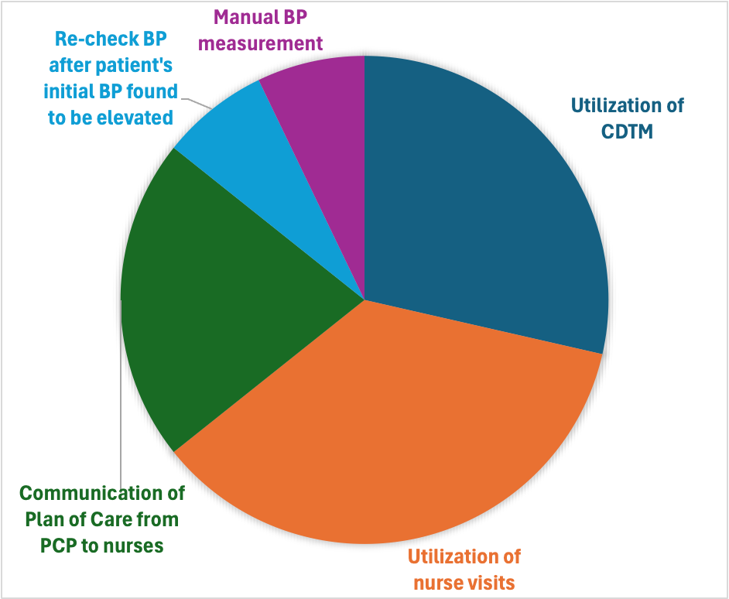
HYPERTENSION CONTROL
Results from: Medical Assistants, Nurses, Providers, & Pharmacists
What part of the hypertension workflow works well in the clinic?

Slide 36
What one change would most improve hypertension management in our clinic from your perspective?
HYPERTENSION CONTROL
Standardized Home BP Logs
Improve BP Measurement Accuracy
UTILIZE CDTM MORE
Group HTN Clinics for Education
Automated BP Machines
Utilize Nurse Visits More
LONGER VISITS
Provider-to-Nurse Communication
Manual BP Measurement
Workflow per Recent Guidelines
Patient Education Outside Visits
Education in Multiple Languages
Remote BP Monitoring
Culturally Sensitive Nutrition Education
Repeat BP Checks in EPIC
Themes from Open-Response Survey Questions Larger = mentioned more frequently

Slide 37
HYPERTENSION CONTROL
Recommendations for Future Practice
Clinic Workflow
Standardize blood pressure measurement technique according to Multisociety Clinical Practice Guidelines
Implement standardized Hypertension Management Guidelines for providers and nurses
Improve communication of hypertension protocols across teams, particularly between providers and nurses.
  Template or Smartphrase

Slide 38
HYPERTENSION CONTROL
Recommendations for Future Practice
Patient Education Interventions
  Culturally appropriate patient education packets in English, Spanish, Haitian Creole
  Customized nutrition information
  Standardized BP logs
  Emphasize metabolic health
  Detailed medication administration instructions
  Group Hypertension Education Sessions
  Greater Utilization of CDTM

Slide 39
HYPERTENSION CONTROL
References
NATIONAL DATA SYSTEM-LEVEL EVIDENCE
- Muntner P, Hardy ST, Fine LJ, et al. Trends in Blood Pressure Control Among US Adults With Hypertension, 1999-2000 to 2017-2018. JAMA. 2020;324(12):1190-1200.
- Fryar CD, Kit B, Carroll MD, Afful J. Hypertension Prevalence, Awareness, Treatment, and Control Among Adults Age 18 and Older: United States, August 2021-August 2023. NCHS Data Brief No. 511. 2024.
- Lee HH, Crawford EB, Cho SMJ, et al. Trends in Prevalence, Treatment, and Control of Cardiometabolic Risk Factors Among Adults With Hypertension in the United States, 1999-2023. J Am Coll Cardiol. 2025;86(25):2577-2593.
CLINICAL INERTIA CARE GAPS
- Phillips LS, Branch WT, Cook CB, et al. Clinical Inertia. Ann Intern Med. 2001;135(9):825-834.
- Ali DH, KiliÃ§ B, Hart HE, et al. Therapeutic Inertia in the Management of Hypertension in Primary Care. J Hypertens. 2021;39(6):1238-1245.
An J, Harrison TN, Ni L, et al. Factors Associated With Treatment Intensification for Uncontrolled Hypertension in a US Health System. J Gen Intern Med. 2025.
DISPARITIES
- Ogunniyi MO, Commodore-Mensah Y, Ferdinand KC. Race, Ethnicity, Hypertension, and Heart Disease. J Am Coll Cardiol. 2021;78(24):2460-2470.
- Lu Y, Liu Y, Dhingra LS, et al. National Trends in Racial and Ethnic Disparities in Antihypertensive Medication Use and Blood Pressure Control. Hypertension. 2022;79(1):207-217.
- Akinyelure OP, Jaeger BC, Oparil S, et al. Social Determinants of Health and Uncontrolled Blood Pressure: The REGARDS Study. Hypertension. 2023;80(7):1403-1413.
- Metlock FE, Hinneh T, Benjasirisan C, et al. Impact of Social Determinants of Health on Hypertension Outcomes: A Systematic Review. Hypertension. 2024;81(8):1675-1700.

Slide 40
HYPERTENSION CONTROL
References Con’t
GUIDELINES SCIENTIFIC STATEMENTS
- Abdalla M, Bolen SD, Brettler J, et al. Implementation Strategies to Improve Blood Pressure Control in the United States: AHA/AMA Scientific Statement. Hypertension. 2023;80(10):e143-e157.
- Jones DW, Ferdinand KC, Taler SJ, et al. 2025 AHA/ACC Guideline for the Prevention, Detection, Evaluation, and Management of High Blood Pressure in Adults. J Am Coll Cardiol. 2025;86(18):1567-1678.
KAISER PERMANENTE PROGRAM
- Jaffe MG, Lee GA, Young JD, Sidney S, Go AS. Improved Blood Pressure Control Associated With a Large-Scale Hypertension Program. JAMA. 2013;310(7):699-705.
- Sim JJ, Handler J, Jacobsen SJ, Kanter MH. Systemic Implementation Strategies to Improve Hypertension: The Kaiser Permanente Southern California Experience. Can J Cardiol. 2014;30(5):544-552.
- Harrison TN, Zhou H, Wei R, et al. Blood Pressure Control Among Black and White Adults Following a Quality Improvement Program. JAMA Netw Open. 2023;6(1):e2249930.
- Fontil V, Gupta R, Moise N, et al. Adapting and Evaluating a Health System Intervention From Kaiser Permanente to Improve Hypertension Management in Safety-Net Clinics. Circ Cardiovasc Qual Outcomes. 2018;11(7):e004386.
PROVIDER / STAFF SURVEY
- Jones, D. W., Ferdinand, K. C., Taler, S. J., Johnson, H. M., Shimbo, D., Abdalla, M., Altieri, M. M., Bansal, N., Bello, N. A., Bress, A. P., Carter, J., Cohen, J. B., Collins, K. J., Commodore-Mensah, Y., Davis, L. L., Egan, B., Khan, S. S., Lloyd-Jones, D. M., Melnyk, B. M., … Williamson, J. D. (2025). 2025
- AHA/ACC/AANP/AAPA/ABC/ACCP/ACPM/AGS/AMA/ASPC/NMA/PCNA/SGIM guideline for the prevention, detection, evaluation and management of high blood pressure in adults: A report of the American College of Cardiology/American Heart Association Joint Committee on Clinical Practice Guidelines. Circulation, 152(11). https://doi.org/10.1161/cir.0000000000001356
- Troy, A. L., Blumenthal, R. S., & Schott, S. (2025). Top 10 prevention takeaways from the 2025 high blood pressure guideline. Nephrology News & Issues, 39(9).
Notes:
We have seen the national problem (Slide 1) and a successful redesign (Slide 2). Now we apply the same principle — diagnose before you treat — to our own practice. The survey captures perspectives from all three stakeholder groups, each of whom sees different barriers. The rest of the presentation walks through those findings.

