Slide 1

STRATEGIC
FOCUSED
Quality Improvement Seminar
Mark Splaine & Ally Chavis
October 8, 2026
RELEVANT
INTERACTIVE
TEAM WORK
INFORMATIVE
FUN
SKILL BUILDING
Nurse Practitioner/Physician Assistant
Residency Training Programs
Notes:
MARK

Slide 2








Welcome!
Notes:
MARK

Slide 3
Session Goals
Learn a bit more about each other
Develop a shared understanding of the seminar series
Discuss a framework for improving care
3
Notes:
MARK

Slide 4
Roles
Moderator
  Mark
Facilitator & Timekeeper
  Emma, Ally
Take-home thoughts report-out
  Ally, Emma & Mark
4
Notes:
MARK

Slide 5
Agenda
Welcome and Introductions (15 minutes)
Seminar information (10 minutes)
Overview of projects (15 minutes)
Break (5 minutes)
Theory burst on QI framework (20 minutes)
Summary and take-home points (15 minutes)
Preview of next session (5 minutes)
5
Notes:
MARK

Slide 6
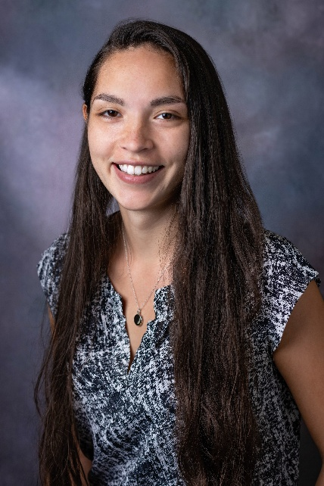

Your Support Team
Ally Chavis, MSW, LCSW
Education Specialist,
Weitzman Institute
Mark Splaine, MD, MS
Quality Improvement
Education Consultant
Notes:
MARK

Slide 7
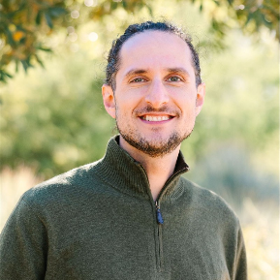
Additional Faculty
Garrett Matlick, DNP
  Clinical Program Director,
  CHC Residency Programs
7
Notes:
MARK

Slide 8
Goals for the Seminars
Provide you with an opportunity to develop the knowledge and skills to improve care
Learn about multiple tools/methods and ways to use them
Create opportunities for you to try these out as a resident (and consider how you might use them in your work after residency)
Understand the concept and importance of high performing teams
Enhance our experience working in an interprofessional environment
Notes:
MARK

Slide 9
Curriculum Plan
  An overview of Quality Improvement (10/8/26)
  Care Observations & Stakeholder Considerations (10/22/26)
  Organizing your Improvement Project (11/5/26)
  Global Aim and Fishbone Diagram (11/19/26)
  Process Mapping (Flowcharts) (12/10/27)
  Measurement to Inform Change (1/14/27 & 1/28/27)
  An Approach to Testing a Change (2/11/27)
  Communication about your Improvement Effort (2/25/27)
  Stakeholder Analysis & Conflict Management (3/11/27)
  Managing Up and Gaining Leadership Buy-In (3/25/27)
  Negotiation (4/8/27)
  Negotiation and More About Cycles of Change (4/22/27)
  Sustaining your Improvement Effort (5/13/27)
  Resident Presentations (5/27/27, 6/10/27, 6/24/27)
Notes:
MARK

Slide 10
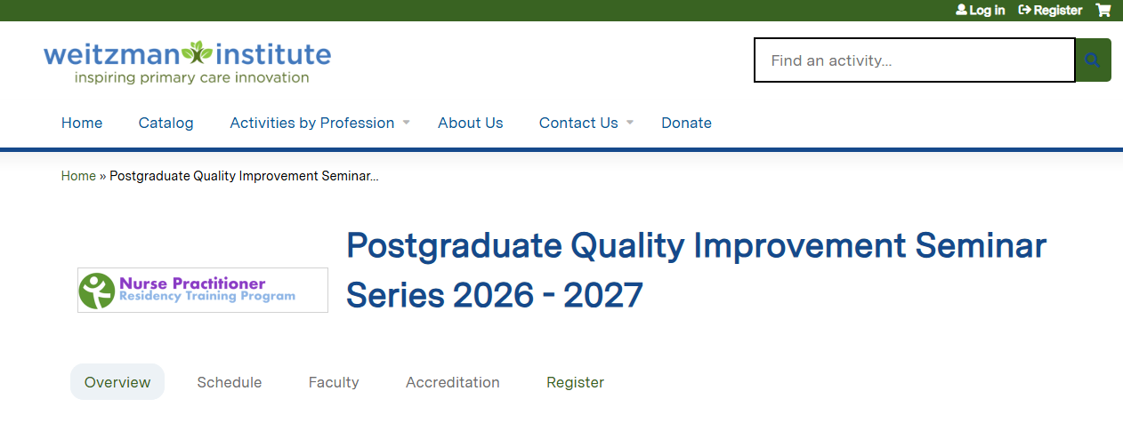
Weitzman Education Platform
Link for video:
https://vimeo.com/1119569445/16321eb95f
10
Notes:
ALLY

Slide 11
Education Credits & Attendance
Each seminar has continuing education credits associated with it
You can earn these credits by:
  Attending the seminar
  Completing the evaluation after the seminar
The seminar team takes attendance
  Make sure your name is visible on Zoom
  If you are attending as a group, use the Zoom chat function to list your group members and site
11
Notes:
ALLY

Slide 12
Introductory Info from You
Survey questions:
  What is a strength you bring to residency?
  What are you passionate about?
  What are you looking forward to learning more about as a clinical provider?
  Have you had any previous experience or exposure to QI initiatives?
  Describe your experience/exposure with QI.
  What do you know about the QI culture at your organization?
  What do you hope to get out of the QI series?
Survey link: https://chc1.iad1.qualtrics.com/jfe/form/SV_bdZt5ijnYYVbp4i
12
Notes:
MARK

Slide 13
Info from Surveys (n=7)
People from 4 organizations
Strengths and passions
  Bilingual, work experience, organized, kindness, positive energy
  Helping underserved, advocacy, equity, connecting, mental health
QI experience (43% said ‘yes’)
  DNP/Masters program, previous work involved QI
Many just starting to learn about QI at their organization
  It exists; alive and active
  It is strongly encouraged and has devoted staff
Thanks for sharing!
Survey link: https://chc1.iad1.qualtrics.com/jfe/form/SV_bdZt5ijnYYVbp4i
13
Notes:
MARK

Slide 14
Poll
Check any of the following that you have done in the past.
  Changed something you do in your clinical work.
  Worked with others or a team to change something in the clinical environment.
  Reviewed data about a group of clients/patients.
  Participated on a committee that discussed operations, safety, quality, client/patient experience.
  Searched for/read about how others (people or organizations) are able to achieve better results in the care they provide
  Discussed the results of the care you provide with a colleague.
  Provided feedback to a colleague regarding something you noticed in the clinical environment.
  Helped a learner understand how care works and described why things are done the way they are done.
  Reviewed and/or implemented an evidence-based practice in
  your work.
14
Notes:
MARK

Slide 15

Reminders About the Series
  Learning is meant to be active and experiential
  Seminars include assignment discussions, theory bursts, and interactive exercises
  Projects are team-based and the topic is chosen by your team of residents (more next slide)
  Resources are available to provide ideas for your project work and to enhance your knowledge/skills
Notes:
MARK

Slide 16

Project Teams
  Project teams are selected by you
    Can be site-based (everyone from one site works on the same topic)
    Can be topic-based (residents from different sites work on a common topic of interest together)
  Team size ideally should be 2-6 people
  Timeline
    Teams should be created by 11/5/26
    Topics should be finalized by 11/19/26
    (by Session IV)
Notes:
MARK

Slide 17
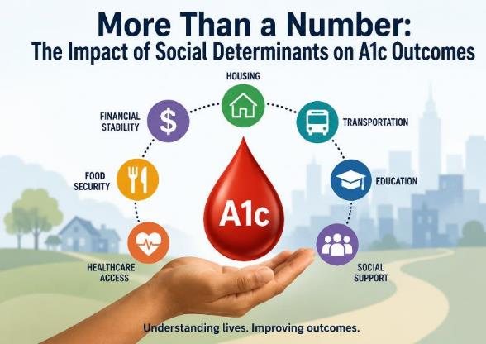
A1c & Life Circumstances: The Hidden Connection
Presented By: DePaul Community Health Center’s NP Residents: Stephanie Haiko, Paige Roberts, Krystal Rosette, Lucienne Sims
June 11, 2026
Notes:
MARK

Slide 18

Improving Provider Self-Efficacy on Pediatric Car Seat Referrals
Seren Carpenter, DNP, APRN, PNP-PC & Becky Jenshke, MSN, APRN, PNP-PC
Notes:
MARK

Slide 19
Improving Continuity of Care for PCPs at Community Health Center
Shenell Johnson & Brenna Keogh
CHC of Meriden, CT
Notes:
MARK

Slide 20
Vaccination Hesitancy:
Tdap
CHC New London:
Kelly Ho
Karen Li
Notes:
MARK
Hello everyone. My name is **** and along with my co-resident ****, we are excited to present our Quality Improvement project, which focused on addressing vaccination hesitancy and increasing adult Tdap uptake right here at our CHC New London site.

Slide 21
Aim Statement
Global Aim: Achieve a 20% increase in Tdap booster administration for the 18–65 age group within the 6-month project period at CHC New London.
Patient Experience: Patient is feeling more prepared to a more efficient clinical encounter, reducing the time the provider spends on basic education.
Provider Experience: Ensuring all the eligible adults (18–65) are identified and educated before the exam starts. This aims to reduce the clinician’s counseling time during the visit, allowing for more complex clinical discussions while maintaining high-quality preventive care."
Notes:
MARK
Now, let’s look at our Global Aim. Our primary performance goal is to achieve a 20% increase in Tdap booster administration for the 18 to 65 age group within this 6-month project period at CHC New London.
But beyond the numbers, we are also focused on the quality of the clinical encounter.
From the Patient Experience perspective, we want patients to feel better prepared for their visit. By providing information early, we reduce the time they spend receiving basic education while on the exam table, making the encounter more efficient.
From the Provider Experience side, the goal is to ensure all eligible adults are identified and educated before the exam even starts. This directly aims to reduce the clinician’s counseling time during the visit. By handling the 'basics' beforehand, it allows us as providers to engage in more complex clinical discussions while still maintaining a high standard of preventive care".
Team Specific Goal:
Increase the acceptance rate of targeted vaccines by 15 percentage points in the cohort that received the proactive educational handout compared to the control cohort (6 months before the project launch).
Decrease the explicit refusal rate for targeted services by 10 percentage points in the intervention cohort compared to the control cohort (6 months before the project launch).
Patient Experience:
Patient is feeling more prepared to a more efficient clinical encounter, reducing the time the provider/RN spends on basic education.
Current Process Steps (for Comparison)
First Step: Patient arrives for the current visit.
Last Step: Provider/RN/MA discusses preventive service at the beginning or the end of the appointment. Patient accepts or refuses.
Revised Process Steps (Intervention)
First Step: PSA/MA identifies patient is eligible for a target service at their next visit.
Next step: PSA/MA provides the low-literacy educational handout with a standardized, brief script.
Next step: Patient reviews information over the next weeks/months.
Last step: Patient arrives at the next appointment. The provider/RN conducts a discussion based on the patient’s pre-existing knowledge and prepared questions, leading to acceptance or refusal.
Areas of Exclusion:
Detailed medical conversations regarding contraindications or complex risk assessments remain the sole responsibility of the clinical provider (MD, DO, NP, PA) and are not a function of the PSA/RN/MA intervention

Slide 22
Influencing Strategy
C = Current
D = Desire
Stakeholder | Current Stance | Desired Behaviors | Short Term Concerns | Short Term Wins
MA | Neutral | Check Tdap status and hand out materials | "Will this make me fall behind schedule?" | Receiving a "Thank you"
Providers | Moderately supportive | Confirms the patient read the handout and orders the shot immediately. | "I don't have 5 minutes to argue with a vaccine-hesitant adult." | Entering a room where the patient says, "I'm ready for that Tdap shot."
Patients | Hesitant | Consent during visit | Lack of prepareness | Empowerment
Notes:
MARK
Moving to our stakeholders, we recognized that the success of this workflow depends on the 'buy-in' of the entire team. We categorized our team into three key groups and developed specific strategies to move them toward our desired outcomes.
For our Medical Assistants: They currently hold a neutral stance. Their primary concern is, understandably, 'Will this make me fall behind schedule?'. To address this, we have asked our Senior MA to demonstrate how the screening and handout process takes less than 20 seconds. The 'win' here is the immediate positive feedback—receiving a 'thank you' from a patient who feels cared for.
For our Providers: They are already moderately supportive but worry about spending extra time arguing with vaccine-hesitant adults within a 20 min visit. Our strategy is to show them the 'win': walking into a room where the patient says, 'I’m ready for that Tdap shot', which will safe our time as a provider.
For our patients. Obviously they are intially lack of the knowledge of the importance of receiving tdap vaccines. Using our strategy of pre-visit education can empowered them to receive the vaccine

Slide 23
Measurement
Materials
Method
- Inability to easily track education delivery
- Educational handout text is too high-literacy/complex.
- No standardized protocol for pre-visit education.
- Lack of timely data feedback on acceptance/refusal rates.
- Handout lacks clear, impactful visuals.
- Education provided only during the visit (time-pressured).
-Acceptance/Refusal not systematically recorded in the EHR/chart
- Handout not given until patient receives the vaccine
-Lack of standardized scripting for staff.
Tdap vaccine hesitancy
- High patient volume/wait times limit staff ability to deliver handout proactively.
- Patient health literacy barriers.
- EHR system does not easily flag patients eligible for the handout.
- Patient cultural/religious beliefs leading to hesitancy.
- Clinical culture prioritizes acute care over preventive outreach.
- No integration to print or send targeted handout automatically.
- Most adults mistakenly believe that Tdap protection from their childhood series is lifelong
Environment
People
Technology
Notes:
MARK

Slide 24
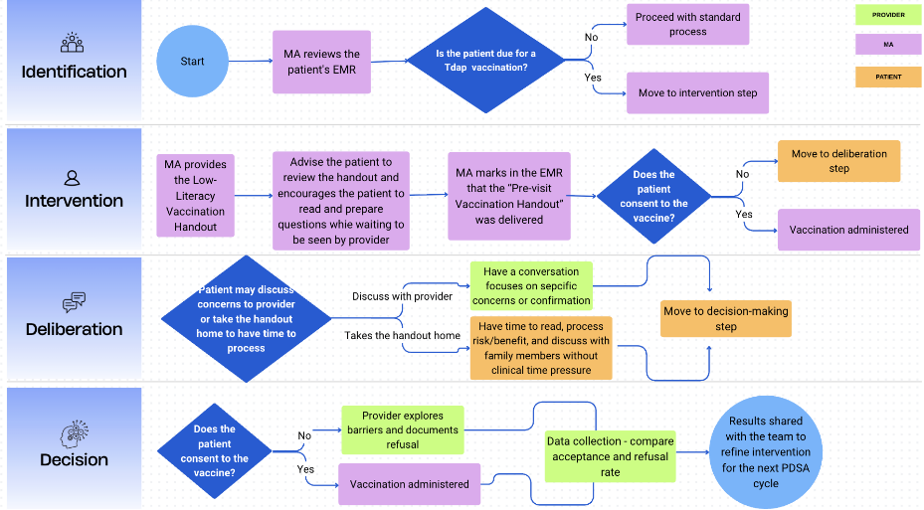
Process Flowchart
Notes:
MARK

Slide 25
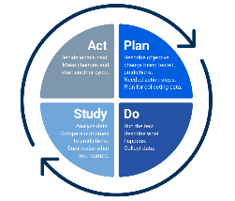
PDSA
AIM:
To test if the pre-visit Tdap educational handout can increase awareness and uptake among adults (18-65).
Describe your first test of change: | Person Responsible
Tdap handout delivery during the rooming process for all adult patients (18-65) seen by one specific provider. | MA
PLAN:
List the task needed to set up this test of change | Person Responsible
Draft & Print Handouts: Print 50 copies of the low-literacy Tdap handout. Daily List Prep: Highlight all patients aged 18-65 on the daily schedule who are overdue for Tdap. Data Record: Place a simple "Yes/No" check-sheet at the room to track handouts given. | MA
Predict what will happen when the test is carried out |  | Measures to determine if prediction succeeds | Person (s) Responsible for Collection of Data
"We predict the MA will be able to deliver the handout to at least 80% of eligible patients without falling behind schedule." "We predict that at least 50% of patients who receive the handout will mention it or ask a question about Tdap when the provider enters the room." |  | Process Measure: Handout Delivery Rate Outcome Measure: Acceptance Rate Balancing Measure: Time added to the rooming process (Self-reported by the MA). | MA & Provider
Notes:
MARK
To put our theories into practice, our primary aim for this test was to see if a pre-visit handout could actually move the needle on awareness and uptake.
For this initial test, we limited the scope to one specific provider's schedule in Pod D. The MA was responsible for three key tasks: printing 50 low-literacy handouts, highlighting eligible patients on the daily schedule, and using a simple 'Yes/No' check-sheet to track every handout given.
We made two specific predictions. First, we believed the MA could achieve an 80% delivery rate without negatively impacting clinic flow. Second, we predicted that at least half of the patients would be 'primed' by the handout and bring it up themselves when the provider entered. To verify this, we tracked our delivery rate as a process measure, the actual vaccination acceptance as our outcome, and used the MA’s self-reported rooming time as a balancing measure to ensure we weren't creating a bottleneck in the clinic."

Slide 26
Results
Initial Data Trends:
While data collection is ongoing, early indicators show that active MA initiation is the primary driver for vaccine acceptance.
The "MA Effect":
We observed a significant increase in patients saying "yes" at the visit when the MA proactively offered the Tdap, compared to the baseline period of passive screening and no EMR alerts.
Barriers & Challenges:
Staffing Transitions: Frequent changes in MA assignments required constant re-education of new staff members to maintain project momentum.
Consistency: Maintaining a steady workflow depends heavily on the individual MA’s familiarity with the project.
Key Learning:
MA-led education is more powerful than any automated alert
Notes:
MARK
"Looking at our results, although we are still in the initial data-gathering phase, the trend is very clear. We’ve noted that once the Medical Assistant initiates the offer of the Tdap vaccine, patients are far more willing to say 'yes' during that same visit. This is a huge shift from our baseline when there were no EMR alerts and MAs weren't prompted to ask.
However, we did encounter some real-world barriers. Specifically, recent changes in MA assignments meant we had to frequently 're-pitch' and re-train new staff on the project. We learned that simply asking the question makes a massive difference in public health outcomes."

Slide 27
Conclusion
Next Steps:
Formally transitioning the project framework to the incoming 2026-2027 residency cohort to ensure longitudinal tracking and continued uptake improvement.
What to do Differently:
If starting over, we would focus earlier on creating a "standardized onboarding packet" for MAs to mitigate the impact of staffing changes and seek ways to automate EMR flags to support the staff.
Advice for Future Residents:
Engage your MAs early
Build in Redundancy: Expect staffing changes. Create simple, written "one-pagers" that any new team member can follow immediately.
Start Small: Focus on one consistent interaction (like the rooming process) rather than trying to change the whole clinic at once.
Notes:
MARK
"As for next steps, we plan to pass this project on to the next residency cohort to ensure continued improvement and data tracking.
In terms of what to do differently, if we were to start this project again, we would focus more on creating a permanent support system within the EMR to help staff, especially when the team changes.
Our advice for future NP residents is this: prioritize your relationship with your MAs. We feel like they are the ones who make these projects move. Also, prepare for a simple handout by having simple, clear instructions ready for anyone new joining to our team, so they understand about our current project. Obviously, QI project just like a marathon, which we would like other sites to join us as a team in the future.

Slide 28



Break!
Take five minutes to recharge and refresh.
28
Notes:
MARK

Slide 29
Models for Improving Care
“All models are wrong, some are useful.”
- George Box
29
Notes:
MARK

Slide 30


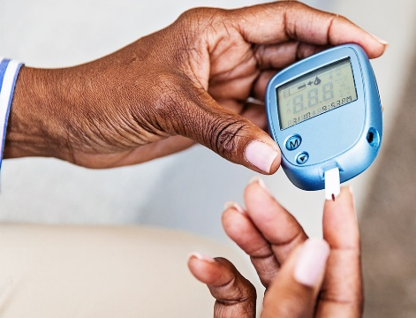
A way to think about the care we provide…
Person w/ Diabetes
Measured Improvement
In Health
Evidence Based
Practice
+
Particular
Patient
30
Notes:
MARK

Slide 31

Linking Evidence to Improvement
Clinic w/ Diabetics
Measured Performance
Improvement
Generalizable Scientific Evidence
+
Particular
Context
Batalden PB, Davidoff F. Qual Saf Health Care. 2007; 16:2-3.
Notes:
MARK

Slide 32
Model for Improvement
What are we trying to accomplish? (Aim)
How will we know that a change is an improvement? (Measures)
What change can we make that will result in improvement? (Change)
Three questions...
…coupled with
an approach for
testing change.
Act
Plan
Study
Do
Langley GJ, et. al. The Improvement Guide (2nd Edition), 2009.
Notes:
MARK

Slide 33
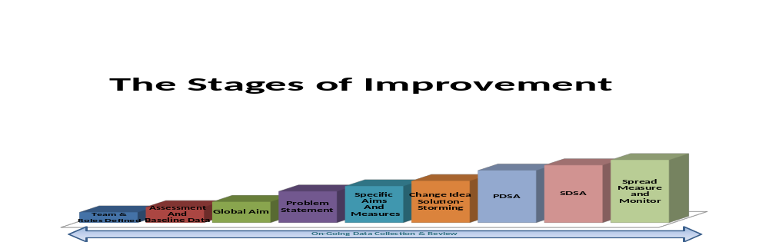
Stages of Improvement
Notes:
MARK

Slide 34
About the Ramp
Adapted from Clinical Microsystems and IHI
A systematic organized approach to improvement that relies on data
Not truly a linear process: often need to step back to get more data or clarify aims before moving forward again
Number 1 mistake: Skipping steps 1-5!
  Everybody has a good idea for how to fix something before understanding why it is happening in the first place.
Notes:
MARK

Slide 35
Tools You Will Use
Project Charter
Global Aim Statement
Fishbone Diagram Template
Process Flowchart Template
Data Display Templates
Stakeholder Analysis Worksheet
Plan-Do-Study-Act Worksheet
Notes:
MARK

Slide 36
Curriculum Plan
  An overview of Quality Improvement (10/8/26)
  Care Observations & Stakeholder Considerations (10/22/26)
  Organizing your Improvement Project (11/5/26)
  Global Aim and Fishbone Diagram (11/19/26)
  Process Mapping (Flowcharts) (12/10/27)
  Measurement to Inform Change (1/14/27 & 1/28/27)
  An Approach to Testing a Change (2/11/27)
  Communication about your Improvement Effort (2/25/27)
  Stakeholder Analysis & Conflict Management (3/11/27)
  Managing Up and Gaining Leadership Buy-In (3/25/27)
  Negotiation (4/8/27)
  Negotiation and More About Cycles of Change (4/22/27)
  Sustaining your Improvement Effort (5/13/27)
  Resident Presentations (5/27/27, 6/10/27, 6/24/27)
Notes:
MARK

Slide 37
Some of you have done quality improvement work previously
Please share an example of something you worked on
Notes:
MARK

Slide 38
What haven’t we figured out yet?
Questions or issues that remain unclear?
Notes:
MARK

Slide 39
Take-home Thoughts
Emma & Mark – share 1 or 2 ideas you will take away from our discussion
Notes:
MARK/GARRETT

Slide 40
Summary
We are using frameworks to guide our thinking about how to organize improvement work
  There are many frameworks/approaches available
  Each framework can be applied to patient care, improvement efforts, and even education
Our seminars together are designed to be interactive
  Your preparation and participation is essential for promoting our shared learning
Getting to know a bit more about each other as well as our sites will help us in our learning
Notes:
MARK

Slide 41
Remember to…
Complete the feedback survey for Session I
If not already done, complete the QI Resident Information Survey
Review list of project topics done by previous teams
Begin talking with colleagues about who you may wish to work with on your project
Notes:
www.clinicalmicrosystem.org
41
MARK

Slide 42
Assignment for Session II
Please do two things:
  Find at least one improvement priority for your organization
  Notice at least one thing at your site that interests you about the way care is provided; is there anything you wonder about in terms of improving care related to what you noticed?
You may work with resident colleagues to generate a composite Notice/Wonder list, or do this individually
Check with leaders/providers/team members at your site to find out about an organization improvement priority
Contact Mark if you have questions or need assistance
Send your Notice/Wonder list to Ally and Mark by Tuesday (10/20/26) at 6pm EDT
Our next session will be on Thursday, 10/22/26
Notes:
www.clinicalmicrosystem.org
42
MARK

Slide 43
References
Batalden PB, Davidoff F. Quality Safety in Health Care. 2007; 16:2-3.
Langley GJ, Moen R, Nolan KM, Nolan, TW, Norman CL, and Provost LP. The Improvement Guide: A Practical Approach to Enhancing Organizational Performance (2nd Edition). San Francisco, CA: Jossey-Bass, 2009.
Notes:
www.clinicalmicrosystem.org
43
MARK

