Slide 1

STRATEGIC
FOCUSED
Quality Improvement Seminar
Mark Splaine & Ally Chavis
October 22, 2026
RELEVANT
INTERACTIVE
TEAM WORK
INFORMATIVE
FUN
SKILL BUILDING
Nurse Practitioner/Physician Assistant
Residency Training Programs
Notes:
MARK

Slide 2
Session Goals
Hear about and discuss many of the things you are noticing and wondering about
Review the evidence for the team-based care approach in primary care
Share some examples of team-based care in your setting
2
Notes:
EMMA

Slide 3
Roles
Theory burst presenter
  Mark
Timekeeper & technical genius
  Ally
Small group facilitators
  Garrett, Ally, Mark
Take-home thoughts
  Mark
3
Notes:
EMMA

Slide 4
Agenda
Welcome and introductions (10 mins)
Assignment small group discussion (30 mins)
Brief break (5 mins)
Theory burst on team-based care (20 mins)
Examples of team-based care (15 mins)
Summary and take-home points (5 mins)
Preview of next session (5 mins)
4
Notes:
EMMA

Slide 5
Curriculum Plan
  An overview of Quality Improvement (10/8/26)
  Care Observations & Stakeholder Considerations (10/22/26)
  Organizing your Improvement Project (11/5/26)
  Global Aim and Fishbone Diagram (11/19/26)
  Process Mapping (Flowcharts) (12/10/27)
  Measurement to Inform Change (1/14/27 & 1/28/27)
  An Approach to Testing a Change (2/11/27)
  Communication about your Improvement Effort (2/25/27)
  Stakeholder Analysis & Conflict Management (3/11/27)
  Managing Up and Gaining Leadership Buy-In (3/25/27)
  Negotiation (4/8/27)
  Negotiation and More About Cycles of Change (4/22/27)
  Sustaining your Improvement Effort (5/13/27)
  Resident Presentations (5/27/27, 6/10/27, 6/24/27)
Notes:
MARK

Slide 6
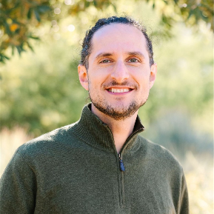
Additional Faculty
Garrett Matlick, DNP
  Clinical Program Director,
  CHC Residency Programs
6
Notes:
MARK

Slide 7
Info from Surveys (n=23)
People from all 8 organizations
Strengths and passions
  Bilingual, work experience, organized, kindness, positive energy
  Helping underserved, advocacy, equity, connecting, mental health
QI experience (78% said ‘yes, have some experience’)
  DNP/Masters program, previous work involved QI
Many just starting to learn about QI at their organization
  It exists; alive and active
  It is strongly encouraged and has devoted staff
Thanks for sharing!
Survey link: https://chc1.iad1.qualtrics.com/jfe/form/SV_bdZt5ijnYYVbp4i
7
Notes:
MARK

Slide 8
Office Hours
Mark will hold office hours for all residents on the 3rd Thursday of each month from 11:30am-12:30pm ET
Mark is available to meet with any resident or team if you need an alternative time – just email to set up a time
8
Notes:
EMMA

Slide 9
More About Projects
Nov-Jan
Charter
Jan-Feb
Data
Feb-Apr
Planning & Making Change
Aim
Fishbone
Stakeholders
Flowchart
Change Ideas
Apr-Jun
  Assess/revise changes
  Collect data
  Prepare presentation
Two expectations – periodic sharing & presentation
As much about the journey as the product
9
Notes:
MARK

Slide 10
Session II Assignment
Now we will focus on your assignment for today’s session
We will divide into two breakout rooms
  Ally and Mark will facilitate the discussion in each room
When in your group please share about either
  A quality improvement priority for your organization
  An example of something you noticed and are wondering about in their clinic setting
Each group will ask for a volunteer to report on highlights of the discussion
After the small group discussion, we will return to the large group to hear each reporter’s summary ideas
10
Notes:
www.clinicalmicrosystem.org
10
MARK

Slide 11
Small Group Discussion
Ally/Garrett’s Group
DePaul CHC
Holyoke HC
Sun River Health
CHC Hartford
CHC Meriden
CHC Middletown
CHC Stamford
Mark’s Group
Montefiore Medical Group
UC Irvine
Yakima NHS
Open Door
CHC New London
CHC New Britain
CHC PMHNP
11
Notes:
www.clinicalmicrosystem.org
11
MARK

Slide 12



Break!
Take five minutes to recharge and refresh.
12
Notes:
MARK

Slide 13
High Performing, Patient-Centered, Team-Based Primary Care
What does the evidence tell us?
Notes:
MARK

Slide 14


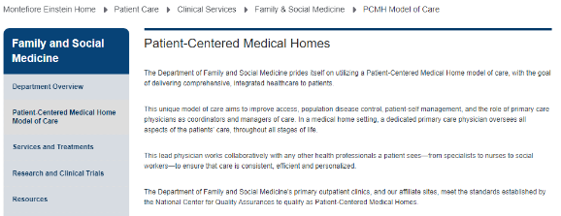






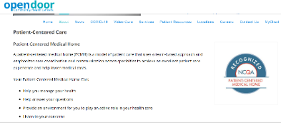


Patient-Centered Medical Home
14
Notes:
MARK

Slide 15
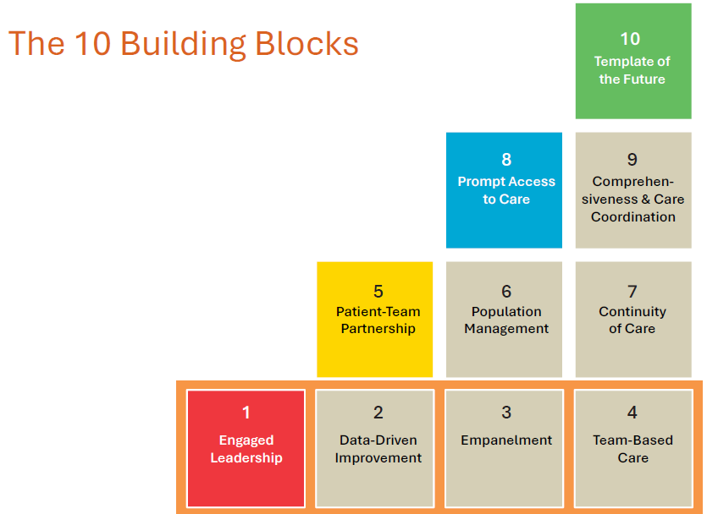

High Performing Primary Care
Bodenheimer T, et. al. Ann Fam Med 2014;166-171. doi:10.1370/afm.1616
Notes:
MARK

Slide 16
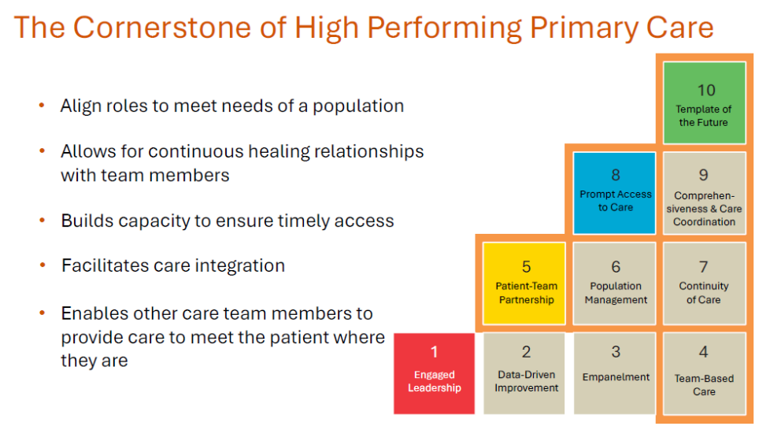
High Performing Primary Care
Notes:
MARK

Slide 17
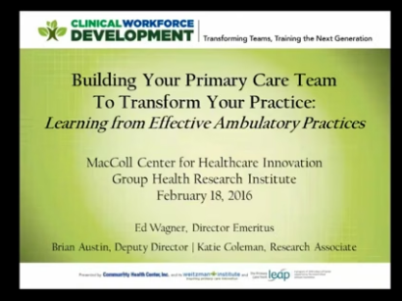
National Cooperative Agreement (NCA) Webinars
https://vimeo.com/635689772/3b16008074
17
Notes:
MARK

Slide 18
Advancing Team-Based Care Webinar
Why are teams important?
What do the data show about impact of teams?
What lessons were learned from studying 30 high-performing practices?
What is the composition of teams?
How do teams enable practices to become high performing?
What are the key functions/competencies of excellent primary care?
Additional webinars on many of the above topics are available through Weitzman Education
  Let Mark or Ally know if you want to explore more
18
Notes:
MARK

Slide 19
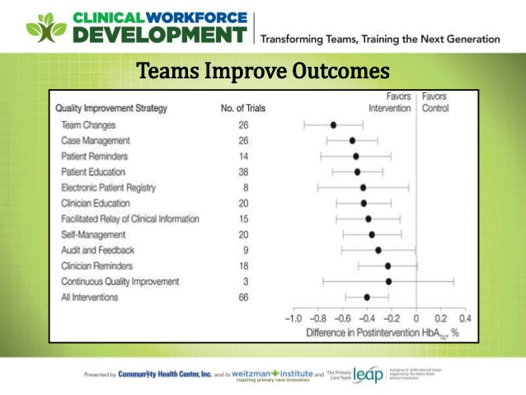
19
Notes:
MARK

Slide 20
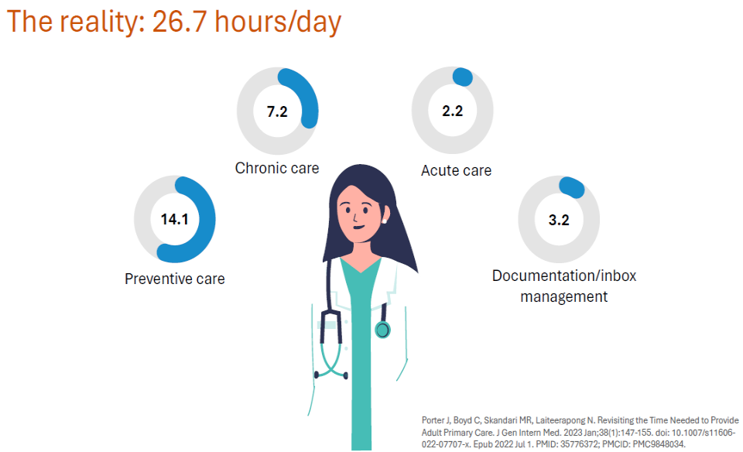
20
Notes:
MARK

Slide 21
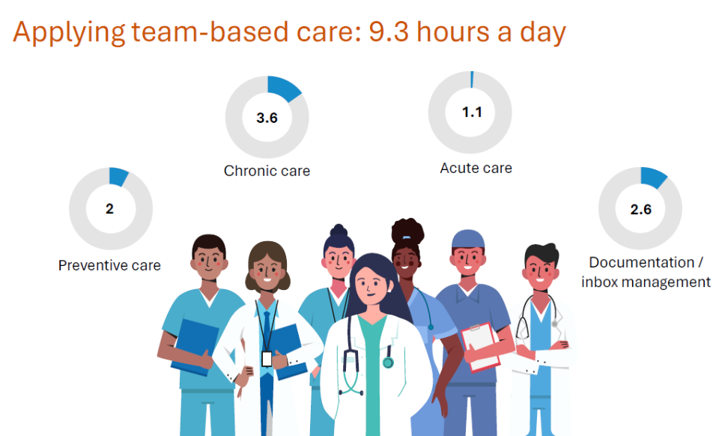
21
Notes:
MARK

Slide 22
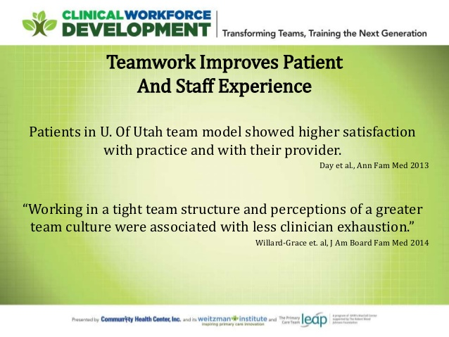
22
Notes:
MARK

Slide 23
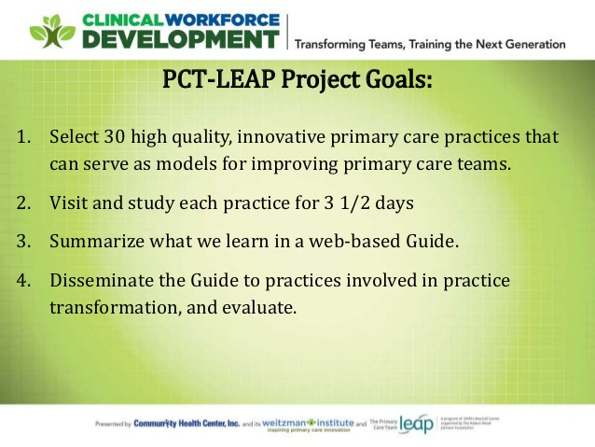
23
Notes:
MARK

Slide 24
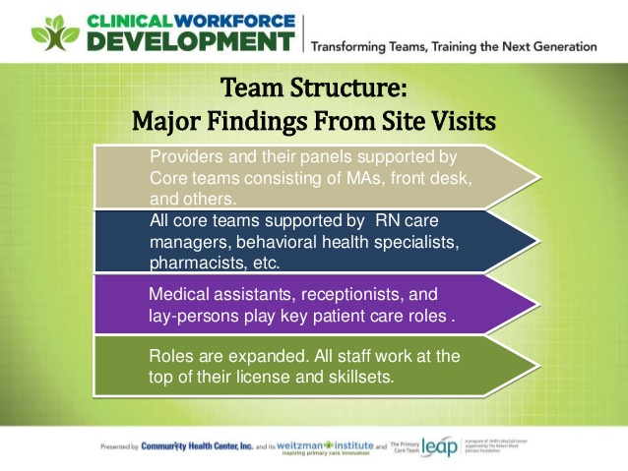
24
Notes:
MARK

Slide 25
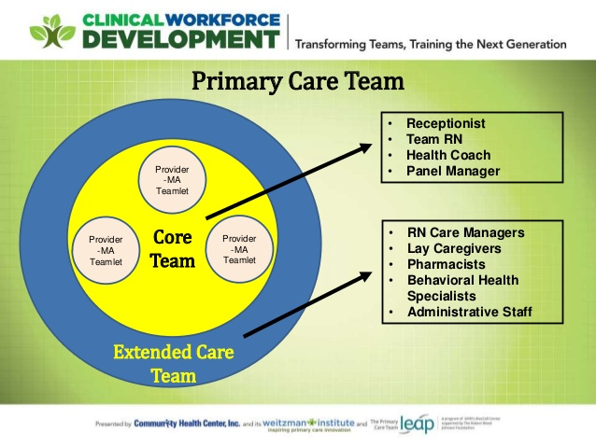
25
Notes:
MARK

Slide 26

https://improvingprimarycare.org
26
Notes:
MARK

Slide 27
Poll Questions
Have you experienced team-based care at your health center? (choose one)
  Yes, No, Maybe, but not sure
In your clinical work, do you work with any of the following (select any that apply)
  Medical Assistant, Nurse, Behavioral Health Provider, Nutritionist, Pharmacist, Social Worker, Other
27
Notes:
MARK

Slide 28
Examples from Sites
We will ask for volunteers to share an example of team-based care you have seen at your site
  DePaul
  CHC New London
  Sun River Health
  Montefiore
  CHC Hartford
In your response, please include any information you may have regarding:
  Who you work with directly when you provide care
  Which health professional disciplines are available at your site
We will hear from as many sites as time allows
28
Notes:
MARK

Slide 29
What haven’t we figured out yet?
Questions or issues that remain unclear?
29
Notes:
MARK

Slide 30
Take-home Thoughts
Mark and Ally – share 1 or 2 ideas you will take away from our small group discussion
30
Notes:
MARK/GARRETT

Slide 31
Summary
You have learned about frameworks to guide your thinking about how to organize improvement work
You have identified some of your organization’s priorities for improvement
You have begun to investigate processes in the clinical environment that you think can be improved with quality improvement interventions
  Consider using one of these processes for your team’s QI project
We have discussed the person-centered, team-based approach to primary care and emphasized the great opportunity at health centers to provide integrated care
31
Notes:
EMMA

Slide 32
Assignment for Session III
Send a list of who you will be working with and what you will focus on for your QI project to Mark & Ally by 11/5/26
Work with your project team to make a draft of the project charter
Send your draft project charter to us by Wednesday, 11/4/26 at 6pm EST
32
Notes:
www.clinicalmicrosystem.org
32
EMMA

Slide 33

Notes:
MARK

Slide 34

A PROJECT CHARTER adds structure as you plan
What are we trying to accomplish? & Why?
Will we know if the change made an impact?
  A tool for training and/or communication
  Baseline data
  Goals
  Measures
  Stakeholders
  Barriers
  Expectations
  Ideas
34
Notes:
MARK

Slide 35
Date charter revised
Problem Statement
Create this statement with team
Team Members
Central Question/ Why work on this now?
Include coach, sponsor and each member (core and extended)
Measures
What is the impact anticipated OR what are the current losses
Scope
Goal Statement
Measurement from PI Goals
Milestones/ Dates
Goals from PI Goals spreadsheet – baseline and follow up.
Date team first meeting and date project charter created
Document first & last process steps.
Deliverables and when they are due
If implementation goal –evidence that it is implemented?
List areas of exclusion for this project
Create this statement with team
Date each PDSA launched, completed.
Project Charter Template
Notes:
MARK

Slide 36
Session III Highlights
We will hear reports from several groups about their draft project charter for their project idea
We will introduce and briefly discuss the templates for creating:
  A global aim statement
  A fishbone diagram
36
Notes:
www.clinicalmicrosystem.org
36
MARK

Slide 37
References
The Primary Care Team Guide (https://improvingprimarycare.org)
Bodenheimer T, Ghorob A, Willard-Grace R, Grumbach K. Ann Fam Med 2014;166-171. doi:10.1370/afm.1616
NCA Implementing Team-Based Care Webinar (https://vimeo.com/635689772/3b16008074)
37
Notes:
www.clinicalmicrosystem.org
37
MARK

