Slide 1
Obesity: moving beyond awareness
Brenda Lee Beauchamp, PsyD, CPCBH
April 14th, 2023

Slide 2
Objectives
Discuss weight bias and stigma and the implications for patient care.
Identify manifestations of weight bias in health care providers.
Integrate strategies to address weight bias and stigma in health care settings.

Slide 3
54 y/o cis female: “I watched the bariatric surgery video and I know it would be good for me but it is scary to think about all the skin excess. I would look horrible, but I won’t tell my doctor because is too embarrassing.”
39 y/o cis female: “I have panic attacks thinking that if I have a heart attack, how would they be able to transport me to the hospital. I have never told anyone.”
28 y/o trans male: “I don’t waste my time on medical visits, I can feel the way the staff looks at me and double judges me for being trans and fat.”
33 y/o cis female:“Why would I bother telling my PCP about my pain? They always tell me the same thing, that is because of my weight and they don’t take me seriously”
63 y/o cis male:“I need a knee surgery and need to lose weight so I can have the surgery. I have tried, I stopped drinking soda and juice and I stopped eating pizza and bread, but nothing is enough. I think I’ll die like this. ”
22 y/o cis female whose father sexually abused her and she believed that being overweight would keep him away of her.

Slide 4
Obesity
Medical condition and should be treated as such.
Defined by having a BMI of 30 or more and is further divided into
clases I-III.
Class III obesity vs Morbid obesity
Highly stigmatized condition in the modern society.
One of the largest issues in primary care.
Multiple complex factors
Obesity and mental health:
depression, anxiety and low self-esteem, lack of motivation

Slide 6
Challenges
Financial cost:
paying more for items such as clothing, furniture, airline tickets, mattresses, bikes and caskets.
Work setting: people with obesity get hired, paid and promoted less than their thinner peers.
15% of hiring managers would even hire an overweight woman.
Weight discrimination is actually illegal only in Michigan and some cities.
Insurance companies can legally charge higher rates for people whose Body Mass Index is over 25.

Slide 7
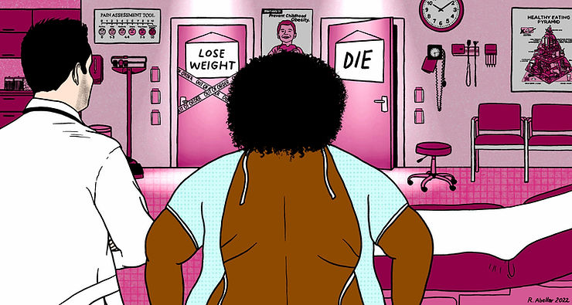
Key concepts
Weight bias: negative attitudes, beliefs, assumptions and judgements toward individuals who are overweight
64% of adults with obesity report experiencing weight bias from a health care provider. (Sabin et al., 2012)

Slide 8
Key concepts
Weight stigma: refers to stereotypes and labels we assign to people who have obesity.
Weight discrimination: actions against people who have obesity that can cause social exclusions and inequities.

Slide 9
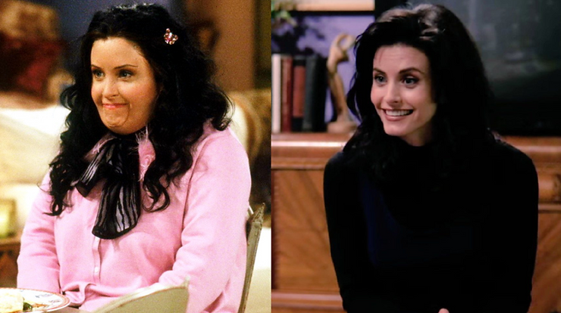
Last aceptable form of bias…
Media: mocked in television and movies.
Pitch Perfect’s Fat Amy: narrative…the character is “lazy or unintelligent”

Slide 10
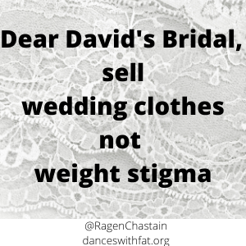
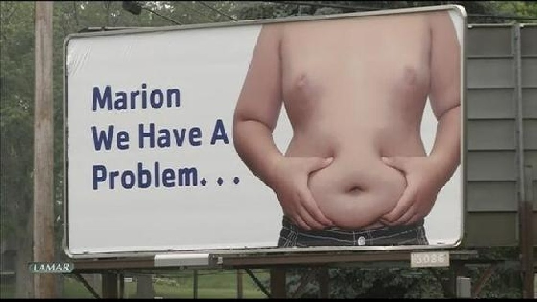
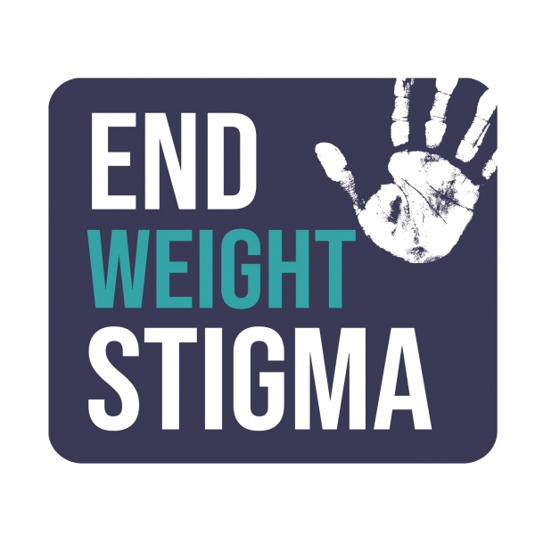
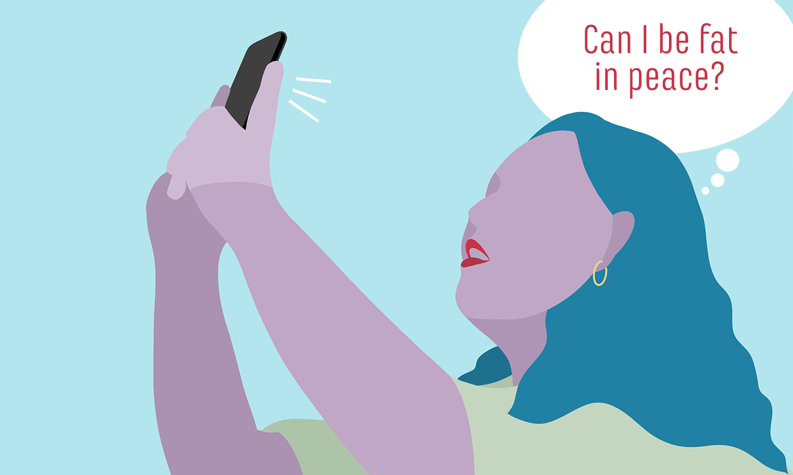

Slide 11
Stereotypes and negative attiude toward patients
Annoying
Greater waste of time
Lazy
Awkward
Non compliant
Unintelligent
Unsuccessful
Lacking of self discipline and self control
Overeaters
Unattractive
Insecure
Slow
Sloppy
Dishonest
Feeling repulsed by them, and would prefer not to touch them.

Slide 12
Impact of weight stigma in healthcare settings
Results in reduced quality of care.
Poor health in people with overweight and obesity.
Less time with patients with obesity and show them less empathy.
Less discussion with patients.
Reduced preventive health services and exams (fewer cancer screens, pelvic exams, mammograms).
Patients often just told to go on a diet, regardless of what other medical issues they may have.
Delay going to the doctor until they could lose weight.

Slide 13
Survey- 2,400 adult women about their experiences of weight bias:
69% reported doctors were a source of weight bias
52 % reported they had been stigmatized by a doctor on multiple occasions.
High body mass index (BMI):
less desire to help the patient and express less respect for the patient.
more likely to say treating the patient is a waste of time.
Nurses: individuals affected by obesity as noncompliant, overindulgent, lazy and unsuccessful.
31 % “would prefer not to care for individuals affected by obesity”
24 % agreed that individuals affected by obesity “repulsed them”
12 % : “would prefer not to touch individuals affected by obesity”
Psychologists: beliefs about individuals affected by obesity versus “average” weight individuals:
More pathology
More severe psychological symptoms
More negative attributes
Worse prognosis in treatment

Slide 14
Weight related barriers in healthcare
Inaccesible equipment and facilities:
46 % of women affected by obesity reported encountering small gowns, narrow exam tables and inappropriately sized medical equipment (seats, scales, etc).
The subject of weight itself can become an obstacle for a conversation:
Professionals report inadequate training to understand obesity.
35 % reported embarrassment about being weighed and inappropriate comments about their weight.

Slide 15
Impact of weight bias on patients
Internalized stigma and development of unhealthy coping strategies (ex. Binge eating).
Delay preventive services.
Avoid interactions with health care professionals.
Vulnerable to mental health issues.

Slide 16
Language matters
Least Stigmatizing / Blaming Words
Most Stigmatizing / Blaming Words
People-first language
“A person with obesity”
Weight
Unhealthy weight
High BMI
Unhealthy Weight and Overweight:
most motivating for weight loss
Fat
Morbidly Obese
Obese
Fat and Morbidly Obese/Chubby:
Least motivating for weight loss

Slide 17
Important considerations
Meaning of food: collective counsciousness
Eating and food are basic needs- we need to eat to live
Instrument for nurturing and care
Psychological role:
control, fill a void, instant gratification, food used as self reinforcement or for behavioral modification
I.e. if you finish your homework, you can have dessert
Cultural role:
Western culture: everything has to be done fast.
Approach to food
Other factors:
Unhealthy food is more affordable than actual healthy food. No time to cook or prepare foods.

Slide 18
Recommendations
Acknowledge the existence of weight stigma.
Do not assume a patient with obesity is automatically engaging in overeating behaviors.
Focusing more on health and wellness and less on weight or weight loss.
Don’t weight patients or discuss their weight in public areas.
Clinical visit should be focused on information gathering and understanding of a patient's particular situation.
lifestyle changes and health behaviors than emphasize achievable behavioral goals.
Compassionate and knowledgeable.

Slide 19
Promoting changes in behavior
“Eat less and exercise more”:
environmental, genetic and physiologic causes of obesity
blame on the patient as the sole cause and contributor of their obesity.
Consider patients’ previous negative experiences.
Explore all causes of presenting problems (not just weight).
Emphasize the importance of behavior change rather than weight.
Acknowledge the difficulty of making lifestyle changes.
Recognize that small weight losses can improve health.

Slide 20
Think about your own implicit bias
Am I comfortable working with people of all shapes and sizes?
Do I give appropriate feedback to encourage healthful behavior change?
Am I sensitive to the needs and concerns of individuals with obesity?
Do I treat the individual or only the condition?
How do I feel when I work with patients of different body sizes?
Do I make assumptions regarding a person’s character, intelligence, abilities, health status or behaviors based only on their weight?
What stereotypes do I have about persons with obesity?
How do my patients affected by obesity feel when they leave my office?
Do they feel confident and empowered, or otherwise?

Slide 21
How to have these conversations?
Is it necessary to weigh the patient in that visit?
Ask to the patient if they want to discuss their weight in that visit.
Ask for permission to weigh the patient.
Ask them if they want to know their weight.
Use motivational interviewing strategies.

Slide 22
Some examples
“Could we talk about your weight today?”
“How do you feel about your weight?”
“Has your weight fluctuated over the past year?”
“Are you aware of the effect of weight on (eg, surgical risks, menstrual cycle, pregnancy, fertility)?
“I would like to discuss your specific health risks, including (weight and any other particular risks).”
“Do you have access to healthy foods?”
Explore if patient knows what are healthy foods.
“Are you able to find time and a safe space for exercise?”

Slide 23
Assessing ambivalence and motivation:
How ready do you feel to change your eating patterns and/or lifestyle behaviors?
How is your current weight affecting your life right now?
What kinds of things have you done in the past to change your eating?
What strategies have worked for you in the past?
How do you feel about changing your eating or exercise behaviors?
How would you like your health to be different?
What steps do you feel ready to take to improve your health?
How ready do you feel to change your eating patterns and/or lifestyle behaviors?
How is your current weight affecting your life right now?
What kinds of things have you done in the past to change your eating?
What strategies have worked for you in the past?
How do you feel about changing your eating or exercise behaviors?
How would you like your health to be different?
What steps do you feel ready to take to improve your health?

Slide 24
To keep in mind
All bodies are good bodies and deserve respect and care.
Weight is a continuum and there is not a BMI cutoff in which a person goes from being healthy to unhealthy.
The goal is the healthiest body weight that is realistic for that person.
We need to move beyond awareness.
We need to create public policies that aid in reducing weight stigma and discrimination.
Embarrassing people into losing weight doesn’t work, the result is the opposite, will increase weight gain over time as well as disordered eating.

Slide 25
References
Abrams, Z. (2022). The burden of weight stigma. Monitor on Psychology, 53(2).
www.apa.org/monitor/2022/03/news-weight-stigma
Klipstein, S., Ryann, G. (2019). Ethical considerations for the care of patients with obesity. ACOG Committee Opinion. American College of Obstetricians and Gynecologists, 133 (1).
www.ObesityAction.org
Puhl R, Brownell KD. (2001). Bias, discrimination, and obesity. Obesity Research, 9:788-805.
Puhl, R., & Brownell, K.D. (2006). Confronting and coping with weight stigma: An investigation of overweight and individuals with obesity. Obesity, 14, 1802-1815.
Sabin JA, Marini M, Nosek BA (2012) Implicit and Explicit Anti-Fat Bias among a Large Sample of Medical Doctors by BMI, Race/Ethnicity and Gender. PLOS ONE 7(11).
Sabharwal S, Campoverde Reyes KJ, Stanford FC. Need for Legal Protection Against Weight Discrimination in the United States. Obesity (Silver Spring). 2020 Oct;28(10):1784-1785.
Sarwer DB, Polonsky HM. (2016) The Psychosocial Burden of Obesity. Endocrinol Metab Clin North Am. 45(3):677-88.
Simon GE, Von Korff M, Saunders K, Miglioretti DL, Crane PK, van Belle G, Kessler RC. Association between obesity and psychiatric disorders in the US adult population. Arch Gen Psychiatry. 2006 Jul;63(7):824-30.
www.tosconnect.obesity.org
www.uconnruddcenter.org.
www.worldobesity.org

